Slide 1
Consensus on the Rational Use of Antithrombotics in
Veterinary Critical Care
Journal Club
10/15/20
Tomas Boullhesen-Williams
ECC resident
Cornell University

Slide 2
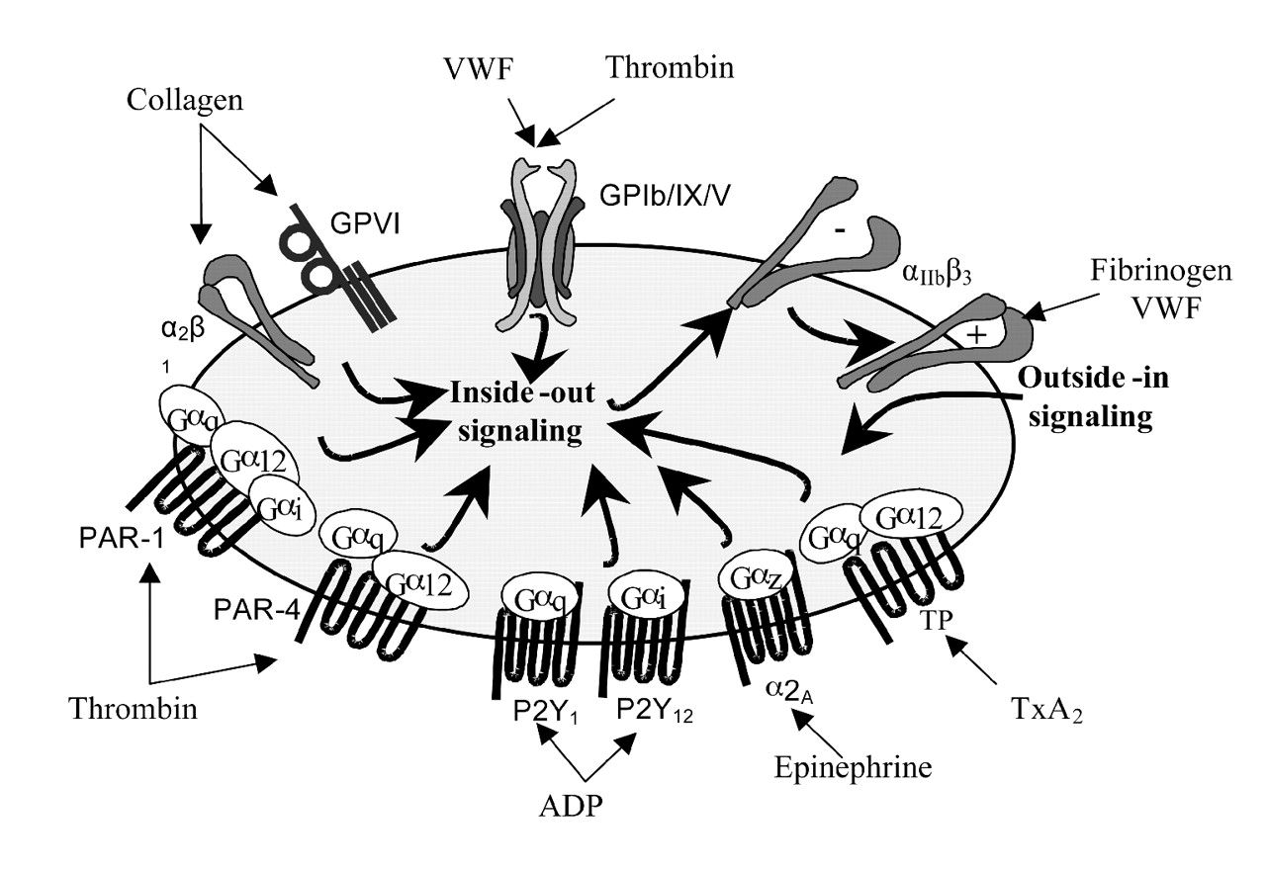
Coagulation quick overview
ADP:
  P2Y1 is coupled to Gq and initiates calcium mobilization resulting in shape change and reversible platelet aggregation
  P2Y12 is coupled to Gi resulting in inhibition of adenylate cyclase and lowering of cAMP levels. P2Y12 activation is associated with irreversible platelet aggregation
Thromboxane receptor (TXA 2 /PGH 2):
  Platelets possess two types of receptors, TP alpha and TP β, which are coupled to G proteins; TP alpha is coupled to Gs while TP β is coupled to Gi. TXA 2 and PGH 2 interact with both receptor types

Slide 3
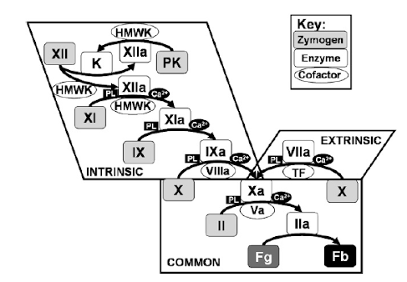
Coagulation quick overview
Cascade model:
Extrinsic pathway: (TF) III + VIII → X -- (3 + 7 = 10)
  Clotting trigger is extravascular (cell-bound protein: TF)
Intrinsic: (XII → XI → IX → VIII → X) -- (TENET - Ten, Eleven, Nine, Eight, Ten)
  no extravascular trigger
Common pathway: formation of Xa+Va complex which generates IIa. IIa then cleaves Fibrinogen to Ia (fibrin), which spontaneously polymerizes into an insoluble fibrin gel

Slide 4
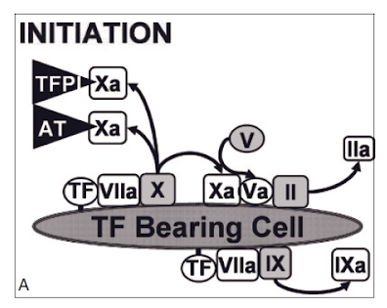
Coagulation quick overview
Cell based model of IIa generation:
Initiation:
Cell injury → blood is exposed to a TF-bearing cell and VII is activated and rapidly binds to TF
TF+VIIa → activates additional TF+VIIa which generates small amounts of IXa and Xa
V is also activated by Xa
The resultant enzyme and cofactor (Xa and Va) form the prothrombinase complex which cleaves II to generate IIa on the surface of the TF-bearing cell.
Any Xa that dissociates from the membrane surface is rapidly inactivated by TFPI and AT-HSPG.
Xa therefore, is restricted to the surface of the TF-bearing cell on which it was generated
However, IXa is not inactivated by TFPI and can dissociate and move to the surface of nearby platelets or other cells
Small amounts of IIa also leave the cell surface

Slide 5
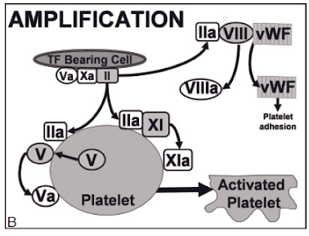
Coagulation quick overview
Amplification:
Once a small amount of IIa has been generated in the first phase, it is available to activate platelets
IIa binds to platelets → extreme changes in the platelet surface → shape changes, shuffling of phospholipids (externalization of Pser and PEth) and release of granule contents
Granules: induce further activation and clotting reactions
Negative surfaces → promote binding of coag proteins to the activated membrane
IIa also cleaves VWF from VIII and forms VIIIa
IIa generated in the initiation phase activates XI and V on the platelet surface

Slide 6
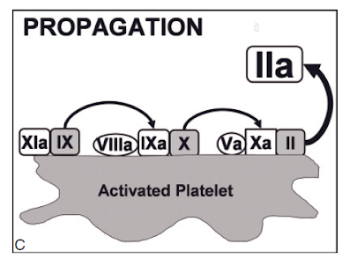
Coagulation quick overview
Propagation:
This phase occurs on the surface of the platelets
Platelets are activated → express ligands → promote cell-cell interactions → platelet aggregation
IXa generated by TF-VIIa (generated in initiation phase) can bind to VIIIa (generated in amplification phase) on the platelet surface
XIa cleaves additional IX and activates it
Once the intrinsic tenase complex (IXa+VIIIa) forms on the platelet membrane, it rapidly begins to generate Xa on the platelet. In this phase, Xa is not inhibited since platelets do not express AT-HSPG.
Xa rapidly binds to Va (generated by IIa in the amplification phase) and cleaves II to IIa.
This prothrombinase activity results in a burst of thrombin
When enough IIa is generated with enough speed to cleave Fibrinogen, a clot forms

Slide 7
Domain 1—Defining populations at risk
The goal of Domain 1:
  to explore the association between disease and thrombosis in a number of conditions identified as potential risk factors in the current veterinary literature
  to provide the basis for recommendations on prescribing documented in the subsequent domains.

Slide 8
IMHA (dogs only)
a. Immune-mediated hemolytic anemia (IMHA) is strongly associated with the development of thrombosis in dogs
b. We recommend antithrombotic therapy for dogs with IMHA
MOA:
Increased TF expression
Platelet activation
Procoagulant microparticules and neutrophil extracellular traps

Slide 9
PLN
a. PLN is associated with the development of thrombosis in dogs.
b. We recommend antithrombotic therapy for dogs with PLN.
22 studies reviewed, 15 studies (ranging from LOE 2–5, Fair) support an association between PLN and thrombosis
Because of the lack of control groups in the majority of these publications, a clear cause and effect relationship between PLN and the development of thrombosis cannot be established
Studies support hypercoagulable changes in this patient population

Slide 10
Pancreatitis (dogs only)
a. Severe pancreatitis may be associated with the development of thrombosis in dogs.
b. We suggest that antithrombotic therapy be considered for dogs with acute pancreatic necrosis
Information regarding the incidence of thrombosis in dogs with pancreatitis compared to healthy dogs is lacking.
Recommendations were derived from studies supporting a hypercoagulable state in dogs with pancreatitis
MOA:
  reduced TM expression in liver, lung, and spleen
  reduced antithrombin
  decreased fibrinolysis

Slide 11
Steroid administration
a. Corticosteroid administration favors a hypercoagulable state in dogs
b. Treatment with corticosteroids may be associated with the development of thrombosis
c. We suggest that antithrombotic therapy be considered for dogs receiving corticosteroids where other risk factors for thrombosis exist.
d. There is insufficient evidence to define an association between corticosteroid administration and development of thrombosis in cats.
No studies directly investigating the relationship between glucocorticoids and the increased risk of thrombosis in dogs were identified.
MOA:
  increased coagulation factors
  Platelet aggregation
  Fibrinogen concentration
  Clot strength
  Thrombin generation along with reduced antithrombin

Slide 12
Hyperadrenocorticism
a. Hyperadrenocorticism (HAC) is associated with thrombosis in a small subset of dogs only
b. We suggest HAC should be investigated in dogs presented with thrombosis.
c. A diagnosis of HAC alone does not warrant antithrombotic therapy unless other risk factors and/or comorbidities exist.
22 papers reviewed; 10 retrospective papers (no control groups) suggest that HAC is associated with the development of thrombosis

Slide 13
Cancer
a. Cancer in dogs, in particular ADC, is associated with the development of thrombosis in a small subset of dogs only
b. There is insufficient evidence to support routine anticoagulation of dogs with cancer
c. Therapy be considered for dogs with cancer where hypercoagulability is demonstrated, or where other risk factors for thrombosis exist
Neoplasia is one of the most common underlying disease processes identified in retrospective studies of canine thrombosis
MOA:
  overexpression of circulating TF
  Thrombocytosis
  Platelet hyper-reactivity
  Hyperfibrinogenemia
  Reduced antithrombin activity

Slide 14
Sepsis
a. Sepsis is associated with the development of thrombosis in a small subset of dogs only
b. There is insufficient evidence to support routine anticoagulation of dogs with sepsis
c. We suggest that antithrombotic therapy be considered for dogs with sepsis where hypercoagulability is demonstrated, or where other risk factors for thrombosis exist
Sepsis is consistently listed as an underlying cause of thrombosis in retrospective studies of thrombotic conditions in dogs, but most studies lack controls
MOA:
  Reduced endogenous anticoagulants (protein C and AT)
  Increased fibrinogen
  Increased thrombin activatable
  Fibrinolysis inhibitor
  TM downregulation
  Platelet hyperreactivity

Slide 15
Cerebrovascular disease
a. Cerebrovascular disease is more likely to result from a thrombotic event rather than be the cause of one.
b. We suggest that antithrombotic therapy be considered when an ischemic stroke is identified, and a concurrent medical condition associated with a risk for thrombosis is present.
Studies suggest that ischemic strokes are the result of the hypercoagulable conditions rather than a risk factor for thrombosis themselves

Slide 16
Cardiac disease in dogs and cats:
a. Feline cardiomyopathy (HCM, RCM, UCM and DCM is strongly associated with risk of ATE.
b. Cats with a history of ATE, left atrial (LA) dilation, spontaneous echocontrast, or reduced LA appendage flow velocity may be at particular risk
c. We recommend antithrombotic therapy for cats with cardiomyopathy, particularly in those with the above risk factors
FATCAT: quantifying the cumulative risk of ATE in 1,730 cats over 10 years → the cumulative risk of ATE at 1, 5, and 10 years was 3.5%, 9.5%, and 11.3%, respectively, in cats with HCM compared to 0.0%, 0.4%, and 0.7%, respectively, in apparently healthy cats
a. Canine cardiac diseases are not associated with a high risk of development of thrombosis
b. We suggest that antithrombotic therapy be considered in individual dogs where other risk factors for thrombosis exist
There is very limited evidence linking cardiac disease in dogs to the development of venous or arterial thrombosis.

Slide 17
In summary
High risk for thrombosis:
a. Dogs with IMHA or PLN.
b. Cats with cardiomyopathy and associated risk factors
c. Dogs or cats with >1 disease/risk factor for thrombosis (eg, pancreatitis with sepsis).
Low/moderate risk for thrombosis:
a. Dogs or cats with a single risk factor/disease.
b. Dogs or cats with known risk factor conditions that, with treatment, are likely to resolve in days to weeks.

Slide 18
Domain 2—Defining rational therapeutic usage
Goal of domain 2: to establish what drug or drug combination should be administered in venous and arterial thromboembolic disease settings, to define rational therapeutic usage
Venous thromboembolism (PLN and IMHA):
  Thrombi form under low-shear conditions
  Typically fibrin rich and their formation is less dependent upon platelet number or function
Arterial thrombotic complications (such as feline cardiomyopathies):
  Thrombi form under high-shear conditions
  Typically platelet rich → drugs that limit the ability of platelets to activate, aggregate, or adhere may be most effective
This pathophysiologic rationale underpins the convention of administration of anticoagulant drugs in venous thrombosis and antiplatelet agents in arterial thrombosis

Slide 19
Antithrombotic agents in VTE
Antiplatelet agents versus anticoagulants for VTE (dogs)
a. Anticoagulants may be more effective than antiplatelet agents for VTE prevention in dogs in general and in dirofilariasis specifically
2.2 Antiplatelet agents versus anticoagulants for VTE (cats)
a. No evidence-based recommendations can be made regarding the use of antiplatelet agents for VTE in cats.
b. We suggest that anticoagulants rather than antiplatelet agents be used for the prevention of VTE in cats
There is a single prospective study directly comparing 2 antiplatelet agents (aspirin and prostacyclin) with an anticoagulant (heparin) in the setting of thrombus formation under venous shear conditions → Heparin was superior to aspirin for prevention of thrombus formation
Other retrospectives showed conflicting results regarding superiority
Direct comparison between drugs is still lacking

Slide 20
Antithrombotic agents in ATE
Antiplatelet agents versus anticoagulants for ATE (dogs)
a. We suggest that antiplatelet agents may be more effective than anticoagulants for the prevention of ATE in dogs
b. We suggest that anticoagulants may also be effective for prevention of ATE in dogs
Antiplatelet agents versus anticoagulants for ATE (cats)
a. We recommend that antiplatelet agents be used for the prevention of ATE in cats
b. No evidence-based recommendations can be made regarding the use of anticoagulants for ATE in cats
studies showed that anticoagulants were inferior to antiplatelet agents in the setting of arterial thrombosis
Although direct comparisons suggest superiority of antiplatelet agents for ATE in dogs, multiple studies suggest efficacy of anticoagulants including UFH, LMWH, and direct inhibitors of Xa and thrombin for arterial thrombosis in dogs

Slide 21
Clopidogrel versus aspirin in animals at risk of thrombosis
Dogs
a. Insufficient evidence to make strong recommendations
b. We suggest that clopidogrel may be more effective than aspirin in dogs at risk for ATE
Cats
a. We recommend that clopidogrel be used instead of aspirin in cats at risk for ATE
b. There is no evidence on which to base recommendations regarding the use of aspirin or clopidogrel in cats at risk for VTE

Slide 22
Novel antithrombotic agents in animals at risk of thrombosis
New antiplatelet agents versus clopidogrel or aspirin (dogs)
a. There is insufficient evidence to make recommendations
We suggest that both abciximab and ticagrelor appear safe and may be efficacious
New antiplatelet agents versus clopidogrel or aspirin (cats)
a. Insufficient evidence to make
b. We suggest that abciximab appears safe and may be efficacious as an antiplatelet agent in cats.
No clinical studies that evaluate novel antiplatelet agents in dogs and cats were identified

Slide 23
LMWH versus UFH in animals at risk of thrombosis
UFH versus LMWH (dogs)
Insufficient evidence to make strong recommendations regarding the use of UFH versus LMWH
LMWH may be used in preference to UFH because of the positive safety profile of LMWH and more reliable bioavailability of the LMWH products compared to UFH
UFH versus LMWH (cats)
No evidence-based recommendations can be made
We suggest that LMWH may be used in preference to UFH because of the documented efficacy of LMWH and the positive safety profile of LMWH
Neither dalteparin or low-dose UFH dose produced meaningful anti-Xa activity. None of the dogs in the study developed thrombosis, but 4 dogs that received high-dose UFH bled
There is evidence indicating that enoxaparin may be beneficial in dogs with IMHA but that study did not compare LMWH with UFH
Evidence lacking in cats

Slide 24
Direct Xa inhibitor in animals at risk of thrombosis
Direct Xa inhibitors versus UFH (dogs)
There is insufficient evidence to make strong recommendations regarding the use of the direct Xa inhibitors versus UFH
Direct Xa inhibitors may be used in preference to UFH based on evidence of equivalent efficacy, combined with reliable pharmacokinetics and the ease of oral dosing
Direct Xa inhibitors versus UFH (cats)
a. No evidence-based recommendations can be made in cats
b. Direct Xa inhibitors can be considered in cats based on reliable pharmacokinetics and a favorable preliminary safety profile
Several experimental studies in canine models of vessel occlusion demonstrate at least equivalent efficacy for the direct Xa inhibitors compared to UFH

Slide 25
Direct Xa inhibitors versus LMWH on outcome
Direct Xa inhibitors versus LMWH (dogs and cats)
a. There is insufficient evidence to make strong recommendations
b. Either the direct Xa inhibitors or LMWH in dogs is reasonable
Paucity of data comparing LMWH to direct Xa inhibitors in dogs. No prospective randomized clinical studies that compared these 2 drug classes
Multiple studies reviewed the pharmacokinetics in dogs

Slide 26
UFH versus warfarin on outcome in dogs
a. There is insufficient evidence to make strong recommendations regarding the efficacy of heparin products versus warfarin in dogs or cats
b. UFH or LMWH be used in preference to warfarin

Slide 27
Combination therapy for venous thrombosis on outcome
a. No evidence-based recommendation can be made regarding the efficacy of direct Xa inhibitors versus warfarin in dogs or cats
b. Direct Xa inhibitors should be used in preference to warfarin in both dogs and cats
Insufficient evidence comparing direct Xa inhibitors with warfarin in dogs or cats at risk of thrombosis

Slide 28
Combination therapy for VTE on outcome
Combination anticoagulant and antiplatelet therapy for VTE (dogs)
a. Aspirin or clopidogrel in addition to LMWH or individually adjusted UFH therapy may be considered in dogs at high risk of VTE, where the risk of clot formation is felt to outweigh the increased risk of bleeding resulting from combination therapy
Combination anticoagulant and antiplatelet therapy for VTE (cats)
a. There is insufficient evidence to make strong
b. Combination therapy may be considered where there is a high risk of thrombosis and the risk of clot formation is felt to outweigh the increased risk of bleeding resulting from combination therapy
Little evidence from veterinary literature suggesting a benefit for combining anticoagulant and antiplatelet drugs over anticoagulant therapy alone in dogs at risk of venous thrombosis

Slide 29
Combination therapy on ATE on outcome
Combination antiplatelet and anticoagulant therapy for ATE (dogs and cats)
a. There is insufficient evidence to make strong recommendations for or against the use of combination antiplatelet and anticoagulant therapy in dogs at risk for ATE
b. Combination of clopidogrel or aspirin with LMWH may be considered in dogs at risk for ATE

Slide 30
Domain 3—Defining antithrombotic protocols
Goal of this domain: to determine whether some antithrombotic protocols are more effective than others and the route and frequency of administration. Also to highlight potential adverse effects and to evaluate safety profiles
Drugs evaluated:
Aspirin
Clopidogrel
Warfarin
UFH
Dalteparin and enoxaparin
Fondaparinux
Rivaroxaban

Slide 31
Aspirin therapy
Dogs
a. Oral aspirin may be effective for prevention of ATE in dogs
b. No evidence-based recommendations can be made for a specific aspirin dosage
c. We suggest that aspirin be given for 2–3 days before full therapeutic effects of aspirin are anticipated, although commencement of aspirin therapy after an arterial insult may still be effective at preventing thrombosis
d. No recommendations can be made for, or against, use of aspirin for VTE
Cats
a. We recommend against aspirin as a sole antithrombotic in cats at risk for ATE
b. No recommendations can be made concerning appropriate aspirin dosage in cats

Slide 32
Clopidogrel therapy
Dogs
a. We recommend clopidogrel at 1.1–3 mg/kg PO q24h for the prevention of ATE in dogs.
b. We suggest a single oral loading dose (eg, 4–10 mg/kg) may be useful for obtaining therapeutic plasma concentrations more rapidly
c. No recommendations can be made for, or against, use of clopidogrel as sole agent for VTE in dogs.
Cats
a. We recommend clopidogrel at 18.75 mg PO q24h, for prevention of ATE in cats.
b. We suggest a single oral loading dose (eg 37.5 mg total) may be useful for obtaining therapeutic plasma concentrations more rapidly.
c. No recommendations can be made for, or against, use of clopidogrel for VTE in cats.

Slide 33
Warfarin therapy
Warfarin (Dogs)
a. We suggest that warfarin should not be used in dogs because it inconsistently improves outcomes and is commonly associated with bleeding complications
Warfarin (Cats)
a. No evidence-based recommendations can be made
b. Warfarin should not be used in cats because of marked interindividual variation coupled with a narrow therapeutic index

Slide 34
UFH
Unfractionated Heparin (Dogs)
a. can be effectively administered by the IV or SC routes
b. Optimal UFH dose likely varies in individual dogs to maximize antithrombotic effects and minimize hemorrhagic complications
c. Initial IV dosing scheme of 100 U/kg bolus, then 480–900 U/kg/24h (20–37.5 U/kg/h) CRI
d. Initial SC dosage of UFH of 150–300 U/kg q6h
e. We recommend that UFH is not administered by inhalation or PO
Unfractionated Heparin (Cats)
a. Only a SC route of administration of UFH has been investigated
b. Initial SC dosage of UFH of 250 U/kg q6h

Slide 35
Dalteparin therapy
Dogs
a. Initial SC dosage of 100–175 U/kg q8h in dogs
b. Minor bleeding may be noted at the doses reported above, but serious bleeding is unlikely
Cats
a. In cats, frequent SC administration is likely necessary for maintenance of the human target anti-Xa activity range
b. We suggest lower dosages compared to dogs may be acceptable at increased frequency eg, 75 U/kg SC q6h
c. Bleeding complications, usually minor and self-limiting, may occur with a variety of dosing schemes
Little data exists regarding dosages and efficacy in small animals

Slide 36
Enoxaparin therapy
Dogs
a. Dosage of 0.8 mg/kg SC q6h is safe and well tolerated
b. This dose may not achieve anti-Xa levels considered to be therapeutic in people in all breeds
c. Only minor bleeding complications have been reported
Cats
a. We suggest enoxaparin at a dosage of 0.75–1 mg/kg SC q6-12h should be considered in cats with a risk of VTE
b. We suggest enoxaparin be administered q6h to reduce interindividual variation in peak anti-Xa activity

Slide 37
Fondaparinux therapy
a. No studies of fondaparinux in dogs were identified
b. A dose of fondaparinux of 0.06 or 0.20 mg/kg SC q12h was sufficient to achieve a peak plasma anti-Xa activity in cats considered effective in people, without bleeding complications
Only one study in cats (6 patients), none in dogs

Slide 38
Rivaroxaban therapy
Rivaroxaban (Dogs)
a. Based on preliminary data, rivaroxaban appears safe and well tolerated in dogs
b. Dosage of 1–2mg/kg/day in dogs
Rivaroxaban (Cats)
a. Based on preliminary data, rivaroxaban appears safe and well tolerated in cats
b. Dosage of 0.5-1mg/kg/day in cats

Slide 39
Domain 4—Refining and monitoring antithrombotic therapies
Goals of this domain:
  Systematically review and summarize the evidence for therapeutic monitoring of antithrombotic drugs to reduce the risk of complications or improve any outcomes
  Develop clinical practice guidelines regarding antithrombotic monitoring
Tests for monitoring anticoagulant therapy included:
PT, INR, activated clotting time (ACT), aPTT, anti-Factor Xa activity, and viscoelastic tests (TEG, TEM and sonoclot)

Slide 40
Aspirin monitoring
a. Adjusting therapy to achieve platelet inhibition via platelet aggregometry in dogs receiving aspirin therapy can be considered
b. Some evidence suggests that in dogs receiving aspirin, platelet inhibition detectable via aggregometry (various agonists), is associated with reduced risk of arterial thromboembolism
c. Monitoring techniques are currently too varied to provide uniform recommendations at this time

Slide 41
Clopidogrel monitoring
Guidelines not formulated given the lack of literature addressing this item
Warfarin monitoring
a. We suggest that warfarin should not be used in dogs or in cats
b. If warfarin is used, we recommend monitoring warfarin therapy ideally with PTINR to achieve a target of 2–3, or 1.5–2.0 times the baseline PT
c. Close therapeutic monitoring, particularly early in the course of therapy, is indicated to maximize efficacy and reduce the risk of complications

Slide 42
UFH monitoring
a. Anti-Xa activity for UFH monitoring in dogs because evidence supporting the use of other monitoring tests (eg, ACT, aPTT, TEG, and Sonoclot) is limited at this time
b. An anti-Xa target of 0.35–0.7 U/mL is recommended to minimize thrombosis risk and improve outcome, although minor hemorrhage may still occur
c. There is insufficient evidence to make a strong recommendation for a specific anti-Xa target in cats
d. An anti-Xa target of 0.35–0.7 U/mL is reasonable in cats until more evidence is available

Slide 43
Low molecular weight heparin monitoring
a. There is insufficient evidence to make strong recommendations for therapeutic monitoring of LMWH in dogs or cats.
b. We suggest adjusting therapy in dogs, targeting anti-Xa levels of 0.5–1.0 U/mL 2–4 hours postdose can be considered.
Rivaroxaban monitoring
Guidelines for rivaroxaban monitoring were not formulated given the lack of literature addressing the PICO questions

Slide 44
Domain 5—Discontinuation of therapy

Slide 45
Discontinuation of therapy for invasive procedures
a. In patients at high risk for thrombosis, anticoagulation should not be discontinued for invasive procedures.
b. In patients at low to moderate risk for thrombosis, consideration may be given for discontinuation of anticoagulation prior to invasive procedures

Slide 46
Discontinuation antiplatelet agents before surgery
a. Antiplatelet therapy with a single antiplatelet agent should be continued
b. Discontinuing one agent if animals are receiving dual antiplatelet therapy
c. We suggest that these patients are at increased risk of bleeding and that close attention be paid to surgical hemostasis.
Antiplatelet agent discontinuation 5–7 days prior to an elective procedure versus no discontinuation (low to moderate risk)
a. We recommend that antiplatelet agents should be discontinued prior to the planned procedure
b. 5 to 7 days is a reasonable amount of time to clear the effects of a drug that is an irreversible inhibitor of platelet function
Antiplatelet agent discontinuation 5–7 days prior to surgery versus 24 hours (high risk)
a. We recommend against withdrawing antiplatelet agents within 5 days of a procedure
Antiplatelet agent discontinuation 5–7 days prior to surgery versus 24 hours (low to moderate risk)
a. We recommend that antiplatelet agents be discontinued within 5 days of a procedure

Slide 47
Discontinuation of heparins before surgery
UFH/LMWH discontinuation 24 hours prior to an elective procedure versus no discontinuation (high risk)
a. We recommend that heparin therapy should not be discontinued
b. We recommend that surgery be planned to occur at nadir of anticoagulant effect (approximately 6–8 h after prior dose if given by subcutaneous injection)
c. We suggest that these patients are at increased risk of bleeding and that close attention be paid to surgical hemostasis.
UFH/LMWH discontinuation 24 hours prior to an elective procedure versus no discontinuation (low to moderate risk)
a. We recommend that consideration may be given to taper (UFH) or stop (LMWH) therapy prior to a procedure

Slide 48
Restarting antithrombotic therapy following surgery
Restarting antithrombotic therapy 24 hours post surgery versus 3–5 days (high-risk patient)
We recommend that in patients at high risk, antithrombotic therapy should be restarted as soon as possible after surgery provided there is no evidence of ongoing bleeding
Restarting antithrombotic therapy 24 hours post surgery versus 3–5 days (low to moderate risk patient)
a. No evidence-based recommendation can be made for patients at low/moderate risk.
b. We suggest that in patients at low/moderate risk, antithrombotic therapy be restarted once there is no evidence of ongoing bleeding.
5.10 Restarting antithrombotic therapy 24 hours post-surgery vs 3–5 days (patients that develop thrombosis)
a. We recommend that antithrombotic therapy should be initiated immediately in patients that develop thrombosis in the postoperative period

Slide 49
Discontinuing antithrombotic agents following dissolution of venous and arterial clots
a. We recommend that if the underlying causative conditions have resolved, that antithrombotic therapy should be discontinued following thrombus resolution
b. In patients with unknown underlying conditions or where these conditions cannot be cured or resolved, we recommend antithrombotic therapy should be continued indefinitely

Slide 50
Abrupt versus tapered discontinuation of unfractionated heparin
a. We recommend that if UFH is administered as an IV constant rate infusion (CRI) it should be tapered (weaned) rather than abruptly discontinued
b. Clinicians should consider weaning UFH therapy administered by the subcutaneous route
Abrupt versus tapered discontinuation of LMWH
a. Clinicians do not need to wean low molecular weight heparin therapy prior to discontinuation

Slide 51
Abrupt versus tapered discontinuation of oral Xa inhibitors
Weaning of direct oral Xa inhibitor therapy
a. Clinicians should consider weaning direct oral Xa inhibitor therapies.
“Rebound hypercoagulation phenomenon” following discontinuation of heparins: (seen with UFH and LMWH)
Elevated thrombin production may contribute to post-infusion thrombophilia
Decreased activity of tissue factor pathway inhibitor (TFPI) may also have contributed to thrombophilia
For anti-Xa: There is not enough strong evidence to support a rebound effect following discontinuation these meds, there is also not strong evidence to refute this possibility

Slide 52
Thank you!

