Slide 1
Critical illness-related corticosteroid insufficiency
Dr. Williams
Cornell University
June 2020

Slide 2
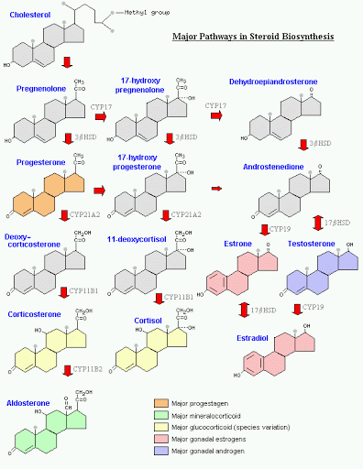
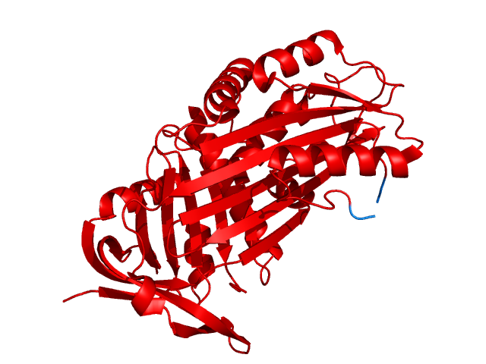
Why are steroids important?
Cortisol
Synthetized in adrenal cortex
Derived from cholesterol
Binds to cortisol-binding globulin or Transcortin (95%)
Metabolized in liver

Slide 3
Why are steroids important?
Functions of cortisol
Carbohydrate, protein and fat metabolism
Anti-inflammatory effects
  Stabilizes lysosomal membranes
  Decreases permeability of capillaries
  Decreases chemotaxis and phagocytosis
  Immune system suppression

Slide 4
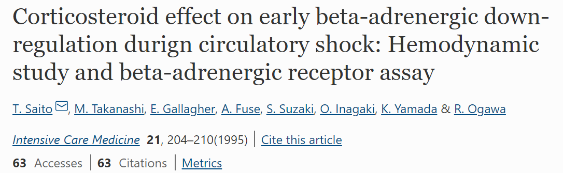
Hemodynamic effects of cortisol
    Up-regulate synthesis of β-adrenergic receptors
    Increase density of β-adrenergic receptors
      Prevents β adrenergic desensitization

Slide 5
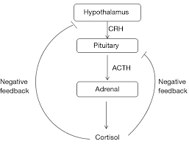
Cortisol Secretion
Corticotropin releasing hormone
ACTH
Cortisol
Response to stress:
  Inflammation/pain
  Hypotension
  Hypoglycemia
  Hypoxemia

Slide 6
1) How does steroids help maintain vascular tone? (2 mechanisms)
    Through the up-regulation of β-adrenergic receptors and prevention of β adrenergic desensitization

Slide 7

Critical illness-related corticosteroid insufficiency
Who is she?

Slide 8
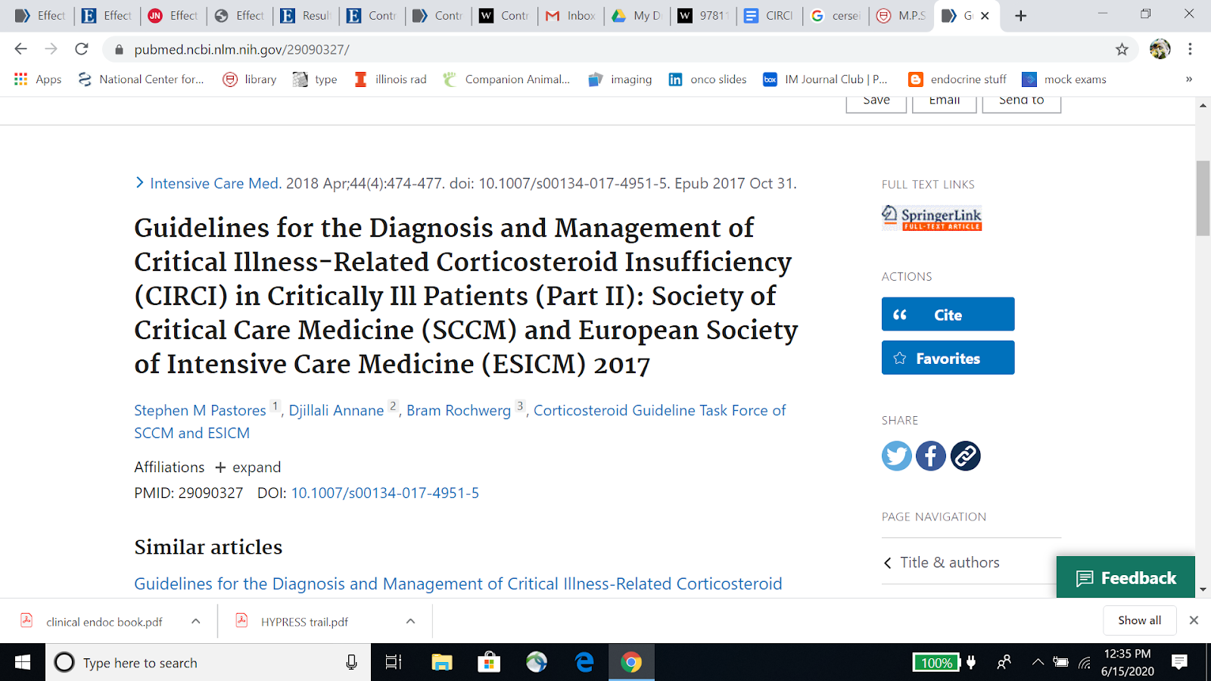
Impairment of the hypothalamic pituitary axis during critical illness
Dysregulated systemic inflammation resulting from inadequate glucocorticoid-mediated anti-inflammatory activity for the severity of the disease (sepsis or septic shock)
increased levels of biological markers of inflammation and coagulation over time, morbidity, length of ICU stay and mortality

Slide 9
Pathogenesis
identified in dogs with sepsis/septic shock, trauma, GDV, neoplasia, and genetic mutation (ABCB1/MDR1)
identified in cats with neoplasia, trauma, and sepsis/septic shock
Not been documented in stable patients
relative and transient
most likely multifactorial

Slide 10
Mechanisms for development:
1. Proinflammatory cytokine mediated inhibition of CRH and ACTH secretion
2. Cytokine mediated steroid receptor dysfunction and reduction
3. Corticostatin-mediated ACTH receptor antagonism

Slide 11
Mechanisms for development:
4. Leptin-mediated inhibition of the HPA axis during illness
5. Tissue resistance
  reduction of circulating transcortin concentrations
  increased cytokine mediated conversion of cortisol to cortisone (inactive)

Slide 12
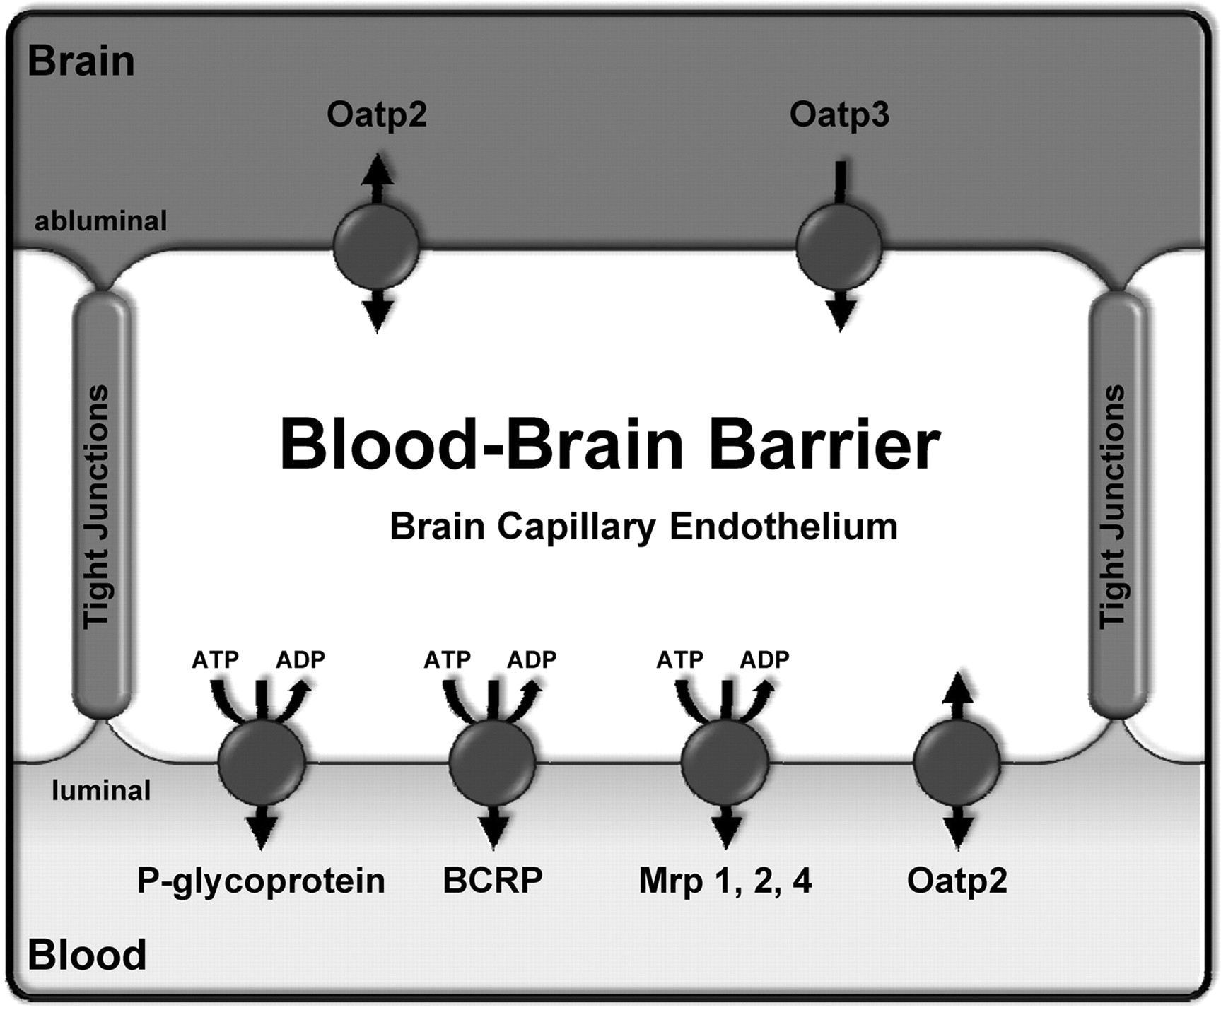
Mechanisms for development:
6. Disruption of pituitary and/or adrenal gland function
7. ABCB1 gene mutation resulting in the lack of P-glycoprotein

Slide 13
Clinical signs
vague and nonspecific
Human patients with septic shock: hypotension that is refractory to fluid resuscitation and requiring vasopressor therapy

Slide 14
Diagnosis
Critically ill patients requiring vasopressor support
Humans typically have normal or elevated basal serum cortisol concentrations and a blunted response to ACTH stimulation
  Similar findings in critically ill dogs
  No consensus exists regarding the identification of patients with CIRCI in human or vet med

Slide 15
Methods to try identify CIRCI
1. Evaluation of adrenal function: ACTH stim test:
  In dogs: IV administration of 5µg cosyntropin/kg up to a maximum of 250µg
  In cats: IV administration of 125µg of cosyntropin/cat
2. Low-dose (0.5µg/kg IV) ACTH stim testing
Might be more sensitive diagnostic test in detecting patients with insufficient adrenal gland function than the standard-dose test

Slide 16
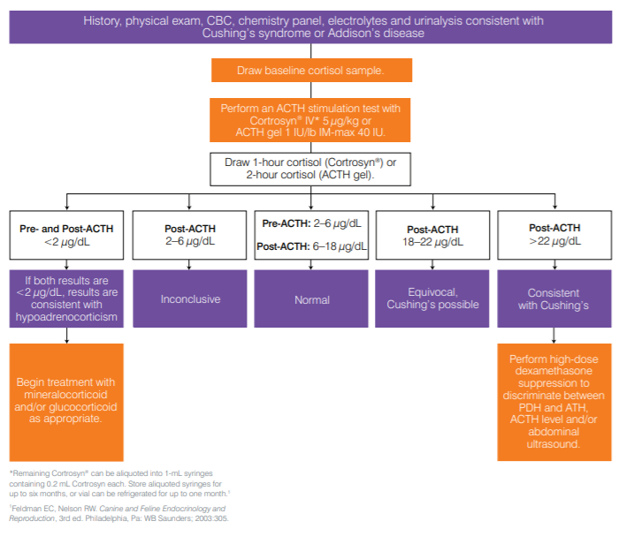

Slide 17
Methods to try identify CIRCI
3. Serum free cortisol:
serum free cortisol may be a more precise predictor of adrenal gland function
1) Transcortin can decrease by approximately 50% due to systemic inflammation
2) May be falsely low in hypoproteinemic patients, resulting in overestimation of CIRCI
3) Less likely to be altered in states of hypoproteinemia
4) May not accurately represent the biological activity of serum free cortisol during illness
5) Canine and feline studies are lacking, ability to measure not widely available

Slide 18
Methods to try identify CIRCI
4. Delta cortisol concentration
Humans: basal cortisol ≤34 µg/dL + delta cortisol concentration ≥9 µg/dL in response to stim test - favorable prognosis:
1) basal cortisol >34µg/dL + delta cortisol concentration <9µg/dL - poor prognosis
2) delta cortisol of <9µg/dL – one diagnostic criterion for CIRCI in humans
Veterinary studies
1) septic dogs with delta cortisol ≤3µg/dL after stim test - more likely to have systemic hypotension and decreased survival
2) acutely ill dogs with delta cortisol ≤3µg/dL after a stim test - more likely to require vasopressor therapy

Slide 19
2) Name three methods to try diagnose CIRCI
ACTH stim test
Delta Cortisol
Serum free cortisol

Slide 20
Methods to try identify CIRCI
Three scenarios may indicate CIRCI:
1. Dogs with normal or elevated basal cortisol and post-stim cortisol less than the normal reference range
2. A normal or elevated basal cortisol and flatline response (cortisol <5% greater than the basal)
3. Delta cortisol concentration ≤3µg/dL
Cats: Diagnostic criteria undetermined

Slide 21
Differential diagnosis
Refractory hypotension
1. Sepsis/septic shock/SIRS without CIRCI
2. Absolute spontaneous hypoadrenocorticism
3. Decompensated hypovolemic shock
4. Cardiovascular disease:
a. Cardiogenic shock
b. Overdose of vasodilator therapy
5. Hypermagnesemia
6. Diabetic ketoacidosis
7. Anaphylaxis

Slide 22
3) Describe scenarios that might warrant treatment with steroids in a critically ill dog
Refractory hypotension
Dogs with normal or elevated basal cortisol and post-stim cortisol less than the normal reference range
A normal or elevated basal cortisol and flatline response (cortisol <5% greater than the basal)
Delta cortisol concentration ≤3µg/dL

Slide 23
Treatment
In humans:
1. Optimal dose yet to be determined
2. Human protocols hydro 200–300mg IV SID for a 70kg person (2.9–4.3mg/kg IV q 24h). CRI or q 6h
3. Repeated bolus injections of HC causes significant hyperglycemia - not observed with CRI
- Surviving Sepsis Campaign guidelines recommend using a CRI over repeated bolus doses for avoidance of these side effects

Slide 24
Treatment
physiological to supraphysiological dosages
  (1 – 4.3mg/kg IV q 24h of hydrocortisone [q 6h or CRI], 0.25–1mg/kg IV q 24h of pred)
2. The American College of Critical Care Medicine Task force recommended against the use of dexamethasone for the treatment of CIRCI, because it may interfere with ACTH stimulation testing

Slide 25
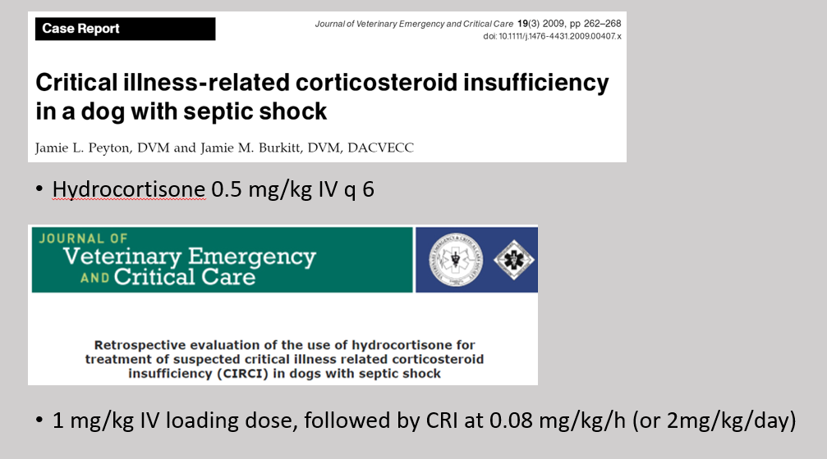
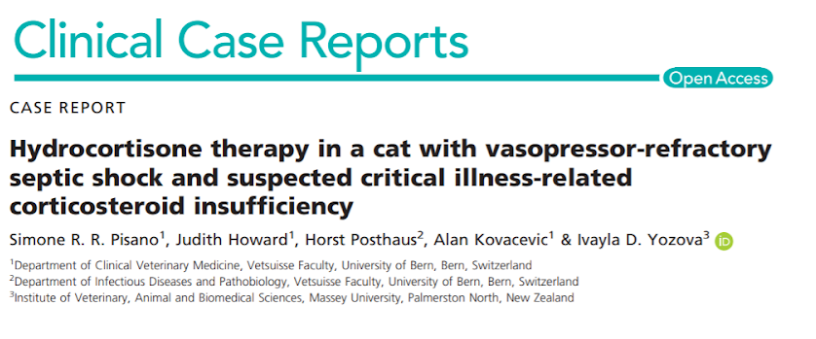
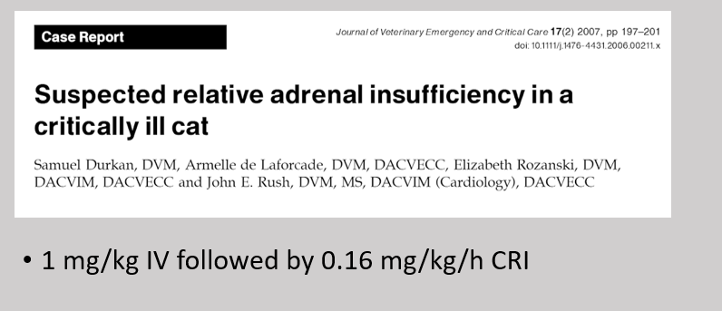
Treatment
no guidelines for treatment of CIRCI in vet med

Slide 26
So when do we treat?
It is reasonable to start volume-resuscitated, vasopressor-dependent animals on hydro after performing stim test:
1. treatment can be stopped if normal stim test
2. Steroids can be continued in patients that have:
(a) normal or elevated basal cortisol and a post-stim cortisol less than the reference range
(b) normal or elevated basal cortisol and flat line response
(c) delta cortisol concentration ≤3µg/dL
(d) demonstrated a significant improvement in cardiovascular status within 24h of starting corticosteroid therapy

Slide 27
Treatment
HPA dysfunction in CIRCI is transient
lifelong therapy not required
Steroid dose are slowly tapered
Stim test should be repeated following the resolution of critical illness and discontinuation of steroids

Slide 28
Prognosis
Human critically ill patients with CIRCI have a worse prognosis
Nonsurvivors: low basal cortisol (<9µg/dL), very high basal cortisol (>44µg/dL), and/or a low cortisol response to stim test (delta cortisol <9µg/dL)
2. Poor cortisol response to stim test (delta cortisol <9µg/dL) is associated with poor response to vasopressor therapy
3. Replacement therapy with steroids improved survival without causing overt harm (e.g., infection or GI hemorrhage)

Slide 29
Prognosis
not fully known for dogs with CIRCI:
Delta cortisol ≤3µg/dL after stim test in septic dogs assoc w/ systemic hypotension and decreased survival
2. Acutely ill dogs with delta cortisol ≤3µg/dL after stim test - more likely to require pressors
3. Elevated basal serum cortisol and decreased basal serum thyroid concentrations at 24 and 48h after hospital admission assoc w/ death in dogs with parvo

Slide 30
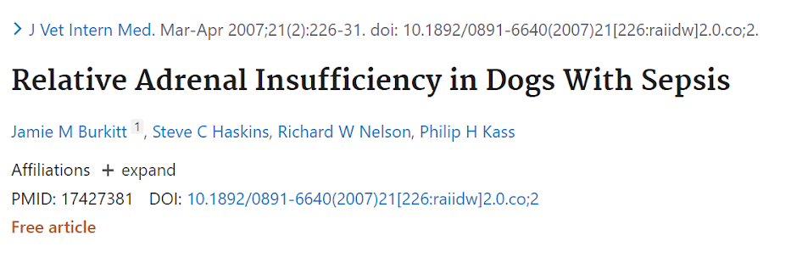
Dogs with a delta cortisol < 3 ug/dL following a standard 250 ug/dog ACTH stim test
  more likely to be hypotensive and had decreased survival compared to dogs with a cortisol increase > 3 ug/dL

Slide 31
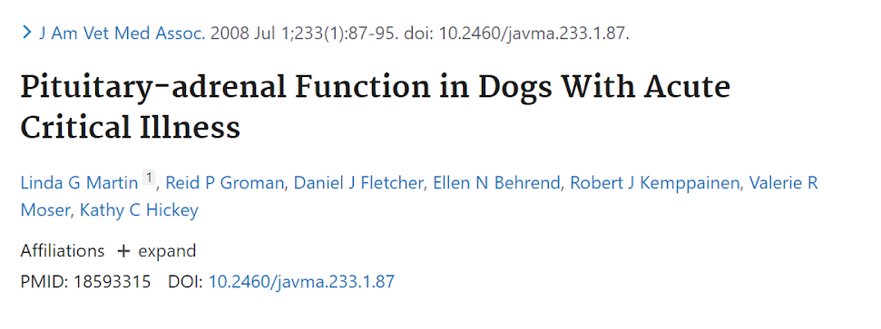
Delta cortisol < 3 ug/dL 1 hour after 5 ug/kg cosyntropin were more likely to be pressor-dependent than dogs with delta cortisol > 3 ug/dL

Slide 32
3) True or false
Acutely ill dogs with a delta cortisol greater tan 3µg/dL after stim test are more likely to require pressors

Slide 33
Total cortisol vs plasma or serum cortisol?
Recommend against using plasma free cortisol level rather than plasma total cortisol for diagnosis of CIRCI
Is the hemodynamic response to hydrocortisone superior to stim test for diagnosis of CIRCI?
Suggest the use of stim test rather than the hemodynamic response to hydro for diagnosis of CIRCI

Slide 34
Should steroids be administered among hospitalized adult patients with sepsis without septic shock?
Suggest against use of steroids in patients with sepsis without septic shock. Conditional recommendation, moderate quality of evidence. HYPRESS trial.
Should steroids be administered among hospitalized adult patients with septic shock?
Suggest using steroids in patients with shock that is not responsive to fluid and moderate to high-dose vasopressor therapy.
Recommended dose of steroids?
Suggest long course and low dose: IV hydro <400 mg/day for 3 or more days

Slide 35

Thank you!

