Slide 1
Pulmonary Parenchymal disease
Samantha Davis, DVM

Slide 2
Topics covered
Interstitial lung disease/pulmonary fibrosis
Aspiration pneumonia
Pulmonary edema
  Cardiogenic
  Non cardiogenic

Slide 3
Pulmonary parenchyma
After the lower respiratory tract, the terminal bronchioles divide into respiratory bronchioles
These have few alveoli
Last are the alveolar ducts which are completely lined with alveoli
Regions of the lung with alveoli= respiratory zone
Portion of lung distal to terminal bronchioles= acinus
Alveoli are inherently unstable structures; surfactant lowers the surface tenson to allow for greater stability

Slide 4
Pulmonary parenchyma
Exchange oxygen and carbon dioxide in the blood in the pulmonary capillaries
Pulmonary capillaries are wrapped around the alveoli, only 1 RBC passes through at a time, minimizing the space oxygen must travel between the alveolus and hemoglobin molecule
For optimal gas exchange ventilation and perfusion should match
Arterial walls contain smooth muscle, so if one section of lung is not receiving adequate oxygen the arteries will constrict and divert blood flow to another lung unit
Removes inhaled particles, however alveoli have no cilia so alveolar macrophages are utilized
Notes:
Pulmonary circulation receives blood from the RV to pulmonary capillaries to oxygen to RBCs and CO2 to alveoli
Bronchial circulation which delivers oxygenated blood from the aorta to the lung tissue

Slide 5
Interstitial lung disease
ILD are noninfectious and nonmalignant pulmonary diseases with radiographic and clinicopathologic overlap
The majority of ILD have no known underlying etiology- varying levels of inflammation and fibrosis
Over 200 types of ILD in humans, less known in canines but are likely under-reported
Not always interstitial- can affect the parenchyma, pleural space, airways and vessels
Pulmonary interstitium- anatomic space lined by alveolar epithelial cells and capillary endothelial cells as well as loose connective tissue

Slide 6
ILD- pathophysiology
Hypothesized to be secondary to repetitive insult to the distal lung parenchyma and an aberrant wound healing process
Injured alveolar epithelium leads to increased epithelial cell death, abnormal re-epithelialization, pneumocyte type II hyperplasia and activation of alveolar epithelial cells
This creates a pro-thrombotic environment along with activation of coagulation
These processes can turn epithelial cells into fibroblasts → epithelial mesenchymal cell transition→ myofibroblasts
Over time this leads to fibroblasts, myofibroblasts and an excessive production of collagen which leads to abnormal lung tissue → diffusion impairment
Notes:
#1 hematogenous vs airborne

Slide 7
ILD
Human classification scheme for ILD:
  Idiopathic interstitial pneumonia (IIP)
  ILD of known cause
  Miscellaneous ILD
Notes:
Not one scheme used

Slide 8
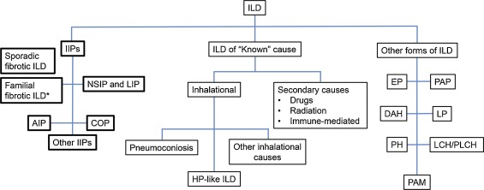

Notes:
Veterinary

Slide 9
CIPF
Canine idiopathic pulmonary fibrosis is an ILD classified as an IIP sub classified as a familial and fibrotic in WHWT
The trigger is unknown, in human cigarette smoking, environmental agents, GERD and herpes virus are risk factors
In WHWT terriers a survey showed that living in an old house, poor ventilation and frequent trips to the groomer were risk factors
Maatta et al found bile acids in BAL samples in WHWT with CIPF which may support GERD and micro-aspiration as a cause
Hereditary, increased serum levels of TGF-beta

Slide 10
Histopathology
Diffuse, mature uniform fibrosis of the alveolar wall throughout the lung
Often there are areas of more severe, but less mature fibrosis
Fibrosis is worst adjacent to the bronchi
Mild to moderate interstitial lymphoplasmacytic inflammation

Slide 11

Signalment and signs
Most commonly affects WHWT, but can affect other terriers or breeds
Middle aged to older with no sex predisposition
Signs: cough, exercise intolerance, dyspnea, cyanosis, collapse
Often present with advanced disease
PE: BAR or dyspneic, “Velcro” crackles on inspiration bilaterally, soft right sided heart murmur

Slide 12
Diagnosis
No associated changes in CBC/Chemistry/urinalysis
Perform fecal to r/o parasitic disease
ABG- low PaO2 and high A-a gradient
Six minute walk test
Thoracic radiographs- broncho-interstitial pattern, +/- patchy alveolar pattern, +/- cardiac and pulmonary artery enlargement
Echocardiogram- PH found in 20% to 60% of WHWT with suspect CIPF
Notes:
Rads: not sensitive or specific mainly used to r/o other disease, hard to differentiate from old age changes, hard to determine severity or progression of disease

Slide 13
Advanced diagnostics
HRCT- ground glass opacity, mosaic attenuation, linear and reticular opacities, consolidation or bronchial wall thickening
Bronchoscopy - bronchial mucosal irregularity, mild to moderate increase in bronchial mucous, bronchomalacia, dynamic airway collapse and bronchiectasis
BALF- increased macrophages, neutrophils and mast cells
Biomarkers: WHWT (healthy vs sick) ET-1, chemokine ligand 2, IL-8, PIIINP, MMP-9, CB vs CIPF- ET-1, MMP-9, MMP-2, PIIINP, WHWT- TGF-beta, IL-8
Notes:
HRCT similar findings in humans, if meet criteria do not need lung biopsy for diagnosis
bronchoscopic changes cannot differentiate between CB and CIPF

Slide 14
Treatment
No effective treatments, leading cause of lung transplants in humans worldwide
Pirfenidone- antifibrotic- downregulate collagen and growth factors, no clinical studies in dogs
Nintedanib- severe GI signs in dogs
Prednisone may reduce cough, no clear benefit to oral vs inhaled
Theophylline
PPIs or H2 blockers
Sildenafil if PH

Slide 15
Prognosis
May develop acute exacerbation, primary vs secondary
MST 32 months from onset of clinical signs
MST 11 months after diagnosis
Can have a slow or rapid disease progression
High chemokine ligand-2 and severity of HRCT findings were negatively associated with survival

Slide 16
Fibrotic ILDs
Excluding familial fibrotic ILD in WHWT
End stage presentation of progressive fibrotic disease that often presents with restrictive lung disease
These disease processes may have underlying etiologies that would be amenable to treatment
Described in cats but in smaller populations

Slide 17
NSIP and LIP
Non-specific interstitial pneumonia and lymphocytic interstitial pneumonitis
NSIP histopathologic diagnosis described in WHWT
LIP described in FIV positive cats based on BALF

Slide 18
Acute interstitial pneumonia
“Idiopathic ARDS”
Criteria: less than 60 days duration, bilateral diffuse infiltrates on imaging, diffuse alveolar damage on histo, no previous inciting event or imaging changes
AIP could be confused with AE of IPF, however AIP is due to a single insult, not repetitive
No reports in dogs and cats especially since one of the ARDS criteria is a known inciting factor

Slide 19
Cryptogenic organizing pneumonia
Granulation tissue obstructs bronchioles and alveoli
Few case reports in veterinary medicine – research dogs, secondary to toxic fume inhalation, often an idiopathic steroid responsive form

Slide 20
Aspiration pneumonia
May refer to pneumonitis (inflammation) or pneumonia (infection)
Aspiration occurs secondary to inadvertent inhalation of gastric acid, oropharyngeal secretions and/or ingesta
Local irritation by the gastric acid changes the local environment and promotes bacterial invasion, compromises gas exchange
Risk factors: breed, anesthesia, esophageal disease, seizures, vomiting or regurgitation, laryngeal disease
Events are witnessed <1% of the time
Mortality rate ~25%, very important to start treatment early
Notes:
Breeds- irish wolfhounds, brachycephalic (FB, EB and pugs) 3.7X more likely to develop, hx of GI signs most common, pugs tended to be older and have neuro dz

Slide 21
Pathophysiology
Can be a benign event – ‘bland aspiration’
Pneumonitis – secondary to large volume, low pH and presence of food
  Chemical burn- (pH 1.8-2.5)
  Immunological- alveolar macrophages and type II pneumocytes release inflammatory cytokines→ neutrophils release proteases and oxidants→ compromise vascular endothelial integrity → increase permeability→ proteins and fluid increase in the alveoli → inhibits gas exchange and consolidation occurs
Notes:
If contents pH >2.5 even with large volumes lower morbidity and mortality, high with contents <1.4 even with small volumes
4 hours after aspiration --- large numbers of neutrophils present

Slide 22
Pathophysiology
Pneumonia – aspiration of colonized oropharyngeal and gastric contents, due to acidic contents and pathogenic bacteria
Inflammatory events may be incited without evidence of acid burn due to the presence of bacteria (regardless of pH and volume)
Macrophage activation→ cytokine and inflammatory mediators→ microvascular disruption and edema→ airway collapse and damage to mucociliary clearance → epithelial injury from burn enhances bacterial adherence → changes to the phospholipid and protein components of surfactant, increases surface tension-→ atelectasis
Bronchoconstriction→ increased airway resistance
Notes:
Surfactant- decreased surface tension and decreases work of breathing

Slide 23
Signs
Acute changes in respiratory pattern and effort
Harsh lung sounds or crackles on auscultation
Fever
Coughing
30% have normal BV sounds

Slide 24
Diagnostics
Often presumptive diagnosis based on history, clinical signs and radiographic findings
CBC/chemistry- elevated WBC counts +/- LS
Thoracic radiographs- interstitial to alveolar pattern in dependent lung lobes → right middle, right cranial, left cranial
  Patient in dorsal recumbency, more likely to see caudal lobes affected
Oxygenation status – hypoxemia (PaO2 < 80 mmHg) in 79% of patients, (SPO2 < 90%) in 56%
BAL/TTW – neutrophilic, mixed neutrophilic or macrophagic inflammation, 75% of TTW positive → E. coli, MR-S. aureus, K. pneumoniae, enterococcus
Notes:
The right mainstem bronchus is a more direct continuation of the trachea so higher prevalence in right side in sternal patients
Samples should be obtained – patient stability or cost

Slide 25
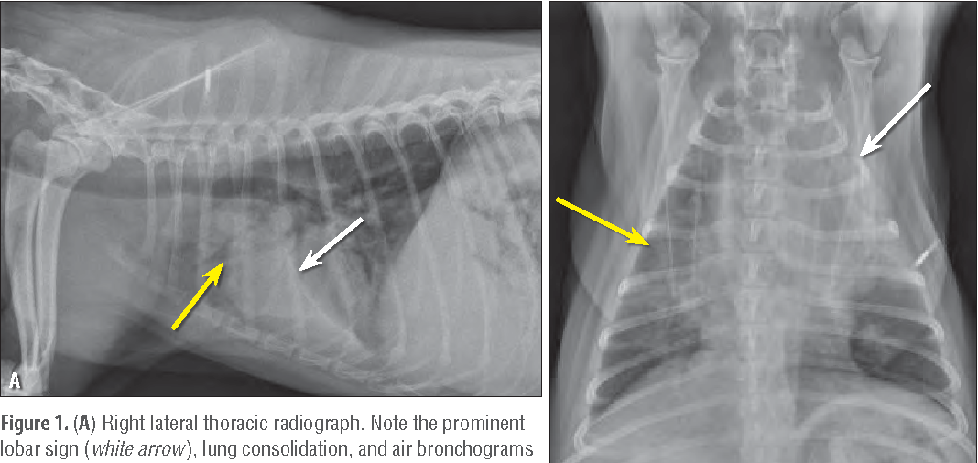
Thoracic radiographs

Slide 26
Treatment
IV fluids- judicious use of fluids, increased vascular permeability so increased hydrostatic pressure can allow for fluid extravasation into pulmonary parenchyma
Antibiotics- beta lactam or cephalosporin and a fluoroquinolone, unclear if coverage is needed for anaerobes
Oxygen
Nebulization- unclear benefit, hypertonic saline increased mucociliary clearance over normal saline, NAC can decrease viscosity but causes bronchoconstriction
Bronchodilator- no increased survival benefit found
Notes:
If witnessed the oropharynx should be suctioned
Antibiotics are not recommended in humans unless signs for >48 hrs

Slide 27
Prognosis
Overall survival rates 30-80%
Disease processes that are untreatable (laryngeal paralysis, megaesohoagus, etc) are likely to result in repeated in episodes which increase the likelihood of euthanasia
Tart et al 2010, survival rate 81%, retrospective, patients with >2 lung lobes affected had a worse outcome, 77% of airway samples had positive cultures – 42.6% were mixed gram +/gram- (E. coli most common)
No statistical survival with any treatments except colloids- negative association with survival
Notes:
Diagnostic and treatment modalities assocaited with survival, retro, 125 dogs, AP based on 2+ criteria- rads, clinical signs, wbc changes, airway culture, history compatible

Slide 28
Prevention
Anesthesia considerations:
  Fasting – Savaas et al 2009- small meal 3 hours prior to GA less likely to aspirate
  ET tube cuff pressure 20-30 cm H2O, removing ET tube as late as possible
  Medications- PPIs may decrease damage to esophagus and less likely to cause pneumonitis due to higher pH
Notes:
PPIs have been associated with hospital acquired pneumonia in people

Slide 29
AP in felines
Levy et al 2019- retrospective all cats diagnosed with AP or bronchopneumonia, 28 cases
3 view CXR were necessary for inclusion
Most common presenting complaints were increased RE, anorexia, vomiting and lethargy
Right middle and left cranial were the most commonly affected lung lobes
Same predisposing factors as dogs- recent vomiting and GA most common

Slide 30
Pulmonary edema
Cardiogenic vs non cardiogenic
Accumulation of extravascular fluid in the pulmonary parenchyma or alveoli
Most often caused by high pressure edema (cardiogenic) or increased permeability edema (NC)
Starling forces, reflection coefficient (relative permeability of the membrane to protein) filtration coefficient (overall fluid flow from vasculature of specific tissues)
Mechanisms to decrease edema formation: decrease interstitial COP, increase interstitial hydrostatic pressure and increased lymphatic drainage
Lymphatics and bronchial circulation clear edema
Notes:
Reduced reflection = increased perm

Slide 31
Causes
Cardiogenic edema most often secondary to left sided congestive heart failure
Chronic compensation results in fluid retention to maintain cardiac output which leads to congestion and edema
DCM and MMVD in dogs, HCM in cats
IVF therapy can also cause high pressure edema, rarely in cases without pre-existing cardiac or pulmonary pathology
Non cardiogenic edema secondary to ARDS→ inflammation, infection, sepsis, SIRS, trauma, multiple transfusions, smoke inhalation, submersion, toxins or PTE
Mixed cause edema- neurogenic PE (head trauma, seizure, electrical cord bite) vs negative pressure PE (upper airway obstruction, strangulation)
Notes:
NPE- massive neuronal sympathetic activity causes both types of edema “blast theory”, high pressure and then increased perm
NPPE- subatmospheric intrathoracic pressure

Slide 32
Pathophysiology
High pressure edema- high pulmonary capillary pressure → fluid extravasation→ overwhelms lymphatic removal→ fluid flows toward the peri-bronchovascular interstitium where there is no gas exchange→ then to all parts of the pulmonary interstitium→ finally reaching the alveoli
Increased permeablity edema→ injury to the microvascular barrier leading to high protein fluid leakage → increased permeability so protective mechanisms are no longer intact → small rise in hydrostatic pressure can result in large amount of interstitial edema
If concurrent endothelial and epithelial injury, the intravascular space and alveoli have a direct connection so alveolar flooding occurs

Slide 33
Clinical signs
Dyspnea
Loud crackles or course lung sounds
Weakness
Cyanosis
+/- heart murmur

Slide 34
Diagnostics
WAIT! Until patient is stable
SPO2
ABG
TFAST- Lisciandro et al, 2017- cats with CHF vs no resp disease
CXR- interstitial to alveolar pattern, perihilar for cardiogenic with enlarged pulmonary veins vs caudo-dorsal distribution for NP in dogs, cats can have diffuse or patchy distribution
Bouyssou et al 2016- 49 dogs, 11 cats with NCPE from varying causes, very variable appearance!
Notes:
Compared with CXR, 12% had B lines with no disease vs 100% with CHF, >3 at every site

Slide 35
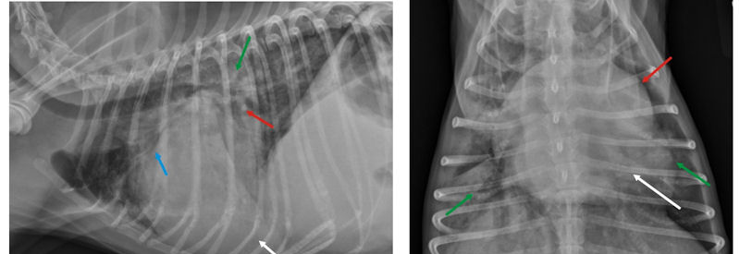
Cardiogenic PE

Slide 36
Treatment
Cardiogenic- oxygen, furosemide, butorphanol, pimobendan
Non- cardiogenic- oxygen, judicious use of IVF
Mechanical ventilation

Slide 37
Prognosis
Variable depending on etiology
NPE and NPEE usually good prognosis
Severe NCPE usually carries a poor prognosis
Cardiogenic- dogs with MMVD MST is 1 yr, cats with HCM MST is 6 mos, DCM MST 6 mos

Slide 38
References
Laurila HP, Rajamäki MM. Update on Canine Idiopathic Pulmonary Fibrosis in West Highland White Terriers. Vet Clin North Am Small Anim Pract. 2020 Mar;50(2):431-446. doi: 10.1016/j.cvsm.2019.11.004. Epub 2019 Dec 20. PMID: 31866093.
Reinero C. Interstitial lung diseases in dogs and cats part I: The idiopathic interstitial pneumonias. Vet J. 2019 Jan;243:48-54. doi: 10.1016/j.tvjl.2018.11.010. Epub 2018 Nov 20. PMID: 30606439.
Dear JD. Bacterial Pneumonia in Dogs and Cats: An Update. Vet Clin North Am Small Anim Pract. 2020 Mar;50(2):447-465. doi: 10.1016/j.cvsm.2019.10.007. Epub 2019 Dec 5. PMID: 31813555; PMCID: PMC7114575.
Sherman R, Karagiannis M. Aspiration Pneumonia in the Dog: A Review. Top Companion Anim Med. 2017 Mar;32(1):1-7. doi: 10.1053/j.tcam.2017.05.003. Epub 2017 May 27. PMID: 28750782.
Tart KM, Babski DM, Lee JA. Potential risks, prognostic indicators, and diagnostic and treatment modalities affecting survival in dogs with presumptive aspiration pneumonia: 125 cases (2005-2008). J Vet Emerg Crit Care (San Antonio). 2010 Jun;20(3):319-29. doi: 10.1111/j.1476-4431.2010.00542.x. PMID: 20636985.

Slide 39
References
Levy N, Ballegeer E, Koenigshof A. Clinical and radiographic findings in cats with aspiration pneumonia: retrospective evaluation of 28 cases. J Small Anim Pract. 2019 Jun;60(6):356-360. doi: 10.1111/jsap.12990. Epub 2019 Mar 6. PMID: 30843218.
SACCM
Bouyssou S, Specchi S, Desquilbet L, Pey P. RADIOGRAPHIC APPEARANCE OF PRESUMED NONCARDIOGENIC PULMONARY EDEMA AND CORRELATION WITH THE UNDERLYING CAUSE IN DOGS AND CATS. Vet Radiol Ultrasound. 2017 May;58(3):259-265. doi: 10.1111/vru.12468. Epub 2016 Dec 22. PMID: 28005303.
Darcy, H. P., Humm, K., & Ter Haar, G. (2018). Retrospective analysis of incidence, clinical FEATURES, potential risk factors, and prognostic indicators for aspiration pneumonia in three brachycephalic dog breeds. Journal of the American Veterinary Medical Association, 253(7), 869-876. doi:10.2460/javma.253.7.869

