Slide 1
Searching Folio’s inventory
Laura E. Daniels
For Cornell University Library
February 19, 2021

Slide 2
What I’ll Cover today
Structure of Inventory
Search Interface
Types of searches
Filters
Examples
Your questions, I hope

Slide 3
What I won’t cover today*
Query search (advanced searching)
Creating or editing records
Searching other apps
*Not because these are not important

Slide 4
caveats
Some functionality critical to effective searching is not in the Honeysuckle release
Sorting and display improvements being made are not in the Honeysuckle release
Documentation I share is in progress
My internet connection at home may contribute to system slowness in demos

Slide 5
What is inventory?
Holds bibliographic, holdings, and item data
But is not a cataloging tool
Non-MARC… with underlying MARC source data
In general, if you search the cataloging module in Voyager now, you’ll be searching the Inventory app in FOLIO

Slide 6

How do I get there?
https://cornell-training.folio.ebsco.com/
Use “SSO” login at the bottom of the page
Look for

Slide 7
Search interface
Left, middle, and right panes (standard FOLIO layout)
Segments (correspond to record types)
Search options
Filter options
Reset all option

Slide 8
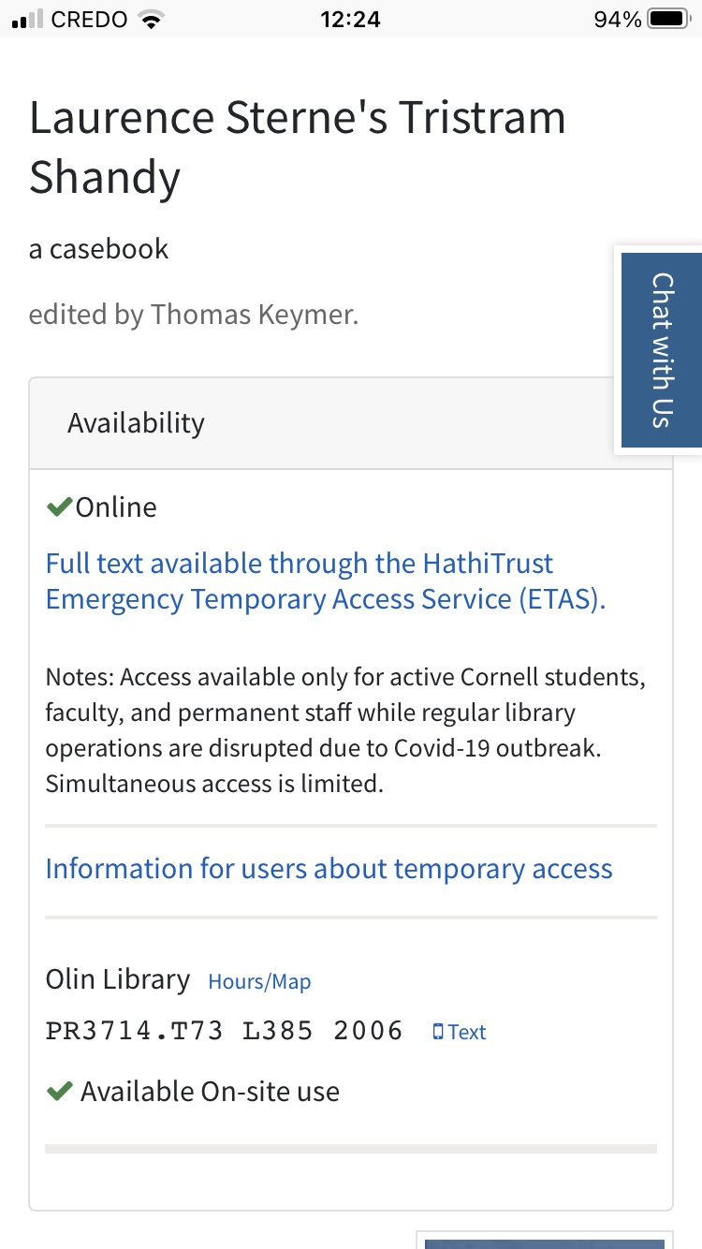
Example: call number
A student comes up to you with a question about a book. They have this record displayed on their phone
Because the call number is part of the holdings data, this search is done in the holdings segment
Call number, normalized
vs.
Call number, eye-readable

Slide 9
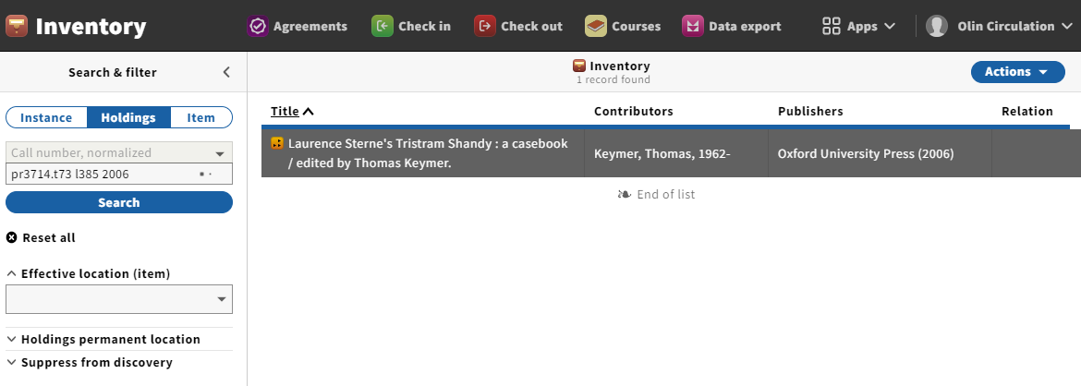

Slide 10
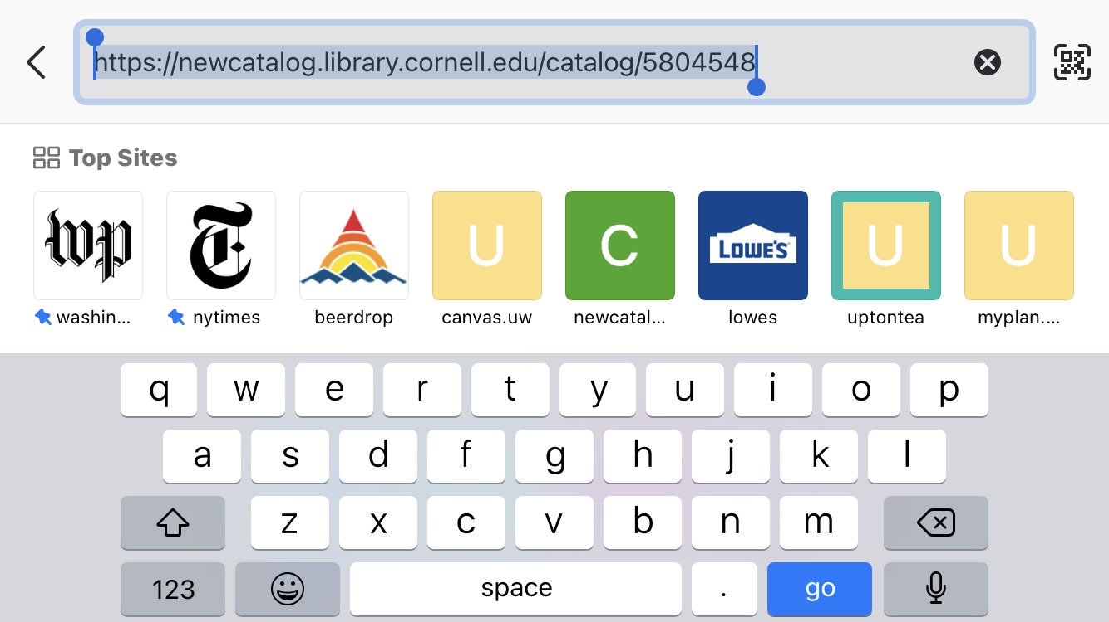
Example: hrid
Using the same example, you look more closely and find the catalog URL, which includes the bibid for this title.
That bibid is called the Instance HRID (human readable identifier) in FOLIO. This search is performed in the Instance segment.

Slide 11
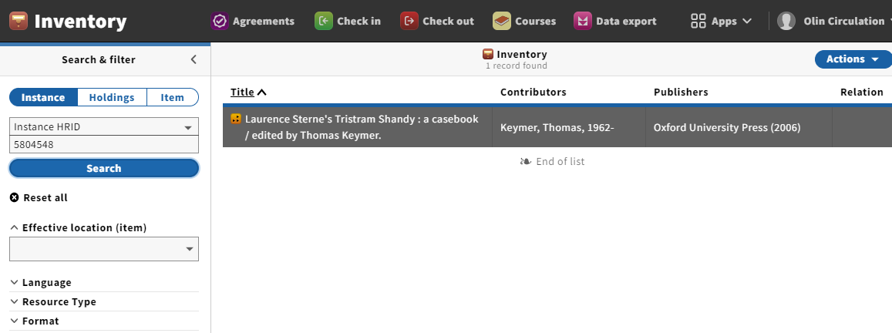

Slide 12
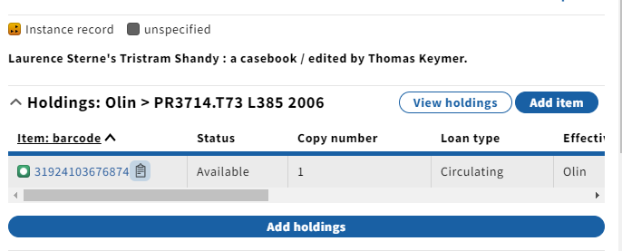
Example: barcode
If you have the book, or its barcode available, you can search that in the item segment.
Tip: if you’re already viewing a record in Inventory you can easily copy the barcode (and some other numbers) using the clipboard icon.

Slide 13
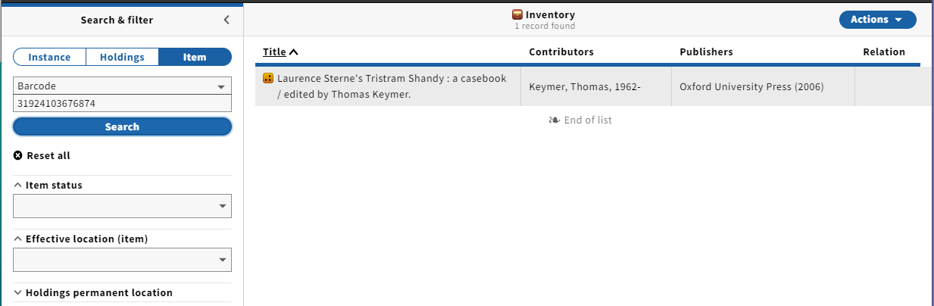

Slide 14
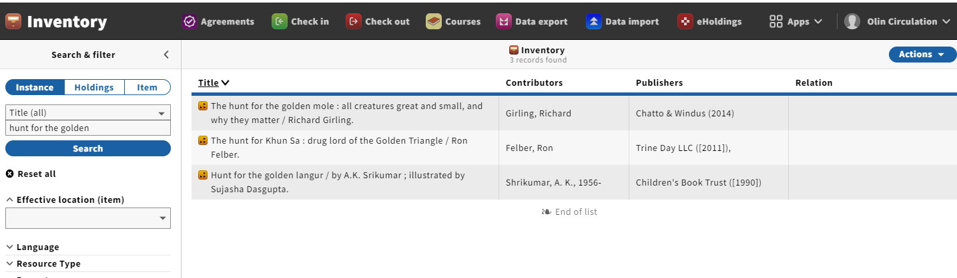
Example: title
The title search is different that we are used to. It is a keyword search within the title field, not a phrase search and not left-anchored.

Slide 15
Title, continued
Also, the “statement of responsibility” part of the title field is included in the title index, since Instance records don’t have the same “subfields” that MARC has. Since that information is not always part of the title, don’t rely on it when searching.

Slide 16
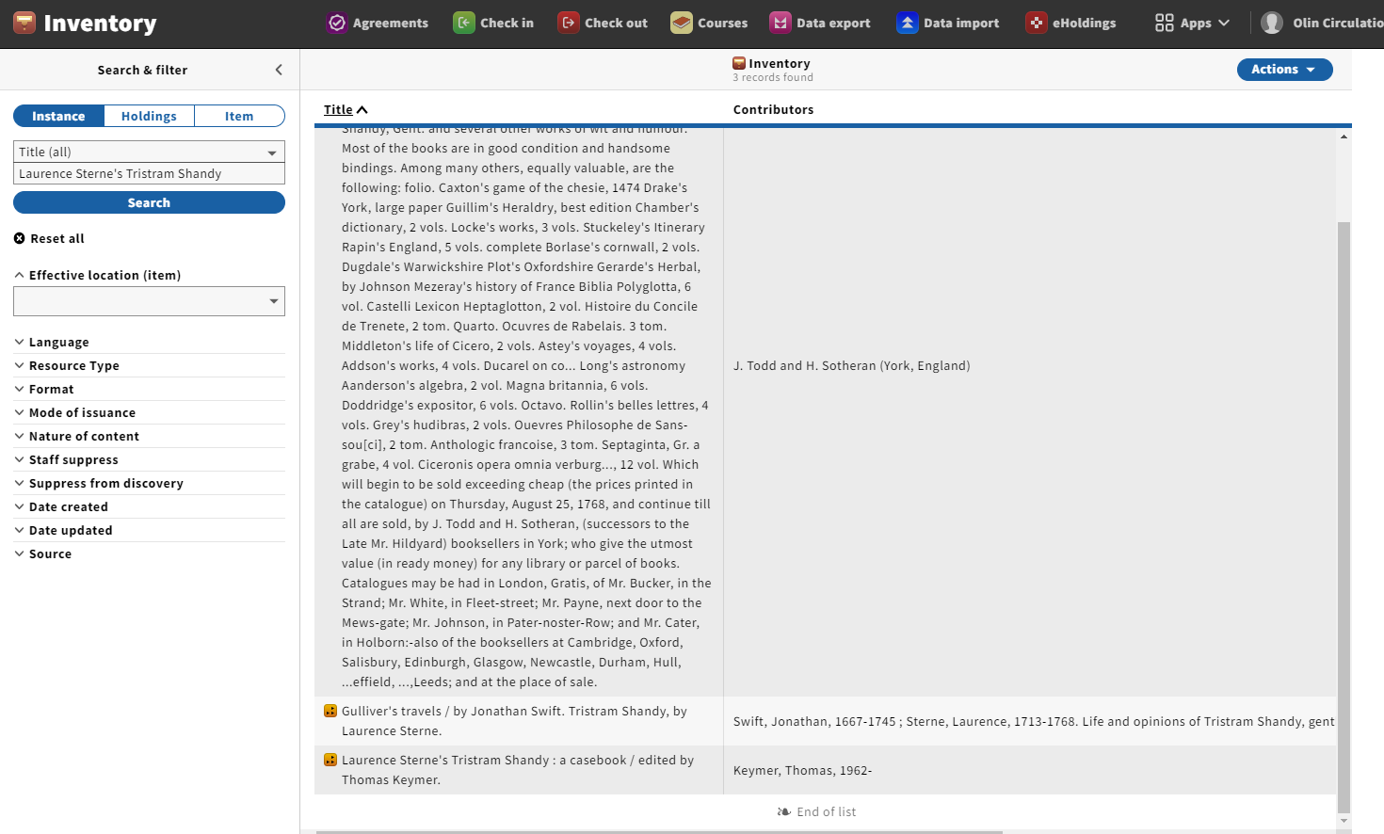

Slide 17
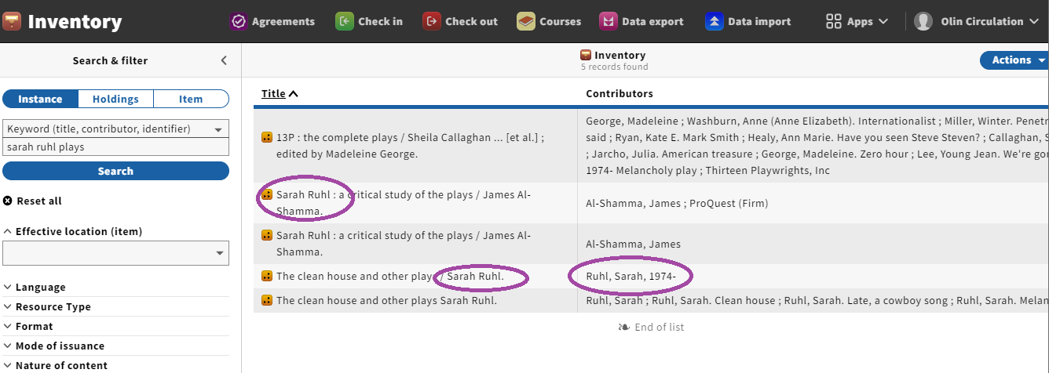
Example: title and author
We don’t have the same explicit author/title search that Voyager does, but we can approximate it using the Keyword search.
Be aware that the author may actually be coming from the title field, though.

Slide 18
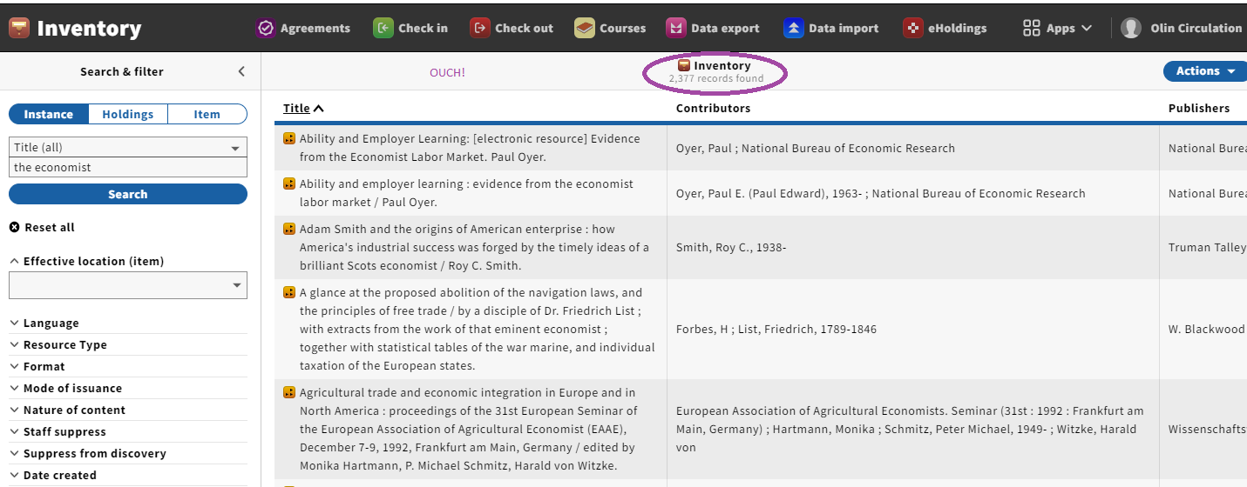
Example: serial with common title

Slide 19
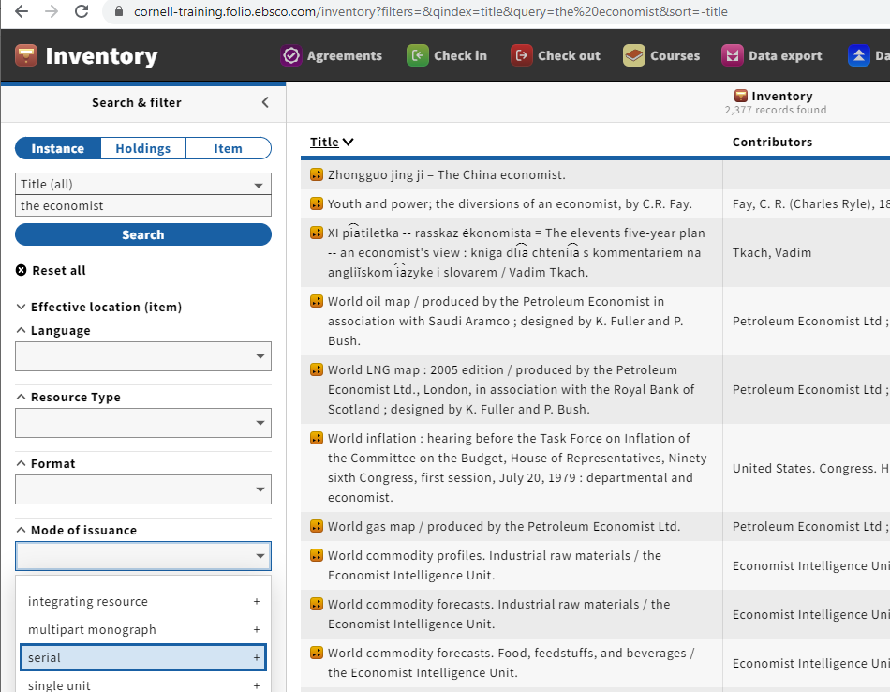
When our data is completely mapped, this limit should work – but it doesn’t right now. So what else can we do?

Slide 20
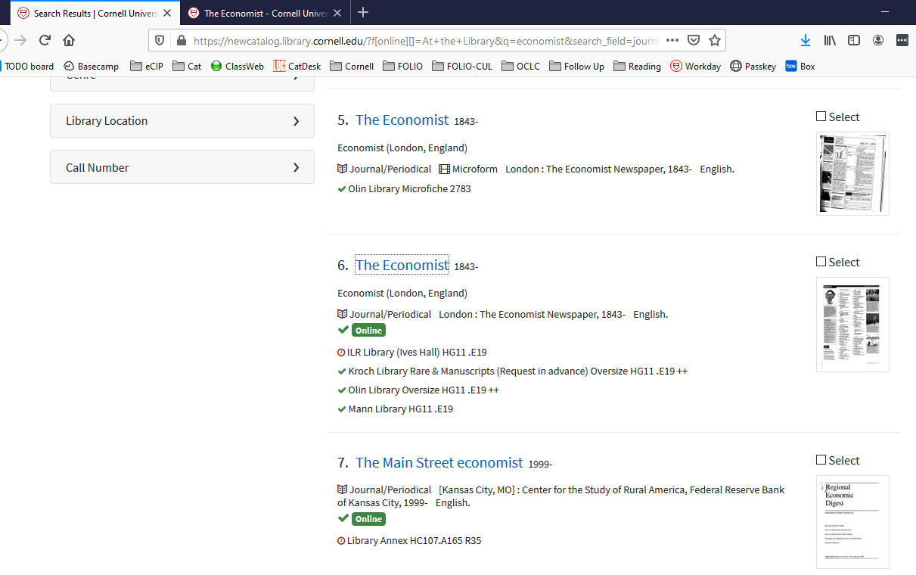
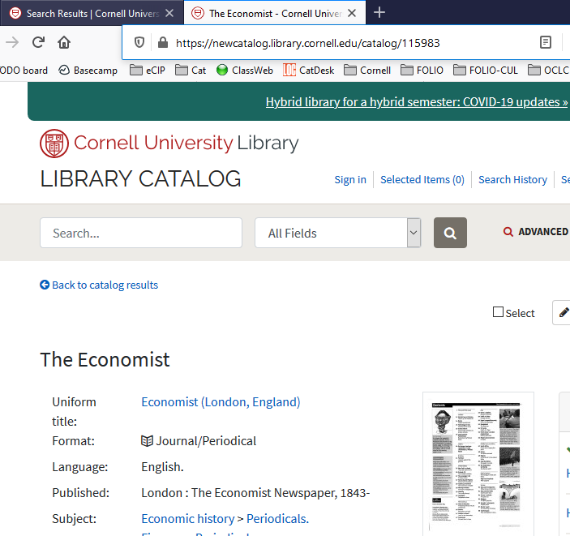
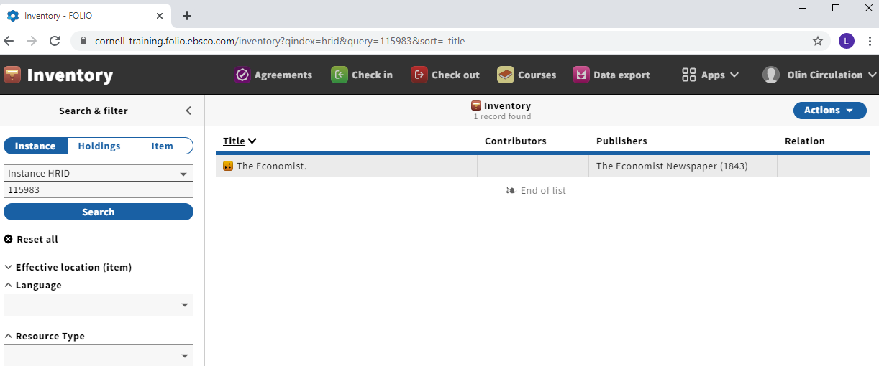
Hack: Use Blacklight (public catalog) to find the record id

Slide 21
Where can I find more information?
Cornell Library FOLIO documentation on Confluence
LTS FOLIO documentation on Confluence
FOLIO wiki: Inventory information, tips, and tricks
FOLIO wiki: Community Contributed Resources

