Slide 1
Physiology of Pain
And Pain scores

Slide 2
“an unpleasant experience associated with actual or potential tissue damage”

Slide 3
Types of pain – True or False
- Chronic pain serves a biological function and it has been very well documented that it responds to opioids when combined with an NSAID
FALSE

Slide 4
Types of Pain
Acute
Chronic
result of a traumatic, surgical, or infectious event
begins abruptly and is relatively brief
generally alleviated by analgesic drugs
has a biological function (serves as a warning)
symptom of disease
persists beyond the usual course of an acute disease
associated with a chronic pathological process
seldom permanently alleviated by analgesics, but may respond to a combination
It’s a disease itself
No biological f(x)
imposes severe detrimental stresses
Notes:
Allodynia: pain caused by a non painful stimulus
Hyperalgesia: exaggerated response to a painful stimulus

Slide 5
Neuroanatomy of Nociceptive PATHWAYS
Nociception: reception of signals from activation of nociceptors
stimuli for nociceptors can include mechanical, thermal, or chemical
Some nociceptors monomodal, some others polymodal
Nociceptors are naked nerve endings, widely distributed in skin and deep tissues
These represent the peripheral termini afferent neurons that possess lightly or unmyelinated, small-diameter axons
Notes:
Nociception does not necessarily mean Pain
Stimulation does not = Pain

Slide 6
Nociception
What is the definition of nociception?
The physiologic process of (1) transduction of a painful stimuli within the afferent nerve ending, (2) transmission of pain stimuli to the dorsal horn and (3) modulation of pain within the spinal cord and supraspinal structures that finally results in (4) perception of pain

Slide 7
Components of Nociception
Transduction: transformation of physical energy (noxious stimuli) into electric activity at the peripheral nociceptor
  Chemical stimuli
  Thermal stimuli
  Mechanical stimuli
  Will release chemical substances
Notes:
Noxious stimuli triggers trasnduction

Slide 8
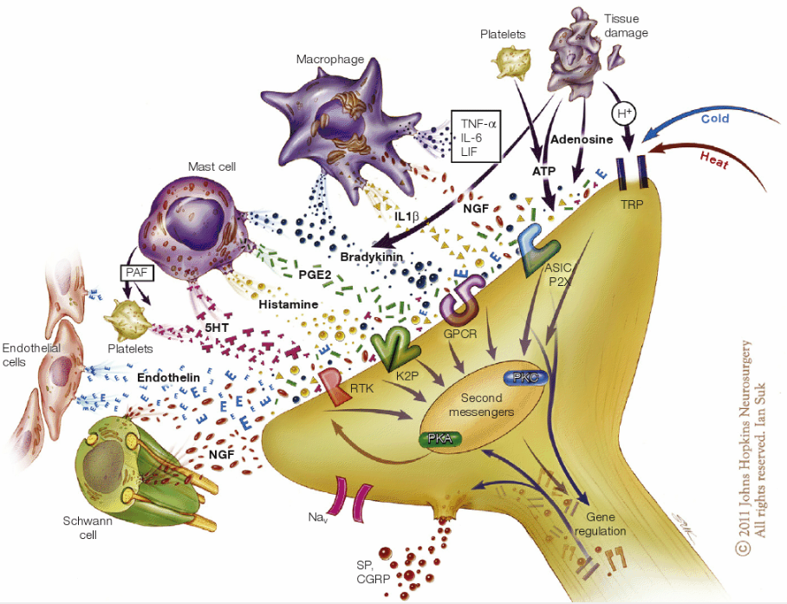
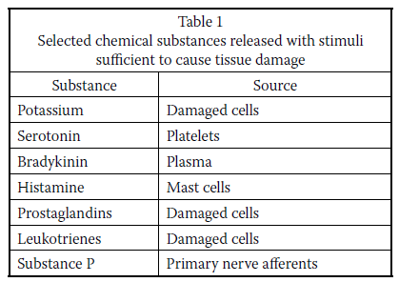
The painful soup
Notes:
Also called inflammatory soup
Tissue injury and infection cause inflammation via plasma extravasation and infiltration of immune cells such as macrophages, T cells and neutrophils into the damaged tissue. The infiltrated immune cells and resident cells, including mast cells, macrophages and keratinocytes, release several inflammatory mediators, such as bradykinin, prostaglandins, H⁺, ATP, nerve growth factors (NGFs), pro-inflammatory cytokines (tumour necrosis factor (TNF; formerly known as TNFα), interleukin-1β (IL-1β) and IL-6) and pro-inflammatory chemokines (CC-chemokine ligand 2 (CCL2), CXC-chemokine ligand 1 (CXCL1) and CXCL5). Nociceptor neurons express the receptors for all of these inflammatory mediators, which act on their respective receptors on peripheral nociceptor nerve fibres. These receptors include G protein-coupled receptors (GPCRs), ionotropic receptors, and tyrosine kinase receptors, and their activation results in the generation of second messengers such as Ca²⁺ and cyclic AMP, which in turn activate several kinases, such as protein kinase A (PKA), PKC, calcium/calmodulin-dependent protein kinase (CaMK), phosphoinositide 3-kinase (PI3K) and the mitogen-activated protein kinases (MAPKs) extracellular signal-regulated kinase (ERK), p38 MAPK and JUN N-terminal kinase (JNK). Activation of these kinases causes hypersensitivity and hyperexcitability of nociceptor neurons (known as peripheral sensitization) through the modulation of key transduction molecules such as transient receptor potential cation channel subfamily A member 1 (TRPA1), TRPV1 and Piezo (a stretch-activated ion channel), as well as key conduction molecules such as the voltage-gated sodium channels Nav1.7, Nav1.8 and Nav1.9. Nociceptor neurons also express Toll-like receptors (TLRs; specifically, TLR3, TLR4 and TLR7), which can be activated by exogenous ligands (known as pathogen-activated molecular patterns, which include viral and bacterial components) and endogenous ligands (known as danger-activated molecular patterns, such as RNAs). Certain microRNAs (for example, let-7b) serve as novel pain mediators to activate nociceptors via TLR7, which is coupled to TRPA1 (the coupling is further enhanced when TLR7 is activated by let-7b). Bacterial infection with Staphylococcus aureus also directly activates nociceptors and induces neuronal hyperexcitability by releasing bacterial N-formylated peptides (FPs) and the formation of the pore-forming toxin α-haemolysin (α-HL). Activation of nociceptors also releases substance P and calcitonin gene-related peptide (CGRP), which are involved in the generation of neurogenic inflammation. CGRP also negatively regulates lymphadenopathy after inflammation. 4-HNE, 4-hydroxynonenal; 5,6-EET, 5,6-epoxyeicosatrienoic acid; ASIC, acid-sensing ion channel; FPR1, formyl peptide receptor 1; HETE, 5-hydroxyeicosatetraenoic acid; HMGB1, high mobility group protein B1; P2X3, P2X purinergic receptor 3; PGE₂, prostaglandin E₂; RTK, receptor tyrosine kinase.

Slide 9
What is an algogenic substance?
Endogenous chemical substrates that lower the threshold potential for activating nociceptors
Name 5 algogenic substances
Histamine
Serotonin
Bradykinins
Prostaglandins
Substance P

Slide 10
Transduction phase:
can be abolished by local anesthetics
NSAIDs will obtund transduction by decreasing production of endogenous algogenic substances

Slide 11
Components of Nociception
2) Transmission: is the propagation of nerve impulses through the nervous system
  Peripheral afferent nociceptors
    A – β fibers
    A – δ fibers
    C – fibers
  Ascending Pathways – Spinal Cord
    spinocervicothalamic tract
    spinoreticular tract

Slide 12
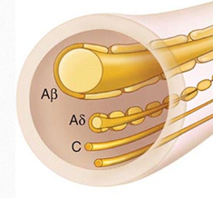
Primary Afferent Nerves:
A-β Nociceptor:
Activated by light touch and/or moving stimuli
Largest & myelinated - 6-22 μm diameter
Fast conduction (velocity of 33-75 m/s)
Primarily in skin, normally don’t produce pain

Slide 13
Primary Afferent Nerves:
A-δ Nociceptor:
Activated by mechanical and thermal stimuli
Small & myelinated nerves (2-5 um diameter)
Fast conduction (velocity of 6-30 m/s)
Short-lasting, pricking-type pain

Slide 14
Primary Afferent Nerves:
C Nociceptor:
Activated by mechanical, chemical and thermal stimuli
Unmyelinated (2 um diameter)
Slow conduction (velocity of 0.5-2 um/s)
Dull, poorly localized, burning type pain

Slide 15
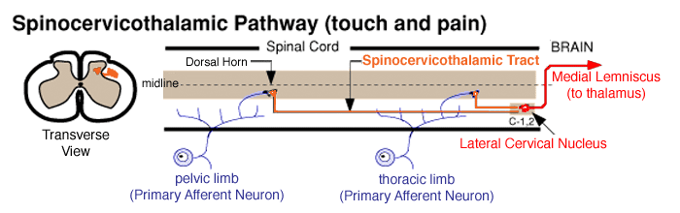
spinocervicothalamic tract
superficial pain & tactile sensations
afferents synapse dorsal horn → 2ry afferents then mediate local reflexes → spinal cord segments CI and C2 → they synapse in lateral cervical nucleus
from this nucleus → project through the brain stem to the thalamus
Some collaterals will terminate in the RF
From thalamus → somatosensory cortex
Highly discriminative: the painful stimulus can be precisely determined
F(x) assessment: superficial pain test

Slide 16
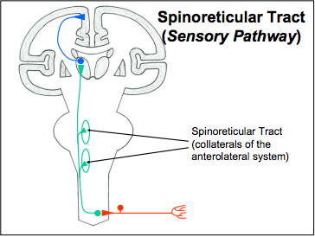
spinoreticular tract
deep-pain & visceral sensations
afferents enter cord & diverge & send collaterals rostral and caudal to the segment of entry
Axons of neurons in this system are present diffusely in the lateral and ventral funiculi
Decussation of axons occurs diffusely throughout the long axis of the tract
Most projections terminate in the RF. Most deep pain that is consciously perceived arrives at the cortex via diffuse reticular projections to the thalamus
activates the limbic system → emotional responses to pain
Visceral pain poorly localized: afferent fibers have large overlapping receptor fields
F(x) test: deep pain testing

Slide 17
Components of Nociception
3) Modulation:
Peripheral Modulation
Some inflammatory mediators will lower the threshold of nociceptors
Others will stimulate nociceptors and can thus be considered nociceptor activators
primary hyperalgesia (increased responsiveness of nociceptors) and allodynia (normally nonnoxious stimuli, become capable of activating nociceptors)

Slide 18
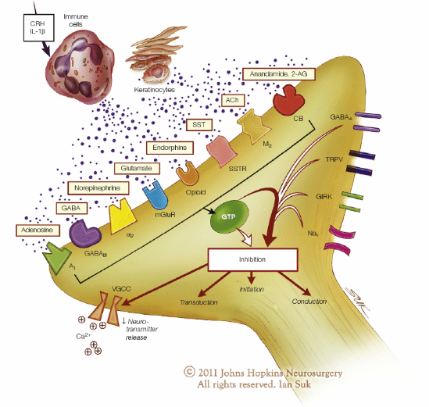

Slide 19
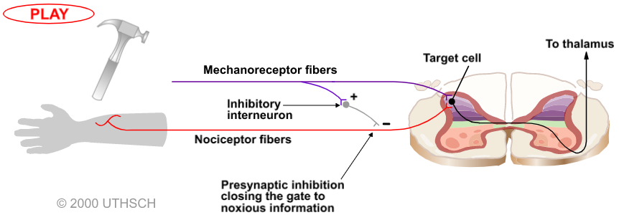
Neuronal Circuits that Modulate Pain
GATE CONTROL THEORY
collateral sensory fibers carrying non painful input activate inhibitory interneurons, which inhibit pain transmission at the spinal cord level
reduce the sensation of sharp pain by activating low-threshold mechanoreceptors

Slide 20
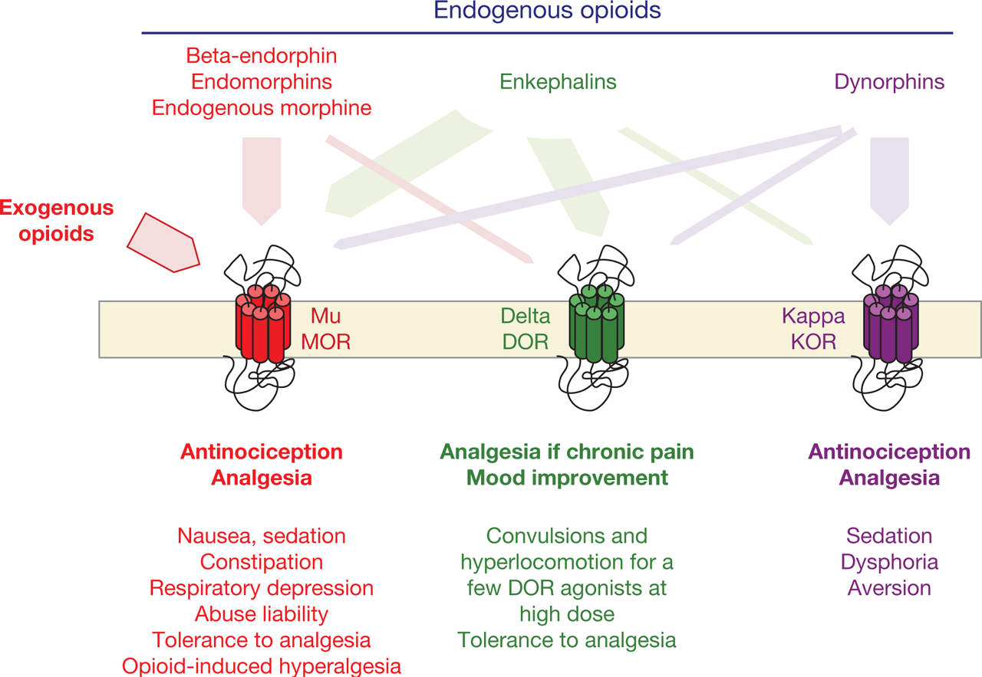
Endogenous Opioid System
Endogenous substances
Enkephalins
Endorphins
Dynorphins
analgesia, mood regulation, and modulation of the stress response
brain’s reward center with behavioral and social implications on mood disorders and addiction

Slide 21
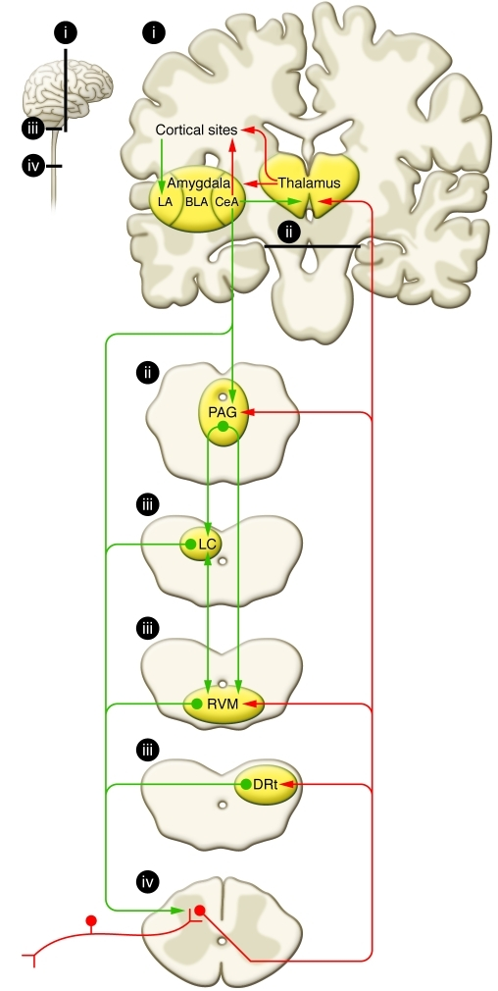
Descending Inhibitory Nerve System
Control the entry of nociceptive information to the brain:
Periaqueductal gray matter (PAG)
Rostral ventromedial medulla (RVM)
Main transmitters:
Serotonin
Norepinephrine
Activity in these systems will recruit interneurons whose neurotransmitters inhibit transmission in spinal cord pain pathways

Slide 22
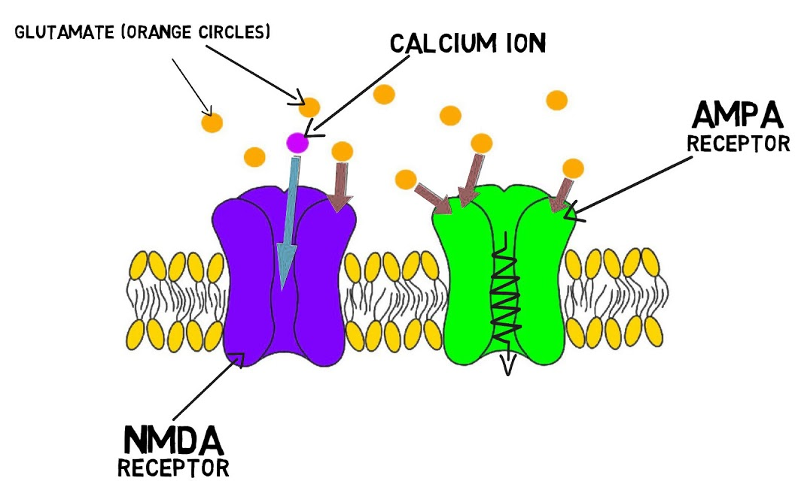
What is Central sensitization?
enhanced excitability of dorsal horn neurons and is characterized by increased spontaneous activity, enlarged receptive field (RF) areas, and an increase in responses evoked by large and small caliber primary afferent fibers
Name the 2 receptors that play a key role in central sensitization and pain wind-up
AMPAr
NMDAr

Slide 23
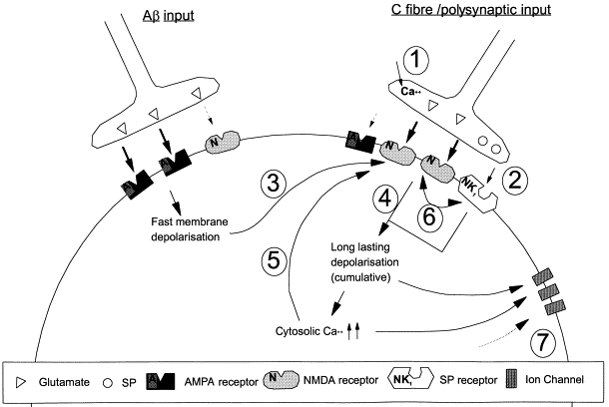
PAIN ‘WIND-UP’
occurs with rapid, continuous firing of primary nociceptive afferents
The high-frequency of action potentials stimulates release of increased amounts of glutamate & substance P
increased exposure to GLU activates NMDA receptors (activated only w/ persistent membrane depolarization) on the postsynaptic membrane
AMPAr → NMDAr
NMDAr activation via Ca → upregulation of receptors
This change can last from hours to days (and longer) after the causative event ends

Slide 24
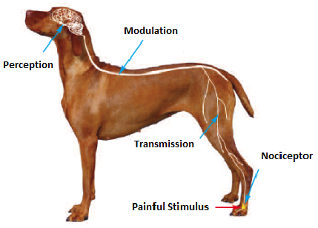
Components of Nociception
4) Perception: integration of thalamocortical, reticular, and limbic function to produce the final conscious subjective and emotional experience of pain
can be obtunded with GA or opioids and a2-agonists either alone or with tranquilizer/sedatives

Slide 25
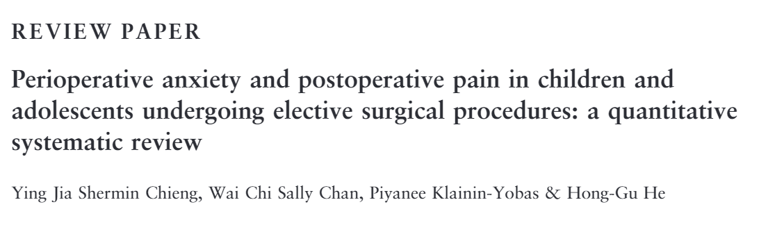
The increase in awareness of pain will reduce pain thresholds and consequently increase the pain experienced

Slide 26
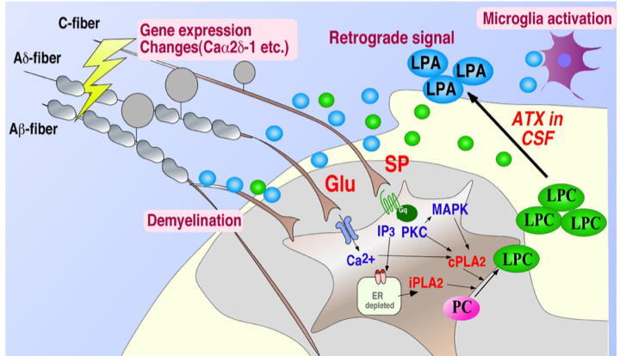
Neuropathic Pain
injury to the nervous system: secondary to trauma, vascular, endocrinopathy, or infection
Hyperalgesia and allodynia
Damaged afferents apt to develop collateral sprouting in response to neurotrophic factors released by damaged tissues
Aberrant collaterals can produce an abnormal perception of pain
Decreased number of GABAr
Loss of opioid receptors → lack of response
Increased number of CCKr → opioid antagonist
NMDAr → key part of spinal facilitation of pain

Slide 27
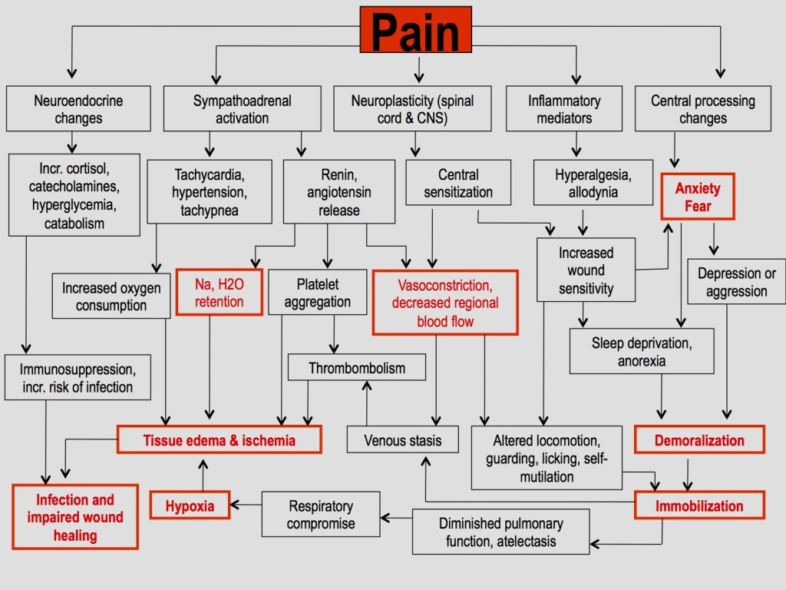
So why does pain matter?

Slide 28
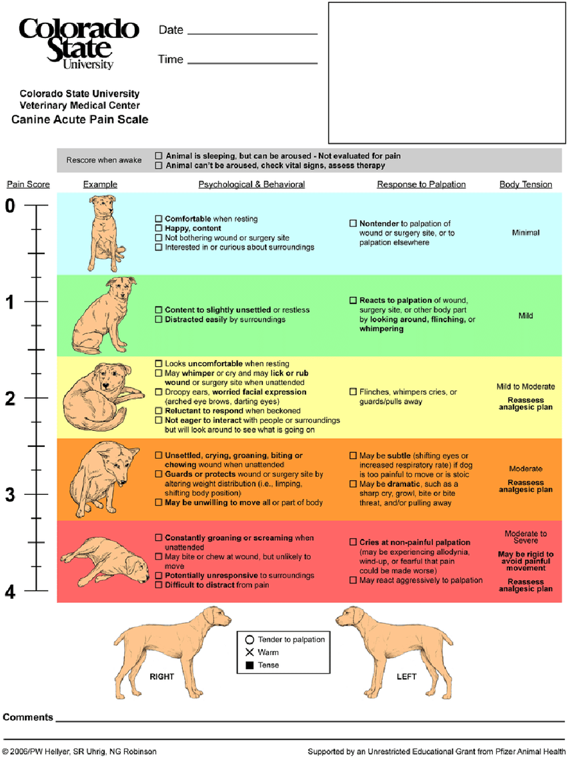
Assessment of pain and pain scales
- Inherently difficult in vet patients
- Confounded by stress/anxiety
Physiologic changes not always reliable
- No single pain scoring system universally accepted/adopted
- Based on physiologic & behavioral responses
- Must recognize limitations

Slide 29
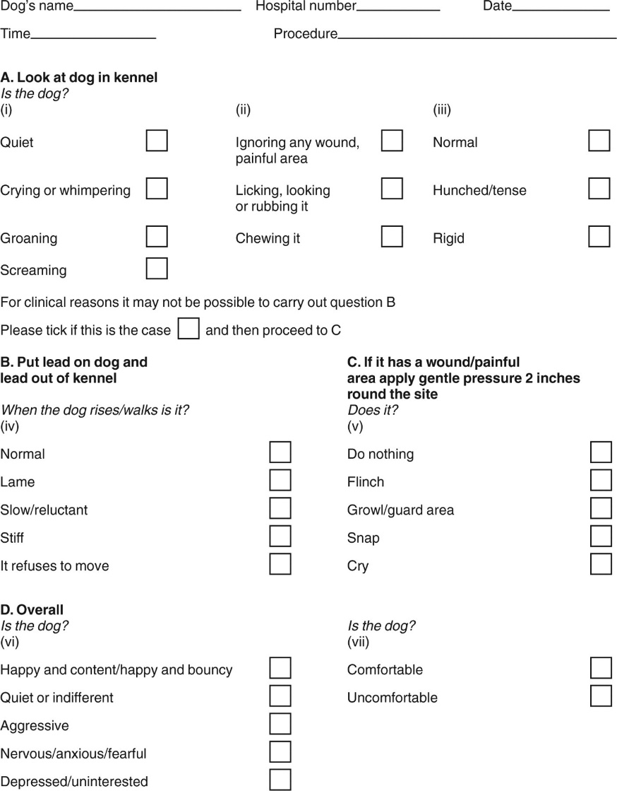
Glasgow Composite Measure Pain Scale
28 descriptor options within 7 behavioral categories
Within each category, the descriptors are ranked numerically
The pain score is the sum of the rank scores

Slide 30
Now let’s do some drugs
How do Opioids work?
by binding to receptors in the dorsal horn and meso-limbic system, they inhibit the pre-synaptic neurotransmitter release by polarizing the pre-synaptic membrane. They raise the pain threshold or decrease perception

Slide 31
Opioids
- Receptors throughout peripheral & central NS
- Also GI, urinary tract, smooth muscle
- Act centrally to limit nociceptive input to CNS

Slide 32
TYPE | EXAMPLE
Pure MU agonist | Morphine, hydromorphone, methadone, remifentanil, oximorphone
Partial MU agonist | Buprenorphine
K Agonist- MU antagonist | Butorphanol

Slide 33
Advantages
Safe (minimal side effects)
Efficacious
Rapid onset of action
Reversible
Metabolism
Hepatic conjunction + urine excretion

Slide 34
Mu agonists:
Main side effects
Preserve CV function (LV function, CO, BP)
Vagally-mediated bradycardia & 2nd degree AV block
Respiratory depression
  response to CO2
  Depresses pontine & medullary respiratory centers
  - Vomiting/nausea common
Morphine > hydro > oxy > methadone & fentanyl
decreased GI motility
Urine retention
Dysphoria, agitation (cats)

Slide 35
Partial agonists
Buprenorphine
- Partial μ-agonist
- Ceiling effect
- Excellent transmucosal absorption (cats), good (dogs)
- Longer acting (6-8hr)
- Variable sedation, can get dysphoria
- Respiratory depression & vomiting uncommon → good for increased ICP/IOP
- Difficult to reverse effects (10x naloxone dose)

Slide 36
Butorphanol
- κ agonist, μ-antagonist
- Useful for mild sedation, cough suppression, unstable patients
- (minimal systemic effects/ceiling effect)
- Respiratory depression → less potential for increase ICP
- Less Vomiting & effects on GI compared to full μ
- Minimal analgesia (some from κ)
- Partial reversal of μ-agonist opioids
- Maintains weak analgesia/sedation due to κ agonist effects

Slide 37
Naloxone
- Opioid antagonist
- Competitively binds with high affinity to μ, κ, δ receptors
- Abrupt reversal of sedation, analgesia, respiratory depression
- Short-acting (20-30 min)
- Observe for re-narcotization

Slide 38
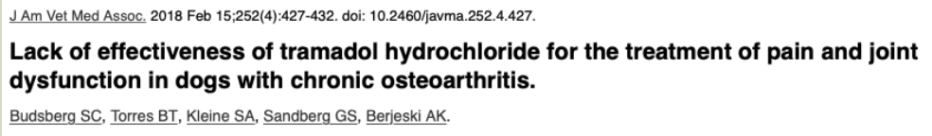
Opiod related
Tramadol
- Slight μ-receptor binding activity
- Analgesia attributed more to inhibition of serotonin & norepinephrine reuptake
- Mild analgesic
- Most useful as adjunctive with NSAIDs
- Side effects: mild sedation, constipation

Slide 39
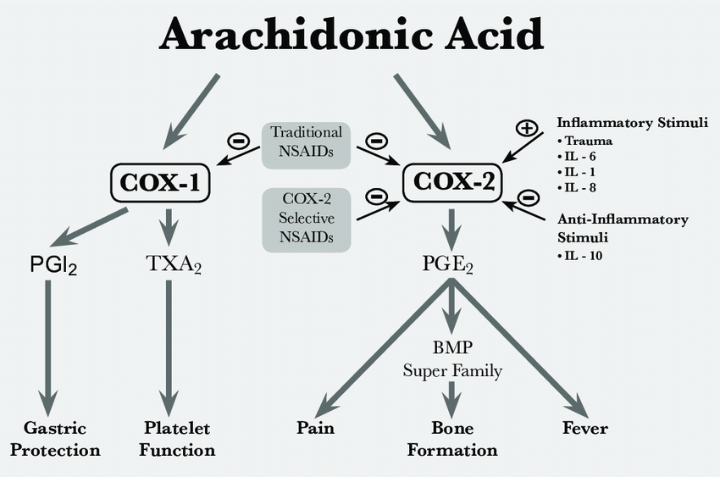
How do NSAIDS work?
inhibition of the COX1 and COX2 therefore inhibiting the transformation of AQ acid into PG and LT

Slide 40
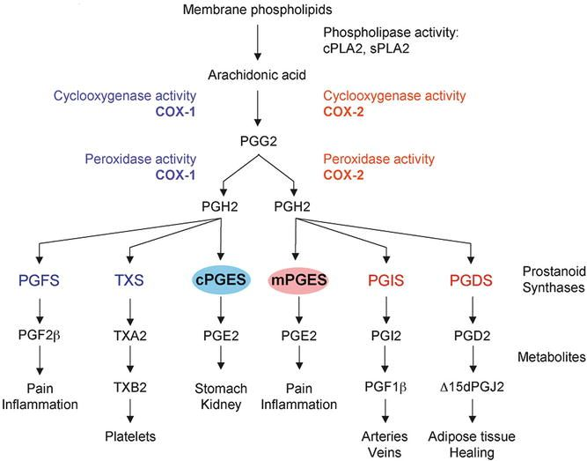
NSAIDS
MOA
- Inhibition of COX → analgesic, anti-inflammatory, antipyretic activity
- Drugs have variable COX-1/COX-2 selectivity
- COX-1: basal prostaglandin production for homeostatic processes
- COX-2: at sites of inflammation

Slide 41
Side effects
- GI ulceration
- Kidney injury
- Hepatocellular injury (rarely)
Contraindications
Hypotension
Hypovolemia
Pre-existing renal disease
Existing or high risk for gastric ulceration
Bleeding disorder
Concurrent with steroids

Slide 42
ALPHA 2 AGONISTS
CNS effects
- α2 receptor → decreased norepi release → sedation & analgesia
- Tolerance to opioids, synergistic analgesia, neuroprotective
CV effects (dose-dependent)
- α2 receptor on vascular smooth muscles → vasoconstriction/ increased SVR
→ increase BP → bradycardia via baroreceptor reflex (+ central
sympatholytic)
- Decrease HR + increase afterload = decrease CO (50%) and ultimately decrease in BP
- Preserved blood flow to heart, brain, kidneys?
- Anticholinergics for bradycardia not recommended

Slide 43
Respiratory effects
- Minimal
GI effects
- Vomiting (CRTZ)
- decreaseSalivation/gastric secretion
- Decrease GI motility
Other
- Inhibit insulin release (→ hyperglycemia)
- Decrease DH & renin release
- Increase ANP (→ diuresis/natriuresis)

Slide 44
Atipamezole
- Highly selective α2 antagonist
- IM: reverses sedation, analgesia, CV effects in 5-10 min
- IV: can cause transient but severe dysphoria, hypotension
- But give IV in CPR!
Side effects:
- V, D, hypersalivation, tremors

Slide 45
Ketamine
Effects:
- Increase Central sympathetic response/Incr catecholamine → increase HR, CO, BP
- Increased Myocardial contractility & O2 consumption
- Arrhythmias
- Minimal respiratory depression, bronchodilator
- Increased Muscle tone/tremors/seizure activity
- Excitement/dysphoria in recovery

Slide 46
Contraindications:
- Head trauma or other concern for Increase in ICP or IOP
- Cardiac diseases: SAS, PS, HCM
- Pheochromocytomas
- Uncontrolled hyperthyroidism

Slide 47
Gabapentin
- MOA unknown
- Structurally related to GABA but does not act as agonist
Uses:
- Neuropathic pain analgesic
- Can prevent allodynia or hyperalgesia
Side effects:
- Sedation, ataxia
- Use with caution if renal insufficiency
- Abrupt discontinuation → withdrawal-precipitated seizures?

Slide 48
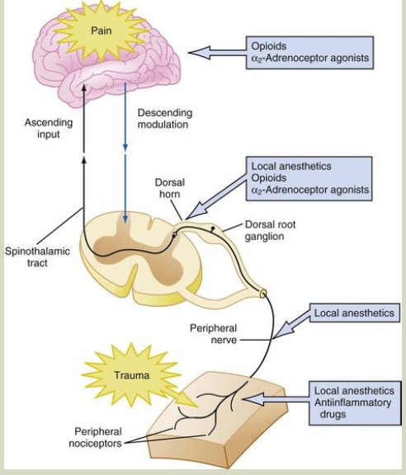

Slide 49

THANK YOU!

