Slide 1
Female reproductive system:
Estrus, ovulation, fertilization, gestation, parturition, dystocia, pseudopregnancy, pyometra, cystic hyperplasia
Victoria Chu

Slide 2
Anatomy:
Notes:
The paired ovaries are the female gonads; they contain the oocytes and are responsible for much of the dog's reproductive hormone production.
The oviducts are small ducts that transport the oocytes from the ovary to the uterus. The bicornuate uterine horns join and form the uterine body anterior to the cervix. The cervix is a structure consisting of dense connective tissue that connects the uterus to the vagina.
And the vagina is the female copulatory organ that opens at the external genitalia, or vulva.
The mesometrium is part of a larger support system throughout the abdominal cavity; the mesometrium is specifically the part that supports the uterus.

Slide 3
Anatomy
Long vagina, short uterine body, and long uterine horns.
The ovaries and ovarian tubes receive blood supply from the ovarian arteries, whereas the vagina receives blood supply via the vaginal artery. The major blood supply of the uterus is via the uterine artery, but the cranial and caudal aspects of the uterus receive some blood supply via the ovarian and vaginal arteries respectively
Innervated by both sympathetic and parasympathetic nerve fibers.
  Sympathetic innervation of the ovary runs concurrently with the ovarian artery, while sympathetic innervation of the uterus and vagina forms plexuses both within the respective organs and within the broad ligament (having arisen from retroperitoneal pelvic tissue).
  Parasympathetic nerve fibers arise from the pelvic nerves and innervate via the pelvic plexus

Slide 4
Estrous cycle:
Canine
  Variable depending on breed and size
  Typically starts between 6 months (small breed)-18 months (large breed) of age
  Happens about every 7 months (range every 4-12mo)
Feline
  Induced ovulators so only ovulate if copulation occurs
  Typically starts at 4 months of age
  2-3 heat cycles a breeding season

Slide 5
Name the 4 stages of estrous cycle

Slide 6
Estrous cycle:
Proestrus (~9 days)
  “Getting ready” phase with bloody vaginal discharge
  Female may be more interactive with male, but will not allow mating
Estrus (~7days)
  Period of sexual receptivity and when ovulation occurs
  Female allows mating to occur and stands to be mounted
Diestrus (Metestrus) (~60 days)
  During this phase, either gestation occurs if fertilization successful or pseudopregnancy state
  Progesterone driven
    Required to maintain pregnancy
    Progesterone surge happens in either case
Anestrus (~5 months)
  Period of inactivity between cycles

Slide 7
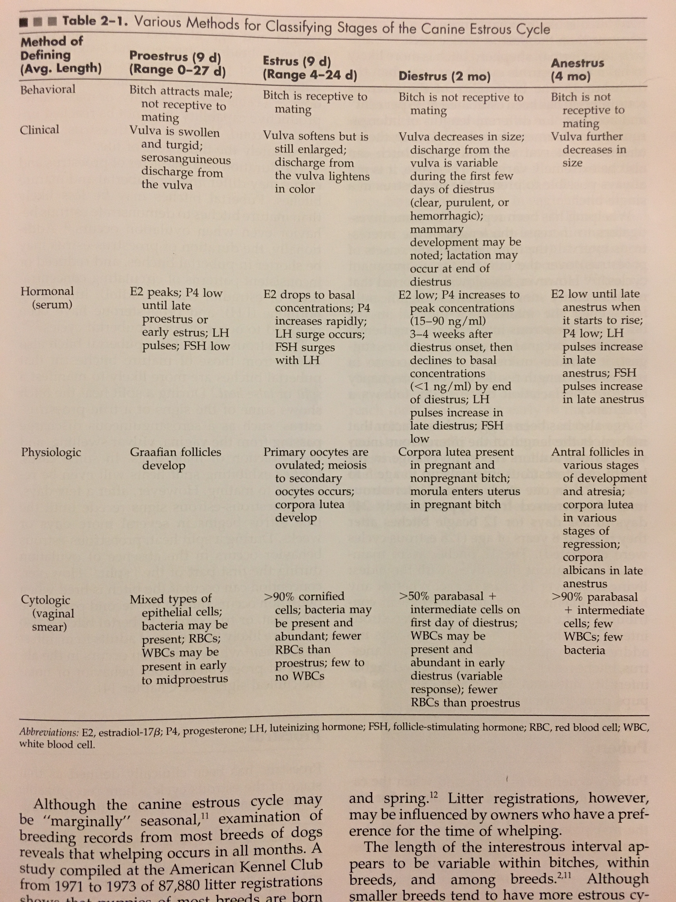
Notes:
Proestrus: estrogen levels increase from developing follicles
Estrus: continued release of FSH with LH surge leads to ovulation within 24-72 hours after surge of LH

Slide 8
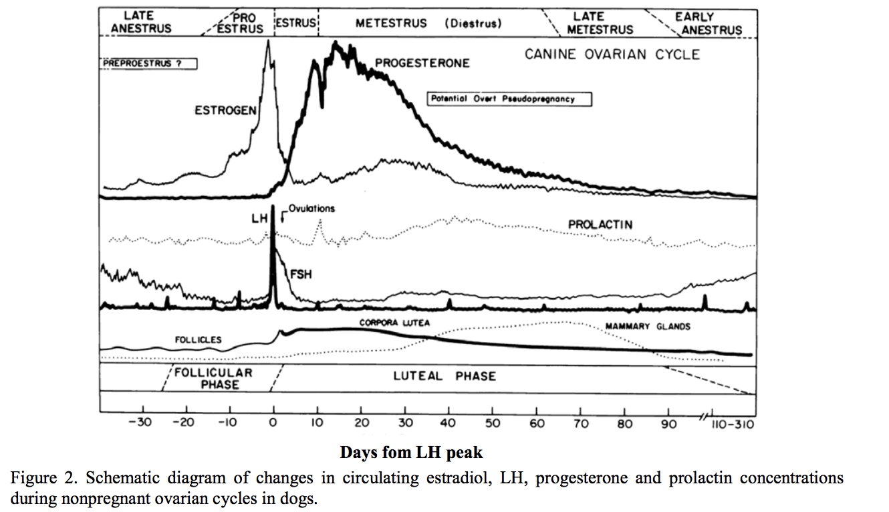

Slide 9
Pseudopregnancy
Effects vary among individuals
  Physical changes: increased appetite, weight gain, distended abdomen, enlarged mammary glands, lactation
  Behavioral changes: withdrawn or moody behavior. Nesting behavior
  Some may show no changes at all.

Slide 10
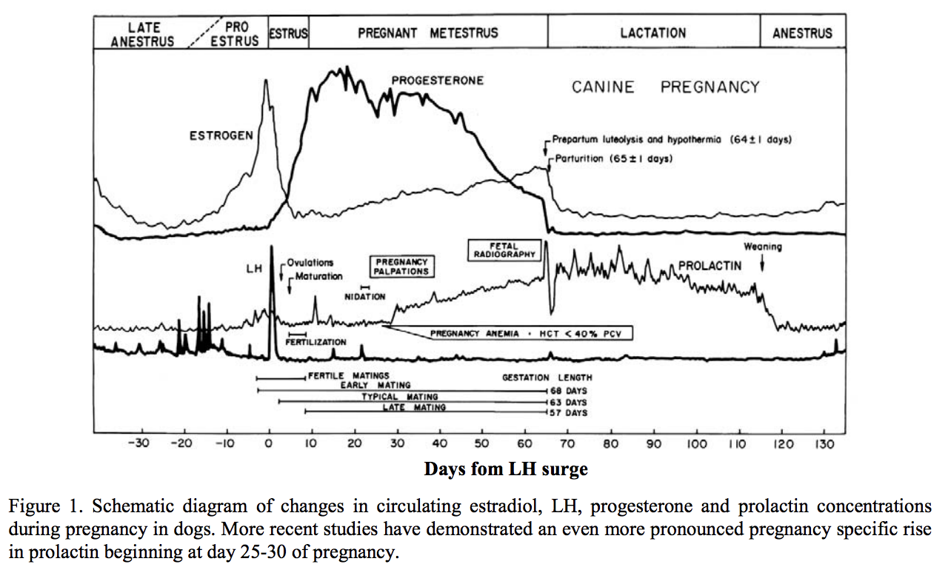

Slide 11
Fertilization
Ovulation typically 2nd day of estrus
Fertilization window 3 days before to 4 days after ovulation
Optimal breeding day 2 days after ovulation
What two hormonal assays could be helpful to determine ovulation?
Progesterone
  Progesterone <1.0ng/mL during anestrus and most of proestrus
  Values rapidly increase >1.0ng/mL just before and during preovulatatory LH surge
  At ovulation, progesterone 4-10ng/mL
  Peaks to 15-90 ng/mL by 15-30 days post LH surge
Luteinizing Hormone
  Ovulation typically 2-3 days post LH surge
  Oocyte maturation and fertilization typically 4-6 days post LH surge
  LH surge may be for only 24 hours, so single sample may not be helpful and can miss surge

Slide 12
Types of fertilization techniques
Natural mating
Artificial insemination with fresh semen
  Recommend minimal insemination dose >150 mil sperm
  Whole ejaculate of healthy male ~250-2500 mil sperm
  AI semen deposited at external cervical os and female hindend elevated for 5 min
Artificial insemination with chilled extended semen
  Chilled to 4 degrees C and added to extender
    Extender: 1 part egg yolk to 4 part heat-treated pasteurized cream
  Motility of sperm decreases so should be used within 4 days
  AI semen same as fresh semen
Artificial insemination with frozen semen
  Motility of frozen-thawed semen already decreases to 65% once thawed and decreases to 45% at 24 hr and 15% at 48 hour
  Frozen thawed semen deposited at lumen of uterus either transcervical or surgically through laparotomy injected through uterine wall

Slide 13
Gestation: What is average?
Canine average 63-65 days with larger litters having shorter gestation
Feline average 63-67 days from first mating
Progesterone secreted by corpus luteum maintains pregnancy
  Peak progesterone level at 20-30 days between 15-80ng/mL
  Progesterone levels then steadily decline
  Must be above 2ng/mL to maintain pregnancy

Slide 14
Name 4 ways to estimate parturition

Slide 15
Estimating expected date of parturition
Vaginal cytology
  Estimate 57 +/- 3 days from onset of cytological diestrus
  Sudden shift from primarily superficial cornified cells (>90%) seen through estrus to 50% non-cornified parabasal and intermediate cells within 24 hours onset of diestrus
Endocrinology
  Serum luteinizing hormone
    65 days post peak LH
  Progesterone
    63 days post ovulation
    Progesterone typically 4-10ng/mL at ovulation
Abdominal ultrasound
  Fetal crown rump length and body diameter parameters on more than two fetuses predicts day 30-39 of pregnancy

Slide 16
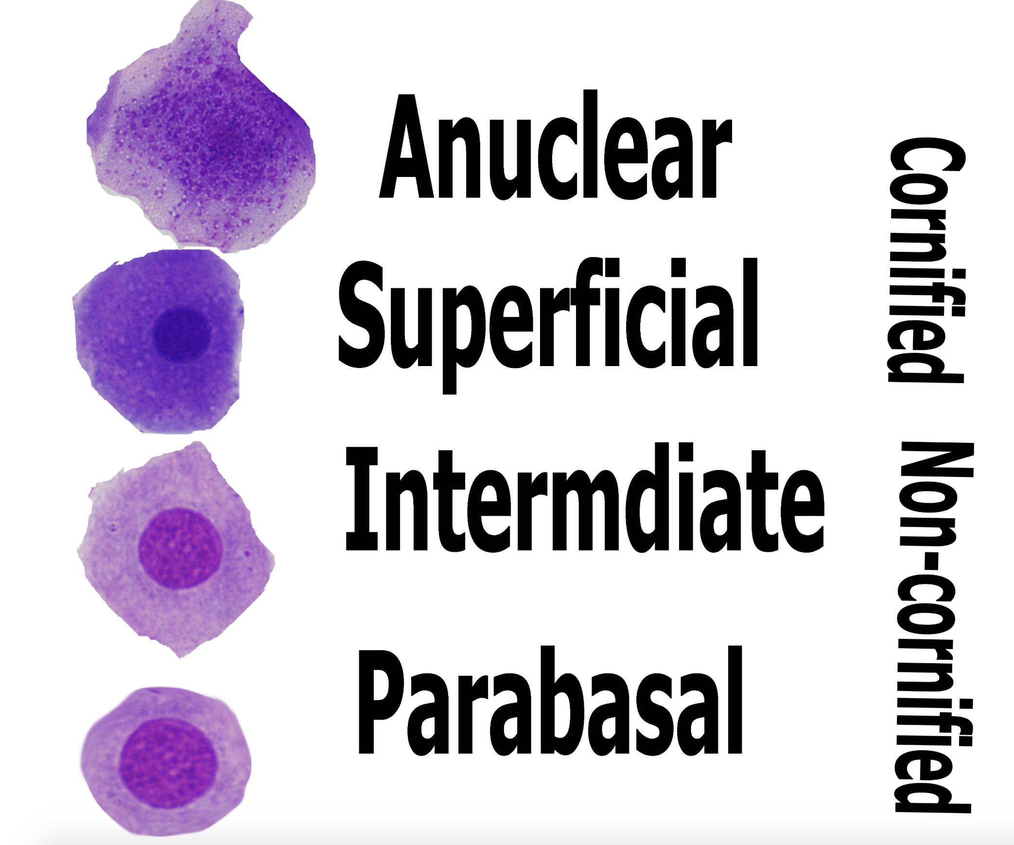
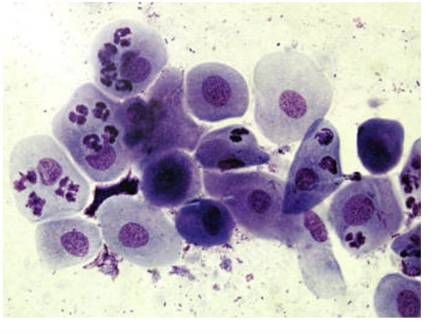
Vaginal cytology
Diestrus when >90% cornified cells becomes 50% non-cornified

Slide 17
Parturition
Signal from fetus
  Maturation of fetal adrenal cortices release cortisol
Estrogen release
  Ovarian tissue then increases estrogen secretion through day 45-60 of pregnancy
  Estrogen stimulates upregulation of genes encoding myometrial contraction-associated proteins and prostaglandin release from uteroplacental complex
Prostaglandin E2 (PGE2)
  PGE2 is luteolytic results in corpus luteum regression and decrease progesterone
  Progesterone level will drop from 4-10ng/mL to 2ng/mL in 12-24 hour at end of pregnancy
  Parturition will occur 24-48 hours post rapid decline of progesterone

Slide 18
Parturition (Cont’d)
Prostaglandin F2-alpha
  Increases myometrium sensitivity to oxytocin
Oxytocin
  Secreted by posterior pituitary gland in response to pressure on cervix
  Facilitates smooth muscle contraction of myometrium and softening of cervix

Slide 19
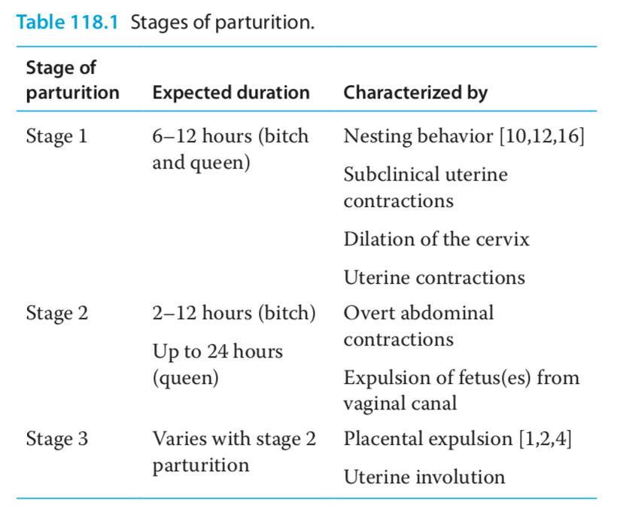
What are the Stages of parturition

Slide 20
Dystocia
Definition: inability to expel fetus(es) from uterus or birth canal
Name some risk factors:
  Breed: brachycephalic and chondrodysplastic breeds
  Small litter size (singleton pregnancies)
  Excessive litter size
  Age of female
  Underlying metabolic disease leading to uterine inertia

Slide 21
Four clinical categories of dystocia
Etiology:
  Maternal origin, fetal origin, small litter size, unknown cause
  Fetal cause 37% due to malpresentation
Failure to begin stage 2 labor
Cessation of stage 2 labor before completion
Prolonged unproductive stage 2 labor
Apparently normal stage 2 labor with fetal distress

Slide 22
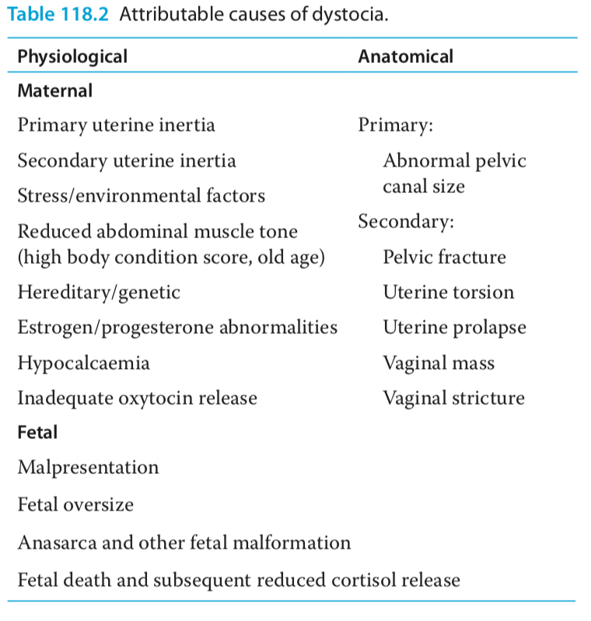
Causes of dystocia

Slide 23
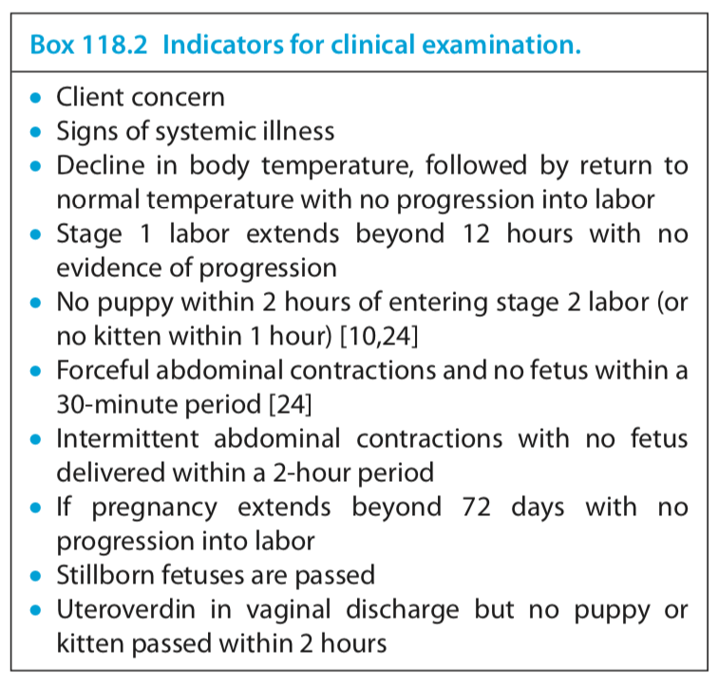
Indicators for clinical examination

Slide 24
Indicators for intervention
Obstruction (diagnosed via vaginal exam, radiograph, or ultrasound)
Female has not entered labor and progesterone <2ng/mL
Female is systemically ill
Fetal heart rate bradycardic <160-180bpm at term
Suspicion for uterine rupture or torsion

Slide 25
Medical Management
Only 30% parturition success rate for dystocias
Prerequisites
  Labor not prolonged
  Cervix is dilated
  Fetal seize within limits for vaginal delivery
  Obstructive causes of dystocia have been ruled out
Acid-base or electrolyte disturbances corrected prior to supplemental calcium or glucose
Low ionized calcium
  10% Ca Gluconate 0.2mL/kg IV as CRI over a few min
  Monitor ECG for HR and rhythm
  Increases force of smooth muscle contraction
Hypoglycemia
  Dextrose 0.25-0.5mL/kg diluted 1:1 over 10 min period
Oxytocin
  0.5-2 IU SC or IM
  Used in conjunction of Ca gluc to stimulate smooth muscle contraction

Slide 26
Surgical management
Anesthesia: premed not needed, induction with alfaxolone or propofol, maintain on low level isoflurane
Ventral midline approach
Uterine horns exteriorized and packed with single uterine incision at base
Fetus manipulated to incision and chorioallantois is broken with hemostats
Amnion also ruptured and umbilicus clamped and tied off
Uterine incision closed with single layer absorbable modified cushings pattern
Oxytocin administered 0.5-1 IU/kg SQ
Rest of abdomen closed
Post op NSAID injection, meloxicam or rimadyl

Slide 27
Postop care
Increased risk of mismothering with c-section
Neonates weighed every 12 hours for first 2 weeks growing at 2-4g per day
Dam fed high quality food several times a day during lactation
Calcium supplementation not needed unless concern for eclampsia
Neonate fed soon after parturition to ensure transfer to maternal antibodies through colostrum
Neonates fed every 2-3 hours for first few days

Slide 28
Cystic hyperplasia
Progesterone secretion during diestrus
  Increases secretory activity of endometrial glands, deceases myometrial contractility, functionally closing cervix and allows accumulation of fluid within uterine lumen
  Leads to mucometra, hydrometra, or pyometra
    Definitive diagnosis requires cytology and culture of intrauterine fluid
CEH caused by repeated exposure of endometrium to progesterone
Bacterial infection from opportunistic organisms from vagina occur secondary to CEH and lead to pyometra

Slide 29
Pyometra
Present shortly after recent estrus and is preceded by cystic endometrial hyperplasia
  Canine 1-4 mon post estrus
  Feline 2-5 weeks post estrus
Name some clinical signs
  Vaginal discharge (purulent to hemorrhagic to mucoid)
  Fever
  PU/PD
  Vomiting
  Signs of shock
  SIRS and sepsis
Pathogens
  E-coli 70%
  Staphylococcus aureus, Enterobacter, pseudomonas, klebsiella, proeus, streptococcus

Slide 30
Diagnostics
Vaginal cytology/culture
  Large number of degenerate neutrophils and intra/extracellular bacteria
  However, large number of neutrophils with some bacteria normal during diestrus
  Use with other diagnostics to diagnosis pyometra
AUS
  Uteromegaly, thickened uterine walls, proliferative endometrial changes, fluid-distended convoluted tubular horns, anechoic to hyperechoic luminal fluid
  Fluid can be homogenous to flocculent
  Can see moderate to advanced CEH with 1-4mm anechoic cysts within thickened endometrium
CBC
  25% normal
  Usually marked leukocytosis with severe neutrophilia with left shift and toxic changes
  May have mild to moderate non-regenerative anemia
Chem
  Variable, but most common changes include azotemia, elevated LE, hyperbilirubinemia, hypercholesterolemia, hyperglobulinemia, hypoalbuminemia, hyperproteinemia
  Azotemia may be due to dehydration and/or e. coli endoxin induced renal tubular damage
    BUN >60 associated with AKI and poor prognosis

Slide 31
Treatment
Stabilization
  Evaluation of cardiovascular, respiratory, and metabolic system and stabilization prior to anesthesia recommended
Antibiotic
  Broad spectrum started immediately upon presentation of all pyometra cases
  Target e. coli and have good uterine penetration
  Combo fluoroquinolone and extended-spectrum penicillin
  Can consider TMS or third generation cephlasporins
  Continued 2 weeks for surgical cases, 1 month for medical management

Slide 32
Surgical management vs Medical management
Surgical management
  Treatment of choice, especially in non-breeding animals
  Surgery removes source of purulent exudate and endotoxin release
  Pursued if peritonitis or uterine torsion suspected
Medical management
  Considered in highly valuable breeding females <6yrs old
  If patient condition deteriorates or no significant clinical improvement seen within 2 days of initiating medical therapy, surgical management should be considered

Slide 33
Surgical management
Pyometra OHE similar to spay surgery except uterus grossly enlarged and can be friable
After removal of uterus, remaining uterine lumen is lavaged and omentalized.
Peritoneal cavity must be copiously lavaged
Uterine fluid submitted for cytology and culture and susceptibility
Closed suction drain placed with peritonitis
Post op monitoring for sepsis, hypovolemia, azotemia, anemia, hypoglycemia, liver/renal dysfunction, acid-base derangement

Slide 34
Medical management
Risk of future recurrence after treatment and potential reduction in fertility
First goal to remove effects of progesterone to facilitate cervical relaxation, myometrial contractions, and improve local uterine immunity
  Allows natural expulsion of purulent contents and bacteria through open cervix
  Prostaglandins +/- dopamine agonists +/- progesterone receptor antagonists
Second goal prevent bacterial proliferation with antibiotics
In animal with advances CEH, final goal to facilitate endometrial regeneration by prolonging anestrus thus preserving fertility
  Androgen receptor agonists like mibolerone

Slide 35
Medical management
Prostaglandin F2-alpha and prostaglandin agonists
  PGF2-alpha with repeated doses leads to luteolysis, decreasing progesterone levels
    Cervical opening and decreased glandular secretions
  Prostaglandins promote uterine contractions
  Natural form – dinoprost tromethamine
  Synthetic form – cloprostenol or alfaprostol
  Dose dependent side effects with narrow therapuetic index
    Occurs within 20-30 min and abates within 30 in
    Recommend hospitalization

Slide 36
Medical management
Dopamine agonists
  Cabergoline or bromocriptine (off-label) used in combo with PGF2-alpha
  Antiprolactin activity causing luteolysis indirectly by decreasing prolactin levels at 25 days after LH peak
  Prolactin major supporter in long term maintenance of functioning corpus luteum
Progesterone receptor antagonists (antiprogestins)
  Aglepristone used in combo with PGF2-alpha
  Negligible uterotonic effects so can be used safely regardless of cervical patency
  Syntergistic actions lead to better recovery rates with successrates of 72-100% canine and 90% feline
  Lower recurrence from 0-18% no occurrence within a year

Slide 37
Medical management
  Clinical improvement should be seen within 48 hours of treatment
  Copious vaginal discharge for at least 48 hour, then decreases but lasts for 7-10days
  Rapid reduction in uterine diameter seen on AUS within 24-48 hours
  Future fertility decreases to 75-87%
  20-70% recurrence in all treated females followed over 27 mo period
  Recommend mating at first estrus after cure since pregnancy prevents uterine disease
  Recheck weekly CBC to monitor decreasing neutrophilia with resolved left shift by 1st week and normal neutrophil count by 2 weeks

