Slide 1
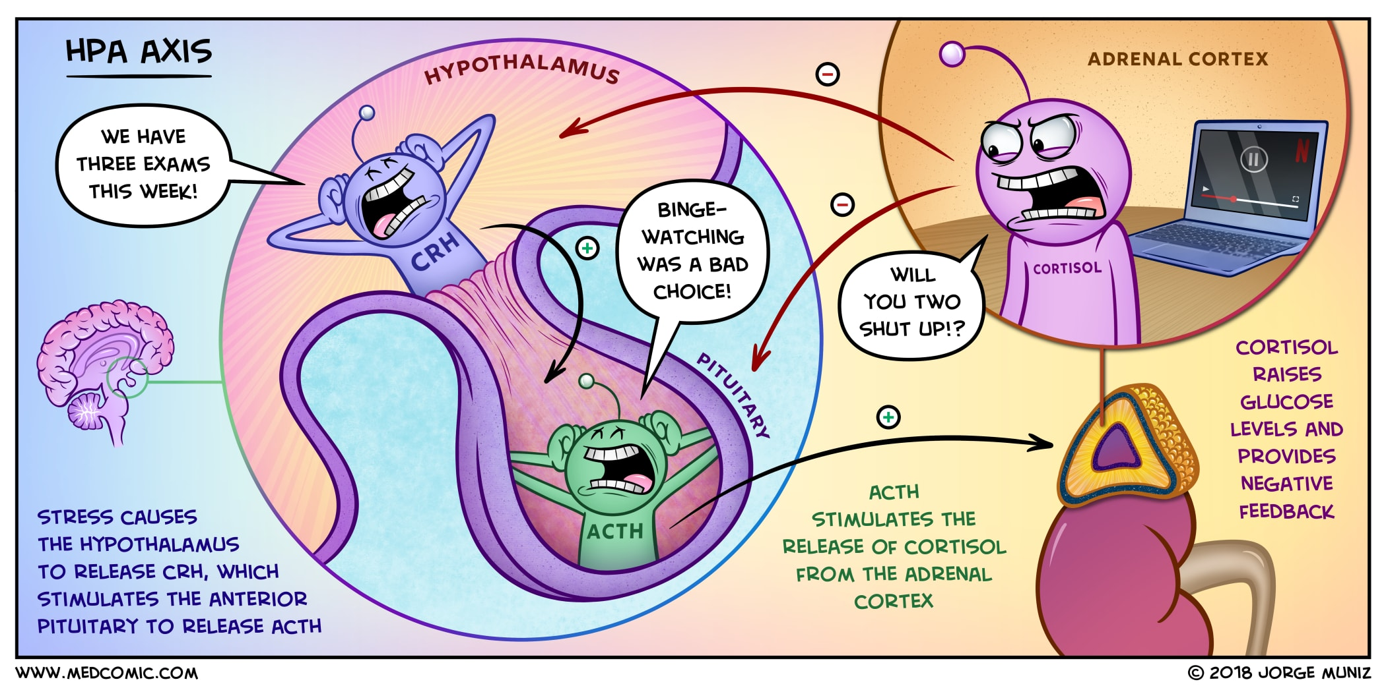
The Adrenal Glands
Notes:
Noelle Herrera
6/23/20
Nelson & Feldman’s Canine & Feline Endocrinology, 4th Ed Chapters 10, 12, 13
Except for CIRCI on page 508.
Not any of their sources.
Randolph’s Notes

Slide 2
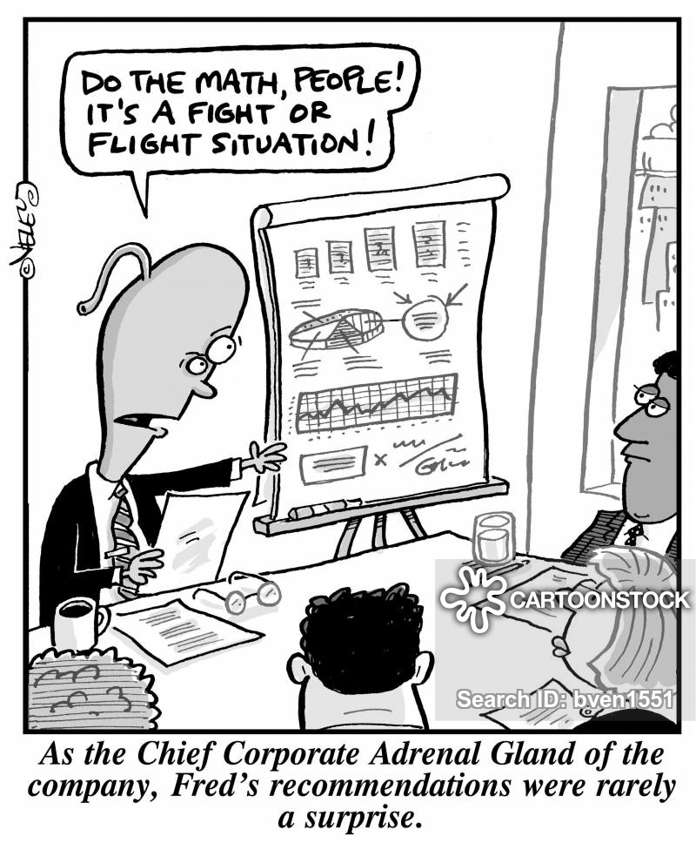
Background
Hypoadrenocorticism
Hyperadrenocorticism
Pheochromocytoma
Miscellaneous
Notes:
https://www.google.com/url?sa=i&url=https%3A%2F%2Fwww.cartoonstock.com%2Fdirectory%2Fa%2Fadrenal_gland.asp&psig=AOvVaw1QFFTP3-Mb4620b46FFJ3p&ust=1593020738067000&source=images&cd=vfe&ved=0CAIQjRxqFwoTCOies-6-mOoCFQAAAAAdAAAAABAD

Slide 3
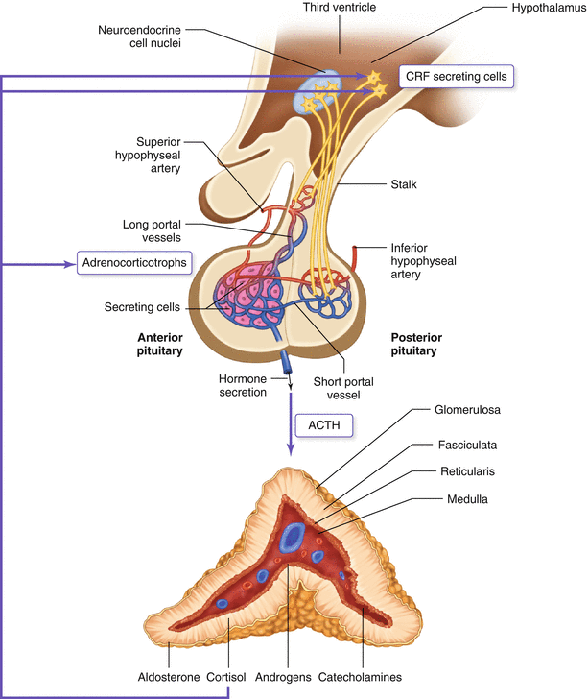
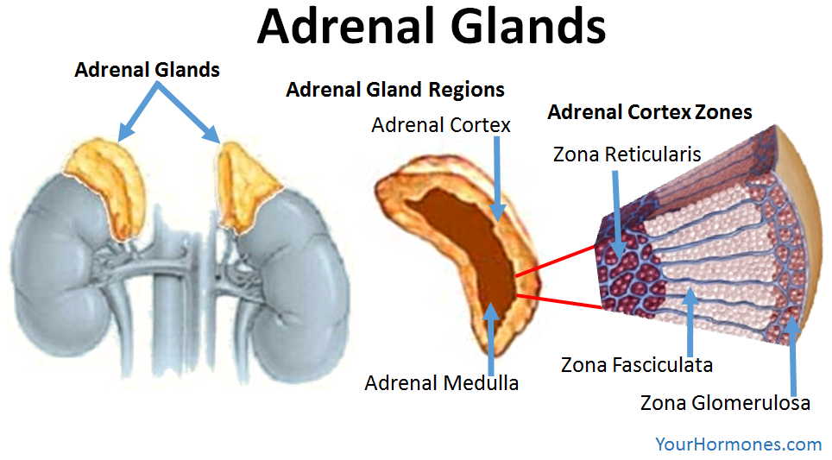
Notes:
https://www.google.com/url?sa=i&url=https%3A%2F%2Flink.springer.com%2Fchapter%2F10.1007%2F978-3-319-18371-8_10&psig=AOvVaw3YIDD4sy9GlzISkIT3aOkj&ust=1593019069883000&source=images&cd=vfe&ved=0CAIQjRxqFwoTCIDlo9O4mOoCFQAAAAAdAAAAABAb
https://www.google.com/url?sa=i&url=https%3A%2F%2Fwww.yourhormones.com%2Fadrenal-glands%2F&psig=AOvVaw3YIDD4sy9GlzISkIT3aOkj&ust=1593019069883000&source=images&cd=vfe&ved=0CAIQjRxqFwoTCIDlo9O4mOoCFQAAAAAdAAAAABAi

Slide 4
Adrenal Glands
The adrenal gland is made of:
  Medulla which secretes catecholamines
  Cortex which secretes three types of steroid hormones:
    Mineralocorticoids (aldosterone)
    Glucocorticoids (cortisol)
    Androgens (dehydroepiandrosterone and androstenedione) that serve as substrates for the synthesis of estrogen and testosterone in peripheral tissues
The adrenal cortex has three layers:
  Zona glomerulosa (outermost, contains aldosterone synthase enzyme and makes aldosterone)
  Zona fasciculata (contains 17a-hydroxylase and makes cortisol and androgens)
  Zona reticularis (contains 17a-hydroxylase and makes cortisol and androgens)
Adrenal steroid hormones are derived from cholesterol and all contain a CCCP nucleus. Enzymes in the adrenal cortex (*) catalyze formation of the different adrenal steroids.
Notes:
CCCP = cyclopentanoperhydrophenanthrene
(*) = P450scc, 17-a-hydroxylase, 3-B-hydroxysteroid-dehydrogenase, 21-B-hydroxylase, 11-B-hydroxylase, and aldosterone synthase.
Other hormones produced in the adrenal gland include progesterone and 17-a-hydroxyprogesterone but only small amounts are secreted into the systemic circulation.

Slide 5
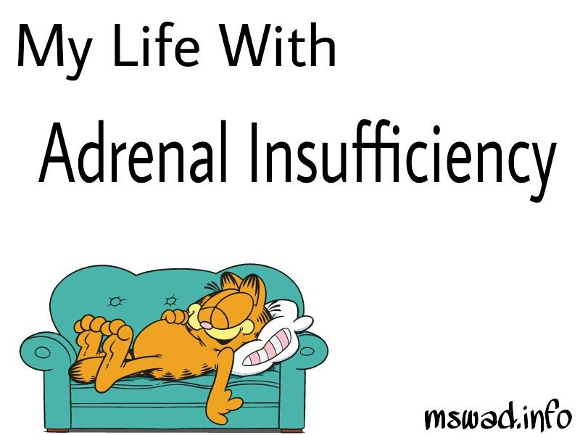
Hypoadrenocorticism
Addison’s Disease
The Great Pretender
Notes:
https://www.google.com/url?sa=i&url=https%3A%2F%2Fwww.pinterest.com%2Fpin%2F337910778267063592%2F&psig=AOvVaw1DuMB-hSpoc_nW89dH92ku&ust=1593020272857000&source=images&cd=vfe&ved=0CAIQjRxqFwoTCKj-1469mOoCFQAAAAAdAAAAABAo

Slide 6
Regulation of Glucocorticoid Synthesis/Release
Synthesis/secretion of cortisol is regulated by the HPA axis
  CRH is released by neurons in the hypothalamus and acts on the AP
  ACTH is released from the AP and travels through the blood to act on the adrenal glands
  Cortisol is then synthesized and released by the adrenal glands
  Rising cortisol levels in the blood has negative feedback on CRH and ACTH
  Rising ACTH also has negative feedback on CRH
CRH is released in response to:
  Stress
  Hypoglycemia
  Exercise
ACTH is released in response to:
  CRH
  Arginine vasopressin
  Angiotensin 2
  Cholecystokinin
  Atrial natriuretic factor
  Vasoactive peptides
Notes:
HPA = hypothalamic pituitary adrenal axis
AP = anterior pituitary
CRH = corticotropin releasing hormone
ACTH = adrenocorticotropic hormone
Humans have a circadian rhythm of release ACTH where it’s concentration is highest in the morning - dogs/cats do not.

Slide 7
Effects of Glucocorticoid Synthesis/Rease
Stimulates hepatic gluconeogenesis and glycogenolysis
Enhances protein and fat catabolism
Helps maintain vascular reactivity to catecholamines
Helps maintain normal blood pressure
Counteracts the effects of stress
Helps maintain normal GI mucosa
Influences digestion and intestinal absorption of nutrients and increases intestinal brush border and mitochondrial enzymes
Suppresses vasopressin secretion due to negative feedback on vasopressin release by the periventricular nucleus.
Binds to mineralocorticoid receptors as avidly as aldosterone
  However, typically has only weak mineralocorticoid activity because it is inactivated to cortisone by the aldosterone sensitive cells in the collecting tubules.

Slide 8
Effects of Glucocorticoid Deficiency
Hypotension
Hypoglycemia
Anorexia, Weight loss
Vomiting, Diarrhea
Decreased mobilization of protein and fat from tissues leading to muscle weakness
Increased susceptibility to stress
Inability to maintain vascular tone and endothelial integrity
Hyponatremia
  Although usually attributed to mineralocorticoid deficiency, can occur with cortisol deficiency secondary to stimulation of vasopressin secretion, which is stimulated by hypovolemia and lack of negative feedback of cortisol on the paraventricular nucleus.
  Hyponatremia and loss of the renal medullary concentration gradient can lead to polyuria in isolated glucocorticoid deficiency.
Notes:
GI signs secondary to mucosal hemorrhage/ulceration and atrophy/inflammation of the gastric mucosa:
Decreased GI motility
Increased vascular permeability
Poor tissue perfusion
Hypovolemia
Vascular stasis

Slide 9
Regulation of Mineralocorticoid Synthesis/Release
Renin-angiotensin axis:
  Increased Angiotensin 2 increases release of aldosterone from the adrenal cortex by increasing conversion of cholesterol to pregnenolone and corticosterone to aldosterone.
    Angiotensin synthesis is stimulated by decreased ECF volume → increased renin secretion from the juxtaglomerular cells that surround the afferent arterioles as they enter renal glomeruli
    Renin acts on angiotensinogen to form angiotensin 1, which is then converted to angiotensin 2 by angiotensin converting enzyme primarily in the lungs.
Plasma potassium concentration
  Increased potassium increases release of aldosterone from the adrenal cortex
To some extent plasma sodium and ACTH levels
  Zero ACTH will decrease aldosterone secretion but will not cause deficiency on its own

Slide 10
Effects of Mineralocorticoid Synthesis/Release
Increases absorption of sodium and secretion of potassium in the kidneys, sweat glands, salivary glands, and intestinal epithelial cells
  Main site of action in the kidneys is the distal nephron (principal cells of the connecting segment and collecting tubules)
    Promotes tubular reabsorption of sodium and chloride and excretion of potassium
    Increases the number of sodium and potassium channels in the luminal membrane and increases the activity of the Na-K-ATPAse pump in the basolateral membrane.
      Chloride is passively absorbed via paracellular diffusion.
      Potassium is exchanged for sodium by the Na-K-ATPase pump and then secreted from the cell into the lumen.
    Aldosterone also enhances sodium reabsorption in the collecting tubules
      Hydrogen ions are exchanged for sodium in the intercalated cells of the cortical collecting tubules.
      Thus a deficiency of aldosterone causes a mild metabolic acidosis.

Slide 11
Effects of Mineralocorticoid Deficiency
Hyponatremia and hypochloremia:
  Impaired ability to conserve sodium and chloride and excrete potassium and hydrogen ions.
  Loss of sodium and chloride lead to concurrent loss of water. This decrease in ECF volume leads to progressive hypovolemia, hypotension, reduced cardiac output, and decreased GFR leading to pre-renal azotemia. Even more sodium is lost through vomiting and diarrhea, and continued loss of sodium and chloride through the GI tract and kidneys leads to depletion of total body salt stores and severe volume depletion.
Hyperkalemia:
  Hyperkalemia results from aldosterone deficiency because of decreased renal perfusion which reduces GFR and depresses cation exchange by the DCT.
  Hyperkalemia is worsened by metabolic acidosis which promotes shift of potassium ions from the intracellular to the extracellular space in exchange for hydrogen ions intracellularly.
  Decreases myocardial excitability, increases the myocardial refractory period, and slows conduction. Hypoxia secondary to hypovolemia and poor tissue perfusion contribute to myocardial dysfunction. Arrhythmias and death.
Mild metabolic acidosis:
  Develops as a result of impaired ability to reabsorb bicarbonate and chloride ions in the renal tubules, as well as from failure of the poorly perfused kidneys to excrete metabolic waste products and hydrogen ions.
PU/PD:
  Polyuria with compensatory polydipsia may result from aldosterone deficiency due to natriuresis and resultant loss of the renal medullary concentration gradient.

Slide 12
Hypoadrenocorticism or Addison’s Disease
Destruction of the adrenal glands
Primary Hypoadrenocorticism:
  Bilateral adrenal gland destruction
  Accounts for more than 95% of cases in dogs
  Must lose >90% function of both glands before clinical signs occur
    Dogs that present with clinical signs have bilateral disease
Secondary Hypoadrenocorticism:
  Primary reduction in ACTH release from the pituitary gland
  Much less common
  This decrease in ACTH causes atrophy of the cortices leading to decreased cortisol but spares the zona glomerulosa and its mineralocorticoid synthesis/release

Slide 13
Hypoadrenocorticism or Addison’s Disease
Destruction is believed to be gradual
  When there are still glucocorticoid and mineralocorticoid reserves, symptoms may only manifest in times of stress (waxing and waning history)
  As destruction progresses, you can have an acute metabolic crisis without any obvious inciting event
Primary hypoadrenocorticism:
  In most cases, there is severe lymphoplasmacytic inflammation and adrenocortical atrophy of all layers of the adrenal cortex. Immune-mediated adrenalitis is the most likely etiology of the majority of spontaneous cases of canine primary addisons however it is most often not diagnosed and as such is considered idiopathic
  Other causes of primary hypoadrenocorticism in dogs includes granulomatous destruction (blasto, histo, cryptococcus), amyloidosis, hemorrhagic infarction, and metastatic neoplasia
  Iatrogenic addisons can occur with treatment of cushings
    Mitotane is cytotoxic to the adrenal gland. 5% of dogs may develop permanent mineralocorticoid deficient addisons
    Trilostane’s effect is usually reversible, but there is a possibility of adrenal necrosis and hemorrhage believed to be secondary to high circulating ACTH concentrations
Notes:
Metastasis to the adrenal glands - most commonly pulmonary, mammary, prostatic, gastric, and pancreatic carcinomas and melanoma however only lymphoma and bilateral anaplastic neoplasia have been reported to cause adrenal failure in dogs.

Slide 14
Hypoadrenocorticism or Addison’s Disease
Measurement of decreased cortisol is demonstrative of disease
Concurrent low aldosterone levels are assumed if there are concurrent electrolyte disturbances (hyponatremia and hyperkalemia)
  30% of dogs with primary hypoadrenocorticism have normal electrolyte concentrations at the time of diagnosis (= atypical addison’s or glucocorticoid deficient hypoadrenocorticism)
There are rare reports of isolated hypoaldosteronism in humans either due to inadequate secretion of renin by the kidneys (called hyporeninemic hypoaldosteronism, implying there is abnormal kidney function) or mutations in the biosynthetic cascade of aldosterone synthesis (called hyperreninemic hypoaldosteronism, implying there is abnormal adrenal gland function).

Slide 15
Polyglandular Autoimmune Syndromes
Types 1 and 2 in humans
Type 1: adrenal insufficiency, hypoparathyroidism, and chronic mucocutaneous candidiasis.
Type 2 or Schmidt syndrome: adrenal insufficiency, primary hypothyroidism, and insulin dependent diabetes mellitus
  Reports of dogs with primary hypoadrenocorticism and primary hypothyroidism
  Could have hypoparathyroidism and diabetes mellitus
Takeaway: Consider primary hypothyroidism in an Addisonian with a poor response to treatment.

Slide 16
Secondary hypoadrenocorticism
Spontaneous:
  Reduced secretion of ACTH by the AP resulting in decreased synthesis and secretion of adrenal gland hormones, especially glucocorticoids.
  Also decreased CRH release by the hypothalamus.
  The most common cause of either is cancer, less so inflammation and trauma.
Iatrogenic:
  Hypophysectomy for the treatment of pituitary dependent cushings results in permanent secondary addisons.
  Most commonly, iatrogenic adrenal insufficiency is secondary to the abrupt withdrawal of exogenous steroid administration
  Ketoconazole via dose-dependent mechanism (repeated high doses)

Slide 17
Hypoadrenocorticism or Addison’s Disease
Signalment:
Young to middle-aged (avg. 4 mo. to 14 yrs, most commonly about 4 yr old)
More commonly female
Familial Tendencies (usually autosomal recessive)
  Standard Poodles (Esp black & female)
  NSDTR
  Portuguese Water Dogs
  Bearded Collie

Slide 18
Hypoadrenocorticism or Addison’s Disease
History & Clinical Signs:
Acute or gradual
Commonly wax and wane
Can be triggered by a stressful event
Anorexia, vomiting, lethargy/depression, weakness, weight loss, diarrhea, and shaking/shivering are common
Other signs include PU/PD and abdominal pain
Episodic illness or GI signs like lethargy, vomiting, diarrhea, and/or dehydration that improve with supportive care should alert you of potential addisons, especially if recurrent
Less commonly, seizures due to hypoglycemia, episodic muscle cramping, and GI hemorrhage.
Notes:
All of these signs can be caused by glucocorticoid deficiency alone. But if mineralocorticoids are also affected then PU/PD, hypovolemic shock, collapse, and dehydration are more prominent, and the illness presentation is more severe.

Slide 19
Hypoadrenocorticism or Addison’s Disease
Physical exam:
Poor body condition, lethargy, weakness, severe dehydration, abdominal pain, bradycardia, weak pulses, hypothermia, hypotension, decreased CRT, and other signs of hypovolemic shock.
**Presence of bradycardia in a dog with other evidence of hypovolemic shock should raise a red flag**
Melena and hematochezia can occur and other clinical signs of anemia (pale mm, weakness, and collapse)
May be normal if just mild glucocorticoid deficiency

Slide 20
Hypoadrenocorticism or Addison’s Disease
Clinical pathology:
Hyponatremia (81%) & Hyperkalemia (96%)
  Na:K <24:1 was 100% specific for addisons in one study but <24% in another study so just remember there are many diseases that can cause this:
    Renal and urinary tract disease
    GI disease
    cardiorespiratory disease
    Sample contamination with potassium EDTA

Slide 21
Hypoadrenocorticism or Addison’s Disease
Clinical pathology:
Hypochloremia
Hyperphosphatemia
Hypercalcemia: secondary to volume contraction, decreased GFR, increased intestinal absorption, and decreased urinary excretion.
Hypocholesterolemia: result of either decreased fat absorption or concurrent hepatopathy. Glucocorticoids are thought to be important for fat absorption.
Azotemia: hypovolemia, hypotension, & decreased renal perfusion.
  Usually BUN > creatinine. Hemorrhage in the GI tract serves as substrate for the production of ammonia, which is then absorbed into the portal circulation and converted to urea (BUN) by the liver.
Notes:
30-40% of dogs have totally hypercalcemic whereas 18% have ionized hypercalcemia
Acidemia can lead to mild ionized hypercalcemia by decreasing protein binding of calcium.

Slide 22
Hypoadrenocorticism or Addison’s Disease
Clinical pathology:
Hypoalbuminemia: anorexia, GI blood loss due to mucosal ulceration, decreased synthesis due to hepatopathy, and PLE.
  Glucocorticoids have been reported to influence digestion and intestinal absorption of nutrients, especially amino acids.
  Increased vascular permeability may be cause of PLE.
  Can have hypocalcemia alongside.
Hypoglycemia: cortisol deficiency leads to decreased hepatic gluconeogenesis and increased peripheral sensitivity to insulin
  30% of dogs, can be severe enough to cause seizures
Elevations in liver enzymes:
  30% of dogs
  Concurrent immune-mediated hepatitis or the liver could have been affected secondarily due to hypotension and impaired tissue perfusion. Regardless, dogs with addison’s have hepatic abnormalities that resolve with treatment for the addisons alone.

Slide 23
Hypoadrenocorticism or Addison’s Disease
Clinical pathology:
Non-regenerative anemia (NC, NCH):
  due to lack of red cell production from cortisol deficiency + GI hemorrhage
  more likely in atypical addison’s
Lymphocytosis & lack of stress leukogram:
  Lymphocytosis & eosinophilia or normal neutr/lymp when stressed/obviously sick
    Cortisol causes lymphopenia due to redistribution of recirculating lymphocytes to transiently sequester in lymph nodes and bone marrow
    Lymo >0.75K/uL had a 100% sensitivity. Specificity was 35%, thus presence of lymphopenia excluded a diagnosis of addisons.

Slide 24
Hypoadrenocorticism or Addison’s Disease
Clinical pathology:
Metabolic acidosis: Aldosterone deficiency impairs renal tubular hydrogen ion secretion. Worsened by hypotension and poor tissue perfusion
  It rarely requires specific treatment. Adequate fluid and mineralocorticoid replacement restores renal perfusion which in turn enhances urinary hydrogen ion excretion.

Slide 25
Hypoadrenocorticism or Addison’s Disease
Urine Specific Gravity:
The USG of a dog with normal renal function and pre-renal azotemia should be >1.030 whereas USG in a dog with primary renal failure is within or near the isosthenuric range (1.008 to 1.020)
Most patients with addisons have reduced urine concentration ability due to chronic urinary sodium loss causing a reduction in the renal medullary sodium content, loss of the normal medullary concentration gradient, and impaired capacity for water resorption by the renal collecting tubules.
  Hyponatremia also interferes with stimulation of vasopressin release by reducing serum osmolality.
  As a result, 60% of addisonian dogs have a USG consistent with that of primary renal failure so measurement of serum cortisol is very important in any patient with azotemia and isosthenuria.

Slide 26
Hypoadrenocorticism or Addison’s Disease
Clinical pathology:
May mimic other diseases:
  Liver failure (hypoglycemia, hypoalbuminemia, hypocholesterolemia, inc ALT & ALP)
  Renal failure (anemia, azotemia, hypercalcemia, hyperphosphatemia, and low USG)
  Insulinoma (hypoglycemia, increased ALT & ALP)
  PLE (hypoalbuminemia, hypocholesterolemia, and non-regenerative anemia)

Slide 27
Atypical Hypoadrenocorticism
Clinical pathology:
30% of addisonians can be atypical
Dogs tend to be older, have more chronic signs, and are more likely to be anemia, hypoalbuminemic, and hypocholesterolemic.
Reasons for normal electrolytes in an addisonian dog include:
Secondary addisons
Selective destruction of the ZF and reticularis
Early stage of disease → progress within next year
Compensation for natriuresis by increased salt intake
Concurrent illness like hypothyroidism
Potassium falsely decreased by anorexia, diarrhea, and administration of potassium-free fluids.

Slide 28
Hypoadrenocorticism or Addison’s Disease
Imaging:
Radiographs:
Microcardia
Small cranial lobar pulmonary artery
Narrow caudal vena cava
Small liver
Megaesohagus or esophageal dilation: suspect secondary to muscle weakness.

Slide 29
Hypoadrenocorticism or Addison’s Disease
Imaging:
Ultrasound:
Small adrenal glands
Sometimes the right adrenal gland may not be found.
Sometimes measuring the left adrenal gland thickness is helpful for diagnosis:
  <3.2mm strongly suggestive but the lack or presence of does not definitively diagnose.

Slide 30
Hypoadrenocorticism or Addison’s Disease
Diagnosis:
Basal Cortisol:
  Helpful in ruling out the disease.
  <2 ug/dL is 100% sensitive for Addisons meaning if >2 then your patient does not have addisons disease.
  Must follow with ACTH to confirm disease
ACTH Stim test: Measures adrenal reserve
  Gold standard test for diagnosis
  The lowest dose of synthetic ACTH (cosyntropin) that stimulates maximal secretion of cortisol in healthy dogs is 0.5ug/kg whereas the lowest dose of ACTH that results in maximal cortisol stimulation in dogs with suspected adrenal dysfunction is 5ug/kg.
    Serum cortisol pre and 1 hour post. If you must clinically administer dexamethasone prior to performing the stim, use one dose of dexamethasone
Notes:
Dexamethasone does not interfere with ACTH testing of cortisol. Would have to wait 48 hours if one dose of pred used.

Slide 31
Hypoadrenocorticism or Addison’s Disease
Diagnosis:
ACTH Stim test:
    Diagnosis is made by a pre and post less than lower reference range (usually <2ug/dL)!
    Sometimes equivocal results occur where the post is 2-8:
      Could be true addisons or from prior steroid administration, treatment with mitotane/trilostane/ketoconazole, gel, loss of potency of ACTH due to improper storage, etc, errors in testing.
      Other differentials include CIRCI and sex hormone secreting tumors but for the former, the pre is usually above the reference range and in the latter the tumors have overt signs of cushings.
      If no idea why weird response, measure basal ACTH prior to and retest in 1-4 weeks and compare to prior ACTH endogenous.
Endogenous ACTH: Primary vs Secondary disease
Notes:
Measurement of endogenous ACTH is difficult and labile. Recommended in dogs with confirmed addisons but normal electrolytes- this helps distinguish primary from secondary disease. ACTH above reference range confirms secondary or pituitary disease. We care to know if primary disease to monitor electrolyte levels moving forward as they may require supplementation.
Measurement of endogenous aldosterone is also difficult and not widely available

Slide 32
Treatment of Hypoadrenocorticism
Approach depends on if acute crisis or chronic clinical signs:
IVC: Collect blood and urine (cbc, chem, UA, basal cortisol).
Restoration of intravascular fluid volume
  Bolus(es) of 0.9% NaCl as indicated by serum sodium
    no more than 10-12mEq/L/day change in sodium
    acidifying
Treat hyperkalemia as indicated
If remains hemodynamically unstable, give 0.1-2 mg/kg dexamethasone IV
Administer 5 mcg/kg cosyntropin. Collect blood 1 hour later. (= stim)
If dexamethasone not previously administered, then give 0.1-2 mg/kg dexamethasone or 5mg/kg or 0.3mg/kg/hr hydrocortisone IV.
  Continue dexamethasone every 12 hours at 0.05-0.1mg/kg or hydrocortisone at 1mg/kg every 6 hours until you can switch to orals.
If clinical suspicion is high can administer 2.2mg/kg of percorten IM (mineralocorticoid).
Notes:
DOCP = deoxycorticosterone pivalate, safe to give one dose if not addisonian.

Slide 33
Treatment of Hypoadrenocorticism
Other supportive care like blood products, GI protectants, antiemetics, and antibiotics as indicated by vomiting, diarrhea, GI ulceration, ileus, etc.
Most dogs respond the most to IV fluid therapy, most after the boluses but also within 24-48 hours of treatment.
Complications include GI ulceration and bleeding, bacterial translocation and sepsis, DIC, and aspiration pneumonia secondary to megaesophagus. Takes longer to heal with GI bleeding that requires transfusions.
If unexpected delayed or poor response: look for uncommon causes like cancer, adrenal necrosis, and granulomatous disease.

Slide 34
Treatment of Hypoadrenocorticism
Switch to orals once the patient is eating, not vomiting, and otherwise improved
Prednisone at 0.1-0.22mg/kg/day as starting dose. Gradually taper over several weeks until the lowest dose that will control the clinical signs.
  Pred can be discontinued in as many as 50% of dogs being treated with fludrocortisone for mineralocorticoid replacement because of its intrinsic glucocorticoid activity. However, if on DOCP then still needs daily or EOD prednisone.
  Double the dose in times of stress.
  Can have acute crisis from abrupt cessation of chronic steroid use.

Slide 35
Treatment of Hypoadrenocorticism
Switch to orals once the patient is eating, not vomiting, and otherwise improved
Mineralocorticoids if hypoNa/hyperK
  Percorten (DOCP)
    Only drug approved by the FDA.
    Rapid onset of action and is effective within a few hours of injection so no overlap is needed when transitioning to DOCP from fludrocortisone.
    Initially given 2.2mg/kg IM every 25 days initially.
    Serum electrolytes should be checked at 12 and 25 days for the first 1-2 months.
      15 day is for titration of dose, the 25 allows adjustment of days.
      If normal still at 25 then can gradually go out to 30 days. Taper dose by 10% a month with measurement of sodium and potassium prior to each dose. Once they start to get outside the reference range prior to the next injection, the next dose should be increased to the previous dose that resulted in normal electrolytes for the whole time period.

Slide 36
Treatment of Hypoadrenocorticism
Mineralocorticoids if hypoNa/hyperK
Fludrocortisone:
  Oral synthetic mineralocorticoid
  Must be given daily.
  Starting dose is 0.02mg/kg/day.
  Has glucocorticoid activity and may have clinical signs from that and/or be cost prohibitive at the dose required to normalize electrolytes.
Dogs with secondary addison’s do not need mineralocorticoid replacement because ACTH is not required for aldosterone synthesis/secretion.
Measure electrolytes every 3 months to determine if dosage adjustment or supplementation required (ie for first year of atypical addisonian)

Slide 37
Treatment of Hypoadrenocorticism
Most common reason for poor response to treatment is inadequate mineralocorticoid supplementation
  Others include hypothyroidism, cancer, or granulomatous disease especially if higher than normal steroid doses are needed

Slide 38
Feline Hypoadrenocorticism
Rare, DSH or DLH
Similar to dogs
Differential diagnoses for abnormal serum sodium and potassium concentrations should include GI disease, renal disease, and ascites.
Differentials for low plasma cortisol concentrations with inadequate response to ACTH stimulation includes naturally occurring hypoadrenocorticism, chronic glucocorticoid administration,chronic megesterol acetate administration, and failure to administer ACTH.
Differential diagnoses for addison’s should include lymphoma (and renal disease).
Gold standard diagnostic test remains ACTH but the protocol is different. Longer time to respond.

Slide 39

Canine Hyperadrenocorticism or Cushing’s Disease
Notes:
https://www.google.com/url?sa=i&url=http%3A%2F%2Fwww.cushings-help.com%2Fchecklist-bone.htm&psig=AOvVaw1DuMB-hSpoc_nW89dH92ku&ust=1593020272857000&source=images&cd=vfe&ved=0CAIQjRxqFwoTCKj-1469mOoCFQAAAAAdAAAAABAa

Slide 40
Canine Hyperadrenocorticism or Cushing’s Disease
Occurs from:
Autonomous secretion of cortisol by an adrenocortical carcinoma or adenoma
Pituitary micro or macroadenoma (or carcinoma) causing increased cortisol synthesis/secretion
Iatrogenic exogenous corticosteroid administration
Secretion of ACTH from an ectopic site
Food-dependent cortisol secretion
Pituitary hyperplasia caused by excessive CRH secretion due to a hypothalamic-disorder

Slide 41
Canine Hyperadrenocorticism or Cushing’s Disease
CRH stimulates ACTH secretion but so does pain, trauma, stress, hypoxia, acute hypoglycemia, cold exposure, surgery, and inflammatory mediators.
The negative feedback effects of cortisol on the pituitary gland to lower ACTH secretion occur in three speeds- fast, intermediate, and delayed.
Cortisol and ACTH itself negatively feedback on CRH and thus ACTH.
In humans and dogs, the pituitary gland is divided into two distinct parts:
  pars distalis (anterior)
  pars nervosa (posterior)
  in dogs there is an intermediate area called the pars intermedia that has another cell type within it
    strong ACTH action under tonic negative regulation by dopamine secreted from the hypothalamic arcuate nucleus as well as by serotonin and CRH.
    innervated and controlled by dopaminergic and serotoninergic fibers from the brain.

Slide 42
Steroid Synthesis
Zona glomerulosa:
lacks 17-a-hydroxylase enzyme activity required to synthesis glucocorticoids and sex steroids
has aldosterone synthase which is necessary for synthesizing aldosterone.
Steroid hormones include cortisol, aldosterone, androgens, and estrogens. Their precursor is cholesterol.
Low-density lipoprotein (LDL) particles account for approximately 80% of cholesterol derived to the adrenal glands.
When stimulation occurs, hydrolysis of stored cholesterol esters to release cholesterol, cholesterol uptake from plasma lipoproteins, and cholesterol synthesis also occurs within the adrenal glands.
rate limiting-step in the production of steroids is cholesterol transfer within mitochondria and is regulated by steroidogenic acute regulatory protein.
Notes:
steroid synthesis is constant and secretion requires activation of the biosynthetic pathway.

Slide 43
Pituitary-dependent hyperadrenocorticism
80-85% of dogs with naturally occuring hyperadrenocorticism have pituitary-dependent disease.
Almost all dogs with PDH have a pituitary tumor, the remainder have hyperplasia.
  71-80% of pituitary tumors arise in the pars distalis.
  Pituitary tumors less than 10mm in diameter are classified as microadenomas.
  At the time of diagnosis of PDH, 31-48% have tumors <3mm in diameter.
  Ddx: Carcinoma (rare), hyperplasia
Due to ACTH secretion, both adrenal glands are bilaterally enlarged!!

Slide 44
Adrenal dependent hyperadrenocorticism
Primary adrenocortical tumors (adenomas and carcinomas) develop autogenously
Due to the negative feedback by cortisol, CRH and ACTH are decreased.
Because of the low ACTH concentrations the contralateral adrenal cortex and any non-neoplastic cells in the cancerous adrenal gland atrophy.
Cortical adenomas are partially or completely surrounded by a fibrous connective tissue capsule, are well-demarcated, and usually single.

Slide 45
Canine Hyperadrenocorticism or Cushing’s Disease
Signalment:
Middle-aged or older dogs, vast majority >6 years old
No proven gender predisposition
Statistical predisposition for miniature poodles, boxers, and dachshunds.
  PDH tends to be in smaller breed dogs whereas AT are more commonly in larger dogs.
Because of growing awareness of the disease, it is being diagnosed before clinical signs become severe

Slide 46
Canine Hyperadrenocorticism or Cushing’s Disease
History/ Clinical Signs:
PU/PD
Polyphagia
Panting & increased RE (PTE)
Endocrine alopecia
Abdominal distension/ potbellied appearance: hepatomegaly secondary to glycogen deposition (steroid hepatopathy), abdominal wall muscle weakness from protein catabolism due to excess cortisol, and intra-abdominal fat deposition.
Hepatomegaly
Notes:
Adult onset demodex can occur in 10% of cases. Immunosuppression from excess cortisol. Poor wound healing, thin skin, Inhibits collagen synthesis leading to weaker blood vessel walls, bruising, cartilage laxity
Calcinosis cutis or cutaneous metaplastic ossification (ddx fungal infection, treatment of hypoparathyroidism or renal failure, or idiopathic). Large breed dogs are over-represented. Dystrophic calcium deposition. Firm, palpable erythematous papules to well-demarcated plaques that may feel mineralized. The most common location is the dorsum followed by the head and inguinal area. It does not always resolve with successful treatment of cushings.
Pseudomyotonia rare- persistent active muscle contraction after cessation of voluntary effort. Acenteodtoally sometimes facial paralysis.

Slide 47
Canine Hyperadrenocorticism or Cushing’s Disease
History/ Clinical Signs:
Muscle weakness & wasting
Hypertension
Vomiting, diarrhea, coughing, sneezing, pain or bleeding is not caused by HAC.
Poor appetite and seizures are uncommon and if are related, are in the presence of a pituitary macroadenoma.
Commonly non-pruritic truncal alopecia and/or thin skin without systemic signs warrants screening for the disease.

Slide 48
Canine Hyperadrenocorticism or Cushing’s Disease
Physical Exam Findings:
Abdominal enlargement
Hepatomegaly
Panting
Truncal obesity (fat redistribution)
Bilaterally symmetric alopecia
Hyperpigmentation, skin infections, comedones

Slide 49
SARDS
Sudden acquired retinal degeneration syndrome
Idiopathic retinal disorder that produces sudden, permanent blindness in adult dogs.
  Characterized by non-inflammatory degeneration and loss of retinal photoreceptors.
Sometimes these patients have clinical signs consistent with HAC but diagnostic testing can be true or false positive. And the signs usually resolve with time in dogs with SARDS.

Slide 50
When Canine Hyperadrenocorticism becomes an emergency
Adrenal adenomas and adenocarcinomas can rupture
Pulmonary thromboembolism
Neurologic signs with PDH:
Can invade hypothalamus, infundibular recess, and third ventricle.
CN 2, 3, 4 can also be affected
Dull, listlessness, and inappetence progressing to more severe signs such as circling, pacing, head pressing, ataxia, behavioral changes, blindness, adipsia, and seizures.
Notes:
Box 10-1 on page 395 has a list of clinical signs caused by an enlarging pituitary tumor in dogs with cushings.

Slide 51
Canine Hyperadrenocorticism or Cushing’s Disease
Diagnosis:
CBC
Chem
UA with urine culture
AUS
Should have demonstrable clinical signs before testing

Slide 52
Canine Hyperadrenocorticism or Cushing’s Disease
Clin Path:
Mild polycythemia
Neutrophilia with monocytosis: steroid-enhanced capillary demargination of these cells and prevention of normal cellular egress from the circulation
Lymphopenia: steroid-induced lympholysis
Eosinopenia: sequestration in bone marrow
Thrombocytosis: 75-80% of the time
ALP: glucocorticoids increase synthesis of this enzyme
ALT: usually mild elevation <400. Inc secondary to damage caused by swollen hepatocytes, glycogen accumulation, or interference with hepatic blood flow.
Hypercholesterolemia: 90% of the time, glucocorticoid stimulation of lipolysis causes an increase in blood lipid and cholesterol concentrations. 75% have cholesterol >300.
Hypertriglyceridemia: lipid distribution within particles can also be altered

Slide 53
Canine Hyperadrenocorticism or Cushing’s Disease
Clin Path:
Mild hyperglycemia: glucocorticoids antagonize the effects of insulin leading to increased hepatic gluconeogenesis and decreased peripheral glucose utilization.
Low BUN: polyuria
Hypophosphatemia: ⅓ of dogs, maybe glucocorticoid-induced increase in urinary phosphate excretion
Mildly elevated pre and post-prandial bile acids: ⅓ of dogs

Slide 54
Canine Hyperadrenocorticism or Cushing’s Disease
Clin Path:
USG <1.020
By itself, HAC should not cause glucosuria- likely DM or another concurrent disease
Proteinuria in >50% of dogs but NOT the cause/source of hypoalbuminemia.
  Typically due to glomerulosclerosis
UTIs common in 50% at time of initial diagnosis but not all have clinical signs of a UTI:
  urinary cortisol secretion prevents inflammation
  can have persistent or recurrent UTIs.
Although not actually as common as initially thought, dogs can have concurrent bladder stones and if so, are 10x more likely to have calcium-containing stones.

Slide 55
Canine Hyperadrenocorticism or Cushing’s Disease
Hypertension:
excessive secretion of renin (protein that acts to release angiotensin I)
activation of the RA system via alternative stimulators
enhanced vascular sensitivity to pressors (catecholamines and adrenergic agonists)
reduction of vasodilatory prostaglandins
increased secretion of mineralocorticoids.
Hypertension typically improves with treatment of HAC but may not resolve in all cases. If at risk of end organ damage, treat hypertension then re-evaluate need for it once HAC is well controlled.

Slide 56
Comorbidities with Hyperadrenocorticism
Hypothyroidism can also cause lethargy, hypercholesterolemia and bilaterally symmetric nonpruritic alopecia but NOT PU/PD!
Testing is difficult because hypercortisolemia causes secondary hypothyroidism. If both are diagnosed, treat the HAC first then retest thyroid function.
DM and HAC can occur concurrently but likely not that often. False HAC test results can occur in a non-regulated diabetic.
HAC & gallbladder mucoceles: hyperlipidemia may be a risk factor for GB mucocele formation, or could be because of changes in GB motility or in glycoproteins such as mucin.

Slide 57
Canine Hyperadrenocorticism or Cushing’s Disease
Diagnosis:
Two steps:
Screening
Differentiation
Screening tests include: UC:CR, ACTH stim, and LDDST
Differentiation: additional tests or imaging to distinguish between PDH And AT
Make sure no exogenous steroids have been administered for at least 24 hours and make sure there has not been suppression of the axis based on drug and duration.
Notes:
Demonstrating cushings requires 1) increased cortisol production or 2) decreased sensitivity of the HPA axis to negative glucocorticoid feedback.

Slide 58
Canine Hyperadrenocorticism or Cushing’s Disease
Testing nuisances:
Non-adrenal illness can cause false positive screening test results.
Phenobarbital can also look like Cushings and so if there is clinical concern, then an alternative anti-seizure medication should be tried and then the dog tested for cushings.
Similar clinical signs and clin path to DM- look for calcinosis cutis or symmetrical alopecia to give you specific concern for cushing’s.

Slide 59
Screening Tests:
Urine cortisol: creatinine ratio:
High sensitivity
Safe, easy, cheap
+ LDDST = screening + differentiation
Good for ruling out the disease but not ruling it in.
If you test positive then you must confirm the diagnosis with ACTH or LDDST

Slide 60
Screening Tests:
ACTH stim test:
Gold standard for diagnosis of iatrogenic HAC
Only test recommended for monitoring response to treatment
Safe, simple, relatively quick
Main disadvantage is its lower sensitivity than LDDST and that it can not differentiate PDH from an AT

Slide 61
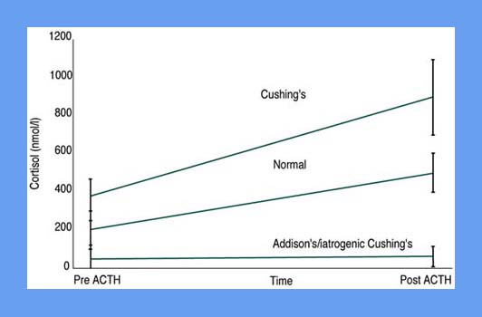
Screening Tests:
ACTH stim test:
Baseline, administer 5 mcg/kg cosyntropin, another cortisol 1 hour later.
Flatline below the limit = iatrogenic because exogenous suppresses endogenous cortisol release.
Healthy has some response whereas spontaneous has a marked response.
Glucocorticoids, ketoconazole, and estrogens affect the test. Phenobarb does not.
Sensitivity for AT is 57-63% and 80% in PDH. Specificity anywhere from 60-93%.

Slide 62
Screening Tests:
LDDST:
Sensitivity is high but has lower specificity
Differentiates PDH from AT in 40% of dogs.
Safe (one anaphylactic reaction), cheap but timely - takes 8 hours
Baseline, then give dexamethasone then measured at 4 and 8 hours.
Lack of suppression at the 8 hours mark is consistent with HAC
  PDH- tumor resistant to feedback.
  AT- cortisol keeps going and that administered doesn't effect the pituitary that has been suppressed.
Sensitivity 85-100% and specificity 44-73%
More severe non-adrenal illness, the more likely a false positive test result- lower specificity.
Notes:
Demonstrates decreased HPA axis sensitivity to negative glucocorticoid feedback, which is one of the two characteristics of HAC diagnosis.

Slide 63
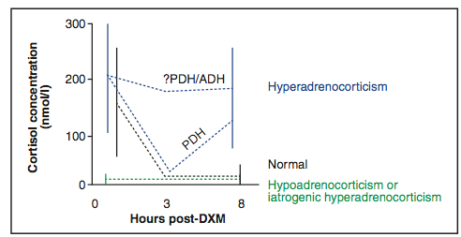
Screening Tests:
Notes:
Demonstrates decreased HPA axis sensitivity to negative glucocorticoid feedback, which is one of the two characteristics of HAC diagnosis.
https://www.google.com/url?sa=i&url=https%3A%2F%2Fendocrinevet.blogspot.com%2F2012%2F05%2Fhelpful-tips-to-improve-accuracy-of-low.html&psig=AOvVaw2ZB-_jrmX15jy0zJBhX8Gv&ust=1593034372101000&source=images&cd=vfe&ved=0CAIQjRxqFwoTCOjvm9HxmOoCFQAAAAAdAAAAABAX

Slide 64
Differentiation Tests:
HDDST - never confirms presence of AT.
Don’t go to if LDDST did not help to differentiate
Endogenous ACTH:
Confirms AT or not
Sometimes LDDST:
If 4 hour is below cutoff or one or both is 50% less than baseline, PDH is present. If not, could be either
Imaging
Notes:
Must have the diagnosis already
There are other tests I did not include but are in chapter 10 of Nelson/Feldmans

Slide 65
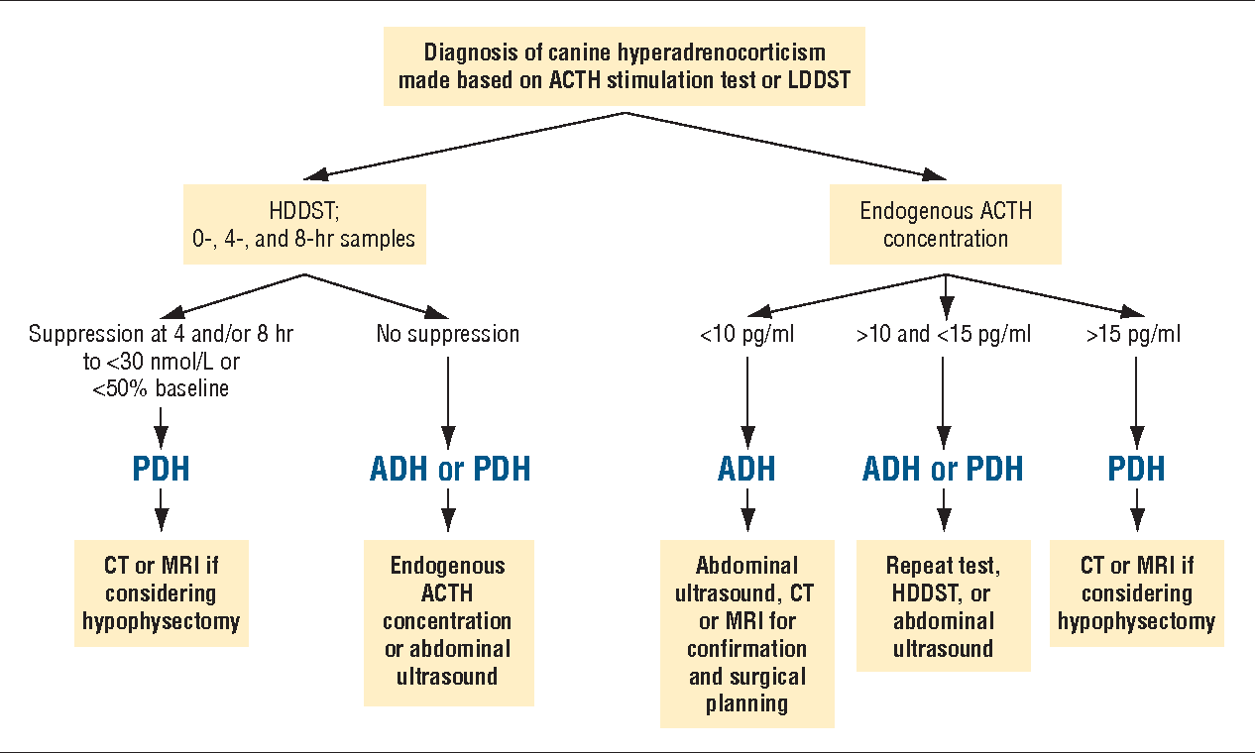
Notes:
https://www.google.com/url?sa=i&url=https%3A%2F%2Fwww.semanticscholar.org%2Fpaper%2FPDH-ADH-or-PDH-ADH-or-PDHADH-PDH-Axlund-Behrend%2F2ae6b9181c26572daa07eea0d5f049eb446aef32&psig=AOvVaw2ZB-_jrmX15jy0zJBhX8Gv&ust=1593034372101000&source=images&cd=vfe&ved=0CAIQjRxqFwoTCOjvm9HxmOoCFQAAAAAdAAAAABAN

Slide 66
Treatment of Canine Hyperadrenocorticism
Pituitary macroadenoma (>10mm diameter):
Radiation therapy for local control.
Survival depends on tumor size and the presence of neurological signs before treatment.
Adrenal tumors:
adrenalectomy is the treatment of choice for a cortisol secreting AT
May be contraindicated b/c of age, comorbidities, metastasis, increased surgical and/or anesthetic risk
>5cm tumors or invasion of the kidneys or vena cava have a high probability of serious postoperative complications and a poor outcome.
Larger the mass, the greater probability it is a carcinoma and that metastasis has occurred.
Most life threatening complication is thromboembolism which occurs within 24 hours of surgery.

Slide 67
Medical Management of Cushing’s
Mitotane:
Lysodren
Selective necrosis of the ZR and ZF so the cortisol and sex hormones.
There are loading and maintenance doses
Nelson & Feldman have more information of relapses, adverse effects, etc.
Trilostane:
Vetoryl
Steroid analogue that inhibits the enzyme 3-B-hydroxysteroid dehydrogenase.
Monitor therapy with ACTH stim.
Reported to be fully reversible but sometimes adrenal necrosis.
Notes:
Published MST for dogs with hyperadrenocorticism in primary care practice in England is 510 days.

Slide 68
Primary hyperaldosteronism
“Conn’s Syndrome”
Excessive and autonomous secretion of aldosterone - unilateral adenoma or carcinoma.
It is the most common adrenal tumor affecting cats but is rare in dogs.
Middle-aged to older dogs with lethargy, anorexia, weakness, PU and PD.
Severe hypokalemia with sodium at the upper reference/ mildly above with the finding of an adrenal mass on AUS should raise suspicion.
Confirmation made by markedly increased aldosterone concentration and suppressed renin activity in addition to exclusion of other causes of hypoakelamia.
Other findings include metabolic alkalosis to shift potassium extracellularly and systemic hypertension.

Slide 69
Incidentalomas
Nodules on the cranial or caudal pole of an otherwise normal appearing adrenal gland in an older dog
<1.5cm maximal diameter and a normal contralateral adrenal gland.
Usually not neoplastic or functional.
Less commonly early-developing cortical tumor or pheochromocytomas - approx 75% are adrenocortical while the others are neuroendocrine.
Follow up with monthly recheck AUS to ensure not growing
Adrenal tumor should be suspected if loss of the typical shape of the gland, asymmetry in shape or size between the two glands, or the mass has infiltrated surrounding structures.
If a max diameter of the mass is 2cm or greater, the chance of malignancy and growth is high.
You should look for hypercortisolemia, hyperaldosteronism, pheochromocytoma
Notes:
Nelson/Feldman’s has a good step by step approach to incidentalomas
>1cm or more
Are they active? Benign? Malignant? Represent metastasis?
Dogs: cushings > pheos
Cats: cortisol > aldosterone. Pheos exceedingly rare in cats.

Slide 70
Occult (atypical) cushings:
Overproduction of sex hormones
Not as common as typical cushings
Refer to Ch. 10 of Nelson & Feldman’s for more information

Slide 71
Feline Hyperadrenocorticism
Ch. 11 Nelson & Feldman’s

Slide 72
Pheochromocytoma
Tumor arising from catecholamine-producing chromaffin cells in the adrenal medulla.
Cells make epinephrine or norepinephrine:
  If they get their blood supply from the cortex then it is high in glucocorticoids and norepinephrine is subsequently converted to epinephrine.
  If the cells make mostly norepinephrine then they receive their blood supply from arters that bypass the adrenal cortex.
Rare in dogs but exceedingly rare in cats.
50% considered malignant because of either local (invasion) or distant metastasis.
Usually unilateral, and they may have one or several additional endocrine neoplasias such as a glucocorticoid producing adrenocortical adenoma or carcinoma, ACTH producing pituitary tumor, parathyroid tumors or hyperplasia, thyroid adenoma or carcinoma or insulinoma

Slide 73
Catecholamines
Norepinephrine (noradrenaline)
Epinephrine (adrenaline)
Dopamine
All are synthesized from the amino acid tyrosine, which is derived from food or formed from phenylalanine in the liver.
Tyrosine enters neurons or chromaffin cells and is converted to L-DOPA by the enzyme tyrosine hydroxylase.
  This conversion step is the rate limiting step in catecholamine synthesis.
  Intracellular catecholamine depletion rapidly increases enzyme activity whereas increased catecholamine levels lead to its down-regulation.
Notes:
L-DOPA = L-dihydroxyphenylalanine.
PNMT = phenylethanolamine-N-methyltransferase

Slide 74
Catecholamines
DOPA is then decarboxylated to dopamine:
  This is either the final product, or in the adrenal medulla and most sympathetic post-ganglionic neurons, gets converted to norepinephrine.
  If in the adrenal medulla, the blood supply is high in glucocorticoids that enhance expression of the enzyme PNMT therefore it gets converted to epinephrine.
    Epinephrine from adrenal medulla
    Norepienphrine from sympathetic postganglions.
    The amount of stored epinephrine to norepinephrine varies between species in the adrenal medulla:
      In dogs 70% is epinephrine while only 30% is norepi
      In cats there is 60% epi and 40% norepi.
Notes:
L-DOPA = L-dihydroxyphenylalanine.
PNMT = phenylethanolamine-N-methyltransferase

Slide 75
Catecholamines
Secretion of catecholamines takes place by exocytosis of the intracellular vesicles as part of the activation of the sympathetic nervous system.
Secretion increases with exercise, perceived danger, surgery, hypovolemia, hypotension, hypoglycemia, and many stressful events.
The plasma half life is 1-3 minutes.
Metabolism of secreted catecholamines is through the liver and kidney. They may also be conjugated in the GI tract.
Metabolites, conjugates, and free catecholamines are excreted in the urine
  Metabolites include metanephrine and normetanephrine.
    These metabolites are constantly leaking into circulation (as opposed to the catecholamines that are secreted only sporadically) therefore measurement of these analytes is superior.
  Free catecholamines account for only a small amount.

Slide 76
Catecholamines
Catecholamines act by binding to receptors located in the cell membrane of target cells.
From there, signal transduction to intracellular sites takes place via G-protein adrenergic coupled receptors
  They are present in most cells of the body and mediate the body’s reaction to stress.
  The two broad categories are alpha and beta receptors but can be further expanded into 9 groups
    Alpha 1 group has 1a, 1b, and 1d
    Alpha 2 group has 2a, 2b, and 2c
    Beta 3 group has b1, b2, and b3

Slide 77
Catecholamines
Epinephrine and norepinephrine both act on alpha and beta adrenergic receptors.
  They have approximately the same potency to stimulate alpha and B1 receptors, however epinephrine is much more potent to stimulate B2 and norepi to stimulate B3.
Norepinephrine causes vasoconstriction at alpha 1 and increases in cardiac contractility and rate at beta 1.
  Epinephrine as the same effects as norepi at these receptors. However, epinephrine also stimulates beta 2 receptors which causes vasodilation in skeletal muscle. Therefore the effect of epinephrine on blood pressure is variable and depends on its plasma concentration -- at low epi levels, mainly B2 stimulation leading to vasodilation while at higher concentrations, a1 is stimulated causing vasoconstriction.
Increase heart rate and contractility (b1), increase blood pressure (a1 & a2), increase respiratory rate (b2), decrease GI motility (b2), increase blood glucose and fatty acids, and increase alertness.
Notes:
Great table in Nelson & Feldman’s

Slide 78
Pheochromocytomas
Tumor size is positively correlated with catecholamine and metanephrines.
Most cases have increased norepinephrine.
Catecholamine release from the tumor is spontaneous.
  Clinical signs can therefore be sporadic.
Can secrete dopamine rarely (are not hypertensive) or other hormones like hypercalcemia with PTHrp
Most commonly in older dogs but can occur in any age.
No sex, intact/neutered, or breed predilection.

Slide 79
Pheochromocytomas
Most commonly the clinical signs are due to the effects of the catecholamines and not space occupying lesion.
  Some signs are constant like lethargy, PD/PU while others may be episodic like panting and tachycardia/tachyarrhythmia.
  Severity and duration and time in between all varies
  Anorexia, weight loss, collapse, pale mucous membranes, nasal bleeding, gingival hemorrhage, ocular hemorrhage, acute blindness, weakness, anxiety, pacing, disorientation, muscle tremors, seizures, vomiting, diarrhea, abdominal enlargement/pain, retroperitoneal or peritoneal bleeding.
An array of lab work results
Metastasize to any organ

Slide 80
Hypertension in Pheochromocytomas
Idiopathic/primary/essential: rare in dogs, 20% of cats
Secondary: secondary to renal or endocrine dysfunction
Endocrine includes primary hyperaldosteronism, cushings, pheochromocytoma, hyperthyroidism, and DM
Hypertension is not found in all pheos and cushings is the most important differential diagnosis.

Slide 81
Back to the Incidentalomas ...
Differential diagnoses for an incidentally found adrenal mass:
Functional: aldosterone producing adenoma, carcinoma, or hyperplasia; glucocorticoid producing adenoma or carcinoma, adrenocortical hyperplasia (ACTH dependent or independent); sex hormone producing adenoma or carcinoma; pheochromocytoma
Nonfunctional: adenoma, carcinoma, hyperplasia; metastasis; miscellaneous others (myelolipoma, lipoma, cyst, abscess hematoma, or granuloma)

Slide 82
Pheochromocytoma vs Cushing’s vs Incidentaloma
Ultrasound appearance does not help narrow down to pheo except that mineralization is uncommon (more likely cushings).
Commonly tumor thrombi, esp caudal vena cava
Most pheos are unilateral and the other adrenal gland is normal in size and shape.
  There could be incidental nodules on the other gland.
CT to determine extent of vascular invasion and to look for metastasis.
Do not aspirate adrenal nodules because in human medicine complication rate is 70% in one study and they only come back of endocrine or neuroendocrine origin.

Slide 83
Diagnosing Pheochromocytomas
Challenging - must have a high index of suspicion because clinical signs are so vague.
Most commonly they include weakness, lethargy, tachypnea, or panting, and acute or episodic collapse.
Hypertension may or may not be present at the time of diagnosis.
Cushings is biggest differential so it should be ruled out first.
Plasma or urine metanephrine & normetanephrine levels
Urine sample taken in the hospital as to not delay treatment (vs at home)
Of all the analytes, normetanephrine is the highest.
A cut off of urinary normetanephrine ratios of 4x the highest level measured in healthy dogs discriminates between cushings and pheos.
  Could be less than 4 times the upper limit.

Slide 84
Treatment of Pheochromocytomas
Considered malignant tumors.
Risk of invasion into surrounding tissues and vessels is high.
Adrenalectomy is the treatment of choice.
Notes:
The short‐term survival rate of dogs undergoing adrenalectomy for tumors <3cm in diameter was 92.2%, and one‐year disease‐specific survival was 83.3%.

Slide 85
Preoperative management for Pheochromocytomas
Anesthetic complications include hypertensive crisis, arrhythmias, pulmonary edema, and cardiac ischemia.
The traditional approach is to block the effects of catecholamines for at least 10-14 days prior to surgery.
Phenoxybenzamine: oral non-selective alpha adrenoreceptor antagonist
  Nonselective meaning it acts on alpha 1 & 2 & has irreversible and long lasting effects. It does not block synthesis (they actually increase levels) but blocks the effects by blocking ability to bind to receptors.
Tachyarrhythmias:
Beta blockers can be added after alpha antagonists have been given for at least 2 days.
  If not, hypertension may worsen with B blocker alone because a1 mediated vasoconstriction will go unopposed.
  Selective B1 blockers like atenolol are generally preferred over the nonselective B blockers like propranolol however at higher doses B1 blockers also block 2 receptors.

Slide 86
Preoperative management for Pheochromocytomas
Herrera et al 2008 study found that dogs that go un-pretreated are 6x more likely to die during anesthesia.
However dose and duration are unknown.
Pre-treat all pheos including the normotensive ones.
Starting dose for them is 0.25mg/kg BID then increase every 2-3 days until a final dose of 1mg/kg BID is reached by 2 weeks.
Last dose is given the evening prior to surgery.
If the dog shows signs of hypotension (weakness, lethargy, syncope) or other adverse effects like tachycardia or vomiting, the dose is reduced.

Slide 87
Preoperative management for Pheochromocytomas
If tachyarrhythmia or tachycardia is seen, a B1 selective blocker like atenolol at 0.2-1mg/kg by mouth every 12 to 24 hours is used)
Esmolol, an ultrashort acting B1 antagonist, can be given during surgery
  Initial bolus 50-500mcg/kg then CRI 50-200mcg/kg/min
Good info regarding peri-operative management in Nelson & Feldman’s Ch. 13
Dogs that survive surgery and do not have metastasis can live for several years.
Without surgery, they can live a year on phenoxy from one study.

Slide 88
Paraganglioma
Tumors of the extra-adrenal sympathetic and parasympathetic paraganglia.
Diverse group of neuroendocrine tumors that exist at many sites in the body including head, neck, thorax, and abdomen.
Sympathetic paragangliomas (non head and neck - therefore thorax and abdomen).
  In humans alone the majority are active and secrete norepinephrine/normetanephrine. Metastasis can occur.
  Uncommon to occur in dogs & cats
Parasympathetic paragangliomas are found in the heart and neck.
  Most are non-active and cause disease because of size/location.
  These are most common in dogs (> SNS) but are still very rare.
  Most commonly along aortic and carotid body. Chemoreceptor tumors or chemodectomas.
Notes:
Pheochromocytomas are tumors that produce catecholamines from chromaffin cells in the adrenal medulla.

Slide 89
Multiple Endocrine Neoplasia
Development of tumors within specific endocrine organs
MEN 1: Wermer syndrome
Parathyroid, pancreatic, and pituitary tumors.
Diagnosis if you have ⅔ tumors.
PHPT is the most common.
MEN 2
Rare in cats
See the chapter for more

