Slide 1
What I learned at IVECCS
9-14-18 to 9-18-18

Slide 2
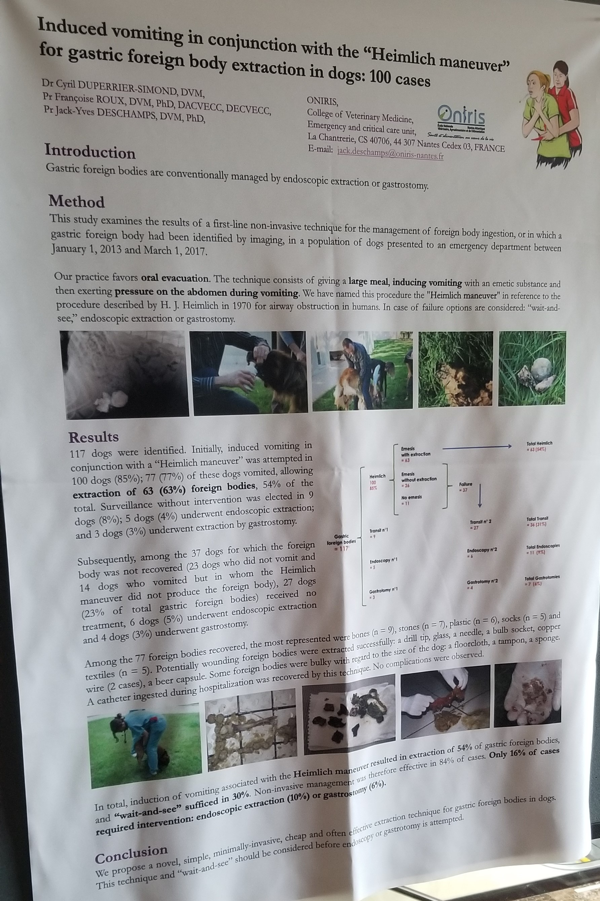
Abstracts- Induced vomiting in conjunction with the ‘Hemilich maneuver’ for gastric foreign body extraction in dogs: 100 cases

Slide 3
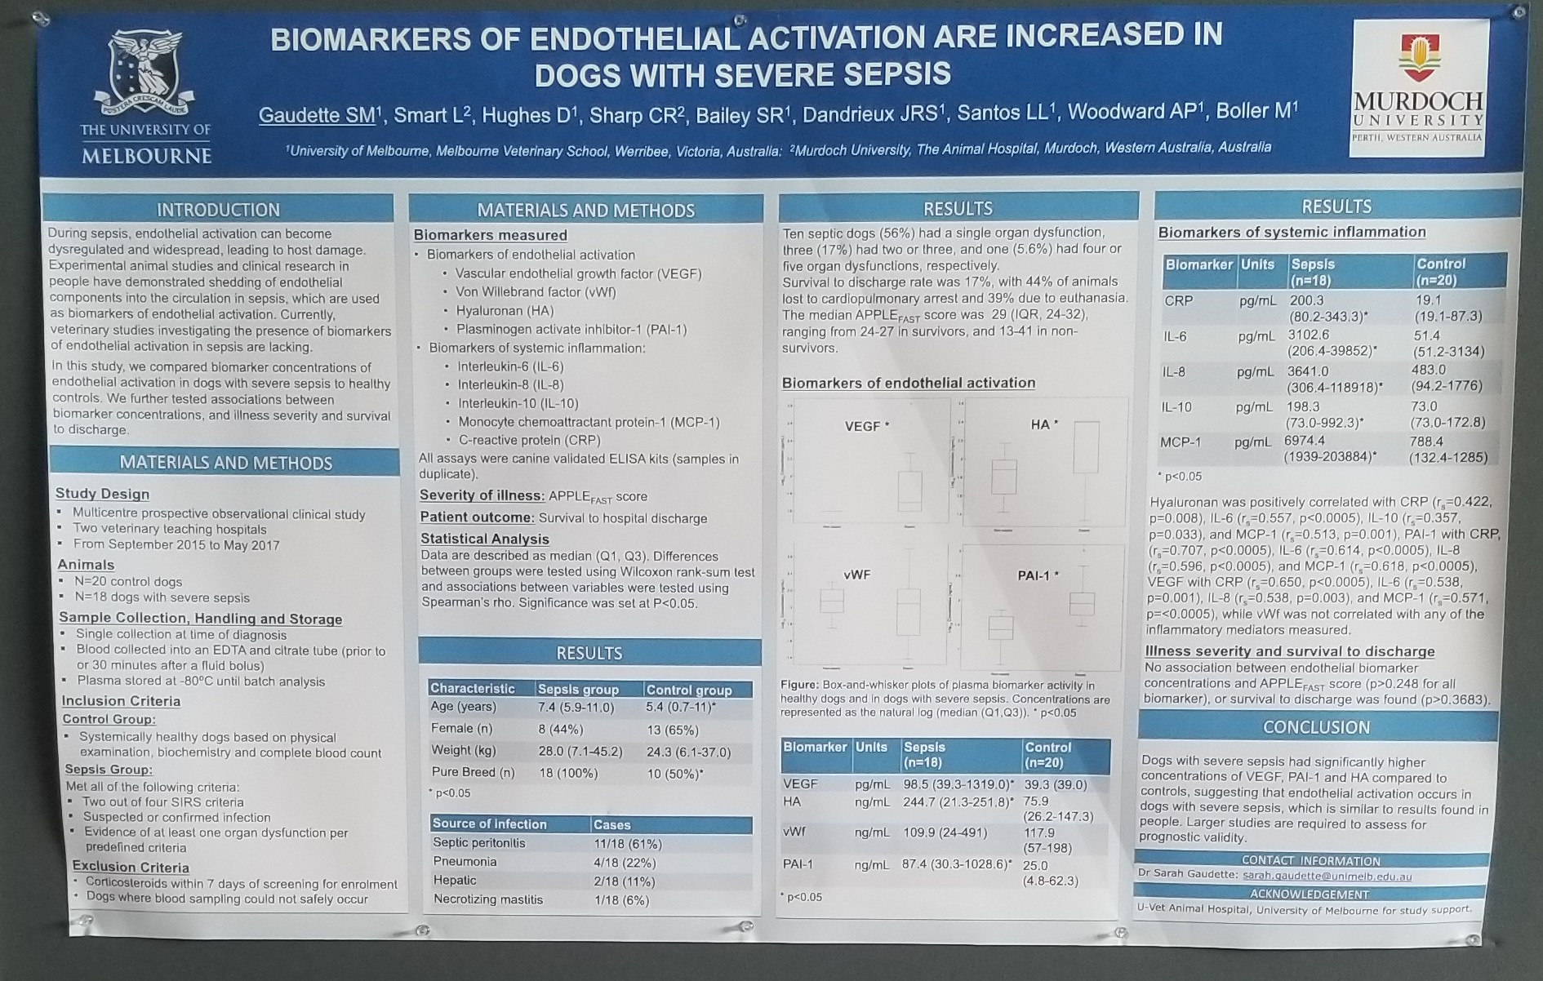
Abstracts- Biomarkers of endothelial activation are increased in dogs with severe sepsis

Slide 4
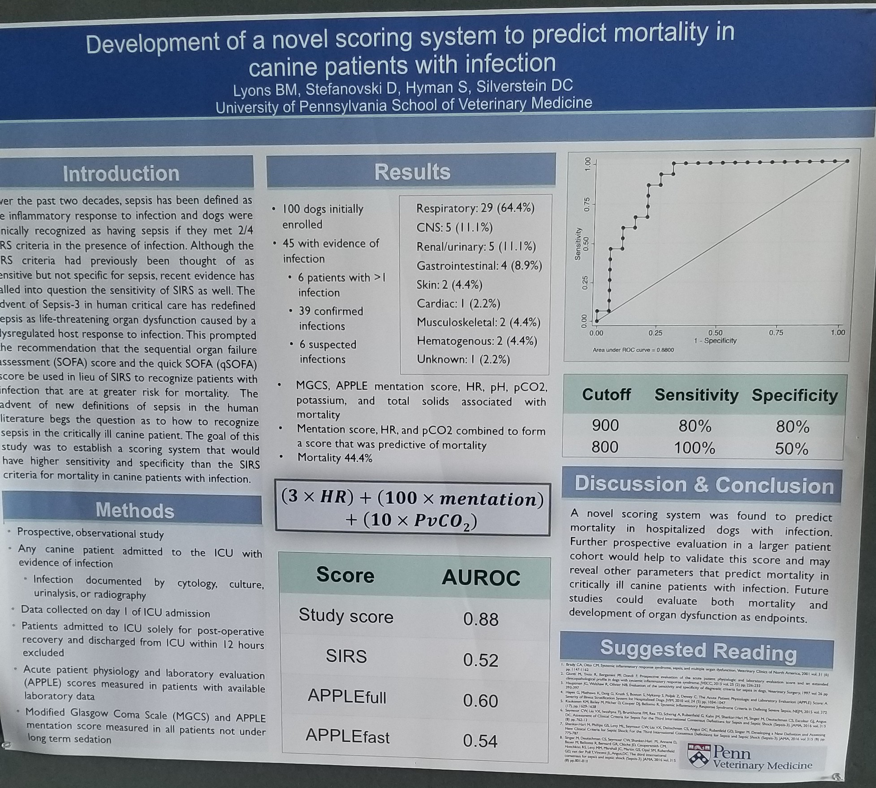
Abstracts- Development of a novel scoring system to predict mortality in canine patients with infection

Slide 5
Damage Control
CT in 5 mins
Surgery in 40 mins
  Hypotensive resuscitation
  REBOA
  Can we even get a chart in 40 mins?

Slide 6
Trauma Induced Coagulopathy: What we know in veterinary medicine
Coagulation dysfunction
  Thought to occur due to dilution, hypothermia, acidosis
  Minimize iatrogenic factors:
    Avoiding dilution with crystalloids
    Staging surgical procedures
    Rapidly treating shock
  Cogulopathy attributed to the injury itself and resultant state of shock
  Hemorrhage- primary cause of preventable death in trauma

Slide 7
Inconsistency in Nomenclature
TAC- trauma-associated coagulopathy
TIC- trauma-induced coagulopathy
ATC- acute traumatic coagulopathy
ACoTS- acute coagulopathy of trauma and shock
ITC- iatrogenic traumatic coagulopathy
TIC has been adopted by the Transagency Consortium of Trauma Induced Coagulopathy (TACTIC) as the official name

Slide 8
Trauma-induced coagulopathy (TIC)
Global hemostatic dysfunction following trauma
  Attributable to a pathologic, primary endogenous coagulopathy that develops early following severe tissue injury and shock
  Exacerbated by exogenous factors that such as further blood loss, hemodilution, genetic factors, and dysfunction of coagulation proteases from acidemia and/or hypothermia
  Further complicated by normal physiology including consumption of coagulation proteases, fibrinogen, and platelets for the purpose of clotting.

Slide 9
Mortality
Human patients that develop early coagulopathy in trauma have a four-fold increase in mortality and require significantly more transfusions than non-coagulopathic patient

Slide 10
Mechanisms of TIC
Endogenous anticoagulation
  Coagulopathy on admission to the ED occurs in approximately 25% of human trauma patients
    independent of fluid administration and consumption
  Activation of the protein C (APC) pathway
    major driver of endogenous coagulopathy in trauma
    Activates in the presence of thrombin-thrombomodulin complex and Protein S.
    Exerts an anticoagulant effect through inactivation of factors Va and VIIIa and profibrinolytic effect via inactivation of plasminogen activator inhibitor 1 (PAI-1).
  Elevated thrombomodulin activity and decreased plasma protein C concentration (indicating conversion to APC).
    Systemic hypoperfusion appears to be important for this derangement to occur

Slide 11
Mechanism of TIC
Counterargument
  Concentrations of APC achieved following trauma are neither able to deplete factor Va nor induce fibrinolysis in vitro.
  Another study
    Overwhelming tPA release is the cause of hyperfibrinolysis in trauma rather than PAI-1 degradation
  Coagulopathic bleeding in trauma is not a new phenomenon, but is rather caused by DIC with a hyperfibrinolytic phenotype.
    Microvascular thrombosis does not appear to occur in trauma hemorrhage and platelets and fibrinogen do not often meet criteria for DIC, many continue to support that the APC pathway of TIC is a clinical entity distinct from DIC.
    One study revealed that among 80 trauma patients sampled approximately one hour from injury, no patient met the ISTH criteria for DIC while 15% met criteria for APC-mediated acute traumatic coagulopathy

Slide 12
Mechanism of TIC
Anticoagulation in TIC is probably a complex interaction of many factors linked to the injury, the individual, and the interaction between the two.
One single pathway is unlikely to predominate, and the individual may, in fact, transition rapidly through many competing pathways in the coagulation/inflammation milieu.
Laboratory testing may capture pathologic processes, physiologic responses to injury must also be considered.

Slide 13
Platelet Dysfunction
Many trauma patients retain platelet counts within the normal range.
  Even slight decreases are associated with increased risk of death at 24 hours
  Platelet dysfunction occurs early in trauma patients and likely contributes to coagulopathic bleeding
  45% of trauma patients demonstrate platelet hypofunction and experience a 10-fold higher mortality .
    Appears to be mediated through decreased aggregation in response to ADP and thrombin. Base deficit, injury severity, and GCS have been variably associated with reduced platelet count and increased dysfunction
    Platelet exhaustion- may be involved wherein massive activation of platelets at the point of injury causes refractoriness over the following hours to days.
    There is some experimental evidence that platelets with decreased response to ADP form a shell around fully functional platelets at the core of a hemostatic plug, possibly in order to prevent widespread thrombosis.
    Testing platelets following trauma may also select for hypofunctional platelets, given that capable platelets are actively participating in clot formation.

Slide 14
Endotheliopathy
The endothelial glycocalyx (EG) is a negatively-charged, carbohydrate-rich network of proteoglycans and glycosaminoglycans overlying the luminal surface of blood vessels.
The EG can be degraded by a variety of chemical mediators including VEGF, TNF-a, catecholamines, matrix metalloproteinases, and oxidative damage.
Injury to this important barrier exposes plasma constituents to a prothrombotic, pro-inflammatory and leaky endothelial surface.
Trauma induced activation of inflammatory mediators and tissue-derived MMPs can cause degradation of the EG and shedding of chondroitin sulfate and heparan sulfate.
  Increases efficiency of the endogenous anticoagulants thrombomodulin and antithrombin, respectively.
  This phenomenon has been termed “autoheparinization” and likely contributes to TIC

Slide 15
Endotheliopathy
Release of endothelial secretory granules, Weibel-Palade bodies (WPB). These granules contain many compounds responsible for inflammation, coagulation, and angiogenesis.
  At least two of these compounds are thought to contribute to TIC:
    tPA (which accelerates fibrinolysis)
    angiopoeitin-2 (which further destabilizes the EG)
Elevations in tPA and Ang-2 have been associated with coagulopathy, higher transfusion requirements, and non-survival in human trauma patients.

Slide 16
Endotheliopathy
Sympathoadrenal activation appears to play a role in endothelial injury during trauma both in animal and human studies.
  Elevations in catecholamines are independently associated with hypocoagulability and hyperfibrinolysis
The extent of endothelial injury can be quantified by measuring EG components such as syndecan-1, a core protein within the EG and vascular endothelial cadherin (VE-cadherin), a primary endothelial adhesion molecule.
In human trauma patients, increased circulating syndecan-1 and VE-cadherin at admission is independently associated with hypocoagulability (measured by TEG), increased transfusion requirements, and mortality.

Slide 17
Fibrinogen depletion and hyperfibrinolysis
Fibrinogen depletion and hyperfibrinolysis: Early fibrinogen depletion is a key characteristic of TIC
  Associated with high mortality and transfusion requirements
Primary mechanisms contributing to hypofibrinogenemia
  Loss and consumption due to ongoing hemorrhage or DIC,
  Dilution with crystalloid fluids and plasma-free transfusion products,
  Rapid consumption due to accelerated clot breakdown (hyperfibrinolysis)
The definitive cause of hyperfibrinolysis in trauma remains unknown and has been the subject of much debate. Prevailing theories include:
  Overwhelming tPA release from activated endothelium,
  APC-mediated inhibition of the PAI-1,
  Consumption and massive plasmin formation associated with thrombin generation and DIC
  Activation of an alternative pathway of fibrinolysis mediated by neutrophil-elastase
While the condition of hyperfibrinolysis is particularly deadly, a multicenter prospective study of 2,500 human trauma patients showed that it is more common for patients to be resistant to fibrinolysis on presentation (46% vs. 18%).
  fibrinolytic shutdown- associated with an increased mortality rate (22%) albeit lower than that of hyperfibrinolysis (34%). The leading cause of death due to fibrinolytic shutdown is organ failure.

Slide 18
Diagnosing TIC
Multiple observational studies in people demonstrate that TIC occurs most commonly in cases with severe tissue injury and hypoperfusion. A multicenter retrospective study of 3,646 trauma patients found that coagulopathy upon arrival at the emergency room was directly correlated to injury severity and shock severity
Animal models of ATC that control for exogenous factors also mirror these findings and it has been suggested that TIC cannot develop in the absence of either tissue injury and hypoperfusion
High plasma catecholamine concentrations in trauma patients are also associated with hypocoagulability and hyperfibrinolysis

Slide 19
Diagnosing TIC
Strong push to use viscoelastic testing not only in establishing TIC diagnosis, but also for guiding treatment.
  The addition of bedside whole blood platelet aggregometry could help further identify patients with platelet hypofunction. It is unclear how patients with a “laboratory” coagulopathy without ongoing clinical bleeding should be managed.
Some patients that meet eligibility criteria for TIC may have established a natural balance that leaves them with a normal phenotype. On the other hand, some patients may appear minimally affected on a laboratory basis but still experience uncontrollable hemorrhage.

Slide 20
Veterinary Studies Related to TIC
Compared to the mass of human literature, published evidence of TIC in clinical veterinary medicine is sparse.
However, murine as well as large animal models of TIC have helped advance what is known about the condition in people.
Distinct differences in coagulation physiology have been observed between animals and humans, both in health and disease.
Therefore, veterinarians must consider this when applying human theory and management in veterinary trauma care

Slide 21
Veterinary Studies Related to TIC
Mischke et al. 2004: Chronologically, the first and second publication evaluated the coagulation status of 31 dogs that had suffered blunt trauma. An attempt to identify ACoT, the investigators captured samples for aPTT, platelet count, individual clotting factors, fibrinogen, FDP concentration and resonance thrombography prior to any intervention (eliminating the possibility of dilutional/iatrogenic coagulopathy) (30). Coagulation abnormalities consisted of elevated FDPs in 87%, reduced FV concentration in 77% (other factors activities not reported in this study), and prolonged aPTT in 67% of traumatized dogs. Individual factor activity was <30% in 5 dogs (16%). Platelet counts and fibrinogen were lower than the reference range in only 10% and 7% of dogs, respectively.
Mischke et al. 2005: Hemostatic testing for these thirty dogs was later compared to a healthy control group of 102 dogs (31). All coagulation factors, protein C, plasminogen, and platelet count were decreased compared to controls with the most common factor deficiency found in FV and FII - again found in 77% of dogs. PT was prolonged in ⅓ and aPTT in ⅔ of these dogs. The one analyte that was not significantly different than control dogs was alpha2-antiplasmin

Slide 22
Veterinary Studies Related to TIC
likely due to concurrent consumption and overwhelming production as an acute phase reactant. Interestingly, 82% of these dogs had increased soluble fibrin, a marker for intravascular coagulation. The overall conclusion of this study was that dogs demonstrate a profound consumptive coagulopathy in the early stages of blunt injury and this was thought to be consistent with evidence of trauma-associated DIC in humans. The publication listed below is also cited in support of this theory.
Loupal 1982: A publication from 1982 cited that 26% of dogs (n=50) that died from traumatic shock showed evidence of microthrombosis and DIC on post-mortem exam. This was more common in dogs that survived for more than one day (32). Simpson et al. 2009: A retrospective study of 235 dogs with blunt trauma revealed that in the 23% of injured dogs that had coagulation testing performed, PT was prolonged in 20% and aPTT prolonged in 47% (32). Most were mild or moderate (1.25-2.0x control). These values were not associated with survival. These samples were drawn within 12 hours of hospital admission and could reflect a combination of acute and iatrogenic coagulopathy.
Abelson et al. 2013: A prospective observational study (33) evaluated the coagulation status of 30 injured dogs that presented without prior resuscitation and within 4 hours of injury with an animal trauma triage (ATT) score of at least 5 (range 0-18). Despite this enrollment restriction, the majority of dogs had ATT scores of 5 or 6, only 5 dogs had scores >10. Thirty percent of dogs had evidence of hemorrhage. No dogs enrolled in this study showed evidence of hypocoagulability via PT, aPTT or TEG values. Only one dog had decreased protein C activity. Instead, 33% of dogs showed hypercoagulability based on TEG G value and approximately 75% of dogs had at least one TEG value consistent with a hypercoagulable state. There was no association between TEG G value and shock indicators or injury severity. The authors suggest that perhaps the injury severity was too low to develop a trauma-induced hypocoagulable state.

Slide 23
Veterinary Studies related to TIC
Holowaychuk et al. 2014: Another prospective observational study (34) enrolled 40 dogs that were injured within 12 hours of presentation to one of two referral centers. In contrast to the previously described study, dogs were enrolled post-resuscitation as long as colloids, hypertonic saline, and blood products were not used. Seventy percent of dogs enrolled had received fluids prior to sampling. Body cavity hemorrhage was present in 25% of enrolled dogs. Mean ATT score was 5 overall. For the purposes of this study, ATC was diagnosed if the dog had one of the following: PT or aPTT >1.5x upper reference range, platelet count lower than reference range, or TEG MA or alpha angle lower than the reference range. When derangement of only one value was used to diagnose ATC, 38% of dogs were eligible for the diagnosis and this was associated with increased risk of blood transfusion. When two values were used to diagnose ATC, 15% of dogs were diagnosed and this was significantly associated with increased injury severity and shock as well as an signal of increased mortality (50% compared to 18%, P= 0.131). Using multivariate analysis for injury severity, TEG values and platelet count were the best predictors of cavitary hemorrhage and need for transfusion. While aPTT was the best predictor of nonsurvival in univariate analysis, no test predicted nonsurvival in multivariate analysis with injury severity. Markers of hyperfibrinolysis were correlated with increased lactate and decreased pH and, though not statistically significant, mean LY30 values were higher in nonsurvivors (6.3% vs. 0.4%).
Gottlieb 2017: A prospective study and the first to investigate traumatic coagulopathy in cats was published in 2017. Eighteen dogs and 19 cats that were presented to the referral center within 8 hours of blunt trauma without having received fluid resuscitation or transfusion were included. Median ATT scores were 4 and 3 for dogs and cats respectively. Of the 12 dogs and 9 cats that had AFAST performed, 8.3% and 22% had evidence of body cavity hemorrhage. One dog and one cat were diagnosed with ATC. Four dogs (22%) and one cat (5.3%) were considered hypercoagulable based on TEG MA and G. ATT was positively correlated with PT and aPTT and negatively with MA and fibrinogen, but no injury severity correlation could be made in cats. However, increased lactate and blood glucose in cats was correlated with decreased MA and G, representing a comparatively more hypocoagulable state. Lynch 2016: A recently published experimental study investigated coagulation changes in dogs during hemorrhagic shock. Five dogs were bled to 20% then 40% of their blood volume and were sustained in a hypotensive state (MAP 40 mmHg) for 60 minutes prior to autologous transfusion of shed blood. At all time points PT was significantly prolonged compared to baseline though never exceeded the upper reference value. Prolongation of aPTT was only statistically significant after sustained hypotension (where it did exceed the upper reference value). TEG variables associated with clot strength (MA and G) decreased significantly over time but remained within the institutional reference interval. Fibrinogen was decreased compared to baseline beginning at the 40% volume time point and persisting beyond transfusion of shed blood. Platelet count was unchanged throughout the study, but platelet function was decreased in response to arachidonic acid (AA) and adenosine diphosphate (ADP) agonists at 20% and 40% shed volume, respectively. Anemia was mild (likely attributable to splenic contraction) and was thought unlikely to have

Slide 24
Veterinary Studies related to TIC
contributed to coagulopathy. While this excellent study was the first of its kind to show the impact of controlled hemorrhagic shock on platelet and coagulation function, these animals did not sustain trauma. Because tissue injury is purported to be a key factor in the development of TIC, it is unclear how trauma would alter the results found in this study.
Two recent case reports have been published documenting coagulopathies early after trauma in the dog.
Yoo et al. 2016: A dog with presumed blunt trauma was presented to an emergency referral center with clinical and laboratory markers of shock and developed an uncontrolled hemothorax despite whole blood and plasma transfusions and attempts at surgical hemostasis (35). Plasma-based tissue factor-activated TEG with and without tPA was performed later using frozen samples from various time points. The sample collected on presentation revealed profound hypocoagulability and hyperfibrinolysis despite relatively mild changes in PT, aPTT, and platelets. Fibrinogen concentration on presentation was not reported. Hyperfibrinolysis was thought to be a major contributor to this dog’s continued bleeding and clinical response was noted following administration of the anti-fibrinolytic drug epsilon aminocaproic acid. The dog in this report had an ATT score of 8 and survived to discharge.
Muri et al. 2018: A dog was presented to a veterinary center within 15 minutes of blunt trauma with an ATT score of 13 and active femoral arterial hemorrhage (36). ROTEM on presentation revealed prolonged clot formation and kinetics as well as reduced clot strength- all were outside of the institutional reference ranges. Most notably, the percent clot lysis at 30 minutes was markedly increased, attributable to hyperfibrinolysis. The anti-fibrinolytic drug tranexamic acid was administered to this dog. The next ROTEM sample was taken approximately 10 hours after presentation and following surgical exploration (in which diffuse surface bleeding was noted), whole blood transfusion, 98 ml/kg crystalloid fluid and 24 ml/kg of Voluven. This sample remained hypocoagulable with respect to clot formation and firmness but clot lysis was normal (presumably due to administration of tranexamic acid). This dog developed septic shock 48 hours after admission and did not survive to discharge. A review of traumatic coagulopathy was published by Palmer and Martin in JVECC in 2014 .

