Slide 1
Deploying Services via OpsWorks/Chef
Using Chef to standardize instance configuration
for apps & services deployed by OpsWorks
Paul Allen
Cloud DevOps Team, IT@Cornell

Slide 2

Agenda
  OpsWorks for Chef Automate
OpsWorks Stacks
  nomenclature
  life cycle
OpsWorks-compatible Repos
Chef (v12+)
DevOps scheme
Updates scheme

Slide 3
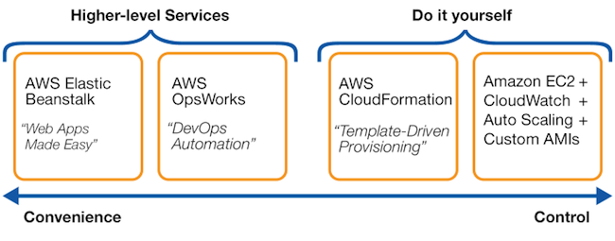

Slide 4
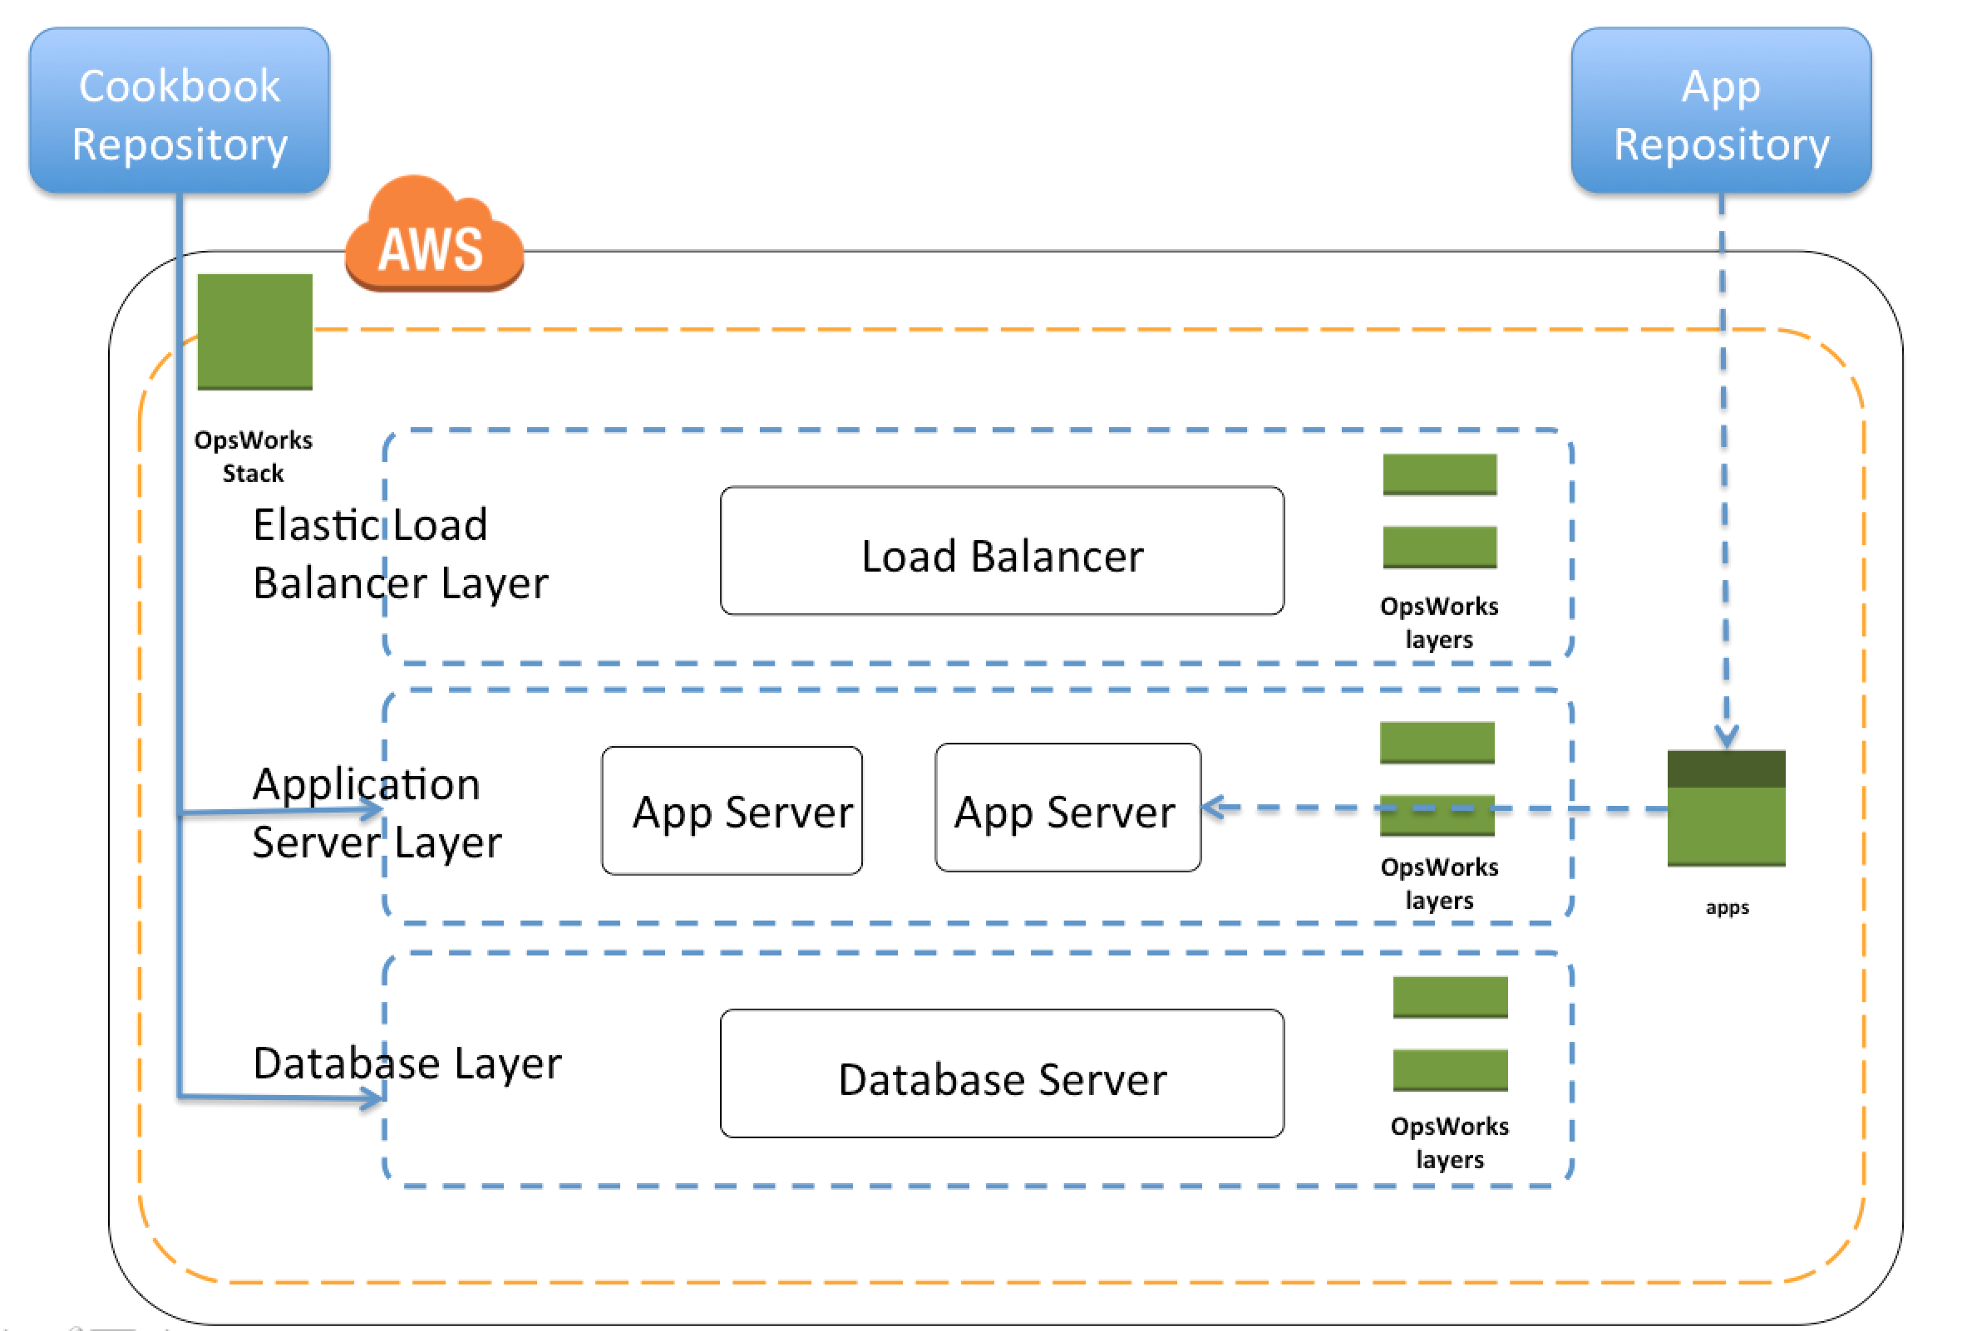

Slide 5
OpsWorks Life Cycle Events
All events can be triggered manually, too
Reboots do not trigger any events
Event | Trigger(s) | Scope
Setup | instance boot | the booted instance
Configure | any instance enters or leaves online state EIP changes to any instance ELB association changes | all instances in layer
Deploy | Setup event | same as Setup event
Undeploy | delete an app in Stack | all instances where app is deployed
Shutdown | instance shutdown | the instance

Slide 6
OpsWorks Lifecycle Example
Instance A [boots]
Instance A [Setup Event]
Instance A [Deploy Event]
Instance A [online]
Instance B [Configure Event]
Instance C [Configure Event]
Instance ... [Configure Event]
Setup recipes
Deploy recipes
Configure recipes

Slide 7
Chef
app-deploy-repo
myapp
install-apache
install-myapp
aws (submodule)
s3_file
OpsWorks-ready repo
Chef Cookbooks
Chef Recipes
opsworks-utils (submodule)
papertrail
dns
route53_record
OpsWorks uses Chef to manage instance
Your recipes layer on top of that

Slide 8
Chef Basics
cookbook: collection of recipes
recipe: collection of resources
resource: files/objects/actions on the node
  service
  file
  remote_file
  directory
  user
  group
  execute
  package
  etc.

Slide 9
Example Chef Resources
remote_file '/tmp/remote_syslog_linux_amd64.tar.gz' do
source 'https://github.com/papertrail/remote_syslog2/releases/download/v0.19/remote_syslog_linux_amd64.tar.gz’
action :create_if_missing
end
execute 'untar-remote-syslog2' do
cwd '/tmp'
command 'tar xzf /tmp/remote_syslog_linux_amd64.tar.gz'
not_if { ::File.exist?('/tmp/remote_syslog') }
end
cookbook_file '/etc/init.d/remote_syslog' do
mode '00555'
owner 'root'
group 'root'
source 'papertrail/remote_syslog’
end
<snip>
service ‘remote-syslog’ do
action :enable
end

Slide 10
Injecting Custom Attribute Values
Cookbook attributes/defaults.rb
  default[‘myrecipe’][‘user’] = ‘apache’
OpsWorks layer custom JSON
  { “myrecipe”: { “user”: “www-data” } }
Realized attribute values in recipe
  user ‘add my user’ do
  username node[‘myrecipe’][‘user’]
  home ”/home/#{node[‘myrecipe’][‘user’]}”
  shell “/sbin/nologin”
  end

Slide 11
Setup Event Recipes
opsworks-util-cookbook::hook-setup
  include_recipe 'opsworks-utils-cookbook::papertrail’
  include_recipe 'opsworks-utils-cookbook::instance-tags’
  include_recipe 'opsworks-utils-cookbook::aws-agents’
  include_recipe 'opsworks-utils-cookbook::aws-alarms’
  include_recipe 'opsworks-utils-cookbook::packages’
  include_recipe 'opsworks-utils-cookbook::timezone’
  include_recipe 'opsworks-utils-cookbook::dns-create'

Slide 12
Possible Deployment/Management Scenario
Shared Resources
(CloudFormation)
OpsWorks TEST Stack and Layer(s) (CloudFormation)
manual/scripted instance management
OpsWorks PROD Stack and Layer(s)
(CloudFormation)
scripted instance management
- S3 bucket(s)
- IAM roles/profiles
- KMS key(s)
- cookbooks
- CF templates
CF templates
command & control
GitHub/BitBucket repo
Jenkins
scripts

Slide 13
Potential Host/App Update Process
assumes ELB
in OpsWorks “app” Layer
  start new instance(s); wait to come online
    security updates automatically applied to instance
    latest cookbook repo pulled from specified GIT branch
    (optional) apply other instance OS updates via Setup recipe
  stop old instances(s)
    ELB connections drain, then Shutdown recipes run
    keep instance(s) in stopped state
      rollback by turning them back on, turning off new ones
      keep as many old instances/versions as you wish

Slide 14
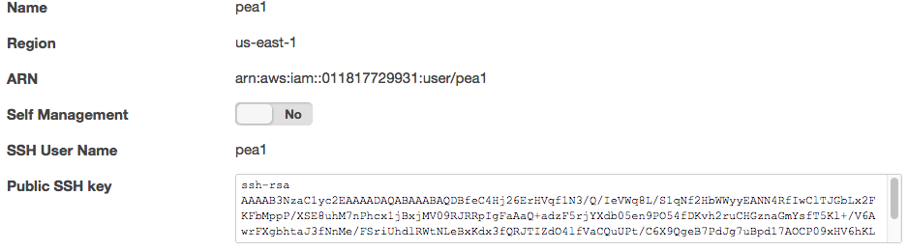
OpsWorks Users
Why?
  Stack Permissions
  SSH/RDP, sudo/admin access
“import” IAM users
upload public SSH key
configure stack X permissions

Slide 15
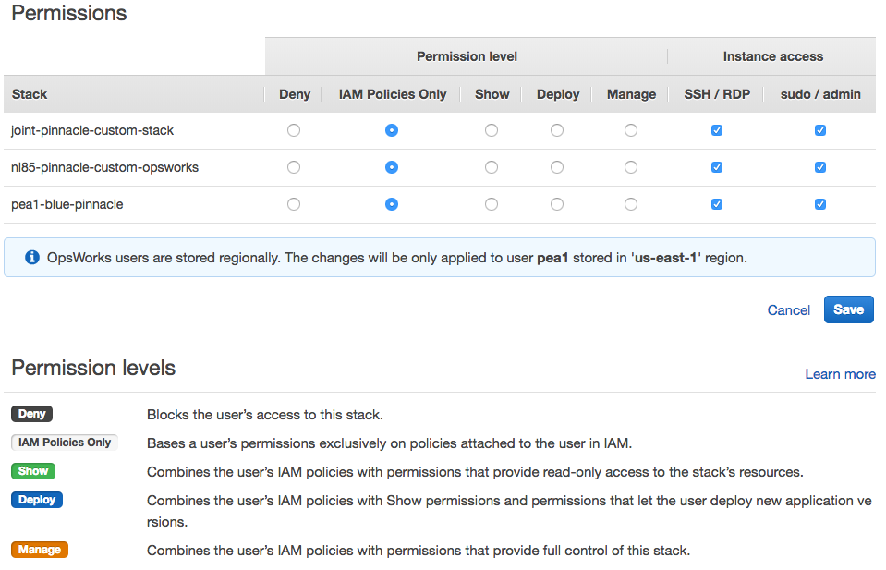
OpsWorks Users
configure user ☓ stack permissions

Slide 16
Opswork “Free” Metrics
Stack / Layer / Instance dimensions (summaries)
CPU, memory, load
Missing: disk utilization

Slide 17
Email
  Paul Allen: pea1@cornell.edu
  cloud-support@cornell.edu
Code
  https://github.com/CU-CommunityApps/opsworks-example
  https://github.com/CU-CommunityApps/opsworks-utils-cookbook
Web
  https://confluence.cornell.edu/display/CLOUD/
  https://blogs.cornell.edu/cloudification/tech-blog/

