Slide 1
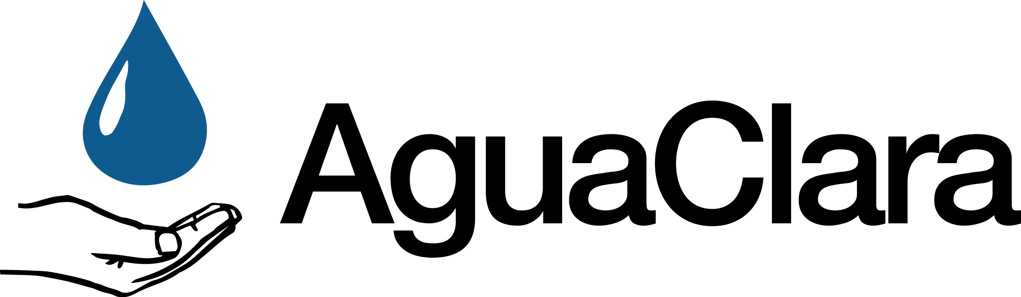
Water Quality Monitoring
for Diarrheal Pathogens
WQMDP
New research on methods to sample viruses, bacteria and protozoa from large samples of raw water and AguaClara treated water in Honduras
For more info: WQMDP AguaClara wiki
WQMDP | Final Presentation Fall 2017
Notes:
Presenter: Ji Young
Citations:
Cornell University AguaClara. (2017). AguaClara. Retrieved November 16, 2017, from http://aguaclara.cornell.edu/
U.S. Environmental Protection Agency. (2017, February 24). Revised Total Coliform Rule and Total Coliform Rule. Retrieved November 16, 2017, from https://www.epa.gov/dwreginfo/revised-total-coliform-rule-and-total-coliform-rulehttp://aguaclara.cornell.edu/
Brooks, Y., Tenorio-Moncada, E., Gohil, N., Yu, Y., Estrada-Mendez, M., Bardales, G., & Richardson, R. (2017, July 19). Performance evaluation of gravity-fed water treatment systems: verifying robust removal of turbidity and Escherichia coli in AguaClara designed plants in rural Honduras during wet and dry weather.
Brooks, Y. M., de la Torre, O., Goodman, L. B., & Richardson, R. E. (2017, June 19). Evaluating the efficiency of an ultrafiltration methodology to determine the presence of waterborne pathogens in environmental water.
Monroe Weber-Shirk, & Ruth Richardson. (2017, September 5). WQMDP Project Scoping Meeting.
Caption:
None
Summary:
AguaClara water treatment plants supply drinking water to approximately 50,000 people in Honduras and India (Cornell University AguaClara, 2017). Until recently, however, the only data collected on how effectively AguaClara plants operated in the field were turbidity measurements. This convention matched the convention used by AguaClara design teams in Ithaca, NY, who gauge plant performance based on the turbidity of the processed water. Turbidity is easy to measure and understand: even a cursory visual inspection can tell an observer a lot about a water sample's turbidity. However, because turbidity measurements only describe how much suspended material there is in a sample and not what makes up the suspended material, turbidity is at best a proxy measure for the potential of a water sample to cause disease (potability). An improvement over turbidity measurement is the measurement of fecal indicator bacteria (FIB), which are used to define important drinking water standards in the United States (U.S. Environmental Protection Agency, 2017). These bacteria originate in the guts of humans and animals, and, in theory, are at least as persistent in the environment as disease-causing pathogens. Work performed by Yolanda Brooks at the Richardson Lab in 2016 quantified turbidity and E. Coli removal by AguaClara plants in Honduras using portable turbidimeters and compartment bag tests, respectively. That work showed that AguaClara plants effectively remove turbidity and E. Coli from drinking water (Brooks et al., 2017a).
Even though metrics such as turbidity and FIB concentrations are useful for quickly determining the potability of a water sample, neither method directly measures the concentration of disease-causing bacteria, protists, and viruses in water. AguaClara would benefit from direct measurement of pathogens because the results would either confirm the team's belief that its plants are doing a good job of providing safe water, or the results would suggest important areas for improvement. To achieve direct measurement, the Richardson Lab has pioneered the use of an OpenArray qPCR analysis protocol that will detect not only species-specific FIB from humans, chickens, and cattle, but also the pathogens E. Coli, Salmonella spp., Hepatitis A, norovirus, Giardia lamblia, and Cryptospordium parvum, among others. Unfortunately, this protocol requires large water samples, on the order of 10 L in volume, to achieve low enough limits of detection to measure the concentrations of individual pathogen species (Brooks et al., 2017b). Additionally, the protocol requires equipment unavailable in Honduras, so samples must be concentrated down to volumes of less than 200 mL for shipment back to Cornell University before the DNA molecules degrade (Monroe Weber-Shirk and Ruth Richardson, 2017). This study first examines the sample collection process from Honduran water source all the way to air shipment by means of a literature review, and second seeks to develop a simpler method of large-sample filtration than those found in the literature.

Slide 2
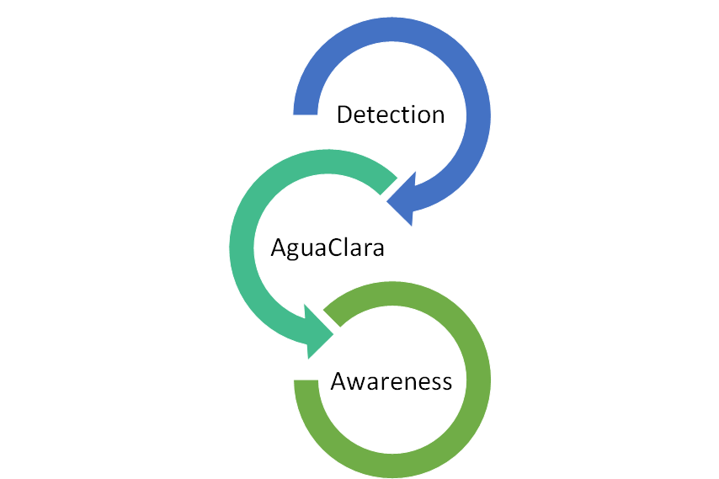
Recall the motivations of our team
Which pathogens are of concern in surface waters in Honduras?
How well do AguaClara plants remove these pathogens ?
How can AguaClara suggest the need of wastewater treatment to the towns?
WQMDP | Research | Final Presentation Fall 2017
Notes:
Presenter: Ji Young
Citations:
None
Captions:
We want to give a brief recap on our primary concern/motivations. There were three questions that we wanted to answer.
Which pathogens are of concern in surface waters in Honduras?
Especially those cause diarrheal ailments
How well do AguaClara plants remove these pathogens (especially viruses, which have reasons to pass through AguaClara plants)?
It would be great to have test results that show that our plants can successfully remove those pathogens.
How can AguaClara suggest the need of wastewater treatment to the towns?
Many location, where AguaClara plants are built or going to be built in Honduras and other countries, send wastewater directly to drinking water sources.
Summary:
See caption

Slide 3
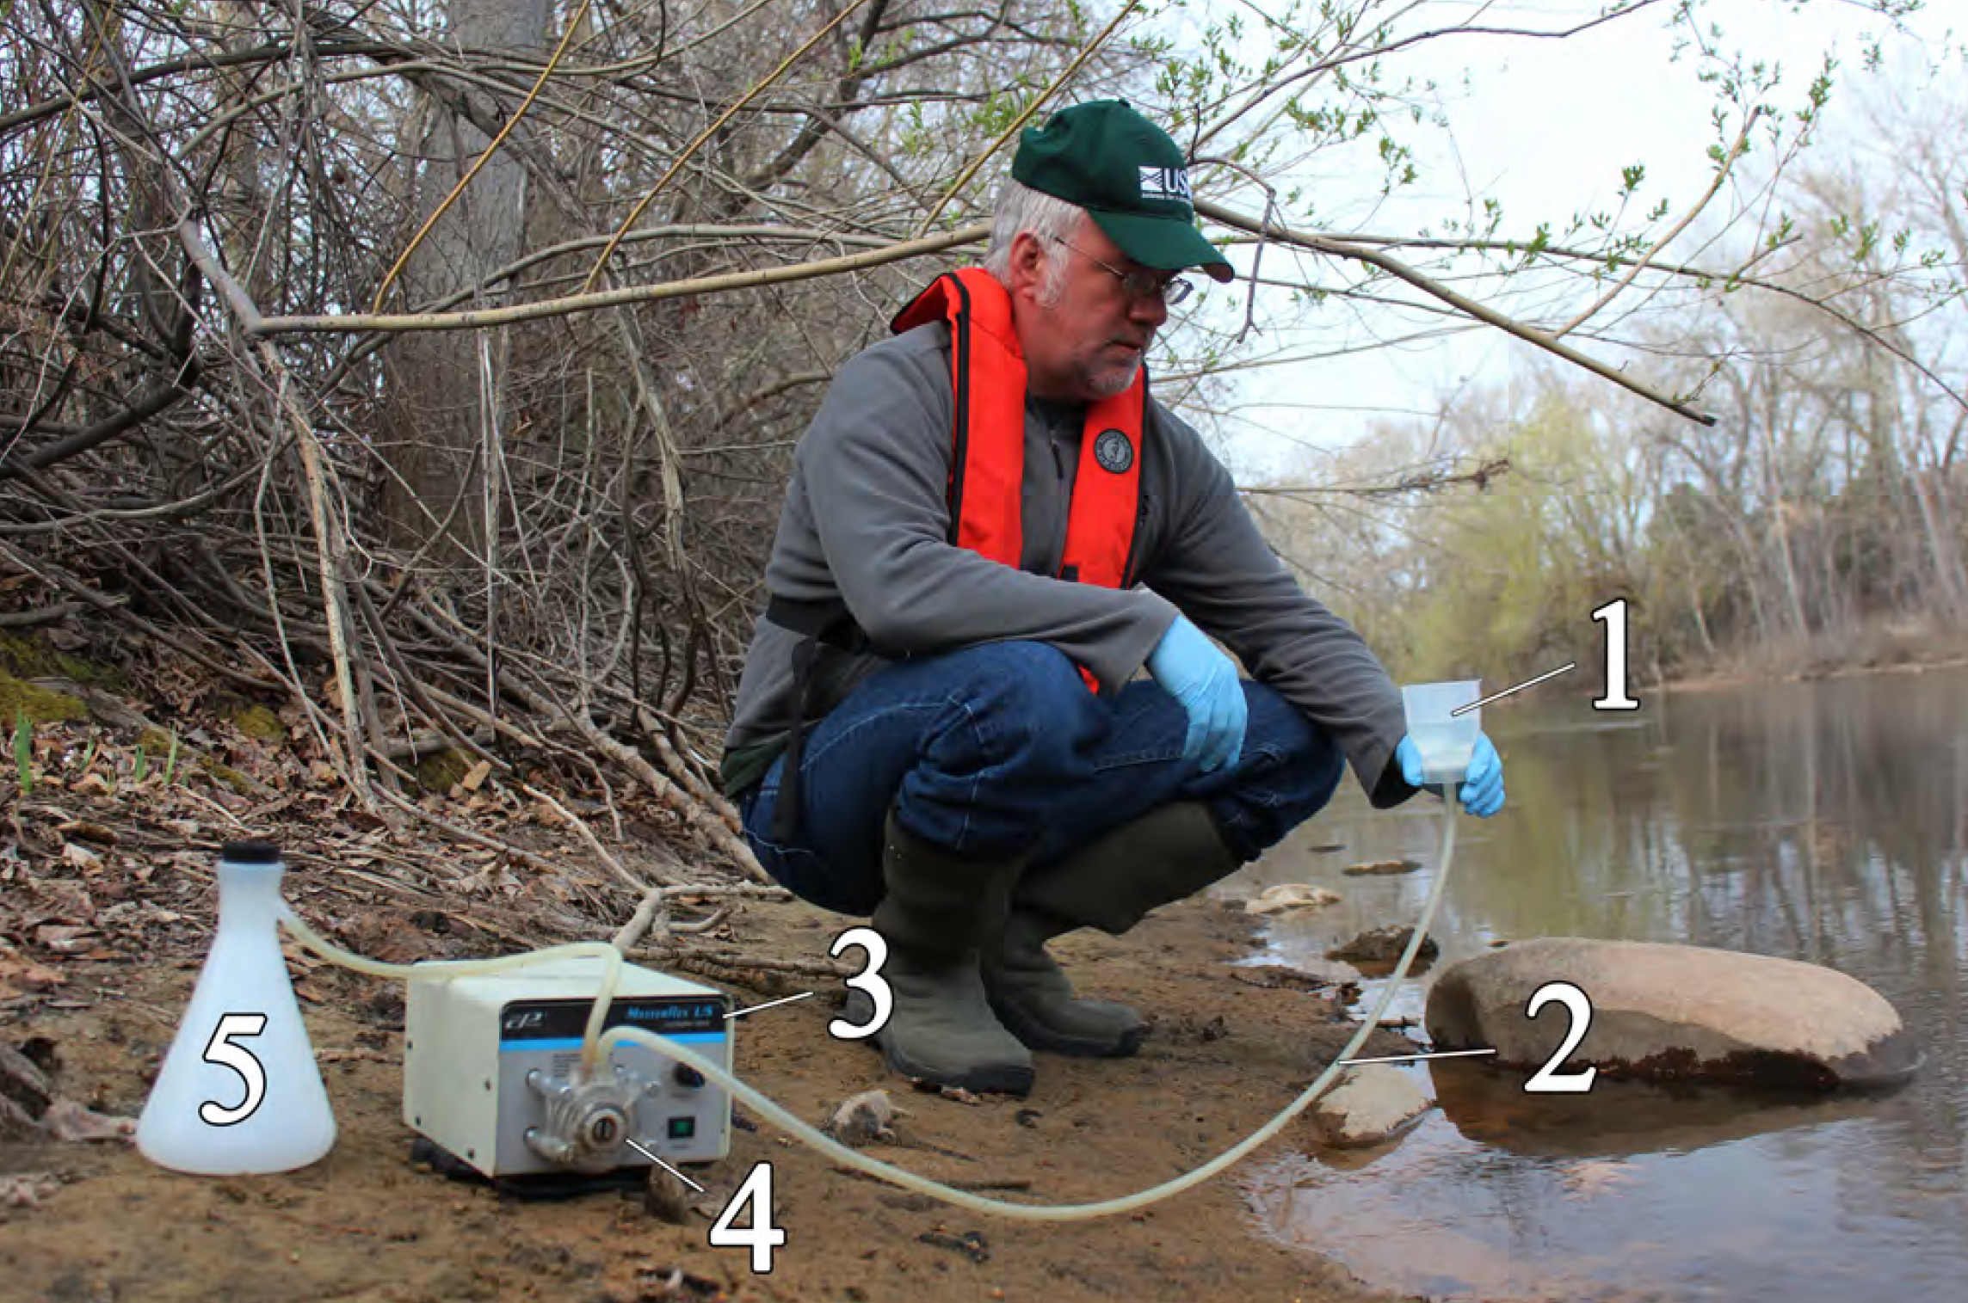
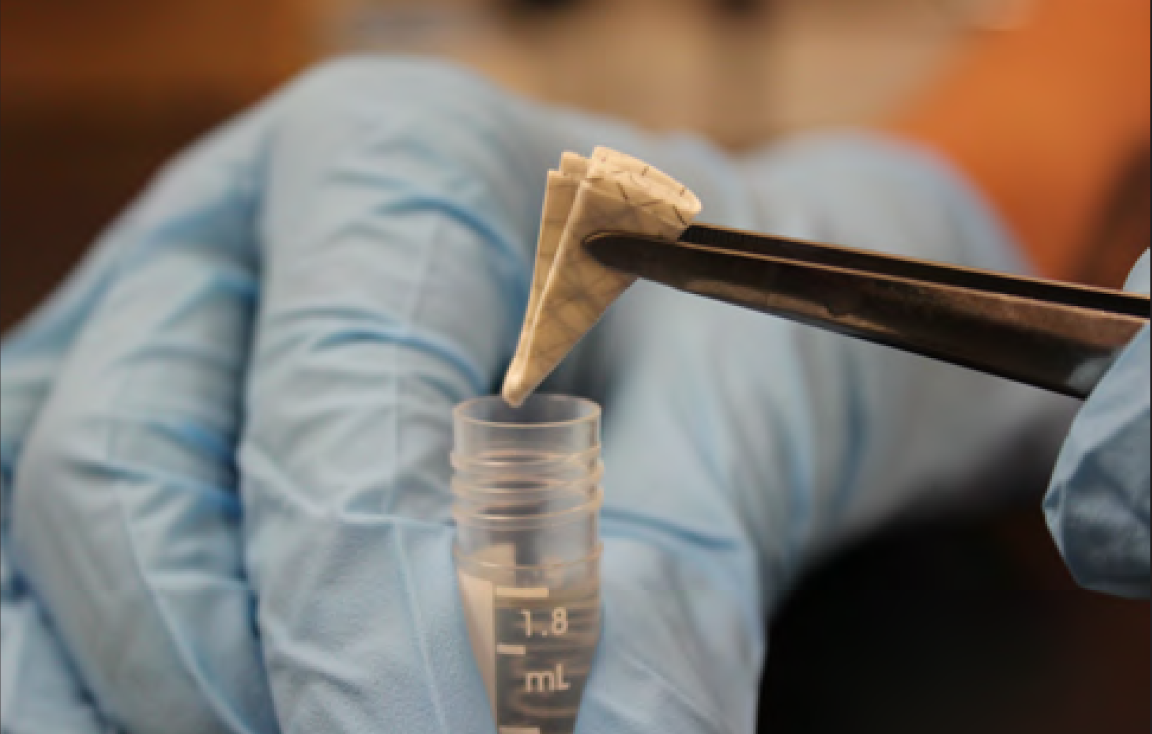
During the first half of the semester, the WQMDP team...
Performed a literature review on
  filtration procedures
  chemical DNA preservation
  international sample shipment
Began testing filter membranes with tap water as a basis for comparison
WQMDP | Research | Final Presentation Fall 2017
Notes:
Presenter: Ji Young
Citations:
Laramie, M. B., Pilliod, D. S., Goldberg, C. S., & Strickler, K. M. (2015). Environmental DNA sampling protocol— Filtering water to capture DNA from aquatic organisms. In U.S. Geological Survey Techniques and Methods (Vol. 2). Reston, VA: US Geological Survey.
De Ley, P., Poiras, L., Mundo-Ocampo, M., Yoder, M., Mann, J., De Ley, I. T., … Wm King, I. (2006). DESS: a versatile solution for preserving morphology and extractable DNA of nematodes. Nematology, 8(3), 367–376. https://doi.org/10.1163/156854106778493448
Nechvatal, J. M., Ram, J. L., Basson, M. D., Namprachan, P., Niec, S. R., Badsha, K. Z., … Kato, I. (2008). Fecal collection, ambient preservation, and DNA extraction for PCR amplification of bacterial and human markers from human feces. Journal of Microbiological Methods, 72(2), 124–132. https://doi.org/10.1016/j.mimet.2007.11.007
Gray, M. A., Pratte, Z. A., & Kellogg, C. A. (2013). Comparison of DNA preservation methods for environmental bacterial community samples. FEMS Microbiology Ecology, 83(2), 468–477. https://doi.org/10.1111/1574-6941.12008
Captions:
Inserting a used membrane filter into a preservation solution: Image is Figure 1.8 from Laramie et al., 2015
The USGS procedure for eDNA collection calls for an open-topped, not in-line, filter. Additionally, the filtrate “waste” goes into a catch flask for easy measuring. Image is figure 3-1 from Laramie et al., 2015
Summary:
The WQMDP performed an extensive literature review and began filter membrane testing in the first part of the semester. The literature review revealed that many field biologists do use membrane filters to collect environmental DNA (eDNA). Upon collection, the sample can be preserved by keeping it cold or by using storage solutions, such as DESS, that slow the degradation of the DNA molecules. For international shipment, the WQMDP team found that preserved pathogen samples will probably need to be triple-packed according to UN standards for non-lethal biological substances. Our early-semester filter testing consisted of running tap water through filter membranes to create a basis for comparison for later tests. 0.1 micrometer pore-size filters were found to clog quite quickly even with extremely low turbidity tap water, which was concerning.

Slide 4
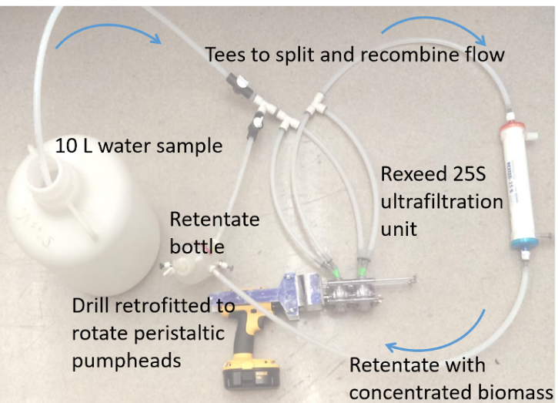
Richardson Lab has developed
an ultrafiltration process to isolate pathogens
WQMDP | Research | Final Presentation Fall 2017
Notes:
Presenter: Steven
Citations:
Brooks, Y. M., de la Torre, O., Goodman, L. B., & Richardson, R. E. (2017, June 19). Evaluating the efficiency of an ultrafiltration methodology to determine the presence of waterborne pathogens in environmental water.
Francy, D. S., Stelzer, E. A., Brady, A. M. G., Huitger, C., Bushon, R. N., Ip, H. S., … Lindquist, H. D. A. (2013). Comparison of Filters for Concentrating Microbial Indicators and Pathogens in Lake Water Samples. Applied and Environmental Microbiology, 79(4), 1342–1352. https://doi.org/10.1128/AEM.03117-12
Sausele, D., & Richardson, R. E. (2017, November 14). Ultrafiltration Process Walk-Through and OpenArray Analysis Discussion.
Caption:
This figure shows the Richardson Lab’s ultra-filtration procedure with recirculation (Brooks et al., 2017). One important aspect of the apparatus that is not clear from the figure is that the waste water tube leaves the filter out of the right-hand side of the image. In this setup the 10 L creek sample is pushed through the system by the retrofitted peristaltic pump, it then goes through the rexeed unit passes the retentate bottle and once again flows through the system. This continues to flow through the system and the biomass builds up in the retentate bottle. This biomass is then passed through a system with multiple in line .45 micron filters and this is analyzed by either qPCR or open array.
Summary:
Professor Richardson's lab, while pioneering the OpenArray qPCR tests for specific pathogen species in water, also tested protocols for isolating pathogenic eDNA from large volume water samples. Their work, based on the work of Francy et al., uses ultra-filters designed for medical dialysis procedures to decrease sample volumes from 10 L to volumes small enough for centrifugation (Brooks et al., 2017). Two filtration protocol options for ultra-filtration systems are detailed by Francy et al (Francy et al., 2013). The Richardson Lab uses the recycling, tangential flow method, which pumps water through the ultra-filtration cartridge, where pure water flows out at one outlet and more concentrated sample flows out at the other outlet into a retentate bottle. As the retentate bottle fills with a concentrated sample, some of the retentate can be recycled back into the ultra-filter cartridge for another round of concentration. Once the sample carboy is empty and the retentate bottle is as concentrated as possible, the retentate is taken out of the ultra-filtration apparatus and filtered through very small pore-size membrane filters. The material captured on the membrane filters is then re-suspended into small volumes of the solution so that it can be centrifuged into a pellet. The pellet is then resuspended in another solution, and the OpenArray qPCR tests are performed (Sausele and Richardson, 2017).

Slide 5
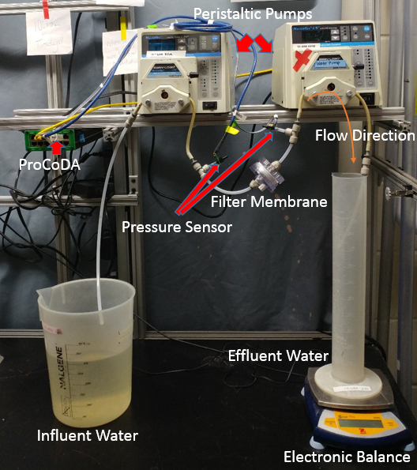
The team attempted to mimic a real 10 L field filtration procedure
10 L of sample water
12.12 NTU sample water
1 filter housing, many membrane changeovers
  thus the “multi-membrane test”
Tracking mass of filtered water and pressure difference across membrane
WQMDP | Research | Final Presentation Fall 2017
Notes:
Presenter: Steven
Citations:
None
Caption:
Apparatus for the multi-membrane test: note the single filter housing and the electronic balance for tracking the quantity of water filtered. While two peristaltic pumps are pictured, only the right one is used during the filtration run. The left one is used to prime the filter housing, that is, remove the air bubbles, after each filter membrane changeover. Pressure sensors upstream and downstream of the filter housing combined with the electronic balance are the three ProCoDa connected sensors.
Summary:
Only one multi-membrane volume throughput test was performed by the WQMDP team. However, since so many filter membranes were used to perform the test, the results can be viewed as predictive of future behavior. The test was performed using a 10 L sample of 12.12 NTU water from Fall Creek in Ithaca, NY. First, raw sample water was pumped through 5 micrometer pore-size filters and collected in a clean container. Then, the water collected in this way was passed through 0.1 micrometer pore-size filters.

Slide 6
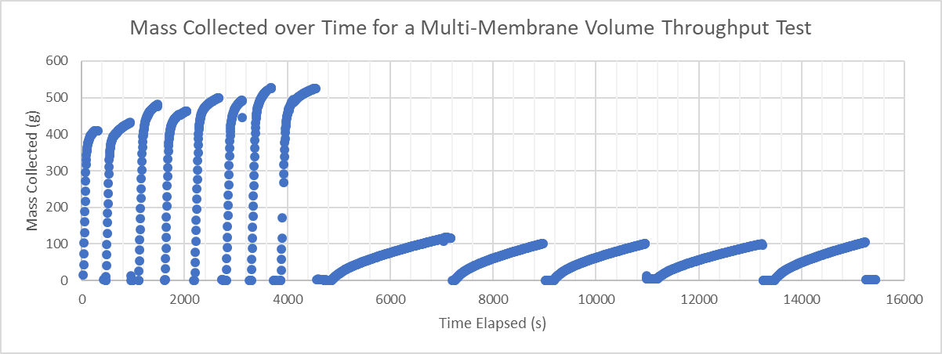
After more than 4 hrs of filtration, only 520 mL had been fully processed
WQMDP | Research | Final Presentation Fall 2017
Notes:
Presenter: Fletcher
Citations:
None
Caption:
The filtrate mass of water collected from each filter membrane in the multi-membrane test. When each filter membrane was changed out for the next membrane, the graduated cylinder containing the filtrate was emptied into a storage container so that mass for the new filter would begin again at zero. See the Appendix Slides for a summary table showing the numerical results of this test.
Summary:
This graph shows the cumulative water collected for each filter, reset to zero when the filter is changed over. The curve shapes for 5 micrometer pore-size filters and 0.1 micrometer pore-size filters are markedly different, with 5 micrometer-pore size filters rapidly reaching 400 mL cumulative filtered water, and 0.1 micrometer pore-size filters slowly approaching 100 mL cumulative filtered water. The difference between a “fresh” 0.1 micrometer pore-size filter and a “clogged” 0.1 micrometer pore-size filter is not very important since neither one allows water to pass quickly anyway. On the other hand, a “fresh” 5 micrometer pore-size filter is much more useful than a “clogged” 5 micrometer pore-size filter because the rate at which water passes through the two is very different.

Slide 7
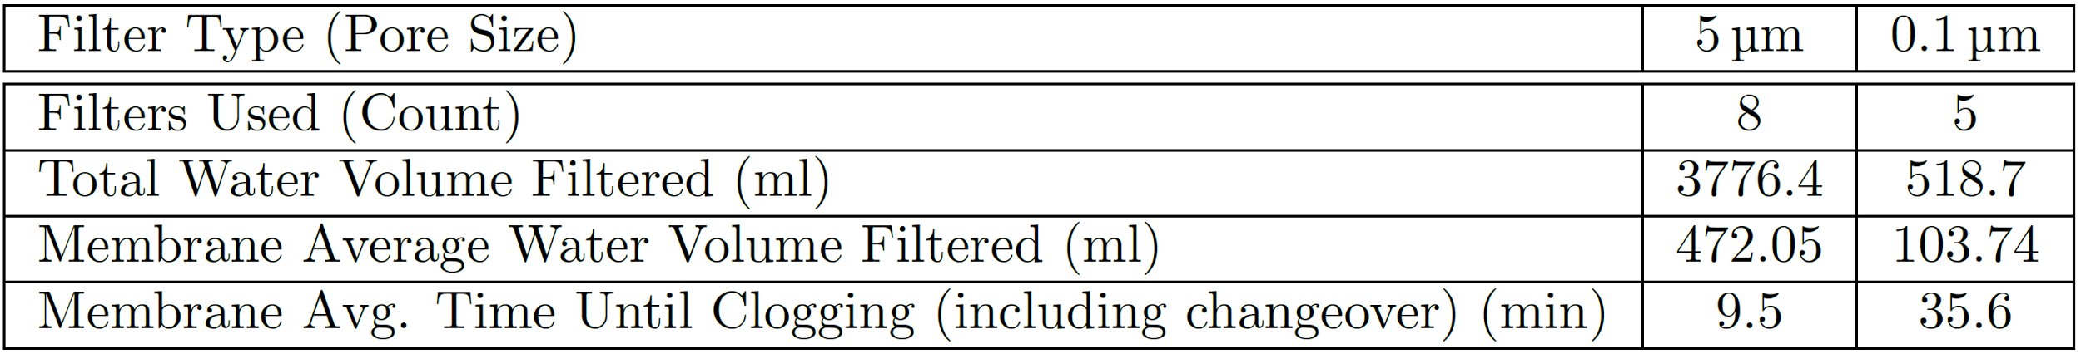
Membrane filtering even small quantities of moderate turbidity water takes a long time
WQMDP | Research | Final Presentation Fall 2017
Notes:
Presenter: Fletcher
Citations:
None
Caption:
A summary table of the multi-membrane test run by the WQMDP team. Note the extremely long run times for the 0.1 micrometer pore size filters and the low volumes collected through that effort.
Summary:
Only one multi-membrane volume throughput test was performed by the WQMDP team. However, since so many filter membranes were used to perform the test, the results can be viewed as predictive of future behavior. The test was performed using a 10 L sample of 12.12 NTU water from Fall Creek in Ithaca, NY. Highlights include that 3.8 L of water were passed through 5 micrometer pore size filters, but only 520 mL of water were passed through 0.1 micrometer pore-size filters. On average, only 100 mL of water passed through 0.1 micrometer pore-size filters before they clogged, whereas 5 micrometer pore-size filters allowed almost 500 mL of water to pass through before clogging.

Slide 8
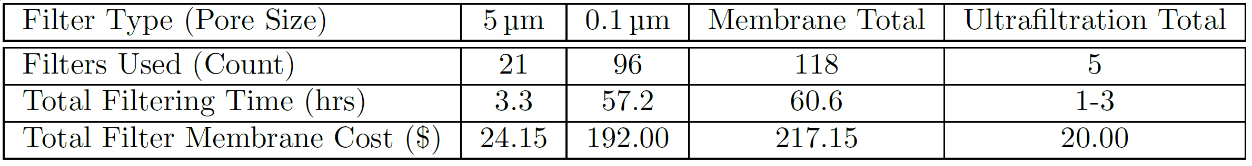
The team projected characteristics of a full 10 L filtration from the available data
WQMDP | Research | Final Presentation Fall 2017
Notes:
Presenter: Fletcher
Citations:
Monroe Weber-Shirk, & Ruth Richardson. (2017, September 5). WQMDP Project Scoping Meeting.
Orvill de la Torre. (2017, September 14). Richardson Lab Tour.
Caption:
Predicted characteristics of the membrane filtration procedure for 10L of 12.12 NTU sample water
Summary:
Assuming that each filter's behavior is independent of the behavior of other filters, the number of filters of each type required to filter 10 L of 12.12 NTU water was estimated by simply dividing 10 L by the average volume of water processed by each type of filter. This yielded a projection of required filter count for each type of filter membrane. Multiplying these filter counts by the average time required to filter for each filter membrane and summing together the result for both filter types yielded a projected process time (See previous slide for table of average filter times). The Ultrafiltration Total column contains estimates of performance for the Richardson Lab's ultrafiltration system (Monroe Weber-Shirk and Ruth Richardson, 2017). Note how there is more than an order of magnitude difference in the times required for filtration, two orders of magnitude higher filter count, and almost an order of magnitude higher materials cost.

Slide 9

“Do you know what this means? It means that this thing doesn’t work at all!
WQMDP | Research | Final Presentation Fall 2017
Notes:
Presenter: Fletcher
Citations:
Zemeckis, R. (1985). Back to the Future. Universal Studios.
Caption:
Doctor Emmett Brown reflects on the effectiveness of his mind reading device in Back to the Future.
Summary:
Hopefully, the slide says it all. Otherwise, the WQMDP team suggests that you take the time to watch Back to the Future and learn what we’re talking about.

Slide 10
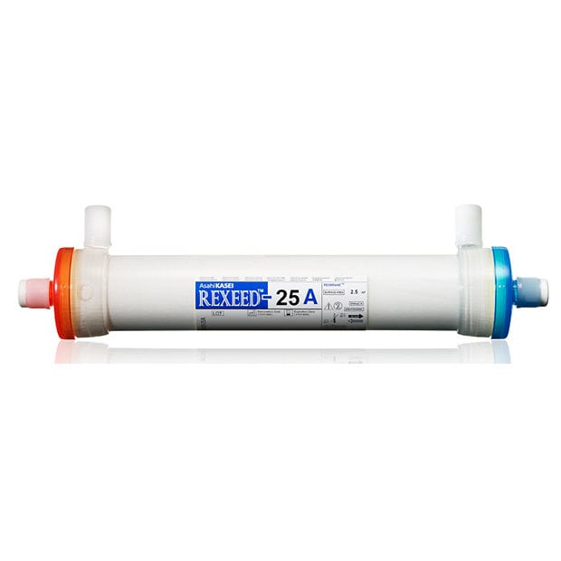
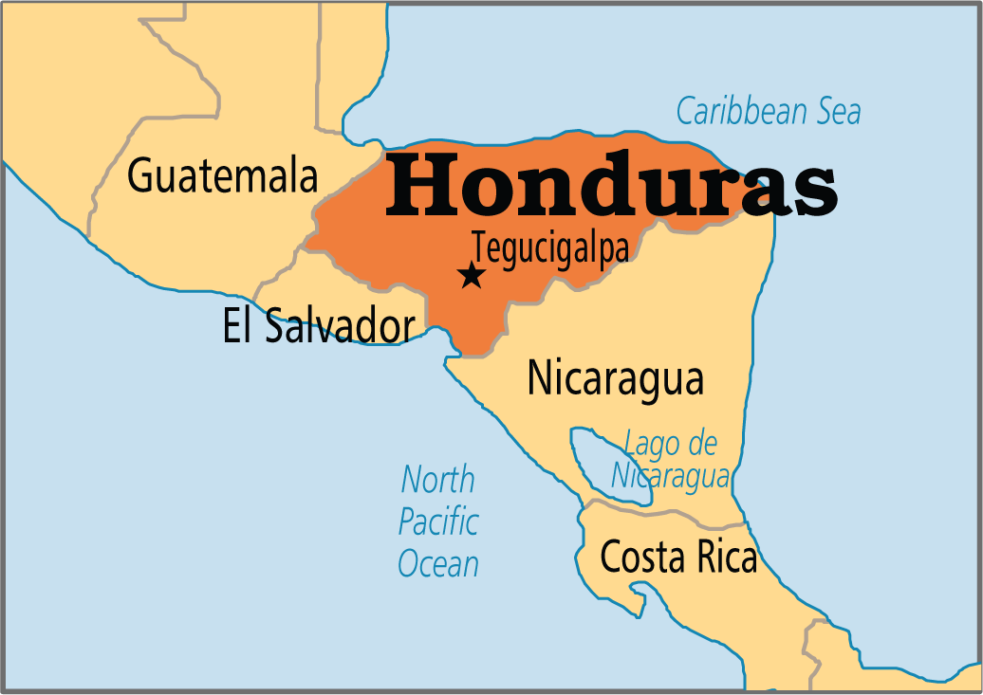

Conclusion is...
WQMDP | Research | Final Presentation Fall 2017
Notes:
Presenter: Ji Young
Citations:
Rexeed dialyzer : http://img.medicalexpo.com/images_me/photo-g/107021-9419571.jpg
Honduras Map: https://mises.ca/wp-content/uploads/2015/03/Honduras.png?67f6f1
Zamorano University: https://www.botany.org/Profiles/Alex_Wiedenhoeft/images/Alex_Wiedenhoeft-8.jpg
Captions:
The conclusion is that the flat membrane-filtration-only method is too slow to be useful in Honduras. The team going to trip to Honduras in January will try to use both flat membrane filtration and ultra-filtration, but for future semester, it is more likely to switch to ultra-filtration. Richardson Lab’s ultrafiltration method looks promising and cost-effective. Also, Professor Richardson is planning to collaborate with Professor Erika Alejandra Tenorio Moncada in Zamorano University. The collaboration will make processing and shipping samples easier, making the additional simplicity of a flat membrane-only filtration method less important.
Summary:
See caption

Slide 11
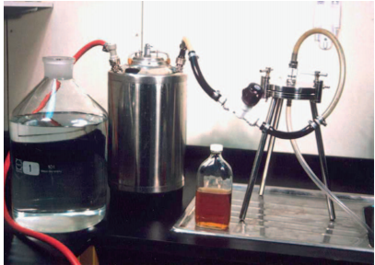
Future Task Option I
Flat membrane filtration with
1) membrane with larger diameter
2) pH adjustment on sample
WQMDP | Research | Final Presentation Fall 2017
Notes:
Presenter: Ji Young
Citations:
Wyn-Jones, P. (2007). Chapter 9 The Detection of Waterborne Viruses. In A. Bosch (Ed.), Perspectives in Medical Virology (Vol. 17, pp. 177–204). Elsevier. Retrieved from http://www.sciencedirect.com/science/article/pii/S0168706907170099
Captions:
From Wyn-Jones, 2007
“positive pressure or vacuum through a cellulose nitrate membrane 142 or 293 mm in diameter and of mean pore diameter 0.45, 1.2 or 5 mm (Fig. 1).”
pH setup: “Since viruses and the filter materials are both negatively charged at neutral pH the water sample must be conditioned to allow electrostatic binding of virus particles to filter matrix. The water sample is adjusted to pH 3.5…”
According to a medical virology textbook (Wyn-Jones, P. (2007)), maybe we chose a right method but just we were doing in a wrong way. Future team may tackle this.
improve design by replacing the filter housing with larger diameter (142 or 293 mm). This setup will enable positive pressure (pushing the water through the membrane) as well.
adjust the pH of sample water to allow electrostatic binding of virus/pathogen particles to filter matrix
However, the bigger filter housing and compatible flat membranes shown in the slide is more expensive and do not adjust the risk of cross contamination during replacement of the membrane.
Summary:
See caption

Slide 12

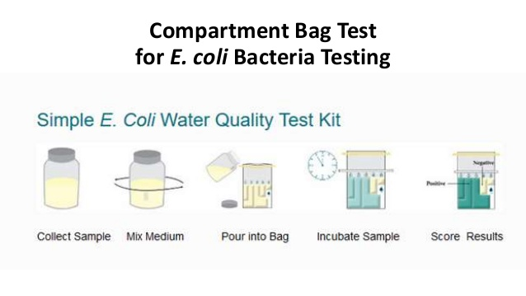
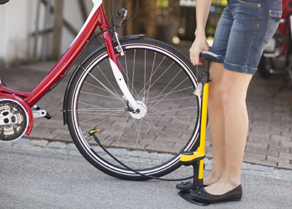
Other Future Task Options
WQMDP | Research | Final Presentation Fall 2017
Notes:
Presenter: Ji Young
Citations:
Rexeed dialyzer : http://img.medicalexpo.com/images_me/photo-g/107021-9419571.jpg
Compartment bag tes t:
https://image.slidesharecdn.com/bd9f53f6-2f18-469c-8b86-6e9e24e62113-160809210046/95/bacteriological-analysis-of-water-chlorination-of-boreholeswells-79-638.jpg?cb=1470776758
Bike pump : https://cdn-www.trails.com/ImageCache/articles/26/2679/bike_pump_GettyImages-113874788.jpg
Captions:
Since this semester's WQMDP team concluded that pathogen collection using membrane filtration is less feasible than ultra-filtration collection methods, the team will explore other options for water quality monitoring for diarrheal pathogens next semester. One idea is to improve current technologies: compartment bag test and ultra-filtration. In the literature review section, compartment bag test was mentioned. It would be valuable to have a kit and training manual prepared in advance for future sampling campaigns that will happen in prospective AguaClara plant sites in Honduras and other countries. For ultra-filtration, Professor Richardson has highlighted the need for more concise and intuitive, written manual which the WQMDP team could help to write. These step-by-step instructions and tutorial videos would help future teams. Also, the Richardson's lab expressed that the results from tangential methods have not been satisfactory, and now shifting to dead-end methods for ultra-filtration. Next semester's WQMDP team may work on developing procedure for dead-end ultra-filtration.
Whether the same flat membrane technology is continued to be explored in the team, or the technology is switched out to ultra-filtration, another option for future work is testing different methods of pumping. In the beginning of this semester, hand-drill-driven pump and reversed-bike pump were on the list of possible substitute for peristaltic pump for sampling done in the field.
Summary:
See caption

Slide 13
Questions
and
Recommendations
Ji Young Kim
Environmental Engineering
jk783@cornell.edu
Steven Lopez
Chemical Engineering
sl2297@cornell.edu
Fletcher Passow
Civil Engineering
fhp7@cornell.edu
WQMDP | Research | Final Presentation Fall 2017
Notes:
Presenter: Ji Young

Slide 14
Appendix
Slides
WQMDP | Research | Final Presentation Fall 2017

Slide 15
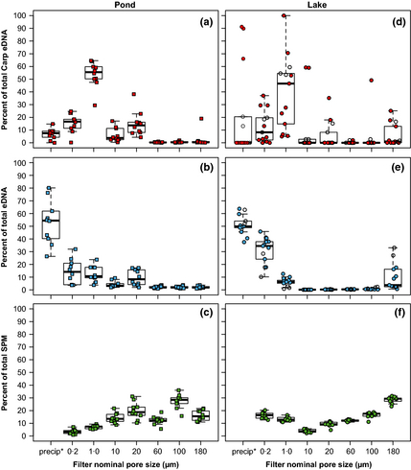
Filtering out eDNA requires filters with tiny pores, and even they don’t catch most of the eDNA
Most eDNA is found on particles smaller than 1 micrometer
Such tiny pore-size filters clog very quickly even with very pure feed water
Much of the total eDNA passes through even the 0.2 micrometer filter and needs to be recovered chemically
WQMDP | Research | Final Presentation Fall 2017
Notes:
Citations:
Monroe Weber-Shirk, & Ruth Richardson. (2017, September 5). WQMDP Project Scoping Meeting.
Laramie, M. B., Pilliod, D. S., Goldberg, C. S., & Strickler, K. M. (2015). Environmental DNA sampling protocol— Filtering water to capture DNA from aquatic organisms. In U.S. Geological Survey Techniques and Methods (Vol. 2). Reston, VA: US Geological Survey.
Turner, C. R., Barnes, M. A., Xu, C. C. Y., Jones, S. E., Jerde, C. L., & Lodge, D. M. (2014). Particle size distribution and optimal capture of aqueous macrobial eDNA. Methods in Ecology and Evolution, 5(7), 676–684. https://doi.org/10.1111/2041-210X.12206
Caption:
From the Turner et al. article: Per cent of total Carp eDNA, total eDNA and SPM in each particle size fraction per water sample from the pond (a, b, c, respectively) and lake (d, e, f, respectively). *The final fractionation step was DNA precipitation using the 0·2‐μm filtrate, but fractionation for SPM measurement did not include this step (see ). Filled symbols are winter; open symbols are spring (only the lake was sampled in spring; SPM was not measured in spring). Data points are horizontally ‘jittered’ within each size fraction to reduce visual overlap. Boxplots include the spring data from the lake in (d) and (e).
© IF THIS IMAGE HAS BEEN PROVIDED BY OR IS OWNED BY A THIRD PARTY, AS INDICATED IN THE CAPTION LINE, THEN FURTHER PERMISSION MAY BE NEEDED BEFORE ANY FURTHER USE. PLEASE CONTACT WILEY'S PERMISSIONS DEPARTMENT ON PERMISSIONS@WILEY.COM OR USE THE RIGHTSLINK SERVICE BY CLICKING ON THE 'REQUEST PERMISSION' LINK ACCOMPANYING THIS ARTICLE. WILEY OR AUTHOR OWNED IMAGES MAY BE USED FOR NON-COMMERCIAL PURPOSES, SUBJECT TO PROPER CITATION OF THE ARTICLE, AUTHOR, AND PUBLISHER.
Summary:
The information gathered to answer the first focusing question in the literature review prompted several important sub-questions. In particular, what is the ideal filter pore size for the collection of eDNA particles? Professor Richardson recommended the use of two filters in series, the first having pores of 3 micrometers and the second having pores of 0.1 micrometers (Weber-Shirk 2017). The USGS eDNA collection protocol, on the other hand, recommends a single filter of 0.45 micrometers to 3 micrometers, depending on the volume of water desired to be pumped before clogging (Laramie et al. 2015). Turner et al. investigated the size distribution total suspended particle matter (SPM) and total DNA containing particles (total eDNA) by using a series of filters of decreasing pore size. Their filter series had filters with 180, 100, 60, 20, 10, 1.0, and 0.2 micrometer pore sizes. They found that "Total eDNA was most abundant below 0.2 micrometers, and SPM was most abundant above 100 micrometers". They also found that "SPM consisted of =0.1% total eDNA", and that filter clogging at the 0.2 micrometer pore size allowed for < 250 milliliters of 1.0 micrometer filtrate to pass through (Turner et al. 2014). These results suggest to this research team that, just as Professor Richardson originally suggested, the primary problem with isolating eDNA from aquatic samples will be clogging of the necessarily small-pore-sized filters. The results also suggest that chemically precipitation of DNA, similar to Turner et al's procedure, might be a good way to recover the large portions of DNA that will pass through even the 0.2 micrometer filter.

Slide 16
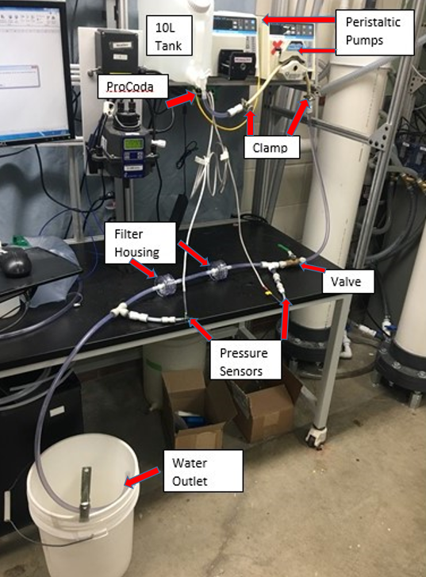
First experimental setup using in-line series filters
10 L of sample water(cascadilla creek water)
1.35 NTU
2 filter housing, valve inserted to minimize water loss during filter changeovers
WQMDP | Research | Final Presentation Fall 2017
Notes:
Citations:
None
Caption:
Initial apparatus for the multi-membrane tests. This apparatus contained a valve to stop the water flow two filter housings holding the 5 and .1 micron membranes, two pressure sensors, the clamps and the peristaltic pumps. The left peristaltic pump was used to prime the system by getting all the air out and the right pump ran the system. The pressure sensors were connected to the computer via ProCoDA and were used to log how pressure varied with time in each trial.
Summary:
This was the original apparatus we attempted to use to simplify the ultrafiltration method. Ideally we were aiming to simplify the process of concentrating the biomass and then running it through a series of in line filters by just going straight to the in line filters with varying membrane sizes. We attempted this by running the 10L straight through first a membrane of 5 microns and then .1 microns. However the 5 micron filter slowed the flow and the .1 micron brought it to almost a dead halt.

Slide 17
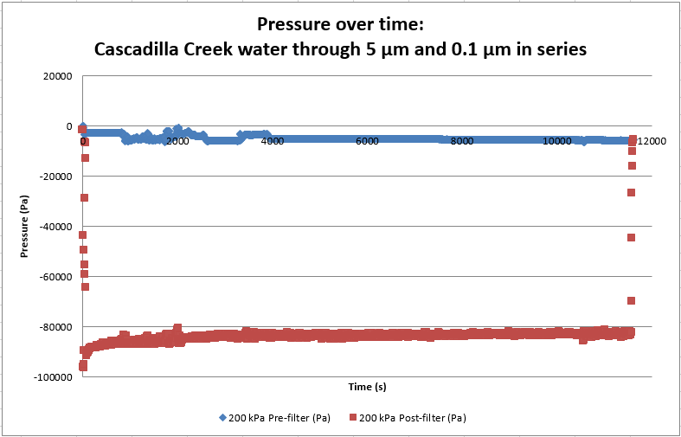
Almost immediate drop to near vacuum pressure
WQMDP | Research | Final Presentation Fall 2017
Notes:
Citations:
None
Captions:
When the creek water was filtered through 5 micron and the .1 micron membrane in series at pump speed of 300 rpm, the pressure fluctuates at -84 kPa. Over total run time of 11600 seconds, or 193 minutes,340 milliliters of effluent water were collected
Summary:
When attempting to run through this system with the 5 micron and .1 micron filters in line it was found that there is an almost immediate drop to vacuum like pressures. This meant that we were getting virtually no flow out of the system and were unable to concentrate a sample that could be analyzed. Due to this it was apparent that this setup was not very practical nor feasible and it required changes that fletcher will now discuss in the modified apparatus. Ran for 3.2 hours with 340 mL of fluid.

