Slide 1
Marijuana Toxicosis in a 4 Year Old FS Shih Tzu
April 12, 2017
Lorenso Escobar

Slide 2

Overview
History
Physical examination findings
  DDx
Toxicokinetics
Therapeutic Plan
  Monitoring parameters
Prognosis
Conclusion
http://pbs.twimg.com/media/CIHXpl3UkAABqL2.jpg:large

Slide 3
Case History
4 YO FS Shih Tzu
Presented to CUHA’s Emergency Service on 11/20/2016 for acute onset trembling and abnormal behavior
Patient was completely normal when observed a few hours prior
Up to date on vaccines and preventatives and not on medications
No other pertinent medical history

Slide 4
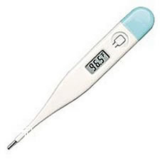
Physical Examination
QAR
Mild hypothermia (98.6 F)
Hyperesthesia, miotic pupils OU, photophobia
Remainder of neurologic exam and physical unremarkable
Notes:
Say where she neurolocalizes to

Slide 5
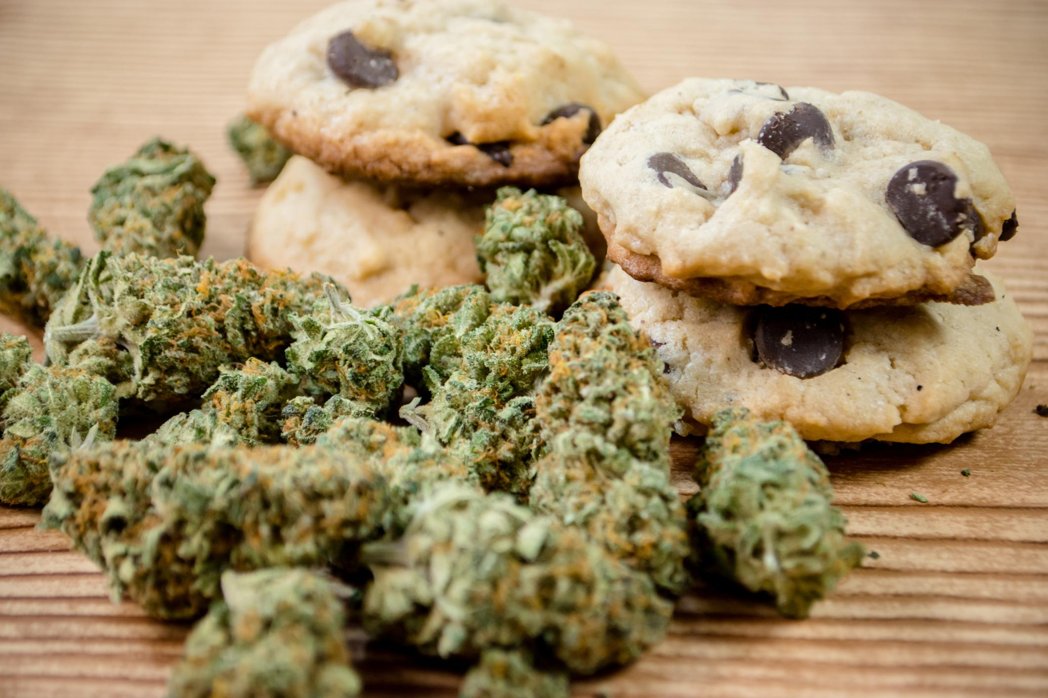
Further Investigation
https://www.justthinktwice.gov/sites/justthinktwice.com/files/field/image/marijuanaandcookies.jpg

Slide 6
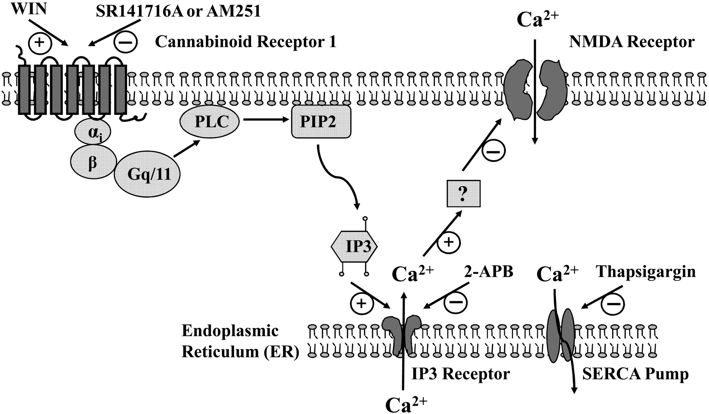
Proposed Mechanisms of Action
http://jpet.aspetjournals.org/content/jpet/331/3/1062/F9.large.jpg
Notes:
Ultimately the mechanism isn’t well fleshed out.

Slide 7
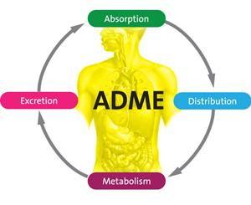
Pharmacokinetics
Rapidly absorbed orally (clinical signs within 30-90 minutes)
Highly lipid soluble, rapidly distributes to fat in CNS
Metabolized by the liver
Excreted primarily through the biliary system (approximately 15% has urinary excretion)
Undergoes enterohepatic recirculation
http://www.adme-pharmacodynamics.com/wp-content/uploads/2015/03/ADME.jpg

Slide 8
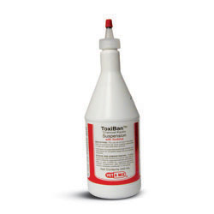
Absorption/Excretion
Absorption rapid, emetics warranted only if caught very early (<2 hours)
Instead activated charcoal is used to prevent remainder of THC absorption
Activated charcoal also prevents resorption of recirculating metabolites
Monitoring electrolytes warranted particularly in small dogs or cats
http://cdn.shopmedvet.com/images/large/RxToxiban-S.jpg
Notes:
Emetics also contraindicated if showing any significant neurologic abnormalities due to increased risk of aspiration.
Temptation to provide high volume intravenous fluid, but remember only 15% of THC excreted through the kidneys. Minimal benefit.

Slide 9
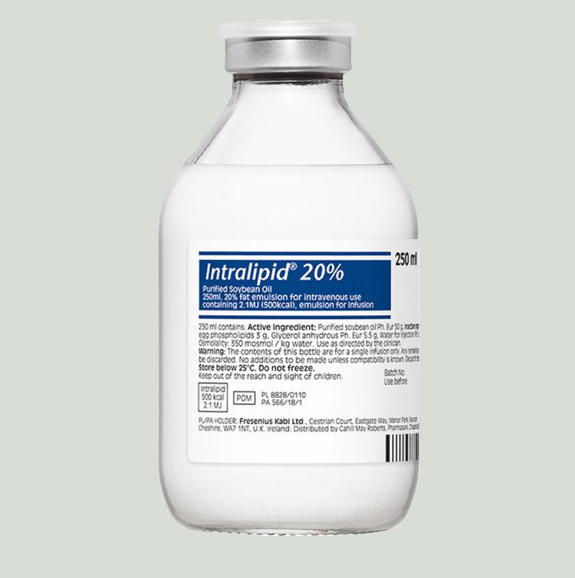
Distribution
Remember that THC is highly lipid soluble?
IV Lipid emulsion therapy 1.5mL/kg bolus then 0.25mL/kg/min for 30-60mins
Can repeat every 4-6hrs
Stop giving if the patient becomes lipemic
http://www.thepoisonreview.com/wp-content/uploads/intralipid_20ml_big.jpg

Slide 10

Prognosis
In short, excellent
Time to recovery appears to be dose dependent (up to 5 days)
2 reported deaths in dogs
  Secondary to aspiration pneumonia
  No lesions on necropsy
cf.chucklesnetwork.com/items/1/1/3/8/8/0/original/two-thumbs-up-where-did-my-thumbs-go.jpg
Notes:
Normally see rapid improvement in 12-24hrs

Slide 11
Clinical Signs
Depression
Ataxia
Bradycardia
Hyperesthesia
Hypothermia
Hypersalivation
Vomiting
Diarrhea
Urinary Incontinence
Seizures
Coma
Depression
Ataxia
Hyperesthesia
Hypothermia
Urinary Incontinence
Notes:
At some time during her stay, the patient had these signs.

Slide 12
Marijuana Differentials
Intracranial disease
Systemic disease
Toxins:
Opiods
LSD
PCP
Ethanol
Benzodiazapines
Ethylene glycol
Propylene glycol
Ivermectin
Methanol
Depressants
Muscle Relaxants
Hallucinogenic Mushrooms
Amphetamines
Notes:
Highlight importance of good history taking. Anything causing diffuse forebrain disease could cause similar signs (infectious/inflammatory(GME etc) or neoplasia most common). And systemic disease resulting in electrolyte or BG derangements

Slide 13

Lab Work
Quick assessment tests
Unremarkable
Venous blood gas
  pH: 7.249 (RR: 7.32-7.38)
  pCO2: 58.1 mmHg (RR: 38-46)
  Na: 152.1 mmol/L (RR: 145-151)
  K: 5.29 mmol/L (RR: 3.9-5.1)
  HCT: 60% (RR: 42-57)
yooniqimages.blob.core.windows.net/yooniqimages-data-storage-resizedimagefilerepository/
Notes:
I would put the patient’s base excess in even though it was normal – you cant interperate a gaslyte without it.
Make sure you explain why we think these changes existed

Slide 14
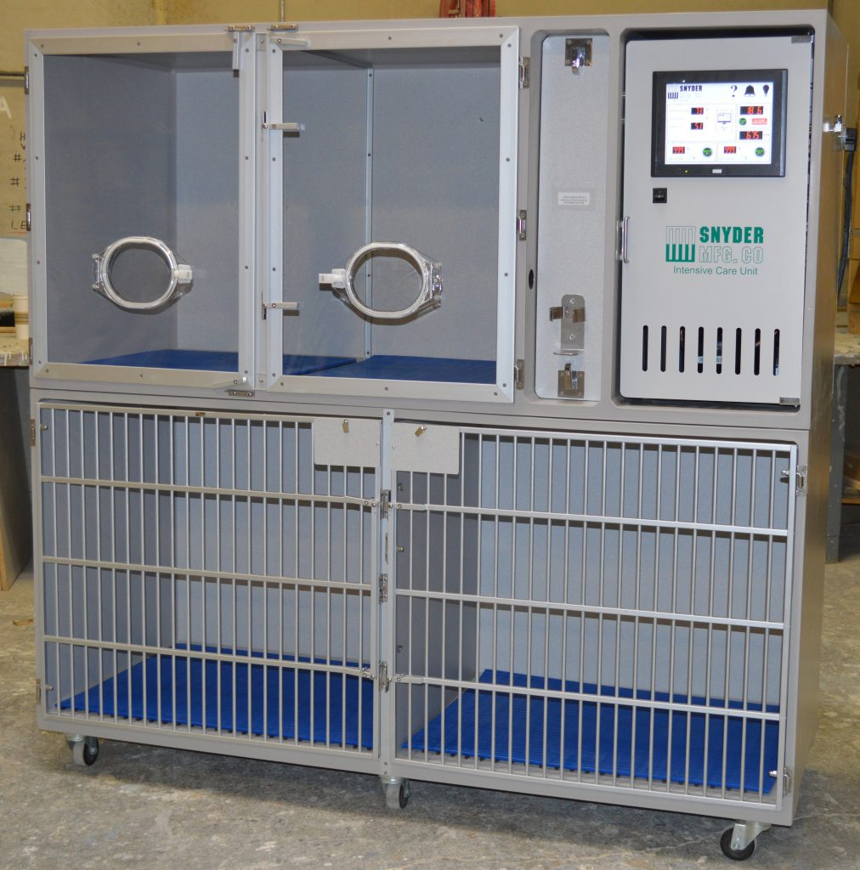
Following Morning 11/21
Physical Examination
No longer hyperesthetic
Ataxic
Urinary incontinent
Dull mentation
Venous blood gas
Worsened hypercapnea and hypernatremia
Took arterial sample, moderate hypoxemia
Stopped charcoal and placed in O2 cage
http://www.snydermfg.com/wp-content/uploads/2016/11/DSC_0067_cropped-1012x1024.jpg

Slide 15
Thoracic radiographs
You can put her images here, say they were normal and so hypoxemia suspected secondary to hypoventilation/respiratory depression, recumbancy

Slide 16

Continued
Venous blood gas - Noon
Worsening Hypercapnea (62.1 mmHg)
Worsening Hypernatremia (158 mmHg)
Marked lipemia
No further IV lipid therapy
Notes:
She had not had lipids since admission so they had already been discontinued, but because of lipemia we didn’t repeat
Discuss why we decided not to act (pCO2 > 60 is indication for mechanical ventilation BUT ventilation has a large number of potential complications and we expected her to improve rapidly if her only problem was toxicity)

Slide 17

Morning of 11/22
Physical Examination
Brighter
Still moderately ataxic
Venous blood gas
Stable PCO2
Decreased Na
https://markingourterritory.files.wordpress.com/2013/11/img_0022.jpg

Slide 18

11/22 Continued
Afternoon Evaluation
Much improved clinically
Brighter
Minimal ataxia
Venous blood gas
Within normal limits
http://school4success.com/wp-content/uploads/2016/01/awesome-full-hd-dog-wallpaper-belive.jpg

Slide 19

Patient Goes Home Happy and Hungry
https://i.ytimg.com/vi/qIAsuByipeQ/maxresdefault.jpg

Slide 20
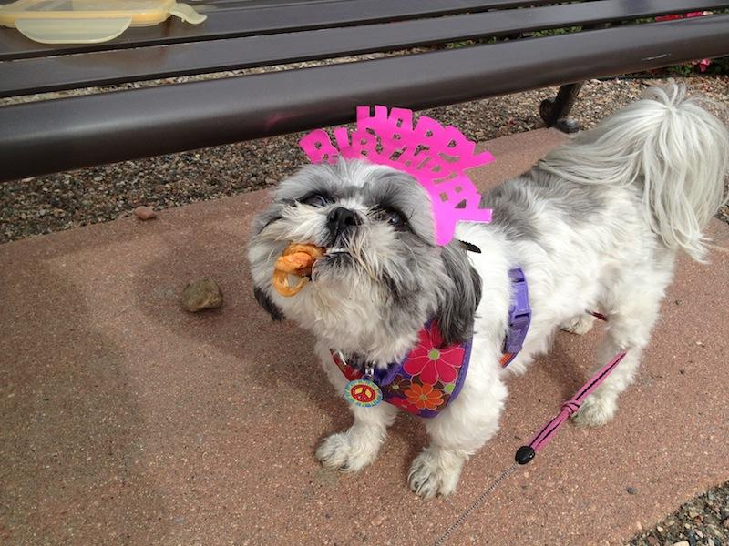
Followup
Had an unrelated trip to ECC for hemorrhagic diarrhea
Owner reports patient is doing well as of 3/20/17

Slide 21
References
Fitzgerald, K. T., Bronstein, A. C., & Newquist, K. L. (2013). Marijuana Poisoning. Topics in Companion Animal Medicine, 28(1), 8-12. doi:10.1053/j.tcam.2013.03.004
Gupta, R. C., (2014). Veterinary Toxicology: Basic and Clinical Principles. Kidlington: Elsevier Science.
Meola, S. D., Tearney, C. C., Haas, S. A., Hackett, T. B., & Mazzaferro, E. M. (2012). Evaluation of trends in marijuana toxicosis in dogs living in a state with legalized medical marijuana: 125 dogs (2005-2010). Journal of Veterinary Emergency and Critical Care, 22(6), 690-696. doi:10.1111/j.1476-4431.2012.00818.x

Slide 22
Thank You
Dr. Wallis
Dr. Bischoff
CUHA Staff
Rotation mates
Patient’s owners

