Slide 1
What I Learned at IVECCS
Mariana Pardo
Nashville, TN
2017

Slide 2
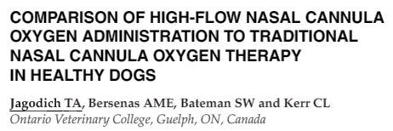
Determine the feasibility, degree of respiratory support, and safety of HFNC in sedated and awake healthy dogs, when compared to traditional nasal cannula (TNC)
Randomized crossover study
  8 healthy dogs
  TNC: 0.1, 0.2, and 0.4 oxygen ﬂow rates (L/kg/min)
  HFNC: 0.4, 1.0, 2.0, and 2.5
  Measured inspiratory/expiratory airway pressures, FiO2, ETO2, ETCO2, PaO2, PaCO2, and vital parameters
  Sedation status, complications, tolerance and respiratory scores

Slide 3
Results:
  CPAP achieved at 1 and 2 L/kg/min, not higher at 2.5 than 2L/kg/min, with worse tolerance scores
  Expiratory air-way pressures increased when sedated
  FiO2 at 0.4 L/kg/min for both methods was 72%
  FiO2 with TNC 0.1 L/kg/min was 27% !
  FiO2 at all HFNC ﬂow rates ≥ 1 L/kg/min was 95%
  PaO2for HFNC 0.4 L/kg/min was lower than at other ﬂow rates
  100% aerophagia
  PaCO2was increased with sedation and HFNC use when compared to baseline
Conclusion
  Use of HFNC in dogs is feasible, safe, delivers predictable oxygen support, and provides CPAP
  May cause a mild increase in PaCO2
  Flow rates of 1–2 L/kg/min are recommended
  If using TNC, ﬂow rates above 0.1 L/kg/min may attain higher FiO2

Slide 4
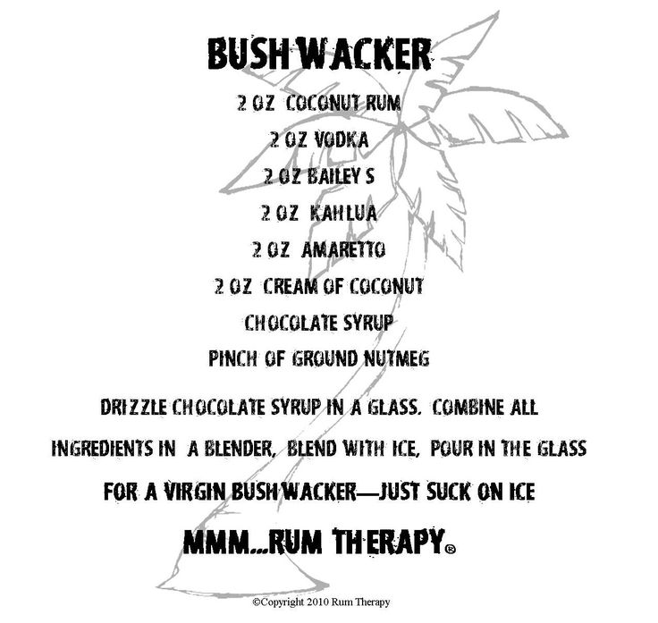
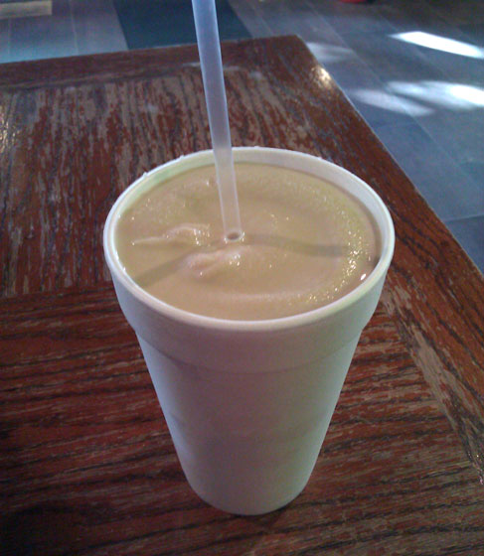
Tennessee Bushwhacker

Slide 5
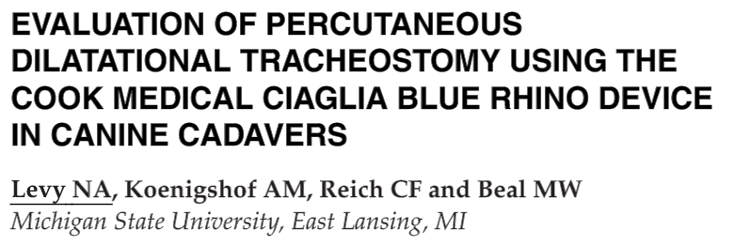
8 operators (4 experienced and 4 unexperienced)
  Experience in ST and Seldinger technique
  None had experience in PDT
Each performed 1 ST and 1 PDT on a cadaver
Procedure times, complications and tracheal mucosal and cartilage injury scores were recorded

Slide 6
100% success rate in placement
PDT (3 min 23s) was faster to place than ST (4 min 49s)
No tracheal or mucosal injuries were noted in ST, PDT had a median injury score 4 (1-5)
Experienced users were faster and had less complications in PDT

Slide 7
PDT can be performed quickly in dogs regardless of experience level
PDT may carry a higher risk for iatrogenic tracheal damage

Slide 8
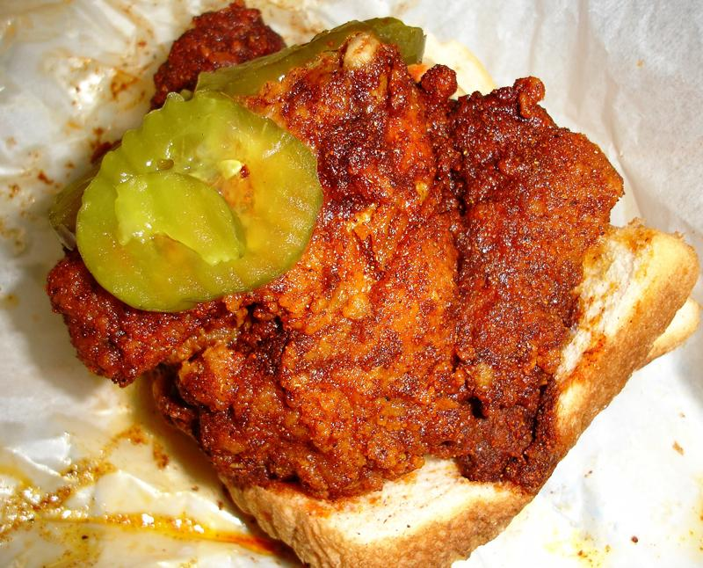

Tennessee Hot Chicken
Nashville specialty
Fried chicken breaded and coated with spices, typically heavy on the cayenne

Slide 9
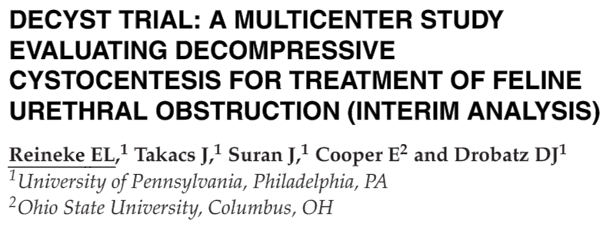
Prospectively evaluated utility and safety of decompressive cystocentesis in feline UO
69 cats randomized to either
  DC prior to urinary catheterization -35
  Urinary catheterization without DC -34

Slide 10
Median vol of urine DC was 70 mL (range:15–162 mL)
Median vol of urine catheterization was 86.5 mL
No signiﬁcant difference in ease of catheterization score of the DC cats compared with the UC cats
No signiﬁcant difference in the time to place the urinary catheter in the DC cats and the UC cats
No signiﬁcant difference in K, BUN, or creat at 8–12 hrs or at 24 hrs after admission, duration of catheterization, hospitalization, or incidence of recurrent UO in the hospital between the DC and UC cats
No complications related to the DC

Slide 11
DC appears safe but does not ease urinary catheterization or signiﬁcantly decrease the time to place a urinary catheter in cats with UO

