Slide 1
M&M Rounds
Michelle Coady
May 8, 2018
Cornell University Hospital For Animals

Slide 2

Bianca – 13yo Female Spayed Yorkshire Terrier
Acute onset of dyspnea
No GI signs or history of cardiac or respiratory disease
2007 – diaphragmatic hernia repaired at CUHA
No current medications
No access to toxins
Notes:
- 13 yo FS Yorkie
- Acute history of labored breathing. Owner left house for an hour this evening, and when she returned home Bianca was breathing abnormally with increased effort.
- No C/S/V/D reported.
- History of diaphragmatic hernia in 2007, repaired at CUHA
- No current meds

Slide 3
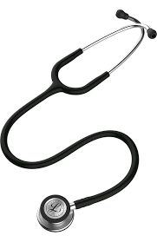
Physical Exam
T = 101.4; P = 200; R = 80
QAR; pink MM; CRT 2 sec
Tachypneic with increased RE
Grade IV-V/VI left systolic heart murmur
Increased lung sounds
Strong pulses
Several missing teeth and moderate periodontal disease
Diarrhea while in ER

Slide 4
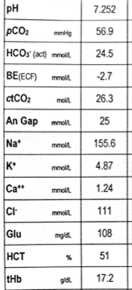
Diagnostics
TFAST: B lines diffusely; worst at R ventral thorax
PCV/TS: 55%, 11.6 g/dL
Hemolyzed and lipemic serum
Azo 15-26 mmol/L
Creatinine 1.3
Could not obtain BP or SP02
Echocardiogram (following day)
  Degenerative mitral valve disease
  Moderate left atrial enlargement
Notes:
Could not obtain BP or SP02
Slow draw

Slide 5
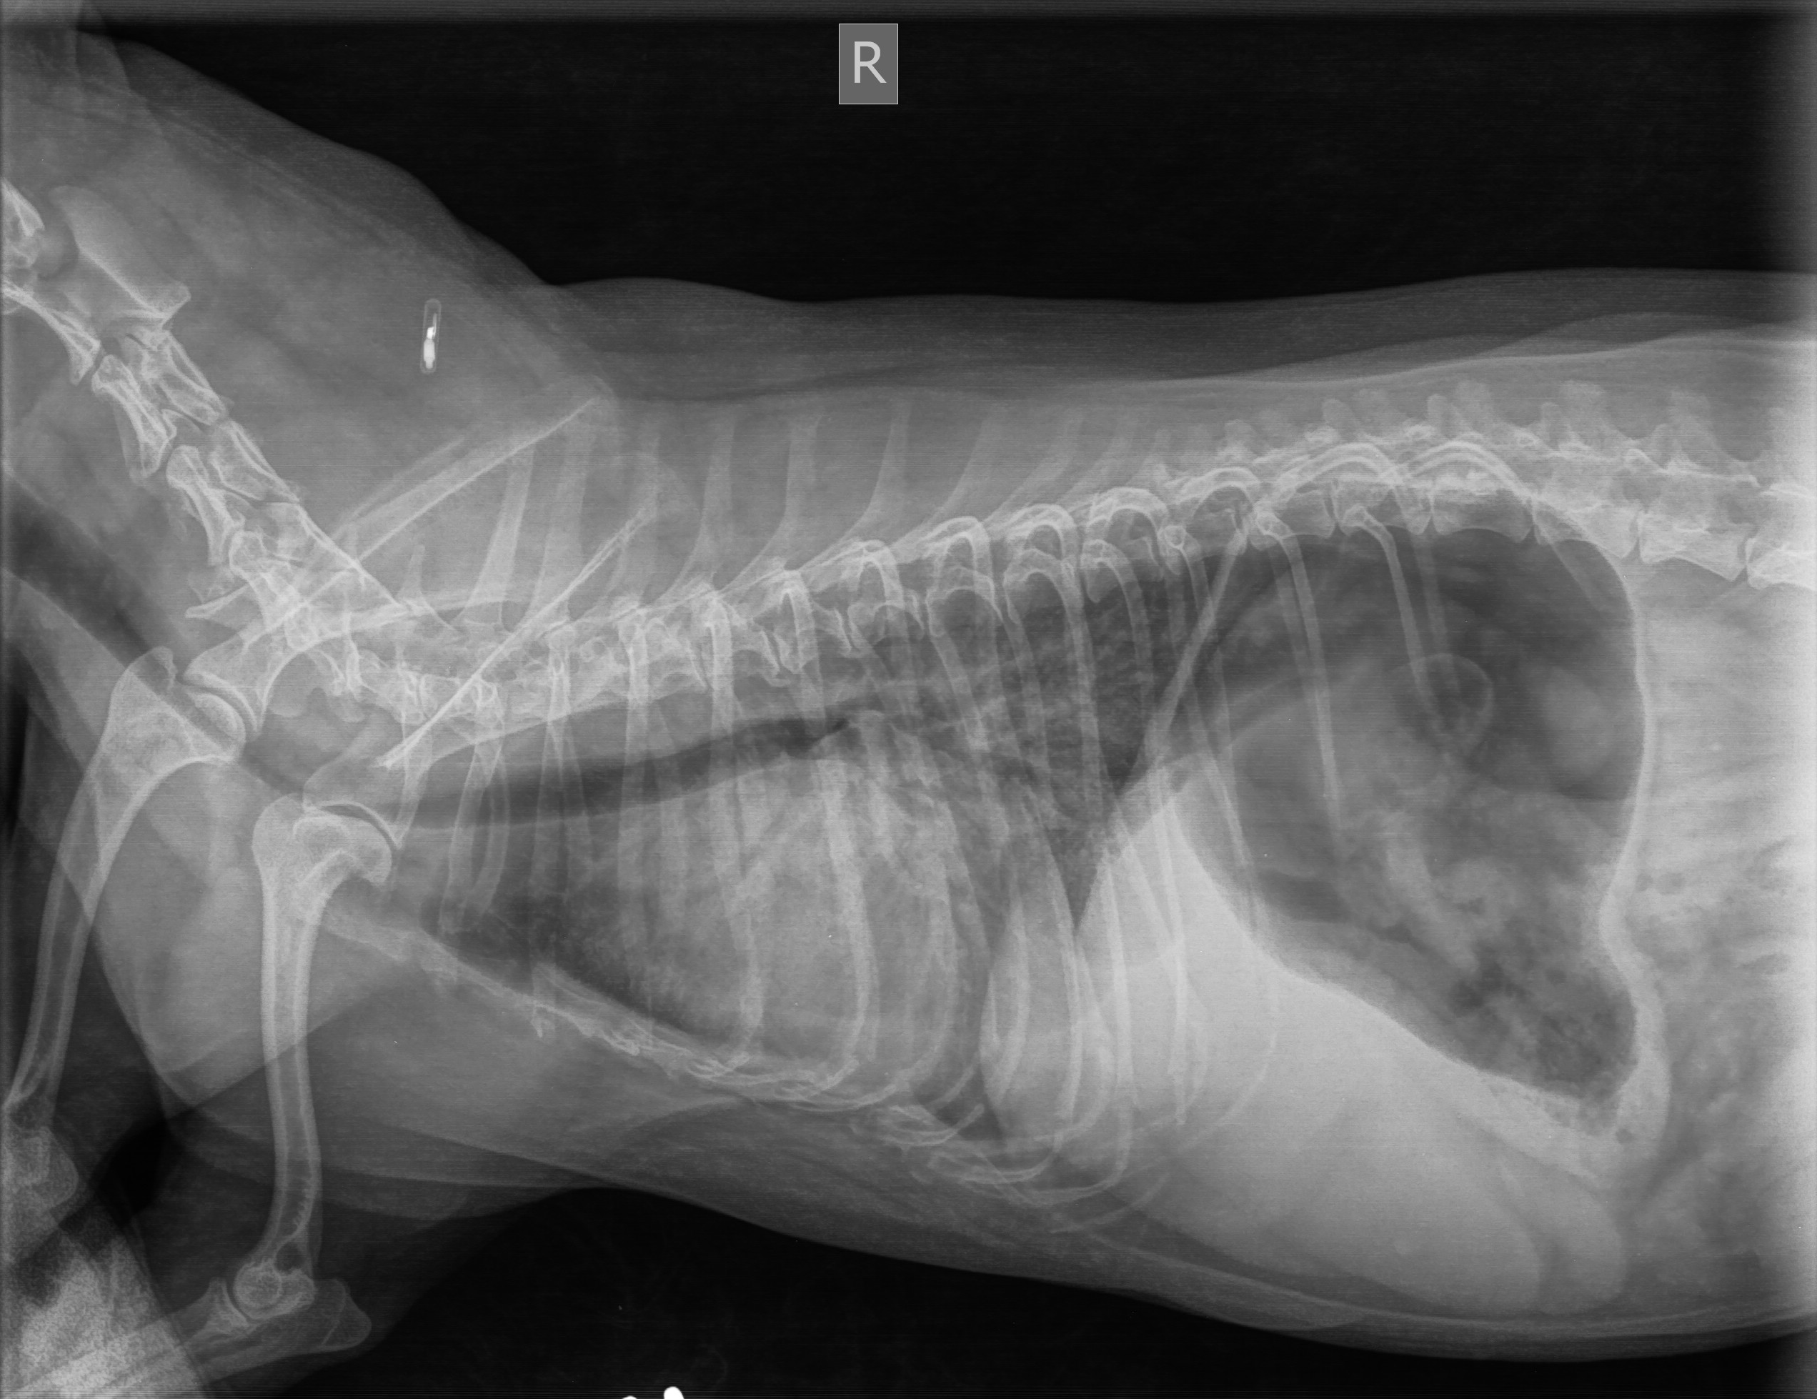
Notes:
4/4/18:
1. Mild to moderate generalized cardiomegaly
2. Multifocal patchy alveolar pattern, right lung
3. Mild pulmonary venous congestion – pul veins diffusely mildly enlarged
4. Incidental, spondylosis deformans
→ left-sided congestive heart failure

Slide 6
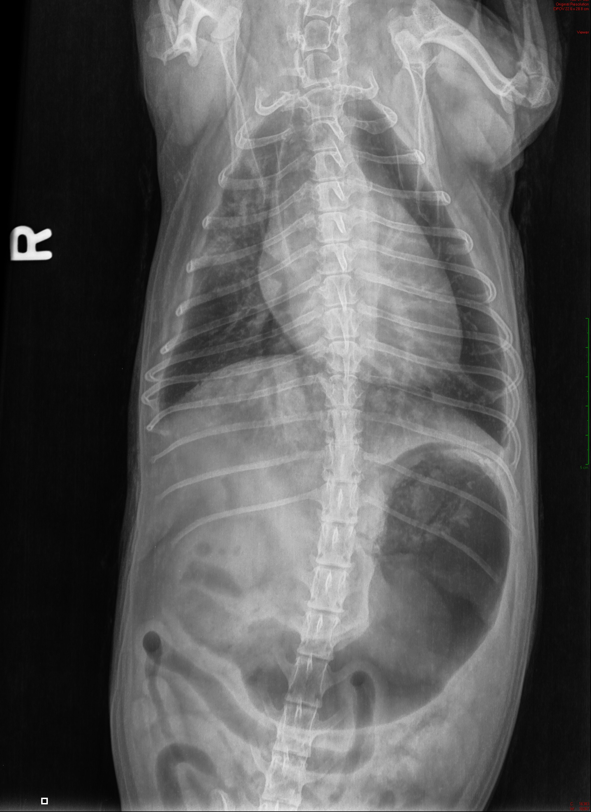
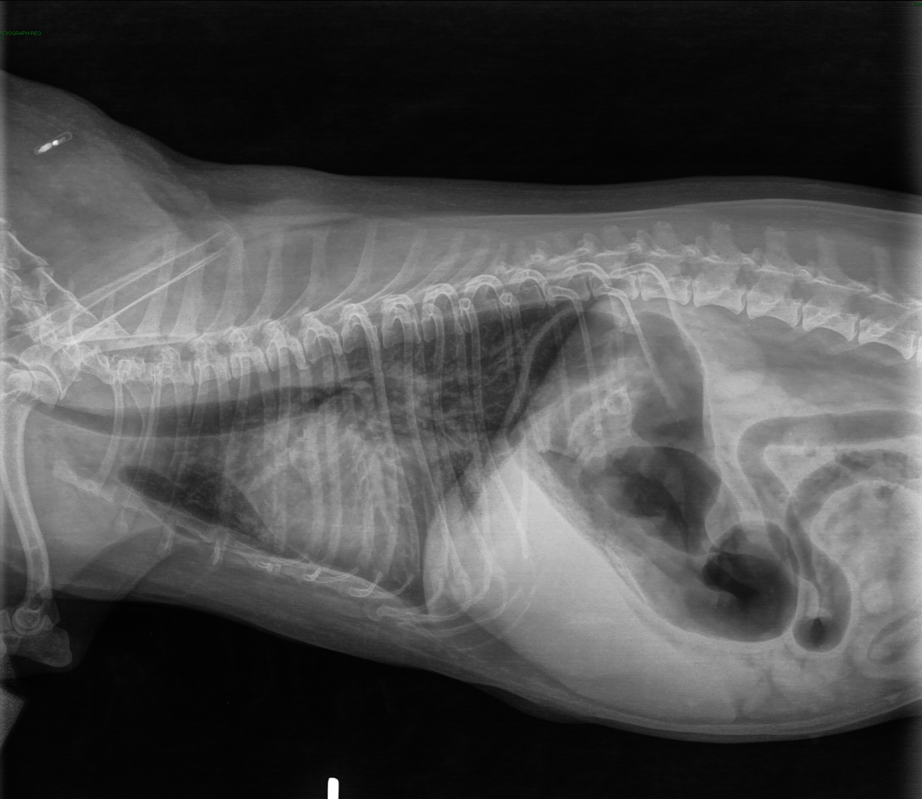
Notes:
DIAGNOSED CHF

Slide 7


Mitral Valve Disease
Most commonly acquired heart disease in dogs (~75% of cases)
Heritable in Cavalier King Charles Spaniels and Dachshunds
Males > females
Left AV valve most commonly affected
Morbidity is directly related to magnitude of valvular insufficiency and volume overload
Notes:
Fox PR. Pathology of myxomatous mitral valve disease in the dog

Slide 8
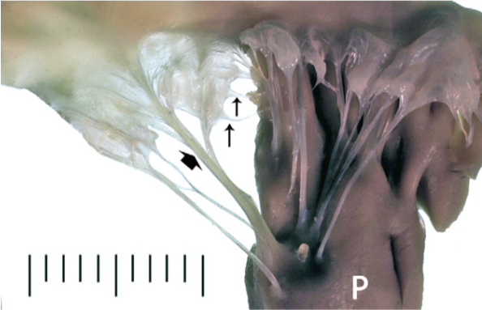
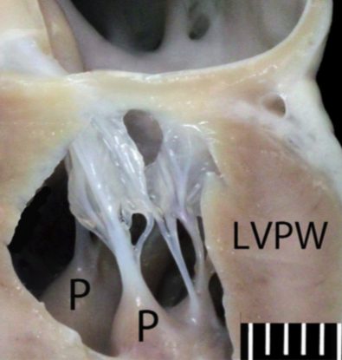
Anatomy of the valve
1. Left atrial wall
2. Mitral valve annulus
  Discontinuous fibrous ring at the confluence of the LA and LV wall
  Supports the leaflets
3. Mitral valve leaflets
  Anterior (septal)
  Posterior (parietal)
4. Chordae Tendineae
  Arise from papillary muscle and insert on leaflets
  First and second order (also third order)
5. Left ventricular papillary muscles and associated LV wall
Notes:
Fox PR. Pathology of myxomatous mitral valve disease in the dog
First order – thin and arise from papillary muscle and insert on free edges of the leaflets --< presents prolapse- section results in acute MR
Second order – arise from papillar ymuscle and insert just beyond the ventricular aspect of the valve leaflets → sectioning impacts ventricular geometry and systolic function
Third order – arise from septal wall

Slide 9
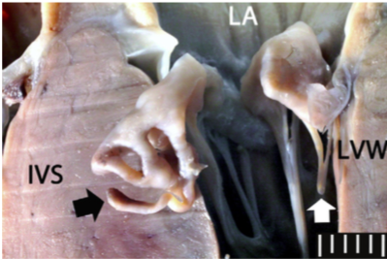
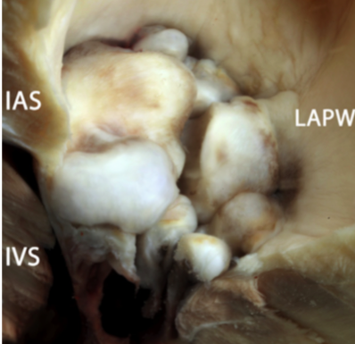
Pathology
Leaflets become opaque and thickened/ nodular; edges bulge in towards atrium
Closed loop degeneration
  In a normal dog, mitral valve orifice is 28% smaller at end-systole than at end-diastole
  With volume overload, orifice is 30% large than normal
  Dilation -> increased regurgitation -> leaflet and chordal stress -> further exacerbation of insufficiency
Notes:
Histopath – expansion of the axtracellular matrix with glycosaminoglycans, proteoglycans, alteration in valvular interstitial cells, attenuation or loss of the fibrosa layer→ apparatus malformation and biomechanical dysfunction
Dorsolateral view from the left atrium looking downward, of severely myxomatous mitral valves from the same dog in Fig. 13. Lesions correspond to Whitney stage IV pathology. Both anterior and posterior leaflets are markedly thickened and convexly shaped, with rounded edges and contracted borders, and protrude into the left atrium. Chordae tendineae were thickened. IAS, interatrial septum; LAPW, left atrial posterior wall; LVPW, left ventricular posterior wall; IVS, interventricular septum. Scale, mm.

Slide 10
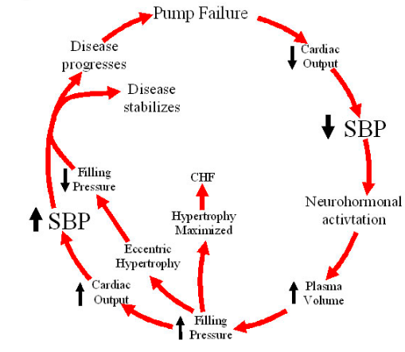
Heart Failure pathophysiology
Increased sympathetic tone
  Increase contractility & HR
  Chronic stimulation results in down-regulation of beta receptors
RAAS activation
  Vasoconstriction via Ang II production, ADH release, endothelin
  Na+/ H20 retention
Volume overload → eccentric hypertrophy
Increase pressure in LV → LA → pulmonary veins → increased hydrostatic pressure → pulmonary edema

Slide 11
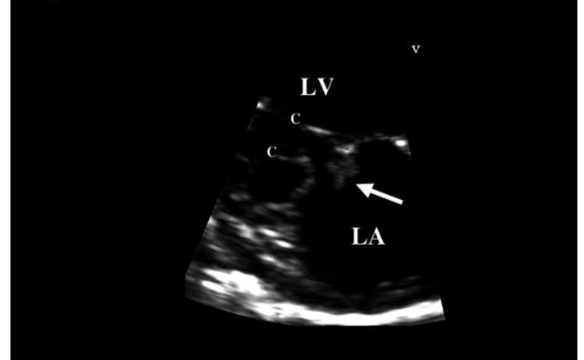
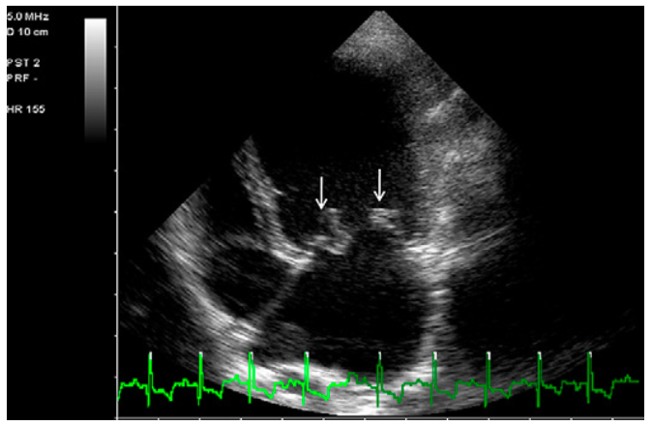
Diagnosis and Treatment
Diagnosis
  Left apical systolic murmur
  Mid-systolic click (mitral valve prolapse)
  Echocardiogram -> thickening of one or both mitral valve leaflets
  CHF diagnosed radiographically
Treatment
  Furosemide
  ACE-I
  Pimobendan
  +/- spironolactone
Notes:
Spironolactone – may reduce the risk of cardiac death and worsening of CHF. At sub-diuretic effects – antifibrotic effect and may prevent replacement fibrosis that occurs in dogs iwht MMVD. Also, aldosterone concentrations can be increased in dogs with MVD receiving furosemide and ACE-I, in which case spironolactone would be beneficial.

Slide 12
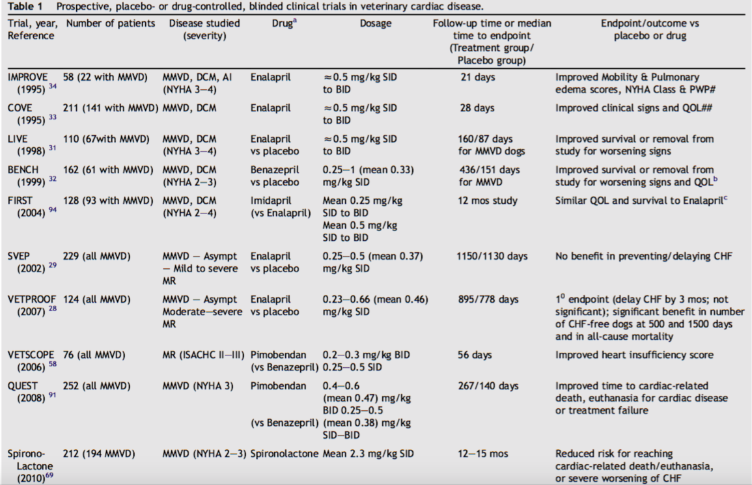
Notes:
+ EPIC
Progression to CHF – survival time varies based on care provided and occurrence of complications
The Long-Term Inves- tigation of Veterinary Enalapril (LIVE) and BENazepril in Canine Heart Disease (BENCH) trials compared enalapril and benazepril, respectively, with placebo in canine patients with heart failure caused by either MMVD or dilated cardiomyopathy. More recently, QUEST was designed to compare the efficacy of pimobendan to benazepril in dogs receiving background therapy for furosemide with or without digoxin; heart failure caused by MMVD was the primary inclusion criterion. In the QUEST trial, the median survival time for all dogs to reach the primary end point represented by sudden cardiac death, euthanasia as a consequence of the cardiac disease, or treatment failure, was about 6 months.18 Survival time was similar for the group of dogs in LIVE that were treated with enalapril.12 In the BENCH study the mean survival time for dogs receiving benazepril was about 14 months.
STUDY

Slide 13
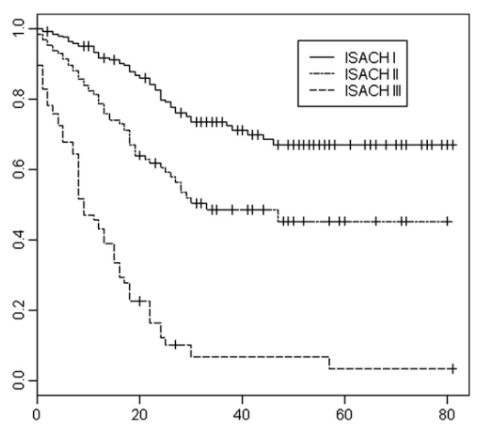
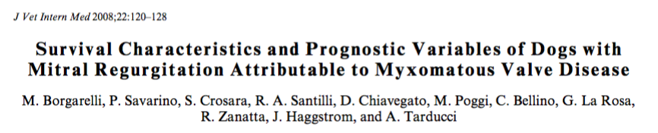
Prognosis
Long pre-clinical period; majority of dogs will die from other disease
~30% of animals with MMVD will progress to heart failure and die from this disease
  70% of asymptomatic dogs still alive at end of 6.6 year follow-up
Notes:
MMVD is the most common acquired cardiovascular disease in dogs (75%)
Long pre-clinical period and many dogs do not progress to CHF/ die for other reasons
558 dogs – 70% of asymptomatic dogs still alive at the end of a 6.6 year follow-up
About 30% of affected animals will progress to heart failure and eventually die from this disease.

Slide 14
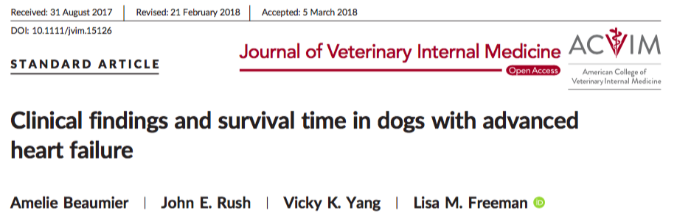
Prognosis
Advanced heart failure = recurrence of CHF after having received pimobendan, ACE-I and furosemide >4 mg/kg/day
MST was 281 days (3-885 days)
Higher furosemide dose and non-hospitalization associated with better outcomes
Notes:
For study purposes, advanced heart failure was defined as recurrence of congestive heart failure signs despite receiving the initially prescribed dose of pimobendan, angiotensin- converting-enzyme inhibitor (ACEI), and furosemide >4 mg/kg/day.
After initial diagnosis of advanced heart failure, 38 (70%) dogs had additional medica- tions adjustments (median 5 2 [range, 0-27]), with the final total medication number ranging from 2-10 (median 5 5).
Median survival time after diagnosis of advanced heart failure was 281 days (range, 3-885 days). Dogs receiving a furosemide dose >6.70 mg/kg/day had significantly longer median survival times (402 days [range, 3-885 days] versus 129 days [range 9-853 days]; P 5 .017).

Slide 15
Back to Bianca…

Slide 16
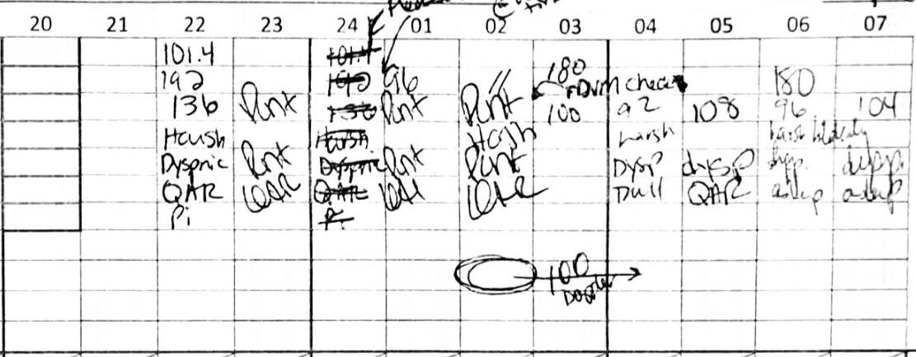
Treatments
O2 @ 40%
Furosemide 2 mg/kg IV
Butorphanol 0.3 mg/kg IV
→ mild improvement?
Pimobendan 0.5 mg/kg total daily dose
Total furosemide received from presentation until 8am -> 12 mg/kg IV
Notes:
Lasix 2 mg/kg IV @ intake at 7:20pm
O2 40%
Butorphanol 0.3 mg/kg IV for rads
Lasix 2 mg/kg IV @ 10pm
Mild improvement in respiratory effort following these treatments, but still tachypneic.
Hospitalized on:
Furosemide 2 mg/kg IV q6-q8
Butorphanol 0.2 mg/kg IV q6 PRN
Pimobendan 0.5 mg/kg total daily dose: 1.25 mg tonight, due for 0.625 mg in AM
Respiratory watch
HR check q2
Recheck BP overnight
2 mg/kg at 10pm and 2am
CRI 0.5 mg/kg/hr from 2am to 5am
Then 1 mg/kg/hr from 5am to 8am

Slide 17
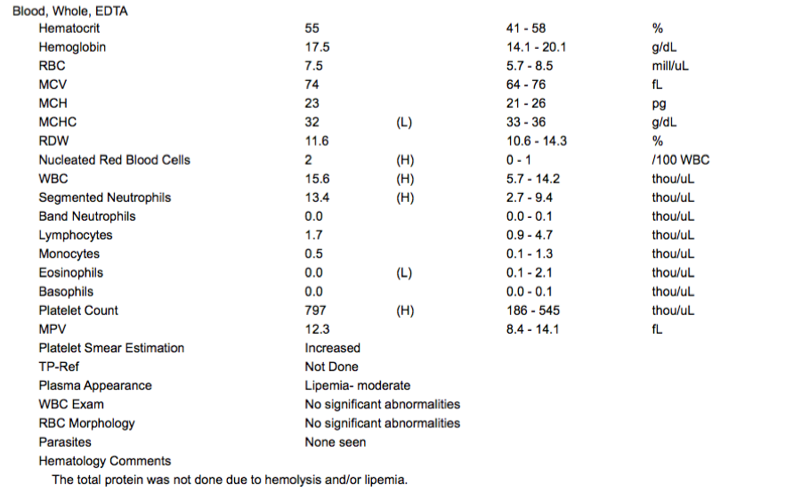
Notes:
Neutrophilic leukocytosis
Inc nRBCs
Thombocytosis

Slide 18
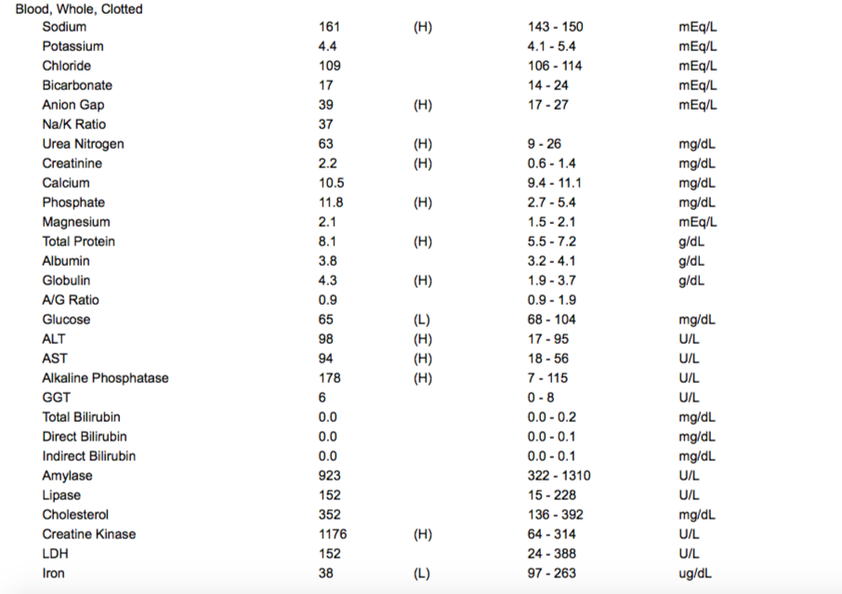
Notes:
Electrolyte changes consistent with furosemide administration
Azotemia
Mild liver enzyme elevation

Slide 19
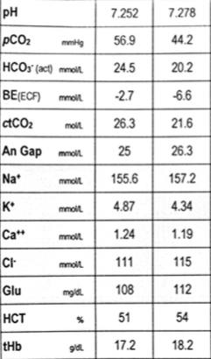
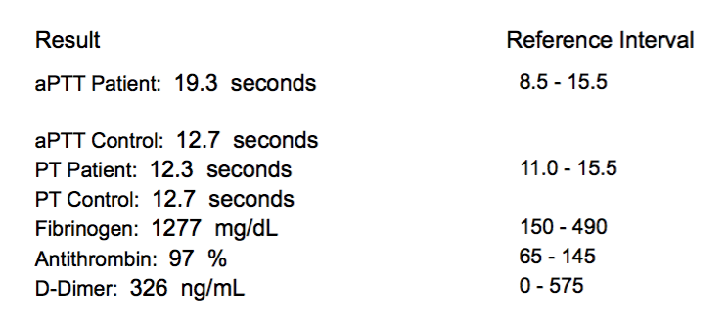
DIC Panel
Notes:
+ Thrombocytosis – normal variant, splenic contraction, chronic hemmorhage, hyperadrenocorticism, DIC/ hypercoaguability, hypotension, inflammation/ immune-mediated dz, paraneoplastic, polycythemia
In humans, it has been suggested that the major cause of sudden death in patients with CHF is thrombotic vascular occlusion and not arrythmia, which means that the state of hypercoagulability is a very significant problem in humans, and possibly also in dog
Very mildly prolonged aPTT
Elevated fibrinogen
Normal D-dimers
Increased FDPs – DIC, hepatic dz, internal hemmorhage, thrombosis, vitamin K antagonism

Slide 20
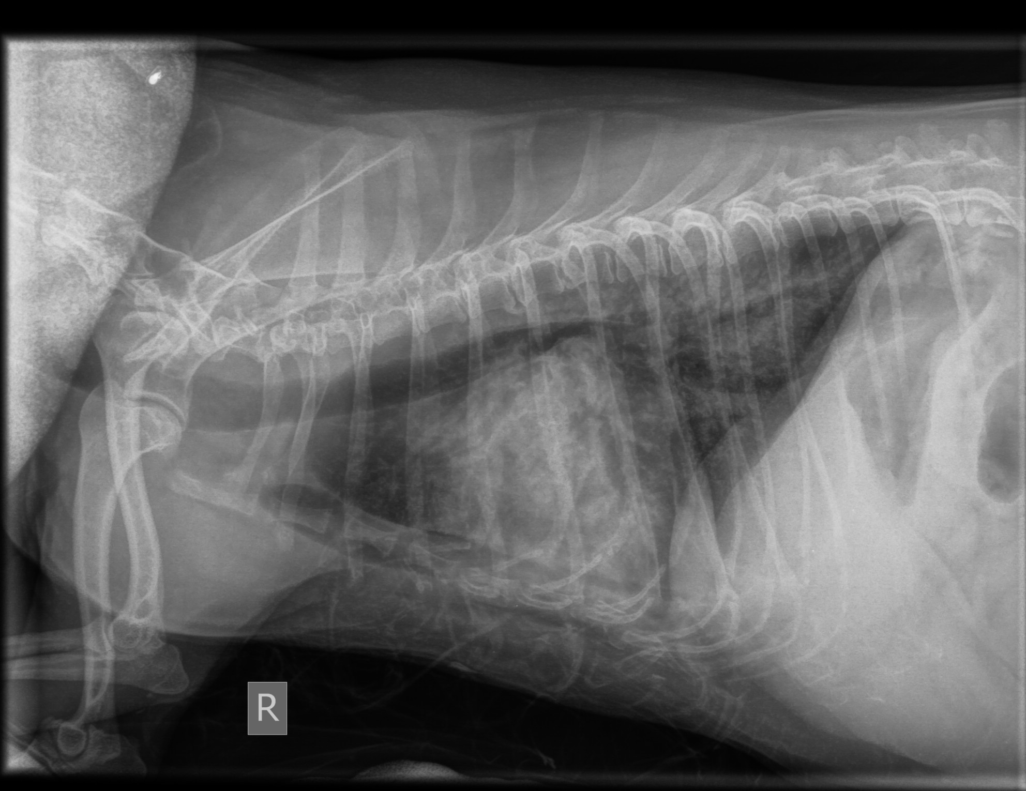
Repeat Radiographs

Slide 21
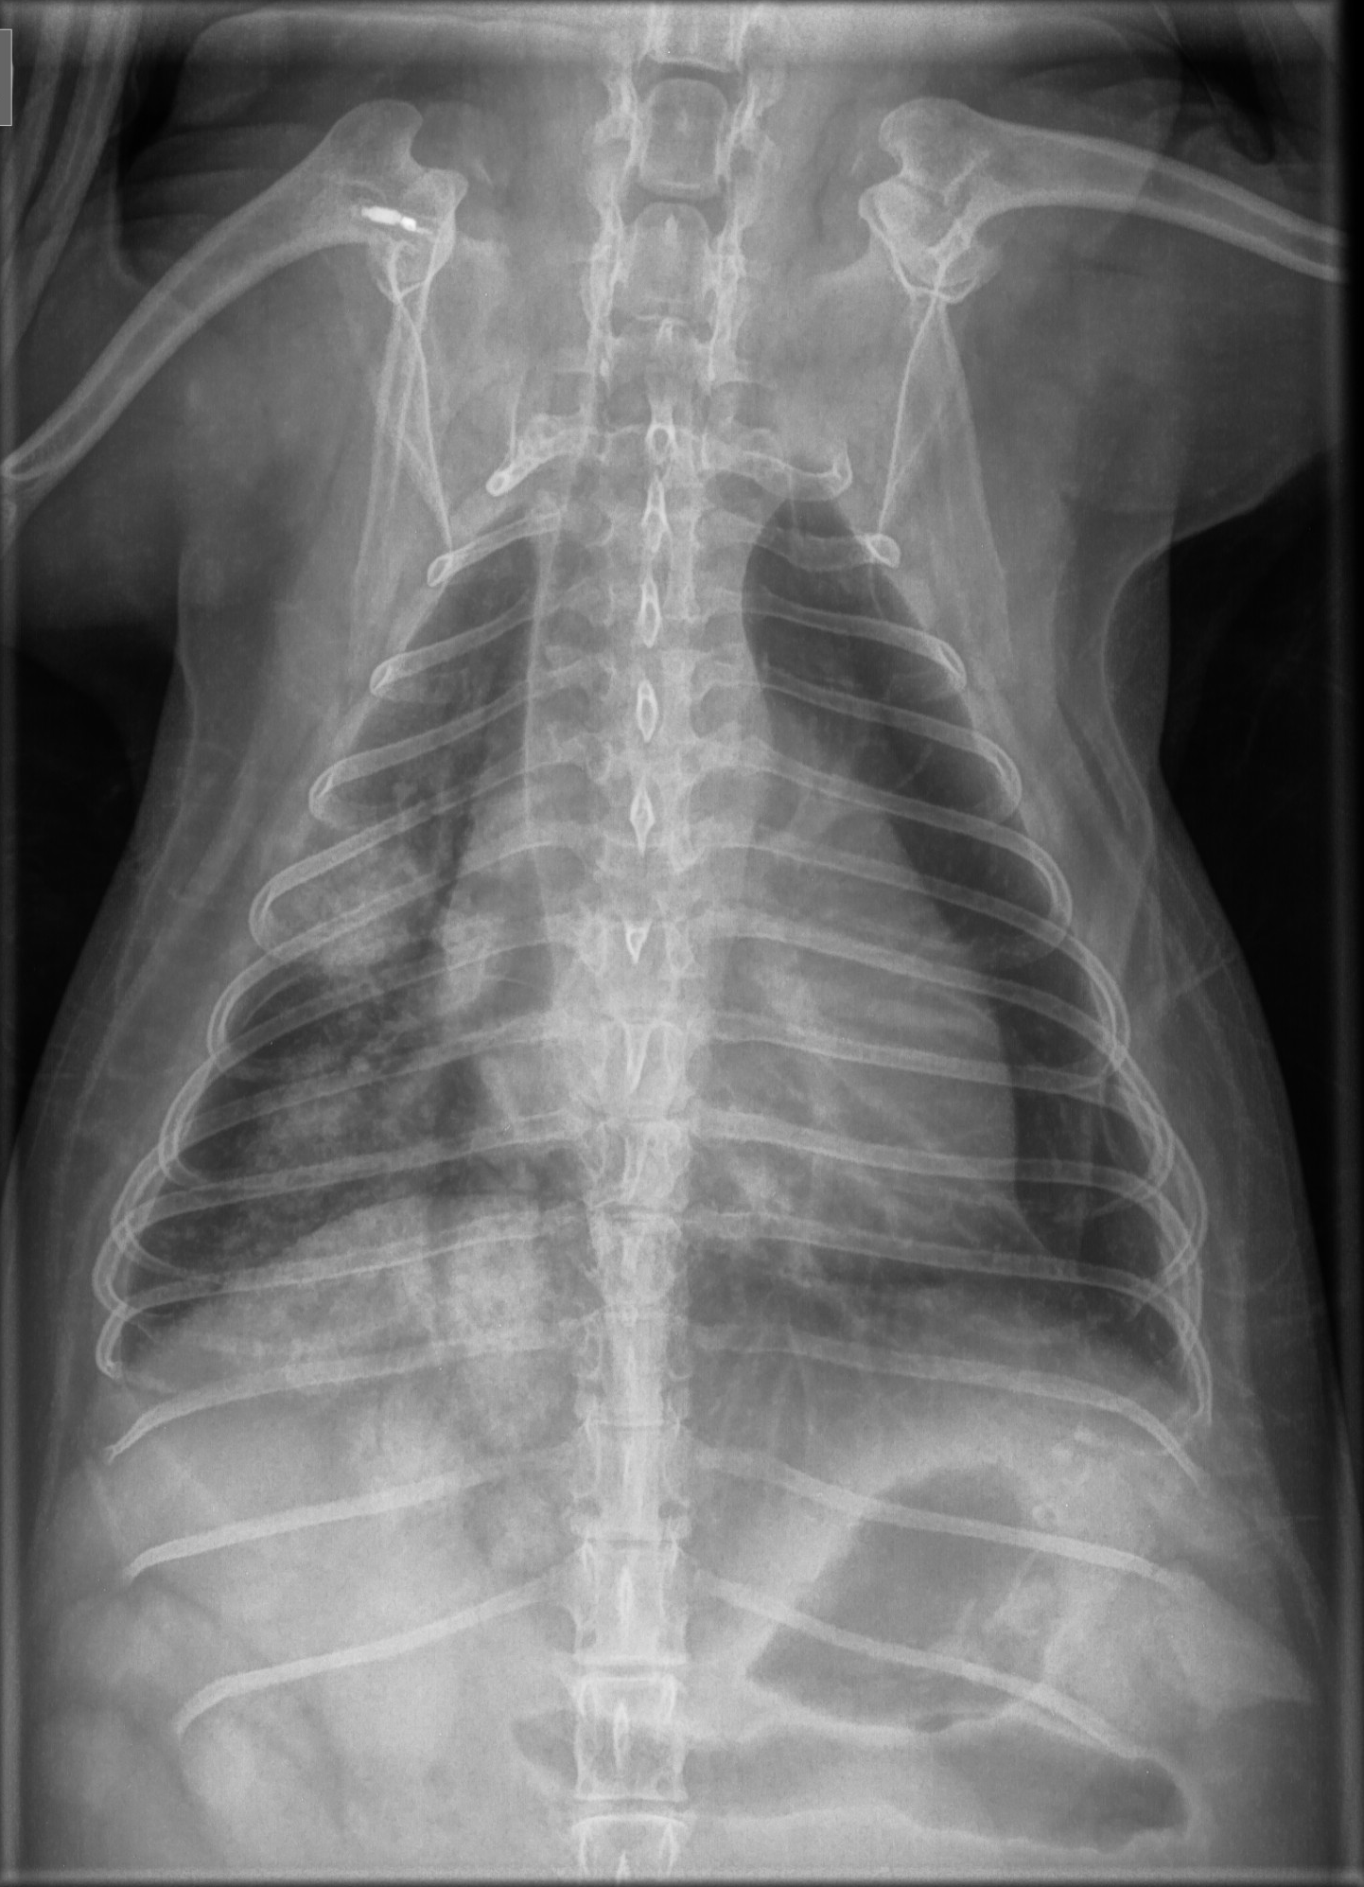
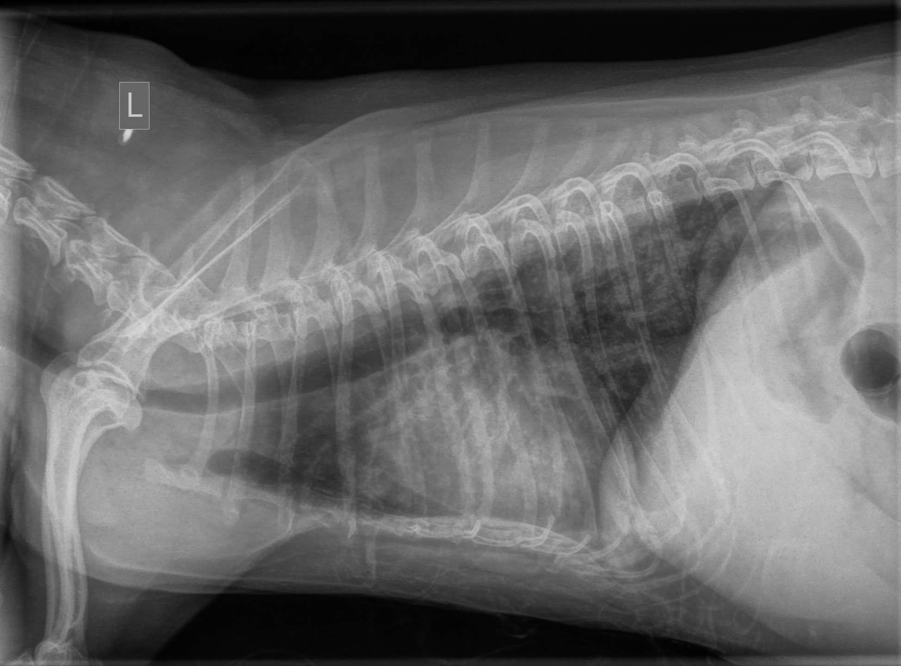

Slide 22
Problem List and Differentials
Left-sided congestive heart failure secondary to MVD
Azotemia
Hepatomegaly
Mildly elevated liver enzymes
Thrombocytosis
Diarrhea
Refractory to treatment?
Chordae tendinae rupture?
Thrombosis? PTE?
Infectious disease – pneumonia?

Slide 23
Complications of MVD
Pulmonary hypertension
Chordae tendineae rupture
  Generally 1st order chordae
  In humans, typically chordae that are associated with larger/ heavier valve leaflets
  Mechanical properties of chordae degenerate as disease progresses
Left atrial rupture
  Severe regurgitation generates high velocity jets of MR
  Atrial endocardium is traumatized
    Jet lesions = Focal, thickened, fibrotic lesions
  → Endocardial tears (partial or full-thickness)
Hypercoaguability/ Thrombosis?

Slide 24
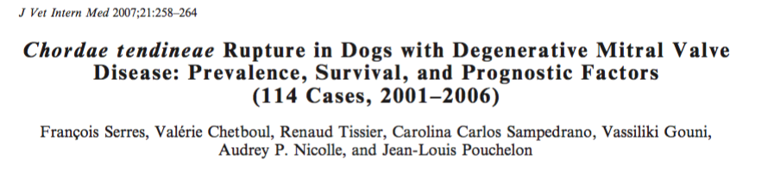
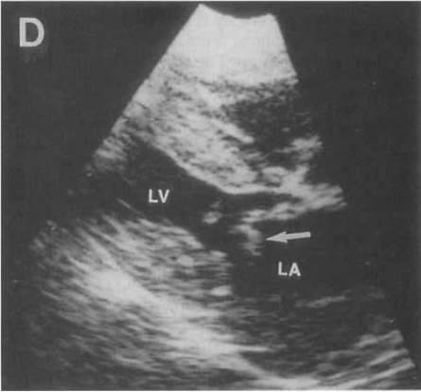
Chordae Tendineae Rupture
Traditionally though to result in acute pulmonary edema and death despite treatment
Diagnosis: flail mitral leaflet with tip pointing into atrium during systole
114/706 dogs with MVD
25% of cases were asymptomatic
93% had severe mitral regurgitation
Only 1 case secondary to endocarditis; all other cases secondary to degenerative valve disease
Notes:
Diagnosis: flail mitral leaflet with the tip pointing into the left atrium during systole
114 dogs (out of 706 dogs with MVD) -> 93% had severe mitral valve regurgitation
Long term follow-up for 57 dogs (treated with ACE-I and diuretics) and 58% survived > 1 year after diagnosis (MST 425 days)
Only 1/604 other cases had rupture – infective endocarditis
Treatment stats at time of diagnosis unknown
25% dogs aymptomatic
Most common clinical signs – 57% chronic cough; 46.5% acute dyspnea, exercise intolerance 16.3%, ascites 8.1%
1/3 had pulmonary arterial hypertension -> not predictive of survival; however presence of ascited (consequence of PAH) significantly influenced survival
96.5% chordae from anterior mitral valve leaflet (septal)
57 dogs included in the survivor/ non-survivor analysis
Wide range of clinical presentation
Other study
28 dogs with spontaneous CTR
1/3 dogs had acute pulmonary edema without known heart disease, others had a history of chronic symptomatic to asymptomatic MVD

Slide 25
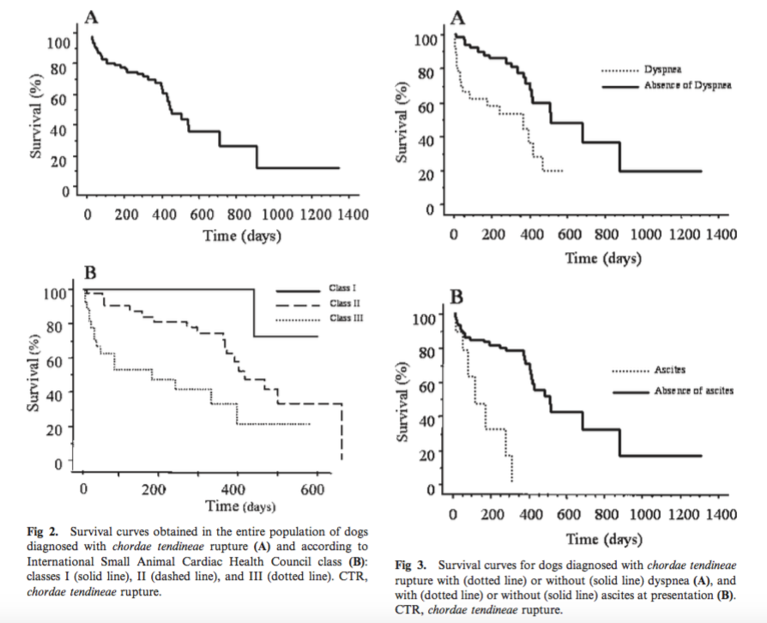
Chordae Tendineae Rupture
Long term follow-up for 57 dogs identified MST of 425 days (58% survive >1 year post diagnosis)
Predictors of survival:
  clinical class
  presence of ascites
  presence of acute dyspnea
  heart rate
  plasma urea concentration
  left atrial size
Notes:
Serres F, Chetboul V, Tissier R et al. Chordae tendineae Rupture in Dogs with Degenerative Mitral Valve Disease: Prevalence, Survival, and Prognostic Factors (114 Cases, 2001–2006). J Vet Intern Med 2007;21:258–264
Diagnosis: flail mitral leaflet with the tip pointing into the left atrium during systole
114 dogs (out of 706 dogs with MVD) -> 93% had severe mitral valve regurgitation
Long term follow-up for 57 dogs (treated with ACE-I and diuretics) and 58% survived > 1 year after diagnosis (MST 425 days)
Only 1/604 other cases had rupture – infective endocarditis
Treatment stats at time of diagnosis unknown
25% dogs aymptomatic
Most common clinical signs – 57% chronic cough; 46.5% acute dyspnea, exercise intolerance 16.3%, ascited 8.1%
1/3 had pulmonary arterial hypertension -> not predictive of survival; however presence of ascited (consequence of PAH) significantly influenced survival
96.5% chordae from anterior mitral valve leaflet (septal)
57 dogs included in the survivor/ non-survivor analysis
Predictors of survival: clinical class, presence of ascites or acute dyspnea at time of diagnosis, heart rate, plasma urea concentration, left atrial size
Wide range of clinical presentation
Other study
28 dogs with spontaneous CTR
1/3 dogs had acute pulmonary edema without known heart disease, others had a history of chronic symptomatic to asymptomatic MVD

Slide 26
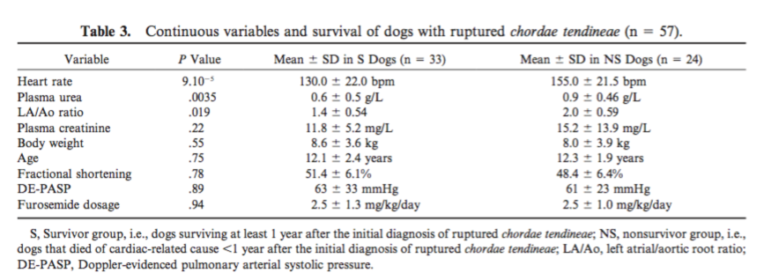

Slide 27
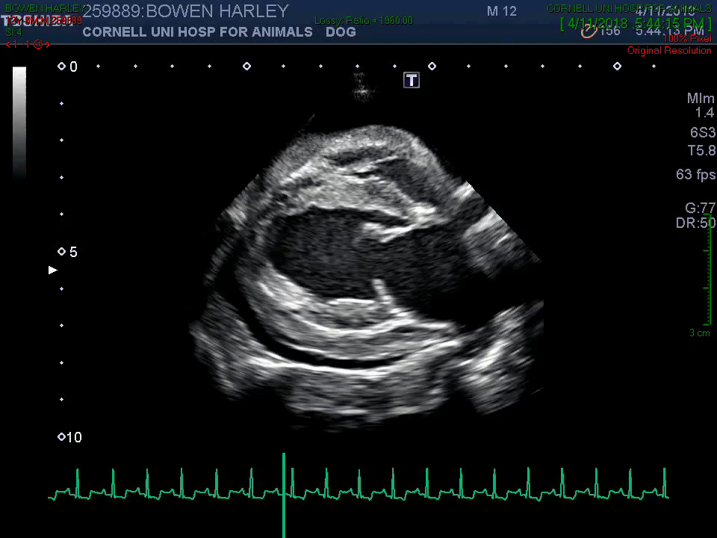
Left Atrial Rupture
Generally consider to have a poor short and long-term prognosis
Nakamura et al. JAAHA 2014
  Case series of LA rupture secondary to MVD
  10/11 dogs survived > 30 days (MST 203 days)
  5 dogs with history of CHF has MST 160 days
  Only 2 dogs were in tamponade and underwent pericardiocentesis? All other dogs managed medically

Slide 28
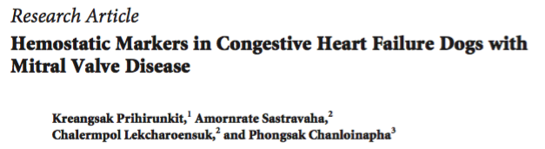
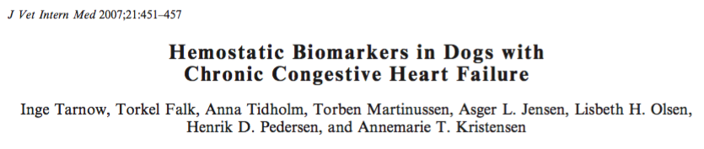
Thrombosis in dogs with CHF?
Higher fibrinogen and D-dimers in dogs with CHF (secondary to MVD or DCM)
  Predisposition for hypercoagulability?
  No association with outcome has been identified
Unlike humans where these hemostatic changes are predictors of mortality and risk of cardiovascular events
Notes:
This study revealed that dogs with CHF had statistically significantly higher plasma fibrinogen, D- dimer and TAT concentrations; and lower plasma antithrombin and protein C activities than control dogs.
le, with more severe cases found in the present study. In humans with cardiovascular disease, high plasma fibrinogen and D-dimer concentra- tions are found in patients with heart failure regardless of etiology30–32 and are predictors of mortality or risk of cardiovascular events.33

Slide 29
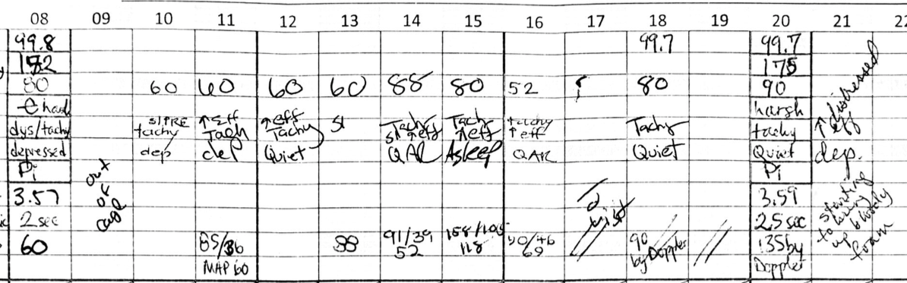
Back to Bianca …
Added broad-spectrum antibiotics
Progressive increase in respiratory effort and coughing up fluid
Periods of cyanosis
Concern for respiratory failure
Owners authorized ventilation
Following induction, cardiac arrest
CPR performed but no ROSC

Slide 30
Necropsy
Severe mitral valve endocardiosis with left ventricular thrombosis
The heart weighs 50 g. The tricuspid valve has moderately thickened leaflets and round raised nodules at the papillary muscle attachment sites. The leaflets of the mitral valve are markedly thickened and nodular. There is a firm, 1.0 x 0.5 x 0.5 cm, red mass attached to the wall of the left ventricle (thrombus, presumptive).
Pulmonary edema (left-sided CHF)
No evidence of rupture chordae tendineae
Rounded liver lobe edges; potentially consistent with some degree of right-sided failure
Choleliths in the gall bladder
Notes:
Severe mitral valve endocardiosis with right ventricular thrombosis
Pulmonary edema
Preliminary Comment:
The changes in the heart include degenerative changes in both atrioventricular valves (more severe on the left) and a thrombus in the left ventricle which is firmly attached to the wall.
There is no evidence of ruptured chordae tendineae. The changes in the lungs are consistent with pulmonary edema secondary to left-sided heart failure.
The changes in the liver may indicate some degree of right-sided heart failure, as well.
Gross Findings:
Heart: Moderate multifocal chronic endocarditis in the bicuspid and tricuspid valves
Lung: Moderate pulmonary edema
Liver: Rounded liver lobe edges.
Gallbladder: Choleliths.
Teeth: Severe periodontal disease with multiple missing teeth
Skin, dorsum of nose: Skin tag, presumptive
Gross Description:
Examined is the carcass of a 3.3 kg, 13-year-old, blue and tan Yorkshire Terrier with a Purina body condition score of 5 out of 9 and mild autolysis. On the left dorsal aspect of the nose, there is a 2 mm diameter red pedunculated non-haired mass. The left arm is shaved distally for catheter placement. The following teeth are missing: 101, 102, 103, 201, 202, 301, 302, 303, 401, 402. The remaining teeth are frequently covered by hard, brown material (calculus).
The heart weighs 50 g. The tricuspid valve has moderately thickened leaflets and round raised nodules at the papillary muscle attachment sites. The leaflets of the mitral valve are markedly thickened and nodular. There is a firm, 1.0 x 0.5 x 0.5 cm, red mass attached to the wall of the left ventricle (thrombus, presumptive).
The pleural surface of all of the lung lobes are heterogenous, mottled pink, red and dark red. The right caudal lung lobe and the left middle and cranial lung lobes exude pink froth on cut surface (edema).
The liver lobes have rounded edges. The liver and gallbladder weigh 198 g. The gallbladder is round and filled with a dark green fluid that has 0.5-1.0 mm diameter hard irregularly shaped gritty objects (choleliths).
The colon is filled with pale green semi-liquid fecal material.

Slide 31
Discussion/ Questions
Was our diuretic therapy appropriate?
Earlier mechanical ventilation?
Role of left ventricular thrombosis?

Slide 32
References
Atkins CE and Haggstrom J. Pharmacologc management of myxomatous mitral valve disease in dogs. Journal of Veterinary Cardiology 2012; 14:165-184.
Beaumier A, Rush JE, Yang VK and Freeman LM. Clinical findings and survival time in dogs with advanced heart failure. JVIM 2017.
Borgarelli M and Haggstrom J. Canine Degenerative Myxomatous Mitral Valve Disease: Natural History, Clinical Presentation and Therapy. Vet Clin Small Anim 40 (2010) 651–663
Borgarelli M, Savarino P, Crosara S et al. Survival characteristics and prognostic variables of dogs with mitral regurgitation attributable to myxomatous valve disease. J Vet Intern Med 2008; 22:120-128.
Fox PR. Pathology of myxomatous mitral valve disease in the dog. Journal of veterinary cardiology 2012;14, 103-126.
Jacobs GJ, Calvert CA , Mahaffey MB et al. Echocardiographic detection of flail left atrioventricular cusp from rupture chordae tendineae in 4 dogs. JVIM 1995;9:341-346
Nakamura RK, Tomkins E, Russell NJ et al. Left atrial rupture secondary to myxomatous mitral valve disease in 11 dogs. JAAHA 2014; 50:405-408.
Nelson OL and Andreasen C. The utility of plasma D-dimer to identify thromboembolic disease in dogs. JVIM 2003; 17:830-834.
Tarnow I, Torkel F, Tidholm A et al. Hemostatic biomarkers in dogs with chronic congestive heart failure. J Vet Inter Med 2007; 21:451-457
Serres F, Chetboul V, Tissier R et al. Chordae tendineae Rupture in Dogs with Degenerative Mitral Valve Disease: Prevalence, Survival, and Prognostic Factors (114 Cases, 2001–2006). J Vet Intern Med 2007;21:258–264

