Slide 1
Lyme borreliosis in Dogs and Cats
Michelle Coady, DVM
Cornell University Hospital for Animals
April 12, 2018

Slide 2
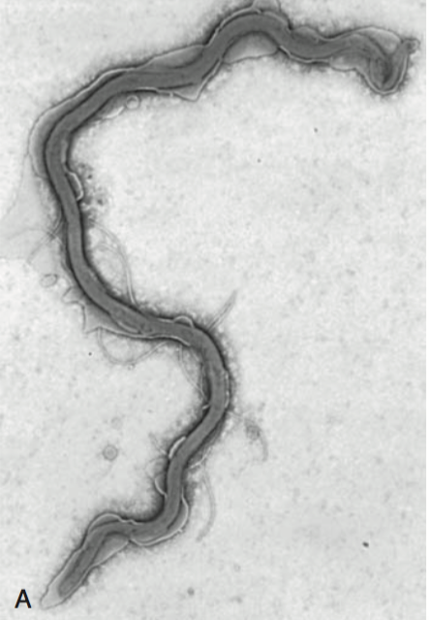
Etiology
Spirochete bacterium
Approximately 52 Borrelia species
  Lyme borreliosis group (Borrelia burgdorferi sensu lato)
    Interstitial migration
  Relapsing fever group
    hematogenous migration
North America: B. burgdorferi senso stricto
  At least 30 strains based on outer surface protein type C genotyping
  Strain OspC type A has increased virulence
  Strains are host-specific
Europe & Asia: B. garinii
Notes:
Different species in NA versus Europe/ Asia may account for different clinical manifestations of dz in humans in these regions
There are at least 52 Borrelia species, including 21 in the LB group (B. burgdorferi sensu lato; Bb-sl; these gram-negative spirochetes generally migrate within the host interstitially), 29 in the relapsing fever group (migrating hematogenously), and 2 undetermined members.
In dogs residing in North America, LB has only been associated with B. burgdorferi sensu stricto (Bb), of which at least 30 subtypes or strains exist, based on outer surface protein C (OspC) genotyping
Strains are host specific – some more common in people than dogs

Slide 3
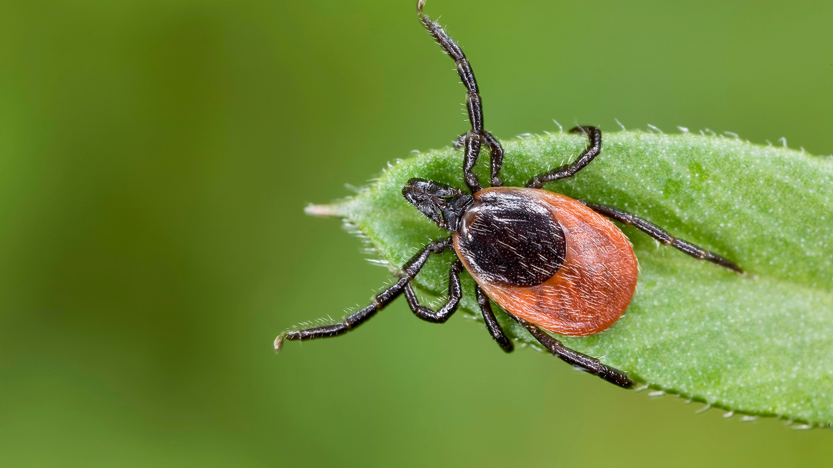
Transmission
Vector-borne
  Ixodes scapularis in East and upper mid-west
  Ixodes pacificus in West
  Ixodes ricinus in Europe
Reservoirs for spirochete
  White-footed mouse
  Shrews
  Squirrels
  Chipmunks
  Birds

Slide 4
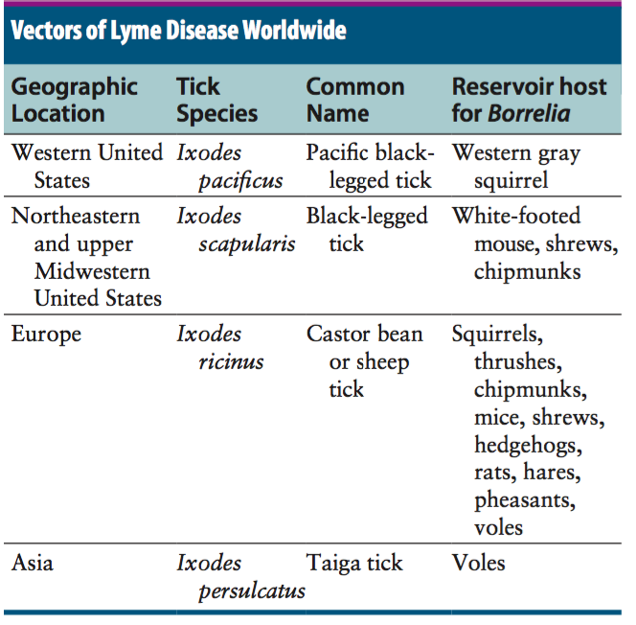
Transmission
Up to 50% prevalence in adult ticks in endemic areas
Borrelia passes transstadially (larva to nymph to adult) rather than transovarially (adult to egg)
Co-transmission of other pathogens is common
  Anaplasma phagocytophilum
Notes:
vector-borne pathogens, such as Anaplasma phagocytophilum, may be co-transmitted and complicate the clinical picture. There is some evidence that co-infection with A. phagocytophilum can enhance the pathogenicity of B. burgdorferi
In endemic areas prevalence in ticks can reach approximately 50%
Passes transstadially within the tick – larva to nymph to adult
(not transovarially – from adult to egg – except for some in the relapsing fever group)

Slide 5
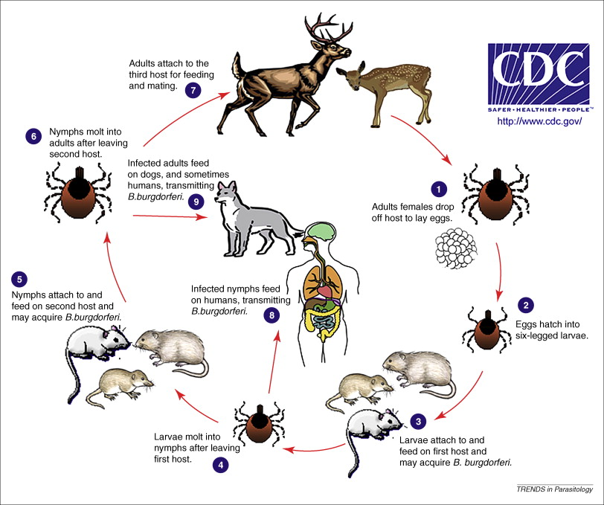
Life-cycle
Borrelia expressed various outer surface proteins at various stages of infection to adapt to the vector and host environment
Once tick starts feeding on host, transmission takes at least 24 hours
Replication at site of attachment and dissemination through connective tissue
Notes:
Outer surface proteins of importance include OspA, OspC, and VlsE. Over the fall, winter, and spring, the spirochete remains dormant within the nymphal tick and expresses OspA, which allows it to adhere to the tick midgut. When the tick ingests mammalian blood in the late spring and summer, OspA expression is downregulated by the spirochete, and OspC expression is upregulated.The spirochete then moves to the tick hemolymph and salivary glands. OspC binds a tick salivary gland protein, which may help the organism evade the host immune response. OspC also binds to mammalian plasminogen and helps the spirochete to disseminate within the mammalian host.23 VlsE under- goes recombinational shuf ing of its genetic code, which further allows the spirochete to evade the immune response. Finally, B. burgdorferi may undergo metamorphosis into a spherical shape when it encounters unfavorable conditions within the host, such as when it is exposed to antibiotics, nutrient deprivation, and changes in pH. This may also contribute to its ability to evade the immune system and resist antimicrobial drug treatment
The complete genome of B. burgdorferi has been sequenced. The organism expresses different outer-surface lipoproteins at different stages of infection, which allows it to adapt to dramatically different environments within the arthropod vector and the mammalian host. This property of the organism has been exploited for the purpose of diagnostic assay and vaccine development.
Spirochete replicates at site of attachment then disseminated primarily through connective tissue. It binds proteins such as plasminogen, β3 integrins such as the platelet integrin αIIbβ3, glycosaminoglycans, bronectin, laminin, and decorin (a collagen proteoglycan).
Humans develop an early skin rash = erythema migrans. Dogs do not.
Only about 10% of affected dogs show overt signs of illness.

Slide 6
Notes:
US – midwest, northeast, mid-adlantic, parts of California

Slide 7
Manifestations of Disease
Arthritis – acute versus chronic
Nephritis
Neuroborreliosis
Myocarditis
Orbital myositis
Notes:
Arthritis and nephritis most common in dogs
Chronic arthritis only documented in humans
A few cases of neuro signs in seropositive dogs
Neuroborreliosis well documented in humans and horses
Fatal myocarditis described in Boxer puppies with no other known cause
Lyme carditis in humans with AV block – not documented in dogs
One case of orbital myositis in a dog, rare in humans

Slide 8

Clinical Presentation
Arthritis
  Fever
  Lethargy
  Lameness
  Swollen, painful joints
  +/- mild peripheral lymphadenoapthy
Nephritis
  Dehydration
  Peripheral edema
  Pleural effusion or ascites
  Hypertension
Notes:
Signs in dogs occur 2-5 months after the tick bite
First joint affected is typically closest to the site of tick bite

Slide 9
Diagnosis
Characteristic clinical signs
History of exposure to endemic area
Positive antibodies – serology!
Complete Blood Count
  Arthritis: minimal changes
  Nephritis: azotemia, hypoalbuminemia, hyperphosphatemia, hypochloremia, hyper or hypokalemia
Biochemistry
  Mild to moderate thrombocytopenia
Urinalysis
  Nephritis – isosthenuria, proteinuria +/- pyuria, hematuria
Coagulation panel
  Low antithrombin
Synovial fluid cytology
  Normal or neutrophilic inflammation
Imaging
  Arthritis is non-erosive
  Nephritis – AUS thickened renal cortices, decreased corticomedullary distinction, +/- effusion
Notes:
Diagnosis based on characteristic clinical signs and history of exposure to an endemic area and positive antibodies
Coags – low antithrombin (glomerular antithrombin loss) → hypercoaguability syndromes

Slide 10
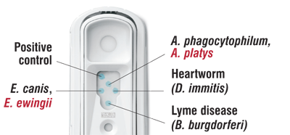
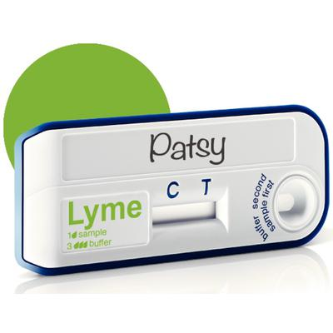
Serology
C6 ELISA lateral flow assay (SNAP 4DX)
  Detects IgG antibodies 3-5 weeks post infection
  Not affected by vaccination
Quantitative ELISA available through lab
No correlation between magnitude of titer and disease severity
Other assays → prone to false positives
  Whole-cell ELISA
  IFA
  Western Blotting
Notes:
C6 ELISA, which detects antibodies against a portion of the VlsE lipoprotein.
The advantages of the C6 ELISA assay are that (1) it detects IgG antibodies 3 to 5 weeks after the time of infection, so by the time dogs develop clinical signs they are virtually always seropositive, (2) it is negative in dogs that have been vaccinated for Lyme disease, because the antigen is not expressed by organisms used in Lyme vaccines.
Another rapid immuno- chromatographic ELISA assay has recently become available in the United States (Abaxis VetScan Canine Lyme Rapid Test) that detects antibodies to a different portion of the VlsE lipoprotein, OspC and p41; these are combined on a single line
Other assays
Other serologic assays that are available include whole- cell ELISA or immunouorescent antibody (IFA) assays and Western blotting. WB has traditionally been considered the gold standard assay. False positives using whole-cell ELISA and IFA have the potential to occur in patients with other spirochete infections, with other inflammatory disorders, and in vaccinated dogs.
Humans – serum that is positive for IgM or IgG with ELISA then undergo WB, which has increased specificity.
A multiplex fluorescent bead assay has been marketed in North America for detection of antibodies to three antigens of B. burgdorferi: OspA, OspC, and OspF.43 The assay uses tiny beads to which OspA, OspC, and OspF are coupled.
As with culture, PCR assays are best performed on skin biopsy specimens collected from a region adjacent to the tick bite site. Low sensitivity in humans – lots of false negatives. Synovial fluid or synovial membrane may also be useful.

Slide 11
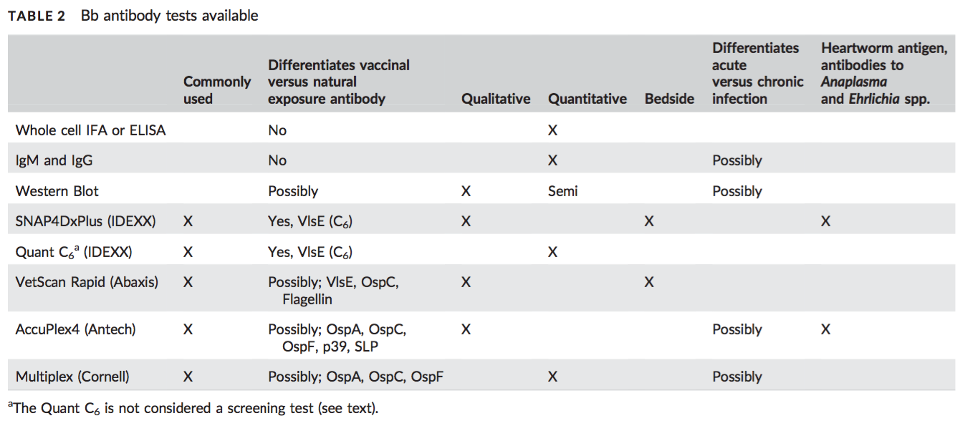
Notes:
C6 based testing (antibodies to C6 antigen)
VlsE – variable major protein-like sequence expressed
2 quantitative tests – insuff evidence that higher titers are associted with illness severity. → look for decreased antigenic load post treatment??
Antibody presence agains C6, VlsE, OspF → indicates exposure
In vaccinated dogs may have interference with OspC – intereferes with Western blot!
OspA -> usually due to vaccination (maybe early infection)

Slide 12
Screening
Annual antibody assay testing in endemic areas
Seropositive dogs -> look for proteinuria
Disadvantages to screening: potential for overuse of antibiotics, expense

Slide 13
Treatment of non-clinical dogs?
Pros | Cons
Prevention of future arthritis or nephritis? | No ability to monitor response to treatment without clinical signs
Treatment of co-infections | Vast majority of clinical dogs do not become ill
 | Overuse of antibiotics/ resistance
 | Potential for adverse effects
 | Expense
Notes:
Overwhelming majority of infected dogs are subclinical and antibody titres may persist for months to years
<10% of infections results in disease

Slide 14
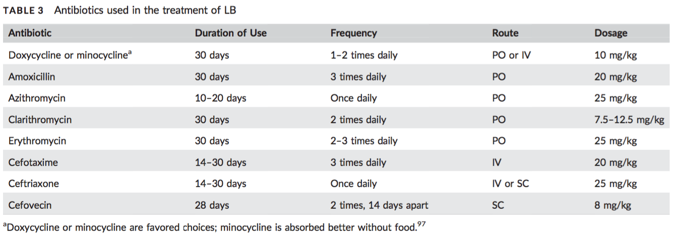
Treatment - arthritis
Rapid response to antibiotics (1-2 days); self-limiting in experimental infections
Doxycycline generally preferred due (efficacy against coinfections, anti-arthritic & anti-inflammatory)
No evidence to treat beyond one month
Notes:
Cefovecin also works
If relapse occurs before completion of antibiotics, consider further diagnostics
Pain management

Slide 15
Lyme nephritis
Immune-complex glomerulonephritis (ICGN)
No staining techniques available to identify immune-complexes in kidney biopsies
Diagnosis of exclusion in seropositive dog
  R/O co-infection Anaplasma, Ehrlichia, Babesia, Bartonella, RMSF, leptospirosis
  Neoplasia, amyloidosis, toxins
<30% of dogs have current or previous history of lyme arthritis
Notes:
is a syndrome of membranoproliferative glo- merulonephritis that has been recognized in dogs in association with exposure to B. burgdorferi. Rare reports of a similar dis- ease in human patients exist.32 Golden and Labrador retriever breeds appear to be overrepresented,33 and it has been suggested that Shetland sheepdogs and Bernese mountain dogs might also be predisposed.34-36 Dogs with Lyme nephritis are younger than dogs with other glomerular diseases. In one study, more than 50% of dogs with Lyme nephritis were 5 years of age or younger.33 Many affected dogs are also thrombocytopenic, and some also have polyarthritis.33 The pathogenesis of Lyme nephritis is uncer- tain; immune-mediated mechanisms have been proposed.37 The DNA or antigen of the spirochete cannot be consistently detected within renal biopsies.37,38 Subendothelial deposits of IgM, IgG, and C3 can be detected within the glomeruli.33 Clinical signs result from proteinuria and renal failure and include inappetence, lethargy, weight loss, vomiting, and polyuria and polydipsia

Slide 16
Treatment - nephritis
Uncomplicated, nonprogressive renal proteinuria or mild hypoalbuminemia without azotemia
  diagnostic work-up
  Antibiotics
  Management of proteinuria, hypertension, hypercoagulopathy with ACE-I or aldosterone receptor blocker, antithrombotics, protein and phosphorus restricted diets , antihypertensives
Severe persistent or progressive disease
  Supportive care (antiemetics, fluid therapy, phosphate binders)
With biopsy confirmation of active immune-mediated pathogenesis or refractory to treatment
  Immunosuppressives for minimum 12 weeks
    Mycophenolate +/- short course of prednisone
    Just prednisone with financial constraints?
Notes:
Transmission electron microscopy - electron dense deposits immunofluorescent staining in glomeruli
Experimental evidence that mycophenolate results in more remissions and longer-term survival

Slide 17
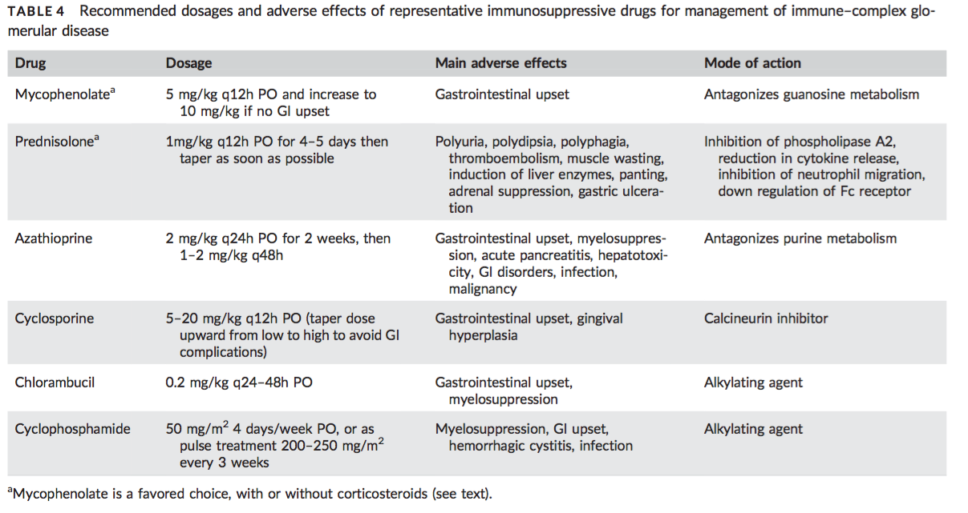

Slide 18
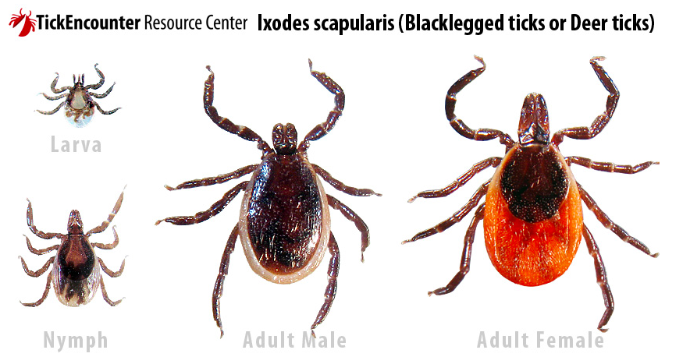
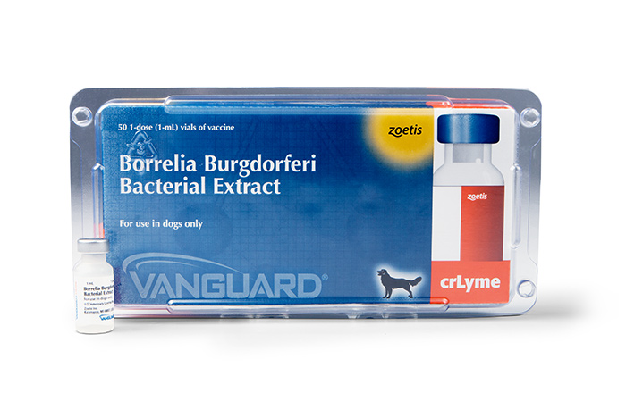
Prevention
Tick control
  Tick checks
  Tick prevention year round (>40 F)
  Fast-acting topical and oral preventatives
  Tick collars
Vaccination
  Induce anti-OspA antibodies – attack OspA expressing spirochetes in tick’s midgut, halting transmission
  OspA titers are not boosted by natural exposure and wane in vaccinated
  Anti-OspC antibody vaccines can eliminate transmitted organisms that express ospC
  Duration of immunity varies
  Vaccine failures at 22 weeks
Notes:
Fipronil takes longer than 24 hours to kill tick
Vanguard Zoetis Lyme vaccine – 15 month immunity study
Vaccinated dogs – 7/16 seroconverted
Controls 14/16 seroconverted after tick challenge

Slide 19
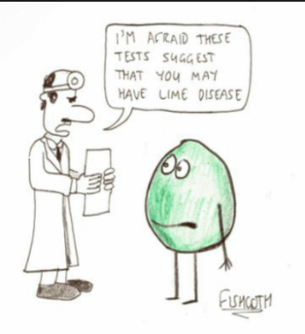
Questions?

Slide 20
References
Littman MP, Gerber B, Goldstein RE et al. ACVIM consensus update on Lyme borreliosis in dogs and cats. JVIM 2018; 1-17.
Littman MP. Lyme nephritis. JVECC 2013; 1-11.
Greene. Infectious disease of the dog and cat 4th Ed.
Skykes JE. Canine and Feline Infectious disease. 2014

