Slide 1
Leptospirosis
Michelle Coady, DVM
Cornell University Hospital for Animals
April 3, 2018

Slide 2

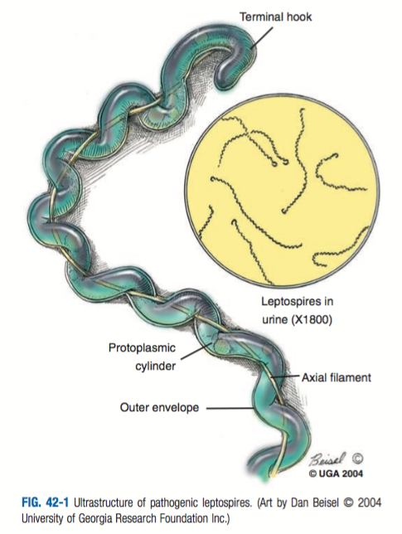
Etiology
Species: Leptospira interrogans
Spirochetes – thing, filamentous, mobile with hook shaped ends
>250 antigentically distinct serovars
~10 serovars are relevant to small animals

Slide 3
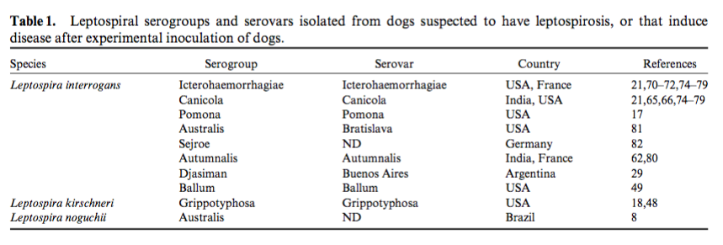
Immunity is serogroup specific
Disease in dogs
  Historically Icterohaemmorhagiae and Canicola prior to development of bivalent vaccine
  Pomona, Bratislava, Autumnalis, Gryppotyphosa now regularly identified
Notes:
Vaccine development is based on serogroups
Unknown if ”new” serovar recognition in changes in disease pattern or just due to improvement in testing methods
Generally though Canicola, Bratislava, Grippotyphosa → renal or heptatic;
Icterohaemmorhagiae and Pomona → hepatic

Slide 4
Epidemiology
Transmission through direct or indirect contact
  infected urine
  veneral or placental transfer
  bite wounds
  ingestion of infected tissues
  exposure to contaminated water, soil or food sources
Spirochetes can survive for several months in soil, preferably neutral or slightly alkaline pH and warm climates
Slow-moving or stagnant water
Notes:
Spirochete can remain viable for several months in the soil
Form biofilms in aquatic environments – slow moving or stagnant water
Survive best in neutral or slightly alkaline pH, and temp 0-25 degrees

Slide 5
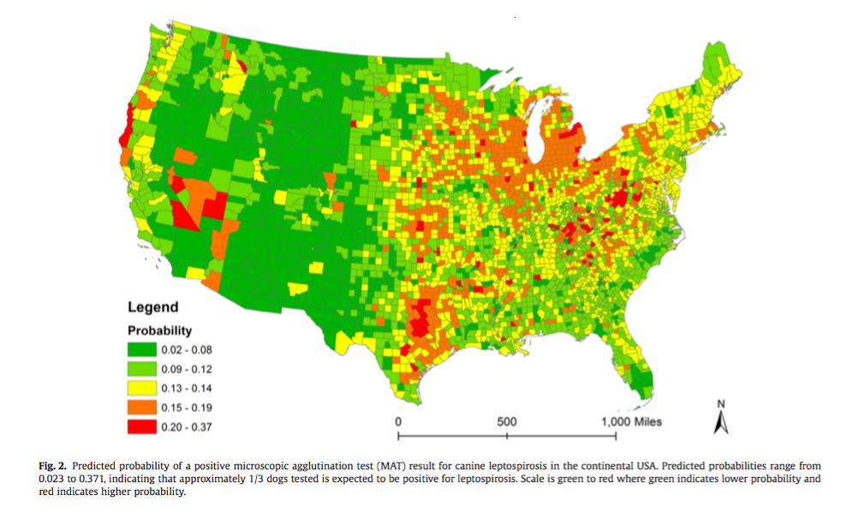
Vet Journal 2017
Notes:
More prevalent in regions with higher annual rainfall and warm climates
Apparent inc incidence in later summer or fall in dogs

Slide 6
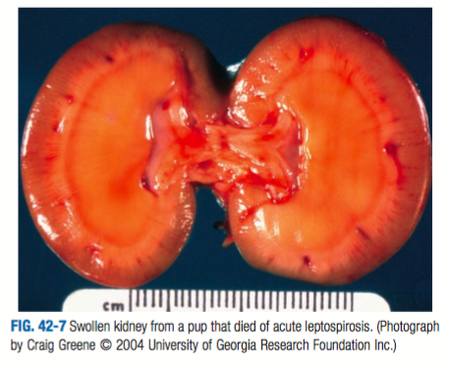
Pathogenesis
Penetrate intact mucous membranes or abraded/ softened skin
Spread to many tissues: kidney, liver, spleen, CNS, eyes, genital tract
~7 day incubation period
Organ damage dependent on host immunity and virulence of organism
Variation in disease expression
Notes:
Leptospires penetrate intact MM of the mouth, nose, eyes, or abraded/scratched/softened skin
Rapid multiplication after entering vasculature, quickly spread to many tissues including kidney, liver, spleen, CNS, eyes and genital tact
Incubation period ~7days but may vary
Antibodies clear infection from most organs, but may persist in kidneys and shed in urine for days to months
Organ damage dependent on host immunity, virulence, etc
Disease expression varies/ illness severity varies
No associations betweens infecting serovar and clinical manifestation of disease

Slide 7
Clinical Syndromes
Renal -> acute interstitial nephritis and tubular dysfunction
Hepatic
  ALI versus chronic active hepatitis
  subcellular damage through leptospiral toxins
Uveitis
Pulmonary hemorrhage/ ARDS
Febrile illness
Abortion
Benign meningitis in humans
Notes:
Renal colonization in infected animals – organism replicates and persists in renal tubular epithelial cells
Acute impairment of renal function possibly from kidney swelling, resulting in decreased renal perfusion and dec GFR → damage to small blood vessels may result in ischemic damage
Acute interstitial nephritis and tubular dysfunction
Leptospiral LPS activated macrophages, stimulating IL1 and interferon secreation
Hepatic dysfunction -> subcellular damage produced by leptospiral toxins.
Degree of icterus in canine and heman lepto patient usually corresponds to severity of hepatic necrosis
Chronic active hepatitis reported as result of Grippotyphosma infection in dogs
ALI can occur from vasculitis/ fluid exudation from effects of toxin
Benign meningitis is documented in humans when leptospires invade the nervous system or CSF in acute phase of illness
Uveitis also documents in humans, dogs, horses
Leptosiral pulmonary hemmorhage syndrome -> ARDS (immune-mediated, high mortality in humans)

Slide 8
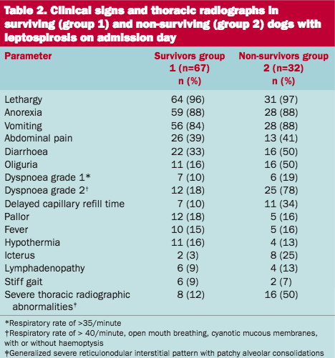
Clinical signs
Herding dogs, hounds, working dogs more commonly affected
Small breed dogs in metropolitan areas also at risk
Clinical signs
  Pyrexia
  Muscle tenderness
  Vomiting
  Rapid dehydration
  Oliguria/ anuria
  Icterus
  Abdominal pain
  Swollen kidneys
JSAP 2017
Notes:
Overt clinical lepto in cats is uncommon. They seroconvert after exposure to lepto, but appear to be less susceptible to infetion. <3% prevalence in US to antibodies to Autumnalis, Brtislava, Canicola, Grippotyphosa, Hardjo, Icterohaemorrhagiae, Pomona
Breed/ signalment – herding dogs, hounds, working dogs more commonly affected but depends on region – eg. 40% of cases at UMN were small breed dogs
Clinical dz is rarely reported in cats.
The study included 99 dogs. At initial presentation, the most common clinical signs were lethargy (96%), anorexia (88%), vomiting (85%), painful abdomen (39%), diarrhoea (38%), oliguria (27%) and tachypnoea (26%). Abnormal laboratory findings included anaemia (63%), thrombocytopenia (63%), leucocytosis (57%), increase of plasma urea (84%) and creatinine concentrations (81%), increased liver enzyme activities (80%), hyperbilirubinaemia (69%), hyperphosphataemia (67%), hyponatraemia (64%), hypoalbuminaemia (55%) and hypokalaemia (29%). Radiological pulmonary changes were detected in 57% of the dogs initially or during the course of disease. Severe dyspnoea, oliguria, azotaemia, hyperbilirubinaemia and severe radiological pulmonary changes were more often found in dogs that did not survive. There was renal, hepatic and pulmonary involvement in 95, 92 and 58% of the dogs, respectively, and multi-organ lesions in 98 dogs(98%); 32 dogs died or were euthanased.

Slide 9
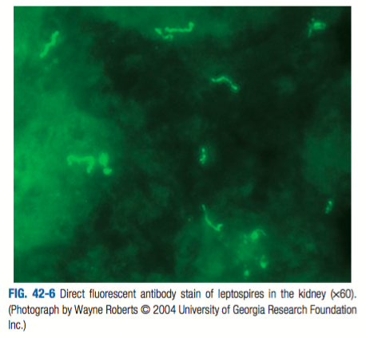
Diagnosis
CBC: inflammatory leukogram, mild to mod non-regenerative anemia, +/- thrombocytopenia
Chemistry: azotemia, increased hepatocellular and cholestatic liver enzymes, electrolyte drangements
Urinalysis: isothenuria or hyposthenuria, proteinuria, pyuria
Migroscopic agglutination test (MAT)
Polymerase chain reaction (PCR)
Antigen tests

Slide 10
Microscopic Agglutination Test (MAT)
Use of darkfield microscopy to assess degree of organism agglutination during dilution of patient serum with live serovars
Preferably paired titers 2-4 weeks apart
Advantages
Widely available
Inexpensive
Disadvantages
Requires pathogenic cultures
Cultures can become cross contaminated
Interpretation is subjective
Notes:
The MAT is widely available and inexpensive, and there is a large body of data regarding its use; as such, it is the current diagnostic test of choice for canine leptospirosis in pa- tients with consistent clinical signs.
Unfortunately, the test is hazardous to perform because of the need to main- tain live cultures of pathogenic serovars, and is difficult to standardize. Test interpretation is somewhat subjec- tive and requires considerable expertise, and serovar identity must be verified regularly to ensure accurate results. Serovar cultures may become cross-contam- inated over time.
Within the first week of illness dogs will often have negative MAT results
Convalencent titires for acute infectious dz are performed 2-4 weeks after the firest titire, although seroconversion can occur as early as 3-5 days. Should wait -14 days
Titers resulting from previous vaccination, exposure, or chronic infec- tion generally change more slowly or not at all.
Thus, although single positive titers can increase suspicion for the disease, even when high ( 800), they do not confirm a diagnosis of leptospirosis. This is especially important in dogs with a history of vaccination, because although postvaccinal titers tend to be low, high titers ( 1,600) have the potential to persist after vaccination, and cross-reactivity to nonvaccinal serogroups can occur.93 In 1 study, the sensitivity of a single MAT titer 800 for diagnosis was 22–67%, depending on the laboratory used, and the specificity was 69–100%.

Slide 11
Polymerase Chain Reaction (PCR)
Detections of pathogenic leptospires or their nuclei acid
Ideal in early course (first week) of untreated infection
After first week organisms will be in a higher concentration in urine than blood
Notes:
PCR detect pathogenic leptospires or their nucleic acid, respectively, and have potential utility early in the course of untreated infection when antibody assays are frequently negative and antimicrobials have not yet been administered.
previous vaccination should not yield false positive results by these methods
first 10 days of infection, organism numbers are highest in blood, and thus blood is the sample of choice during the first week of illness.
After that time, organ- isms are present in highest concentration in urine. When the time of infection is unknown, simultaneous testing of blood and urine may increase diagnostic sensitivity. Re- cent antimicrobial treatment can result in false negative test results for both culture and PCR, although multiple doses of antimicrobials may be required before PCR becomes negative, because PCR detects both viable and nonviable organisms.
Culture is not practical as growth is slow 3-6 months
The sensitivity of 1 assay on blood was greatest when whole blood, as opposed to sera, was used. Sensitivity was 90% in the first 5 days of illness, after which it decreased to 50% (Riediger et al, manuscript in preparation).
Other methods that can be used to confirm the presence of Leptospira spp. in tissues include silver staining of biopsy or necropsy specimens (which lacks sensitivity), immuno- histochemistry, tissue PCR, and in situ hybridization
low-cost rapid assays for IgM or leptospiral antigen that could be performed as point- of-care tests would be useful.

Slide 12
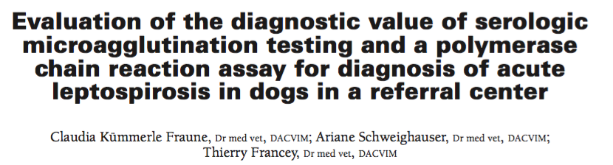
MAT versus PCR
76 dogs with AKI at referral centre
Paired serologic MAT tests (30) and PCR (20) on urine and blood (36)
PCR testing did not result in earlier diagnosis
MAT sensitivity is low in acute blood samples but 100% in convalescent blood samples
Notes:
76 dogs with AKI in a referal hospital in Switzerland
Paired serologic MAT tests (30) and PCR (20) on urine and blood (36)
Serologic MAT results were highly accurate for di- agnosis of leptospirosis in dogs, despite a low sensitivity for early diagnosis. In this referral setting of dogs pretreated with antimicrobials, testing of blood and urine samples with a com- mercially available genus-speci c PCR assay did not improve early diagnosis
Serologic acute testing of an acute blood sample had a speci city of 100% (95% CI, 76% to 100%), a sensitivity of 50% (33% to 67%),
Sero- logic testing of a convalescent blood sample had a speci city of 92% (65% to 99%), a sensitivity of 100% (87% to 100%),
Results of the Leptospira PCR assay were negative for all samples from dogs for which leptospirosis status could be classi ed.

Slide 13
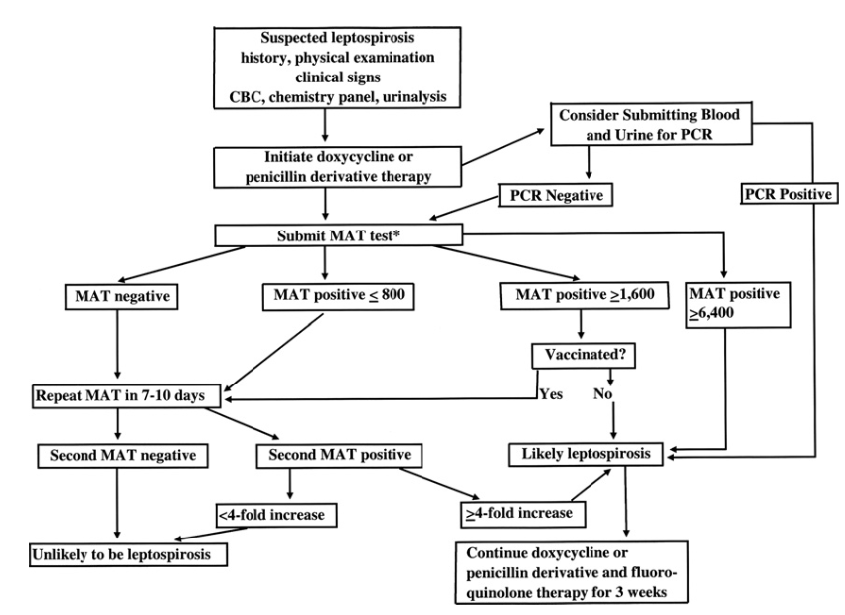

Slide 14
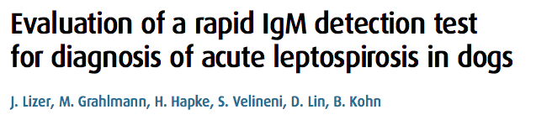
Point-of-care IgM assay
Lateral flow assay (LFA) for leptospira-specific IgM
75% sensitivity and 98% specificity
90% agreement with acute-phase MAT and 100% agreement with convalescent-phase MAT
Vaccine stimulated IgM responses negative in 75% of dogs 12-weeks post vaccines
Notes:
low-cost rapid assays for IgM or leptospiral antigen that could be performed as point- of-care tests would be useful.
Recently, a lateral flow assay (LFA) for detection of Leptospira-specific IgM in canine sera became commercially available in Europe. The present study aims to evaluate the diagnostic performance of this assay using canine sera from a collection of diagnostic accessions. Diagnostic sensitivity was assessed by testing 37 acute-phase and 9 corresponding convalescent-phase sera from dogs with a confirmed diagnosis of leptospirosis. Specificity was determined by testing sera from sick dogs with non-leptospiral infections (n=15) and healthy dogs with incomplete history of vaccination (n=45). During acute phase of illness, LFA scored positive for 28/37 sera with a sensitivity of 75.7 per cent while only 9/37 (24.3 per cent) samples were positive on microscopic agglutination test. The specificity of the LFA was 98.3 per cent (59/60). This test showed 89.7 and 100 per cent overall agreements with clinical diagnosis for acute-phase and convalescent-phase sera, respectively. The impact of vaccination on the LFA was also determined and vaccine-stimulated IgM responses were negative in 19/25 (76 per cent) dogs at 12 weeks post vaccination. In conclusion, the LFA is a rapid and reliable test for early detection of Leptospira-specific IgM during acute phase of canine leptospirosis. However, interpretation of a positive result must be made in the context of clinical signs and vaccination history.
Based on standard criteria, sera (n=107) from 97 client-owned dogs were categorised into group (1) dogs with a confirmed diagnosis of leptospirosis (n=37); group (2) sick dogs diagnosed with non-leptospiral infections (n=15) and group (3) healthy dogs with incomplete history of vaccination (n=45)

Slide 15
Treatment
Supportive care
Treatment of renal or hepatic manifestations of disease
Antibiotics
  Doxycycline 5 mg/kg PO q12 for 2 weeks
  Or Ampicillin 20 mg/kg IV q6; dose reduction in azotemic dogs
  Ceftrixone and cefotamine equally as efficacious as penicillin in humans
  Not effective: first-generation cephalosporins, chlorampenical, fluorquinolones
Dialysis for severe anuric renal failure
Notes:
Penicillins or doxycycline traditionally have been the anti- microbials of choice for treatment of humans and dogs with leptospirosis.107,108 Ceftriaxone and cefotaxime are as efficacious as penicillin in human leptospirosis.107,109 Azithromycin also may be effective.110 First generation cephalosporins appear less effective, and leptospires are resistant to chloramphenicol. Fluorquinolones are often ineffective.
doxycycline, 5 mg/ kg PO or IV q12h for 2 weeks,
If vomiting or other adverse reactions preclude doxycycline administration, dogs with leptospirosis should be treated with ampicillin, 20 mg/kg IV q6h, with dose reduction for azotemic dogs. Penicillin G (25,000–40,000 U/kg IV q12h) also could be used.
Ampicillin should not be administered orally be- cause it is not reliably absorbed from the gastrointestinal tract.

Slide 16
Prognosis
Early and aggressive treatment survival rate >80%
Exceptions: patients with ARDS, patients who require dialysis
Biochemical parameters will return to normal within 10-14 days with appropriate treatment
Unknown if lifelong immunity occurs; continued vaccination is recommended
Notes:
Prognosis for dogs treated early and aggressively is good, excepts those dogs with ARDS
Survivial rates ~80%
Successful treatment is associated with gradual return of serum urea and creatinine concentrations to reference ranges within 10–14 days, although regeneration of dam- aged renal tissue may continue for over 4 weeks
Unknown if lifelong immunity occurs

Slide 17
Public Health Implications
Most human cases are a result of exposure to contaminated water; less commonly infected through pets
Owners should avoid contact with pet’s urine until proper antimicrobial treatment is complete
Other dogs in household should be treated with with antibiotics
Notes:
Recovered or subclinically infected dogs excrete viable organisms in their urine intermittantly for days to months from the time of infection
pIn developing countries, stray dogs may represent a reservoir of infection for humans
In developed countries, most leptospirosis cases in humans result from recreational activities involving water
In 1 study, 10% of 61 leptospirosis cases in humans in Cali- fornia over the last 20 years resulted from pet contact.
In general, animals developing acute leptospirosis are incidental hosts and do not develop a chronic carrier state.
All dogs with acute renal failure, including ‘‘acute-on-chronic’’ renal failure, should be managed as leptospirosis suspects until an alternate diagnosis has been made.
If possible, patients should be placed in floor-level cages and housed away from high traffic areas.
a disposable gown should be worn, and either protective eyewear and a facemask, or, alternatively, a full face shield should be worn if aerosolization of urine is possi- ble, such as when manipulating urinary catheters or collection systems, or when cleaning areas of urine spill- a
hey should be allowed to urinate in a restricted area, preferably one that can be easily and immediately decontaminated, s
Because of the zoonotic potential of leptospirosis, treatment of other dogs in the household that may have been coincidentally exposed to a source of leptospires in the environment is recom- mended, ideally with monitoring of acute and convalescent phase antibody titers. The recommended treatment is doxy- cycline, 5 mg/kg PO q12h for 14 days.
until proper antimicrobial therapy is completed, owners should avoid contact with their dog’s urine and wear gloves when cleaning up urine

Slide 18
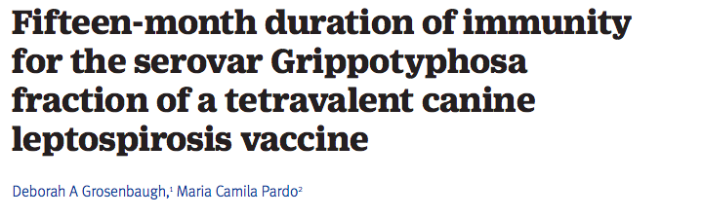
Vaccination
Current vaccines contain serovars for:
  Icterohaemorrhagiae, Canicola, Grippotyphosa, Pomona
Effective protection for at least 12 months
Acute anaphylaxis has been reported, but no more common than with other canine vaccinations
Annual vaccination with 4-serovar vaccine depending on geographic risk
Notes:
Forty-four specific pathogen-free beagles, median age 65 days, received two subcutaneous doses of either a commercially available, five-way combination vaccine or the same vaccine in combination with a tetravalent Leptospira bacterin (Canicola, Grippotyphosa, Icterohaemorrhagiae, Pomona). They were subsequently challenged with a pathogenic strain L kirschneri serovar Grippotyphosa 470 days following completion of the vaccination protocol. Titres of agglutinating serum antibodies were determined at various time points before and after both vaccination and challenge, along with postchallenge reisolation of the challenge organisms from blood and urine, and evaluation of renal histopathology. Clinical signs of generalised leptospirosis were not observed in any of the dogs after challenge. In order to demonstrate efficacy, leptospirosis was defined as having at least one positive urine sample and a positive renal histopathology score; or, in the absence of renal pathology, multiple positive urine samples. Leptospiremia was not demonstrated in any of the vaccinated dogs versus 27 per cent of the controls; leptospiruria was noted in 5 per cent of the vaccinates compared with 76 per cent of controls; and renal lesions were observed in 15 per cent of the vaccinates and 65 per cent controls. Using these criteria, the vaccine was able to significantly prevent leptospirosis (P=0.0001) in the vaccinated animals. This study establishes duration of immunity of at least 15 months for the prevention of disease and renal excretion of leptospires for the Leptospira serovar Grippotyphosa fraction of a quadrivalent Leptospira vaccine.

Slide 19
Questions?

Slide 20
References
Sykes JE, Hartmann K, Lunn KF et al. 2010 ACVIM Small Animal Consensus Statement on Leptospirosis: diagnosis, epidemiology, treatment and prevention. J Vet Intern Med 2011;25:1–13
Lizer, J., Grahlmann, M., Hapke, H., Velineni, S., Lin, D., Kohn, B. (2017) Evaluation of a rapid IgM detection test for diagnosis of acute leptospirosis in dogs. Veterinary Record 180, 517.
Knöpfler, S. , Mayer‐Scholl, A. , Luge, E. , Klopfleisch, R. , Gruber, A. D., Nöckler, K. and Kohn, B. (2017), Evaluation of clinical, laboratory, imaging findings and outcome in 99 dogs with leptospirosis. J Small Anim Pract, 58: 582-588.
White AM et al. Hotspots of canine leptospirosis in the United States of America. The Veterinary Journal 222 (2017) 29–35
Grosenbaugh, DA., Pardo, MC. (2018) Fifteen-month duration of immunity for the serovar Grippotyphosa fraction of a tetravalent canine leptospirosis vaccine. Veterinary Record Published Online First: 19 February 2018.

