Slide 1
ADRENAL Trial:
Adjunctive Glucocorticoid Therapy in Patients with Septic Shock
Venkatesh et al, NEJM, 2018
Mariana A. Pardo BVSC, MV
Journal Club

Slide 2
Introduction
Sepsis has no proven pharmacological treatment
  Antibiotics, fluids and vasopressors as needed
Death rates in hospitalized patients 30-45%
Glucocorticoids have been used as an adjuvant therapy for 40 years without good evidence for or against it

Slide 3
Introduction
1980¹
  Randomized controlled trials showed that high dose methylprednisolone (30 mg/kg) was associated with higher morbidity and mortality than control
2000²
  Randomized controlled trials showed conflicting results of low dose hydrocortisone (200 mg/day) on mortality, but earlier reversal of shock was noted

Slide 4
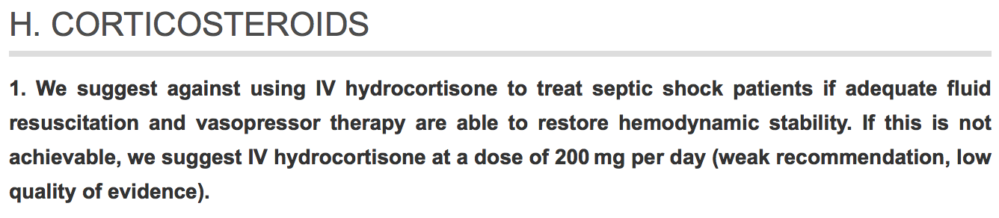
Surviving Sepsis Campaign Guidelines 2016

Slide 5
Rationale for SS Guidelines
CORTICUS Trial
  Multicenter, randomized, double-blind, placebo-controlled trial
  499 hypotensive septic patients despite fluid resuscitation and vasopressors
  All had ACTH stim (46.7% did not have a response)
  50 mg hydrocortisone q6h x 5 days (251) or placebo (248)
  ACTH cannot be used to determine which patient should receive steroids
  Mortality was not significantly different, hydrocortisone group shock reversed more quickly, however had more superinfection and new sepsis/septic shock

Slide 6
Question?
Does hydrocortisone reduce mortality in patients with septic shock?

Slide 7
Methods
Study Design:
  Double-blinded, Parallel-group, Randomized, Controlled Trial
  Comparing IV infusions of hydrocortisone w/ matched placebo in patients w/septic shock undergoing MV

Slide 8
Methods
Patients:
  Adults undergoing MV, with documented or suspected infection, fulfilling 2 or more SIRS criteria
  On vasopressors or inotropic agents for at least 4 hr at the time of randomization
  Exclusion: receiving steroids, etomidate, expected to die within 90 days from pre-existing disease, had treatment limitations or had met inclusion criteria for >24hr
Notes:
Met inclusion criteria for > 24h…. More sick?

Slide 9
Methods
Randomization:
  Hydrocortisone 200 mg/day
  Placebo
  Both CRI for a max of 7 days or until ICU discharge or death
Notes:
Met inclusion criteria for > 24h…. More sick?

Slide 10
Methods
Outcomes:
  1ary: 90 day all cause mortality
  2ary: 28 day all cause mortality, time to resolution of shock, length of ICU stay, LOH, frequency and duration of MV, frequency and duration of RRT, incidence of new-onset bacteremia or fungemia between 2-14 days after randomization, receipt of blood transfusion
Notes:
Met inclusion criteria for > 24h…. More sick?

Slide 11
Statistical Analysis
Logistic-regression model with adjustment for stratification variables, with admission type (medical or surgical) as a fixed effect and trial site as a random effect

Slide 12
Statistical Analysis
Logistic-regression model
  Regression model where the dependent variable is categorical (Live/Dead)
  Allows one to say that the presence of a risk factor increases the odds of a given outcome by a specific factor

Slide 13
Statistical Analysis
Example: Probability of passing an exam versus hours of study
Suppose we wish to answer the following question:
A group of 20 students spend between 0 and 6 hours studying for an exam.
How does the number of hours spent studying affect the probability that the student will pass the exam?

Slide 14
Statistical Analysis
The table shows the number of hours each student spent studying, and whether they passed (1) or failed (0

Slide 15
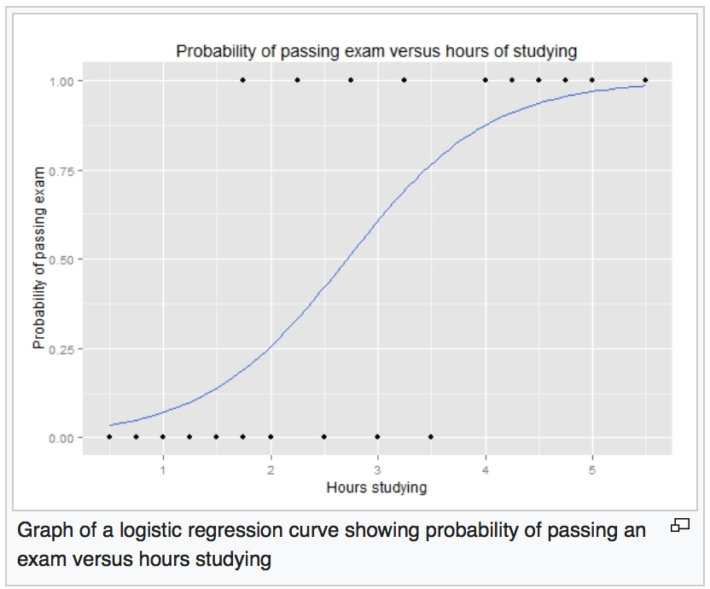
Statistical Analysis
The graph shows the probability of passing the exam vs the # of hrs studying, with the logistic regression curve fitted to the data

Slide 16
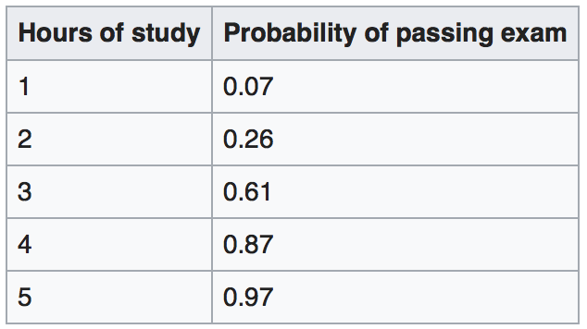
Statistical Analysis
This table shows the probability of passing the exam for several values of hours studying

Slide 17
Statistical Analysis
Logistic-regression model with adjustment for stratification variables, with admission type (medical or surgical) as a fixed effect and trial site as a random effect
Additional sensitivity analyses were performed by adding the following covariates to the main logistic-regression model
  Sex, age, APACHE score, time on onset of shock to randomization, RRT in the 24hr before randomization

Slide 18
Results
3800 patients were enrolled in 69 medical/surgical ICUs
Between day 1-7 hydrocortisone group had higher MAP, higher lactate and lower HR compared to placebo group
No difference in peak dose of norepinephrine between days 1-14

Slide 19
Results
1ary Outcome
  90 day mortality
    27.9% died in hydrocortisone and 28.8% in placebo group

Slide 20
Results
2ary Outcome
  No significant difference in 28 day mortality
  Time to resolution of shock shorter in hydrocortisone group (3d vs 4d)
  Time to ICU discharge shorter in hydrocortisone group (10d vs 12d)
  Hydrocortisone group had fewer blood transfusions
  Hydrocortisone group had initial shorter duration of MV, but taking into account recurrence, there was no ≠
  No ≠ in rate of recurrence of shock, time to hospital discharge, # of days alive and out of the hospital, rate of recurrence of MV, rate of use of RRT and rate of development of bacteremia and fungemia

Slide 21
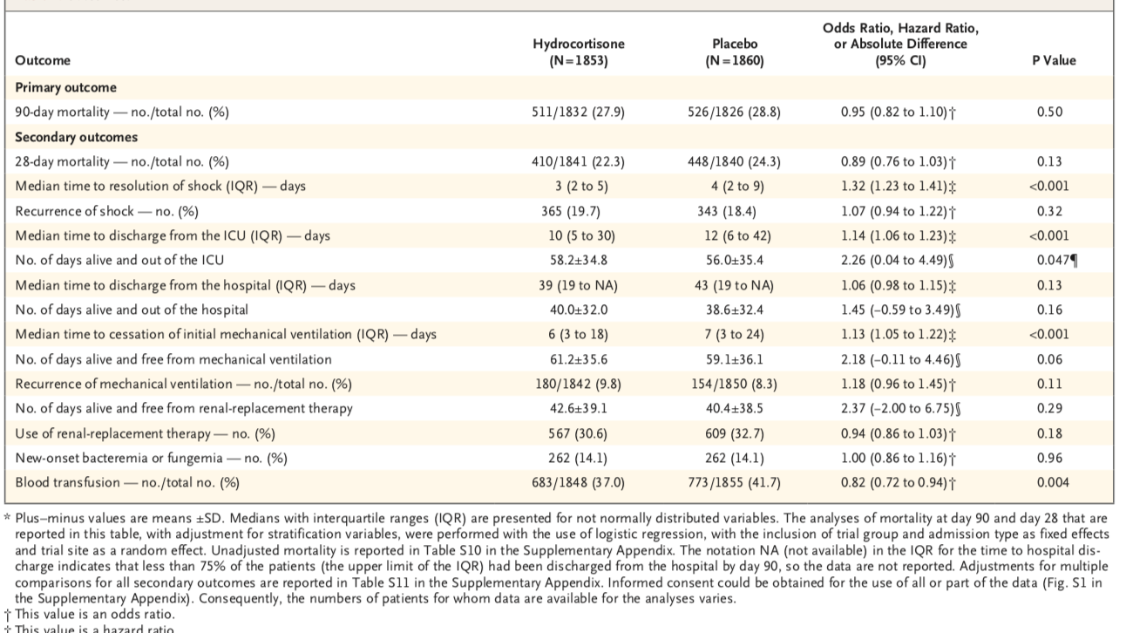

Slide 22
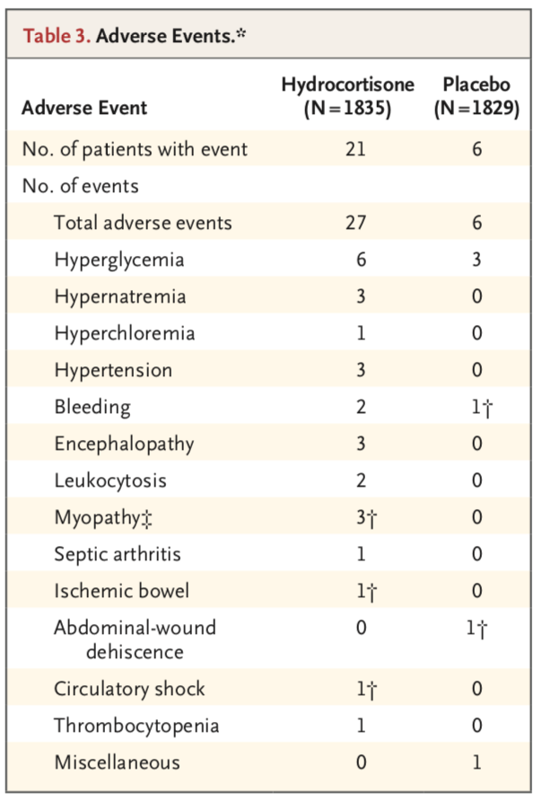
Results
Hydrocortisone group had a higher incidence 1.1% vs 0.3% in the placebo group

Slide 23
Limitations
Collected adverse events only judged by treating clinicians
Did not collect all possible 2ary infection data, only bacteremia and fungemia
Used recurrence of MV as surrogate for myopathy, did not assess long-term neuromuscular weakness

Slide 24
Discussion
Hydrocortisone CRI was chosen since this ha been chosen to attenuate inflammatory response and reverse shock, it may also minimize potentially harmful metabolic effects of steroids
Abrupt discontinuation was performed because a recent study¹ showed no benefit from a tapering strategy of steroids
Notes:
Timing, method and discontinuation of hydrocortisone administration for septic shock patients
Compared bolus vs CRI of hydrocortisone, and effect of tapering steroids
SS guidelines recommend tapering, main argument for this suggestion is a small crossover study in which shock relapse occurred in 30% of patients with sudden discontinuation, which was underpowered to come to that conclusion
Conclusion: Continuous infusion of hydrocortisone could hasten the resolution of septic shock compared to bolus administration. Earlier initiation corresponds with a higher probability of shock reversal. Tapering strategy is unnecessary.

Slide 25
Potential Benefits of Hydrocortisone
Hydrocortisone group had a lower incidence of blood transfusions
Faster shock reversal
Notes:
Hypothesis generating?

Slide 26
Conclusions
In conclusion, in patients with septic shock who were undergoing mechanical ventilation, the administration of a continuous infusion of hydrocortisone did not result in lower mortality at 90 days than placebo.

