Slide 1
Revised Starling Equation & Glycocalyx Model
Jessica Wallis, BVSc (Hons)

Slide 2
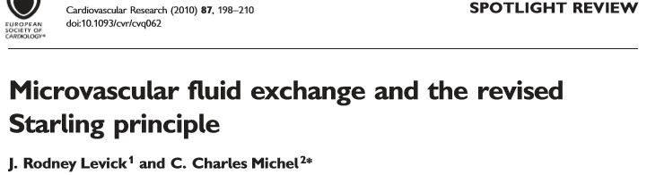
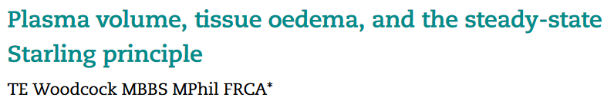
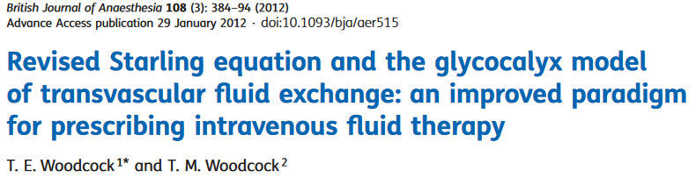

Slide 3
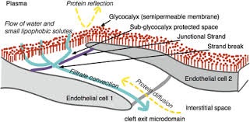
The glycocalyx as a separate ECF compartment
3 Intravascular volumes
  Plasma volume
  Red cell volume
  Non-circulating volume (endothelial glycolcalyx): can account for 1.5L human blood volume in health
Glycocalyx compartment is almost protein free

Slide 4
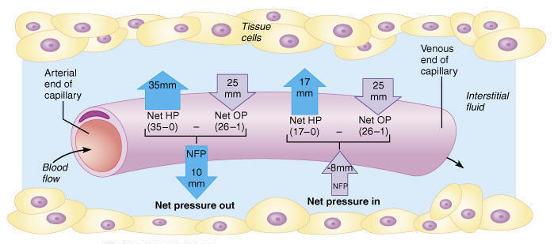
Traditional Starling equation

Slide 5
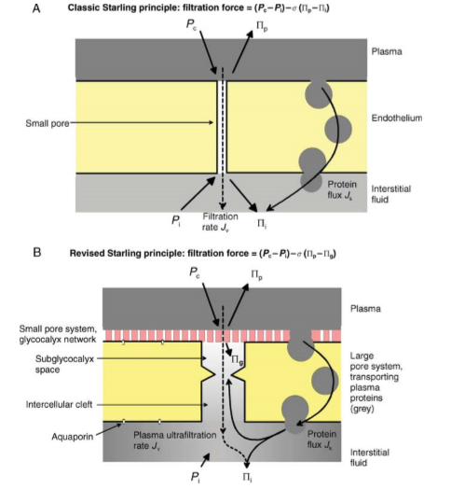
The revised starling principle (Levick & Michel)
Absorption dependent on gradient between interstitial space (high oncotic pressure) and sub-glycocalyx compartment (almost no oncotic pressure)
  Increasing plasma oncotic pressure will not increase fluid resorption from intersitium

Slide 6
Interstitial fluid circulation
Fluid is not resorbed into capillaries as previously thought
  100% of recirculation is via lymphatics in most tissues
  This is not true in certain tissues (eg kidney)

Slide 7
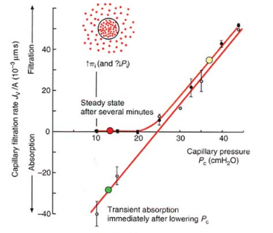
The J Curve

Slide 8
Application to fluid therapy
Administered crystalloids redistribute to both plasma volume and glycocalyx volume
Colloids do not freely penetrate glycocalyx so volume of distribution is only plasma
  May account for increased volume response to administering equal volume of colloids

Slide 9
Application to fluid therapy
Increased capillary pressure (as seen during rapid boluses) will increase capillary pressure and thus Jv
  Slower fluid therapy minimized hyperfiltration and so maximizes intravascular volume
Vasopressors lower capillary pressure and so reduce filtration (Jv)
  More of extracellular volume remains intravascular
  Alpha1 agonists may be used as an anti-edema treatment

