Slide 1
Cochrane Review
Corticosteroids for Pneumonia

Slide 2
Background
Corticosteroids reduce inflammation, an important factor in pneumonia
  Reduce release of cytokines and inflammatory mediators (especially IL-6)
  Reduce BAL neutrophil count
Adverse effects make steroid use controversial
  Hyperglycemia
    Associated with mortality
  Immunosupression

Slide 3
Objectives
Clearly stated at beginning of article
  In particular, we aimed to answer whether systemic steroid treatment:
  1. reduces all-cause mortality among people with pneumonia
  2. reduces morbidity among people with pneumonia
  3. increases complication rates among people with pneumonia.

Slide 4
Methods of Cochrane Review
Review of randomized control trials (RCTs) only
Database searches and verification by primary authors
  Ensuring appropriate end-point measurements and interventions

Slide 5
Assessment of bias
Random sequence generation
Allocation concealment
Blinding of participants and personnel
Blinding of outcome assessment
Incomplete outcome data
Selective outcome reporting
Other bias

Slide 6
Selective outcome reporting
Most important factor:
  Did authors register their hypotheses in database prior to performing study

Slide 7
Assessment of heterogeneity
The more heterogeneous the RCTs are with regards to experimental protocols (different patient pop, outcomes) the more difficult it is to combine the results into an ‘overall effect’

Slide 8
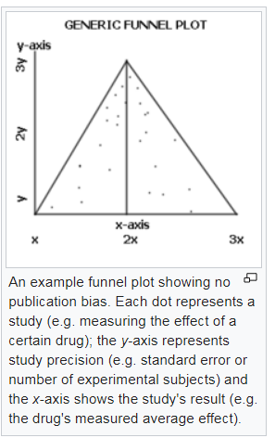
Assessment of reporting biases
Used of a funnel plot to ensure that imprecise studies (studies with few patients, few events, large variation in effects) do not have oversized effects on intervention effect

Slide 9
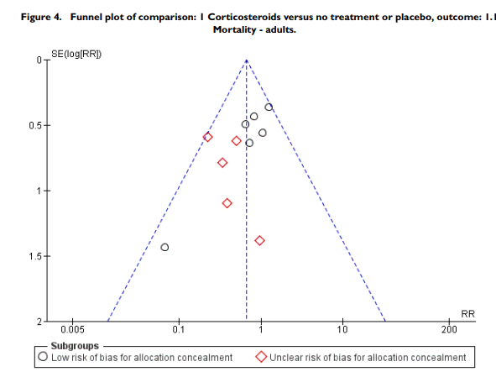

Slide 10
GRADE System
Rates quality of evidence for each outcome from high – very low
Baseline:
  RCT = high
  Non-RCT = low
Then downgraded (or sometimes upgraded) from there

Slide 11
Downgrading
Risk of bias
Inconsistency
Indirectness
Imprecision
Publication bias

Slide 12
Risk of Bias
Done by outcome, rather than by study
Inadequate methods of sequence generation
Lack of allocation concealment
Lack of blinding
Loss to follow-up
Failure to follow intention to treat
Selective outcome reporting

Slide 13
Upgrading
Large magnitude of effect
Dose response
Effect of all plausible confounding factors would be to reduce the effect or suggest spurious effect

Slide 14
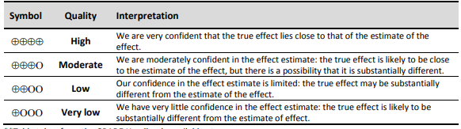

Slide 15
Results
All-cause mortality significantly lower in patients who received corticosteriods
Dose was 40-50mg of pred equivalent per day
  5-10 days
  Often 200mg/day hydrocortisone
Subgroups
  4 trials with non-severe pneumonia
    No mortality difference

Slide 16
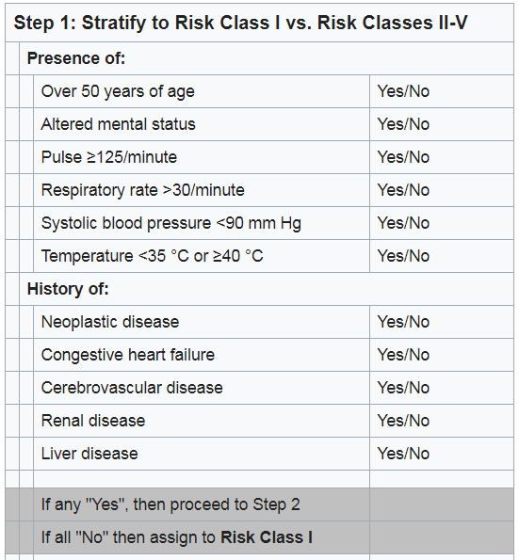
Pneumonia Severity Index

Slide 17
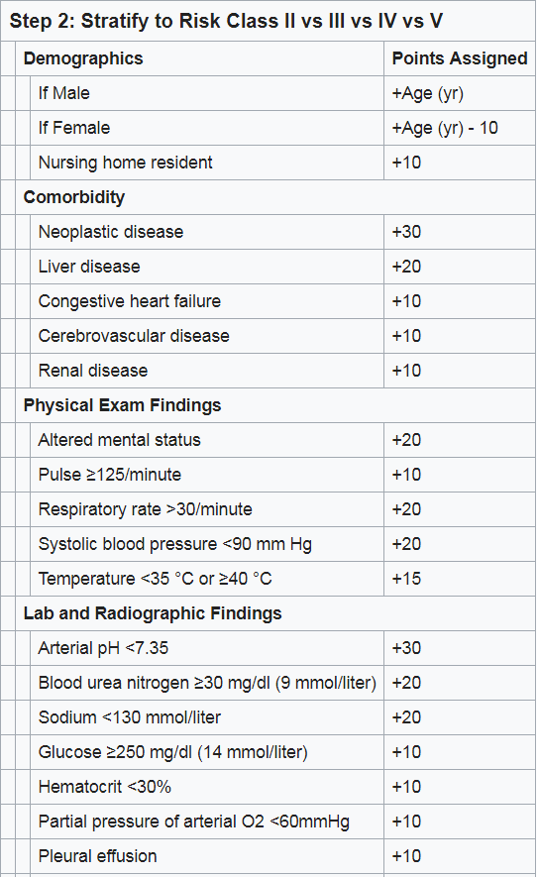
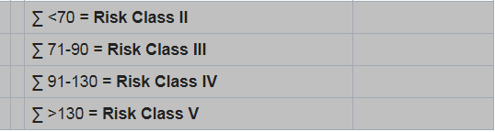

Slide 18
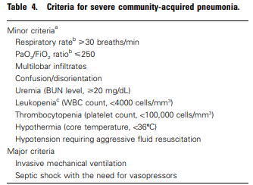
3 Minor or
1 Major Criteria

Slide 19
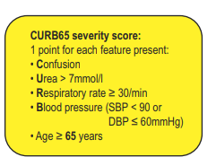
3 points or more

Slide 20
Secondary Results
The need for new non-invasive or invasive mechanical ventilation, not present at onset of pneumonia, was significantly lower in the corticosteroid arm compared to the control arm
The development of shock not present initially was significantly lower in the corticosteroid arm
The length of hospital stay was significantly shorter in the corticosteroid group compared to control (-2.91 days)
The rate of pneumonia complications was significantly lower for the corticosteroid arm when compared to controls
For adults, we found no difference in the rate of secondary infections between the corticosteroid group and the control group

Slide 21
Adverse events
There was a trend towards more adverse events in the corticosteroid arm compared to control, but with no statistical significance
Hyperglycemia developed significantly more frequently in the corticosteroid arm
No significant difference between the two arms for gastrointestinal bleeding

Slide 22
Discussion
For adults, corticosteroids significantly reduced mortality for participants with severe pneumonia
  Number needed to treat for an additional beneficial outcome =18 patients
There was no benefit or harm for steroids with non-severe pneumonia

Slide 23
Corticosteroids reduced the time to clinical cure, length of hospital stay, and length of ICU stay for participants admitted to the ICU.
Similarly, the development of respiratory failure necessitating mechanical ventilation, the development of shock not present at pneumonia onset, and the rate of pneumonia complications were reduced among corticosteroid-treated participants
People with non-severe CAP may benefit from corticosteroid therapy as well, but with no survival advantage

