Slide 1
Fastcatting
Re-view
Or
A Fastcatting refresher

Slide 2
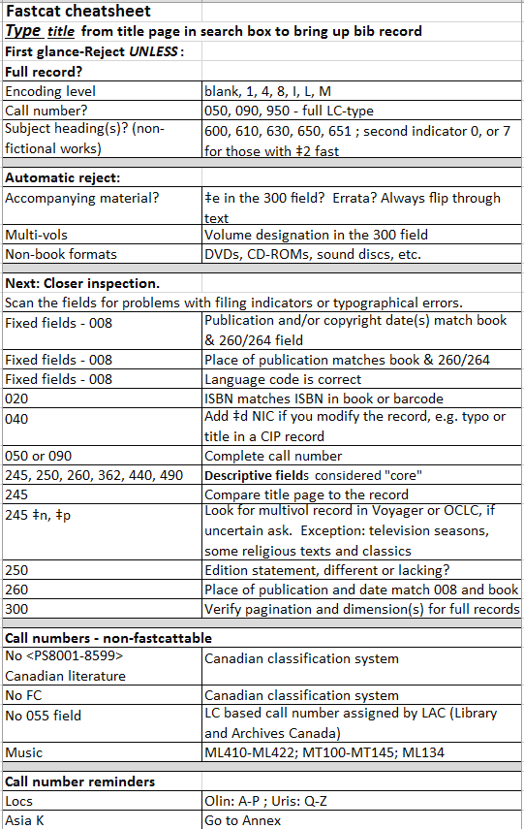

The Fastcat Procedure made easy.

Slide 3

Looking more closely …
FastcatTable?
encoding level: blank, 1, 4, 8, I, L, M
normal looking call number?
Real (Authorized) subject headings, 600, 610, 630, 650, 651, second indicator “0” or second indicator “7” and $2 fast (unless it is a work of fiction, such as a novel, poetry, short stories, etc.)

Slide 4
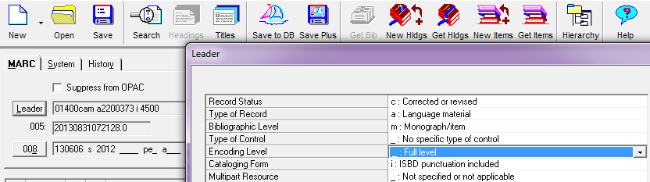
Encoding Levels – blank, 1,4, 8, I, L, M
Just because it has a good encoding level, that doesn’t mean it’s a good record
The acceptable:
blank | Full level | Most complete MARC record created from an inspection of the physical item.
1 | Full level, material not examined | Next most full record after the full level created from information derived from a description of the item (e.g., a printed catalog card.) Used primarily in the retrospective conversion of records.
4 | Core level | Less-than-full but greater-than-minimal level cataloging record that meets core record standards for completeness.
8 | Prepublication level | This includes a record created through the Cataloging-in-Publication (CIP) program
I | Full-level input by OCLC participants | A record that conforms to OCLC's level I input standards
L | Full-level input added from a batch process | Batchloaded from an institution other than LC, NLM, BL, NLC or NLA.
M | Less-than-full added from a batch process | A less-than-full record batchloaded from institutions other than LC, NLM, BL, NLC or NLA.
Notes:
These are the encoding levels we are currently fastcatting.

Slide 5
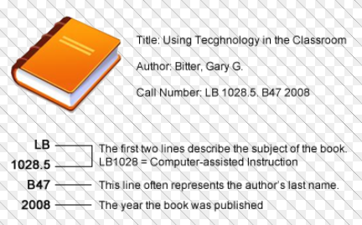
Normal vs. abnormal looking call numbers
(if not the author then the title)
More on this Later …
Notes:
This is a book on education so it’s an L classification, LB is theory and practice of education including philosophy

Slide 6
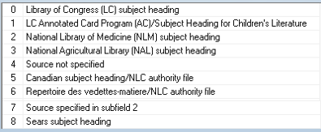
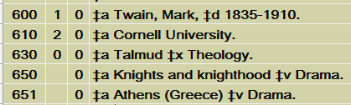
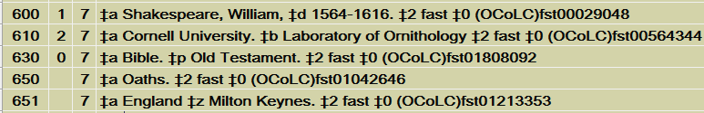
Valid subject headings required for non-fiction works
LC subject headings second indicator 0
FAST subject headings second indicator 7
Library of Congress subject headings
FAST subject headings

Slide 7

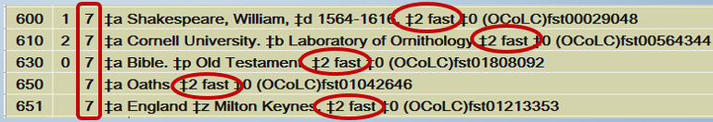
FAST subject headings
(Faceted Application of Subject Terminology)
FAST terminology is derived from the Library of Congress subject headings (LCSH). The development of FAST has been a collaboration of OCLC research and the Library of Congress and began in late 1998.
FAST has been developed in large part to attempt to meet the perceived need for a general-use subject terminology scheme which is:
Our original catalogers who create these records give them an encoding level of 7.
Notes:
We’re working with OCLC on this project. Our original catalogers who create these records give them an encoding level of 7, a minimal level record.

Slide 8

653’s AND 655’s ARE NOT VALID SUBJECT HEADINGS
Bib Records containing solely 653 and 655:
FASTcat Only works of fiction
such as novels, poetry, short stories, etc.

Slide 9
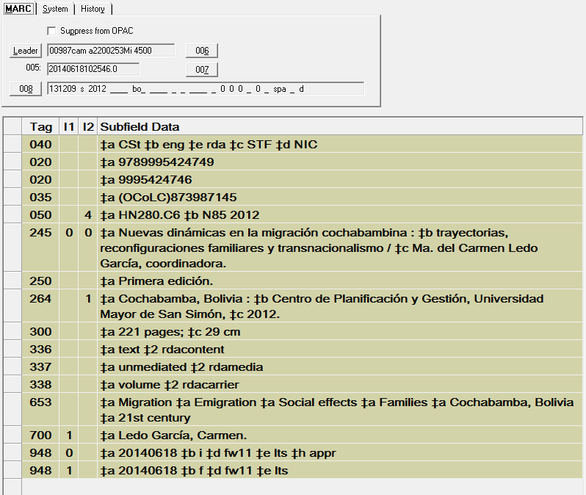
And while we’re on the subject …
Not fiction and no 600, 610, 630, 650, 651, second indicator 0, or 7 for those with ‡ 2 fast
but it was fastcatted!!!
Just because the record has a good encoding level
that doesn’t mean it’s a good record
Notes:
Be careful, a query was run to look at the encoding level “M’s” that were being fastcatted and there were quite a few with 653’s and no valid subject headings. Notice all the delimiter “a’s.”

Slide 10
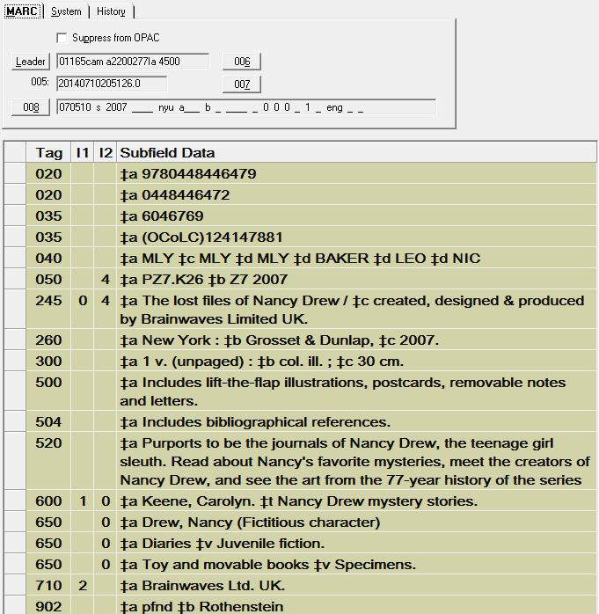

You have to examine the record and the book

Slide 11


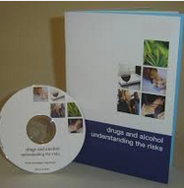
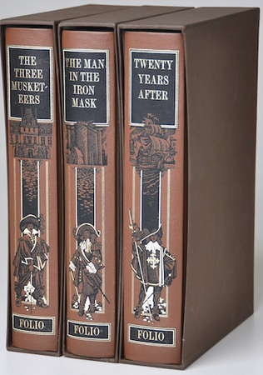
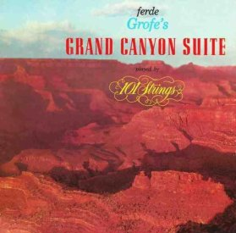
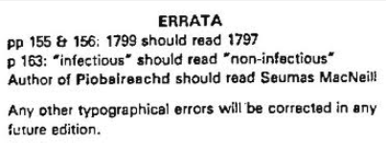
Automatic rejects
Accompanying material: is there a ‡e in the 300 field? Errata? Disc? Always flip through text to check for Extra items.
Multivols: is there a volume designation in the 300 field ?
Non-book formats: DVDs, CD-ROMs, SOUND DISCS, etc.
Notes:
Accompanying material, multivols, non-book formats, errata slips, these are all automatic rejects.

Slide 12

Upon closer inspection …
Scan the fields for problems with filing indicators, typographical errors, anything that doesn’t look right. We’re all detectives.

Slide 13

The title page is our source, not the cover.

Slide 14
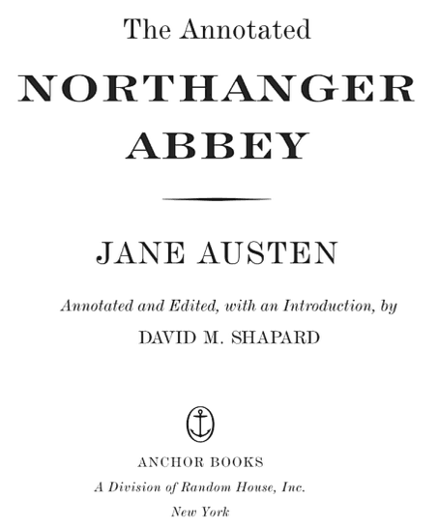
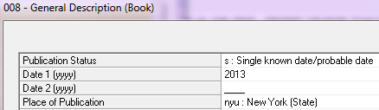
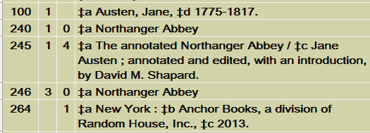
Fixed Fields
It’s in English
Notes:
To search for the record, type in the title from title page. Verify that 245 matches, place of publication, publication date and the language it’s written in.

Slide 15
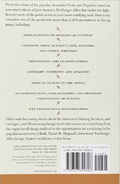
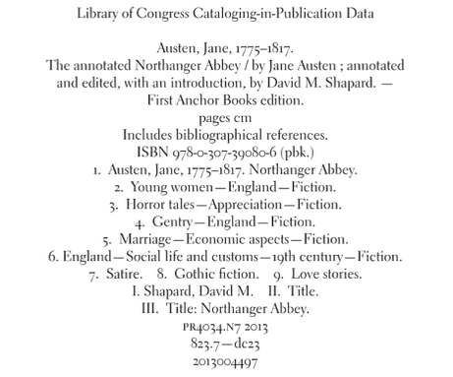
Verify Isbn numbers
(020)
CIP is not a valid source for anything EXCEPT the LCCN number (010)
Try to verify with barcode number on back cover
Only the LCCN is valid in CIP
Notes:
As you know, the CIP is usually on the back of the title page and looks like an old catalog card.

Slide 16




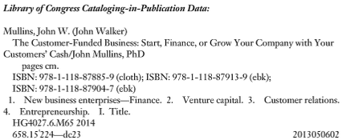
An example of an LCCN error from a cip
Notes:
The CIP on the tp verso of Microeconomics pulled up The Customer-funded business when I searched it.

Slide 17

040 Field
Add a ‡d NIC if you change anything at all on the record, even if you just add a period “ . ”

Slide 18

Descriptive fields considered "core"
245, 250, 260, 362, 440, 490
and need to
match
245 - Title Statement: Title and statement of responsibility area of the bibliographic description of a work.
250 - Edition Statement: Information relating to the edition of a work as determined by applicable cataloging rules.
260 - Publication, Distribution, etc. (Imprint): Information relating to the publication, printing, distribution, issue, release, or production of a work.
362 - Dates of Publication and/or Sequential Designation: Beginning/ending date(s) of an item and/or the sequential designations used on each part. (We see this with serials.)
490 - Series Statement (440 is obsolete but still used by some institutions): Series statement for a series title.

Slide 19

Another reminder
245 Field:
ALWAYS …
Yes, always
search by the title
~using the title page!~
(yes, you Really have to key it in.)

Slide 20

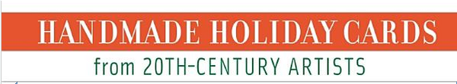

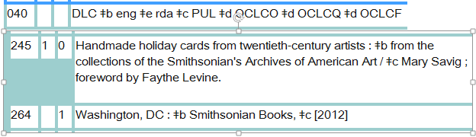
And this is why!
Don’t trust the ISBN
Don’t trust the Encoding level
Cover
On title page
SHOCKING!!!
Full level record
Cover and title page don’t match on an LC record!!!
And there’s not even a 246 for the title variation!!!
Notes:
No, it’s true, the ISBN is not always correct and certainly not the best way to search a title. Even our eyes can trick us when it comes to looking at titles. The correct and best thing to do is type the title into the search box and see what happens. This book could have potentially been lost in the stacks forever and inaccessible to anyone.

Slide 21

The book has to match what is in the record.
It’s as easy as Proofreading.

Slide 22

245 ‡n, ‡p
REJECT & CONSULT
a cataloger or trainer !
Exceptions: television seasons (DVD), some religious texts and classics. Can lose richness of subject headings so it’s tricky.
We may already have a multivol bib record and then need to delete a record, or may need to import multivol record from OCLC. You’re welcome to ask.

Slide 23
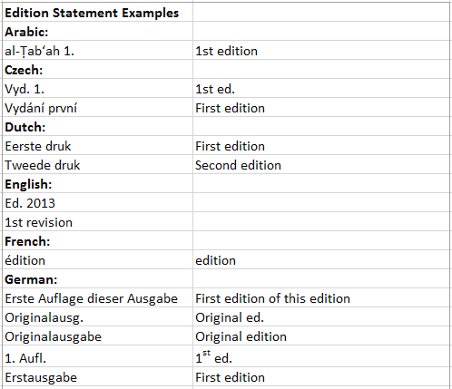
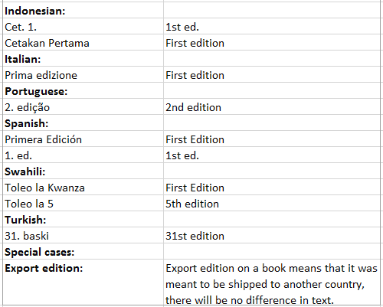
250 - Edition statement
The edition statement in the book and bib record must match.
Scan cover, title page or t.p. verso for edition statement. RDA reflects exactly what is printed in the text.

Slide 24

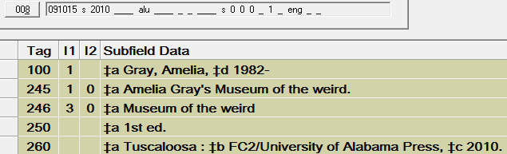

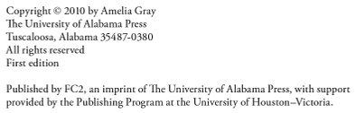
260/264 Field
Place of publication and date match 008 and book

Slide 25
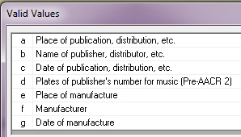

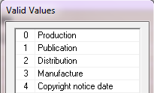



260/264 Field continued …
260 ‡
AACR2
RDA & AACR2
260 - 2nd indicator
264 - 2nd indicator
Not bracketed so publication date was on piece
Bracketed - old RDA rules, no publication date on book so established by copyright date
Note: You may see both 260’s and 264’s in the same record. That’s ok!

Slide 26

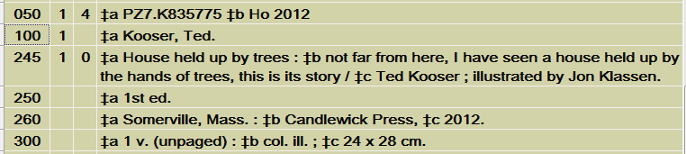
300 Field
Verify pagination and dimension(s) for full records
We all know in Olin/Kroch/Uris libraries for example, if the width is over 26 cm. the book is considered oversize.
24 cm.
But did you know ?
28 cm.
Items for O/K/U stacks which have a width greater than 20 cm. require an oversize designation. Library "regular-size" shelves will handle no more than 20 cm. in width.

Slide 27
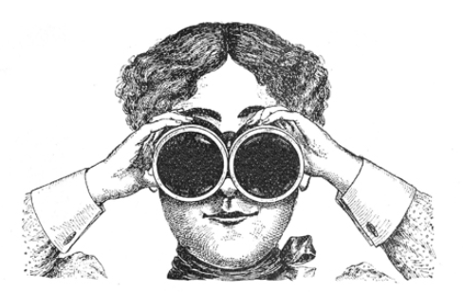
300 ‡e
Accompanying Material
Keep an eye out!
An Access query of OKU bib records with a disc-type mention in the ‡e in the 300 field but no 867 for supplemental material in the holdings.
Of the 218 records addressed 10% had issues:
  Thirteen or 5.96% were lacking marking and tattle tape
  Nine or 4.13% were now lacking the disc which may have needed to be claimed or has now gone missing!
Let’s examine the book regardless of whether or not there’s a ‡e. Discs in the back of a hardcover book get missed the most.
Notes:
Fortunately, Physical Processing while stiffening books caught many of the discs which had been missed and therefore hadn’t been addressed in the holdings. Discs tended to be missed in hard covers however and now that many books are no longer being stiffened more discs may not be discovered in their books. And always examine books, I’ve seen records where there was no mention of a disc in the book and there’s been one. Also, errata are only on the bib if they’ve been glued in by the publisher, so please examine the book.

Slide 28
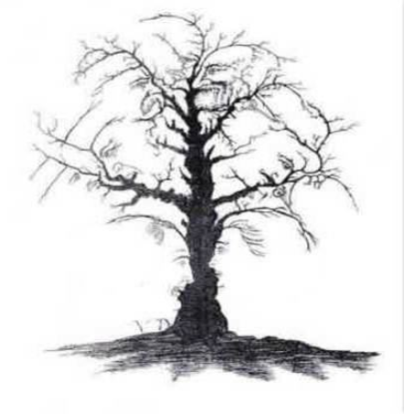
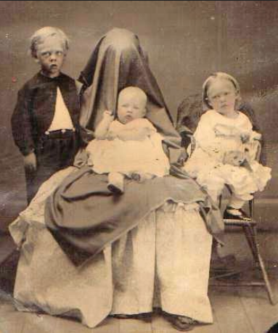

490/440
Watch for Series statements
They can be hiding in plain site

Slide 29

It’s our job.
Scan the fields for problems with filing indicators or typographical errors. Correct obvious typos and
d NIC. Reject questionable items (and annotate flyer or printout) or return to supervisor for clarification.
Notes:
Book detectives.

Slide 30
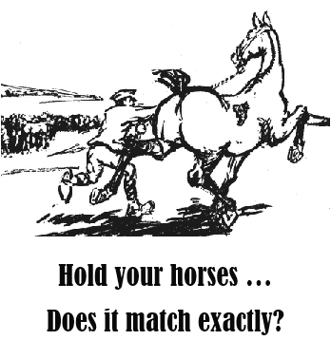
And if something in the book doesn’t match the record:
Look in OCLC for a matching record or ask if uncertain.
Title variation?
Different statement of responsibility?
Different place of publication?
Different publisher?
Different publication date?
Different edition?
Different pagination?
Different size?
Differing series statement?

Slide 31
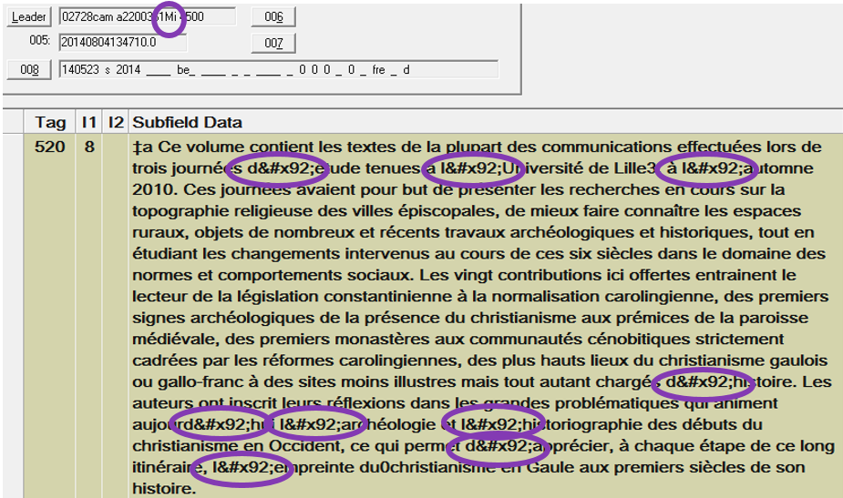
It May be an encoding level “m” but it also may be a lousy record. Coding Mess. Look over the record.
There can be diacritic or punctuation coding issues. You can remerge with the record or a field from OCLC and fastcat accordingly. Or if easier replace with the correct diacritic if not too overwhelming and you feel confident. This is not really a dNIC situation because it’s a glitch in our database, not a problem with the record.
We’re working on this.
Notes:
There can be diacritic or punctuation coding. You can remerge with a record from OCLC and fastcat accordingly. Or if easier replace just that field or the correct diacritic if not too overwhelming and you feel confident. This is not really a d NIC situation because it’s a glitch in our database and not a problem with the cataloging. Batch Processing is working on this.

Slide 32
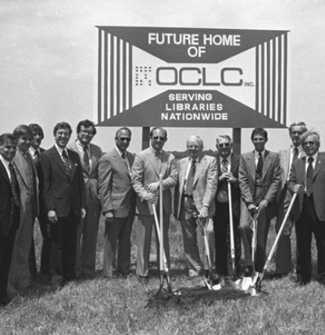
Got a Lousy record?
Dig in OCLC for a better one.

Slide 33
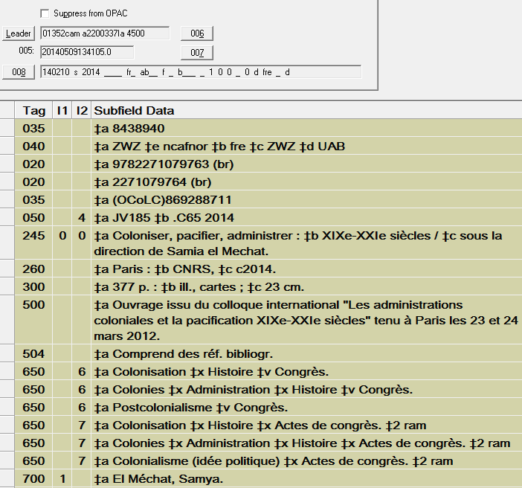
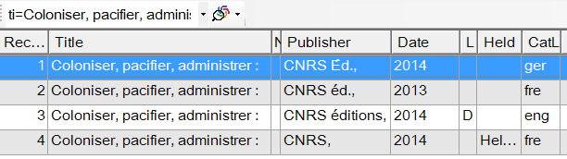
Foreign language records – Bad Because …
It’s only full if you’re French.
Our holdings are on a foreign language record
… but here is the LC record ☹
… NO ENGLISH SUBJECT HEADINGS FOR SEARCHING PURPOSES!!!
Notes:
When we use a foreign language record, our holdings in OCLC are then attached to that record and there’s an LC record available.

Slide 34
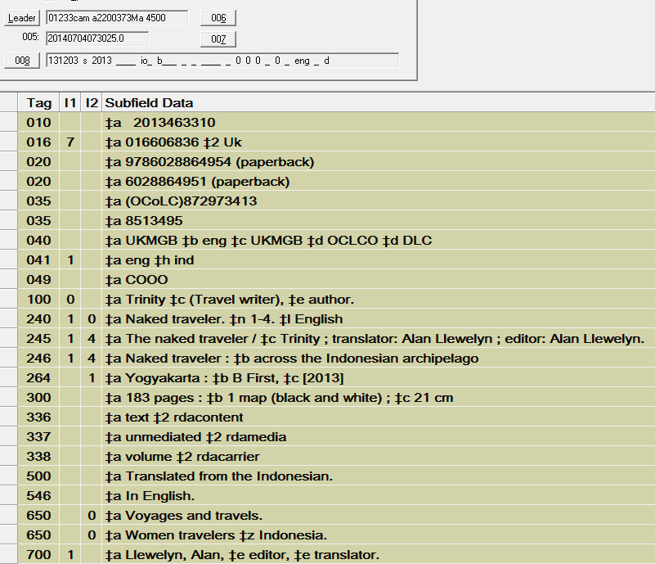
Bad British records, look like rda but …
If they’re fastcattable, that’s ok, just leave them as they are because …
No ‡e rda
Notes:
Lots of RDA elements but AACR2.

Slide 35
It’s not just Bad British records Anymore
OCLC Has gotten in on the act
It’s ok to have mixed AACR2 and RDA elements.
Machine Manipulation of Existing WorldCat Records as of March 31, 2013
Among the changes:
Adding 336, 337, 338 fields
Spelling out non-transcribed abbreviations in 300, 500, 504 and other fields
Converting Latin abbreviations to English equivalents in 245, 260, and other fields
Converting dissertation notes in 502 field to multiple subfields
Heading changes in accordance with RDA
Heading changes are anticipated to spell out abbreviations in headings like "Dept." and to change Bible and Koran headings in accordance with RDA practice.

Slide 36
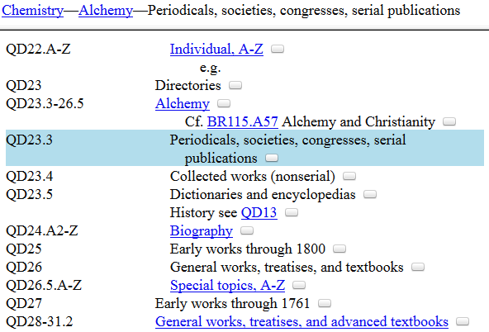
Call Numbers
& How they work (in general)
Subject letter with subclass | QD
Number division | 23
Number division with decimal | .3
Cutter for main entry | .A43
Publication date (optional) | 1990
Q=Science QD=Chemistry
Notes:
Back to call numbers. In this case the title is the main entry. Q=Science QD=Chemistry

Slide 37
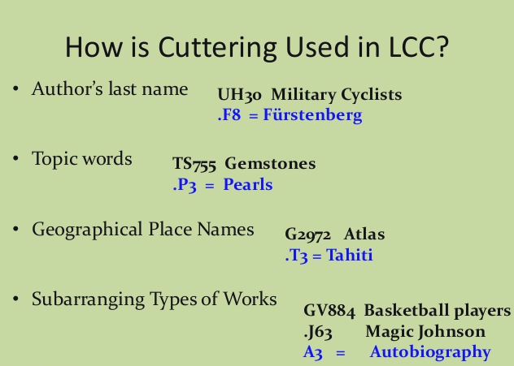


(Library of Congress Classification)
U=Military science
UH=Other services
T=Technology
TS=Manufactures
G=Geography, anthropology, recreation
GV=Recreation, leisure
Cheryl Tarsala - Building cutter numbers

Slide 38
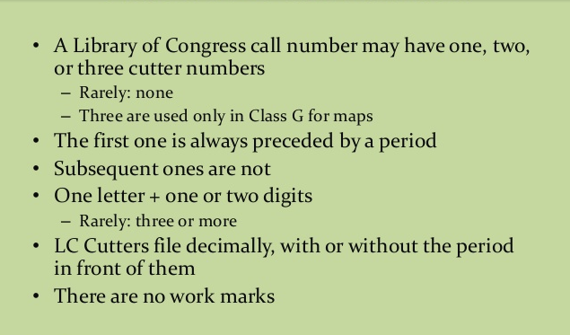
Cheryl Tarsala - Building cutter numbers
Notes:
Work marks, e.g. we used to add “x” for example when fastcatting; a is used for photocopies and is not a work mark.

Slide 39
Good call numbers
TK 7867 .B66 1996 (one cutter, with or without a date are OK)
BX 7795 .F7 R6 (two cutters, with or without a date OK)
TS 557 .R87492 (long Cutters OK)
PN 3443 .D4 M97 Suppl. (extra word OK)
KJC 2690 .6 .F54 1995 (K’s often have 3 subject letters)
PK2916 .S53x 2000 (OK to use, but remove any extra work letters)
PZ7.M3393 Way (PZ call numbers may have a different style Cutter--accept these)
Other examples of unusual call numbers that are suitable:
BS2091.A1 2001 ‡b .P7
BS140 ‡b 2000
E527.5 ‡b 101st
PZ7.R1084 ‡b Cur 2007
QA251 ‡b .M15 v.57
Note: Conference proceedings use the date of the conference, not the publishing date, in the call number.
(series classed)
Ardeen White– Copy cataloging lite

Slide 40
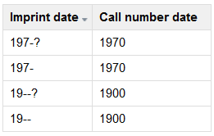
Less common call number situations …
Other uncertain dates in call numbers. If:
Series classed call number
These are similar to the previous slide, except they are based on the subject of the series, so they are more general. They have a label (no., V., Bd., Heft, etc.) and number at the end which comes from the 4xx ‡v field. Reject if the label is missing.
Examples:
HM15.W67 no.176
BM45.K2513 vol.3
HD74.O38 vol.2, no.79
HB31.E85 no.95/12
BC34.A7 v.10-3
P945 .S65 heft 41 (or any equivalent foreign term for volume or number)
PB879.I6 A3 N.F. Bd.22
HB5.V42 N.S. v.250
HJ9777.N42 N47 no.2000-11
DA670.D49 D43 ser.2 v.41
AS222.R645 ser.9, v.13, fasc.1

Slide 41
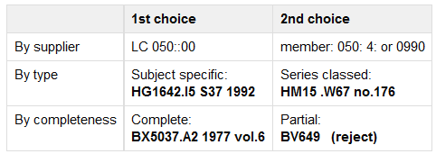
Choosing a call number if more than one: (Preference of call numbers if within the same record)
Unless historically done as series classed – search other parts of the series first to check or search call number

Slide 42
Bad call numbers
Don’t be Duped by Canada
No 055 - Canadian call numbers
No FC class - which Canada uses
No <PS8001-8599> - Canadian literature
Library of Congress based call numbers assigned by Library and Archives Canada (LAC)

Slide 43


More bad call numbers
090::Doc US y 3.SE 4:10-2 T 22/2 (are Gov. docs.)
Class letters wrong. Only K’s can have 3 initial letters.
BQV551 .M35
Cutter wrong or missing
JK526 2000f
HD9744.N83Un4 1994
PQ2621.L6 Z8 D45 1997
PL4209.N (XL:.xA61-Z458L)
HF5415
Missing label in series class number
HA155 .I3 6360
LAW

Slide 44

A few notes …

Slide 45



Copy 2’s
Use the same call number as copy 1and change to copy 2 in the item record.

Slide 46






non-Romanized fields
Arabic, Burmese, Chinese, Hebrew, Hindi, Japanese, Korean, Tibetan, etc.
Try to leave the non-Romanized fields if possible
Notes:
Keep non-Romanized fields. Sometimes it’s impossible because of some of the characters but try to keep them if possible.

Slide 47
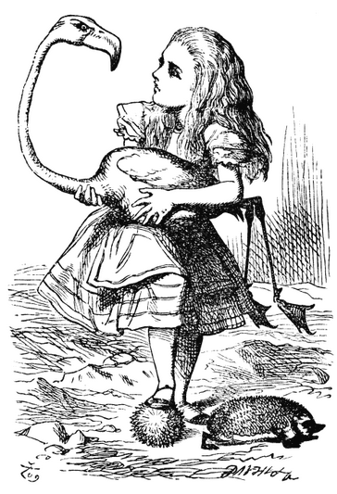
works of fiction, such as a novels, poetry, short stories, etc. do not require subject headings

Slide 48
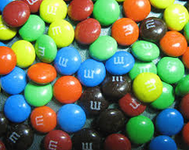
Fastcatting M’s
If you’re not making any changes to the record don’t change encoding level, leave as “M”
Copy catalogers should only change the encoding level to full if they are making corrections on the record

Slide 49
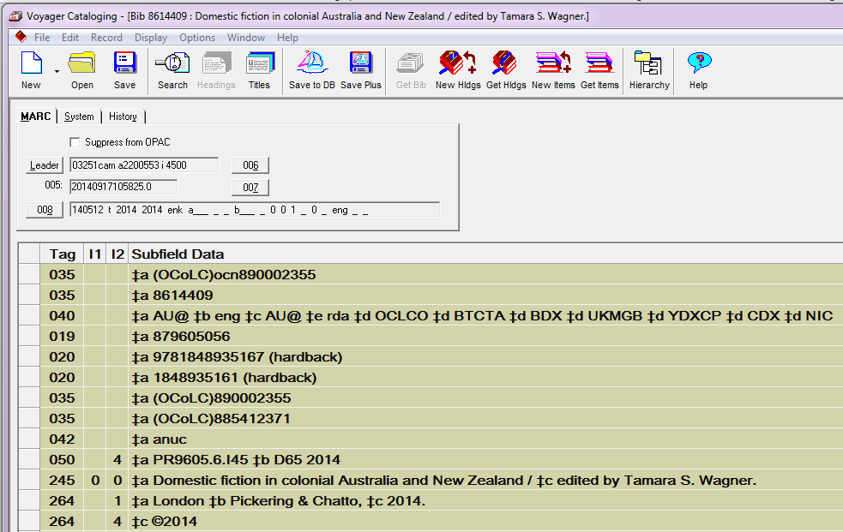
Only one OCLC number per record
our bib number
Two different OCLC numbers = kickout
Possibly attached to the wrong record in OCLC.
Notes:
Be careful when merging.

Slide 50

Reminder:
Our Procedures are reviewed and often changed annually or more frequently as the need arises;
don’t trust paper copies
Notes:
The latest version is only a few clicks away.

Slide 51

Please notice
At the bottom of the cheat sheet there are two links, exclusions and exceptions.

Slide 52

Don’t forget your stat code!
It makes more work for other people.
Without a cataloging stat the records don’t get uploaded to OCLC and someone has to add a stat so it will upload.

