Slide 1
Reading Authority Records
September 2020

Slide 2
What are authority records?
Authorized Access Point (also called Heading)
Variant Access Points (See and See also references)
Works cited/justifications
Additional information (optional)

Slide 3
Why authority records?
Single form chosen to collocate & distinguish

Slide 4
MARC authority records – Access Points (aka Headings)
1xx (100, 110, 111, 150, 151) : authorized access point (heading)
4xx (400, 410, 411, 450, 451) : variant, “see” reference
5xx (500, 510, 511, 550, 551) : related, “see also” reference—corresponds to a 1xx in another record
Indicators (0,1,2) have different meanings for each type of access point, e.g., 100 0_ is a personal name in direct order (Forename first)

Slide 5
670 (“Source data found”)
Contains justification for all information in authority record
1st 670 is for “work cat” (the resource cataloged that required the entity be established)
Additional 670s may justify variant access points or other information such as birth/death dates, fuller form of name, affiliations, etc.

Slide 6
667 (“Nonpublic general note”)
667 ## $a Not same as: -[name or title, LCCN].
667 ## $a Cannot identify with: -[name or title, LCCN].
667 ## $a Formerly on undifferentiated name record: [LCCN of undifferentiated name record].
667 ## $a Coded "provisional" because [reason for coding].
667 ## $a Date of birth removed from all fields per author request, [date updated].
667 ## $a SUBJECT USAGE: This heading is not valid for use as a subject. Works about this place are entered under …
667 ## $a Non-Latin script references not evaluated.

Slide 7
MARC Authority Documentation
https://www.loc.gov/marc/authority/

Slide 8
Examples
Searched/viewed in OCLC Connexion

Slide 9
In each record, what can you tell about the person, and what information may not be recorded?
Many fields are optional
Information in the authority record serves to justify the access point and other recorded information – not necessarily all the information you need to identify the person (or corporate body)

Slide 10
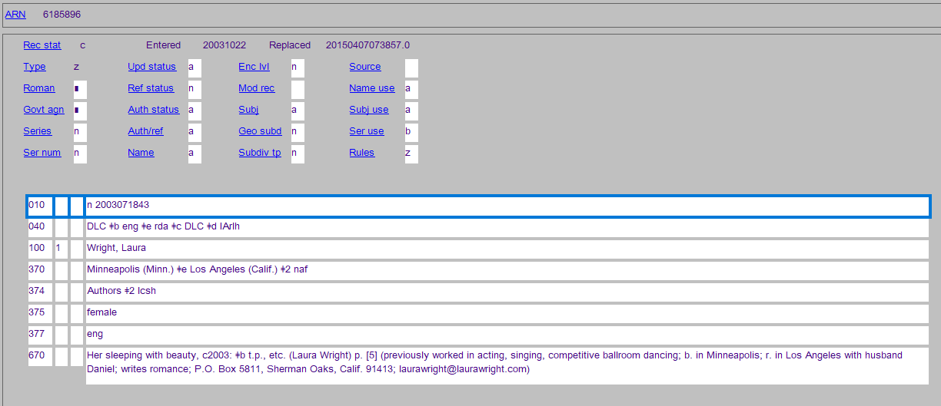
All the information in this record comes from the book cited in the 670 (except the gender which is not actually justified [now considered incorrect practice])

Slide 11
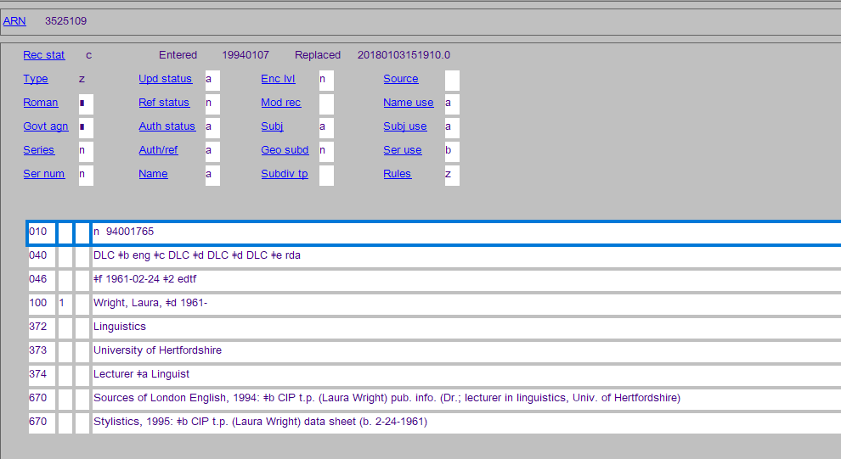
2nd 670 justifies the birth date, which is recorded in the 046 and used as part of the access point

Slide 12
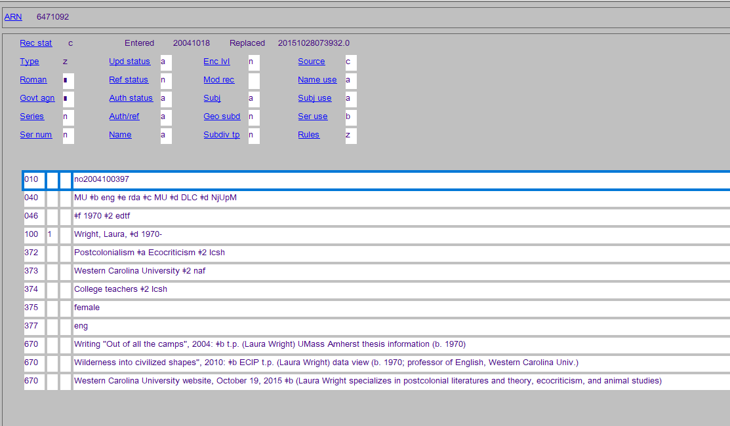
2nd & 3rd 670s justify institutional affiliation, fields of activity, profession

Slide 13
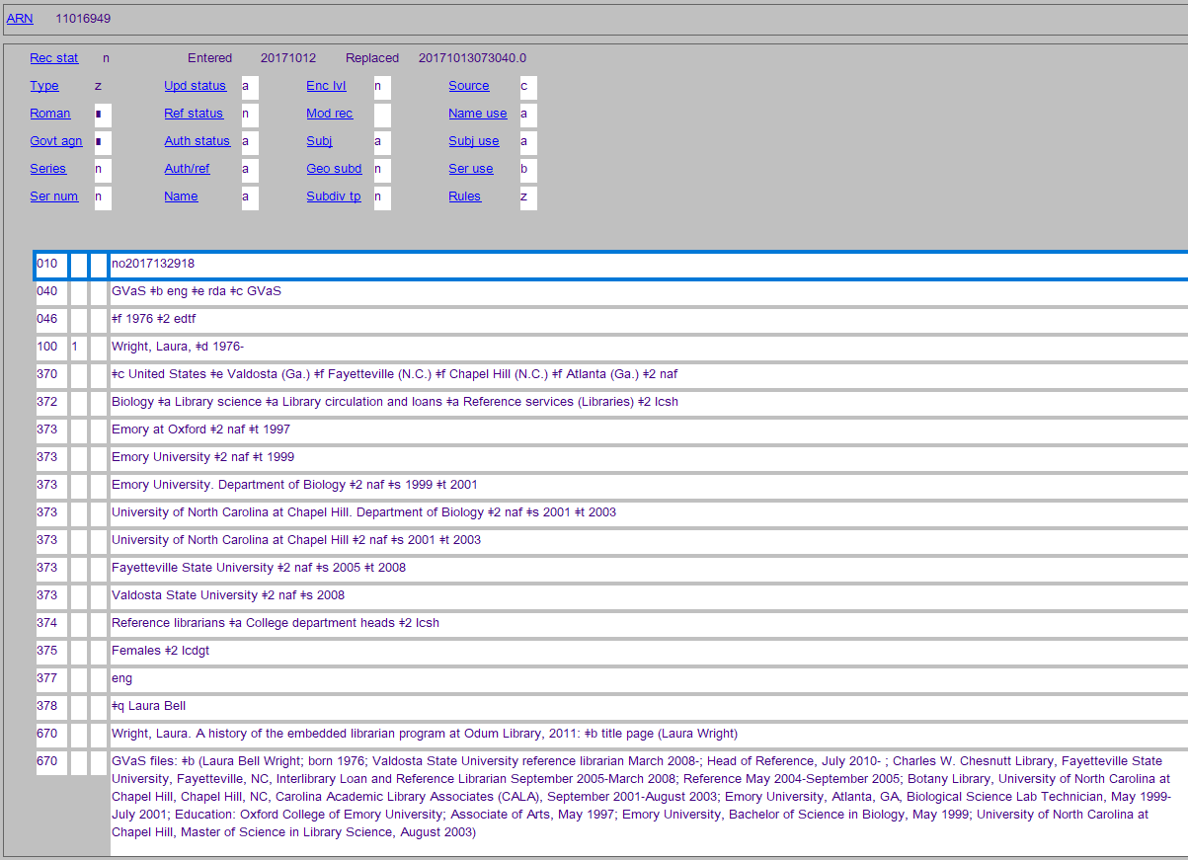

Slide 14
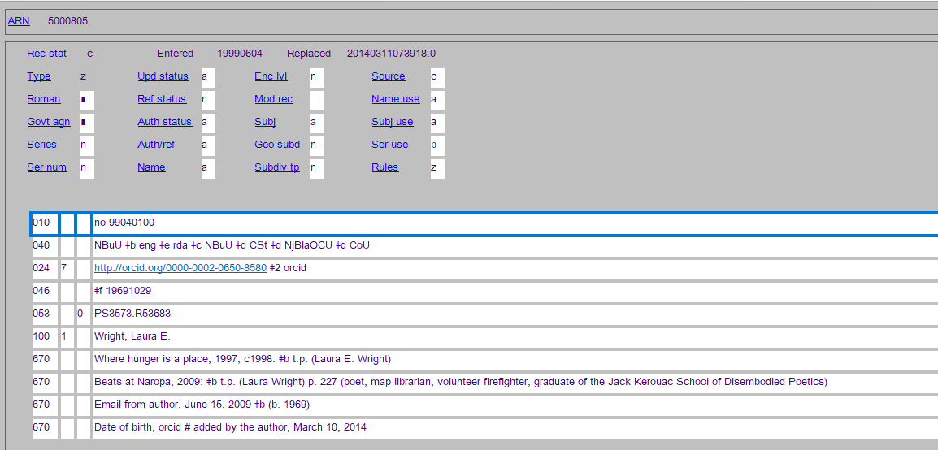
2nd 670 has different form of name; 3rd & 4th 670s cite sources other than published works

Slide 15
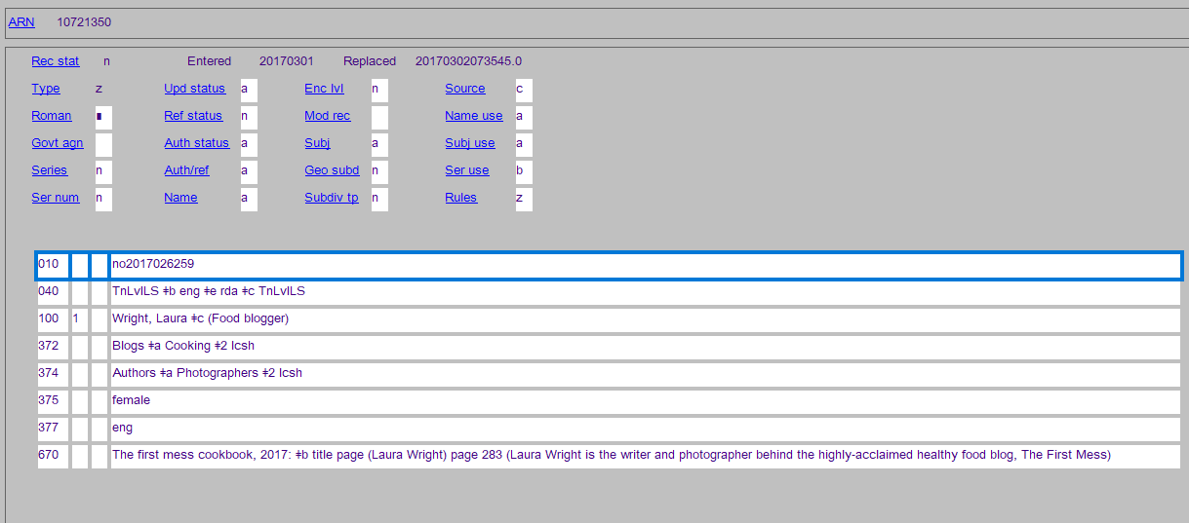
This is a duplicate! (see next slide)

Slide 16
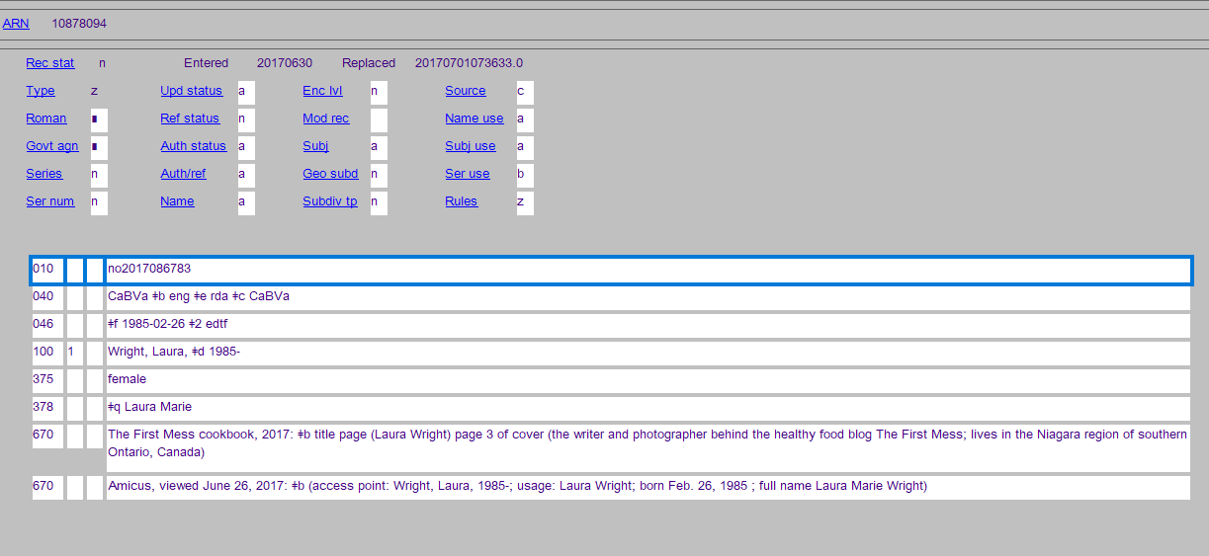
(These need to be reported to LC)

