Slide 1
Securing a Cloud Application
Instance Profiles and Security Groups in AWS
Paul Allen
CIT Cloud DevOps Team

Slide 2
Securing?
Today
  network security
  privileges to use AWS services
Not today
  web application firewalls
  CVE monitoring & remediation
  etc.

Slide 3
Example App - Jadu Forms Engine
Basic Architecture
AWS Architecture
Security Groups
Roles / Instance Profiles
Deployment Processes

Slide 4
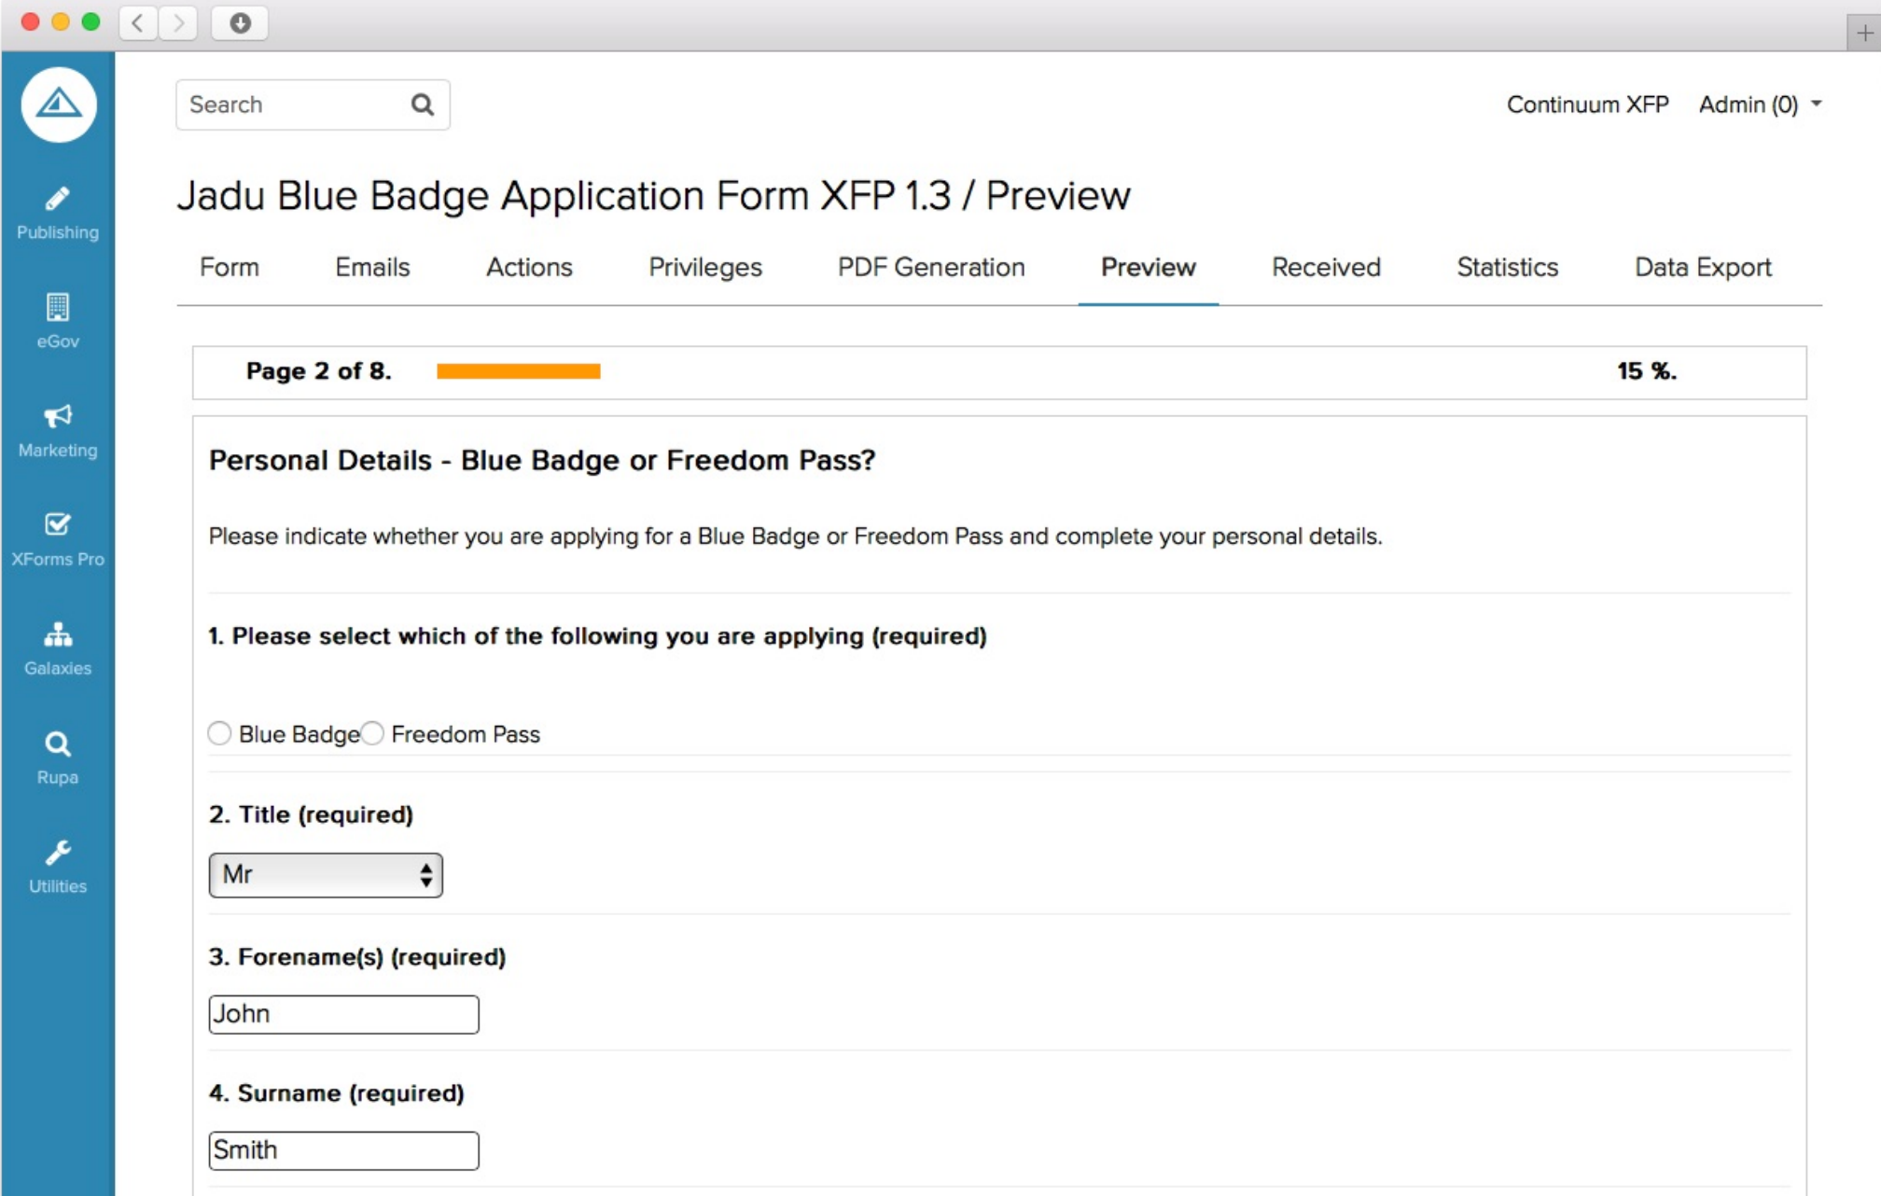
Jadu Forms Engine

Slide 5
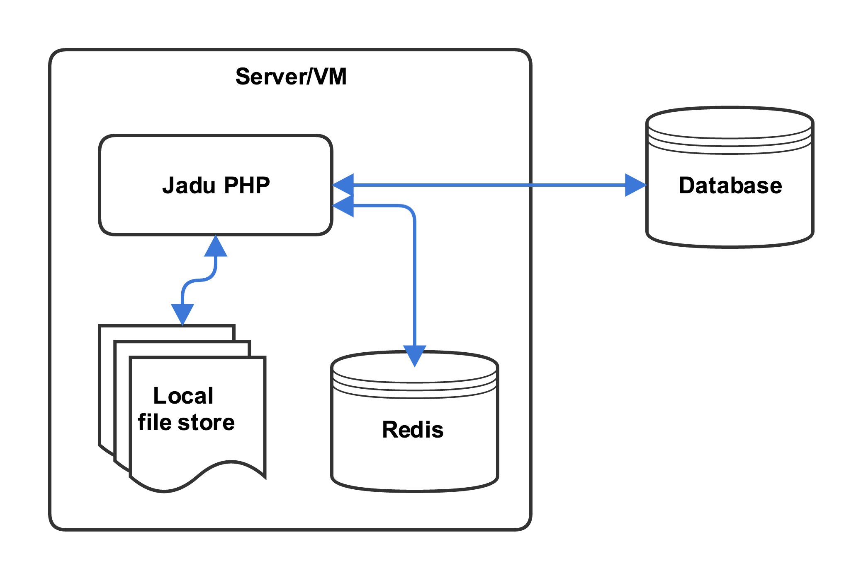
Jadu Application Architecture

Slide 6
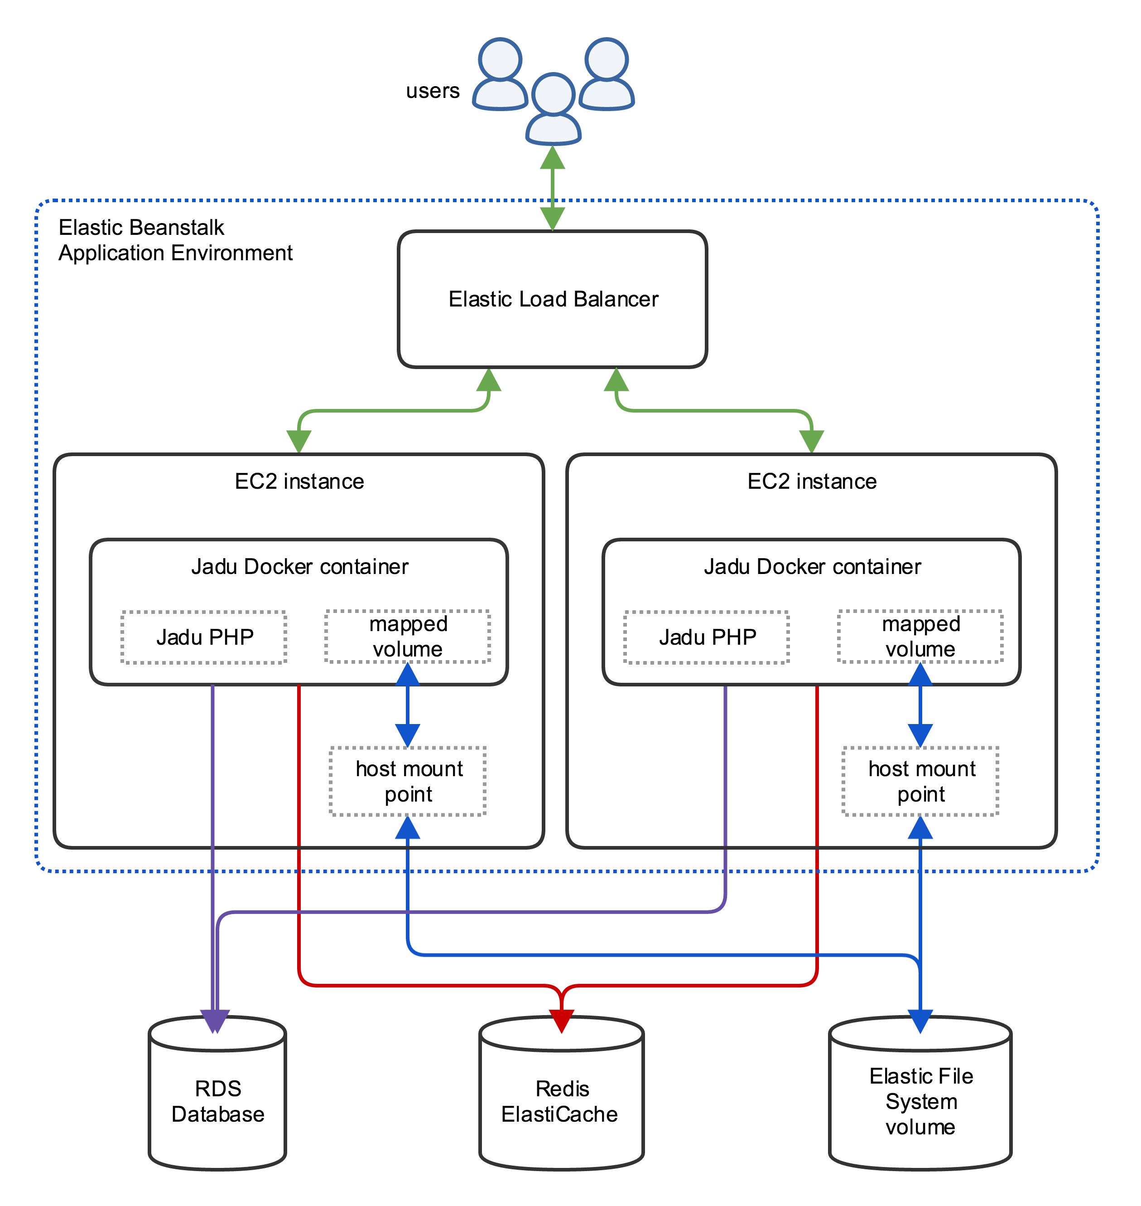
Jadu
AWS
Architecture

Slide 7
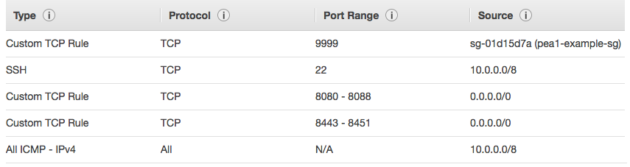
Security
Groups
Inbound
virtual, stateful firewall
  “allow” rules only
  SGs can be source/target for rules
applying multiple SGs has additive effect
default limits:
  5 SGs/NIC
  50 inbound rules/SG
  50 outbound rules/SG
  500 SGs/VPC

Slide 8
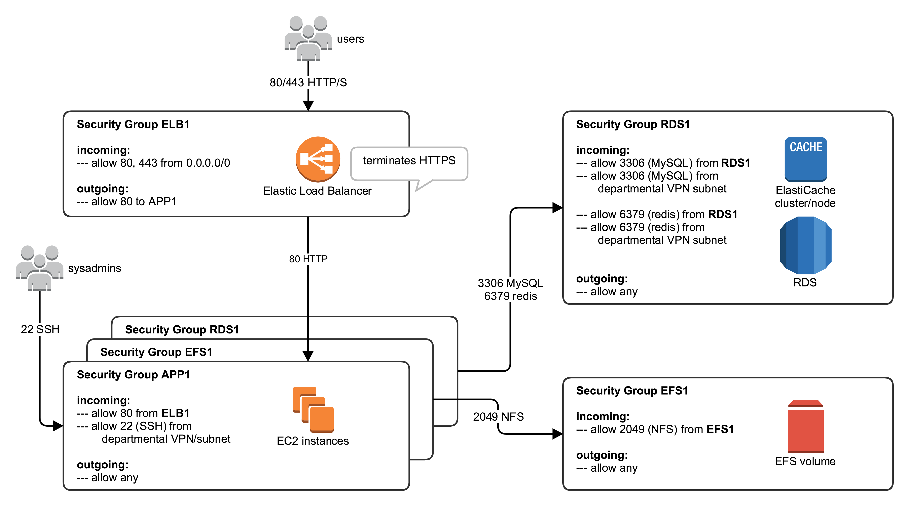
Jadu Security Groups

Slide 9
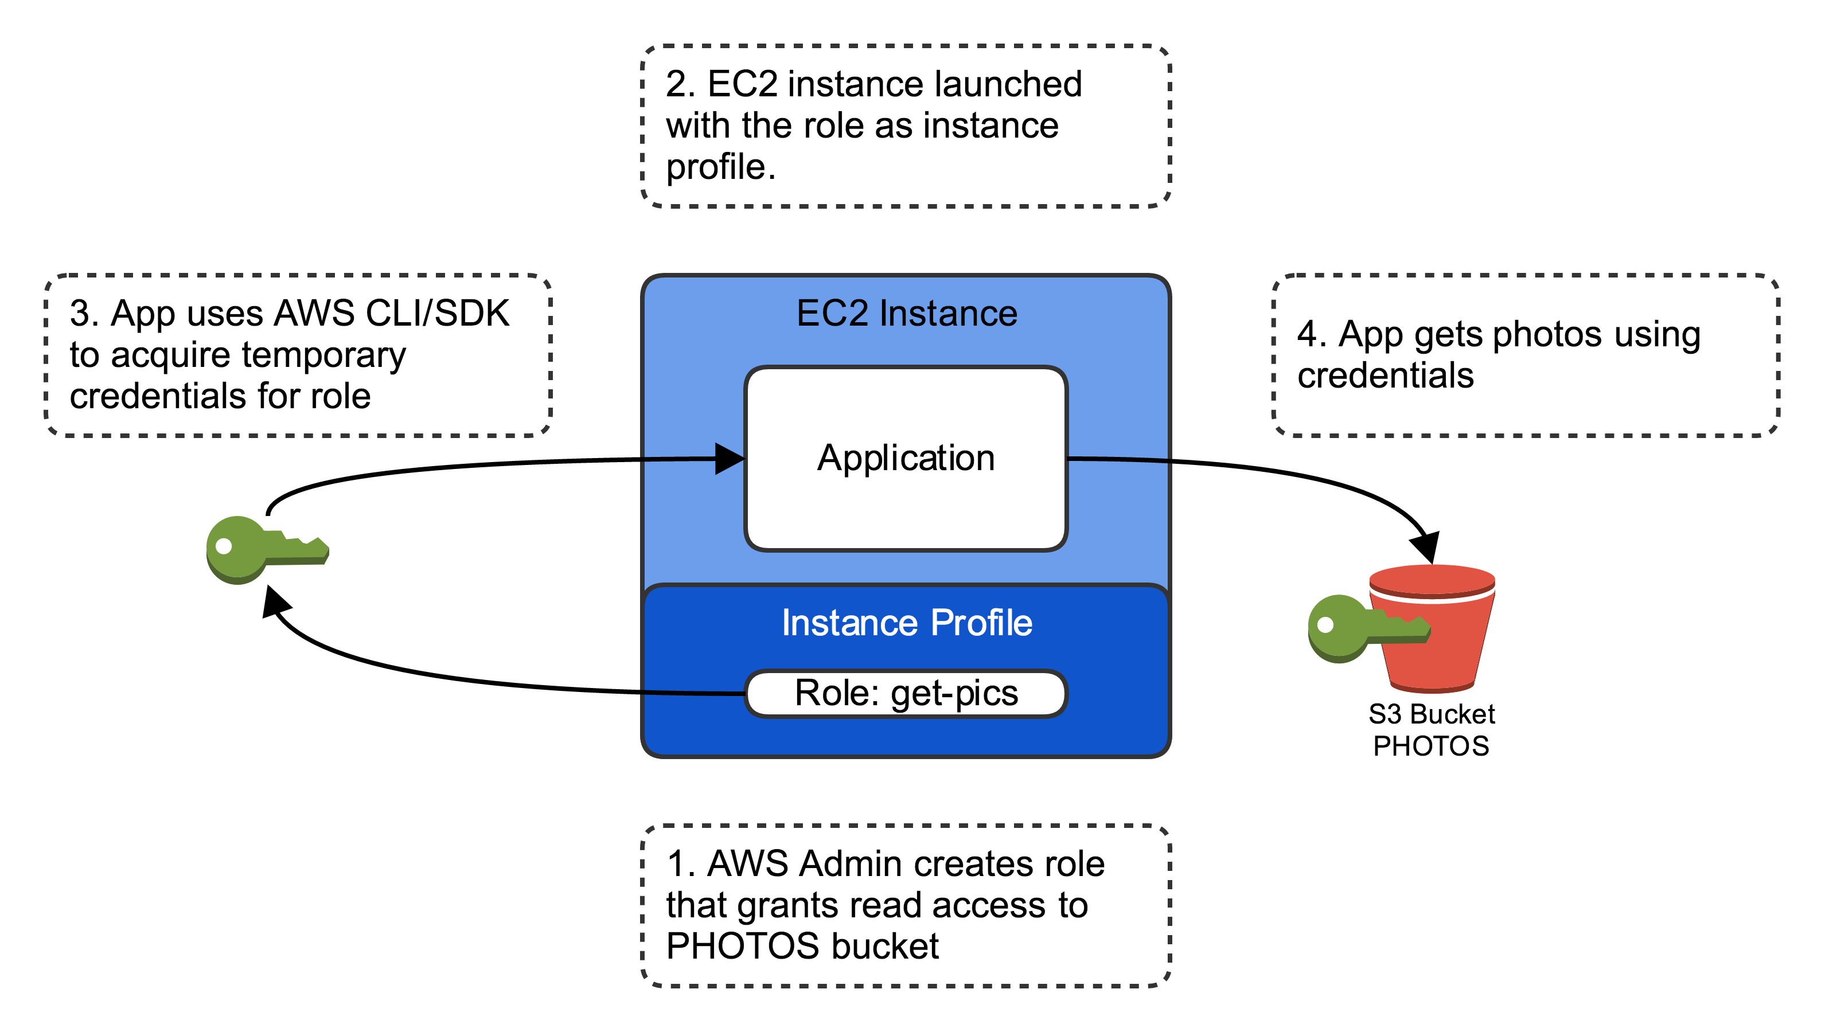
Roles &
Instance
Profiles
role – an identity with permission policies that determine what the identity can/cannot do
instance profile – defines the role that can be assumed by an EC2 instance

Slide 10
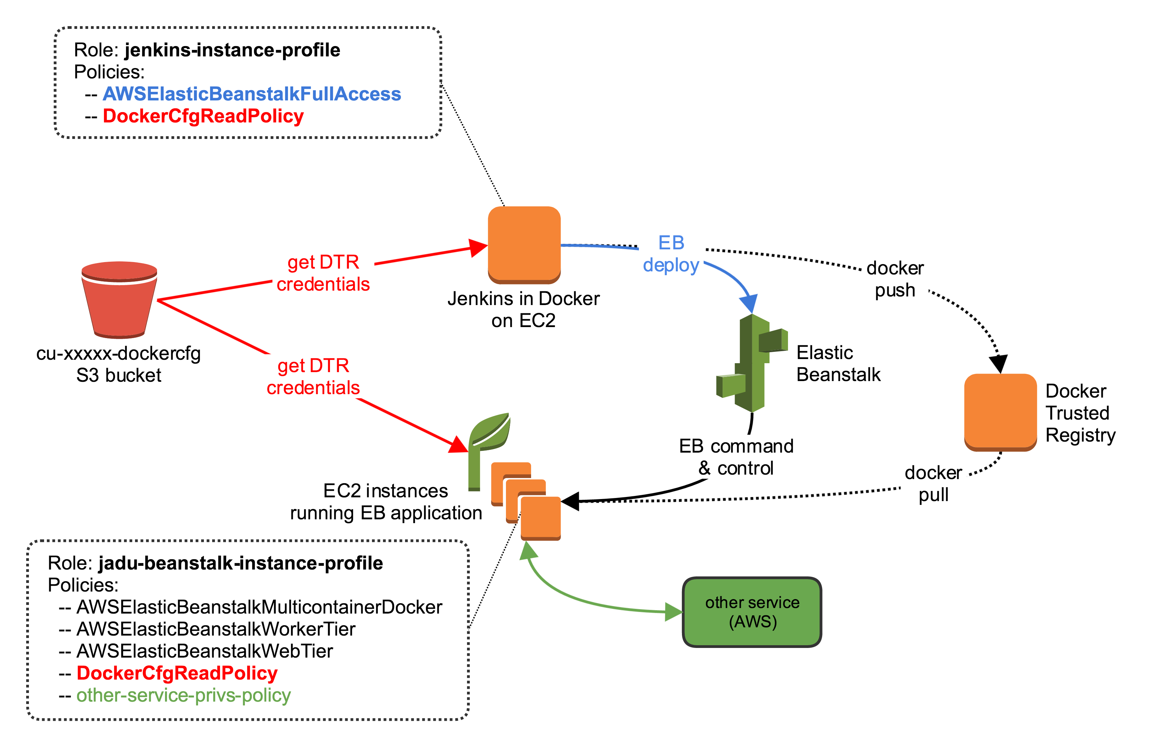
Jadu Instance Profiles
DockerCfgReadPolicy:
{...
"Statement": [{
"Sid": "S1",
"Effect": "Allow",
"Action": [ "s3:ListBucket"],
"Resource": ["arn:aws:s3:::cu-dockercfg”]
}, {
"Sid": "S2",
"Effect": "Allow",
"Action": ["s3:GetObject",
"s3:HeadObject",
"s3:ListBucket” ],
"Resource": [
"arn:aws:s3:::cu-dockercfg/.dockercfg”]
}]}

Slide 11
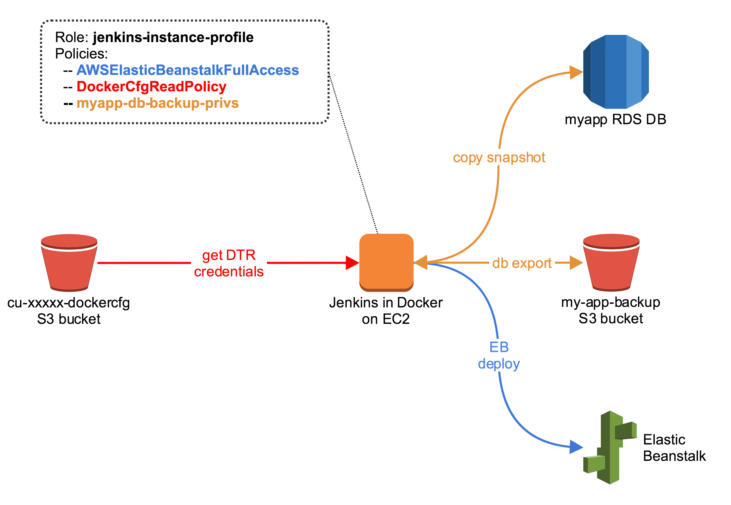
Instance Profile Policies for Other Processes

Slide 12
Paul Allen: pea1@cornell.edu
https://confluence.cornell.edu/display/CLOUD/
https://blogs.cornell.edu/cloudification/tech-blog/
cloud-support@cornell.edu

