Slide 1

Investments
Working to identify and secure sustainable funding for AguaClara
Investments | Final Presentation Fall 2016
Notes:
https://www.overleaf.com/read/stchdhcwfzfh

Slide 2
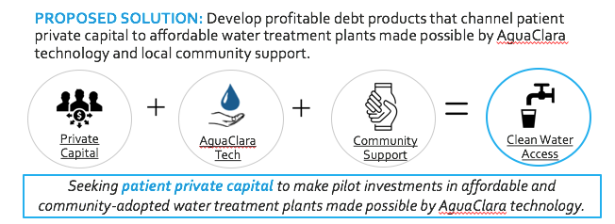
The Idea
Investments | Symposium Presentation Fall 2016

Slide 3
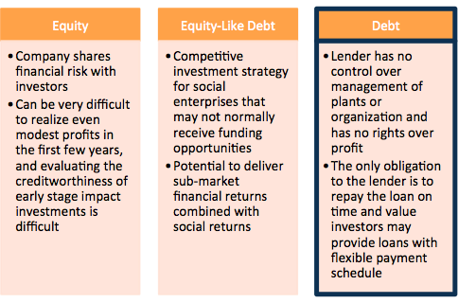
Three Products
Investments | Final Presentation Fall 2016
Notes:
Information gathered in this section references sources in “Section Two: Funding Strategies” in the Appendix.

Slide 4
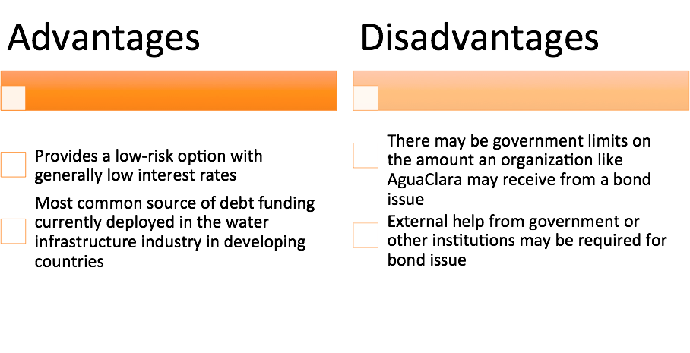
Bonds
Maturities ranging from short term (less than one year) to long term (five to more than 30 years)
Three types
  General obligation
  Revenue
  Special assessment
Investments | Final Presentation Fall 2016
Notes:
Information gathered in this section references sources in “Section Three: Debt Financing” in the Appendix.

Slide 5
Royalties
When investors provide a capital advance to pay for upfront costs and the first few months of operation
Methods of Royalty Repayment:
  Capital can be paid back in incremental percentages based on net income
  Capital can also be paid on a per unit basis where a percentage of each sale goes to the investor
In AguaClara’s case it would be more efficient to pay a monthly royalty on the net income
Investments | Final Presentation Fall 2016
Notes:
Information gathered in this section references sources in “Section Three: Funding Strategies in the Appendix.

Slide 6
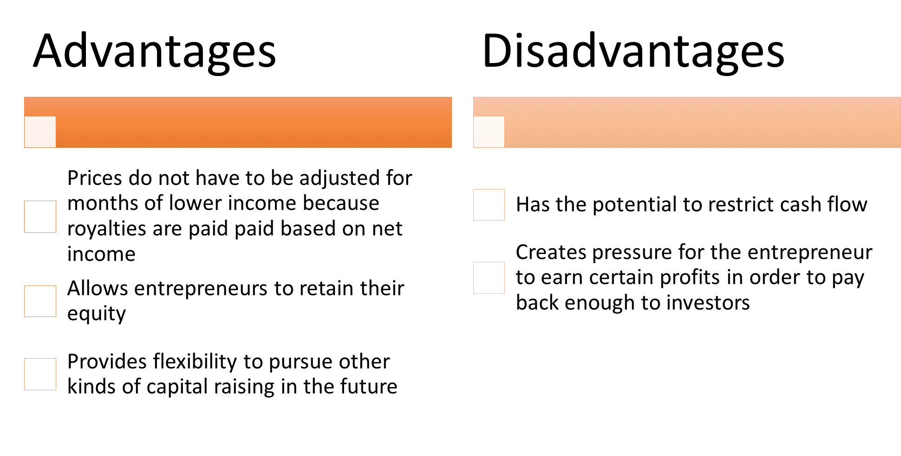
Royalties
Investments | Final Presentation Fall 2016
Notes:
Information gathered in this section references sources in “Section Three: Funding Strategies” in the Appendix.

Slide 7
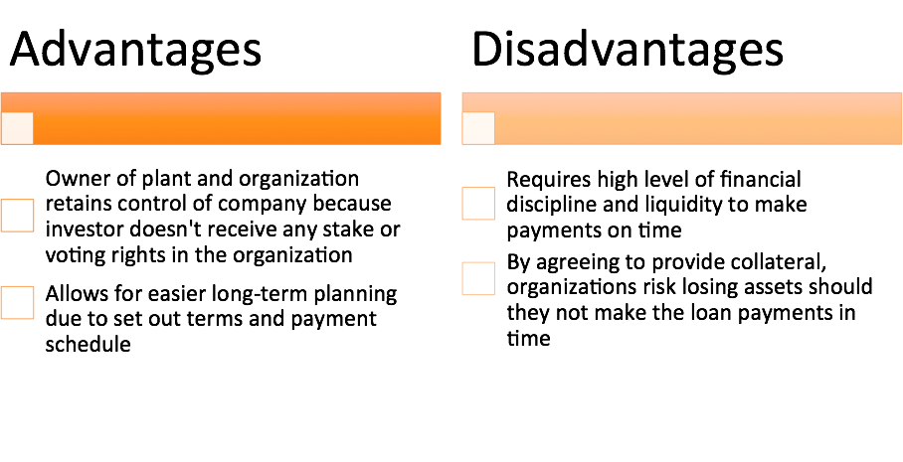
Loans
Investments | Final Presentation Fall 2016
Notes:
Information gathered in this section references sources in “Section Three: Funding Strategies” in the Appendix.

Slide 8
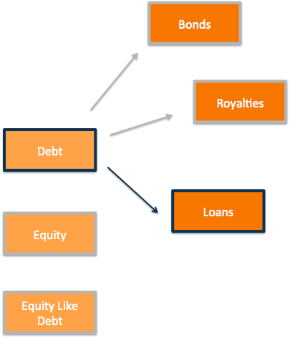
Final Recommendation
Loans are the most optimal source of debt funding at this stage for the project
Impact Investment: Grace periods for repayment can be negotiated given that those who benefit from AguaClara water sanitation are classified in the very low-income bracket
Independence: AguaClara will have the independence to continue operations in a way that doesn’t negatively impact communities
Parallel Cost: Interest will be based on investment required
Notes:
No appendix slides referenced.

Slide 9
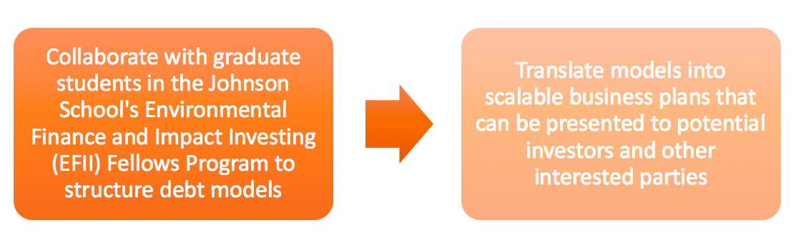
Future Work
Investments | Final Presentation Fall 2016
Notes:
No appendix slides referenced.

Slide 10
Next Steps
Industry Mapping
Product Structuring
Business Planning
Impact Investing
Water Foundations
Potential Investors
Product Options & Iterations
Investor Material and Termsheets
Move to Product Structuring and Business Planning
Investments | Symposium Presentation Fall 2016
Notes:
No appendix slides referenced.

Slide 11
Questions
and
Recommendations
Questions
and
Recommendations
Daniel Cheong
Economics, Philosophy, & CS
ec622@cornell.edu
Nicolette Ocasio
Applied Economics & Management, 2019
neo7@cornell.edu
Gillian Strandberg
Applied Economics & Management, 2018
gls235@cornell.edu
Isa Gabaldon
Hotel Administration, 2018
icg6@cornell.edu
Investments | Final Presentation Fall 2016

Slide 12
Appendix
Slides
Investments | Final Presentation Fall 2016

Slide 13
Appendix
Section One: Background on Traditional Investing
Investment in Water and Wastewater Infrastructure: An Environmental Justice Challenge, a
Governance Solution Alexandra Dapolito Dunn and Erin DerringtonProvides reasons why water sanitation and infrastructure investing is difficult in the traditional sphere: lack of robust returns
  Explains that it is imperative to find alternate solutions, and explained the high need for water infrastructure investments in developing countries
Top Trends and Challenges in Impact Investing For Investors Grace Kim
  Provides impact investing metrics for different forms of financing
  Divided impact investing industry by Total AUM by instrument, as well as Total AUM per sector
Alternative Investments 2020: An Introduction to Alternative Investments -
  Answers important questions about alternative investments like where to obtain capital, how they generate returns, and how is this approach different than traditional investments
Private Financing and Government Support to Promote Long-Term Investments in Infrastructure - Andre Laboul
  Focuses on the main types of government and market-based financing instruments to fund long-term investments
ImpactAssets 50
  A database that shows the geographic focus, impact investment focus, asset class, total assets under management, and other information about impact investing funds
Investments | Final Presentation Fall 2016

Slide 14
Appendix
Section One: Background on Traditional Investing
Global Impact Investing Network (GIIN)
  A guide to learn about impact investing and how they perform financially and socially in the global markets
The Blended Value Proposition: Integrating Social and Financial Returns - Jed Emerson
  Discusses Jed Emerson’s proposal about how investors can achieve financial, but also social returns by blending their expected gain on their investment to include both economic and social metrics
SRI Basics
  An introduction to sustainable and responsible investing, its motivations, and basic terminology
The Hottest Ideas in Impact Investing - James Taylor
  Discusses impact investing based taxes reliefs, the green trend, innovation, expansion to the masses, and other trends in the industry.
Section Two: Water in the Impact Investing Industry
New Investment Model Uses Water Markets And Impact Investors To Restore Nature Kelli Barrett
  Gives background information about water industry, with specific focus on the work of the Nature Conservancy and the development of WSIP’s
Liquid Assets: Impact Investing in the Water Sector Marta Maretich
  Describes background of impact investing in the water industry, including possible risks that can arise
Investments | Final Presentation Fall 2016

Slide 15
Appendix
Section Two: Water in the Impact Investing Industry
New Investment Model Uses Water Markets And Impact Investors To Restore Nature Kelli Barrett
  Gives background information about water industry, with specific focus on the work of the Nature Conservancy and the development of WSIP’s
Liquid Assets: Impact Investing in the Water Sector Marta Maretich
  Describes background of impact investing in the water industry, including possible risks that can arise
  Water Share: Using water markets and impact investment to drive sustainability Brian Richter
    Gives specific figures about water depletion and consumption by region
  Investing in Water: Global Opportunities in a Growth Sector
    Focuses on the specific opportunities and potential risks inherent in investing in the water infrastructure impact investing sector
  Loan Fund in Works for Water Projects - P.J. Cameon
    Explores the advantages and disadvantages of long-term bond financing and the expansion of modern communications into small communities
Section Three: Funding Strategies
Introduction to Structured Products - Investopedia
  Introduction to liquidity, risk, and how they relate to different types of traditional funding models
Impact Investing Across Asset Classes - World Economic Forum
  Explains investment approaches in order of liquidity from cash and cash equivalents to real estate and real assets
Investments | Final Presentation Fall 2016

Slide 16
Appendix
Section Three: Funding Strategies
Equity Like Capital
  Describes basic information about equity-like debt financing, including potential risks for social impact investors
Impact Investing: How does it make a difference?
  Background of different types of impact investing financing, including equity-like debt
A New Approach to Funding Social Enterprises Bugg-Levine, A., Kogut, B., & Kulatilaka, N
  Basic information about equity-like debt financing, including specific examples of companies that are currently employing this type of financing
Sarona Fund
  An impact investing fund that focuses on frontier and emerging markets with social “profits” blended with all investment profits
Revenue-Based Financing
  An introduction into royalty financing, when it is appropriate, and how it differs from traditional financing options like equity and debt
World Economic Forum: Economic Growth and Social Inclusion Research
  An exploration of India and other developing nations’ water infrastructure financing programs
  Used to compare Honduras’ water infrastructure funding with that of other developing nations
Investments | Final Presentation Fall 2016

Slide 17
Appendix
Section Three: Funding Strategies
The Financing of Water Infrastructure: A Review of Case Studies
  A review of 10 case studies of the largest water infrastructure funding cases
Building Local Infrastructure Marketplaces for Sustainable Development Results
  Talks about the long-term sustainability of different types of infrastructure funding projects
Investing In Water Infrastructure: Capital, Operations and Maintenance
  Focuses on the operational aspects of water infrastructure and the success of infrastructure operations in developing nations and how that factors into their risk
The Science of Water: Concepts and Applications
  This book talks about the life of various water infrastructure projects, which is relevant to financing because it changes the length of debt termsPurpose: Debt Financing
Section Four: Debt Financing
Using Bonds To Finance Construction - P.J. Cameon
  Describes the risks associated with issuing bonds to finance water infrastructure projects -- including the challenges for small communities, as well as a detailed description of the advantages/disadvantages of the different bonds employed in this sector
Impact Investing Across Asset Classes
  Includes background and basic description about bond issuance in the impact investing industry
Private Solutions for Infrastructure
  Specifically focuses on the water infrastructure industry in Honduras and how the private sector can play into its development
Investments | Final Presentation Fall 2016

