Slide 1

Sensor Development
Sidney Lok, Grace Mitchell, Andrea Pozo, Cheer Tsang
Fall 2016
This is a new subteam dedicated to creating sensors in response to the needs of two other wastewater subteams. Learn more at https://confluence.cornell.edu/display/AGUACLARA/Sensor+Development
Research | Symposium Presentation Fall 2016
Notes:
Abstract: The fall semester of 2016 marks the beginning of the Sensor Development subteam to AguaClara, which was created in response to the needs of the Upflow Anaerobic Sludge Blanket (UASB) and Anaerobic Fluidized Bed (AFB) subteams. This semester, the primary goals of this subteam are to develop a gas measurement sensor, and a fluidized bed solids concentrator sensor for AguaClara plants. The subteam will finalize a method of gas measurement, program settings in ProCoDa to automate the systems, and build the next generation of the system. For the fluidized bed solids concentrator sensor, the subteam will take measurements of the photosensor output and develop a method to correlate photosensor output to the existing intensity of fluidized solids.
Full report: https://www.overleaf.com/read/jyzxckcyzrfz

Slide 2
The objective is to create biogas sensors for the wastewater teams to monitor their biogas production.
Sensor Development | Research | Symposium Presentation Fall 2016
Notes:
This is our primary objective thus far as a subteam.

Slide 3

UASB and AFB need to monitor methane production.
Equation relating rate of methane production to substrate removal and flow rate. Biogas is comprised of 60-70% methane. (Droste, 1997)
Inconsistencies between experimental and theoretical biogas production from reactors. (Spring, 2014)
Sensor Development | Research | Symposium Presentation Fall 2016
Notes:
Equation was used in the work of the UASB team (Huybrechts, 2010) and is included in our current research report. Qm is the quantity of methane produced per unit time. Both the UASB and AFB reported “inconsistencies between experimental and theoretical biogas production from reactors” in the Spring semester of 2014. The teams needed to determine how much methane was experimentally produced.

Slide 4
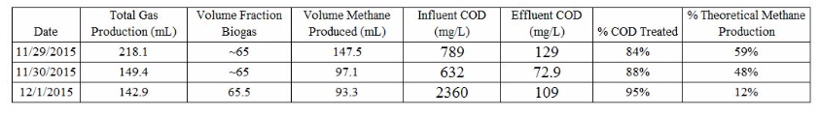
What’s wrong with methane?
Specific reactor data from Table 5 in UASB Fall 2015 Final Report.
Methane produces carbon dioxide and water when it reacts with oxygen.
Sensor Development | Research | Symposium Presentation Fall 2016
Notes:
Table is from UASB Fall 2015 Final Report. As you can see, the volume of methane produced ranged from 65-67% of the total gas production compared to the theoretical values ranging from 12-59%. From the data, there appears to be a significant amount of methane produced. Methane production must be monitored because it is a health hazard, as it produces carbon dioxide and water when it reacts with oxygen. It is also potentially detrimental to the balance of chemicals used in the plant as a whole.

Slide 5
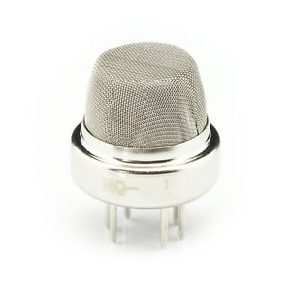
The original sensor did not meet our needs.
Sensors “have a very narrow range of methane concentration.” (AFB, 2016)
Sensor Development | Research | Symposium Presentation Fall 2016
Notes:
One of the original methane sensors used in the project team was an MQ-4. AFB team attempted to model a calibration curve with one of the prototypes in the Spring of 2016, but it was determined that the sensors “have a very narrow range of methane concentration” (Qui Shen at al., 2016).

Slide 6
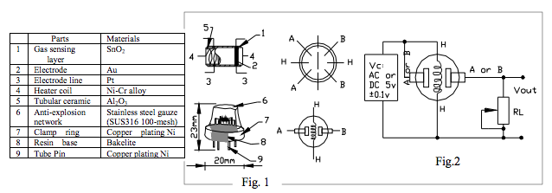
The original sensor did not meet our needs.
Sensors “have a very narrow range of methane concentration.” (AFB, 2016)
Sensor Development | Research | Symposium Presentation Fall 2016
Notes:
This diagram is Figure 4 of our current research report. This design was taken from the technical data sheet of a different company than those used previously in AguaClara, but they are very similar in design and function. When the gas interacts with the sensor, it is ionized and adsorbed by the gas sensing layer. Adsorption creates a potential difference across the gas sensing layer, which then travels through the gas sensing system and out of the tube pins in the form of current. The potential difference creates a difference in resistance across the gas sensing layer. The heater coil provides the necessary conditions for this process to occur. The anti-explosion network protects the gas sensing system, filters suspended particles, and keeps the sensor intact in the condition of high temperature and pressure. The design of this sensor depends on a potential difference created across the sensing layer, which accounts for its relatively narrow range. The new sensors designed by Monroe take a volumetric approach.

Slide 7
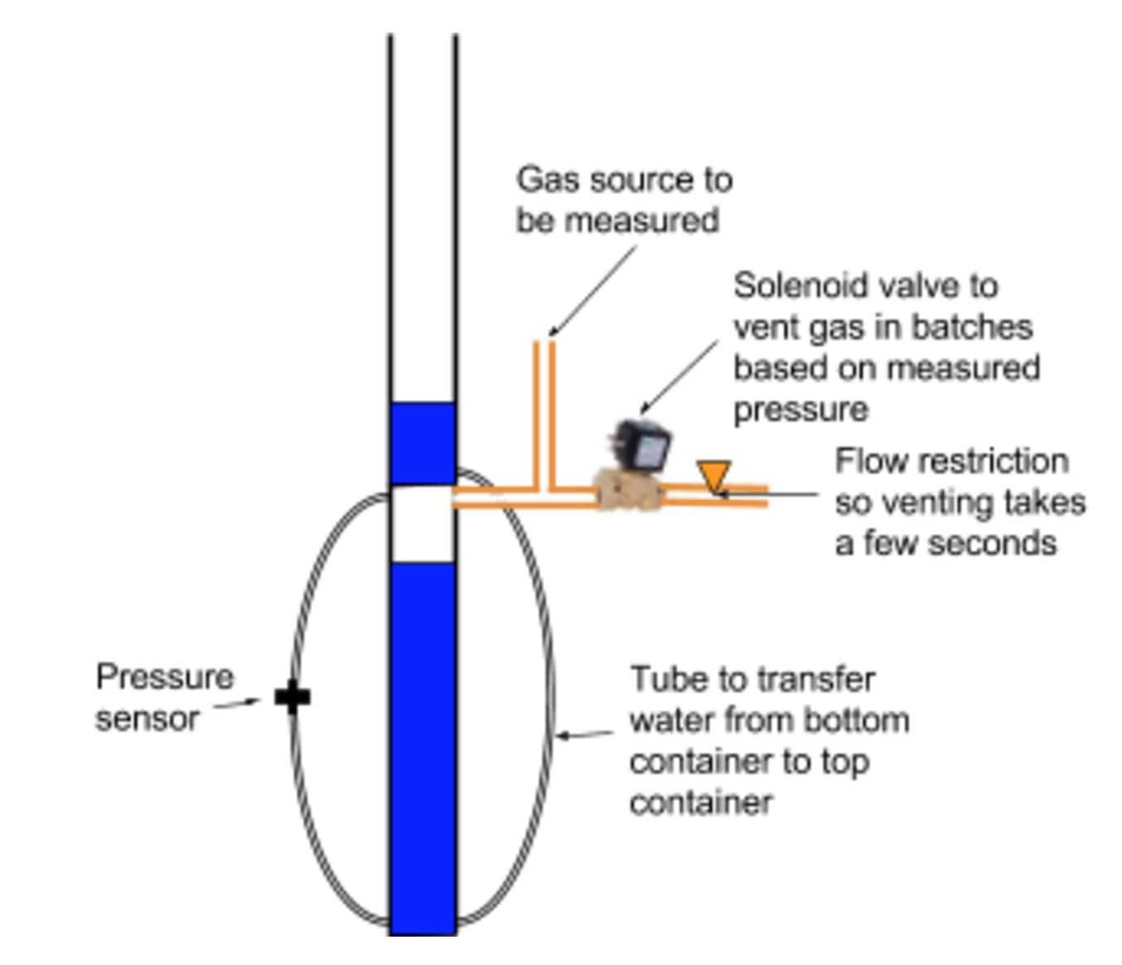
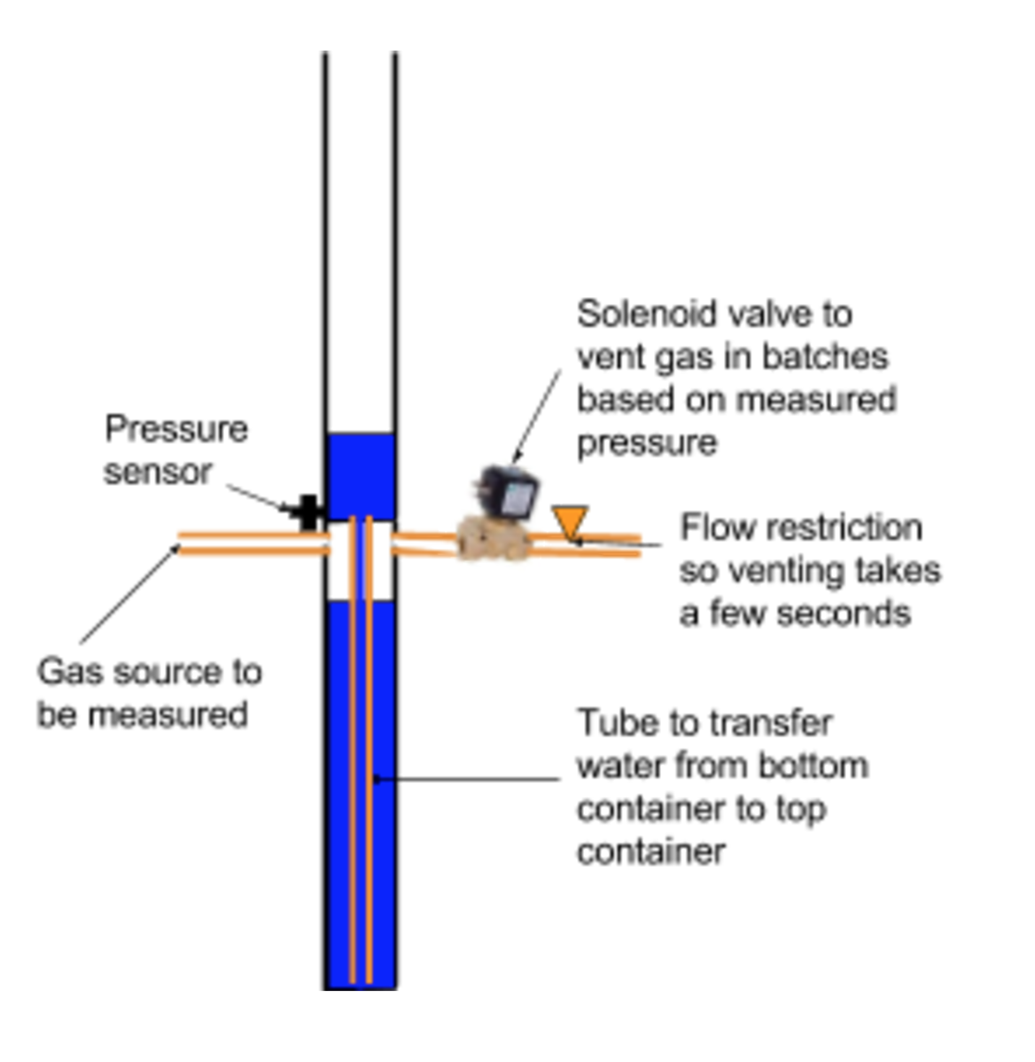
The current gas sensor design is based on the design of the first and second generation sensors.
Sensor Development | Research | Symposium Presentation Fall 2016
Notes:
Figure: The first generation of the pressure-vent system is shown on the left. The second generation of the pressure-vent system is shown on the right. An inner tube was added to the system and the placement of the sensor, gas source, and solenoid valve was modified.
First Generation: previously built before team’s existence
Second Generation: Modified so that the tube transferring water from bottom to top chambers is within the chamber rather than outside, simplifies design.
How it works:
The bottom chamber is first filled with water
When gas pump is turned on, the valve closes. Gas flows through ports, causing water from bottom chamber to be pushed through the inner tube to the top chamber.
Water displacement is measured - allows us to measure volume of gas produced
When water reaches a certain predetermined height, solenoid valve opens, venting gas from the chamber, causes water from top chamber to be released back to bottom chamber

Slide 8
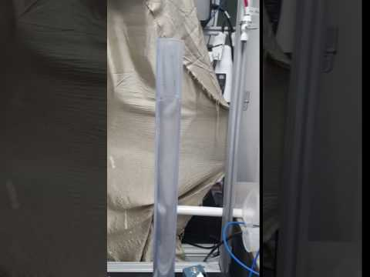
Sensor Development | Research | Symposium Presentation Fall 2016
Notes:
Here we can see the second generation sensor working once the water has finished going up to top chamber.

Slide 9
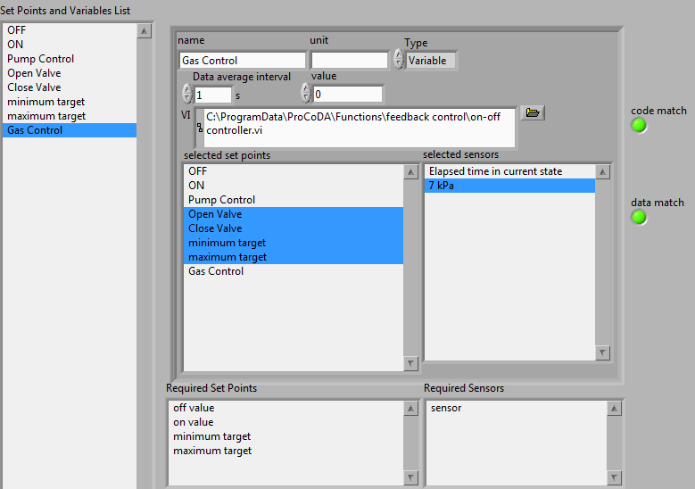
ProCoDA was used to program the gas sensors.
Sensor Development | Research | Symposium Presentation Fall 2016
Notes:
Gas Control: controls opening and closing of valves
ON state: when valve is closed, air pump turns on - pumps air into the gas sensor
Run Pump:
valve is closed, turns pump on until water level reaches a certain height
at maximum target height: opens valve, water drains back down to bottom chamber

Slide 10
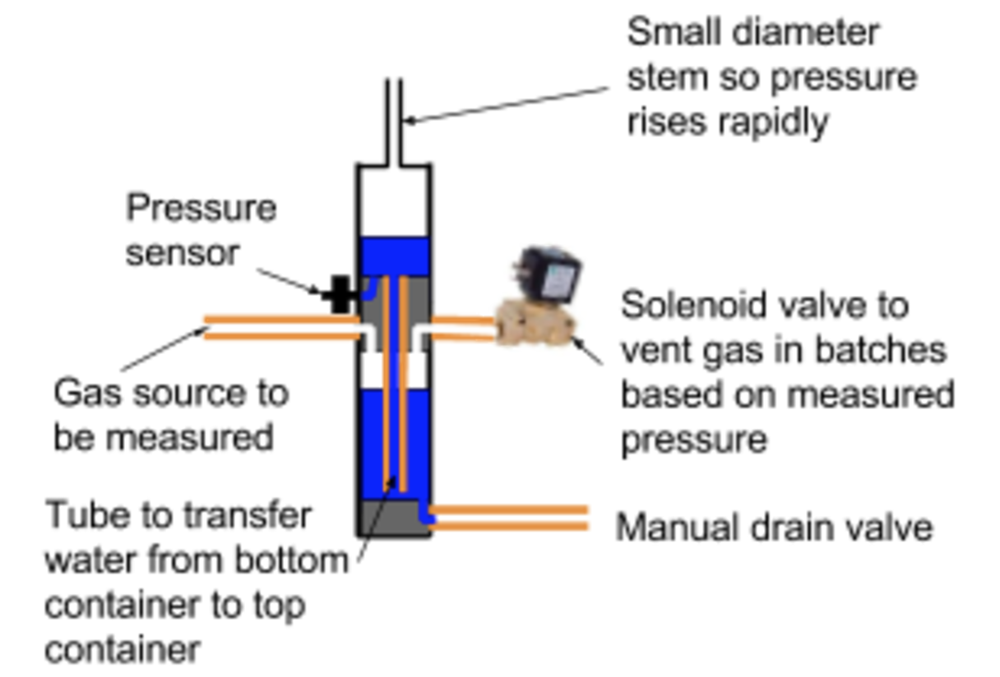
The current gas sensor design is based on the design of the first and second generation sensors.
Sensor Development | Research | Symposium Presentation Fall 2016
Notes:
Figure: The third generation of the pressure-vent system is shown. The apparatus was shortened, with a smaller diameter stem at the top for. The placement of the gas source and solenoid valve was moved to through the plug in order to account for the shorter height. A manual drain valve was added to the bottom of the PVC pipe in case of a need to drain water out of the pipe.

Slide 11
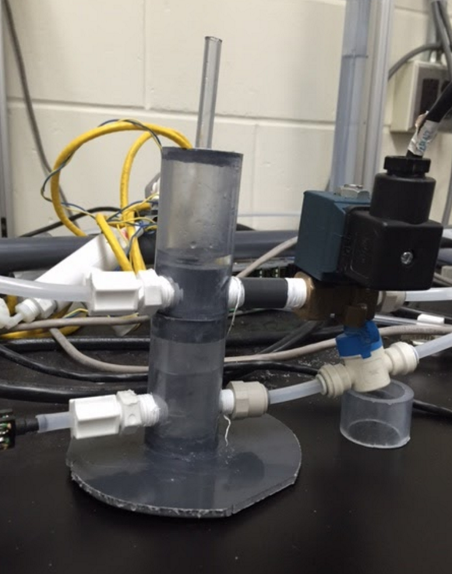
The third generation sensor
was fabricated...
Sensor Development | Research | Symposium Presentation Fall 2016
Notes:
Caption: The first design fabricated by the Sensor Development Team. It is based off of the third generation design detailed in the last slide.
The third generation sensor was fabricated...
If there are any appendix slides that are relevant to this slide, mention it in your notes.

Slide 12
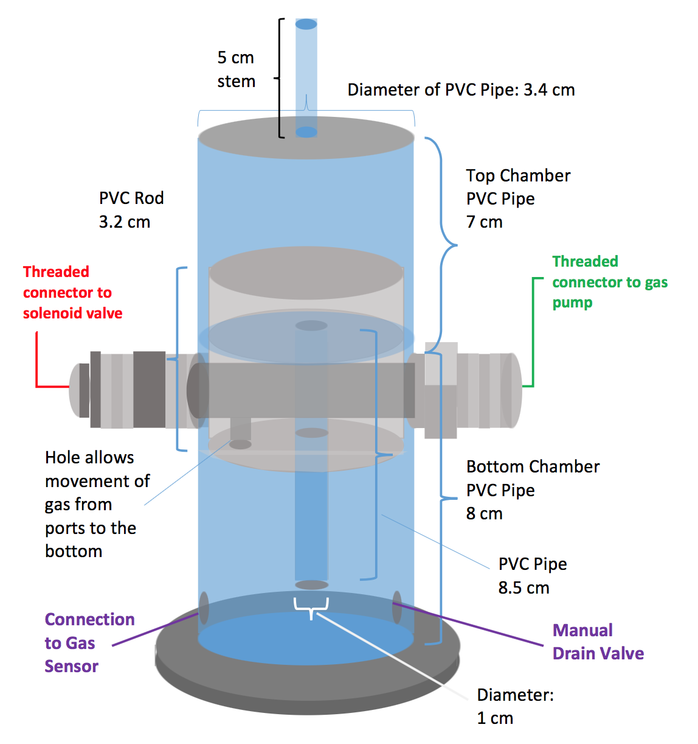
...and later modified.
Sensor Development | Research | Symposium Presentation Fall 2016
Notes:
Caption: This is a schematic of our current sensor design. This diagram is specific to the AFB team.
The first design the team fabricated was later modified to accommodate for several design constraints and concerns.

Slide 13
The sensor was shortened to account for UASB system design constraints.
Sensor Development | Research | Symposium Presentation Fall 2016
Notes:
The sensor was shortened to account for the UASB team’s apparatus’s design constraints.

Slide 14
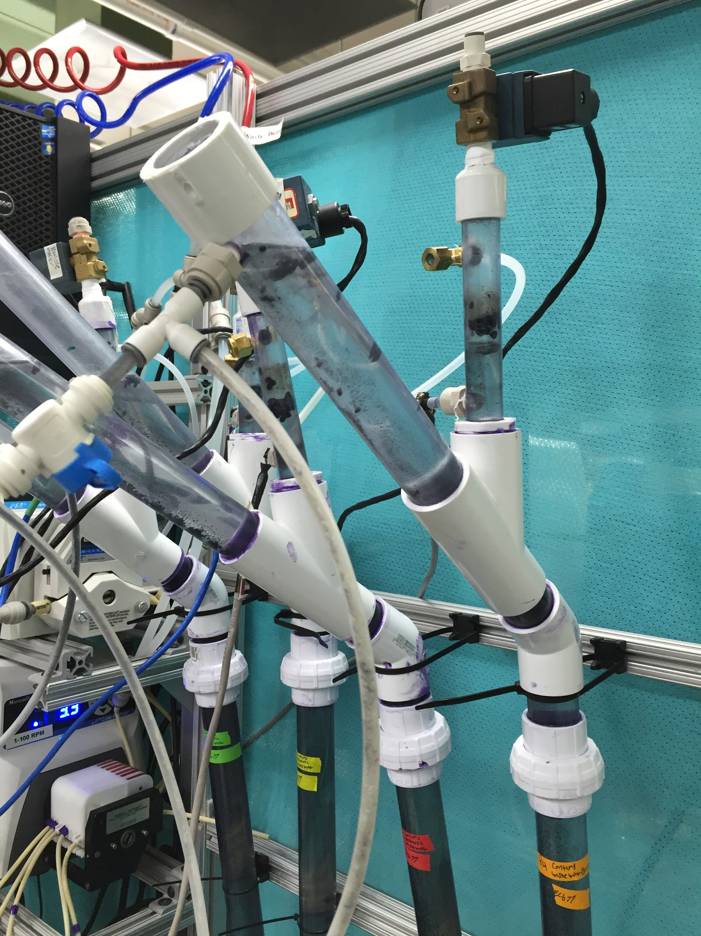
Sensor Development | Research | Symposium Presentation Fall 2016
Notes:
Caption: This image shows the top portion of the UASB team’s apparatus. The blue arrow shows the unwanted direction of flow that would result if the head of 6 cm in the sensor was exceeded.
The sensor design was shortened for the UASB team because the team’s apparatus only allows for 6 cm of head and so the sensor would have to have a 6 cm water height. This is because when the sensor is added to the system, when pressure builds in the sensor, an equal amount of pressure will build in the reactor. This pressure would cause the water to displace out the slanted pipe and into the effluent tube.

Slide 15
The same concern was discussed for AFB, but 10 cm theoretically works for them.
Sensor Development | Research | Symposium Presentation Fall 2016
Notes:
The same concern was expressed for the AFB team, but after evaluating the situation and the AFB team’s larger apparatus, it was concluded that the AFB team had room for 10 cm of head loss. Therefore, the 10 cm water height design we made would work for them. To clarify, the Sensor Development team will be fabricating two sets of 4 sensors. The set for the UASB team will have 6 cm of water height. The set for the AFB team will have 10 cm of water height.

Slide 16
The sensor was also modified to account for evaporation of clean water fill, which could lead to system failure.
Sensor Development | Research | Symposium Presentation Fall 2016
Notes:
There was a second concern brought up of whether or not the system would be able to withstand the evaporation of its clean water fill long enough before it fails. It would fail because the key function of the pressure sensor to measure the water height difference when water is displaced through from the bottom chamber to the top chamber would no longer work once there is little water left in the system.

Slide 17
Sensor Development | Research | Symposium Presentation Fall 2016
Notes:
Caption: This image supports and demonstrates the notion that the pressure sensor would not be able to measure the pressure once the water gets to a certain height after evaporation.

Slide 18
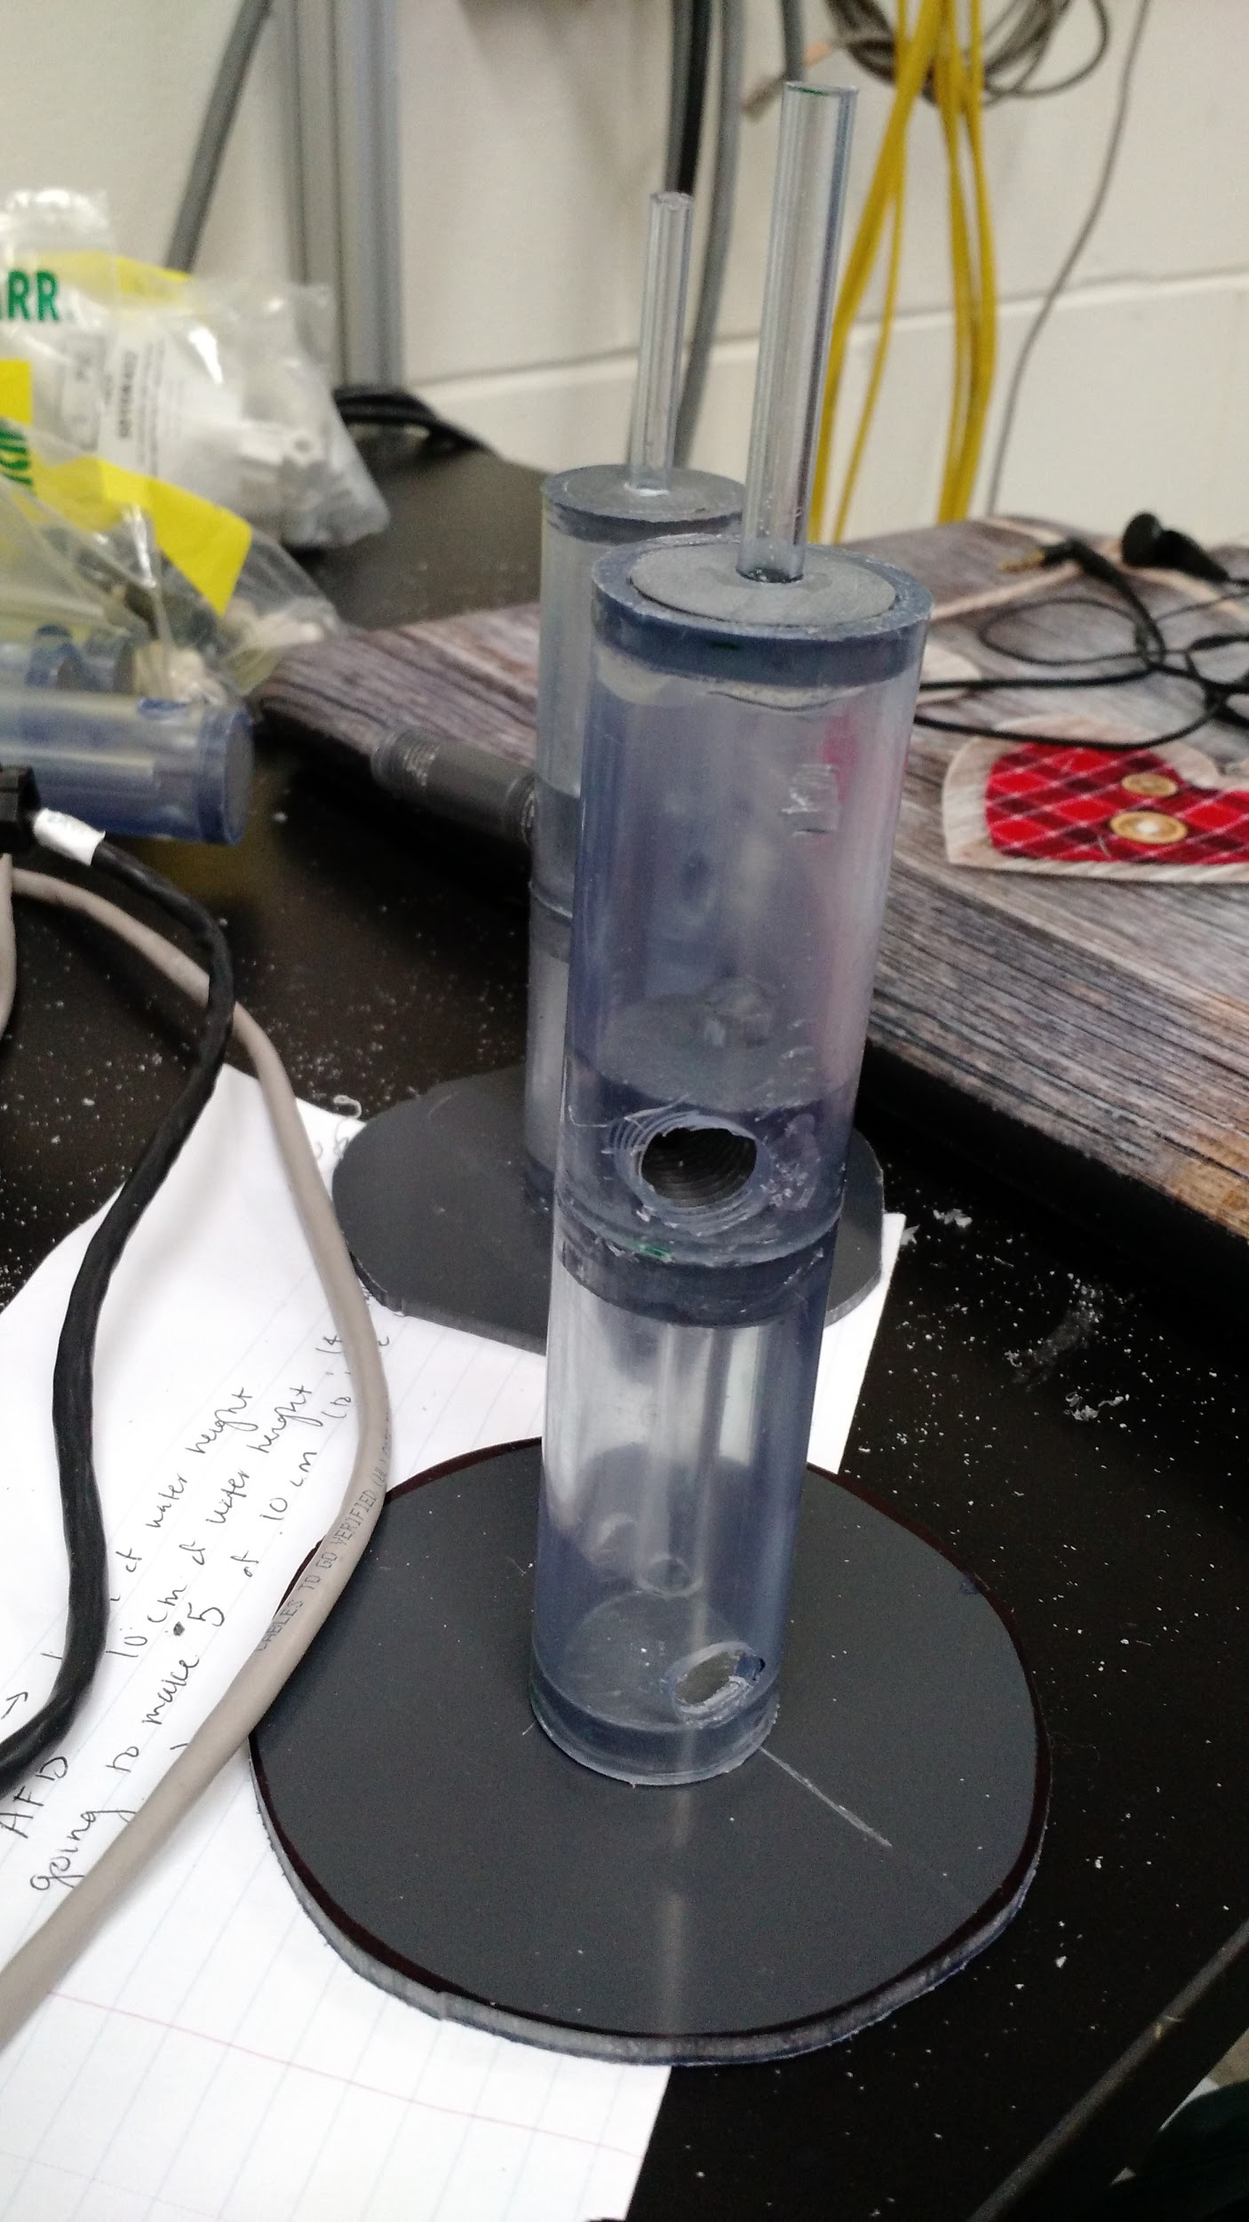
The 10 cm sensors were completed this week.
Sensor Development | Research | Symposium Presentation Fall 2016
Notes:
4 of the 10 cm sensors are currently being built plus one extra just in case, about to be finished so the AFB team can use them as soon as possible.

Slide 19
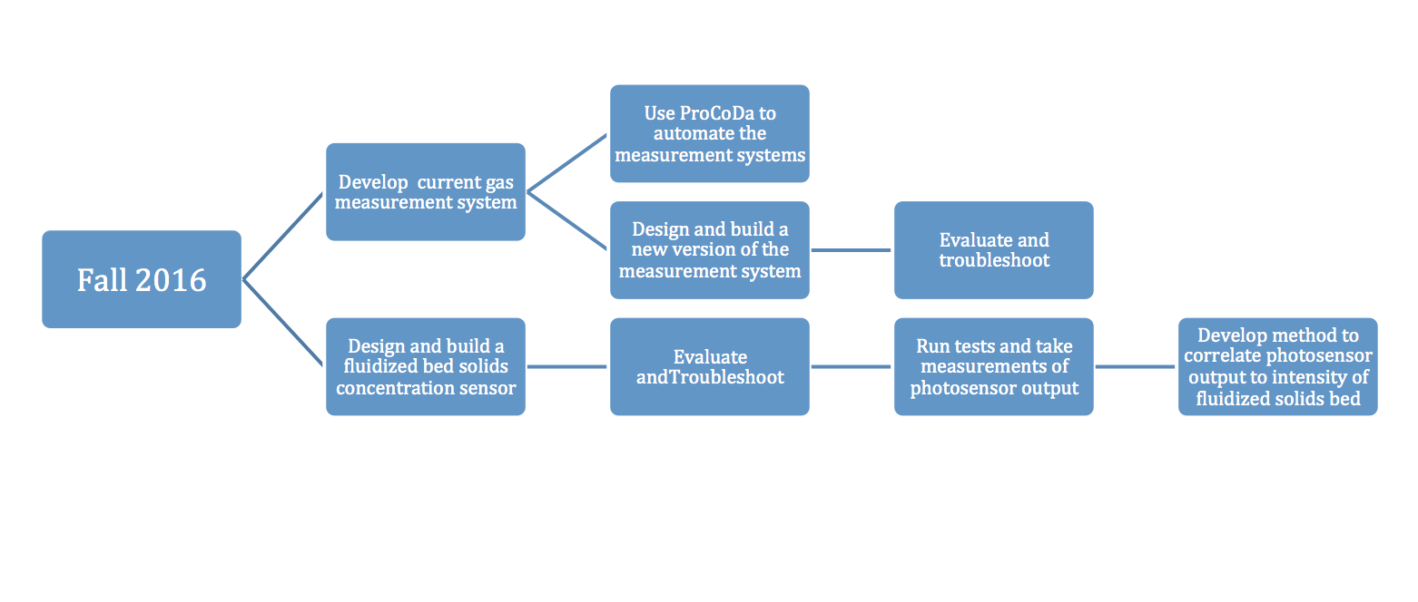
In the coming weeks, we will be fabricating the UASB sensors and beginning our work on other tasks.
Sensor Development | Research | Symposium Presentation Fall 2016
Notes:
4 of the 10 cm sensors are currently being built plus one extra just in case, about to be finished so the AFB team can use them as soon as possible.

Slide 20
Questions
and
Recommendations
Cheer Tsang
Biological Engineering
ct542@cornell.edu
Grace Mitchell
Environmental Engineering
gmm93@cornell.edu
Andrea Pozo
Civil Engineering
ap989@cornell.edu
Sidney Lok
Environmental Engineering
sgl38@cornell.edu
Sensor Development | Research | Symposium Presentation Fall 2016

Slide 21
Appendix
Slides
Sensor Development | Research | Symposium Presentation Fall 2016
Notes:
From this point on, add any slides with figures that will help support your thesis. You might pull these figures from your Final Report.

