Slide 1
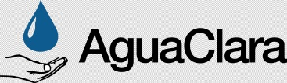
AguaClara: Intro to Teams
Monroe Weber-Shirk
Notes:
Pathogen sampling
Recycle of backwash water

Slide 2
Intro to AguaClara
What is our grand challenge?
What is our vision?
Who is on the team?
What are the strengths that we bring to the challenge? (or how are we tackling the grand challenge?)
What have we accomplished in the first decade?
What’s next?
Notes:
What is our grand challenge?
What is our vision?
Who is on the team?
What are the strengths that we bring to the challenge? (or how are we tackling the grand challenge?)
What have we accomplished in the first decade?
What’s next?

Slide 3
This is going to be different
Not your typical homework set
There is no answer key
Google and Siri don’t know the answers either
Collaborative (not competitive)
Guide by your side (not sage on the stage)
This is real

Slide 4


Slide 5
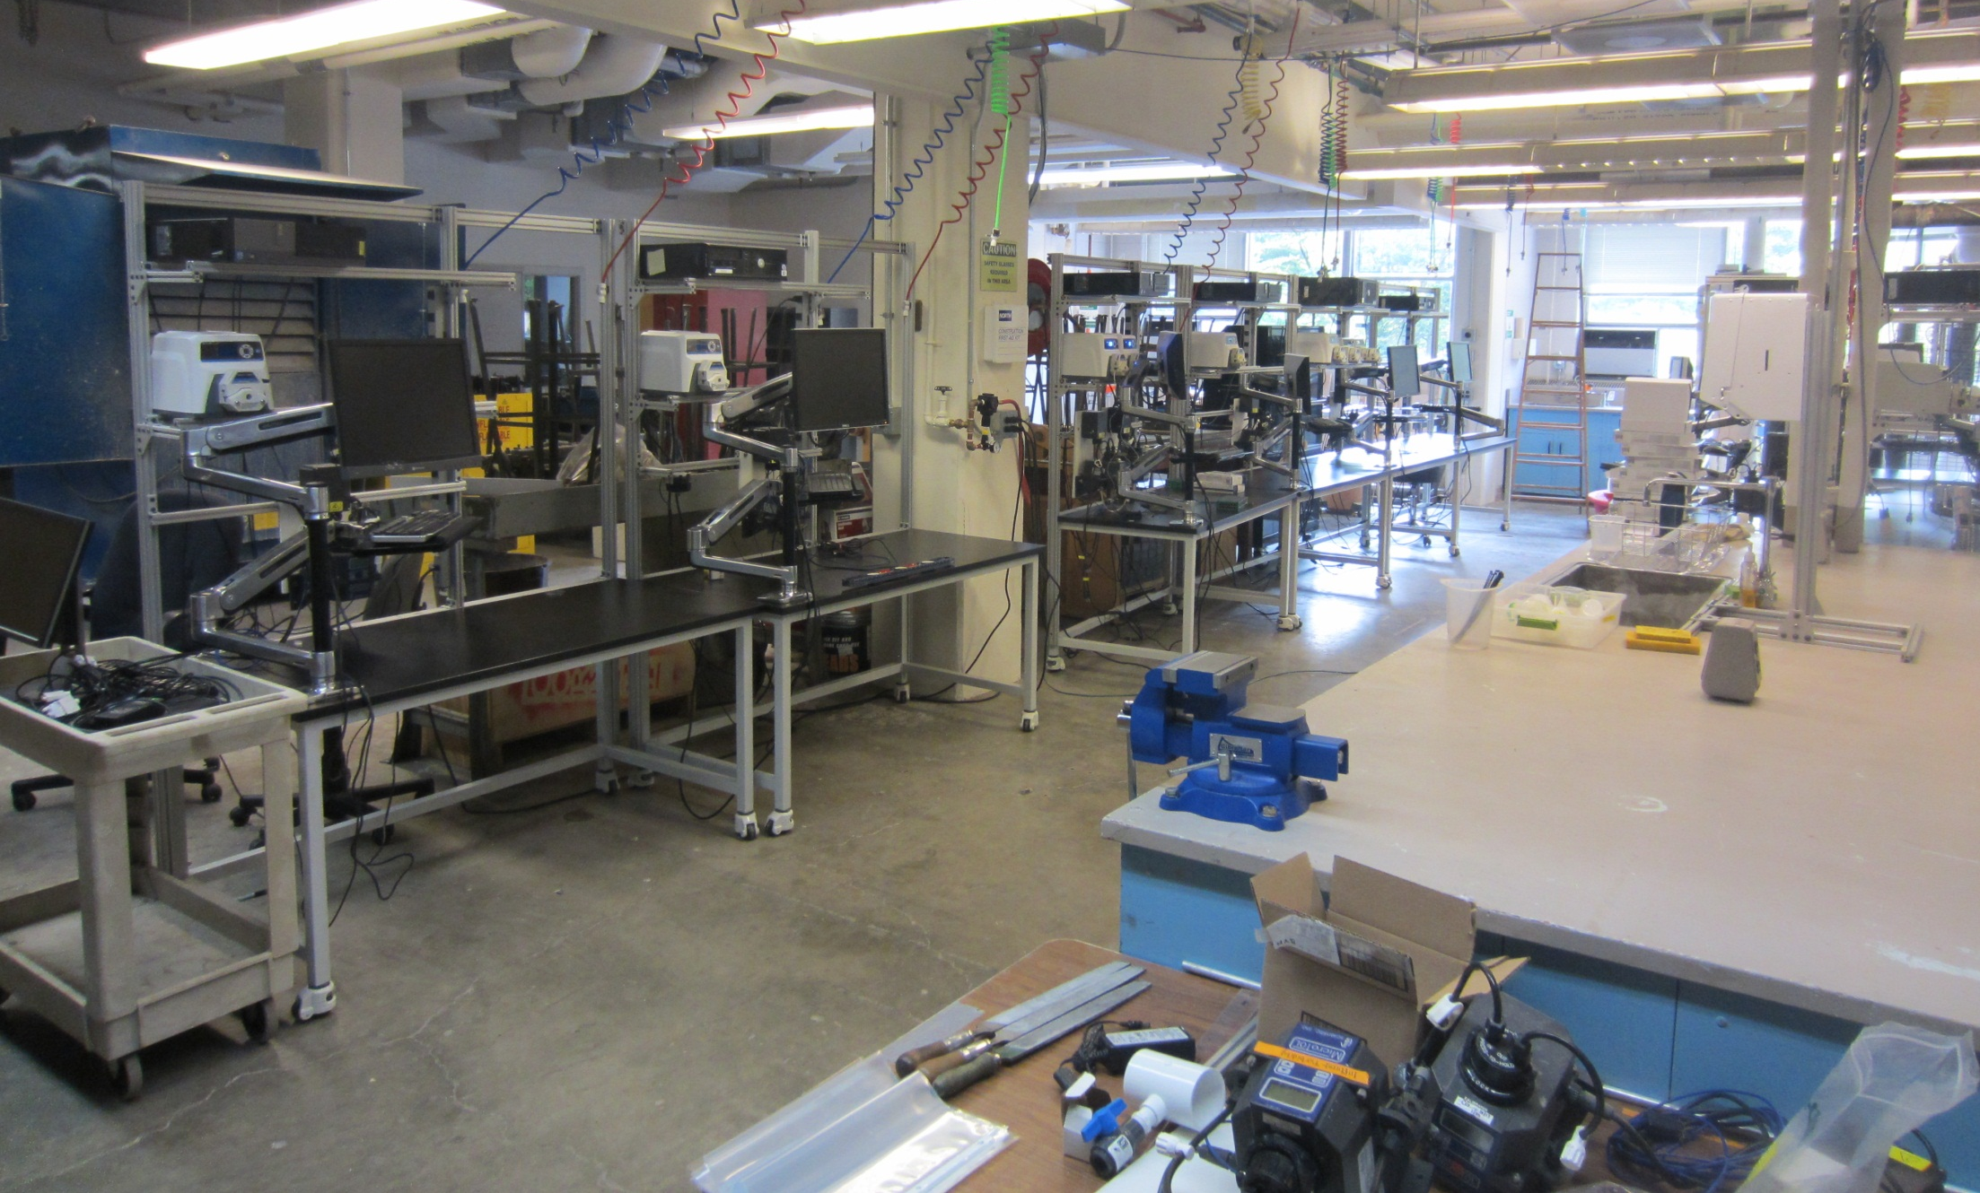
One giant sandbox to create a new world

Slide 6
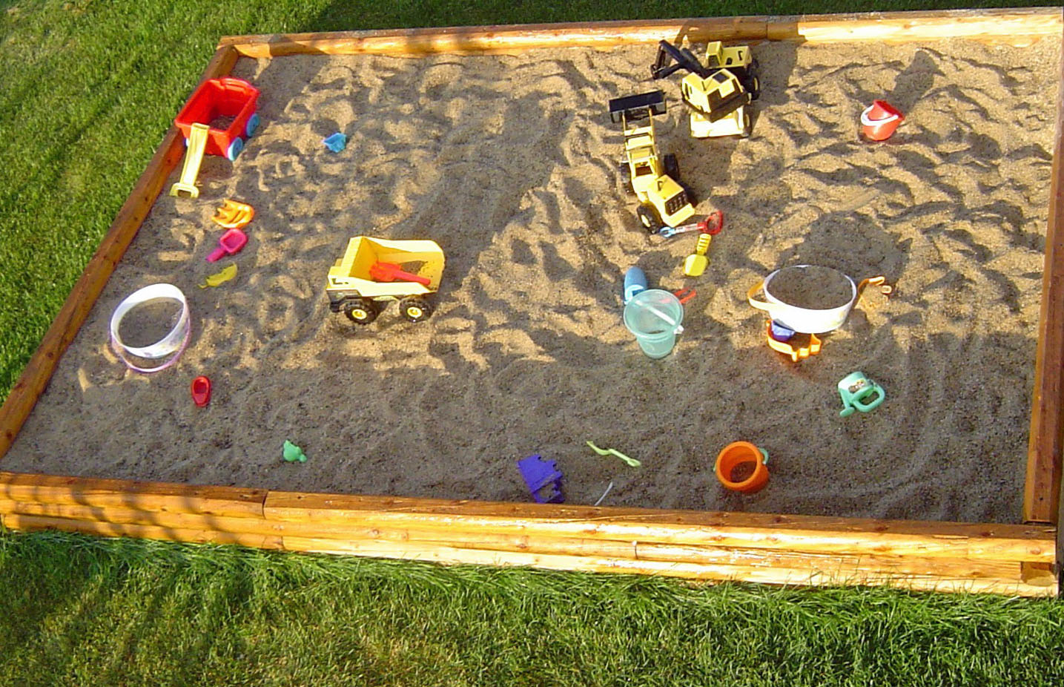
One giant sandbox to create a new world

Slide 7
The experts don’t know the answers
If we knew the answers there wouldn’t be several billion people who don’t have access to safe drinking water
If we knew the answers the vast majority of human sewage wouldn’t be discharged into rivers, lakes, and oceans without treatment

Slide 8
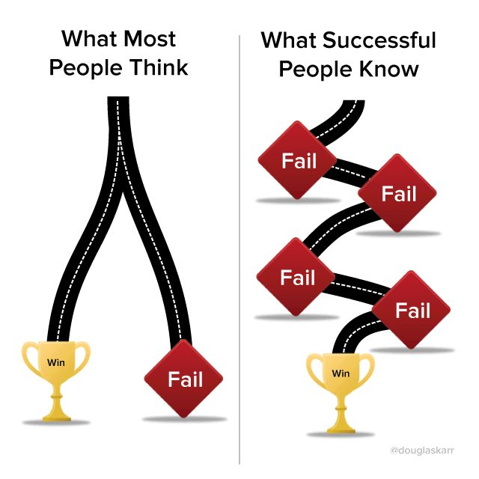
Fail better and faster
It isn’t really this easy….
It isn’t binary! It is evolutionary.

Slide 9
Embrace learning
Embrace Churning
Churn (iterate)
Learn (evolve)
Try
Observe
Repeat
Try
Observe (and really see)
Reflect (ask “Why is this hard?” and “What can I learn?”)
Create a new plan
Repeat

Slide 10
Agency: the capacity to act and change your environment
You are amazing!
You can learn things that no one else knows
You can invent ways to make our world better
Don’t wait for life to happen to you
Take the initiative and change your environment

Slide 11
Types of Teams
High-Performing
Cooperative
members
team
Cooperative
Performance Level
Traditional
Pseudo
Types of Teams

Slide 12
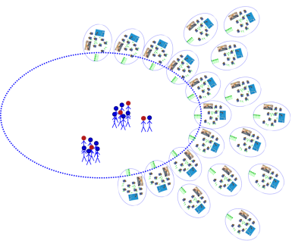


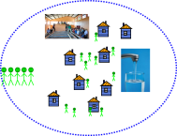
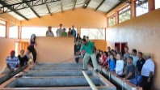
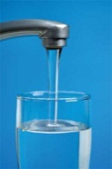
From Cornell Labs to Scale-Up
Regional Partner
Community
Implementation Partner
Network
Journey Inward
Journey Outward
Water Board
Research
Invent
Design
Engage
Notes:
We work with regional implementation partners (IPs) to design and construct the initial plants.
The IPs will then lead the build-out on additional plants, with us in a QA and support role
We work with IP to provide training to local water boards and communities
We use inexpensive, readily available materials to build the plants

Slide 13
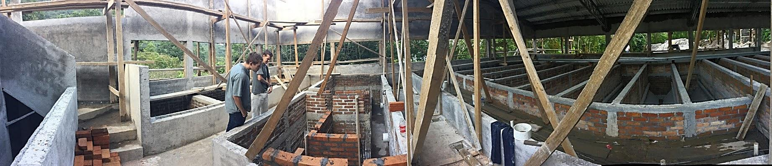
Las Vegas (70 L/s plant)

Slide 14
Team Themes
Going Global
Apps and Algorithms
Lab Research
  Wastewater
  Particle removal
  Dissolved species removal
Fabrication and Physics

Slide 15
Going Global
Public Relations (CEE 2550 only)
  Social Media – its about communication with a global team!
  Cornell publicity and beyond
Webmaster
  Mobile ready, up to date, sharp, and easy to find information
Business Team
  Develop a new model to finance construction of water treatment plants

Slide 16
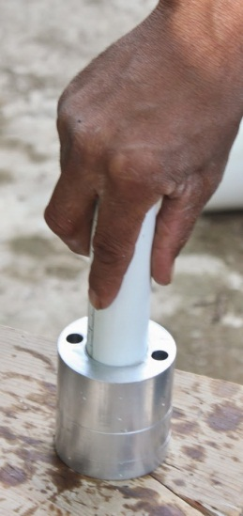
Apps and Algorithms teams
Design (http://designserver.cee.cornell.edu/Designs/)
  Publication arm of the AguaClara program
  Algorithms and documentation
  Bigger plants, smaller plants, keep up
  with the rapidly changing technologies!
Floc size and count app
  Enable us to see what each treatment stage does
Plant Operations Smartphone Tracker (POST)
  App for plant operators and for transparency
  You can track the water quality at our plants

Slide 17
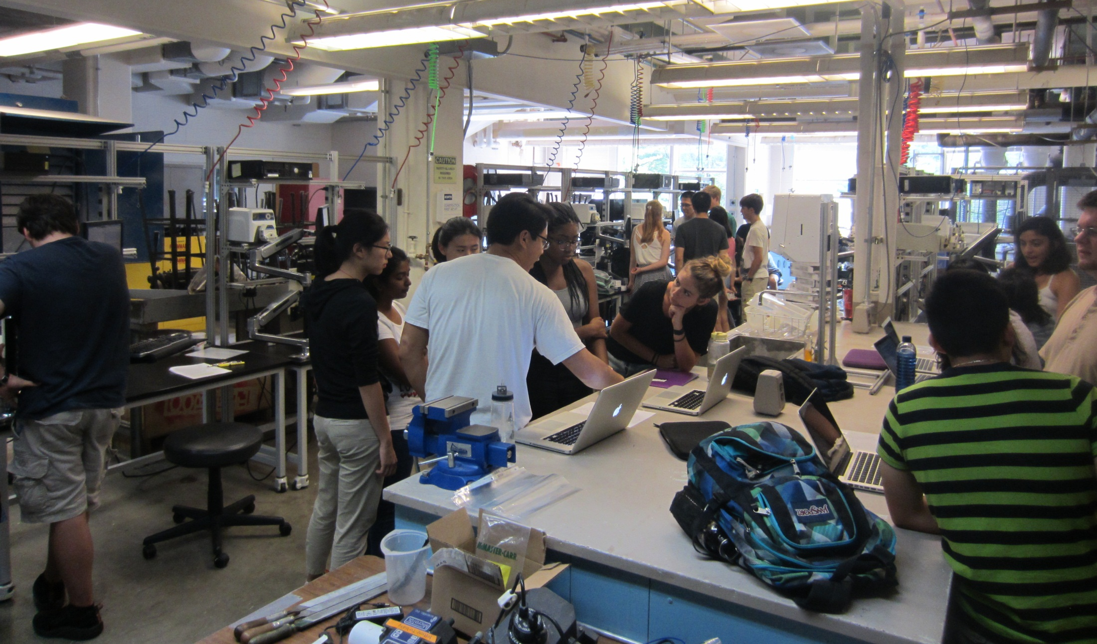
Lab Research Teams

Slide 18
Wastewater
The majority of the wastewater in the global south enters lakes, rivers, and streams without treatment.
Anaerobic Settled Bed (ASB)
  Measure hydraulic residence to set baseline for how fast an AFB could operate
Anaerobic Fluidized Bed (AFB)
  Research/Invent/Design a high rate, low cost, reliable AFB (get the hydraulic residence time below 1 hr!)
Sensors
  Invent sensor hardware/software to monitor biogas production

Slide 19
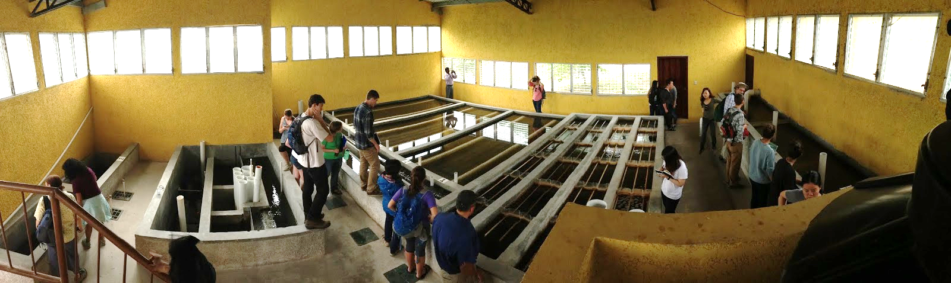
Surface water treatment

Slide 20
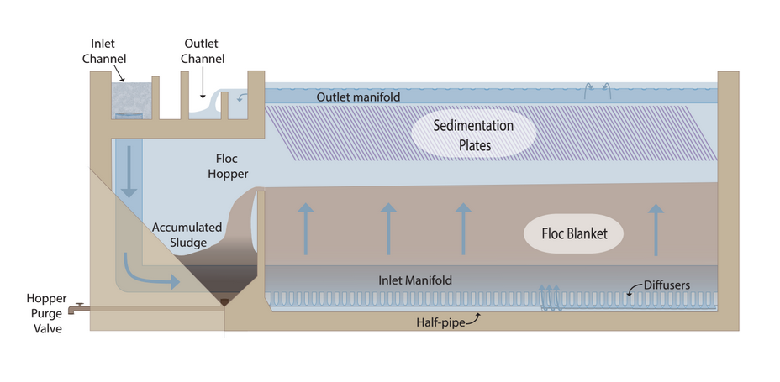
Surface water treatment
High Rate Sedimentation
Stacked Rapid Sand (EStaRS)
Rapid mix contact chamber
Ram Pump
A
B
C
D
E

Slide 21
Surface water treatment
Rapid mix contact chamber
  reduce coagulant demand – gain insights into physics of particle attachment
High Rate Sedimentation – reduce size and cost with applications for AFB too
  Floc blanket concentrators – novel geometry
Milli-Sedimentation
  Test a crossover technology that is between tube settlers and filters

Slide 22
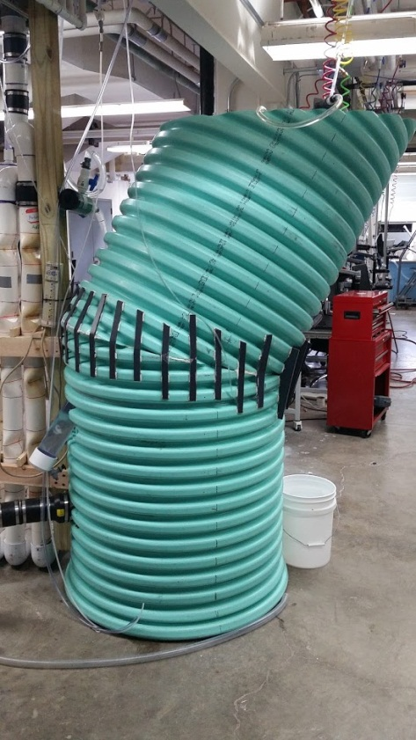
Surface water treatment
StaRS Filtration Theory
  Develop a filter performance model that describes a filter run and enable us to design a better StaRS filter
1 L/s plant test
  Test, modify, and prepare to ship
  to Honduras for demonstration in January

Slide 23
Dissolved Species Removal (EPA P3 Phase II grant)
Invent improved reactor geometry and prepare to take these technologies to India starting next summer
Fluoride floc blanket removal
  Use PACl to remove arsenic and/or fluoride using a single-stage reactor
Countercurrent stacked floc blanket reactor
  Use PACl to remove arsenic and/or fluoride using a multi-stage reactor

Slide 24
Fabrication and Physics teams
Ram Pump
  Test the new ram pump in realistic conditions and prepare to demonstrate in Honduras in January
Chemical Dose Controller (CDC)
  Design an elegant more modular CDC for the 1 L/s plant
Notes:
According to the 2011 census of India, 68.84% of Indians (around 833.1 million people) live in 640,867 different villages.^{[3]}

Slide 25
Fabrication and Physics teams
Prefab 1 L/s Plant
  Research/Invent/Design/Fabricate the next 1 L/s plant with a focus on structural engineering
Enclosed Stacked Rapid Sand Filter (EStaRS)
  Design and Fabricate the next generation of EStaRS
Notes:
According to the 2011 census of India, 68.84% of Indians (around 833.1 million people) live in 640,867 different villages.^{[3]}

