Slide 1
What I Learned at iveccs 2016
Mariana A. Pardo

Slide 2
The role of the Red blood cells in coagulation
Benjamin Brainard VMd, DACVAA, DACVECC
Increase in HCT results in translocation of platelets to periphery of vessels as blood flows > aids in coagulation presumably due to increased contact time with endothelium
RBC release ADP and ATP during mechanical deformation > may explain consumptive thrombocytopenia in liver and splenic neoplasia
RBC contain scrambalase that may promote the exposure of phosphatidyl serine (procoagulant) under unknown circumstances > this may be an additional cause of IMHA hypercoagulability
Transfusion of washed pRBC can shorten bleeding times in patients that are anemic and coagulopathic

Slide 3
The role of the Red blood cells in coagulation
Benjamin Brainard VMd, DACVAA, DACVECC
Effects of free hemoglobin:
  Nitric oxide scavenging properties > vasoconstriction
  Induces cytokine production
  Promotes platelet aggregation and coagulation
  Promotes oxidative injury > inflammation
  Causes release of vWF

Slide 4
The effectiveness of ampicillin-sulbactam continuous infusions vs intermittent infusions at maintaining therapeutic serum antibiotic concentrations in canine septic peritonitis
Samuel Stewart DVM
Methods:
  12 dogs with septic peritonitis
    6 received 50 mg/kg IV of Unasyn followed by CRI at 0.1 mg/kg/min
    6 received 50 mg/kg IV q8 of Unasyn
    Additional antibiotics were allowed to increase spectrum
  Blood samples collected at 0,1,6 and then q12h until PO meds, death or euthanasia
  Liquid chromatography for Unasyn concentrations

Slide 5
The effectiveness of ampicillin-sulbactam continuous infusions vs intermittent infusions at maintaining therapeutic serum antibiotic concentrations in canine septic peritonitis
Samuel Stewart DVM
Results:
  CRI group maintained higher average Unasyn concentrations compared to intermittent bolus group for all MICs evaluated except for 160 ug/ml (p< 0.001)
  CRI group had a significantly higher T>MIC compared to the intermittent bolus except for 160 ug/ml
  No adverse effects were noted
  All dogs survived to discharge

Slide 6
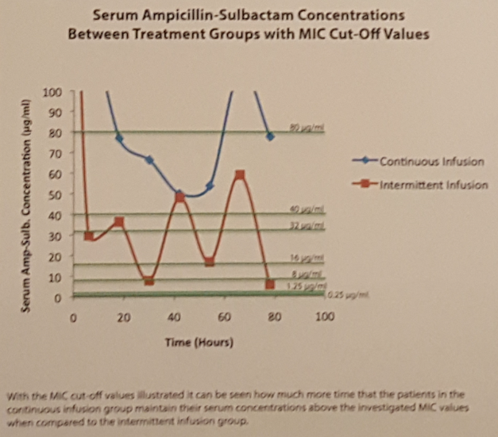
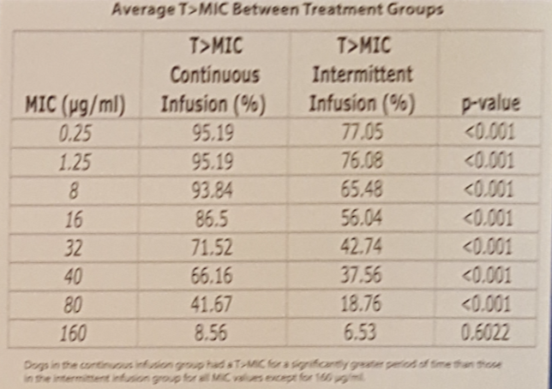

Slide 7
The effectiveness of ampicillin-sulbactam continuous infusions vs intermittent infusions at maintaining therapeutic serum antibiotic concentrations in canine septic peritonitis
Samuel Stewart DVM
Discussion
  MIC of 0.25-16 ug/ml is considered sensitive, >32 ug/ml is considered resistant
  Beta-lactams have a slow continuous kill related to T>MIC
  Concentrations falling below MIC have been shown to lead to rapid bacterial multiplication
  Critically ill patients have greater Vd and increased drug clearance

Slide 8
Regional Anesthesia in critically ill patients
Alessio Vigani DVM, phd, dacvaa, dacveec
Epidural catheters - Controversies
  Anticoagulants
    Risk of hematoma 1 <150000 in people
    Normal clotting times and plt > 50000 for safe placement
    Do NOT remove catheter in the presence of therapeutic anticoagulants
    No increased risk with use of anticoagulants
    Clopidogrel should be discontinued 5-7 days before placement or removal (not much evidence)

Slide 9
Regional Anesthesia in critically ill patients
Alessio Vigani DVM, phd, dacvaa, dacveec
Epidural catheters – Controversies
  Sympathetic Blockade
    In sepsis sympathetic tone is necessary for maintenance of hemodynamic stability, homeostatic control and survival
    In human trials epidural cath in patients with septic shock was associated to decreased survival times, cardiac function and increased Creat, however in trials with patients with sepsis, epidural catheters was associated with improved outcomes
    Severity of sepsis may be important when deciding if epidural catheter should be used

Slide 10
Regional Anesthesia in critically ill patients
Alessio Vigani DVM, phd, dacvaa, dacveec
Epidural catheters – Controversies
  Acute Pancreatitis
    Improves pancreatic and hepatic oxygenation > reduces vasoconstriction from pain and stress
    Improves pancreatic microcirculation, decreased edema and necrosis
    Excellent management of pain
    Still unknown..
      Effect on survival in naturally occurring acute pancreatitis
      Effect on GI function

Slide 11
Regional Anesthesia in critically ill patients
Alessio Vigani DVM, phd, dacvaa, dacveec
Epidural catheters – Controversies
  Catheter Associated Infection
    1 in 10000 in people
    No evidence of hematogenous spread – sepsis does not increase risk of infection
    All bacterial isolates are from the skin
    Bacterial filters do not prevent catheter infections
    Risk factors:
      Insertion site infection
      Catheter-hub disconnection

Slide 12


IVECCS 2016
Grapevine, Texas

