Slide 1
Pheochromocytoma
Physiology, diagnosis and treatment

Slide 2
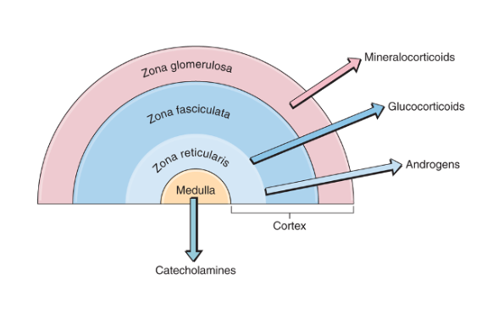
Adrenal Physiology Review

Slide 3
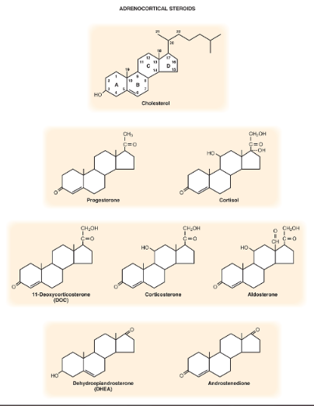
Synthesis of AC Steroid Hormones
Backbone: 21-carbon steroid
GCs: Ketone C3, OH C11/C21
MC: Double bond O C18
Androgens: Double bond O C17
19 Carbon Steroid

Slide 4
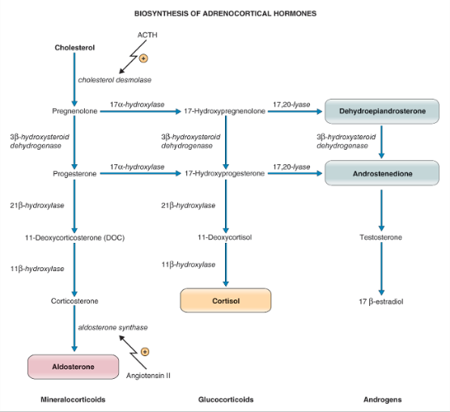
AC Biosynthetic Pathways
Dictated by Presence/Location of Enzymes
Cytochrome P450
Molecular oxygen
NADPH (H+ donor_
Adrenodoxin reductase
adrenodoxin
All layers, rate limiting
CHOL from circulation
Small amount de novo AC
Gets into AC cells via R’ for
lipoproteins, endocytosis,
stored in vesicles
Removal of C20/C21 side chain
Add ketone group at C17 to make
17-ketosteroid (measure in urine)

Slide 5
AC Biosynthetic Pathways
Dictated by Presence/Location of Enzymes
If block 17α-hydroxylase
Can still make corticosterone
(GC activity)
11-DOC and Corticosterone
Have MC activity

Slide 6
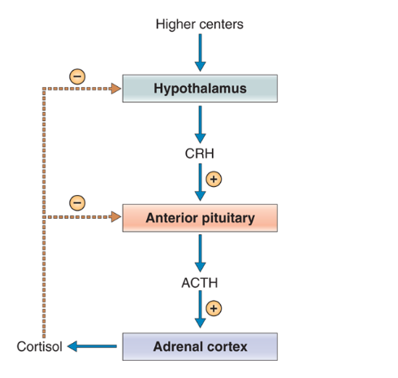
Secretion of AC steroids
Stimulation of cholesterol desmolase by ACTH
  Zonae fasciculata/reticularis under control of HPA
    Cortisol secretion pulsatile and diurnal
    Major burst of secretion in morning before waking = ½ total daily secretion
    ACTH causes
      Transfer of stored cholesterol to mitochondria
      Binding of cholesterol to Cytochrome P450
      Activate cholesterol desmolase
  Zona glomerulosa needs ACTH for first step, but then depends on RAAS

Slide 7
Regulation of Aldosterone Secretion
Primary regulation through changes in ECF volume via RAAS (angiotensin II) and changes in serum K+ levels
  Decrease in ECF volume
    Decrease in renal perfusion pressure
    Increase in renin secretion (juxtaglomerular cells of kidney) >> ANG > ANGI then ANGI > ANGII (ACE)
    ANGII stimulates aldosterone synthesis in ZG
    Aldosterone stimulates Na+ reabsorption from kidney
  Increases in serum K+ increases aldosterone secretion
    Depolarizes adrenal cells and opens voltage gated Ca2+ channels >> increase intracellular Ca2+
    Increased aldosterone stimulates K+ secretion by kidney

Slide 8
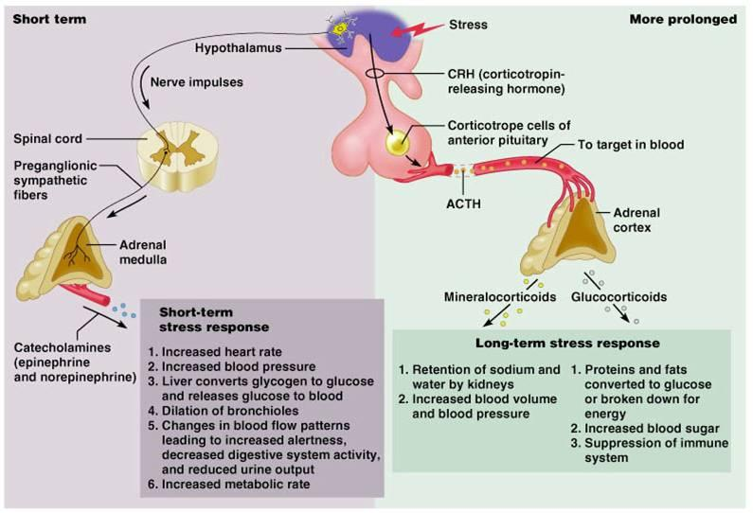
Adrenal Medulla
Cells of the adrenal medulla (AM) are the equivalent of post ganglionic cells of the sympathetic nervous system (SNS)
Epinephrine and norepinephrine are released when preganglionic nerve fibers to the AM are stimulated
  Epinephrine is the major catecholamine secreted by AM in most mammals

Slide 9
Catecholamine Synthesis
Rate
limiting
Cytosol
Chromaffin cells of the AM synthesize CC
Acetylcholine release from preganglionic nerve fibers initiates the synthesis of CC and stimulates the release of CC from chromaffin cells (stimulus-secretion coupling)
Synthesis starts with tyrosine (majority) or phenylalanine
Tyrosine hydroxylase is the rate limiting step in formation of CC
End products (DOPA, dopamine, norepi and epi) inhibit tyrosine hydroxylase
Cytosol
Chromaffin
granules
Cytosol

Slide 10
Catecholamine Synthesis
L-tyrosine
L-DOPA
Dopamine
Norepi
Epi
Rate
Limiting!
Enhanced
by cortisol
Tyrosine
Hydroxylase
DOPA
decarboxylase
Dopamine
Β-hydroxylase
PNMT
From food or
Phenylalanine
In liver
Final product
in neurons
AM post
ganglionic
neurons
AM

Slide 11
Primary Effects of Catecholamines
Work via adrenergic receptors on target tissues
  Alpha (α1 and α2)
    α1: vasoconstriction (high epi > vasoconstriction)
    α2: vasoconstriction, decreases release of insulin/glucagon
  Beta (β1, β2, β3)
    Β1: heart (increase heart rate, contractility, conduction velocity)
    Β2: vasodilation in skeletal muscle
      Epi 10x more potent than norepinephrine with β2 receptors (low [epi] > vasodilation)
    Β3: lipolysis in adipose tissue, thermogenesis in skeletal muscle
      Norepi more potent than epi with β3 receptors
Receptor types on various tissues vary in number

Slide 12
Epinephrine
  Increases [BG] mainly by β2 R’
    Promotes hepatic glycogenolysis & gluconeogenesis
    Stimulates glycogenolysis in skeletal muscle
      No glucose 6 phosphatase so produces lactate
      Liver then takes up lactate and converts to glucose
    Inhibition of insulin secretion (via α R’)
    Stimulation of glucagon secretion by pancreas
  Promotes lipolysis via interaction with R’ on adipose cells

Slide 13
Pheochromocytoma
Phaios: dark
Chroma: color
Cytoma: tumor
Due to the dark staining reaction (oxidation of catecholamines (CC)) when exposed to chromium salts
Tumor arising from catecholamine-producing chromaffin cells in the adrenal medulla (AM)
AM develops as part of SNS and the cells of the AM are modified post ganglionic sympathetic neurons lacking axons

Slide 14
Intro
In dogs: 0.01-0.1% of all canine tumors
Only a few case reports in cats
Malignancy based on local invasion OR distant metastasis
  50% canine pheos are malignant
    34% local invasion of adjacent vessels (vena phrenicoabdominales, vena cava caudalis, renal vessels, adrenal vessels, hepatic vein, aorta, etc.)
    20% metastasis to regional LN and other organs
Size few mm to 15 cm
< 10% bilateral
50-54% of dogs will have additional endocrine OR non endocrine tumors.

Slide 15
CC Metabolism
T ½ _{plasma} = 1-3 minutes
Metabolism in liver and kidney
Inactivation by conjugation in GI tract
CC metabolites, conjugates and free CC are excreted in urine

Slide 16
CC Metabolism
Metanephrine
Epi
VMA
Metanephrine Sulfate
Normetanephrine
Norepi
VMA
Normeta-
nephrine Sulfate
3,4-DHPG
MAO
MAO
COMT
COMT
PST
MAO
PST
COMT

Slide 17
CC Metabolism
Epi and Norepi are in chromaffin cells
  CCs leak from the vesicle to the cytoplasm
  Variable, low rate release into circulation
The end products of metabolism (VMA, metanephrine sulfate) are constantly leaked into the circulation so better for diagnosis of pheochromocytoma

Slide 18
Clinical Signs
Mean age 11-12 years (1-18 years)
Secretion of excessive CC by the pheo (more common)
Space occupying/invasive tumor/metastasis (less common)
Potentially life threatening (collapse, sudden death) due to massive CC release/tumor rupture
Hormone secretion is variable as are clinical signs
  Some clinical signs always (PU,PD, lethargy)
  Paroxysmal episodes (panting, tachycardia)
  Or no clinical signs between episodes
Episodes
  Multiple times per day/week or can be weeks to months between
  Similar severity each time or more commonly progression from mild to life threatening

Slide 19
Secretion of CC by the pheo
Nonspecific
  Anorexia, weight loss, lethargy
Cardiorespiratory/Hypertension
  Tachypnea, dyspnea, panting, arrhythmias, (tachyarrhythmia: SVT, VPC, V-tach), collapse, pale MM, nasal hemorrhage, acute blindness
Neuromuscular
  Weakness, anxiety, pacing, disorientation, muscle tremors, seizures (brain imaging necessary!)
Miscellaneous
  PU/PD, vomiting, diarrhea, abdominal enlargements, abdominal pain

Slide 20
CS due to tumor
Large invasive tumor:
  Large painful abdomen
  Ascites, hind limb edema
Tumor rupture:
  Acute severe lethargy, painful abdomen, tachypnea, weakness, collapse, tachycardia, pale MM, increased CRT
Metastasis:
  Brain: seizures, CNS signs,
  Vertebral canal/bone: paresis, lameness, swelling, local pain

Slide 21
Clinical Pathology
There are no consistent changes on CBC, CHEM, UA
CBC: anemia (chronic disease), polycythemia (hemoconcentration, EPO release, CC induced ischemia of kidneys or pheo), leukocytosis, stress leukogram
Biochemistry: elevated liver enzymes (ALT, AST, ALP - most frequent, hypertension, induced hepatopathy, inflammatory cytokine release), increased cholesterol values (advanced cases, CC induced lipolysis in liver)

Slide 22
BP
Minimal risk
  Systolic <150, Diastolic < 95 mmHg
Hypertension can be idiopathic (primary, essential) or secondary (renal or endocrine)
  >300 mmHg only in pheo
Why?
  Secretion of norepi by pheo
  Co-secretion of neuropeptide Y (vasoconstrictor)
  Compromised blood flow in renal artery due to compression by tumor, increased renin production
Can be intermittent, constant, or constant with peaks

Slide 23
Imaging
CXR/AXR
  Met check (pulmonary mets in 10% pheo dogs, but CT better)
  Cardiac changes due to hypertension/CC
  Retroperitoneal hemorrhage, ascites, organ displacement

Slide 24
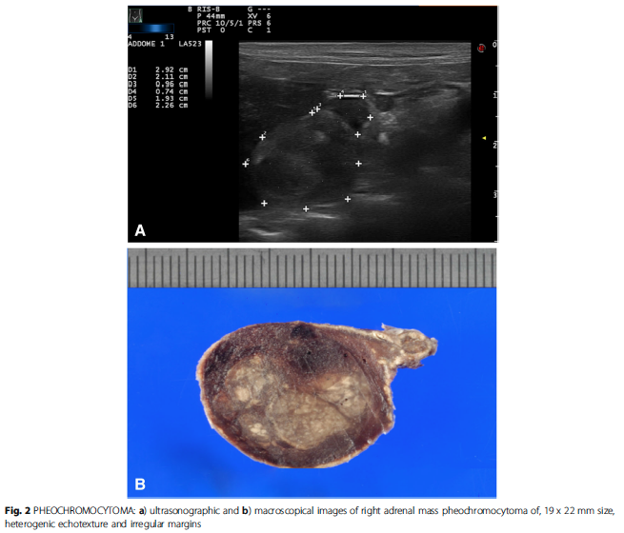
Imaging
Abdominal US
  Not a good way to discriminate between types of adrenal tumors
  May be heterogeneous, hyperechoic parenchyma
  Adrenal nodules/masses (few mm to > 10 cm)
  Can be hypo-, iso- or hyperechoic to kidneys
Difficult to assess via US compression versus invasion (tumor thrombus) of blood vessel

Slide 25
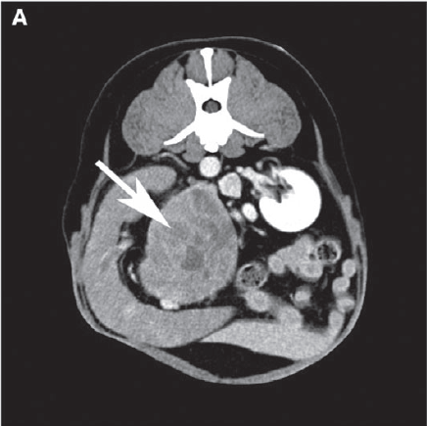
Imaging
CT/MRI
  Indicated in any patient with tumor invasion concern, surgical planning
  Contrast enhanced CT is superior to US for tumor invasion
    Vascular invasion vs mural compression
    Tumor thrombus vs blood clot (and extent of thrombus)
    Ionic (high osmolar) contrast media can stimulate catecholamine release from pheo and may induce hypertensive crisis
      Much safer to use non-ionic low osmolar contrast media
      Consider pretreatment with phenoxybenzamine, experienced anesthetist on board, prepare for hypertensive crisis, arrhythmias
  MRI may be better than CT for vascular invasion (superior resolution and contrast)
  Still can’t definitively say pheo versus other adrenal tumor with CT/MRI

Slide 26
Functional Medical Imaging
Functional characteristics of a tumor
Scintigraphy
SPECT (single photon emission computed tomography)
PET (positive emission tomography, more sensitive and better resolution than SPECT)
Radiotracers (¹²³iodine-metaiodobenzylguanidine, ¹²³I-MIBG) are taken up by tumor cells
  ¹²³I-MIBG = norepi analog localizes to presynaptic adrenergic nerves and sympathomedullary tissue and then into cytoplasmic storage vesicles
  Uptake proportional to number of neurosecretory granules within the tumor

Slide 27
Percutaneous FNA and Biopsy of Adrenals
Contraindicated if Pheo not ruled out
  High rate of complications including death
  70% of patients (hu) have complications
    Hematoma
    Severe hypertension
    Severe pain
    Delay to surgical treatment
    Misdiagnosis
    Difficult surgery due to inflammation and retroperitoneal fixation

Slide 28
Biochemical Testing
CC: dopamine, norepinephrine, epinephrine
Metanephrines: normetanephrine and metanephrine
  Fractionated metanephrines: separate analysis of above by HPLC
  Total = free + conjugated (with sulfate in GI)
  Deconjugated
Collect over 24 hours (urine or plasma)
  HPLC with electrochemical detection
  Tandem mass spec
Urine needs to be acidified to pH < 2 and chilled until run
Plasma: sample into chilled tubes, immediate centrifuge, store in -80ºC

Slide 29
Biochemical Testing
In humans
  Single best test is plasma free normetanephrine
    More norepi than epi
    Free metanephrines direct from pheo, urine can be from GI as well
  Increased urine or plasma normetanephrine by > 4 fold above upper reference interval is ~ 100% probability pheo present
  False positive
    Phenoxybenzamine, β-blocker
    Food, drinks
    Exercise, stress, etc.
      Humans with sympatho adrenal activation usually have larger increase in CC than metanephrines
    Renal Failure (decreased renal clearance)

Slide 30
Dogs with pheo have increased urine norepi, epi and normetanephrine ratios (to urine creatinine) with no overlap between pheo and healthy patients.
Urine normetanephrine significantly higher in dogs with pheo than Cushings (main ddx) with some overlap
  If use cut off of 4x normal than no overlap, but can miss dogs
  Higher levels in critically ill dogs, stabilize first before testing
For plasma free normetanephrine, use species specific reference ranges as much higher in dogs than people
Normetanephrine significantly higher in pheo with almost no overlap, superior to free metanephrine
Unclear if plasma or urine is better in dogs

Slide 31
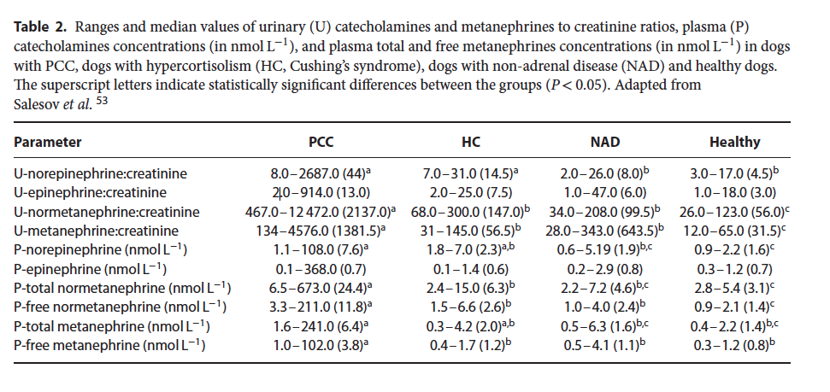

Slide 32
Surgical Treatment
Adrenalectomy ASAP
  Consider these tumors malignant (unpredictable tumor growth and risk of invasion)
  If bilateral MC + GC lifelong
  Tumor thrombus in vena cava NOT absolute contraindication for surgery (adrenalectomy + thrombectomy possible)

Slide 33
Pre-Op Considerations
Minimize CC induced complications
  Hypertensive crisis, arrhythmias, pulmonary edema and cardiac ischemia
  Block effects of CC 10-14 days prior to surgery IN ALL PATIENTS
    Even if CC levels normal
    Phenoxybenzamine, non competitive α-adrenoreceptor blocker, irreversible (until de novo synthesis), long lasting, non selective (α₁ and α₂)
      Does not block CC synthesis
      Blocks α adrenergic response to circulating epinephrine / norepinephrine
      Decreases BP
      Helps expand contracted blood volume
      Decreases frequency of ventricular arrhythmias
      Increase dose q2-3 days to decrease side effects (postural hypotension, dizziness, syncope, nasal congestion)

Slide 34
Phenoxybenzamine
If tachyarrhythmia develops (CC or α-blocker induced)
  Treat ≥ 2 days with phenoxy and then add β adreno receptor blocker
    Β₁ (atenolol) preferred over nonselective (propanolol)
      Atenolol 0.2-1.0 mg/kg PO q12-24hrs
    If given alone hypertension may worsen as α₁ vasoconstriction not opposed
Study of dogs treated with phenoxybenzamine 20 d before surgery with 0.1-2.5 mg/kg BID (median 0.6 mg/kg BID)
  6/6 untreated dogs with arrhythmias died
  1/7 treated dogs with arrhythmias died
  48 pets total, 23 treated.
Start with 0.25 mg/kg PO BID, increase q2-3d to final 1 mg/kg BID
  Surgery 2 weeks after start treatment
  Last dose evening prior to surgery
  If hypotension or other effects decrease dose

Slide 35
Anesthesia/intra-op
Admit 1 day prior to surgery
IVF maintenance rates (expand IV volume, decrease intra-op and post-op hypotension)
Continuous monitoring 24-48 hours post op
  ECG and direct arterial pressure +/- CVP
Complications most common during induction, intubation, surgical incision, manipulation of tumor (communication with surgeon is key)
Severe tachycardia (HR>250 bpm), cardiac arrhythmias, hemorrhage
Severe hypertension (systolic BP > 300 mmHg)
Hypotension after removal (systolic BP < 80 mmHg due to sudden decrease CC, hypovolemia, residual pre-op α-blockers, desensitization α R’
Depth of anesthesia more important than drug
  Premed with opioid that does not cause histamine release (methadone, hydromorphone)
  Induction with propofol, thiopental, etomidate

Slide 36
Intra-op hypertension
  Increase depth
  Phentolamine short acting α-adrenergic agonist
  IV bolus 0.02-0.1 mg/kg then CRI
Persistent tachycardia, tachyarrhythmia
  Esmolol ultrashort acting β₁ antagonist
  IV boluses 5—500 ug/kg then CRI 50-200 ug/kg/min
  DO NOT GIVE BEFORE α blockade to avoid hypertension
Ventricular arrhythmias > lidocaine
Hypotension: decrease dose of BP lowering drugs, give crystalloids, dobutamine, phenylephrine, norepinephrine, vasopressin (increase vascular tone)

Slide 37
Surgery/Post-Op
Open laparotomy or laparoscopic
Length of surgery is a major factor in survival
  10 day survival decreases by 75% for every 1 hour increase in surgery time
Monitor for 48 hours
  Continuous BP, ECG, PCV/TP, blood gas, electrolytes
  Complications common
    Hypotension: don’t forget about surgical bleeding
    Hypertension: CC stores in adrenergic nerve endings, resetting baroreceptors, structural change in vessels, remnant tumor, functional metastasis
    Cardiac arrhythmias

Slide 38
Still unsure of diagnosis?
If still question if pheo or cortisol producing adrenocortical tumor then give dexamethasone intra-op and ACTH stim after. Give GC until test shows normal adrenal cortex.

Slide 39
Medical Management
If surgery not possible
  Use pre-surgical plan (some have survived over 1 year on medical management.)

Slide 40
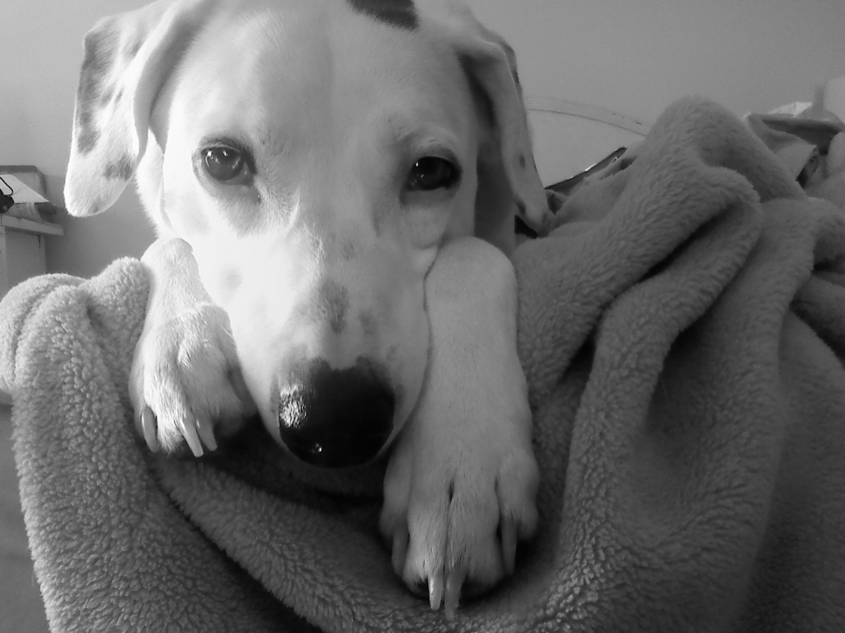
Thank you!

