Slide 1
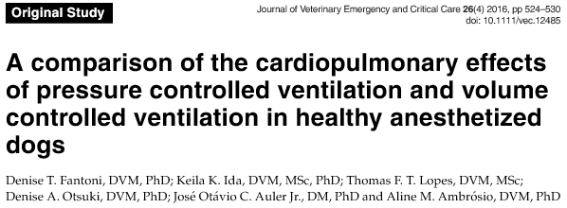

Journal Club
Mariana A. Pardo
2017
Emergency and Critical Care

Slide 2
Purpose of the Article
To compare the effects of pressure control vs volume control ventilation in healthy isoflurane-anesthetized dogs on :
  Lung compliance
  Gas exchange
  Hemodynamics
Is one strategy better than the other in healthy animals?

Slide 3
Hypothesis
PCV would result in better lung compliance and pulmonary gas exchange than VCV, with no significant effects on hemodynamics

Slide 4
Design
Prospective randomized study
University teaching hospital
  Universidade de Sao Paulo, Brazil
Types of Studies
http://research.library.gsu.edu/c.php?g=115595&p=755213

Slide 5
Animals
40 Client owned dogs undergoing OVH
  Randomized to receive PVC or VCV
Inclusion criteria
  3-6 y old
  10-20 kg
  Normal PE
  Normal CBC/Chem

Slide 6
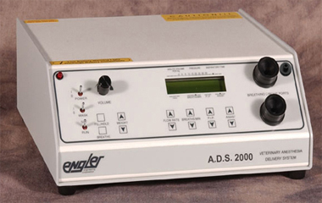
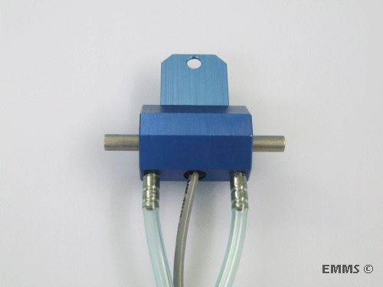
Anesthesia
Premedication
Induction
Isoflurane in 100% O₂
Connected to microprocessor-controlled anesthesia ventilator
Incorporated a calibrated pneumotachograph of fixed area type

Slide 7
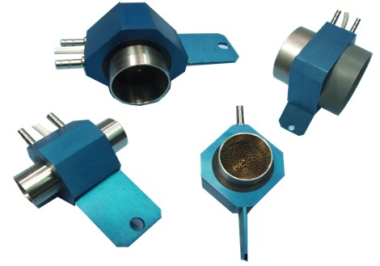
Anesthesia
Pneumotachograph
  an instrument for recording the velocity of respired air

Slide 8
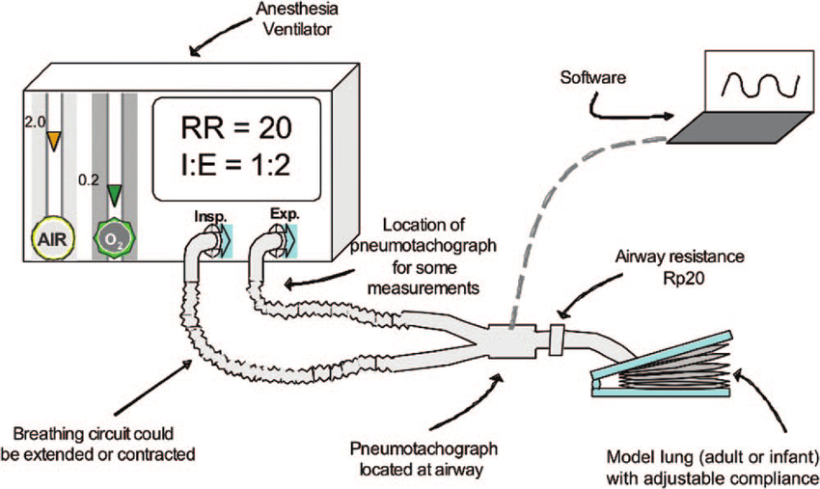
Anesthesia

Slide 9
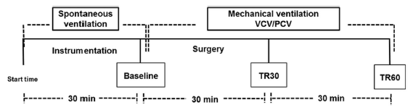
Time Line of the Study Design
Art line → MAP, arterial sampling
ECG → HR
Pulmonary artery cath → CVP, CO, MPAP, PAOP, core temp, mixed-venous sampling
Notes:
Instrumentation:
MPAP: mean pulmonary artery pressure
PAOP: pulmonary artery occlusion pressure

Slide 10
Time Line of the Study Design
Baseline Measurements
Notes:
Instrumentation:
MPAP: mean pulmonary artery pressure
PAOP: pulmonary artery occlusion pressure

Slide 11
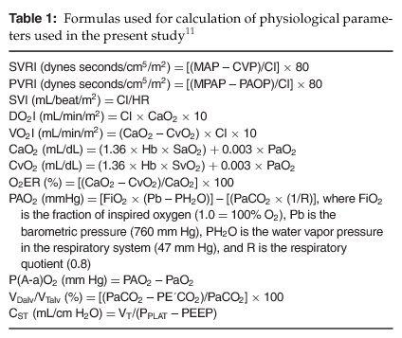
Measurements
Cardiac Index (CI)
Systemic Vascular Resistance Index (SVRI)
Pulmonary Vascular Resistance Index (PVRI)
Stroke Volume Index (SVI)
Oxygen Delivery Index (DO2-I)
Oxygen Consumption Index (VO2-I)
Arterial Oxygen Content (CaO2)
Mixed Venous Oxygen Content (CvO2)
Oxygen Extraction Ratio (O2ER)
Alveolar Oxygen Tension (PAO2)
Alveolar Arterial Oxygen Gradient (P(A-a)O2)
Alveolar Dead Space-Tidal Volume Ratio (V_{dalv}/Vt_{alv})
Static Compliance (C_{ST})

Slide 12
Measurements
Tidal Volume
Minute Volume (VE)
Peak Inspiratory Pressure (PIP)
Plateau Pressure (P_{plat})
Mean Airway Pressure (P_{mean})
Static Compliance (C_{ST})

Slide 13
Time Line of the Study Design
NM Blockade

Slide 14
Time Line of the Study Design
Randomized to PCV or VCV

Slide 15
Ventilation Settings
RR: 20 bpm
PEEP: 5 cm H2O
Tidal volume: 10 ml/kg
  PCV: adjusting inspiratory pressure
  VCV: adjusting inspiratory volume
PIP: 20 cm H20 in VCV

Slide 16
Time Line of the Study Design
Measurements
Measurements
Notes:
Instrumentation:
MPAP: mean pulmonary artery pressure
PAOP: pulmonary artery occlusion pressure

Slide 17
Statistics
Kolmogorov-Smirnov test
  Non-parametric statistics
  determines if two datasets differ significantly
  Used to:
    compare two empirical data distributions
    compare one empirical data distribution to any reference distribution
Types of Non-Parametric Statistics
http://www.mit.edu/~6.s085/notes/lecture5.pdf

Slide 18
Statistics
Kolmogorov-Smirnov test
  Normal distribution

Slide 19
Statistics
Anova (Analysis of variance)
  used to compare differences of means among more than 2 groups
  compares the amount of variation between groups with the amount of variation within groups
Assumptions of ANOVA
•Normally distributed
•Variance is similar within ≠ groups
• Data points are independent

Slide 20
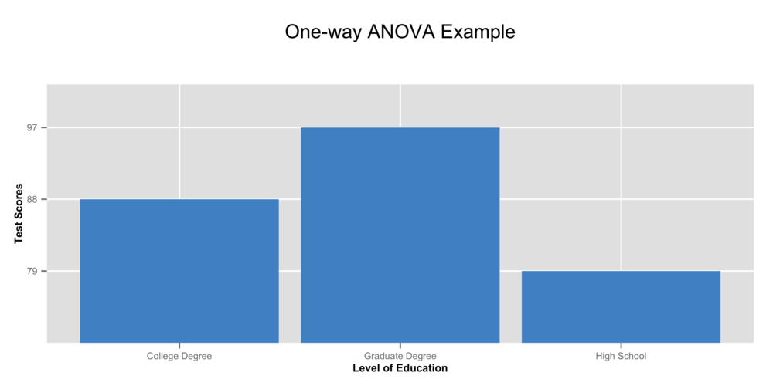
Statistics
Notes:
One-way ANOVA has one continuous response variable (e.g. Test Score) compared by three or more levels of a factor variable (e.g. Level of Education).

Slide 21
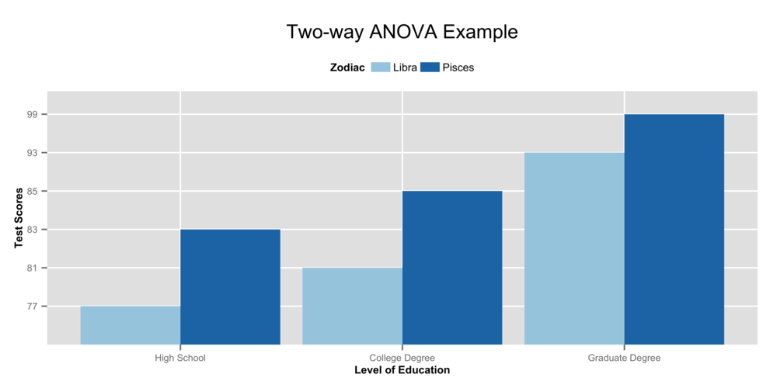
Statistics
Notes:
Two-way ANOVA has one continuous response variable (e.g. Test Score) compared by more than one factor variable (e.g. Level of Education and Zodiac Sign).

Slide 22
Statistics
Anova used for:
  Evaluate body weight between groups
  Evaluated repeated measures within a group to investigate temporal differences
  Compare PCV and VCV groups

Slide 23
Statistics
Tukey’s
  post-hoc test, performed after an ANOVA
ANOVA can tell the whether groups in the sample differ, it cannot tell which groups differ
Notes:
if the results of ANOVA are positive in the sense that they state there is a significant difference among the groups, the obvious question becomes: Which groups in this sample differ significantly? It is not likely that all groups differ when compared to each other, only that a handful have significant differences. Tukey's HSD can clarify to the researcher which groups among the sample in specific have significant differences

Slide 24
Statistics
Tukey’s
  Used when significant time effects were detected within groups
Notes:
if the results of ANOVA are positive in the sense that they state there is a significant difference among the groups, the obvious question becomes: Which groups in this sample differ significantly? It is not likely that all groups differ when compared to each other, only that a handful have significant differences. Tukey's HSD can clarify to the researcher which groups among the sample in specific have significant differences

Slide 25
Statistics
Student’s t test
  determines the probability that two populations are the same with respect to the variable tested.
T test won’t achieve significance if:
Difference isn’t large enough
Variation is too great
Sample is too small

Slide 26
Statistics
Student’s t test
  Used to investigate differences detected between the groups

Slide 27
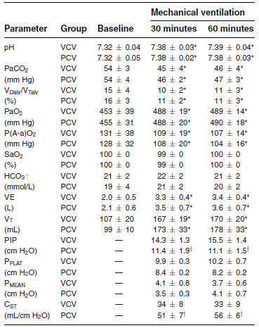
Blood Gas Values and Parameters of Ventilation
Both groups had a significant increase in VE and VT at 30 and 60 min compared to spontaneous ventilation
Notes:
VE: minute ventilation - volume of air moved into the lungs per minute – VT x RR
VT: tidal volume – volume of air inspired or expired with each breath, during normal breathing

Slide 28
Blood Gas Values and Parameters of Ventilation
At 30 and 60 min, changes were associated with a significantly lower PIP and higher Cst in the PCV group compared to VCV
Notes:
PIP: maximum level of pressure applied to the lungs during inhalation
Cstat: compliance during periods without gas flow VT/ Pplat-PEEP

Slide 29
Blood Gas Values and Parameters of Ventilation
At 30 and 60 min, changes were associated with a significantly lower PIP and higher C_{ST} in the PCV group compared to VCV
Notes:
Means that less pressure was needed to reach the same VT

Slide 30
Blood Gas Values and Parameters of Ventilation
Both modes resulted in significantly increase pH and PaO2
Notes:
V_{Dalv}/V_{talv:} Alveolar Dead Space-Tidal Volume Ratio
***PECO2 not on any charts

Slide 31
Blood Gas Values and Parameters of Ventilation
Both modes resulted in a significant decrease in PaCO₂, PECO₂, V_{Dalv}/V_{Talv} and Aa gradient at T30 and T60 when compared to spontaneous ventilation, these changes were not significant amongst the groups
PECO₂?
Notes:
V_{Dalv}/V_{talv:} Alveolar Dead Space-Tidal Volume Ratio , normal is 1/3
***PECO2 not on any charts

Slide 32
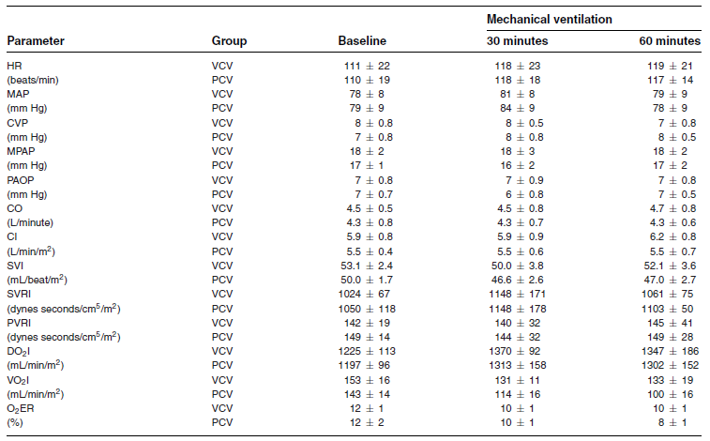
Hemodynamics and Cardiopulmonary Variables
DO₂I, VO₂I, O₂ER and hemodynamic variables did not change significantly over time or between groups
Notes:
DO₂I: systemic oxygen delivery index
VO₂I: systemic oxygen consumption index
O₂ER: Oxygen extraction ratio

Slide 33
Discussion
PCV resulted in improved pulmonary compliance compared to VCV
Gas exchange was adequate in both groups

Slide 34
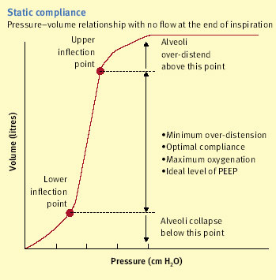
Discussion
Because V_{T} was maintained constant, improved C_{ST} during PCV indicated that less pressure was required to deliver the same V_{T}
C_{stat} = V_{T}
Pplat - PEEP
Compliance: ratio of change in volume to change in pressure
Static Compliance: pulmonary compliance during periods without gas flow (inspiratory pause)
Notes:
Compliance: lungs ability to stretch and expand

Slide 35
Discussion
Besides C_{ST} and PIP differences between groups, all values were within reference intervals
Advantages of PCV over VCV were not clinically relevant since they were healthy dogs…. But what about dogs with lung disease?

Slide 36
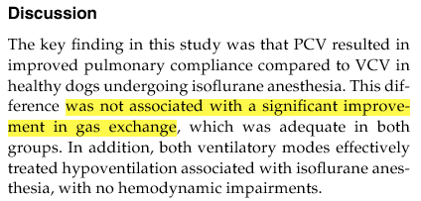
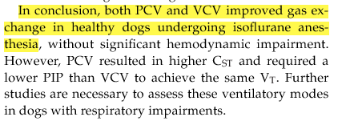
Conclusions

Slide 37
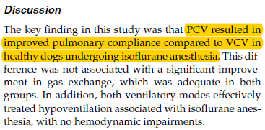
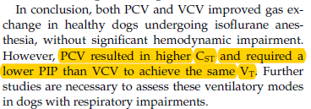
Conclusions

Slide 38
Did they answer their question?
To compare the effects of pressure control vs volume control ventilation in healthy isoflurane-anesthetized dogs on :
  Lung compliance
  Gas exchange
  Hemodynamics
Is one strategy better than the other in healthy animals?
→ improved with PCV
→ no change
→ no change
NO

Slide 39
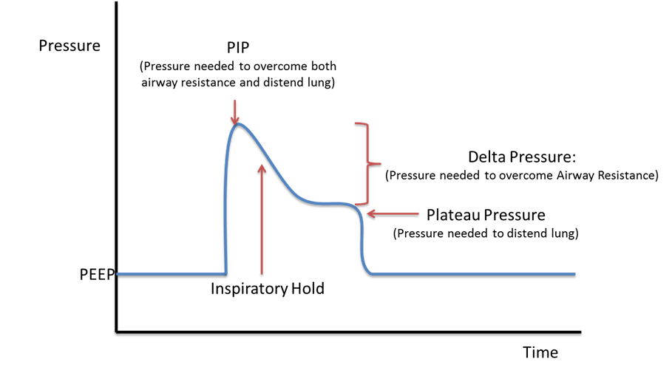
PIP and Pplat

