Slide 1
Advanced Imaging:
CT and MRI
Pia Martiny, DVM
Cornell University Hospital for Animals
ECC Department
1-3-17

Slide 2
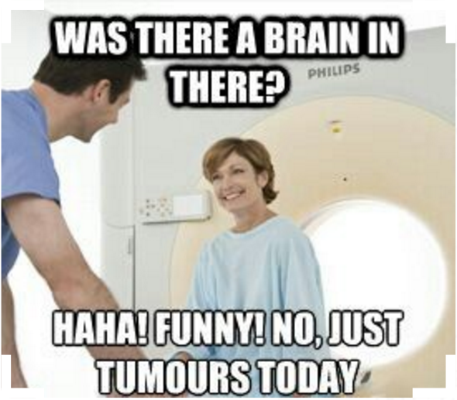
Overview
CT physics
CT applications
MRI physics
MRI applications

Slide 3
X-ray Physics
Electromagnetic waveform
X-rays produced from collision of electrons and anode
  Multiple types of collisions
  Most involve small energy transfers and ionization of target atoms
Notes:
X-rays produced when anode bombarded by electrons
When e- hits target material, different types of collisions take place
Majority of encounters involve small energy transfers e- to electrons that are knocked out of the atoms, leading to ionization of the target atoms
For a typical x-ray tube, over 99% of the input energy is converted to heat.

Slide 4
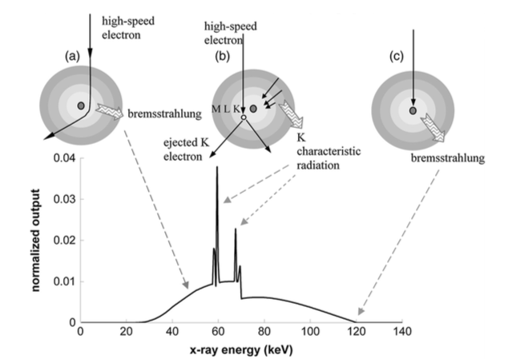
X-ray Physics: Production of X-rays
Notes:
e- interaction with target and its relationship to the x-ray tube energy spectrum
Bremsstrahlung radiation: generated when high-speed electrons are decelerated by the electric field of the target nuclei
Characteristic radiation: produced when high-speed electron ejects target e- from its electronic shell. Outer-shell electrons fill in the vacant shell and characteristic x rays are emitted
A high-speed electron hits the nucleus directly, and the entire kinetic energy is converted to x-ray energy

Slide 5
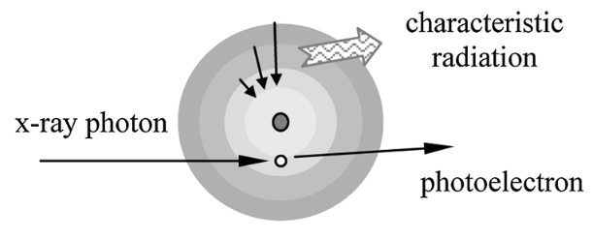
X-ray Physics: Interaction with Matter
Photoelectric effect
  Characteristic x-rays are all absorbed
Notes:
Xray energy is greater than the binding energy of an electron
The incident x-ray photon gives up its entire energy to liberate an electron from a deep shell of an atom (the free electron is often called a photoelectron)
The photon ceases to exist
The hole created in the deep shell is filled by an outer-shell electron and a characteristic radiation results, all of which are reabsorbed

Slide 6
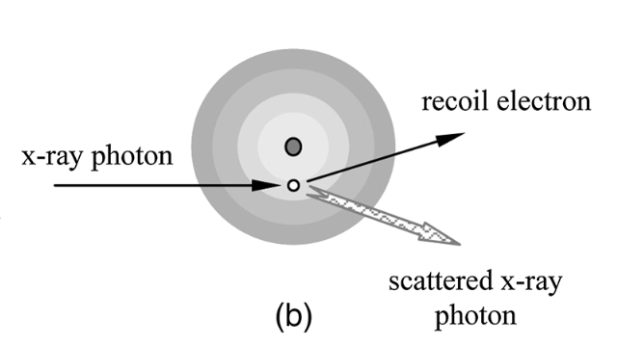
X-ray Physics: Interaction with Matter
Compton scatter
  Decreased contrast between structures
Notes:
An incident x-ray photon strikes an electron and frees the electron from the atom
The incident x-ray photon is deflected or scattered with partial loss of its initial energy but retains most of it’s energy and may undergo additional collisions before exiting the patient
The probability of a Compton interaction depends on the electron density of the tissue
The electron density difference between different tissues is relatively small and so little contrast information between different tissues is provided

Slide 7
X-ray Physics: Interaction with Matter
Coherent scatter/Rayleigh scatter
  An x-ray with an oscillating electric field sets the electrons in an atom into momentary vibration
    Emit radiation of the same wavelength
  Occurs mainly in the forward direction
    Produce a slightly broadened x-ray beam
  No energy is transferred to kinetic energy
  Limited interest to CT

Slide 8
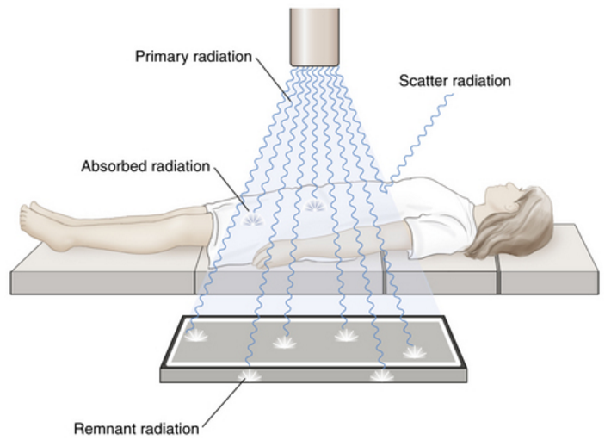
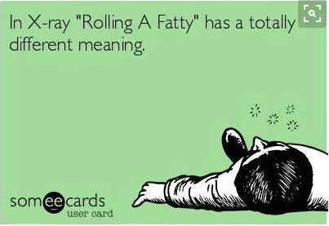
Conventional Radiography
Roentgen 1895
Broad x-ray
Stationary tube
3D volume is compressed in the direction of the x-ray to 2D image

Slide 9
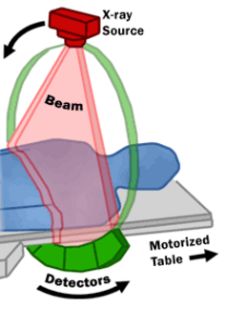
Computed Tomography
Hounsfield, 1967
Narrow, fan-shaped beam
Nonstationary x-ray tube
X-rays are counted by electronic detectors
Reconstruction of detector signals

Slide 10
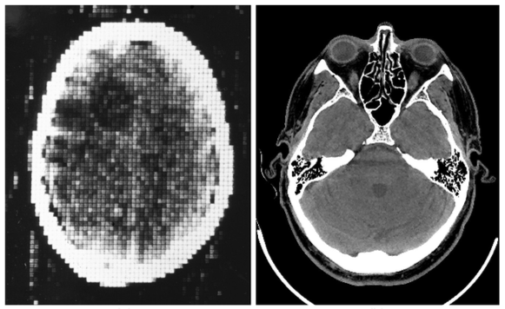
Computed Tomography
‘tomos’
  Imaging of a single plane
  Elimination of the outline of structures in other planes
1972
Modern CT
Notes:
Greek

Slide 11
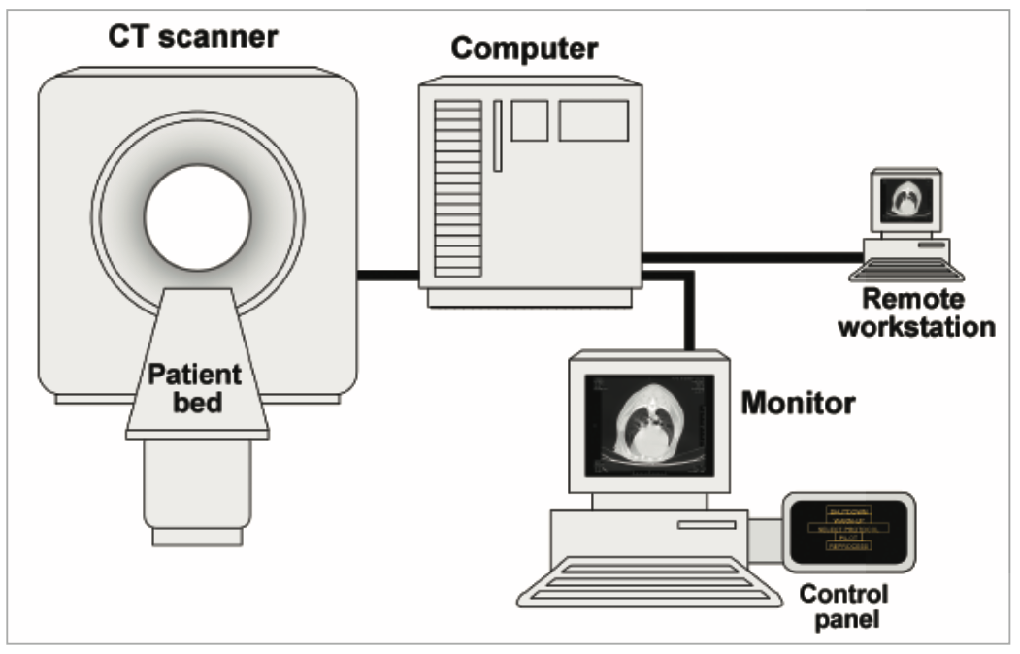
Computed Tomography

Slide 12
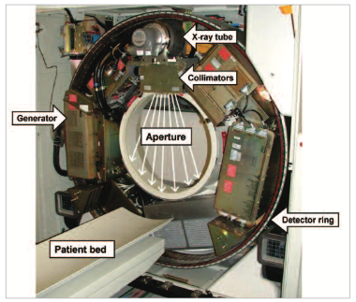
CT Unit Anatomy
Gantry

Slide 13
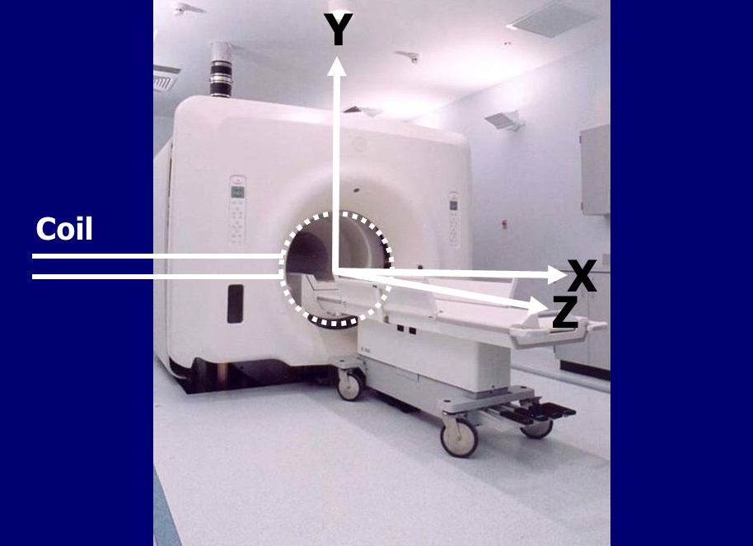
CT Unit Anatomy
Notes:
Y axis
X axis
Z axis

Slide 14
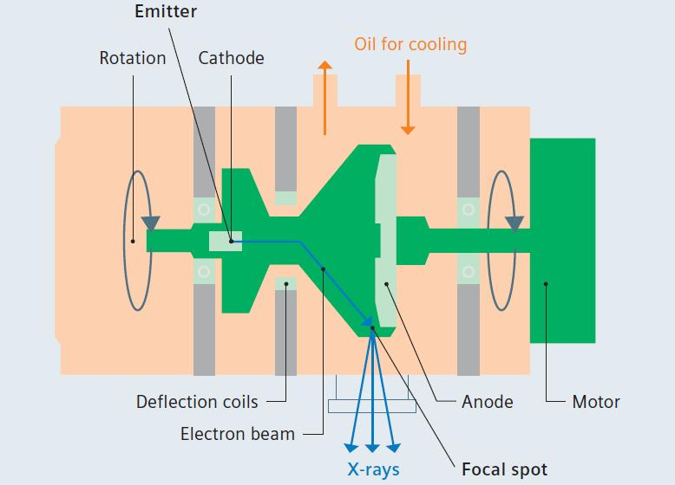
X-ray Tube Anatomy

Slide 15
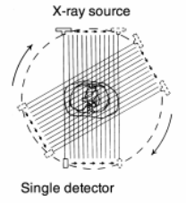
Gantry Anatomy
First generation
  Single pencil beam source
  Single detector
  Parallel projection measurements
  One angle
  ‘translate/rotate scanner’

Slide 16
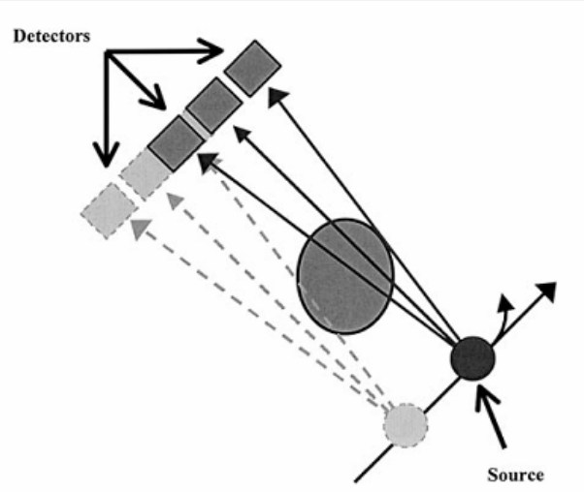
Gantry Anatomy
Second generation
  Fan-shaped beam
  Angularly placed detectors
  Scan times reduced 3x

Slide 17
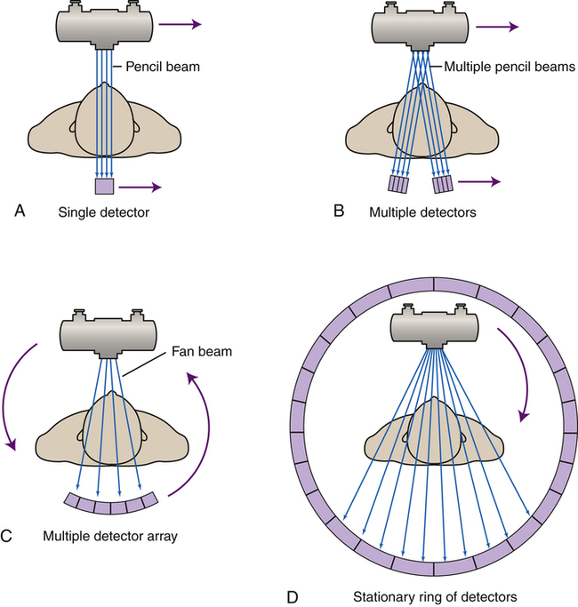
Gantry Anatomy
Third generation
  Simultaneous rotation of the x-ray tube and detector array
  “rotate-rotate geometry”
  “rotating gantry”
  Multislice CT systems

Slide 18
Gantry Anatomy
Fourth generation
  Rotating x-ray tube
  360º ring of fixed detectors
    expensive
  “rotate/stationary geometry”
  Multislice CT systems

Slide 19
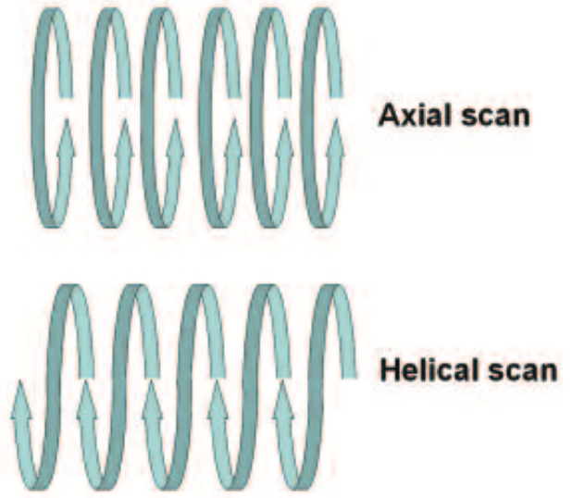
Scan Mode
Axial scan
  ‘Sequential scanning’
  Incremental table translation
Helical scan
  ‘Spiral CT’
  Continuous x-ray tube rotation
  Simultaneous and continuous table translation

Slide 20
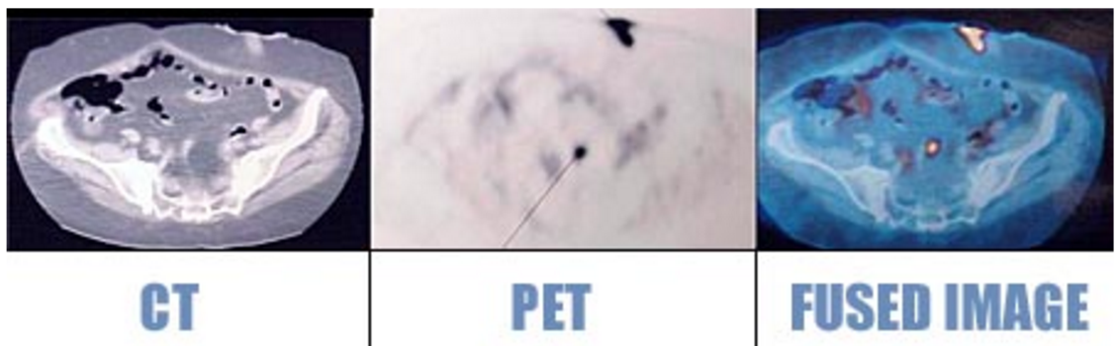
CT and Nuclear Medicine
Positron Emission Tomography/CT
Single Photon Emission CT
Radioisotope provides metabolic and functional information

Slide 21
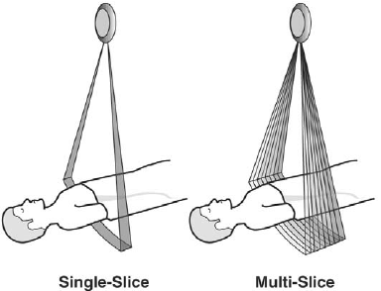
Slice Thickness
‘Thin’ slices
  1-2mm
  Maximal resolution of high contrast structures
  Eg. inner/middle ear bones
‘Thick’ slices
  5-8mm
  Distinguish between tissues of similar attenuation to minimize ‘noise’

Slide 22
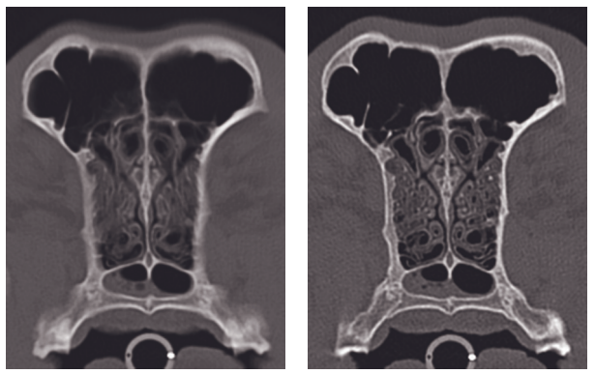
Slice Thickness
5mm slice thickness
1mm slice thickness
Notes:
Blurring of the turbinates

Slide 23
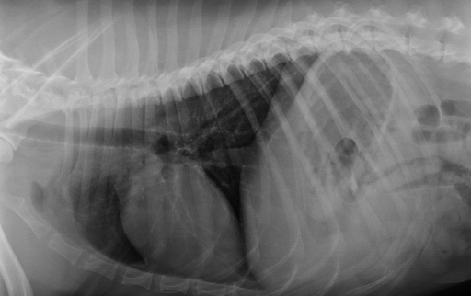
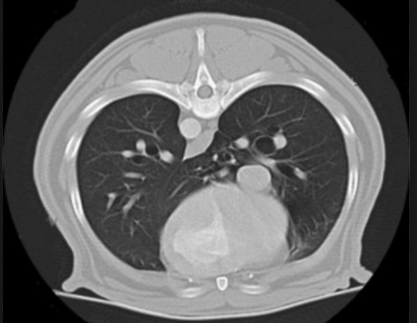
Image Interpretation: Similarities
Properties similar to conventional rads
  Low-density tissues: black
  High-density tissues: white

Slide 24
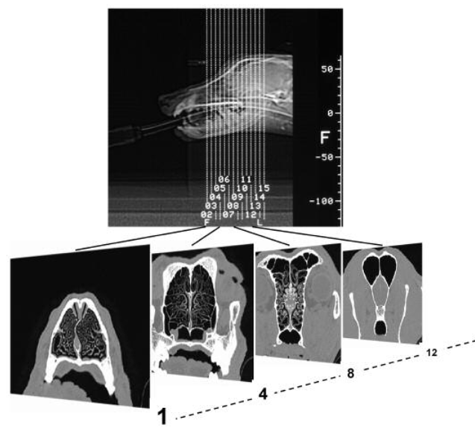
Image Interpretation: Differences
Each CT image represents a thin section of the patient
Multiple images required

Slide 25
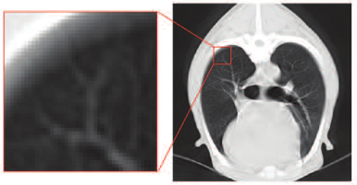
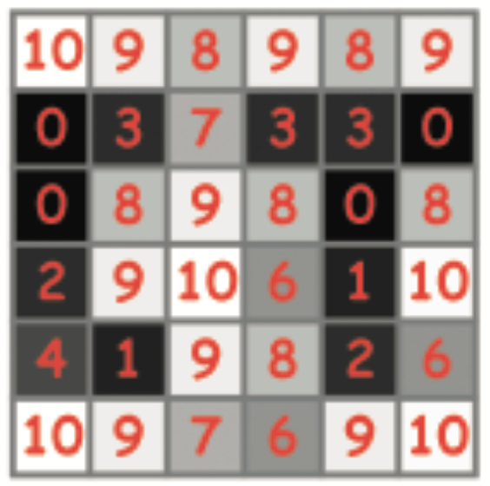
Image Interpretation: Differences
Rads display the sum of attenuation
CT images display attenuation assigned to each pixel
  “picture + element”
  Increased tissue density sensitivity

Slide 26
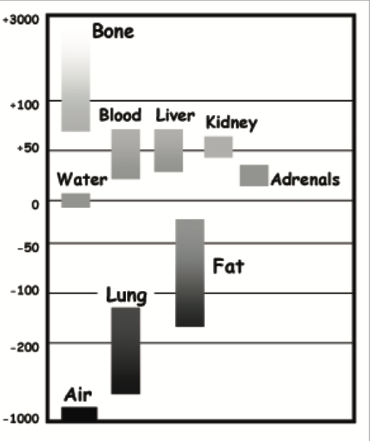
Image Interpretation
CT numbers/Hounsfield units
  -1,000 HU: air
  3,000 HU: compact cortical bone
Window adjustment pending tissue type
  d/t few grey levels of monitor
  Wide window: air or bone-containing structures
  Narrow window: soft tissue and fluids

Slide 27
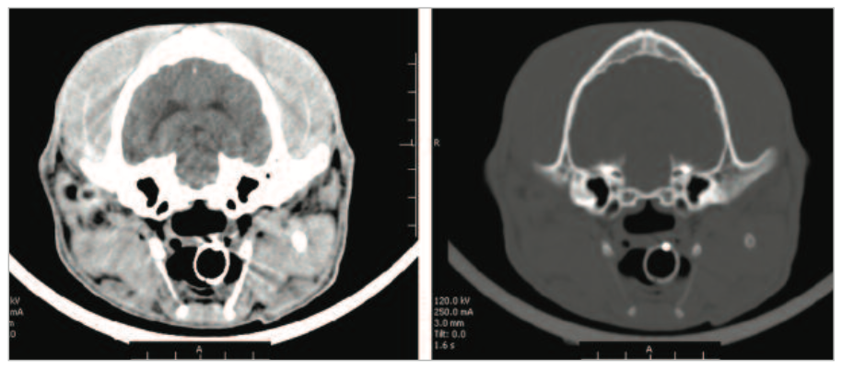
Image Interpretation
Wide window
  Tissues with a wide range of HU
Narrow window
  Differences in organs with a narrow range of HU

Slide 28
Practicalities
Sternal recumbency
Chemical restraint
  Monitored with apron and thyroid shield
  Low scatter due to highly collimated xray beam
Tissue density (not opacity)
  Hyperdense, isodense, hypodense

Slide 29
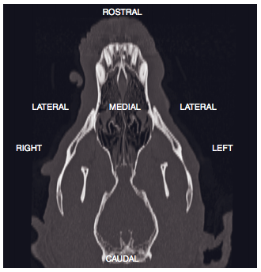
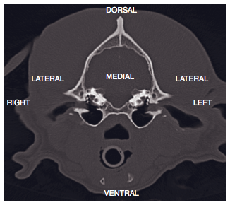
Practicalities

Slide 30
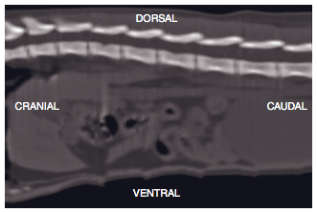
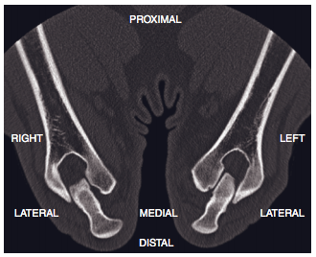
Practicalities

Slide 31
Contrast Media and Applications
IV contrast media
  Iodinated, ionic or non-ionic
Blood flow and vascular permeability dictate tissue enhancement
  Accumulations in vascular, hemorrhagic or edematous lesions
Notes:
May enhance contrast between tissues, or identify vascular filling defects (such as with embolism)
Very rare side effects: renal failure, refractory arrhythmias, or anaphylaxis
Nonionic: increased cost, decreased major side effects

Slide 32
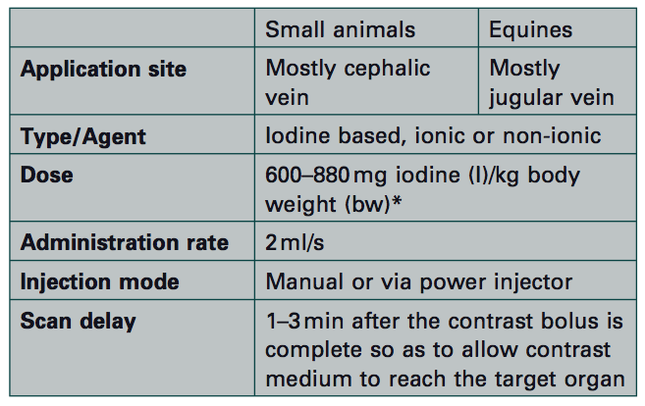
Contrast Media Administration

Slide 33
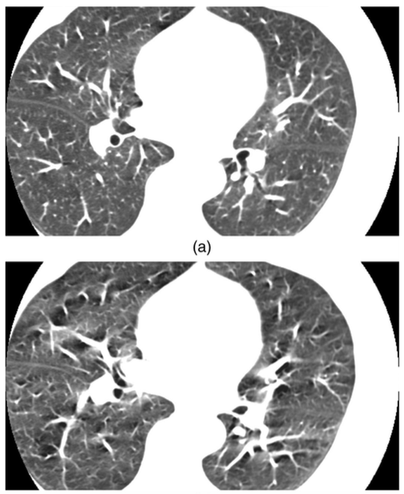
CT Artifact
Respiratory motion artifact
No respiratory motion

Slide 34
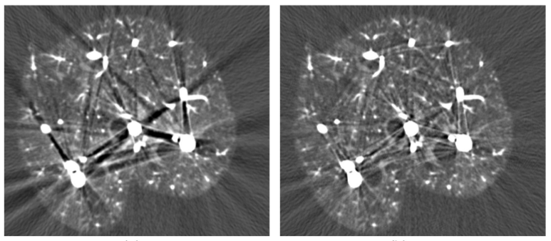
CT Artifact
Contrast-induced artifact
Beam-hardening correction

Slide 35
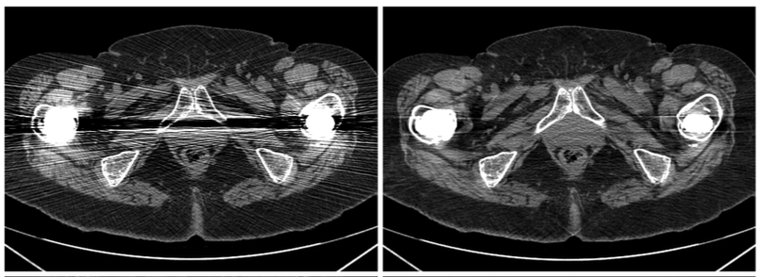
CT Artifact
Metal artifact
Metal-correction algorithm

Slide 36
Indications: CT
Alternative to multiple-view rad study
Following normal rads or US
Gain more information regarding an abnormality visualized with rad/US
Guide biopsy
Determine the extent of a lesion before sx or radiation therapy
Notes:
Detailed examination of a wide range of structures

Slide 37
CT Applications: Head
High contrast tissues
Cross sectional imaging eliminates superimposition artifact
Pre and post contrast scans
  Many inflammatory and neoplastic processes cause disruption of the BBB

Slide 38
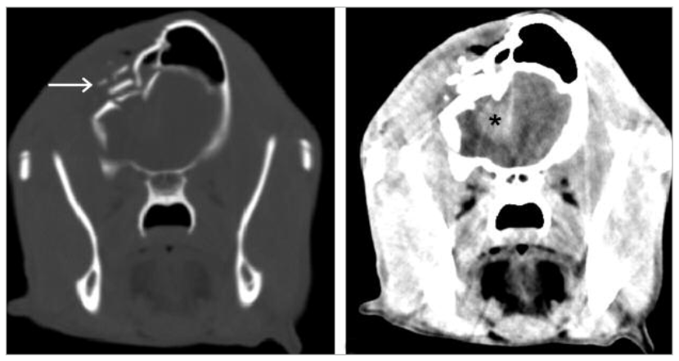
CT Applications: Head
Wide window
Narrow window
HBC CT. Fx of right frontal bone and calvarium. Hyperdense lesion in the right forebrain, representing a hematoma.

Slide 39
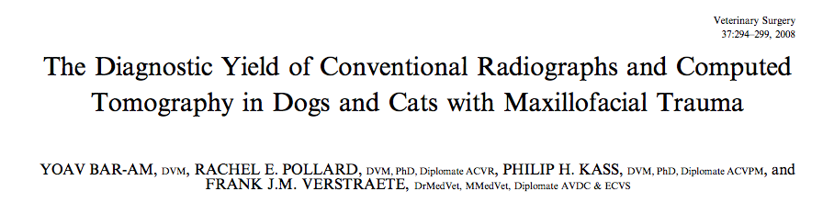
CT Applications: Head
CT images are superior to rads
  Ability to identify skull anatomy
  Ability to detect MFT injuries
Skull radiography is superior for visualizing the mandibular body (LL and OBL views) and dental occlusion (DV view)

Slide 40
CT Applications: Thorax
Rapid scan times
Increased sensitivity for pulmonary metastasis
Nontraumatic/spontaneous pneumothorax

Slide 41
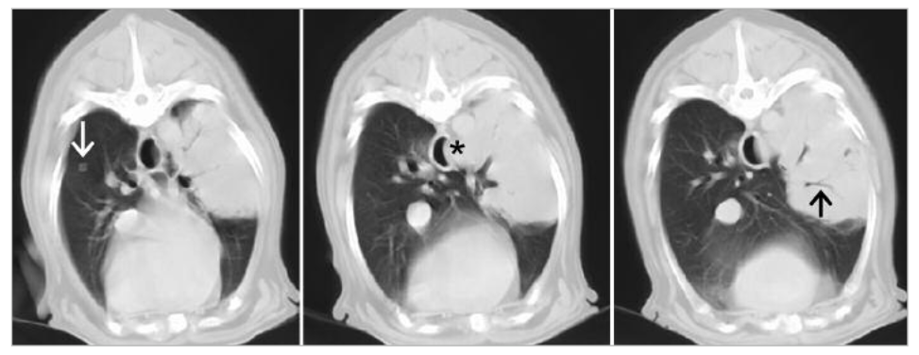
CT Applications: Thorax
Nodule suggestive of pulmonary metastasis
Impingement and possible involvement of the esophagus
Bronchus within the mass and lack of lesions involving the ribs suggests pulmonary mass

Slide 42
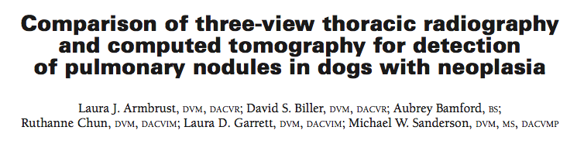
CT Applications: Thorax
CT was more sensitive than rads for detection of pulmonary nodules
  Particularly evident in large-breed to giant-breed dogs
Large-breed and giant-breed dogs with osteosarcoma
  Thoracic CT recc’d if detection of pulmonary nodules will change treatment

Slide 43
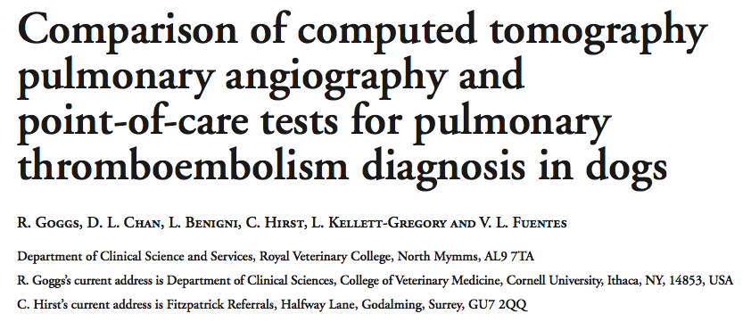
CT Applications: Thorax
In patients with IMHA and respiratory distress:
  CTPA can confirm and rule out PTE in major pulmonary arteries
No clinicopathologic data reliably related to the CTPA diagnosis
  Arterial blood-gases, echocardiographic indices, cardiac troponins
Notes:
PTE confirmed or suspected in 58% of dogs with IMHA and respiratory distress

Slide 44
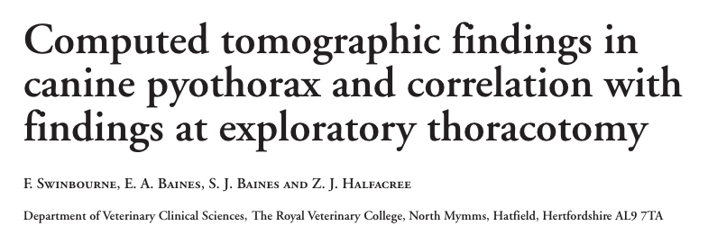
CT Applications: Thorax
May identify lesions that are not overtly evident during surgery
Does not eliminating the necessity to explore the entire thorax
Notes:
CT findings are similar to surgical findings in most cases of canine spontaneous pyothorax
CT may be a useful diagnostic tool for evaluating the nature and extent of the intra-thoracic pathological changes and guiding the management of these cases
Preop CT may identify lesions that would otherwise not be detected at surgery, aiding selection of the most appropriate surgical technique, but not eliminating the necessity to explore the entire thorax

Slide 45
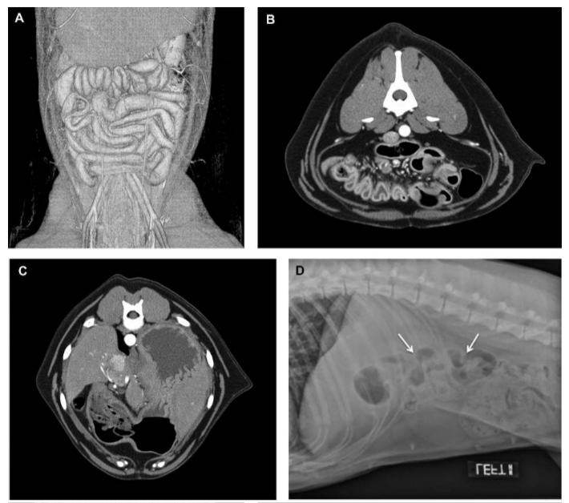
CT Applications: Abdomen
CT is useful for elusive structures
  Pancreas
  Mesentery
  Pelvic canal
Notes:
Demonstrating intestinal plication in same patient with rads and CT

Slide 46
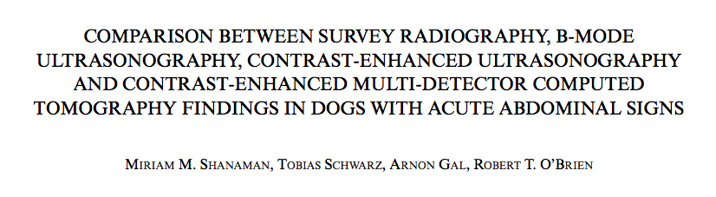
CT Applications: Abdomen
Diagnosis of a surgical condition was only minimally decreased with rads and AUS when compared with CT
  CT shows only slight improvement in accuracy when differentiating surgical from non-surgical conditions
Concurrent rads and AUS yielded 100% accuracy in differentiation of surgical from non-surgical conditions
Notes:
Comparing rads, AUS, CT in dogs with acute abdomen
canine patients presenting with acute abdominal signs; with a focus on the ability to differentiate surgical from non-surgical conditions
Inclusion required a clinical diagnosis of acute abdominal signs and confirmed surgical or non-surgical causes for the clinical signs
Accuracy for differentiation of surgical vs. non-surgical conditions was high for all modalities; 100%, 94%, and 94% for CE-MDCT, ultrasonography and survey radiography respectively

Slide 47
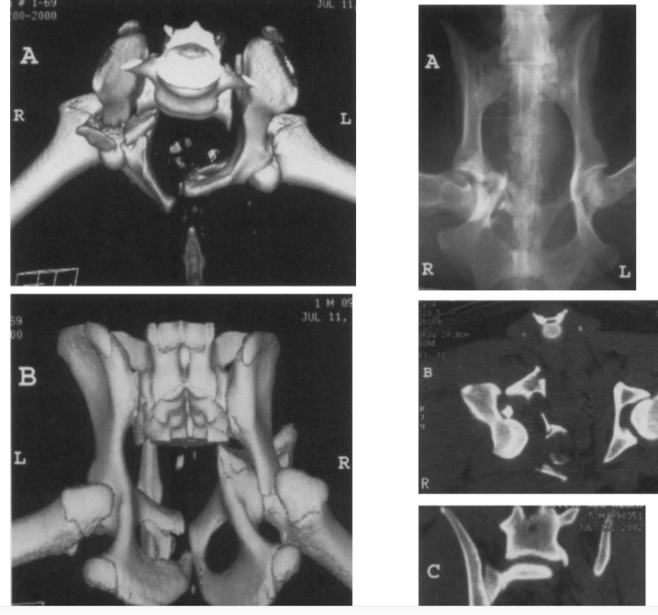
CT Applications: Pelvis
CT is more sensitive than rads in detecting fractures
  Multidirectional xray beam
  Cross-sectional images eliminates superimposition

Slide 48
CT Applications: Pelvis
Indications:
  Acetabular fractures
  Dislocations of the hip
  All potential or recognized sacral fractures
  All potential or recognized sacroiliac injuries
  Questionable stability of the pelvis
  Intrapelvic soft-tissue injuries

Slide 49
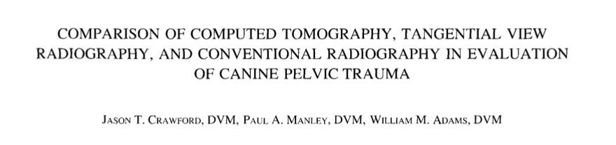
CT Applications: Pelvis
CT is superior to rads in the diagnosis of skeletal and soft tissue pelvic injuries
However, rads detected all clinically important lesions
  Those requiring surgical intervention
Consider CT with questionable stability of the hemipelvis, acetabular involvement, or highly comminuted fractures
Notes:
More skeletal lesions detected by CT scan than by survey radiography
Sites that had the greatest discrepancies were the S1 joints, the acetabula, and the ischia
SI lesions that were not detected radiographically were minimally displaced subluxations of the SI joint….generally treated conservatively, provided that the animal is ambulatory and exhibits minimal discomfort
Neither of the SI lesions that were occult radiographically were repaired surgically
Two false-positive radiographic diagnoses of SI luxations that were ruled out by CT scan, but these did not alter surgical planning as the potential lesions were considered to be minimal
All acetabular fractures except one were positively diagnosed radiographically…. the radiographically occult acetabular fracture was diagnosed by CT scan as a nondisplaced fracture and was not repaired surgically

Slide 50
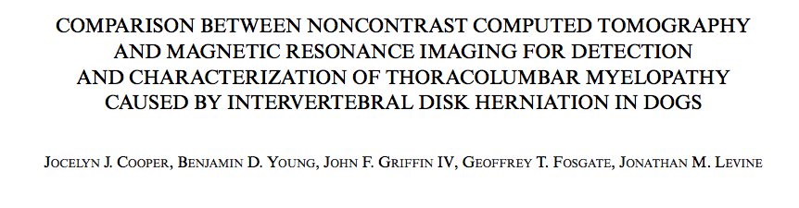
CT Applications: Spine
Noncontrast CT studies are highly sensitive diagnosis of IVDH
  Shorter scan times
Sensitivity of MR (98.5%) > CT (88.6%) for diagnosis of TL:
  IVDH
MR had improved:
  Determination of lesion location
  Type of disk herniation
  Lateralization (in some dogs)

Slide 51
CT Advantages
Short scan time
Universally applicable
  Pacemaker and metals not contraindicated

Slide 52
CT Disadvantages
Limited tissue characterization
Restriction to transverse slices
Practical limit on numbers of X-rays which can be produced in the short duration of the scan

Slide 53
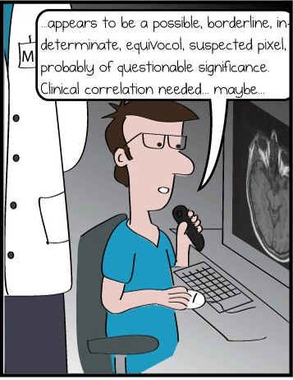
Questions?

Slide 54
MRI Physics
Living tissues have magnetic properties
  Nuclei of certain atoms
  To be magnetic, a nucleus must have:
    an unpaired proton
    an unpaired neutron
    one of each

Slide 55
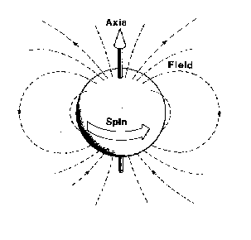
MRI Physics: Hydrogen
Eccentrically located proton
  Highly magnetic nucleus
  Spin creates a magnetic field
    ‘magnetic moment’
  Constitutes 60-70% body mass

Slide 56
MRI Physics
Protons normally have random arrangement
  No net magnetic field
When in a magnetic field, protons have two motions:
  Precession
  Aligned/unaligned orientation

Slide 57
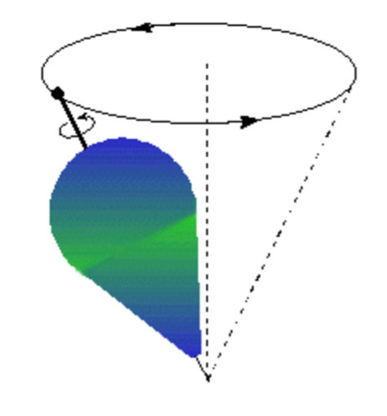
MRI Physics: Orientation in a Magnetic Field
Protons axis motion
  Precession
  Larmor frequency: precession rate
    Dependent on strength of local magnetic field

Slide 58
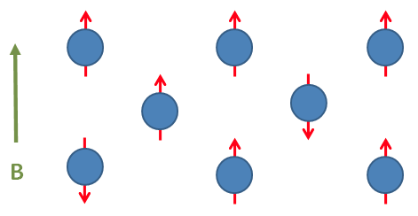
MRI Physics: Orientation in a Magnetic Field
Aligned: low energy position**
  Parallel to magnetic field
Unaligned: high energy position
  Antiparallel to magnetic field
  High energy due to thermal energy
Net magnetic vector

Slide 59
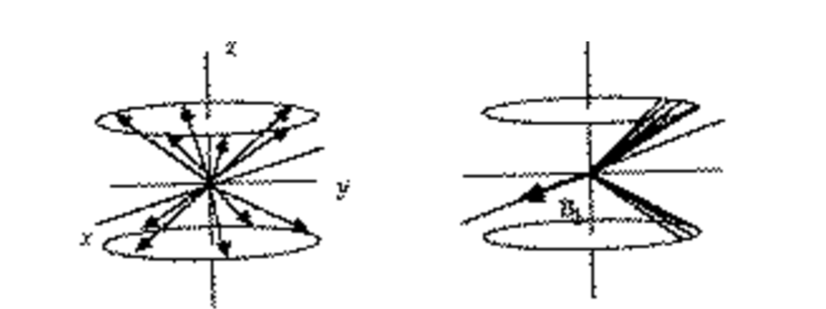
MRI Physics: Orientation in a Magnetic Field
Out of phase
  Unsynchronized precession
In-phase
  Precession of protons together

Slide 60

MRI Physics: Orientation in a Magnetic Field

Slide 61

MRI Physics: Signal Generation
Notes:
When in a constant magnetic field, protons with be aligned or unaligned
Majority are aligned and thus the longitudinal magnetization is present
Unable to detect longitudinal magnetization as it is in the same plane/direction of the magnetic field

Slide 62

MRI Physics: Signal Generation
Radiofrequency applied
  50% aligned
  50% unaligned
  No net magnetization
Notes:
Applying a frequency in which 50% of the protons are aligned and 50% unaligned
Magnetization vector disappears

Slide 63

MRI Physics: Signal Generation
Radiofrequency applied
  Sinusoidal shape ‘pushes’ protons to synchronize
  ‘Resonance’
  Transverse Magnetization
    Detectable
Notes:
The transverse magnetization is detectable and measureable by a short wave radio

Slide 64

MRI Physics: Signal Generation
Notes:
Radiofrequency applied
50% aligned/unaligned
Resonating

Slide 65

MRI Physics: Signal Generation
Radiofrequency removed
  Transverse magnetization lost
  T2 relaxation
  ‘spin-spin’ relaxation
Notes:
Protons naturally repel each other
No net energy transfer occurs with this relaxation
Loss of resonance/coherence

Slide 66

MRI Physics: Signal Generation
Radiofrequency removed
  Reversal from high to low energy state
  Longitudinal magnetization
  T1 relaxation
  ‘spin-lattice’ relaxation
  Energy transfer
Notes:
Without added energy (in the form of radiofrequency), some high energy/unaligned protons fall back to an aligned state
Restored longitudinal magnetization
Measures loss of energy (horizontal to longitudinal magnetization)

Slide 67

MRI Physics: Signal Integration
Voxel
  Volume + element
  1 x 1 x 10mm
  Integrated from hundreds of individual signals
215 x 215 -or-
512 x 512 matrix

Slide 68

MRI Basics

Slide 69

MR Spectroscopy
Allows the determination and quantification of metabolites in living tissue
Can detect metabolic abnormalities
  Even when the morphological images are normal

Slide 70

MRI Unit Anatomy

Slide 71

MRI Unit Anatomy

Slide 72

MRI Unit Anatomy

Slide 73
MRI Physics: Signal Integration
Characteristic proton behaviour
One plane of tissue exposed to a single radiofrequency
  Subsequent perpendicular planes imaged
  Varying frequency intensity and emission
T1 and T2 relaxations can be accentuated
  Characteristic tissue-type behaviour
Notes:
By changing the parameters of the pulse sequence - number of pulses, strengths of the pulses, time intervals between the pulses - different types of information can be elicited from the tissues.
pulse sequencing is used: A series of two or more radio pulses is applied to the tissues in quick succession. The use of a pulse sequence to stimulate the tissues results in a quite different type of signal from the tissues, containing information about tissue T 1 and T 2 characteristics, since the response to later pulses is influenced by earlier pulses in the sequence

Slide 74
MRI Interpretation: Tissue Guide
Tissue | T1-Weighted | T2-Weighted | Flair
CSF | Dark | Bright | Dark
White Matter | Light | Dark grey | Dark grey
Cortex | Grey | Light grey | Light grey
Fat | Bright | Light | Light

Slide 75
MRI Interpretation: Tissue Guide
 | T1- weighted | T2- weighted
Bright Hyperintense | Fat Subacute hemorrhage Protein-rich fluid Paramagnetic substances Laminar necrosis of cerebral infarction Slowly flowing blood | Increased water
Intermediate Isointense | Grey matter darker than white matter | White matter darker than grey matter
Dark Hypointense | Bone Air Increased water Paramagnetic substances Protein-rich fluid | Bone Air Fat Protein-rich fluid Paramagnetic substances
 | ***Increased water: (edema, tumor, infarction, inflammation, infection, hemorrhage (hyperacute or chronic)) | ***Paramagnetic substances: gadolinium, manganese, copper

Slide 76

MRI Interpretation: Scans

Slide 77
Contrast Media and Applications
IV contrast media
  Paramagnetic substances
  Greatly shorten T2 and T1
  Rare idiosyncratic reactions
Blood flow and vascular permeability dictate tissue enhancement
  Accumulations in vascular, hemorrhagic or edematous lesions
Notes:
Gadolinium, iron, copper, manganese
Paramagnetic substances are atoms that are magnetic due to the structure of their outer electron shells, rather than of their nucleus. In even trace (micromolar) tissue concentrations, paramagnetic substances greatly shorten T2 and T1

Slide 78
MRI Considerations: Pacemaker
Magnetically sensitive switch
  Self-test functions
MR field will likely start the pacemaker's rhythm
  Probably is harmless in most circumstances
Tampering with device function
  Most physicians avoid scanning patients known to have a pacemaker

Slide 79
MRI Considerations: Tissue Metal Artifact
Ferromagnetic metals
  Concentrate and distort the magnetic field
Proportionally larger region affected
Most surgical metals are not significantly ferromagnetic

Slide 80
MRI Considerations: Tissue Metal Artifact
Low ferromagnetism
  All steels are predominately iron
    High nickel content steels (15%+)
  Dental fillings
    Mercury-silver amalgam or gold typically
  Tantalum, silver, copper, plastics, lead bullets
MRI ‘ignores’ most metals
  Appear as voids (similar to bone)

Slide 81
Indications
Evidence or suspicion of:
  CNS neoplasm
  Meningitis
  Neurodegenerative disease
  Acute brain ischemia or infarction
  Brain developmental abnormality
  Demyelination or dysmyelination disorder
Seizures
Myelopathy in a non-chondrodysplastic

Slide 82
Advantages of MRI
Tissue can be characterized in a number of ways
Any plane can be imaged
Bone is ‘invisible’, so all anatomic regions can be examined
  Low magnetic susceptibility, little interference with imaging of surrounding tissues
Contrast medium not required
No ionizing radiation

Slide 83

MRI Applications
4 types of IVDD identified
  Disk degeneration
  Bulging of the intervertebral disk
  Disk protrusion
  Disk extrusion
Notes:
With bulging, the disk extends diffusely to the vertebral canal
Protrusion represents a shift in the location of the nucleus pulposus secondary to rupture of the innermost annular fibers at a single point in 1 direction
Dogs were classified as having disk extrusion if the disk had herniated through all layers of the annulus and appeared as a focal epidural mass
Disk degeneration classified by subjective colormetric changes to disc

Slide 84

MRI Applications
CT/myelography may be preferred for the assessment of vertebral fractures
MRI is superior for assessment of soft tissue injuries associated with vertebral fractures
MRI can provide prognostic information in spinal patients

Slide 85
Disadvantages of MRI
Complexity and high cost
Long scan time
Noise and isolation experienced by patient during scan
Exclusion of a substantial fraction of patients due to pacemakers and metallic artifacts

Slide 86

Questions?

Slide 87
References
https://youtu.be/djAxjtN_7VE

