Slide 1
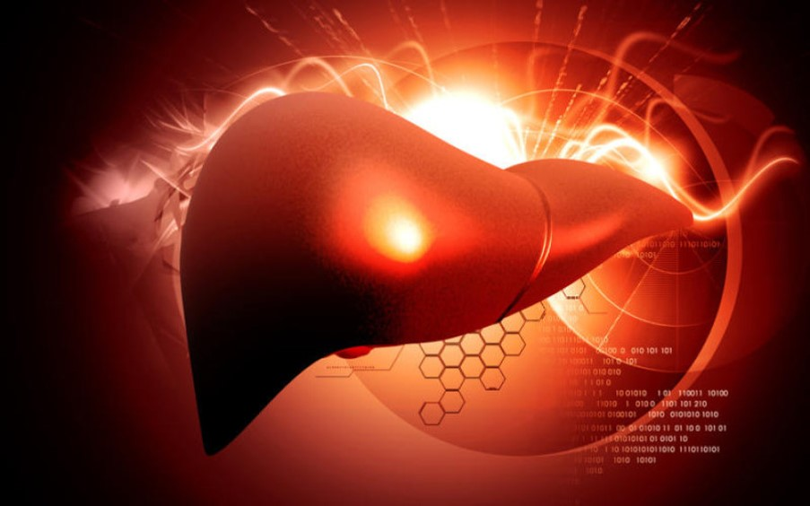

Acute Liver Failure
Mariana A. Pardo
Emergency and Critical Care
2016

Slide 2
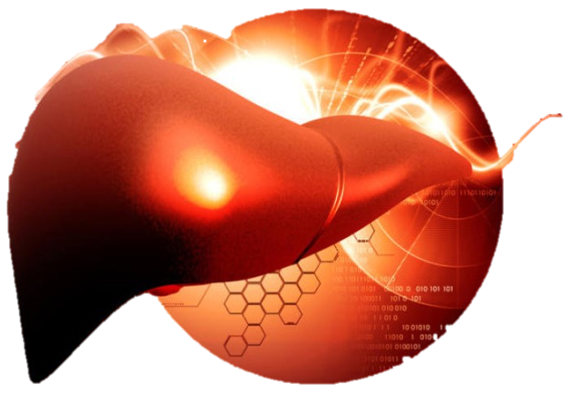

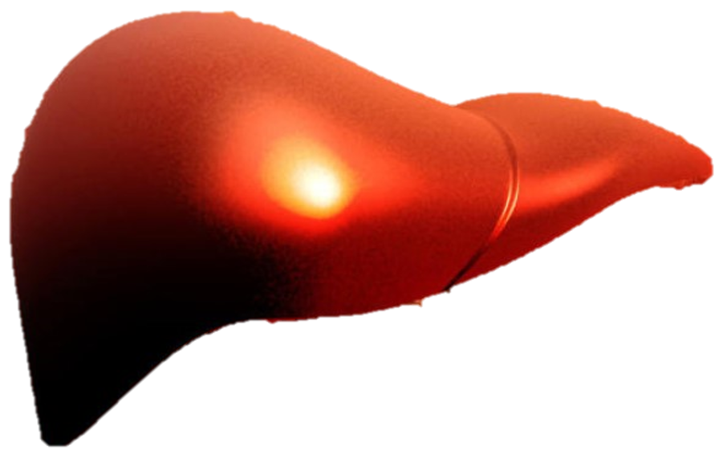
Introduction
Acute liver injury (ALI): denotes acute hepatocellular damage and necrosis with retained hepatic function
Acute liver failure (ALF): occurs once hepatocellular damage is so extensive that it compromises hepatic synthetic, excretory, and regulatory functions

Slide 3

Introduction
ALF criteria in humans:
  Absence of preexisting liver disease
  Presence of hepatic encephalopathy within 8 weeks after onset of hyperbilirubinemia, defined as plasma bilirubin >2.9 mg/dL
  Presence of coagulopathy, defined by an INR

Slide 4
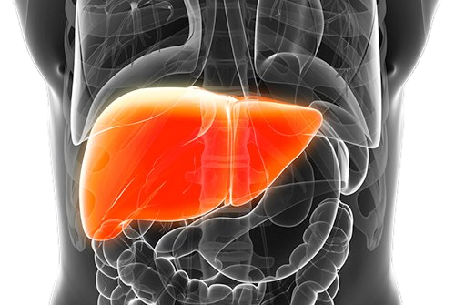
Etiology
Toxic
Drug-Related
Infectious
Idiosyncratic

Slide 5
Etiology
Toxic
  Direct (Destructive):
  Indirect (Disruptive):
Cycad Palms
Blue-Green Algae
Amanita phalloides
Aflatoxins
Xylitol
Xylitol
Carprofen
Acetaminophen
Phenazopyridine
Sulfonamides
Lomustine (CCNU)
Zonisamide
Stanozalol
Benzodiazepine

Slide 6
Etiology
Drug-Related
  Carprofen
  Acetaminophen
  Phenazopyridine
  Sulfonamides
  Lomustine
  Zonisamide

Slide 7
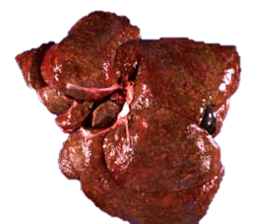
Etiology
Infectious
  Leptospirosis
  Canine adenovirus-1
  Trematodes
Multifocal hepatic necrosis from leptospirosis
http://www.sweetshimas.com/index.php?main_page=page&id=45&chapter=0

Slide 8
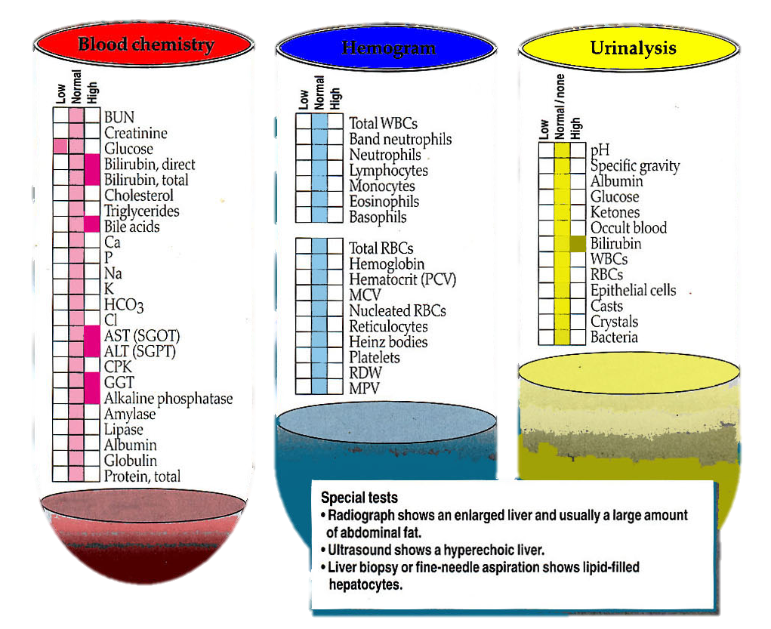
Etiology
Idiosyncratic
  Feline idiopathic hepatic lipidosis
http://maxshouse.com/Illustrations/Hepatic_lipidosis_lab_profile.jpg

Slide 9
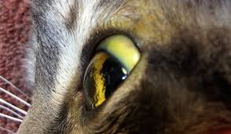
Clinical Signs
Icterus
Coagulopathy
Hepatic encephalopathy
Hypoglycemia
Sepsis
http://criticalcaredvm.com/wp-content/uploads/2015/12/IMG_2067.jpg

Slide 10
Clinical Signs
Icterus
  Severity or the time of onset of icterus and development of HE is used to define and prognosticate ALF
  Associated to poor outcome
  Caused by intrahepatic cholestasis
    Leakage of tight junctions that separate bile canaliculi from blood (ie: toxins, infection)
    Swelling of hepatocytes to the extent that canalicular flow is obstructed (ie: hepatic lipidosis)
    Necrosis of hepatocytes

Slide 11
Clinical Signs
Coagulopathy - Primary
  Mild to moderate thrombocytopenia <90,000 reported in 40% ALF in human
  Xylitol, cycads, aflatoxin and leptospirosis thrombocytopenia in dogs
  Causes of thrombocytopenia
    Decreased hepatic thrombopoeitin production
    Overstimulation of 1ary hemostasis from continuous activation of endothelial cells and release of vWF
    Consumption due to hemorrhage
  Causes of thrombocytopathia
    Increased production of endothelial-derived platelet inhibitors, nitric oxide and prostacyclin

Slide 12
Clinical Signs
Coagulopathy - Secondary
  Decreased coagulation factory synthesis
  Common in cholestatic diseases (ie: hepatic lipidosis)
  Vitamin K deficiency:
    Decreased bile flow altering Vit K absorption from intestines
    Decreased intake of Vit K due to anorexia
    Altered GI flora from antibiotics > decreased Vit K production from bacteria
  Increased PT/PTT, reduced antithrombin and protein C

Slide 13
Clinical Signs
Coagulopathy
  Hyperfibrinolysis
    Decreased clearance of plasminogen activators by the failing liver
  Severity of PT prolongation can be used as a dynamic marker of hepatic function and prognostic indicator
  Low platelet count at presentation is associated with poor prognosis and may reflect early DIC

Slide 14
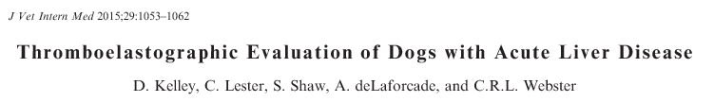
Prospective study: 21 dogs with ALD (recent onset clinical signs + ↑Bili + ↑liver enzymes), ALF (ALD + PT > 1.5x)
ALD
  ↑ R, K, LY30, PT, PTT, vWF activity
  ↓MA, G, antithrombin and protein C activity
MA and LY30 positively correlated with bilirubin and WBC count and negatively with cholesterol
ALD dogs trend towards hypercoagulability and hyperfibrinolysis
ALF
  Greater ↑ K, LY30
  Greater ↓MA, G

Slide 15
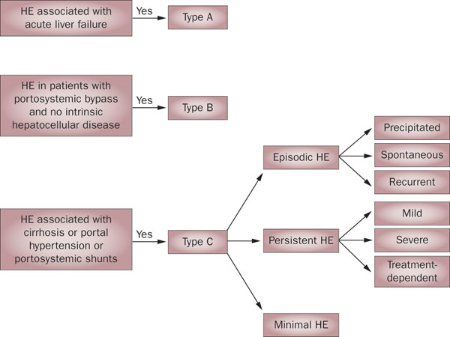
Clinical Signs
Hepatic encephalopathy
  Classification
    Type A - Acute
    Type B
    Type C
  Pathophysiology and treatment of each type is different
  Acute HE signs manifest suddenly and progress rapidly
  Ammonia crucial role in type A HE
http://www.nature.com/nrgastro/journal/v7/n9/fig_tab/nrgastro.2010.116_F1.html

Slide 16
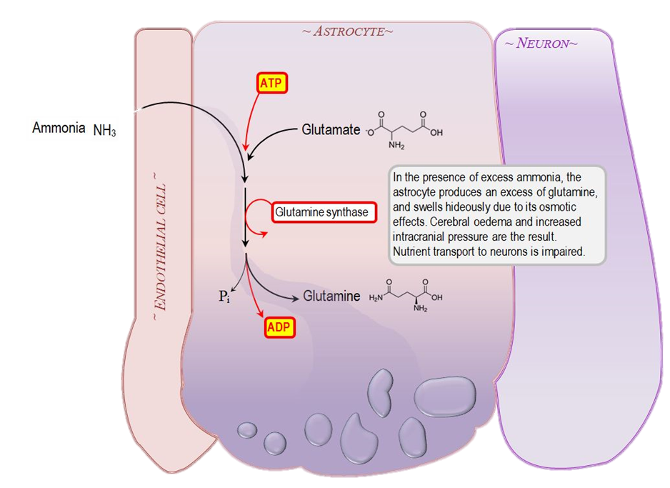
Clinical Signs
Hepatic encephalopathy
  Ammonia
    Produced in GI tract > via portal circulation to the liver > metabolized to urea
    Ammonia that escapes can be metabolized to glutamine by astrocytes
    Glutamine excreted through urine or metabolized back to ammonia in astrocyte’s mitochondria for reentry into urea cycle > mitochondrial damage, ROS production, osmotic swelling
http://www.derangedphysiology.com/main/required-reading/gastroenterology-and-hepatology/Chapter%205.3.1/hepatic-encephalopathy

Slide 17
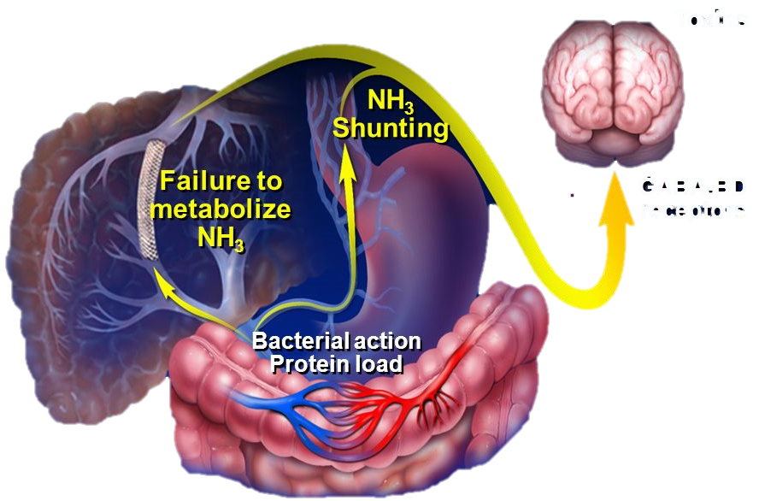
Clinical Signs
Hepatic encephalopathy
  Cerebral Edema and Intracranial Hypertension
    Associated to 20-25% deaths of ALF
    Multifactorial:
      Hyperammonemia
      Astrocyte swelling
      Loss of cell volume regulation (upregulation aquaporin-4 channels in astrocytes)
      Increased cerebral blood flow
      Increased production of inflammatory mediators – Neuroinflammatory response
http://slideplayer.com/slide/522393/

Slide 18
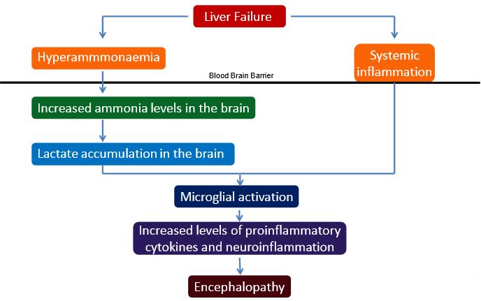
Clinical Signs
Hepatic encephalopathy
  Neuroinflammatory response
http://c.ymcdn.com/sites/www.fshp.org/resource/resmgr/se_2015_am/acute_hepatic_failure_(1).pdf
Notes:
Mechanisms of neuroinflammatory response :
Direct effects of syst proinflmm cytokines and release of proinflamm cytokine from activated microglia due to cerebral lactate accumulation

Slide 19
Clinical Signs
Hypoglycemia
  Euglycemia can be maintained with up to 75% liver parenchyma
  Hypoglycemia occurs due to impaired glycogen storage and gluconeogenesis
Sepsis
  In ALF, liver is unable to effectively remove or neutralize pathogens prior to blood passing to systemic circulation
  In humans with AF, 80% bacteremia (gram – enteric org, staphylococci and fungal org)
  Iatrogenic causes are common (IV caths, U-caths, skin contaminants)

Slide 20
Diagnosis
Transaminases
Inducible enzymes
Electrolyte and acid-base derangements
Ammonia
Imaging
Tissue sampling and histopathology
Coagulation testing

Slide 21
Diagnosis
Transaminases
  24-48hr after the initial insult ALT can increase 100 fold – peaks in 5 days, then begins to decline if insult is removed
  AST can indicate more severe hepatocellular necrosis, activity parallels ALT
  Liver is responsible for clearance of transaminases > ALF sustained transaminase activity
  Declining ALT may be due to resolving injury or end-stage hepatic failure
ALT
AST
Hyperbilirrubinemia
↑PT
Hypoglycemia
Hypoalbuminemia

Slide 22
Diagnosis
Inducible enzymes
  ALKP: increases 2-5 fold and gradually declines after ALF
  GGT: remains unchanged or mildly increased in ALF, however extrahepatic biliary obstruction will increase GGT over days to weeks

Slide 23
Diagnosis
Electrolyte and acid-base derangements
  Hypokalemia:
    Due to decreased caloric intake, vomiting and diarrhea
    Stimulates renal ammoniagenesis in proximal tubules, higher concentrations of K+ suppress renal ammoniagenesis and increase urinary excretion of ammonium
  Hypophosphatemia:
    Due to intracellular shift of P due to hepatocyte regeneration – may be a positive prognostic indicator, hyperphosphatemia is a negative prognostic indicator
  Hyperlactatemia:
    Due to hypoperfusion, tissue hypoxia and anaerobic metabolism - poor prognostic indicator in ALF, HE and acetaminophen toxicosis

Slide 24
Diagnosis
Ammonia
  Healthy patients venous and arterial ammonia are similar
  Liver dysfunction, ammonia enters systemic circulation ↑ arterial [ammonia] – arterial samples used to be recommended, venous may still be useful
  Actual brain ammonia exposure is more important than the concentration in circulation – intact BBB is important (not measurable)
  Persistant hyperammonemia useful for prognosis, associated with increased rates of cerebral herniation and mortality rates
  Samples should be kept on ice and run within an hour
    Exposure to air > falsely low
    Room temperature > falsely high

Slide 25
Diagnosis
Imaging
  Radiographs – non specific findings
    Size and cholelyths
  Ultrasound
    Hepatomegaly – rounded liver borders
    Diffuse hypoechogenicity
    Increased contrast between hypoechoic hepatic parenchyma and hyperechogenic periportal tissue
    Accuracy to differentiate causes of diffuse hepatic disease < 40% in dogs, < 60% cats
  CT – useful in detection of autoimmune ALF
  MRI – cerebral edema

Slide 26
Diagnosis
Tissue sampling and histopathology
  FNA, percutaneous, laparascopic, surgical biopsies
  PT/aPTT, platelet count should be measured before
  Risk factors for bleeding:
    Platelets < 80,000
    aPTT > 1.5 times in cats
    Prolonged PT > upper limit in dogs
Coagulation testing
  CBC
  PT/aPTT
  DIC panel
  TEG

Slide 27
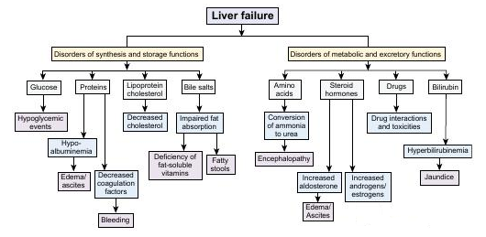

Slide 28
Therapy
Fluid resuscitation
Maintenance of normoglycemia and normal electrolyte status
Nutrition
Supplementation
Specific therapies and antidotes
Management of complications

Slide 29
Therapy
Fluid resuscitation
  ALF patients are typically hypovolemic and hypotensive > microcirculatory disturbances, ↓ fluid intake, ↑ fluid losses (vomiting and diarrhea)
  Avoid LRS if possible due to lactate needing liver metabolism
  Vasopressors if needed
    Norepinephrine
    Vasopressin and analogs should be avoided since they can cause cerebral vasodilation and ↑ ICP
  Consider relative adrenal insufficiency and use of corticosteroids if still hypotensive despite fluid resuscitation

Slide 30
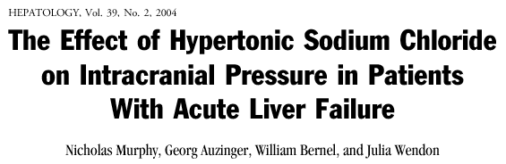
Prospective randomized controlled clinical trial
  Group 1: standard of care
  Group 2: standard of care + HS 30% CRI (Na 145-155 mmol/L)
ICP measured for 72 hours
Higher norepinephrine doses needed in group 1
ICP ↓ significantly in 1st 24hr in group 2

Slide 31
Therapy
Maintenance of normoglycemia and normal electrolyte status
  BG q2-4h, supplement as needed
  Monitor K, P, Mg at least daily, supplement as needed
  Avoid hyponatremia > cerebral edema
    In acute hyponatremia use hypertonic saline to rapidly improve cerebral edema
    In hypervolemic hyponatremia > vaptans (antagonize vasopressin > aquaresis)

Slide 32
Therapy
Nutrition
  Hypermetabolic state with a higher energy requirement > catabolic state by a negative nitrogen balance
  In patients without HE > any GI diet
  In patients with HE > limit dietary protein to minimize ammonia production
    Dogs 15-20% dry matter protein
    Cats 30-35% dry matter protein
    Soy or diary protein may produce lower ammonia than meat
  30-50% dietary calories in complex soluble carbohydrates
  Lipids increase absorption of fat-soluble vitamins 15-30% dogs, 20-40% cats

Slide 33
Therapy
Nutrition
  Vit K in all ALF patients
  B-vitamins in animals anorexic for >7days
  Thiamine 25-50 mg PO q12h or 50-100 mg PO q24h for 1 week
    Cats: cervical ventroflexion, dilated, poorly responsive pupils, slow CPs
    Dogs: depression, vestibular signs, profound muscle weakness, exaggerated spinal reflexes, cervical ventroflexion, slow menace response

Slide 34
Therapy
Supplementation
  Healthy liver have potent intrinsic antioxidant systems including glutathione
  Damaged liver have less available glutathione resulting in ↑ROS concentrations leading to hepatocyte death
  Silymarin: derivative of milk thistle, scavenges ROS, prevents lipid peroxidation, induces antioxidant system
    20-50 mg/kg/day

Slide 35
Therapy
Supplementation
  Vit E: free radical scavenger, when ROS are formed it acts as a lipid peroxidase protecting mb phospholipids from peroxidative damage (competes with Vit K, do not use if coagulopathic)
    100-400 IU q12-24h dogs
    30-50 IU q24h cats
  SAMe: crucial component of transmethylation (maintains cell mb), transulfuration (generates glutathione) and aminopropylation (anti-inflammatory)
    20 mg/kg/day dogs
    180 mg q12h for 3 days, then 90 mg q12h for 11 days cats with acetaminophen toxicosis

Slide 36
Therapy
Supplementation
  N-Acetylcysteine: thiol donor, stimulates glutathione synthesis, detoxifies hepatotoxins, free radical scavenger, improves microcirculatory blood flow
    140 mg/kg loading dose IV, then 70 mg/kg q4h x 17 doses (4.5 days)
    150 mg/kg loading dose IV, 12.5 mg/kg/h x 4 h, then 6.25 mg/kg/h until evidence of improving hepatic function (resolving HE, improving coags, ↓ liver enzymes)
    Side effects: intracranial vasodilation > ↑ ICP
    Prolonged IV NAC is not recommended, PO SAMe after protocol

Slide 37
Therapy
Specific therapies and antidotes
  Acetaminophen toxicity
    N-acetylcysteine or SAMe
  Mushroom poisoning
    Penicillin G 300,000 – 1 million U/Kg/day IV
    Silymarin 30-40 mg/kg/day x 4 days
    +/- NAC
  Hepatic lipidosis
    Early nutrition – feeding tube
    Dietary protein reduces hepatic lipid accumulation (only restrict in HE)
    Risk of refeeding syndrome

Slide 38
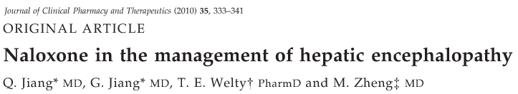
Naloxone
  Meta-analysis
  Elevation of opioid peptides have been found in acute and chronic liver failure
  Consider in patients not responding to standard therapies
  Naloxone 2mg in 500mL of saline – 0.4 mg/h
  Administer for 3 days or until patient awakes

Slide 39
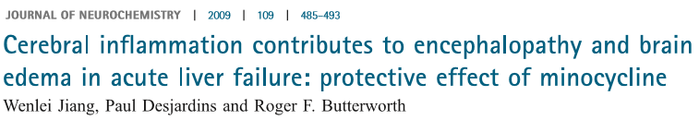
Minocycline
  Inﬂammation plays a signiﬁcant role in the pathogenesis of brain edema in ALF
  Microglial activation and expression of pro-inﬂammatory cytokines is increased in ALF
  22 mg/kg q12h – rat study
  Prevented microglial activation and up-regulation of IL-1β, ΙL-6 and TNF-α
  Attenuated progression of encephalopathy and brain edema

Slide 40
Therapy
Management of complications
  Infection
    Staph, Strep, enteric gram neg bacilli common
    Empirical AB recommended when infection is suspected or likelihood of sepsis is likely (profgression og HE, refractory hypotension, SIRS)
  Coagulation disorders
    Although coagulopathic, spontaneous bleeding is uncommon
    FFP if clinical signs of bleeding
    Vit K 0.5-1.5 mg/kg PO, SQ for 3 doses, then weekly until hyperbilirubinemia resolves
    GI bleeding is common – proton pump inhibitors

Slide 41
Therapy
Management of complications
  Hypoglycemia
    BG q2-4h
    Hyperglycemia is associated to cerebral edema
  Hepatic encephalopathy, cerebral edema and ↑ ICP
    Unlike type C HE, insufficient evidence to recommend lactulose or rifaximin, neomycin
    Hyperosmotic agents are mainstay therapy
    Head elevated 15-30⁰
    Avoid jug caths or sticks
    Sedation to ↓ cerebral metabolic rate
      Propofol 6 mg/kg/h IV
      Pure mu opioids

Slide 42
Future Treatment Strategies
Controlled hypothermia
Liver assist devices
Liver transplantation
Stem-cell therapy

Slide 43
Future Treatment Strategies
Controlled hypothermia
  32-33⁰C (89.6-91.4 ⁰F) decreases cerebral metabolic rates and CBF
  Accepted adjunctive therapy to control cerebral edema and intracranial hypertension secondary to acute HE
  Side effects: coagulopathies, impaired hepatic regeneration, insulin resistance, increased risk of infection
  No studies in vet med

Slide 44
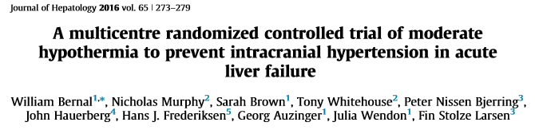
In patients with ALF controlled hypothermia did not prevent increased ICP or improve survival

Slide 45
Future Treatment Strategies
Removable Substances
Ammonia
Bilirubin
Bile acid
Aromatic amino acids
Medium & short chain fatty acids
Tryptophan
Copper
Creatinine
Urea
Diazepam
Liver assist devices
  Improve HE, but not mortality
  Artificial devices
    Remove substance from blood similar to hemodialysis
  Bio-artificial devices
    Human or porcine hepatocytes incorporated in an extracorporeal circuit

Slide 46
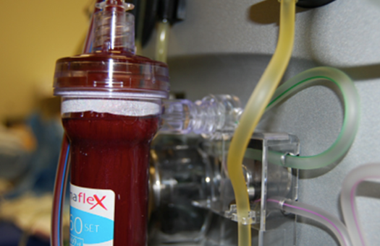
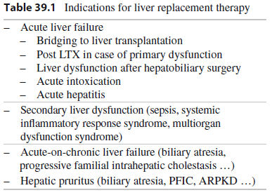
Future Treatment Strategies

Slide 47
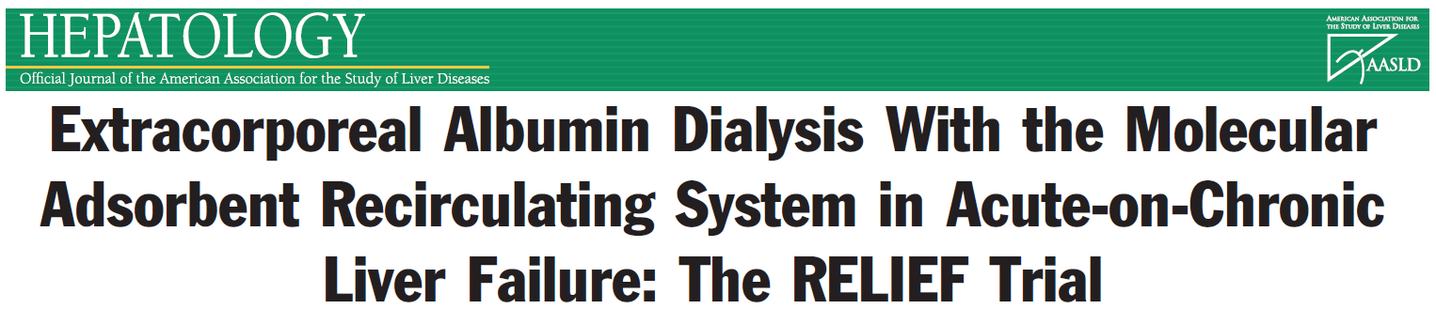
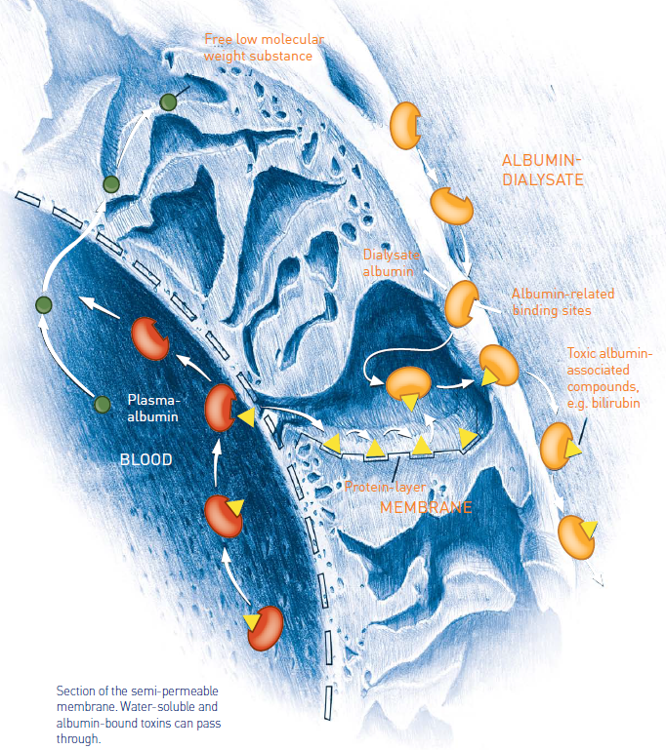
Improves hemodynamics and HE
Survival was similar in both groups
http://www.gambro.com/PageFiles/1946/Mars%20Therapy%20brochure.pdf?epslanguage=en

Slide 48
Future Treatment Strategies
Liver transplantation
  Only ALF therapy shown to improve mortality rate in humans
    20% without transplant, 80% with transplant
  Not available in vet med yet

Slide 49
Future Treatment Strategies
Stem-cell therapy
  Regenerative medicine is being investigated as an alternative to transplants
  Currently being investigated in vet med

Slide 50
Prognosis
Prognosis varies depending on:
  Underlying etiology
  Degree of hepatocellular damage
  Capacity of the liver to regenerate
  Stage of the disease when treatment is initiated
  Presence and rapidity of sequelae such as HE
  Response to therapy
Negative prognostic indicators
  Reduced factor V/VIII ratio, hyperphosphatemia, hyperlactatemia
ALF prognosis in dogs and cats is poor

Slide 51
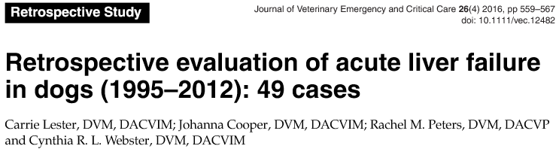
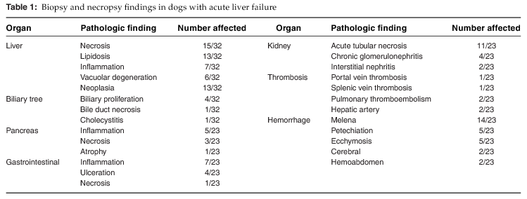
Notes:
TUFTS
49 dogs with ALF defined as acute onset clinical signs + hyperbilirrubinema + coagulopathy with or without encephalopathy
Neoplasia 27%, presumptive lepto 8%, ischemia 2%, , 71% idiopathic (likely toxin)

Slide 52
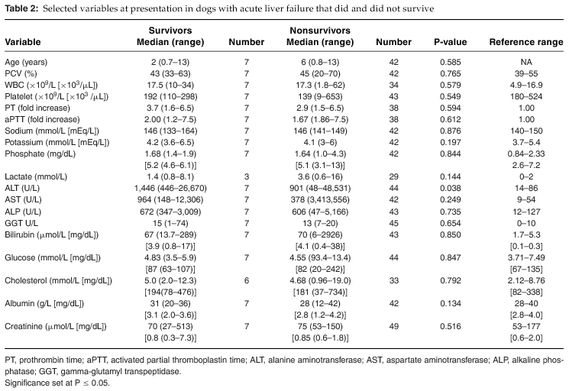
Notes:
Higher ALT activity at presentation was associated with survival (more hepatocytes?)

Slide 53
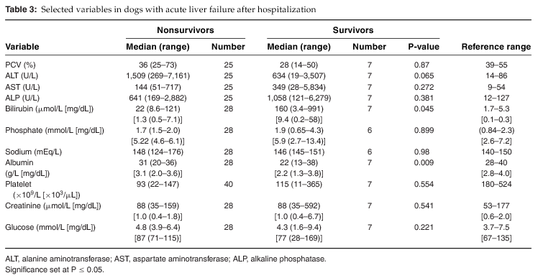
Notes:
Several variables were associated with nonsurvival and these primarily reflected the progressive hepatic dysfunction such as increasing bilirubin and decreasing albumin

Slide 54
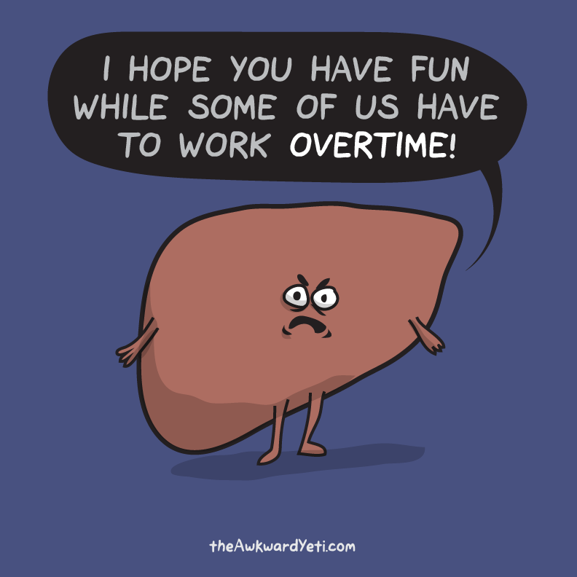
Thank You!
  Questions…?

Slide 55
References

