Slide 1
Cloud and DevOps Learning and Training Opportunities
May 3, 2016
Paul Allen
CIT Cloudification Services

Slide 2
Cloudification Services Team
Mission:
  Facilitate Campus’ transition to the cloud while encouraging modern DevOps practices
Team
  Shawn Bower
  Ned La Celle
  Marty Sullivan
  Paul Allen
  Nicole Rawleigh
  Sarah Christen (mgr)
Notes:
Benefits of cloud adoption are limited if you aren’t embracing DevOps practices.
How does one go about learning cloud devops technologies?

Slide 3
DevOps
What?
  infrastructure as code
  blah, blah, blah, …
Tools of the Trade
  IaaS, PaaS: AWS, Azure, …
  continuous integration/deployment: Jenkins, …
  configuration management: Chef, Puppet, Ansible
  containers: Docker, …
  monitoring: ELK (Elasticsearch, Logstash, Kibana), PaperTrail, CloudCheckr, OpsGenie, Pingdom, New Relic, …
Notes:
- Enhanced communication between developers and operations
- Cornell norm: we are both DEV and OPS
- any given resource is ephemeral

Slide 4
Connecting with Cornell’s Cloud Community
Monthly cloud practitioners meeting
  e.g. Ansible for Class Roster
HipChat AWS room
Cloudification Services Confluence site
Monthly training
CU-CloudCollab GitHub
General queries:
  cloudification-l@list.cornell.edu
Specific requests:
  cloud-support@cornell.edu
https://confluence.cornell.edu/x/MtPeEw
Notes:
One of the prime learning opportunities is to connect with other folks in Cornell’s Cloud Community

Slide 5
On-campus, In-person Training
Past
  AWS EC2/RDS 101 (~quarterly)
  AWS Lambda & API Gateway
  Azure Hands On 101
  Docker (bi-annually)
Upcoming - May 20
  AWS EC2 Container Service (Docker in AWS)
What do you want?
https://confluence.cornell.edu/x/0qOoEw

Slide 6
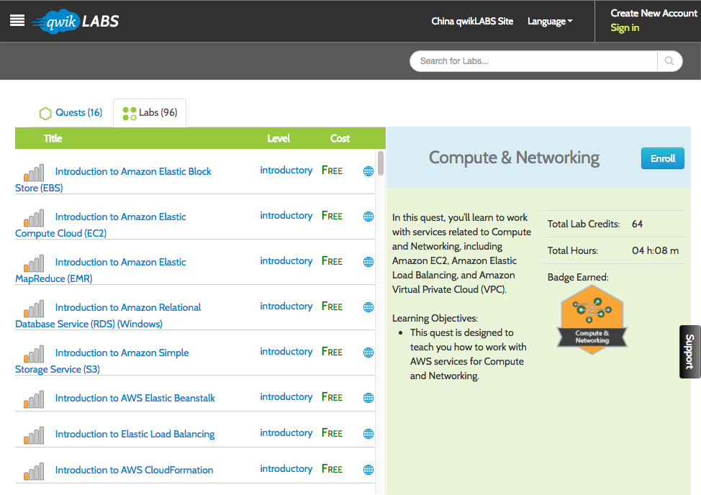
Tutorials and Online Training
qwikLABS – “official” AWS training
hands-on
free intro courses
Payment options
  Unlimited $55/m
  or, per course
Notes:
qwikLABS
- sometimes free

Slide 7
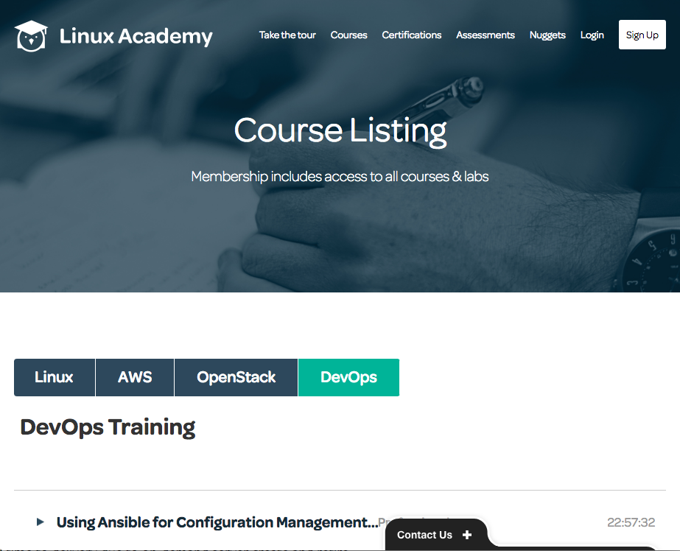
Tutorials and Online Training
Linux Academy – AWS, DevOps, Linux
hands on
certification prep courses
Payment options
  Unlimited $29/m
  Cornell group license
Notes:
qwikLABS
- sometimes free

Slide 8
Tutorials and Online Training
Lynda – limited AWS
free to Cornell
3 recent courses
  AWS Enterprise Security (Apr-2016)
  AWS Data Services (Sept-2015)
  Fundamentals of Cloud Data Storage (Sept-2015)
Notes:
qwikLABS
- sometimes free

Slide 9
More Resources
AWS Whitepapers
  “Architecting for the Cloud – AWS Best Practices”
  …
Cornell Libraries Online
  Books 24x7
  Safari Books Online
Cornell Cloudification Tech Blog
  “The Cornell Standard VPC”
  “Automatic OS Patching”
  …

Slide 10
April-2016 Hackathon
15 people (veterans ←→ newbies)
AWS gaps solved
  update DNS for variable IP on boot
  update AMU for auto-scaling group
  automate growing size of root EBS
  automate config of logging for ELB
  find & restore EBS snapshot
https://github.com/CU-CloudCollab/aws-gaps
Notes:
More hackathons to come

Slide 11
GitHub CU-CloudCollab
you are welcome - 100% public
examples
  aws-examples – CLI examples
tools repos
  cucloud_module - Python cloud library
  ebs-restore
aws-gaps
  list of gaps as “issues”
  e.g., autokill instances based on tag
https://github.com/CU-CloudCollab/aws-gaps

Slide 12

“100 Days DevOps” Training
Mentored, focused training
Activities
  mini devops project
  programming exercise
  Linux Academy-AWS Architect Associate
  Linux Academy-Chef/Puppet/Ansible
  The Phoenix Project

