Slide 1
 | SSL Server Certificate (InCommon) | AWS Certificate Manager
Use where? | on any Cornell server (and elsewhere) | Amazon CloudFront AWS Elastic Load Balancer
Use on AWS Elastic Compute Cloud (EC2)? | yes | no
Who can request? | Cornell net admins | anybody with an AWS account
Terms | 1, 2, 3 years | 13 months
Auto-renewal | no | yes
Single Domain? | yes | yes
Multi-domain? | yes | yes
Wildcard Domain? | yes (not preferred) | yes
Code Signing Certificate? | yes | no
Unified Communications Certificate | yes | no
Extended Validation Certificate | coming soon | no

Slide 2
AWS Certificate Manager
AWS user makes certificate request
AWS checks with domain registrants
registrants respond with (dis)approval
AWS issues certificate
How is Cornell Support Desk involved?
  Help AWS users (AWS administrators) perform self-service
  Receive requests from AWS for
    noc@cornell.edu
    cornell.edu and Cornell-owned domains

Slide 3
Supported Activities – Level 1
request a certificate
have ACM resend validation email
use certificate on Elastic Load Balancer, Elastic Beanstalk, CloudFront
see list of my ACM certificates (and requests)
determine state of certificate request
determine if Cornell received domain validation email
AWS user self-service

Slide 4
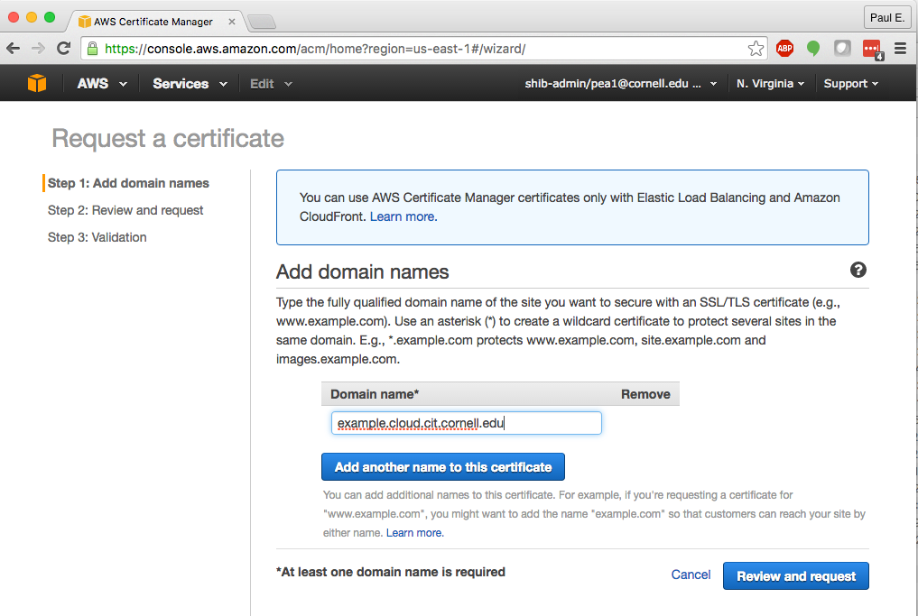
Request – Step 1

Slide 5
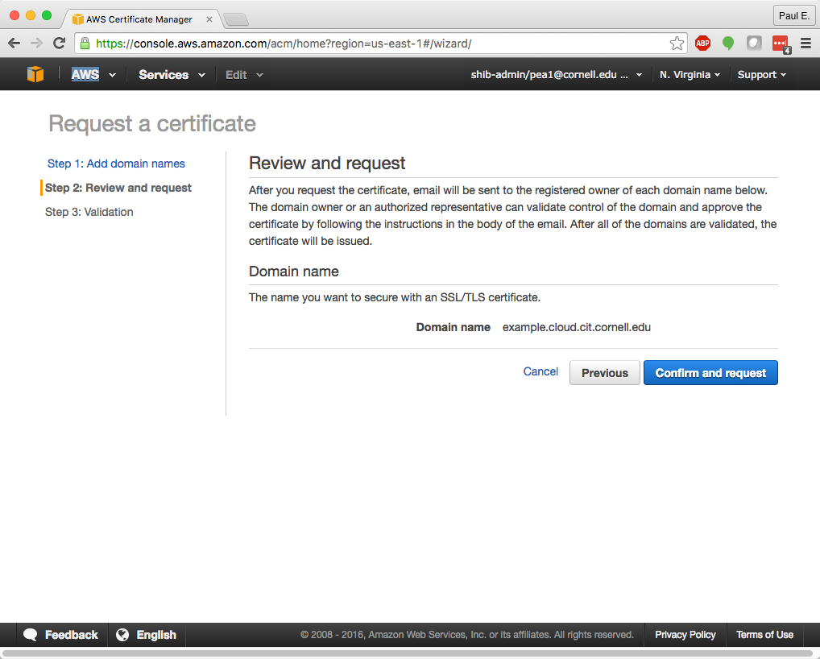
Request – Step 2

Slide 6
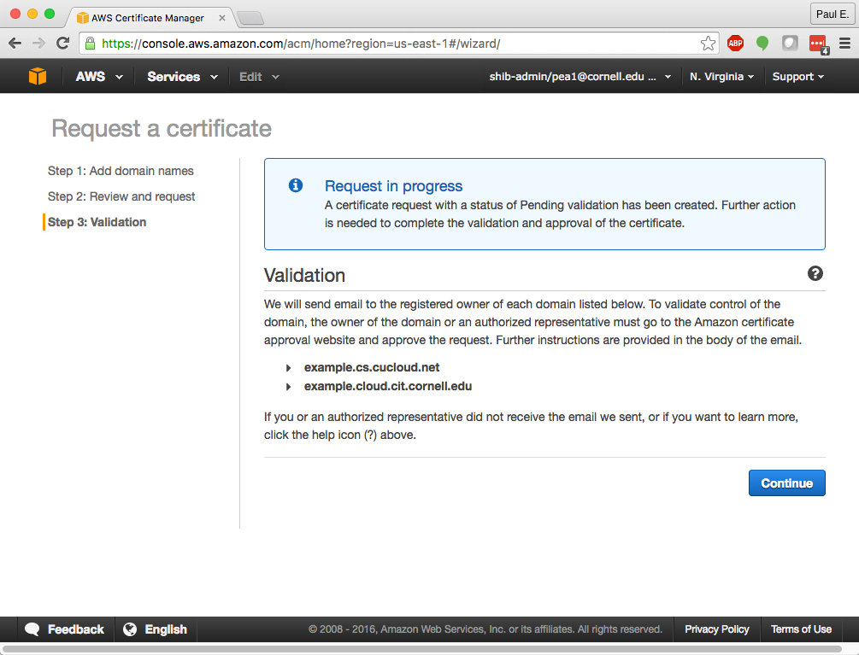
Request – Step 3

Slide 7
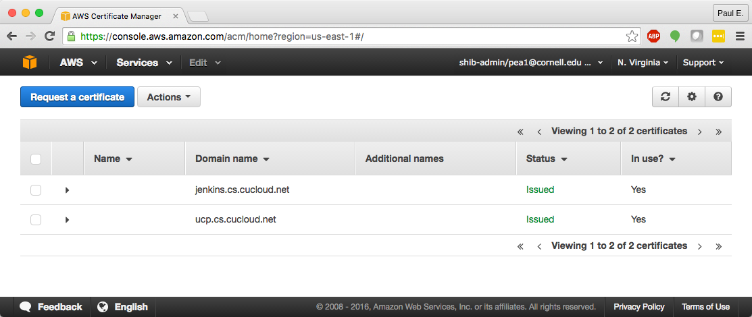
AWS Certificate Manager User Interface

Slide 8
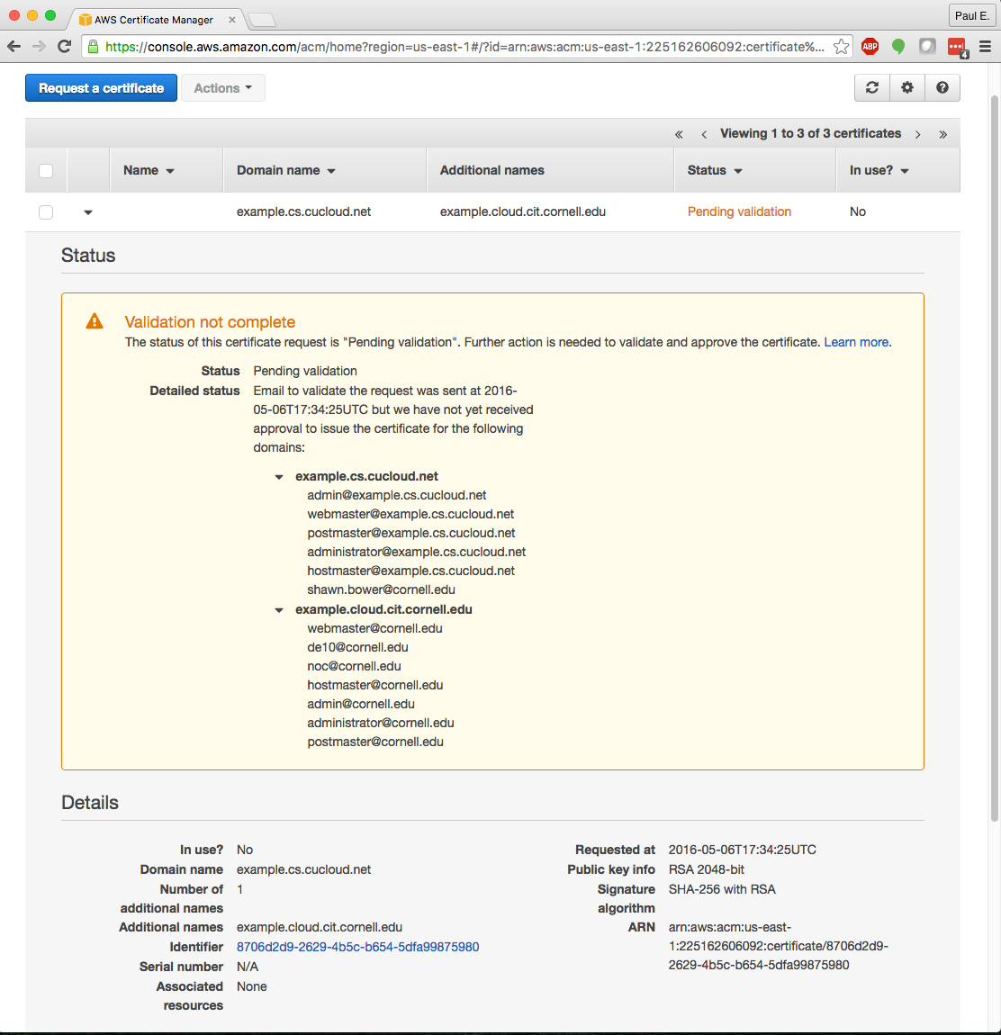
Approval sought from domain contacts & guessed emails addresses

Slide 9
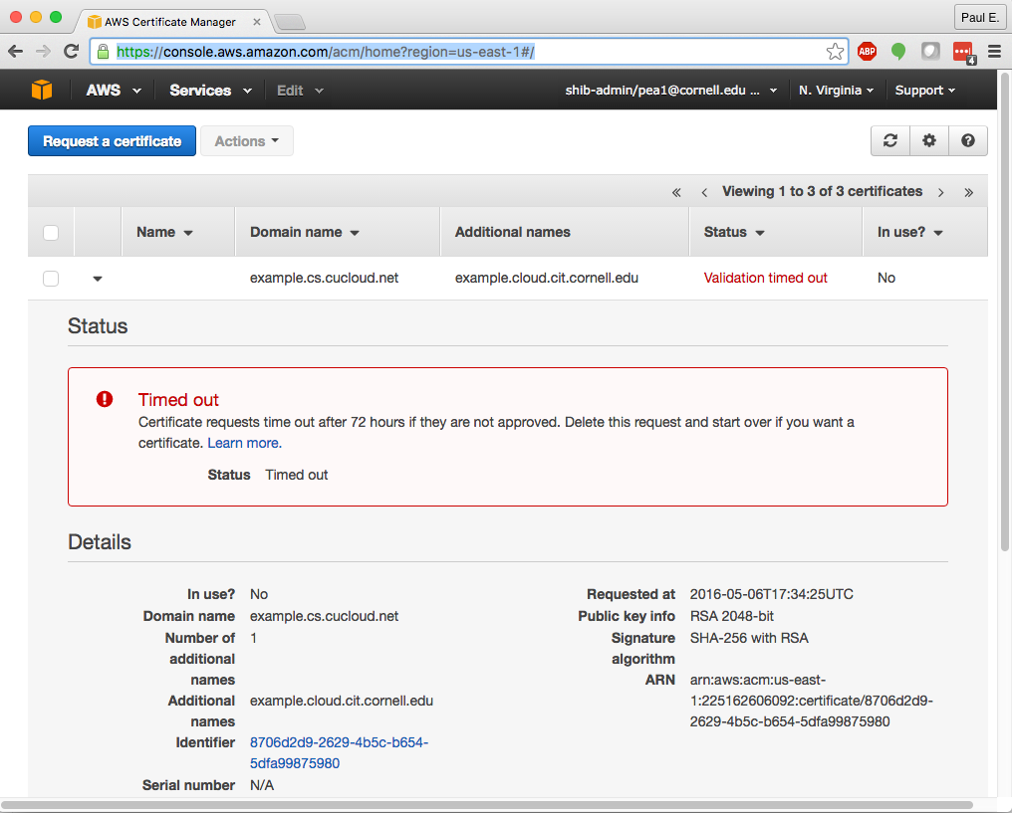
Request time-out – 72 hours

Slide 10
Supported Activities – Level 2
Cornell AWS admins (shib-admin)
Cornell domain admins
Approve certificate requests for domains with noc@cornell.edu as contact
  for cornell.edu sub-domains
  other domains
Determine status of approval requests that came to Cornell (noc@cornell.edu)
Determine where AWS sent approval requests

Slide 11
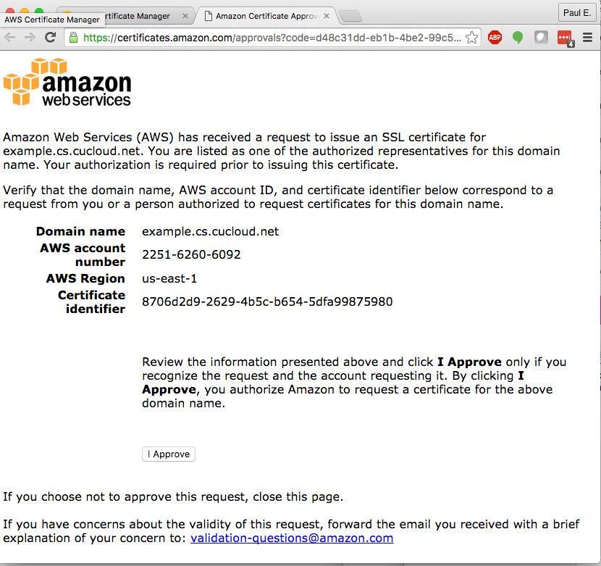
Emailed request for approval to domain contacts

Slide 12
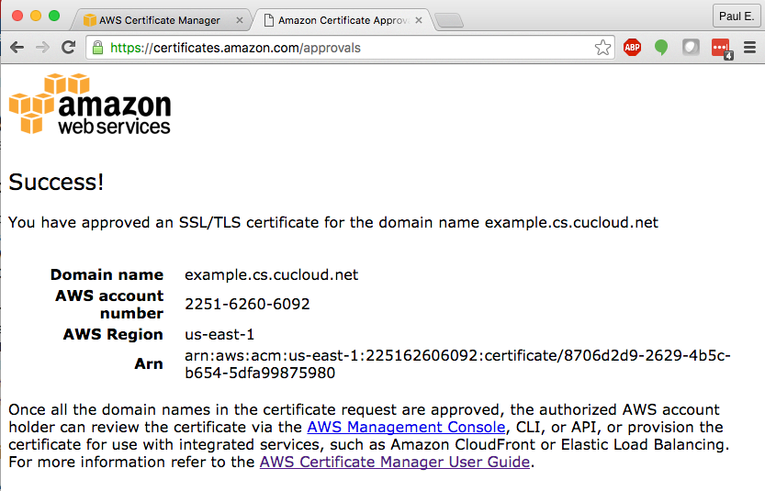
Response after Domain Contact Approval

Slide 15
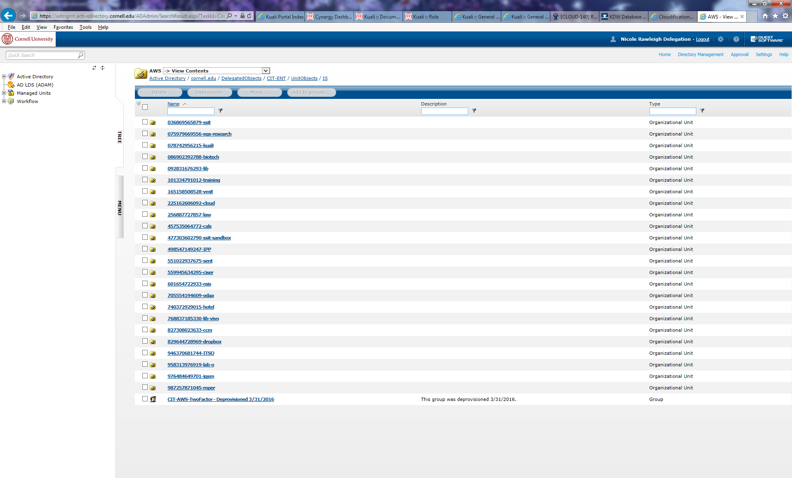
Cornell AD – AWS admin groups

