Slide 3
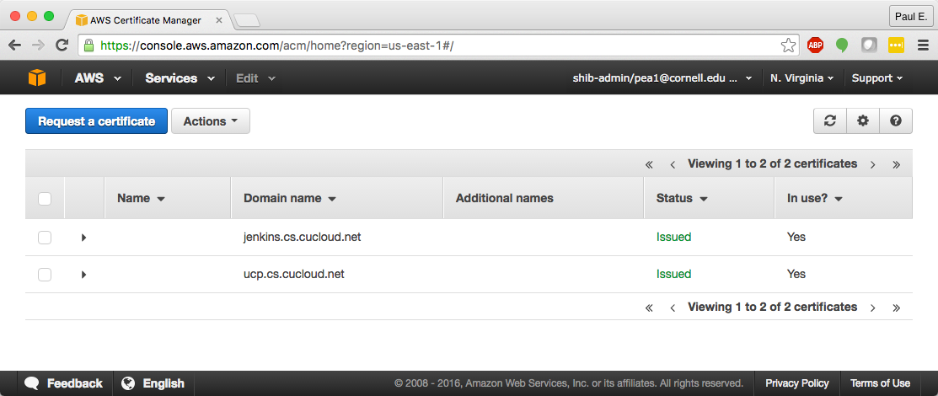
AWS Certificate Manager User Interface

Slide 4
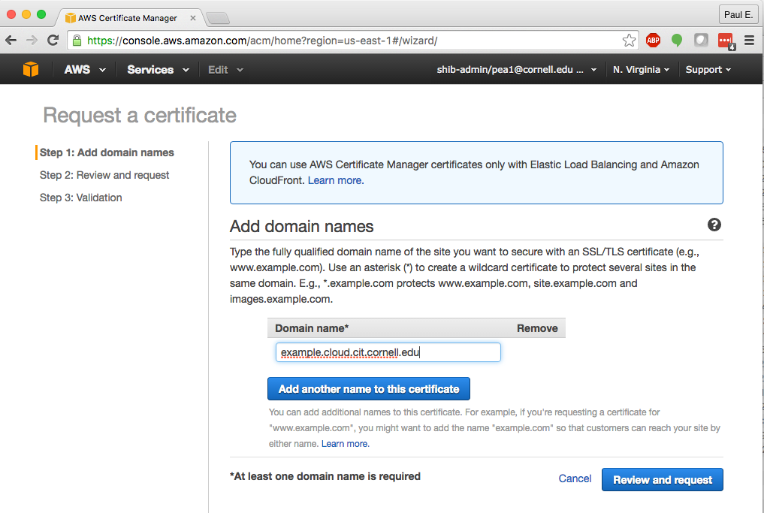
Request – Step 1

Slide 5
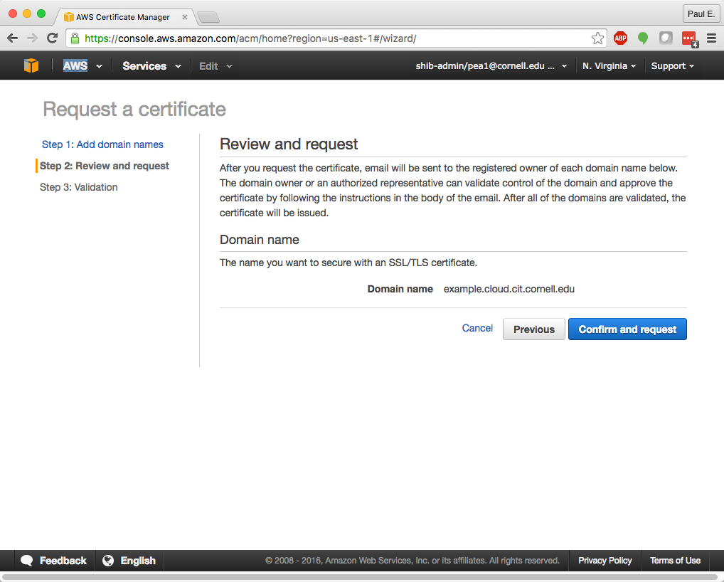
Request – Step 2

Slide 6
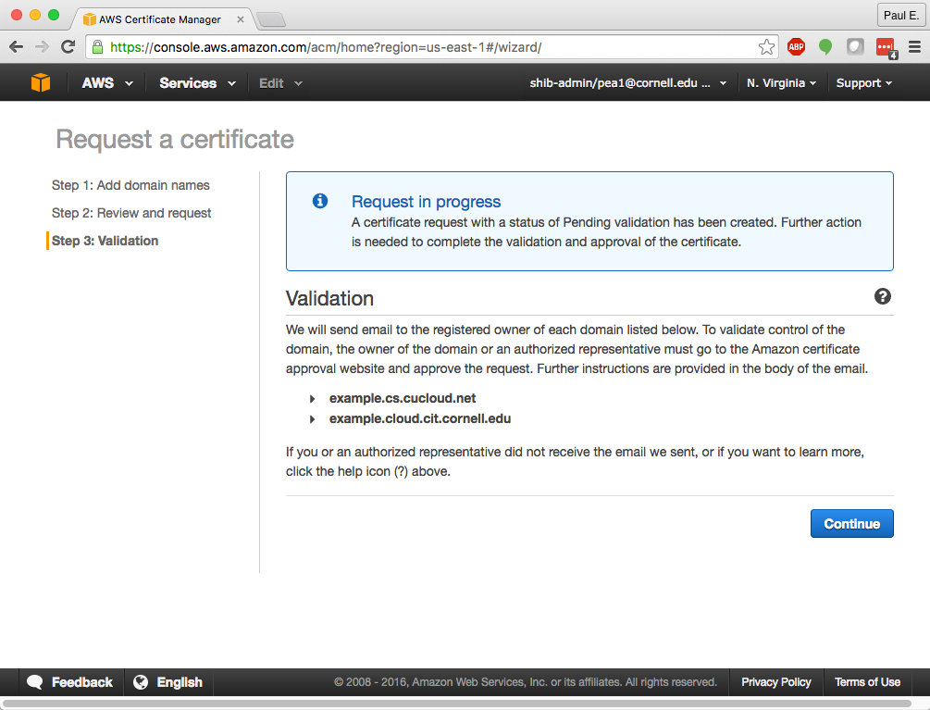
Request – Step 3

Slide 7
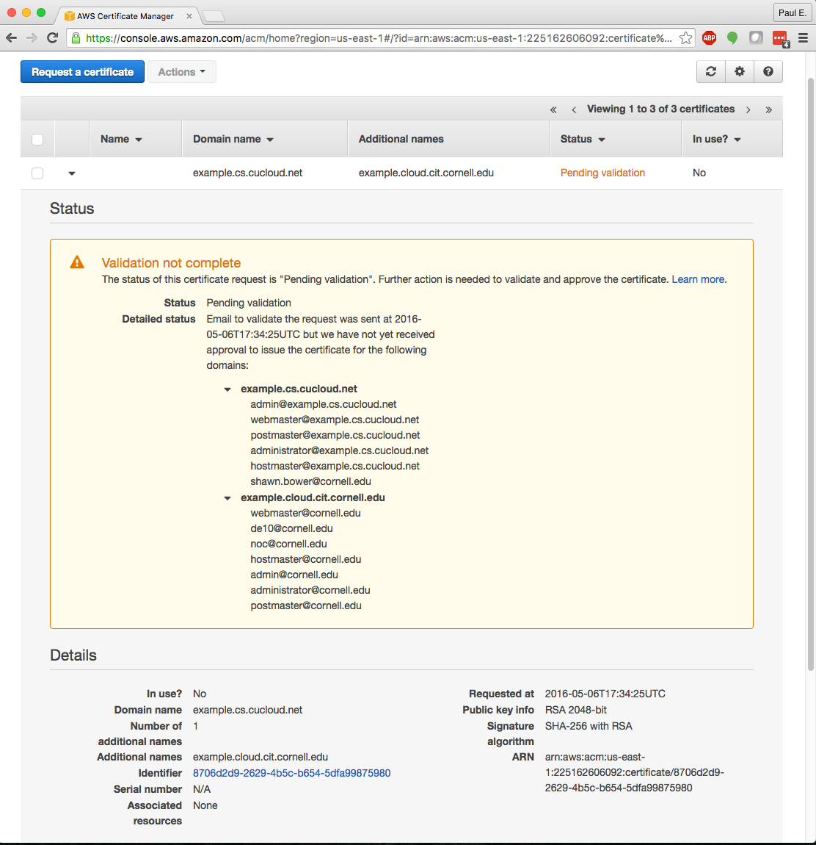
Status – Pending Validation

Slide 8
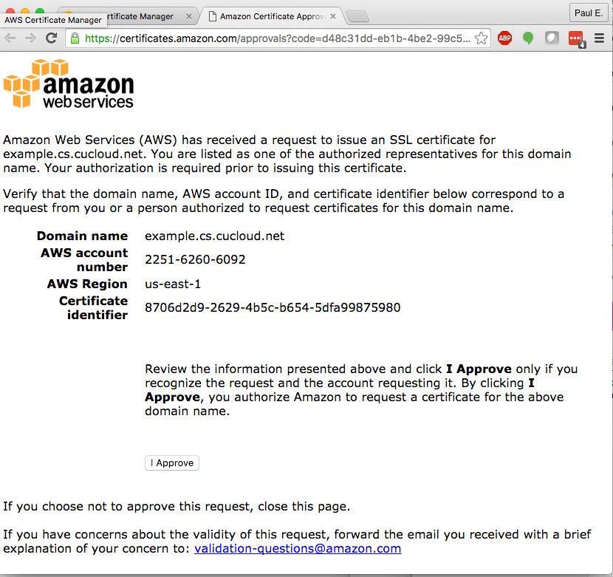
Emailed Request for Approval – Domain Contact

Slide 9
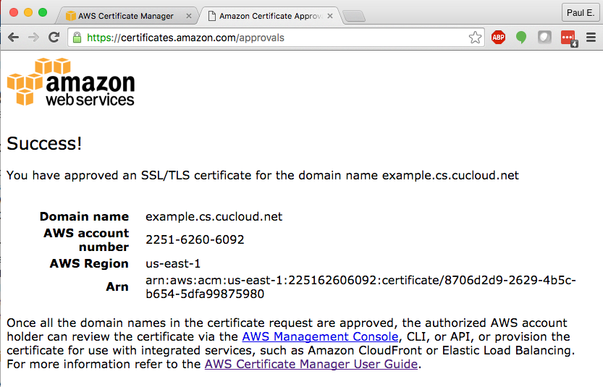
Response after Domain Contact Approval

Slide 10
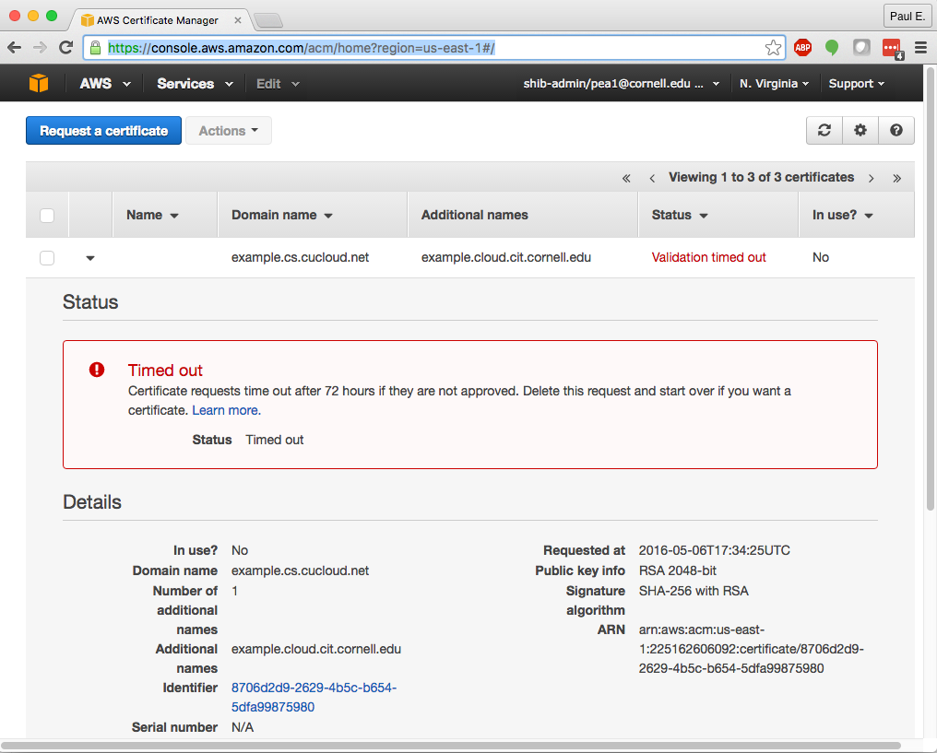
Request – Timed Out

Slide 11
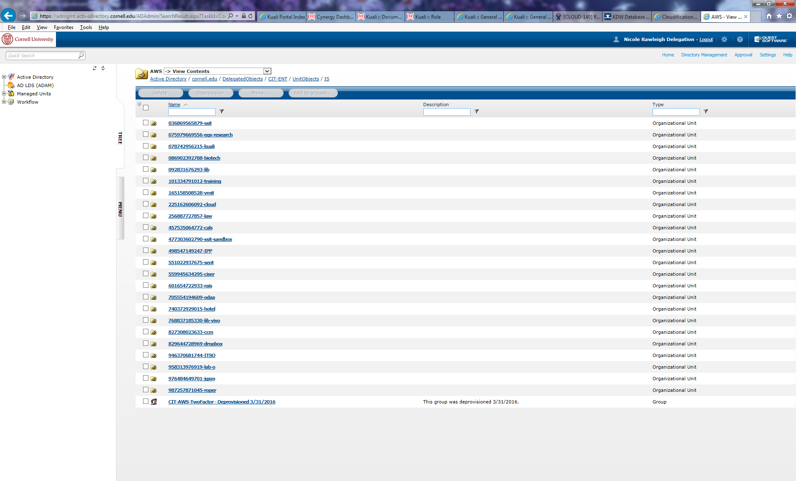
Cornell AD – AWS admin groups

