Slide 1
High Rate Sedimentation
Plate Settlers
Aobei Cheng
Sidney Lok
Yuqi Yu
Lishan Zhu
Notes:
Sidney

Slide 2
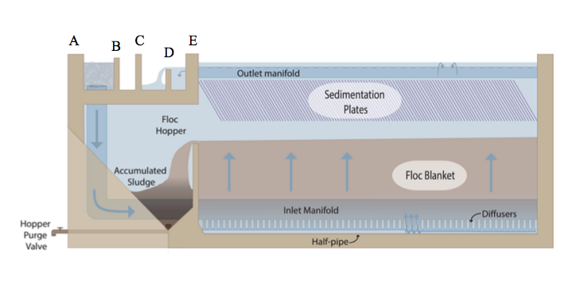
Introduction
Affordability more communities
Large plants cost more…
  space
  money
Notes:
Sidney

Slide 3
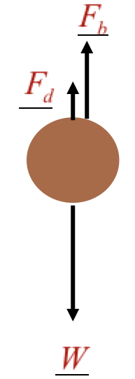
Introduction
Smaller sedimentation tank
higher upflow velocity
flocs go out of tank
Focus: concentrating the floc blanket
Notes:
Sidney

Slide 4
Goals for the semester
Maintain a colloidal particle blanket at upflow velocities higher than 1 mm/s
Explore different plate settler geometries to concentrate floc density
Notes:
Sidney

Slide 5
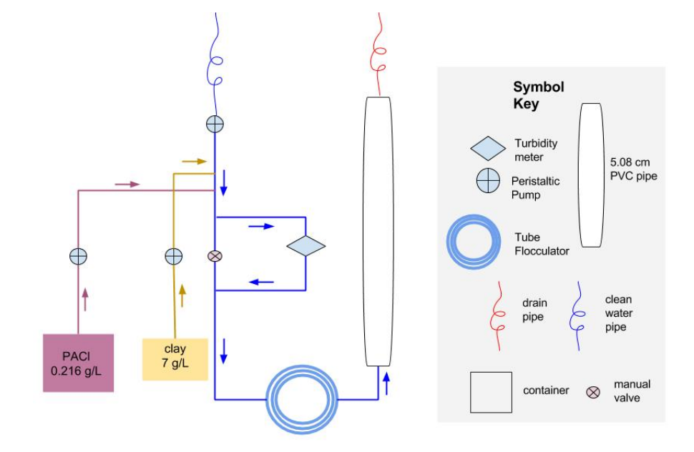
Flocculator Design
Notes:
Yuqi

Slide 6
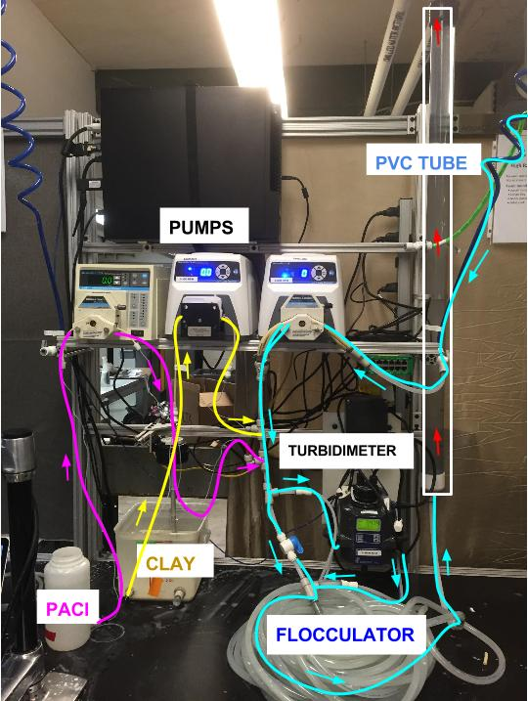


Flocculator Design
Flow Rate (Q):
Flocculator tubing diameter:
0.95 cm (⅜ inch)
Energy Dissipation Rate (ε):
ε=4057mW/kg
ε should be between 5 and 10 mW/kg!
Notes:
Yuqi

Slide 7
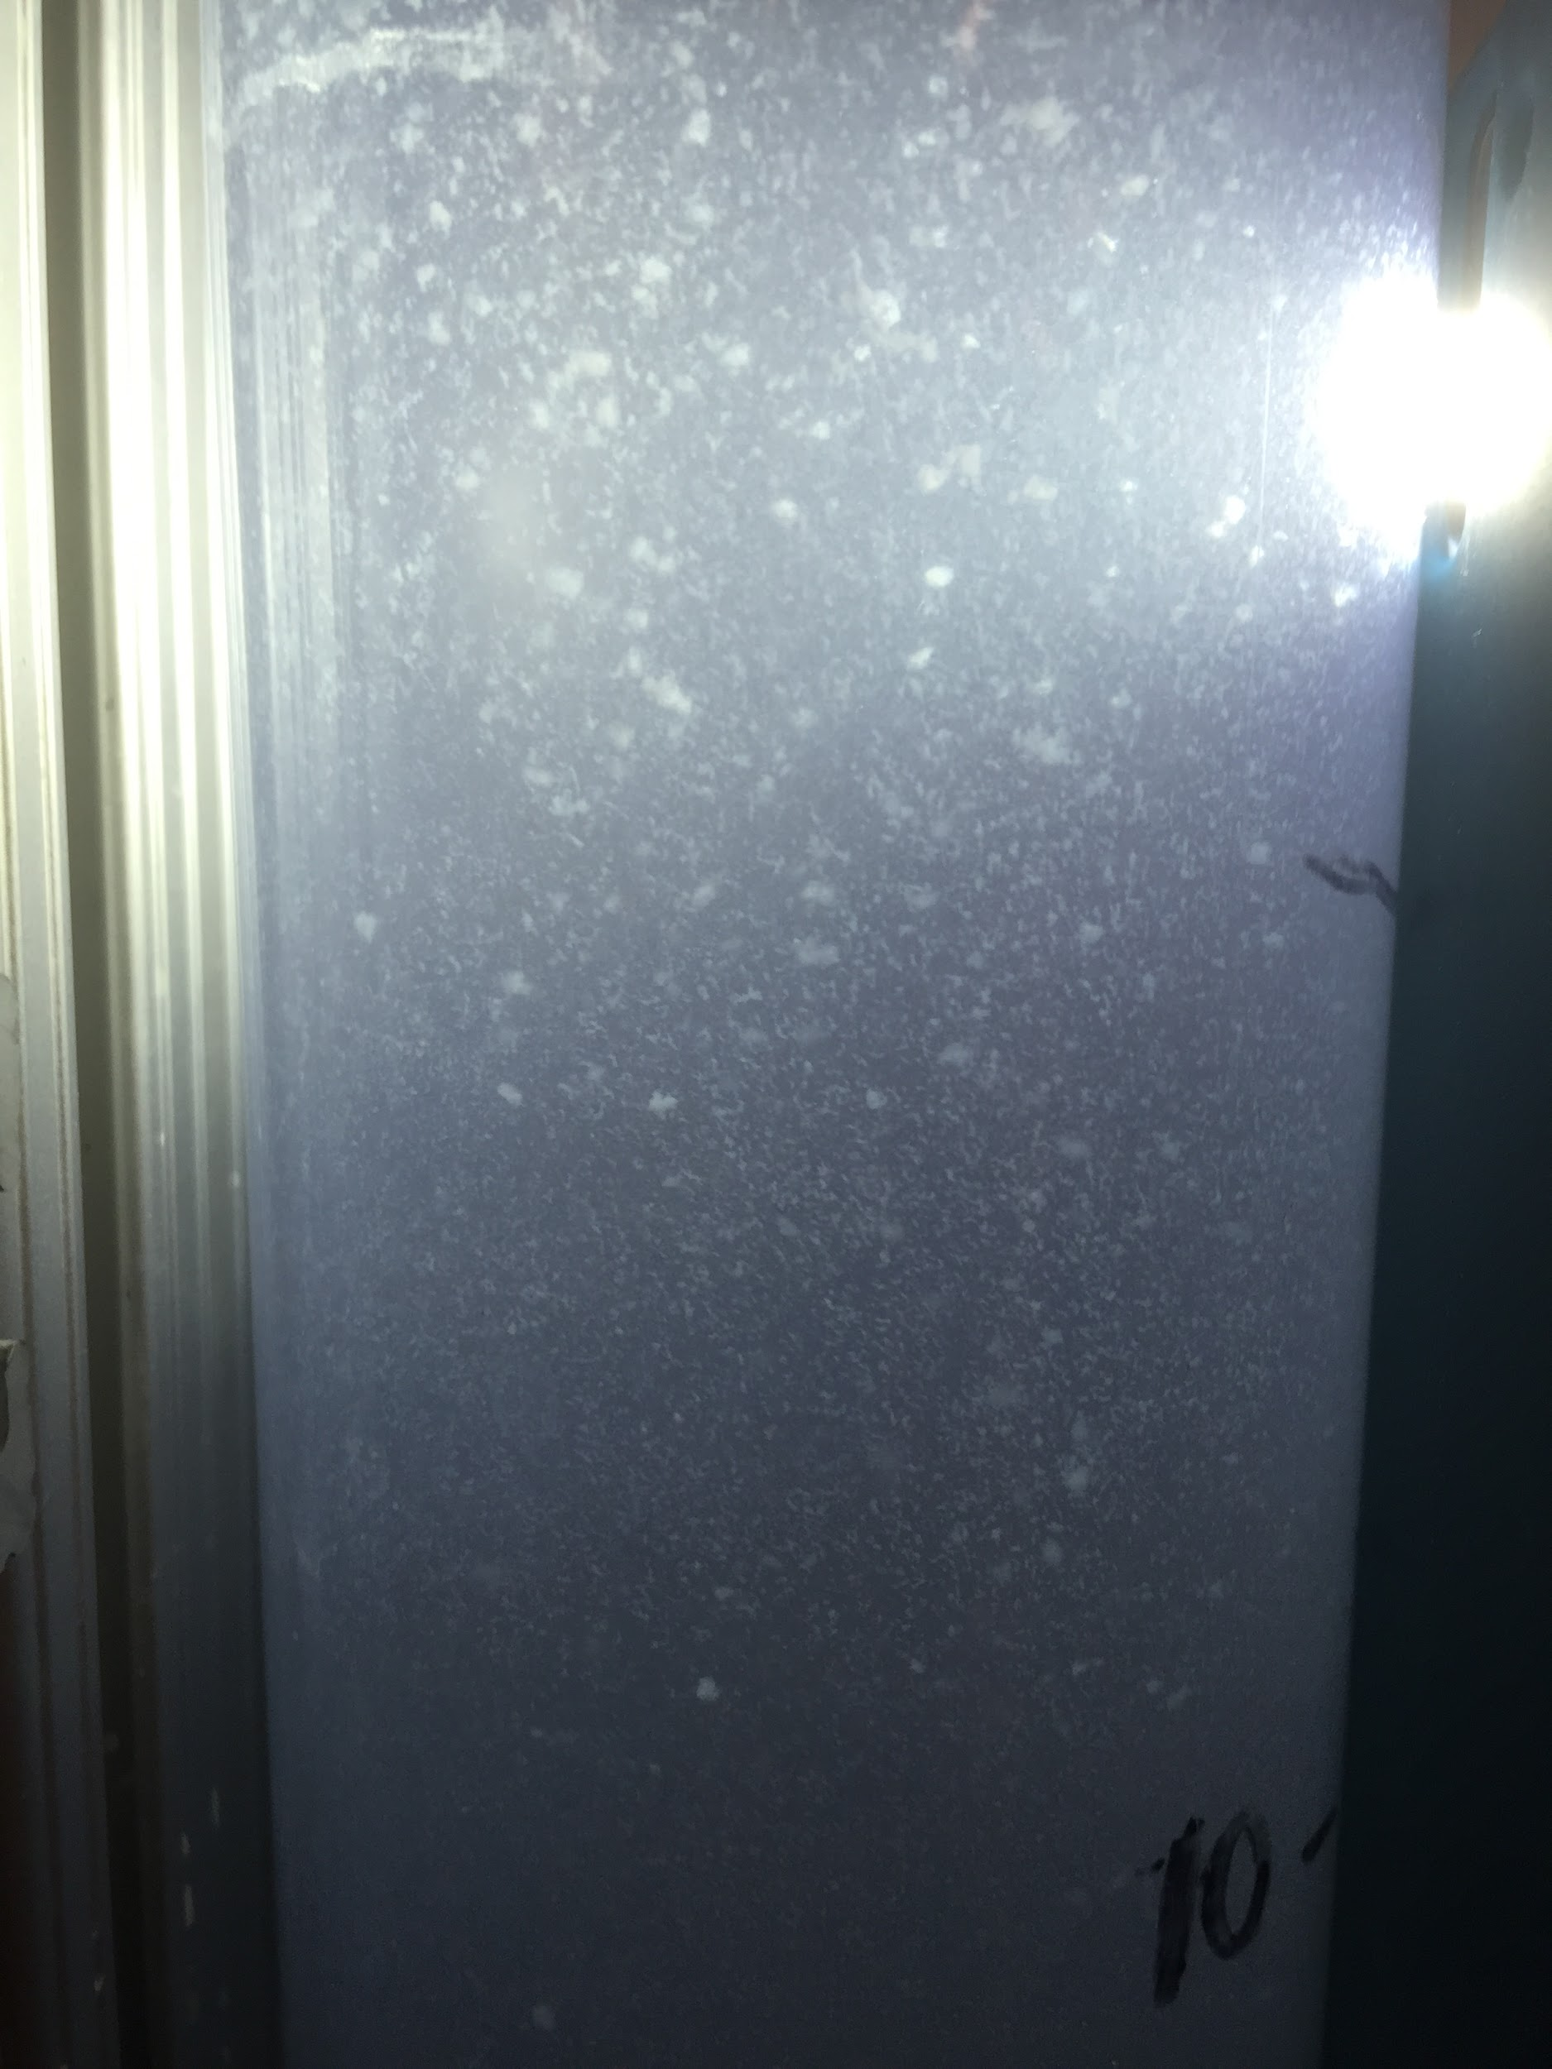
Flocculator Design
Keep using the ⅜ inch flocculator in addition to the energy dissipation rate constraints to return the flow rate.
When Q=7mL/s, ε=6.963mW/kg
Notes:
Yuqi

Slide 8
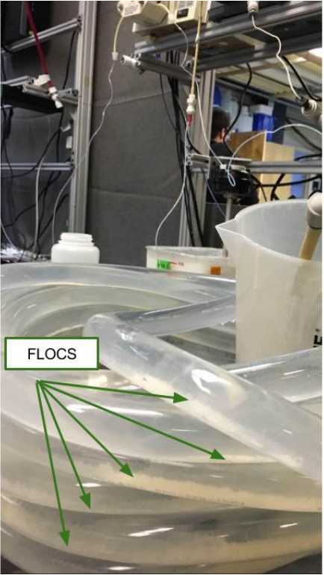
Flocculator Design Take II
Increase of tubing from ⅜ inch to ⅞ inch diameter
Settling of “monster flocs” on tube walls
Modified the flocculator shape
Notes:
Albert

Slide 9
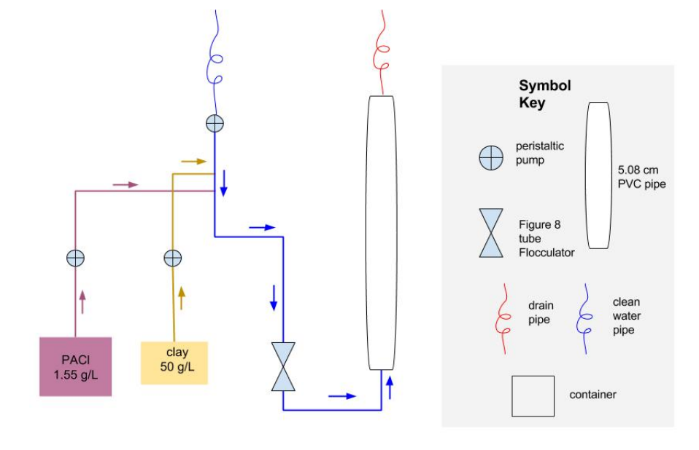
Flocculator Design Take III
Notes:
Albert

Slide 10
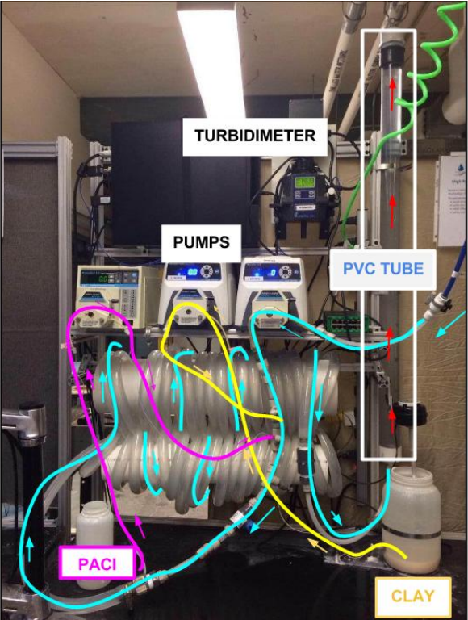
Flocculator Design Take III
Figure eight design = more circulation at bends of flocculator
Circulation should continuously push the flocs through the tube
We ran the apparatus but...
Notes:
Albert

Slide 11
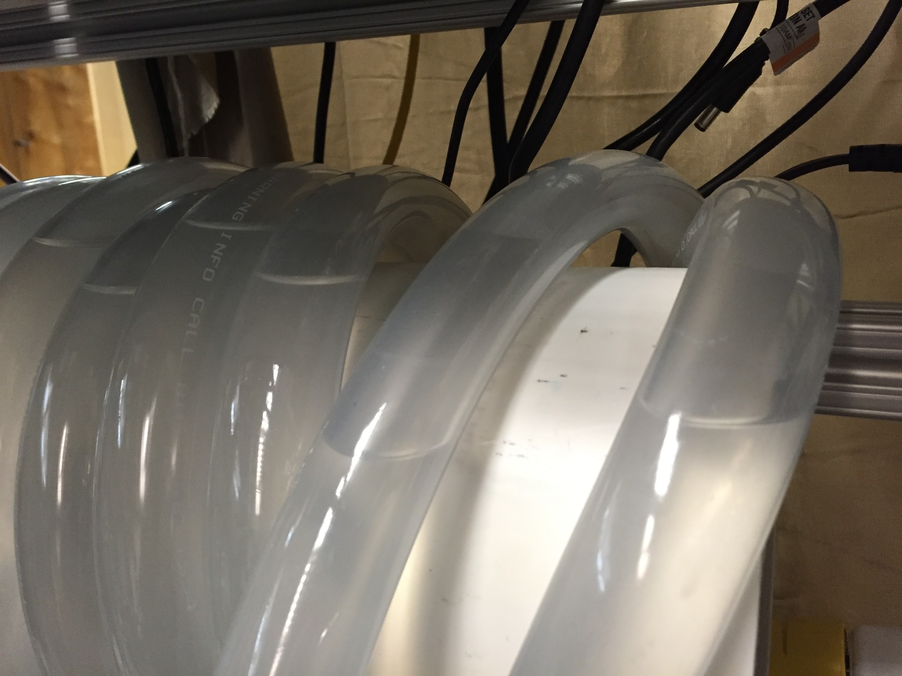
Flocculator Design Take III
Air pockets at the top bends of flocculator are preventing flow
Air pockets
Notes:
Albert

Slide 12
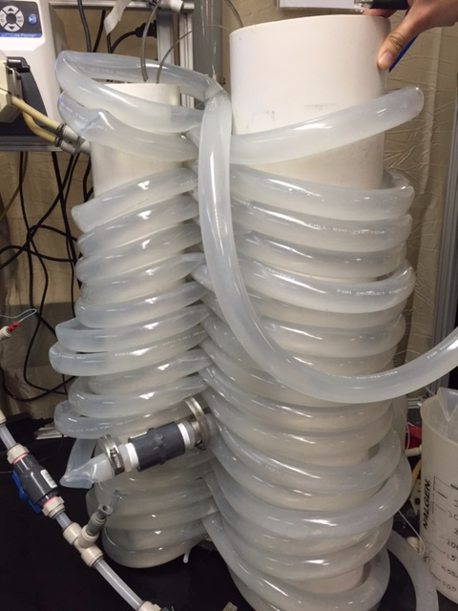
Flocculator Design Take III
Ran water vertically to remove air bubbles
Use 80/20 to fix pipes on lab bench
Notes:
Lishan

Slide 13

Future work
Remove air pockets and run the modified tube flocculator apparatus
Design and create our sedimentation tank
Start experiments with plate settlers in our full apparatus:
  Continuous plates
  Porous plates
  Zigzag plates
  Combinations
Notes:
Lishan

Slide 14

Questions?
Thanks for listening!

