Slide 1
HRS
Plate Settlers
The Spring 2016 HRS - Plate Settlers team experimented with various plate settler designs to maintain a floc blanket at upflow velocities higher than 1 mm/s. A high density floc blanket is necessary to prevent flocs from escaping the sedimentation tank at higher upflow velocities. For more information please visit the High Rate Sedimentation team page
Notes:
Abstract: This semester, the goal of the High Rate Sedimentation - Plate Settlers team was to maintain a suspended layer of colloidal particles (flocs) at upflow velocities higher than 1 mm/s. The suspended layer, referred to the floc blanket, circulates flocs, enhances flocculation and is self-cleaning. As the floc blanket grows in height, it spills over a weir into a sludge collection chamber to prevent sludge build-up inside the sedimentation tank. Increasing the upflow velocity in the sedimentation tank decreases the necessary plan-view area and cost of construction. A high density floc blanket is necessary to prevent flocs from escaping the sedimentation tank at higher velocities. The High Rate Sedimentation - Plate Settlers team explored different plate settler geometries in the sedimentation tank to concentrate the floc blanket.
Full Report: https://www.overleaf.com/4433470rttqjj#/13257409/

Slide 2
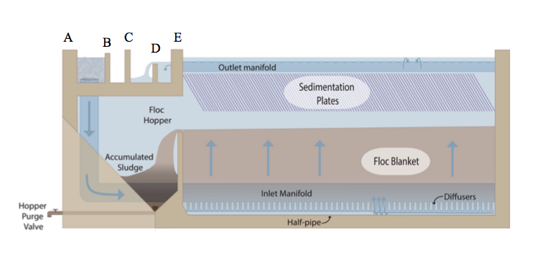
The objective is to increase
the availability of AguaClara plants
HRS - Plate Settlers | Research | Final Presentation Spring 2016
Notes:
Anyene, O., Ge, L., and Yu, Y. (2015). High Rate Sedimentation, Fall 2015.
Technical report, Cornell University, Cornell University AguaClara.
Figure caption: A side-view diagram of the current AguaClara Sedimentation tank shows the process flocs go through during sedimentation. Water from the flocculator enters the sedimentation tank through diffusers on the inlet manifold. As the floc blanket grows in height, excess flocs spill over into the floc hopper and accumulate as sludge. Any small particles that escape the floc blanket can be captured in the sedimentation plates.
Summary: The objective is to increase the availability of the AguaClara plant. Since the goal of AguaClara is to provide clean, sustainable drinking water to more communities, increasing affordability is a large step toward that goal. A large portion of construction costs come from the building surrounding the plant. Thus, to decrease costs it is critical to decrease the plan-view area of the water treatment plant. In a water treatment plant, the step that requires the largest plan-view area is sedimentation. To decrease the area needed for the sedimentation tank, a higher upflow velocity through the plant is necessary.

Slide 3
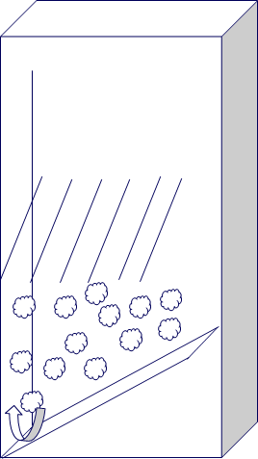
It is necessary to maintain a floc blanket at the higher upflow velocity
Importance of the floc blanket
  enhances flocculation
  self-cleaning
HRS - Plate Settlers | Research | Final Presentation Spring 2016
Notes:
Caption: This figure demonstrates a concentrated floc blanket and the placement of plate settlers that will help concentrate the floc blanket.
Summary: The floc blanket is important because it enhances the flocculation of particles in the tank and is self-cleaning. The floc blanket minimizes the distance between flocs and causes them to collide and form larger flocs. However, higher upflow velocities push lighter flocs out of the tank and makes it difficult to maintain a floc blanket. A high density floc blanket is necessary to prevent flocs from escaping the sedimentation tank at higher velocities because a dense floc blanket will cause more collisions between particles and create larger flocs. These larger flocs will settle more easily at high upflow velocities than smaller flocs. The HRS - Plate Settlers team explored different plate designs and geometries in order to concentrate the floc blanket.

Slide 4
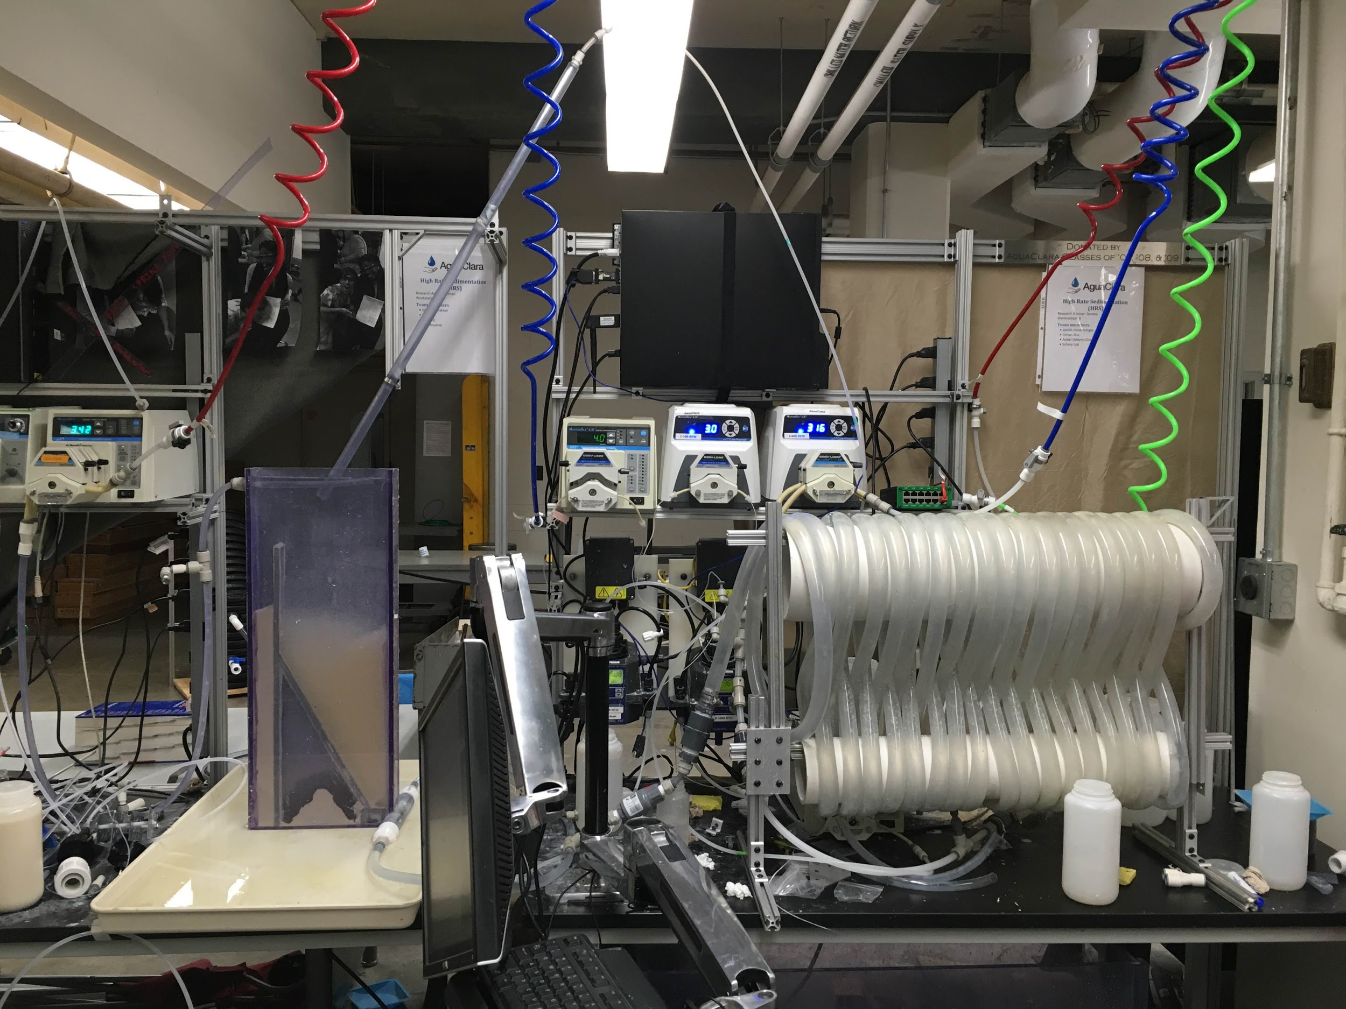
Plate Settlers
Flocculator
Sedimentation Tank
HRS - Plate Settlers | Research | Final Presentation Spring 2016
Notes:
Caption/Summary: The apparatus used to conduct experiments is comprised of three main parts: a flocculator, sedimentation tank, and plate settlers.

Slide 5
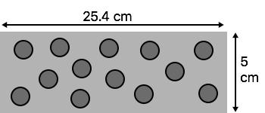

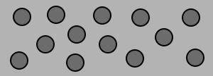
Floc blanket stabilizer plate design
Porous
Continuous
HRS - Plate Settlers | Research | Final Presentation Spring 2016
Notes:
Caption: Continuous and porous plates were designed to help stabilize the floc blanket. They were 25.4 cm long and inserted at a 60 degree angle with 2.5 spacing.
Summary: The team designed two types of plate settlers to experiment with: continuous plates and porous plates. The difference between continuous and porous plates is that porous plates have holes drilled into them while continuous plates do not. Both were angled at 60 degrees, had lengths of 25.4 cm, and were spaced 2.5 cm apart. The angle of 60 degrees was chosen because Culp et. al determined that at 60 degrees floc would continuously slide down the plate settlers.
See appendix A for equations that were used to derive these specifications.

Slide 6
Having two sloped bottoms
leaves more space for plate settlers
Two sloped bottoms vs One sloped bottom
HRS - Plate Settlers | Research | Final Presentation Spring 2016
Notes:
Caption: The difference between the amount of space taken up in the tank with two sloped bottoms and with one sloped bottom.
Summary: When designing the sedimentation tank, the team chose between having two sloped bottoms or one sloped bottom by taking into consideration the amount of space that would be left at the top of the tank to experiment with plate settler placement. The team ultimately chose the two sloped bottom tank design because, as seen in the diagram above, it leaves more space at the stop for experimentation.

Slide 7
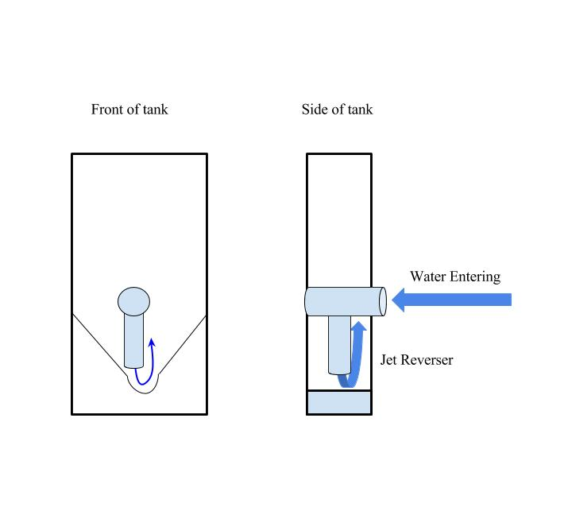
The jet reverser is positioned near the middle of the tank
HRS - Plate Settlers | Research | Final Presentation Spring 2016
Notes:
Caption: Pictured is the design for the High Rate Sedimentation-Plate Settlers sedimentation tank. Water enters through a coupling and then exits through a PVC jet reverser. The curved bottom reverses the direction of the influent water jet as shown in the schematic.
Summary: The entrance of water in the two sloped bottom tank was designed to be near the middle of the slope. Water would enter the tank through a pipe that is perpendicularly drilled into the tank. The water would exist perpendicularly through a diffuser and hit the curve at the bottom of the slope insert. In order for the water to properly reverse direction and going up through the tank, the jet reverser is placed a little off to the side.

Slide 8
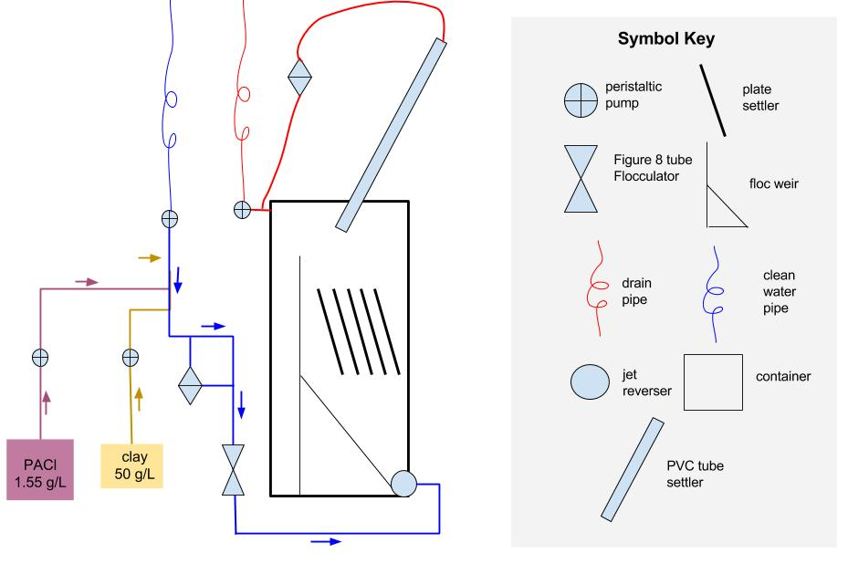
Schematic of experimental apparatus
Upflow velocities tested:
  3 mm/s
  4 mm/s
HRS - Plate Settlers | Research | Final Presentation Spring 2016
Notes:
Caption: The schematic of the experimental apparatus.
Summary: The experiments were conducted with continuous and porous floc blanket stabilizers at an upflow velocity of 3 mm/s and 4mm/s. Tap water passes through a 6-600 RPM pump. Coagulant and clay stock solutions pass through separate 1-100 RPM pumps. The coagulant and clay stock solutions rapidly mix with the water through a tee-connector. The rapidly-mixed water goes straight into the figure-eight shaped tube flocculator. The water then enters the sedimentation tank, and then go through the floc blanket stabilizers and the tube settlers. Finally the water leaves through the disposal line. The sedimentation tank pictured is that of the HRS - Floc Blanket team. Because of the limited time, the HRS - Plate Settlers team and the HRS - Floc Blanket team connected our fabricated flocculator and sedimentation tank, respectively, in order to start running experiments.

Slide 9
Continuous plates were more effective at 3 mm/s upflow velocity
82.2% removal
79.8% removal
HRS - Plate Settlers | Research | Final Presentation Spring 2016
Notes:
Caption: Representations of continuous and porous plates.
Summary: At 3 mm/s, continuous plates (82.2% removal) performed slightly better than porous plates (79.8% removal). However, at 4 mm/s, porous plates (73.0 \% removal) performed slightly better than continuous plates (70.7 \% removal). Thus, there is no clear evidence of which plate geometry is more effective in aiding particle removal during sedimentation.
See appendix B for graphs of the data that was logged

Slide 10
Porous plates were more
effective at 4 mm/s upflow velocity
56.3% removal
70.7% removal
73% removal
HRS - Plate Settlers | Research | Final Presentation Spring 2016
Notes:
Caption: Representations of continuous, porous, and no plates.
Summary: At 3 mm/s, continuous plates (82.2% removal) performed slightly better than porous plates (79.8% removal). However, at 4 mm/s, porous plates (73.0 \% removal) performed slightly better than continuous plates (70.7 \% removal). Thus, there is no clear evidence of which plate geometry is more effective in aiding particle removal during sedimentation.
See appendix B for graphs of the data that was logged

Slide 11
Summary of Results
Plate Type | Upflow Velocity | Average Influent Turbidity | Average Effluent Turbidity | Percent Removal
Continuous | 3 mm/s | 100 NTU | 17.8 NTU | 82.2%
Porous | 3 mm/s | 100 NTU | 20.2 NTU | 79.8%
None | 4 mm/s | 100 NTU | 43.7 NTU | 56.3%
Continuous | 4 mm/s | 100 NTU | 29.3 NTU | 70.7%
Porous | 4 mm/s | 41.5 NTU | 11.2 NTU | 73%
Notes:
Summary: These are the experimental results. There is no significant evidence that one plate geometry is more effective than the other. However, there is much greater removal with the addition of both floc blanket stabilizer plates.

Slide 12
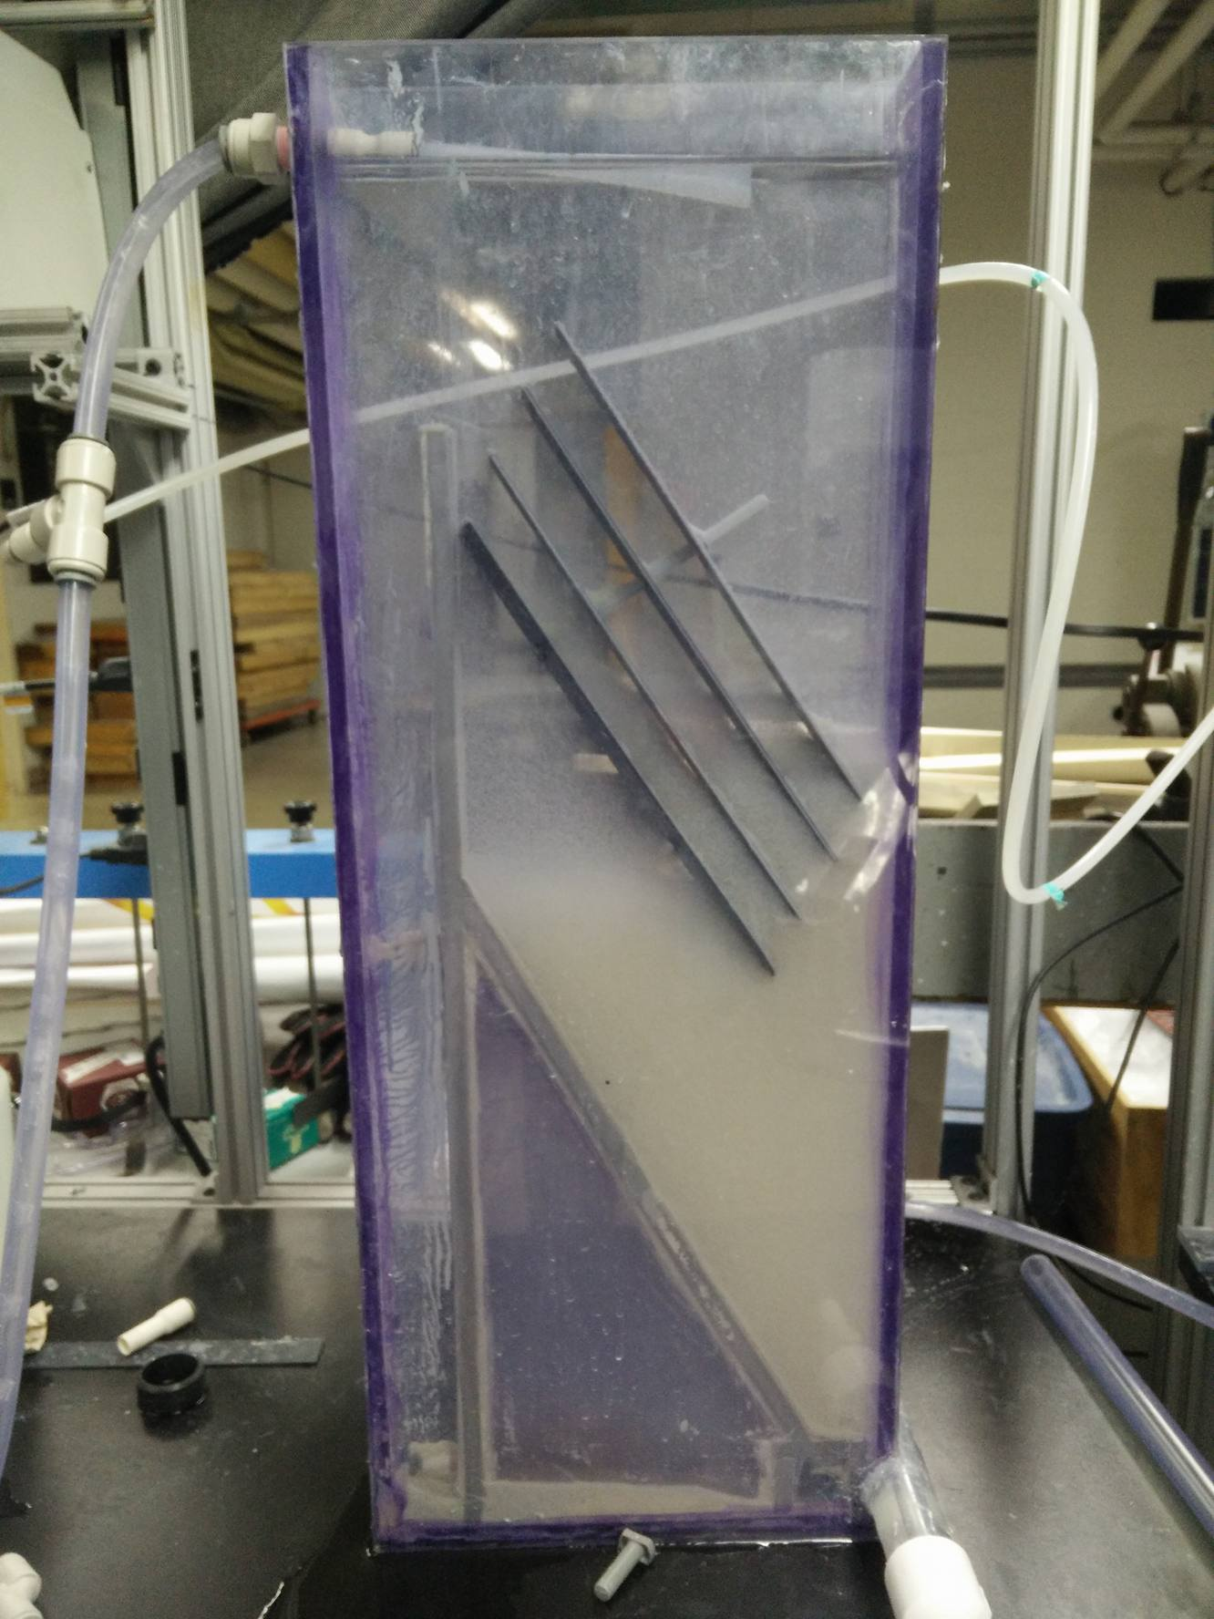
Conclusions
Addition of plates in the floc blanket effectively concentrated the floc blanket at upflow velocities as high as 4 mm/s
Notes:
Caption: The figure demonstrates the positive effect that the presence of plate settlers have on the concentration of the floc blanket.
Summary: The research done this semester has proved that the addition of plates in the floc blanket can effectively concentrate the floc blanket at upflow velocities as high as 4 mm/s.

Slide 13
Conclusions
No significant difference between porous plate and continuous plate effectiveness
Notes:
Summary: No solid conclusion could be drawn about the effectiveness of each plate geometry, but the addition of plate settler floc blanket stabilizers does aid in particle removal.

Slide 14
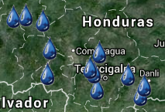
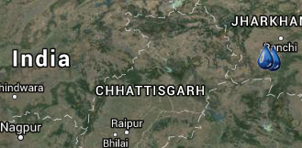
Conclusions
Notes:
Figure: http://aguaclara.cee.cornell.edu/about/projectmap/
Caption: Each droplet represents an existing AguaClara water treatment plant
Summary: Since the current AguaClara design operates at 1 mm/s without floc blanket stabilizers, the addition of these plates would allow operation at higher upflow velocities with similar performance. Efficiency at higher velocities opens the door to the possibility of smaller sedimentation tanks, and therefore more cost effective treatment plants. As further research is done on high rate sedimentation, more communities will be able to have access to sustainable drinking water treatment plants.

Slide 15

Future Work
Standard Operating Procedures
Running three tests at more upflow velocities
Repetition of Tests
Quantify floc size, floc density, floc shape
Notes:
Image Citation: http://www.truthortradition.com/wp-content/uploads/2013/08/work_in_future_kingdom-720x340.jpg
Summary: In the coming semesters, it is crucial that the apparatus is started and stopped using a standard set of operating procedures to avoid operational bias. Imminent next steps of testing include running three types (no plates, continuous plates, porous plates) of tests for more upflow velocities between 1 and 5 mm/s. Moreover, repeated trials are necessary to make concrete conclusions when two variables deliver similar results. From a broader point of view, progress toward improving high rate sedimentation requires quantifying are floc size, floc density, floc shape, and the resulting floc blanket density. If the previously mentioned attributes can be easily quantified, it would allow researchers to more directly approach the issue of creating efficient sedimentation tanks even at high upflow velocities.

Slide 16
Questions and
Recommendations
Albert Cheng
EnvE, B.S.
ac2325@cornell.edu
Sidney Lok
EnvE, B.S.
sgl38@cornell.edu
Yuqi Yu
EnvE, M.Eng
yy648@cornell.edu
Lishan Zhu
EnvE, B.S.
lz242@cornell.edu

Slide 17
Appendix
Slides

Slide 18
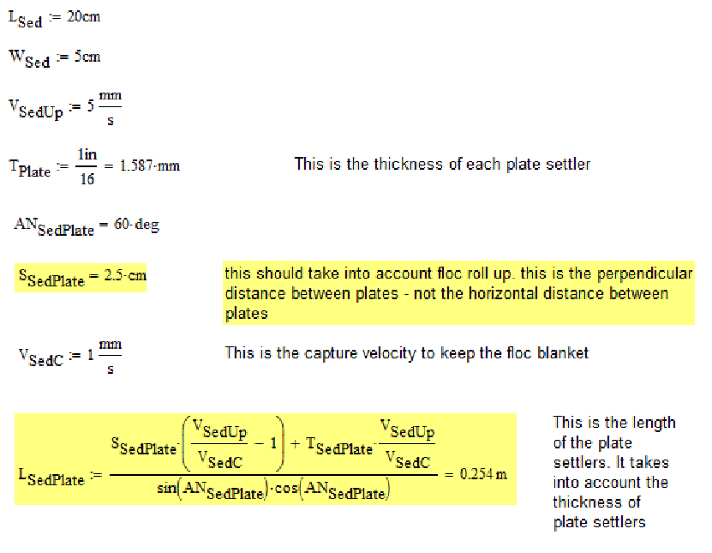
Appendix A
Notes:
Floc blanket stabilizers design
Citation: Weber-Shirk, M. (2015). Sedimentation.

Slide 19
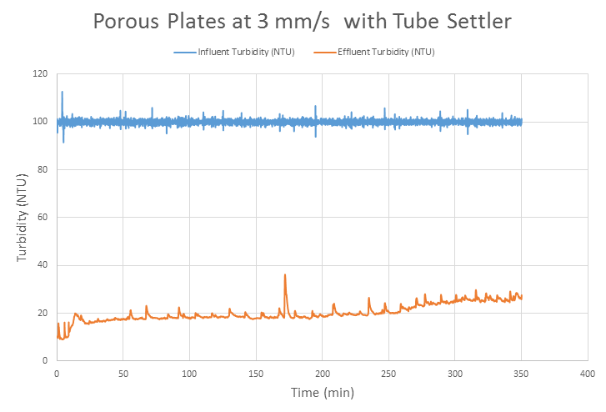
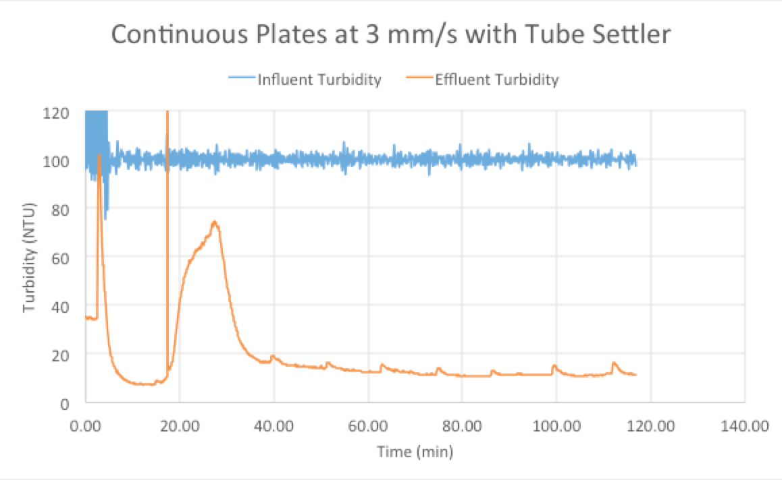
Appendix B
HRS - Plate Settlers | Research | Final Presentation Spring 2016
Notes:
Experimental results at 3 mm/s
Caption: Graphs of data collected on influent and effluent turbidity with porous plates and with continuous plates at 4 mm/s with a tube settler.
Summary: At 3 mm/s, continuous plates (82.2% removal) performed slightly better than porous plates (79.8% removal). However, at 4 mm/s, porous plates (73.0% removal) performed slightly better than continuous plates (70.7% removal). Thus, there is no clear evidence of which plate geometry is more effective in aiding particle removal during sedimentation.

Slide 20
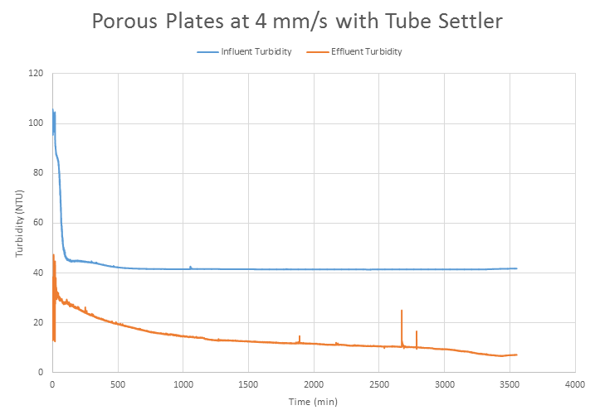
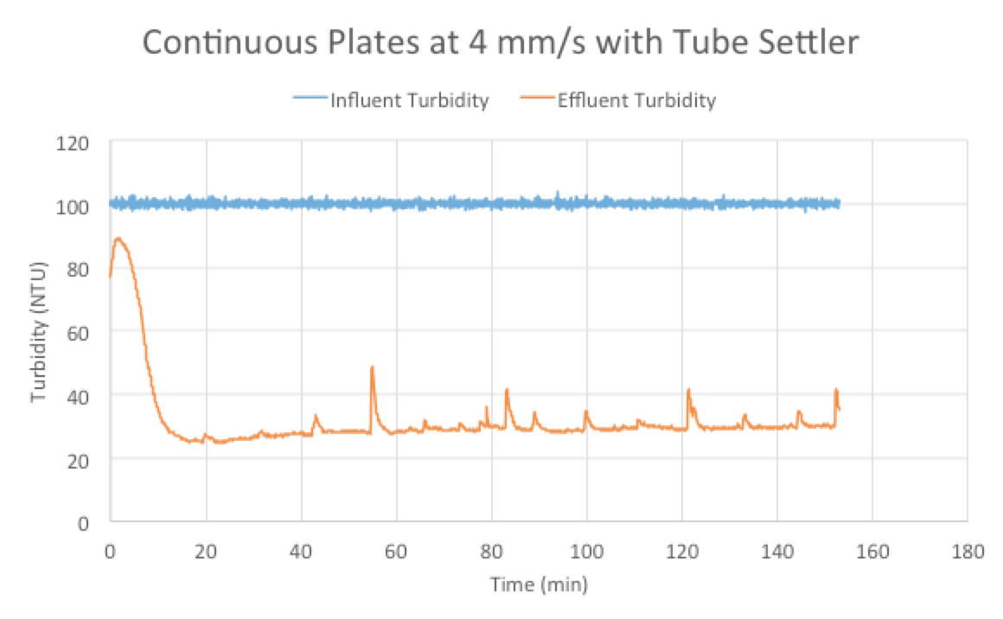
HRS - Plate Settlers | Research | Final Presentation Spring 2016
Notes:
Caption: Graphs of data collected on influent and effluent turbidity with porous plates and with continuous plates at 4 mm/s with a tube settler.
Summary: At 3 mm/s, continuous plates (82.2% removal) performed slightly better than porous plates (79.8% removal). However, at 4 mm/s, porous plates (73.0% removal) performed slightly better than continuous plates (70.7% removal). Thus, there is no clear evidence of which plate geometry is more effective in aiding particle removal during sedimentation.

Slide 21
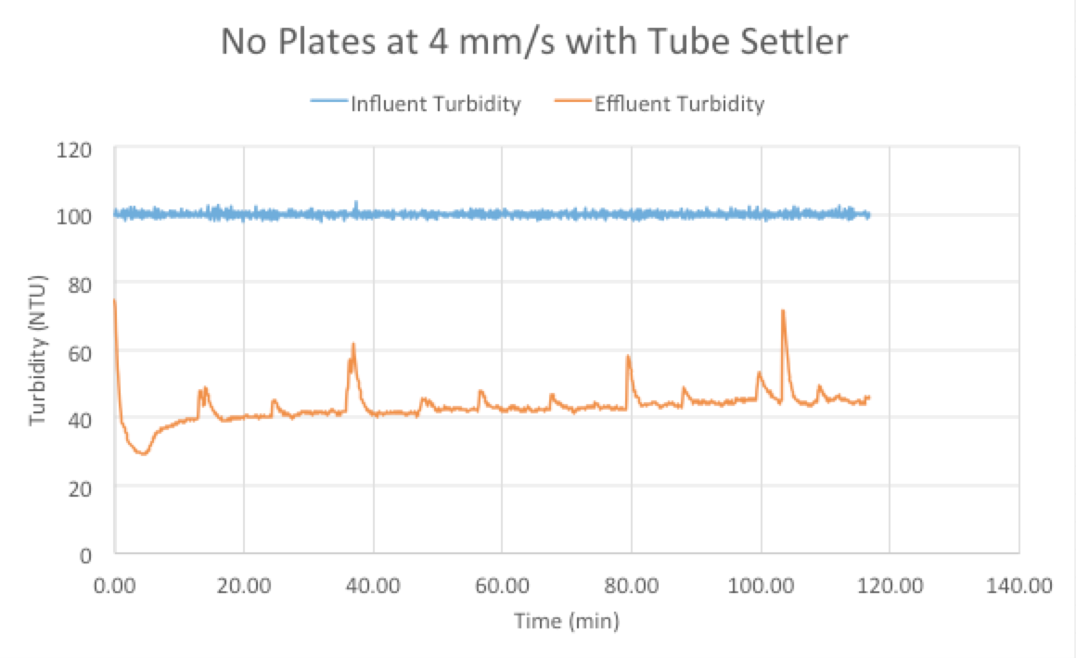
HRS - Plate Settlers | Research | Final Presentation Spring 2016
Notes:
Caption: Graphs of data collected on influent and effluent turbidity with continuous plates and without any plates at 3 mm/s with a tube settler.
Summary: Experiments were conducted at 4 mm/s with continuous plates and without any plates in the sedimentation tank. The data collected showed that experiments conducted with continuous plates had a much better removal rate (70.7% removal rate) than experiments conducted without any plates (56.3% removal rate). Thus, it can be concluded that the addition of plates as floc blanket stabilizers is effective in both concentrating the floc blanket and reducing the effluent turbidity.

