Slide 1
Microbiological Water Safety
Jacqueline Dokko and Janak Shah

Slide 2
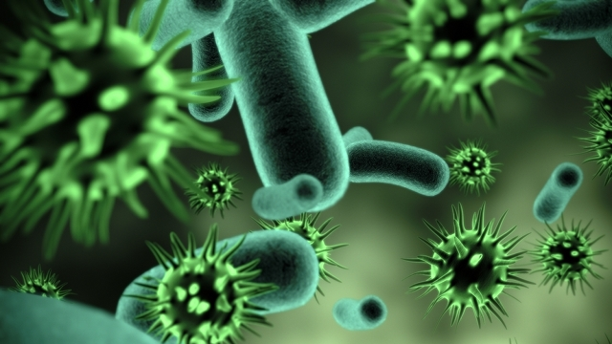
Introduction
The purpose of this team is to test the safety of the water exiting AguaClara plants.
Pathogens must be completely absent to ensure safety.

Slide 3
Goals
Develop a test to determine the safety of water of water treated by AguaClara plants
Test must be inexpensive
Test must be able to operate in a low resource setting
Test must have a reasonable incubation time
Test ideally should enumerate bacterial colonies.

Slide 4

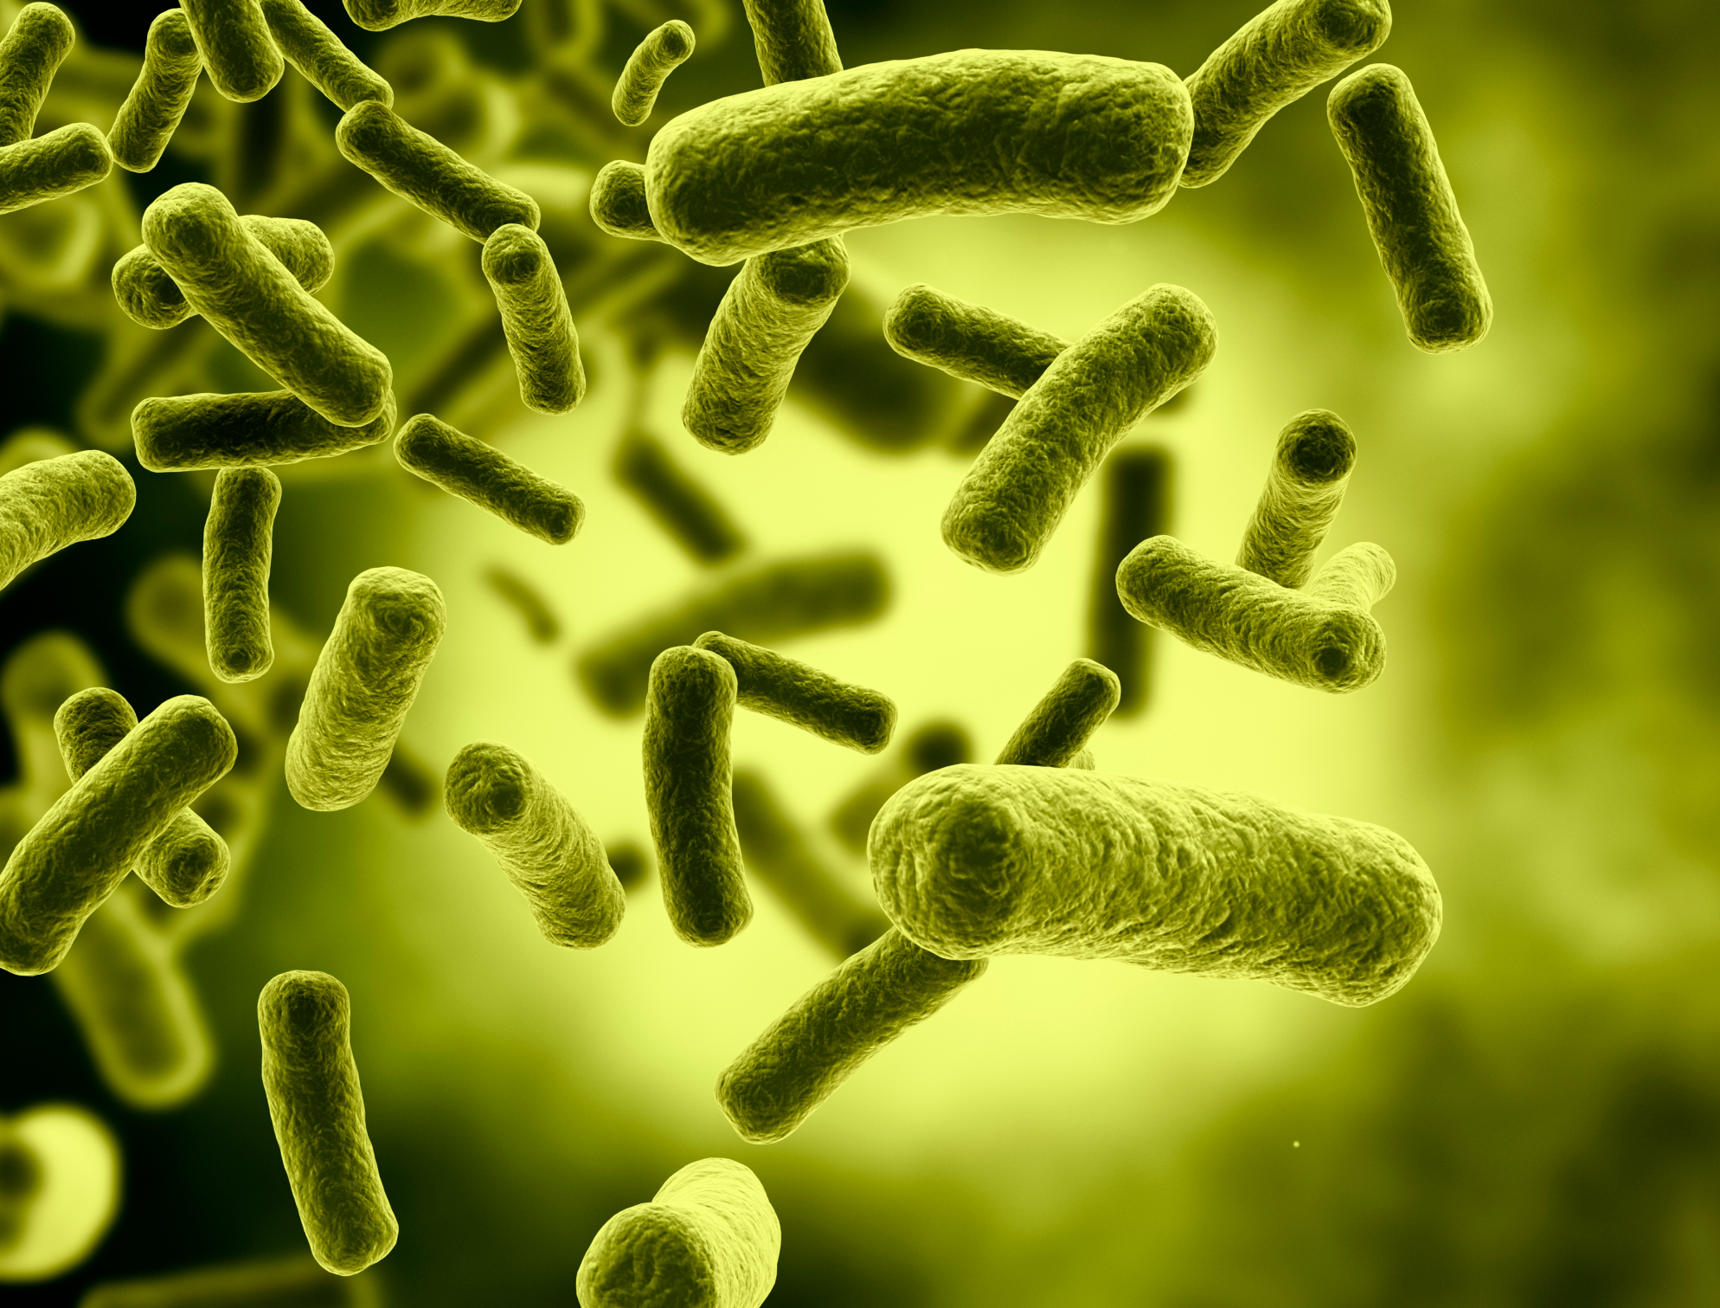
Issues
Unexpected events can take place during lifetime of plant operation
Leaks in pipes and tanks
Improper cleaning of backwashing filters
Increased precipitation
All of the above lead to
E. Coli and coliform growth

Slide 5
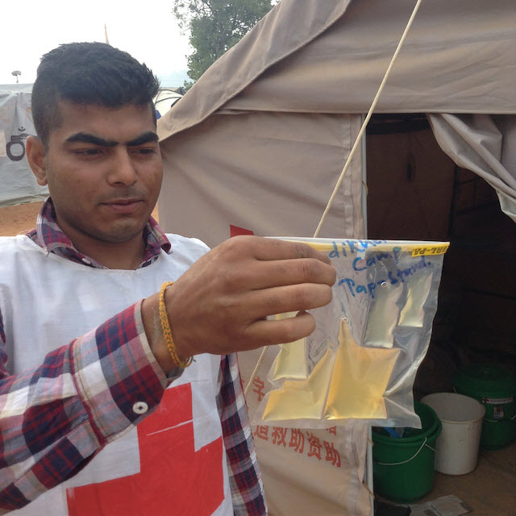
Research
The compartmentalized bag test was found to be accurate for higher concentrations of E-coli.
However, the incubation time for this test is 24-48 hours.
Color change is due to the metabolism of glucuronides to β-glucuronidase

Slide 6
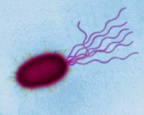
Research cont.
Sliding colony counter method:
Sliding sample through tube containing medium and attempting to count individual bacterial colonies
Issue is that E-coli swims at speeds of apprx. 172 cm/day, which is too fast to isolate colonies.

Slide 7
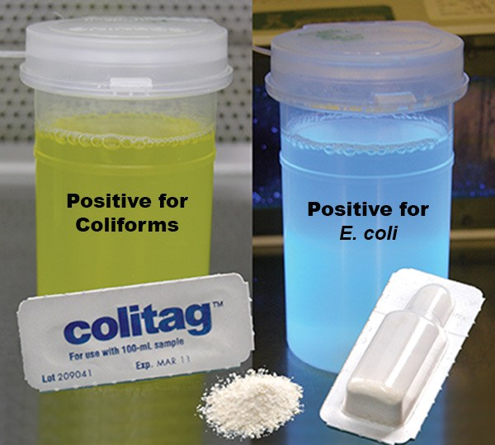
Future Work
Possible methods:
Sliding Colony Counter
Investing in Colitag or Colilert
Isolating bacterial colonies in sample using thickener

Slide 8
Questions?

