Slide 1


Microbiological Water Safety Detection
The purpose of this presentation is to convey the work done by the MSWM subteam this semester. More information can be found on our team page on the AguaClara wiki page and in our research report.
Research | Final Presentation Spring 2016
Notes:
The ultimate goal for the microbiological water safety monitoring (MWSM) team is the development of a test that detects pathogens in water. The test must be of low cost (under ten dollars for each test), have a reduced incubation time from the standard 48 hours, and be able to be used in a low-resource setting such as Honduras. The team tested methods indicating the presence or absence of bacteria compared to quantitatively determining bacterial presence. Upon understanding the cost and efficiency of each method, it was possible to narrow down the methods that could be used as a model for microbial detection for AguaClara purposes.
https://www.overleaf.com/4423556rsgdmy#/13218343/

Slide 2


Problems
Causes of E.Coli and coliform growth:
Leaks in pipes and tanks
Improper cleaning of backwashing filters
Increased precipitation
Unexpected events can take place during lifetime of plant operation
Microbiological Water Safety Monitoring| Research | Final Presentation Spring 2016
Notes:
http://water.usgs.gov/edu/images/coliforms.gif
Total coliforms are an umbrella category that encompasses fecal coliforms a form of which are E. Coli
See appendix for more on existing methods of detection.

Slide 3
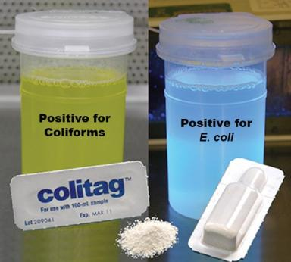
Goals
Testing AguaClara water post-plant-treatment
Creating a low cost test
Creating a reliable test
Creating a fast test
Enumeration vs Presence/Absence
There are a plethora of pathogen detection methods, but few that can be used in low resource areas.
Microbiological Water Safety Monitoring| Research | Final Presentation Spring 2016
Notes:
https://secure.nelsonjameson.com/images/products/1010406.jpg
Coliag has “snap-packs” of media powder which can show coliform and E. Coli growth via color change. E. Coli growth can be shown with UV light, coliform growth can be observed under regular light.

Slide 4
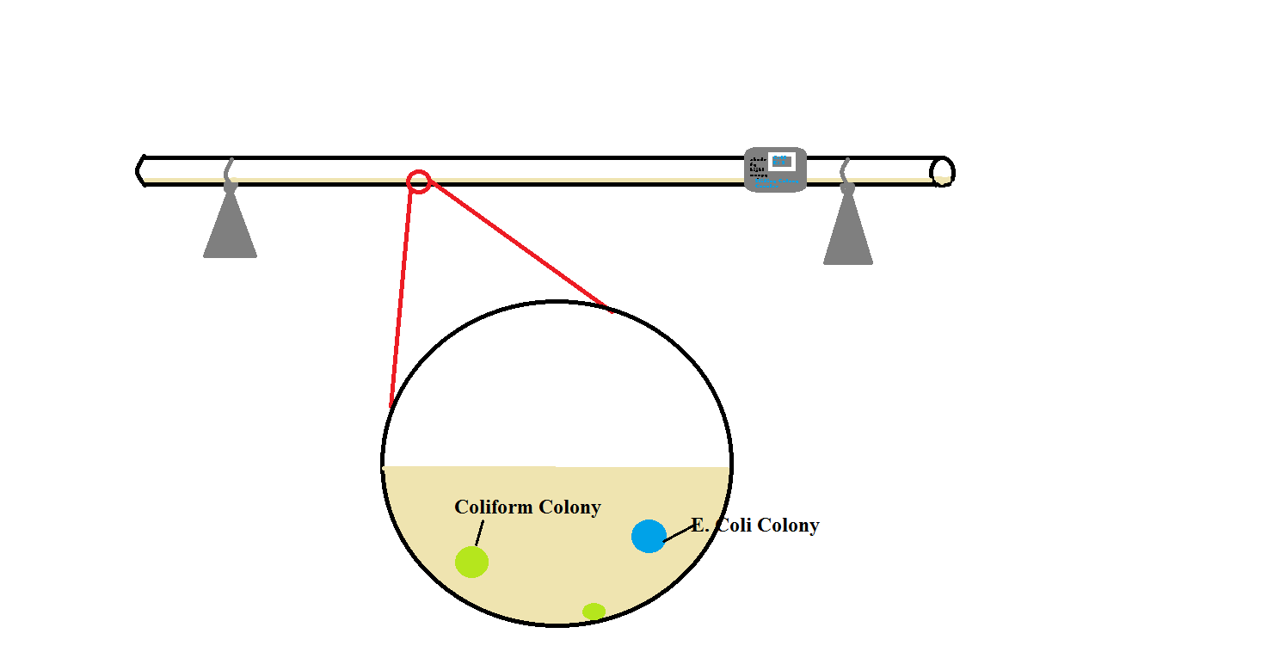
Sliding Colony Counter
Design Goal: tube incubator with sliding colony counting device.
Microbiological Water Safety Monitoring| Research | Final Presentation Spring 2016
Notes:
This is the rough design of the sliding colony counter. The tube would have thickened Colitag media and the coliform colonies would turn bright green and the E. Coli colonies would turn blue under UV light. The sliding colony counter, which works by counting individual bacterial colonies, would start on one side of the tube and slowly slide down the tube to count how many of each colony are present throughout the tube.
The issue is, however, that the swimming speed of E-coli is too fast for this method to work without increasing the viscosity of the media.

Slide 5
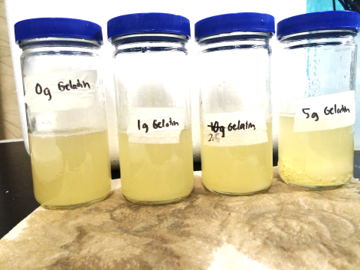
Methods
Used water sample from creek
Created LB Broth
Heated up samples
Mixed with gelatin
Incubated
Microbiological Water Safety Monitoring| Research | Final Presentation Spring 2016
Notes:
The image displayed is from the the first iteration, after 48 hours of incubation. The 1 g gelatin sample had a thick layer of gelatin on the bottom and it seemed that the gelatin was holding the colonies at the bottom. The 2.5 g gelatin sample had a ball of gelatin at the bottom of the bottle. The ball of gelatin had many air bubbles and the turbidity of the sample around the gelatin seemed to indicate the presence of many but indistinguishable colonies. The 5 g gelatin sample had a layer 1.25 cm thick of gelatin on the bottom with many air bubbles. The entire surface seemed to have colonies growing.
The initial procedure was done by melting gelatin and placing this gelatin into media. However, to ensure that the mixtures of media and gelatin were uniform, the samples were heated up to about 35 degrees C and then mixed with gelatin.
See appendix for more images of the 1st and 2nd iterations.

Slide 6
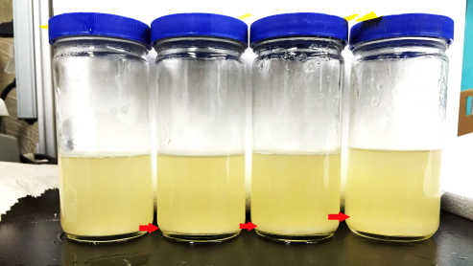
Difference in gelatin concentration correlated to difference in bacterial retention
0g Gelatin
1g Gelatin
2.5g Gelatin
5g Gelatin
Greater gelatin concentrations tended to yield thicker layers on the bottom of the jars.
Microbiological Water Safety Monitoring| Research | Final Presentation Spring 2016
Notes:
The image displayed is from the The control has almost no bacterial layers on the bottom. 1g has a thin layer of bacteria on the bottom held down by the small amount of gelatin and some growth on the walls. the 2.5g jar has a slightly thicker layer. The 5g jar has the most significant amount of gelatin+bacteria. There does not really seem to movement or resuspension of the bacteria when the jar is moved whereas the 1g and 2.5g jars show some resuspension.
As one can see, however, only the bottom of the jars are thickened media. The media itself is still liquid, and the majority of colony forming units are at the bottom of the jar where the gelatin is holding bacteria down. This led to our new procedure of testing what concentration of gelatin was required to thicken media in its entirety.

Slide 7
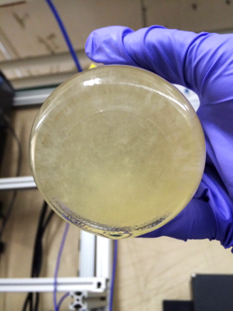
Isolation of colony forming units only occurred in 5g gelatin
Control and 1g Gelatin were similar
2.5g gelatin: thicker layer but no isolation
CFUs-colony forming units
Microbiological Water Safety Monitoring| Research | Final Presentation Spring 2016
Notes:
The bottom of the 5g jar has distinguishable CFUs as some are circled in red.These kinds of colonies could not be observed in the other samples.

Slide 8
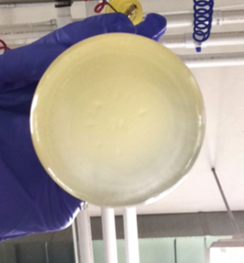
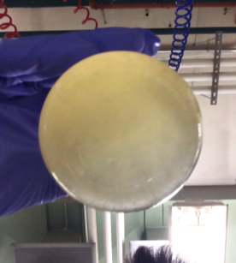
Isolation of colony forming units only occurred in 5g gelatin
1g Gelatin
2.5g Gelatin
Compared to the 5g gelatin jars, the 1g and 2.5g gelatin samples only formed layers of bacteria rather than colonies.
Microbiological Water Safety Monitoring| Research | Final Presentation Spring 2016
Notes:
As one could see here, the 1g and 2.5g jars only have an overall turbid layer rather than separate colonies compared to the 5g bottle from the previous slide.

Slide 9
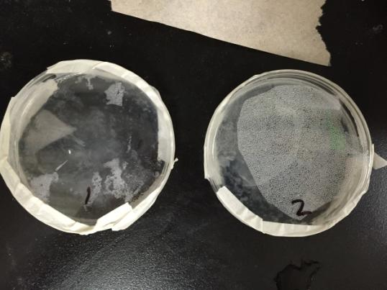
Implementation of the pour plate method
Thinner spread, more area
Less sample water
Greater ratio of gelatin to sample
Bacterial films formed
Microbiological Water Safety Monitoring| Research | Final Presentation Spring 2016
Notes:
The pour plate method allows for the plating of liquid samples with colonies growing within the gelatinous media. Since the 15 ml of tap water was the only liquid heated, the 1 ml sample containing E. Coli was not heated, thus lowered the chances of microbial death. Once the 1 g of gelatin was melted in the 15 ml of water, the 1 ml sample was poured onto the plate, followed by the melted gelatin. Following this swift step, the lid of the petri dish was placed back on the dish and was gently swirled clockwise and counterclockwise before the gelatin hardened. The petri dishes were sealed with tape around the perimeter to ensure minimal contamination. Both the petri dishes and jars were incubated for 24 hours and 48 hours.
The bacterial films were not exactly the kind of colonie we were expecting, it is most likely due to a lack of gelatin.

Slide 10
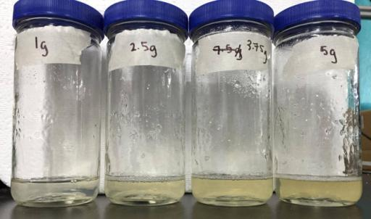
Exclusively gelatin experimentation
More gelatin→ Darker media
Microbiological Water Safety Monitoring| Research | Final Presentation Spring 2016
Notes:
Since the previous iterations seemed to be testing too many factors at the same time the team decided to take a step back and test only the gelatin concentrations to determine the minimum gelatin concentration required to form the desired thickness. The lowest concentration used (1g/15ml) was enough to provide the thickness desired. The higher concentrations darkened the liquid, which could disturb the ability
This experiment was done by mixing different gelatin concentrations with only water. This deviated from our previous methods. The results indicated that a lower concentration of gelatin was enough to thicken liquid. However, the next iteration involved testing gelatin with media to ensure consistency and making sure that media was not affected by gelatin differently than water.

Slide 11
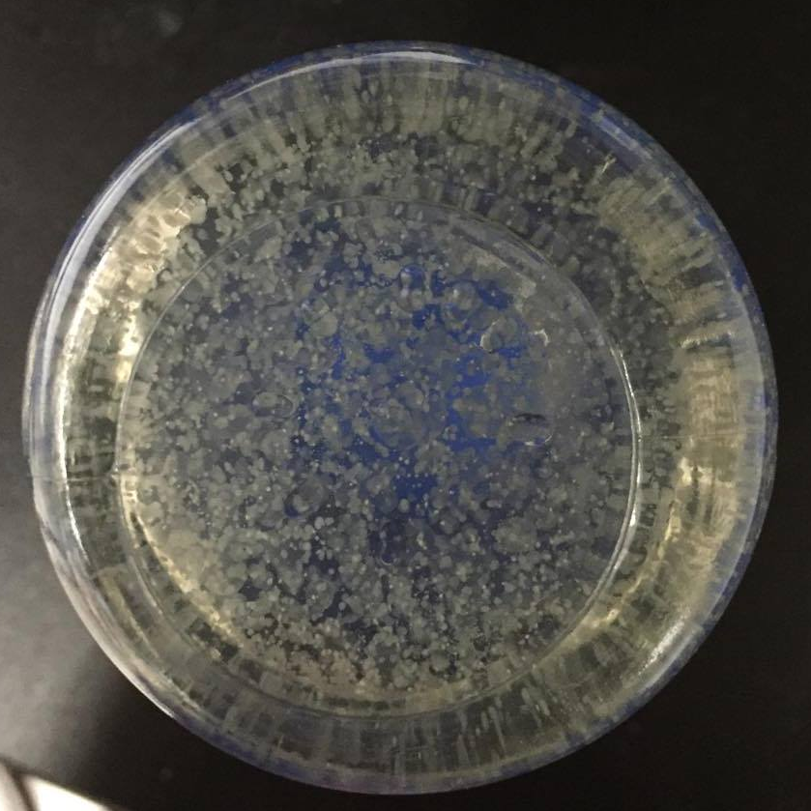
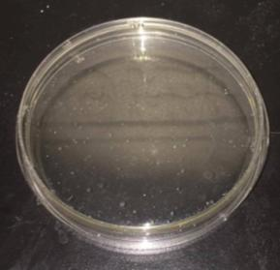
Combination of gelatin and media in both jars and plates
Used minimum required gelatin concentration found from previous experimentation with LB media instead of water
Microbiological Water Safety Monitoring| Research | Final Presentation Spring 2016
Notes:
The results of this iteration were highly informative. Both jars and the petri dish had solid media, which indicated that the gelatin worked regardless of whether being mixed with water or media. Both 1 g and 2.5 g of gelatin thickened 20 ml of media. The 1 g of gelatin also thickened the media in the petri dish. One result that was not expected was the growth of bacterial colonies. As shown in Figure 1, there are many white dots on the bottom of the jar. These dots represent colony forming units, (CFUs), and where easy to distinguish from one another. Therefore, in 20 ml of media that used tap water instead of contaminated water, 1 g of gelatin was able to isolate bacterial colonies. The 2.5 g of gelatin also thickened the media, and created, and as shown in Figure 2, a darker color than the 1 g of gelatin. Only a few bacterial colonies grew in this thickened media. A few bacterial colonies grew in the petri dish. However, these colonies were unexpected since the water used for this experiment were thought to have been sterile. The colonies could very well have been due to contamination of the water or the equipment used. Another iteration could be done in the future to determine the true cause.
One question we will look into for next semester is whether tap water was contaminated to the degree that bacterial colonies were able to grow once incubated, or whether the equipment used was contaminated: This could have contributed to bacterial growth.
See appendix for more images from the 6th iteration.

Slide 12
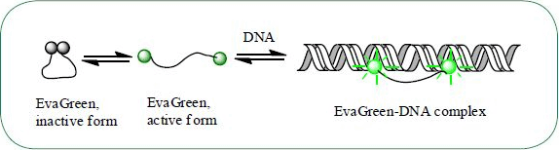
Future Work
Color indication integration
Investigate contamination
Differing container shapes
An indicator will aid in identifying colony forming units
Microbiological Water Safety Monitoring| Research | Final Presentation Spring 2016
Notes:
http://www.komabiotech.co.kr/www/product/productdesc.phtml?seq=123
The diagram shows EvaGreen dye binding to DNA and fluoresces, thereby identifying bacterial colonies.
The future goal of the sliding colony counter will involve mixing an indicator with the media, which will make the task of identifying CFUs easier.

Slide 13
Questions
and
Recommendations
Jacqueline Dokko
Biological Engineering
jmd475@cornell.edu
Janak Shah
Chemical Engineering
jhs373@cornell.edu
Microbiological Water Safety Monitoring| Research | Final Presentation Spring 2016

Slide 14
Appendix
Slides
Microbiological Water Safety Monitoring| Research | Final Presentation Spring 2016

Slide 15
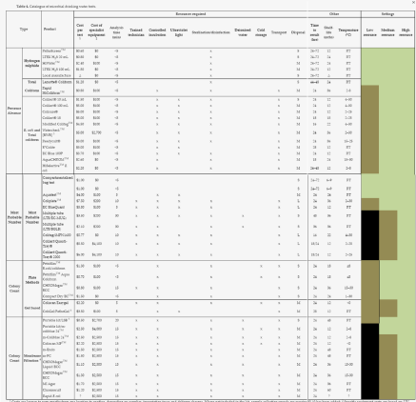
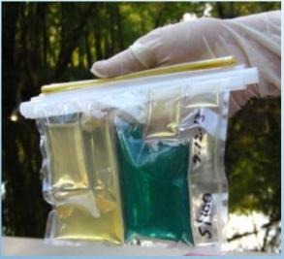
Literature Review
A chart of all of the different types of detection.
The compartmentalized bag test.
Microbiological Water Safety Monitoring| Research | Final Presentation Spring 2016
Notes:
Though the chart is difficult to see, it is a compilation of all of the methods along with their characteristics. The very right color coded section shows which ones can be used in low resource settings, as one can see there are few that fit that category. The compartmentalized bag test

Slide 16
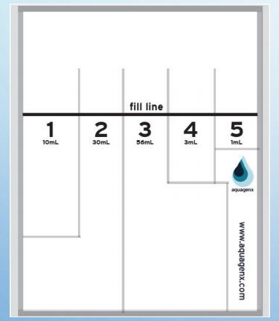
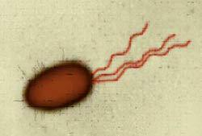
Literature Review
Microbiological Water Safety Monitoring| Research | Final Presentation Spring 2016
Notes:
https://waterinstitute.unc.edu/files/2015/06/-Water-Microbiology-Conference-2015.pdf
The image shows the different compartments in the compartmentalized bag test. The different compartments contain different volumes of sample to be placed in. The image on the right shows E-coli propelling itself by using flagella, or the tail-like structures at its rear. These contribute to the high swimming speed of E-coli.

Slide 17
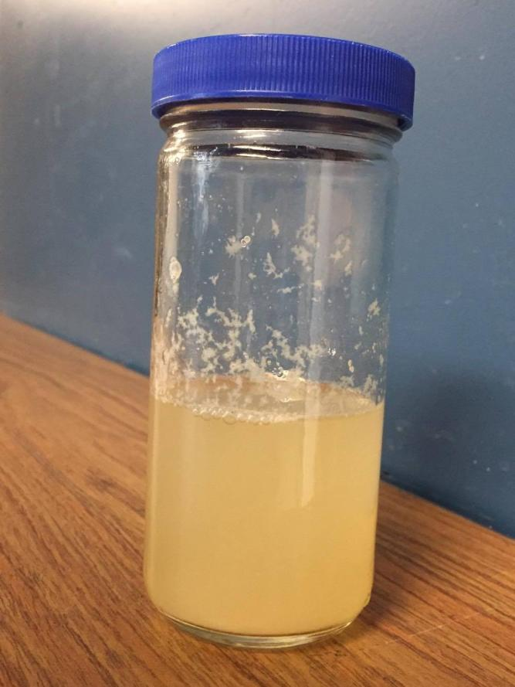
First Iteration
1g Gelatin
Microbiological Water Safety Monitoring| Research | Final Presentation Spring 2016
Notes:
Observe the bacterial growth on the walls. Possibly due to the method of mixing the gelatin. The gelatin may have stuck to the walls and facilitated bacterial growth on the walls.

Slide 18
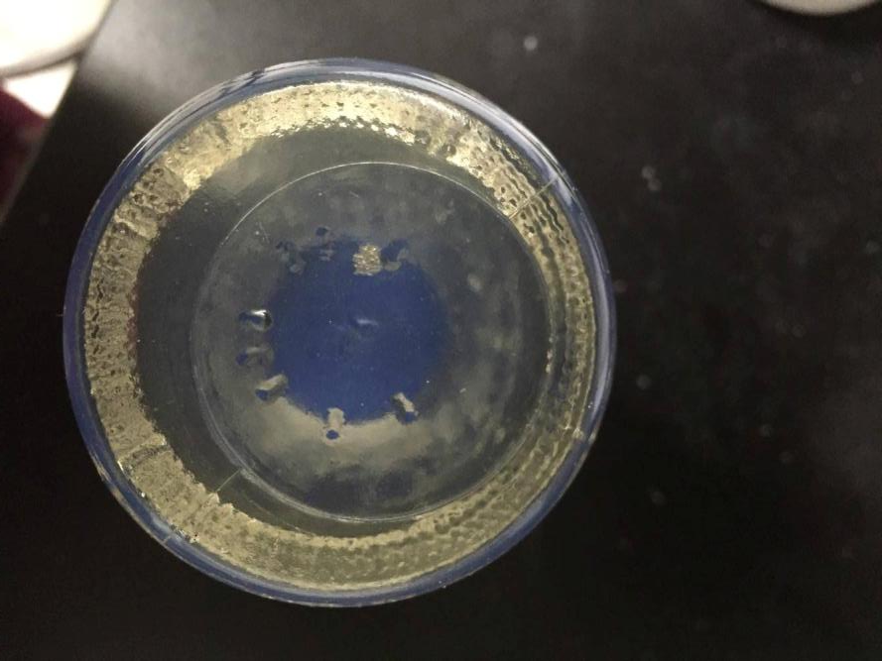
Sixth Iteration
2.5g Gelatin
Microbiological Water Safety Monitoring| Research | Final Presentation Spring 2016
Notes:
The 2.5g bottle had not bacteria even though it contains the same waster as from the 1g bottle. This may be an indication that the 1g bottle may have been contaminated or that the 2.5g concentration of gelatin was too great for the bacteria to be able to grow. Future iterations will hopefully clear this up.

