Slide 1

High Rate Sedimentation Floc Blanket
This semester the HRS- Floc Blanket team built a sedimentation tank with two goals: increasing the upflow velocity and decreasing the plan view area without decreasing the plan view area. Over the course of the semester, different experiments were performed to test the strength of the floc blanket under various conditions.
More information can be found in the HRS-Floc Blanket Spring 2016 report.
Research | Final Presentation Spring 2016
Notes:
The High Rate Sedimentation - Floc blanket team built a sedimentation tank model with the goal of increasing the upflow velocity and decreasing the plan view area, without degrading the performance of the floc blanket inside the tank reactor.Under high-turbidity conditions, a stable floc blanket was maintained under upflow velocities from 1-4 mm/s. Two methods of encouraging floc re-circulation, viz., in-reactor lamella plates and sludge recycling, were tested to observe effects on effluent turbidity. Results indicated that neither method had a strong enough effect to fully recommend increased upflow velocity, but future testing in improved apparatus with low turbidity influent has potential.
The report for spring 2016 can be found here - https://www.overleaf.com/4423329wkxhxp#/13217587/

Slide 2
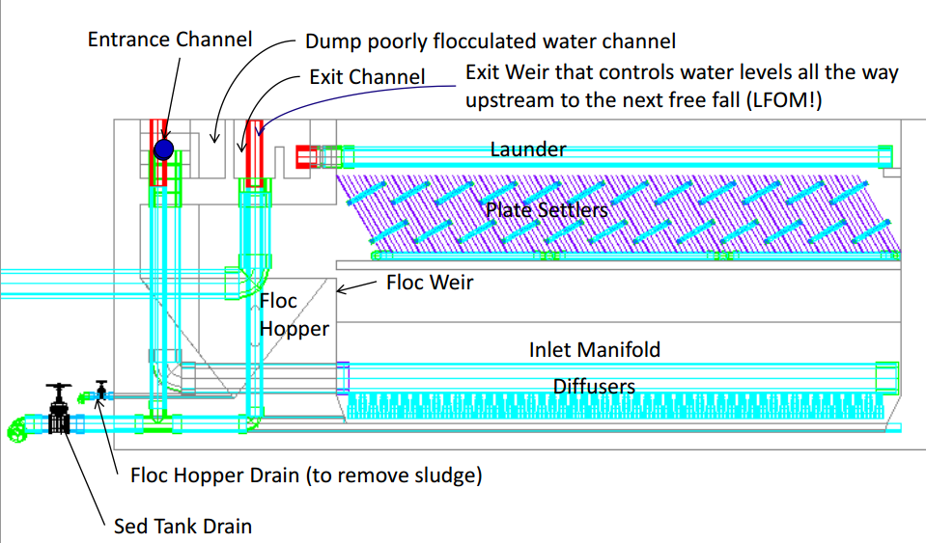
Floc blankets increase efficiency
Sedimentation is the slowest step in the water treatment process
Floc blankets in the current AguaClara sedimentation tanks are primarily stable under 1 mm/s upflow velocity
A stable floc blanket decreases the effluent turbidity of the tank
A higher upflow velocity with a stable, concentrated floc blanket is desired.
HRS1 | Research | Final Presentation Spring 2016

Slide 3

Faster sedimentation saves time and money
A higher upflow velocity will result in a decrease in plan view area and construction costs and expedite the sedimentation process
Improve upon the work that was done by the High Rate Sedimentation Team last semester
Further research efforts in providing more people with clean drinking water!
HRS1 | Research | Final Presentation Spring 2016

Slide 4
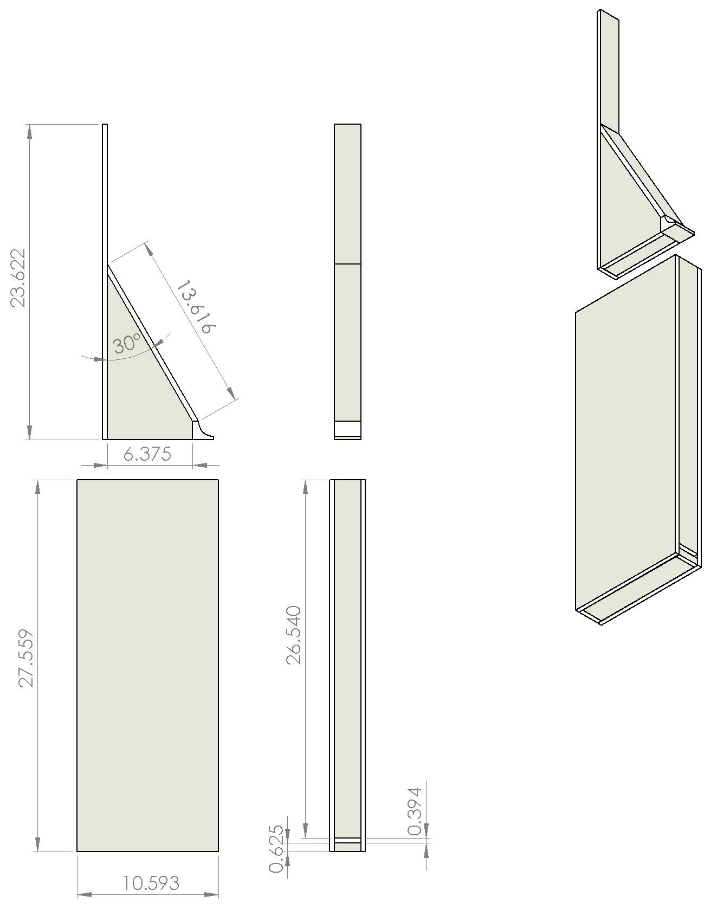
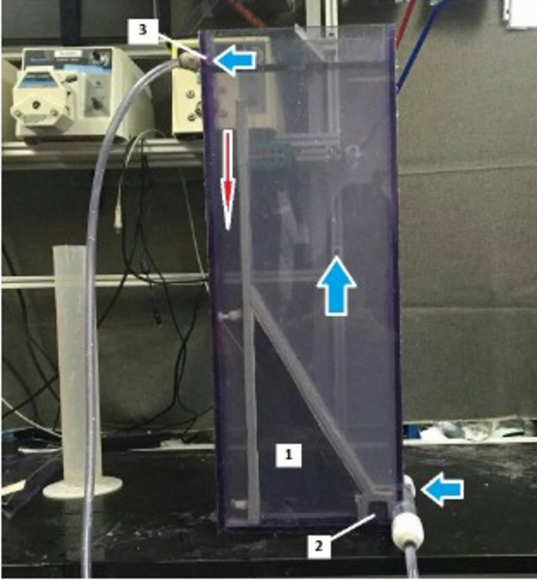
We constructed a bench scale model
Tank with the insert (1) and jet reverser (2) and outlet (3).
Blue arrows show water entering, rising through the tank and exiting, the red arrow points into the sludge hopper where flocs will fall and consolidate.
This design is an improvement upon the work done last semester. It is a bench scale model that is a fairly accurate representation of the current AguaClara sedimentation tank model
HRS1 | Research | Final Presentation Spring 2016
Notes:
The figure on the left is the SolidWorks visual representation of the assembly of the sedimentation tank with the insert. Side and front views of tank (below) and insert (above) are depicted. The tank consists of a thin rectangle of PVC with a small slit in the bottom front to allow for influent water. The insert consists of a jet reverser attached to a sloped reactor bottom and a floc weir to separate the reactor area from the sludge hopper. The insert is lowered into the tank and experimental modules lowered in on top of the insert (modules not shown). The figure on the right shows the constructed sedimentation tank. The arrows show the flow of the water through the tank.

Slide 5
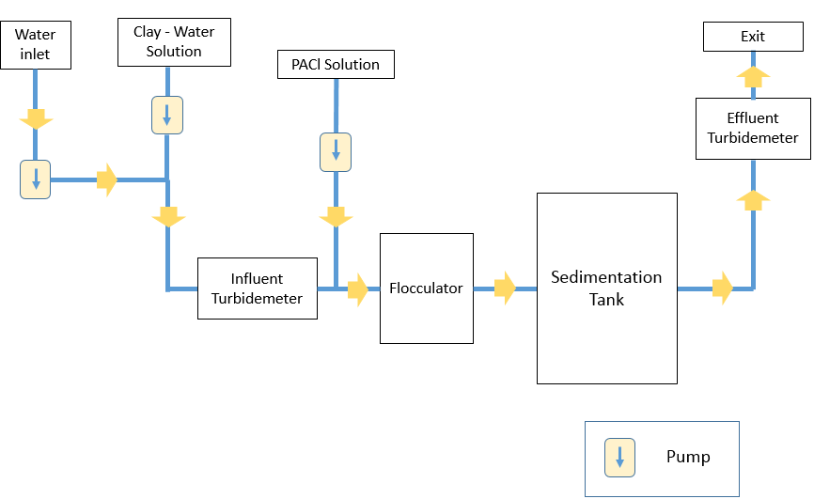
HRS1 | Research | Final Presentation Spring 2016
Notes:
Schematic of experimental apparatus.
Water entered the system through the water inlet. Next, water passed through the influent turbidimeter after mixing with the clay water solution. Then the coagulant was added to the clay-water solution. After that the water passed through the flocculator. Post flocculation water entered the sedimentation tank. From the outlet of the sedimentation tank the water passed through the effluent turbidimeter and then exited the system.

Slide 6
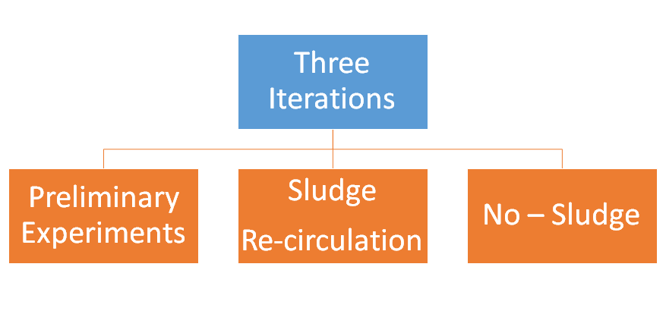
HRS1 | Research | Final Presentation Spring 2016
Notes:
The figure shows the iterations HRS 1 carried out.
The first iteration was preliminary experiments to test the tank and its compatibility with the flocculator.
In the second iteration we carried out the experiments to study the floc blanket concentration. In these experiments we added sludge to the flocculator to build the floc blanket faster.
The third iteration was carried out to study the significance of sludge recirculation in our experiments. In this iteration we duplicated the experiments from 2nd iteration without any sludge recirculation.

Slide 7
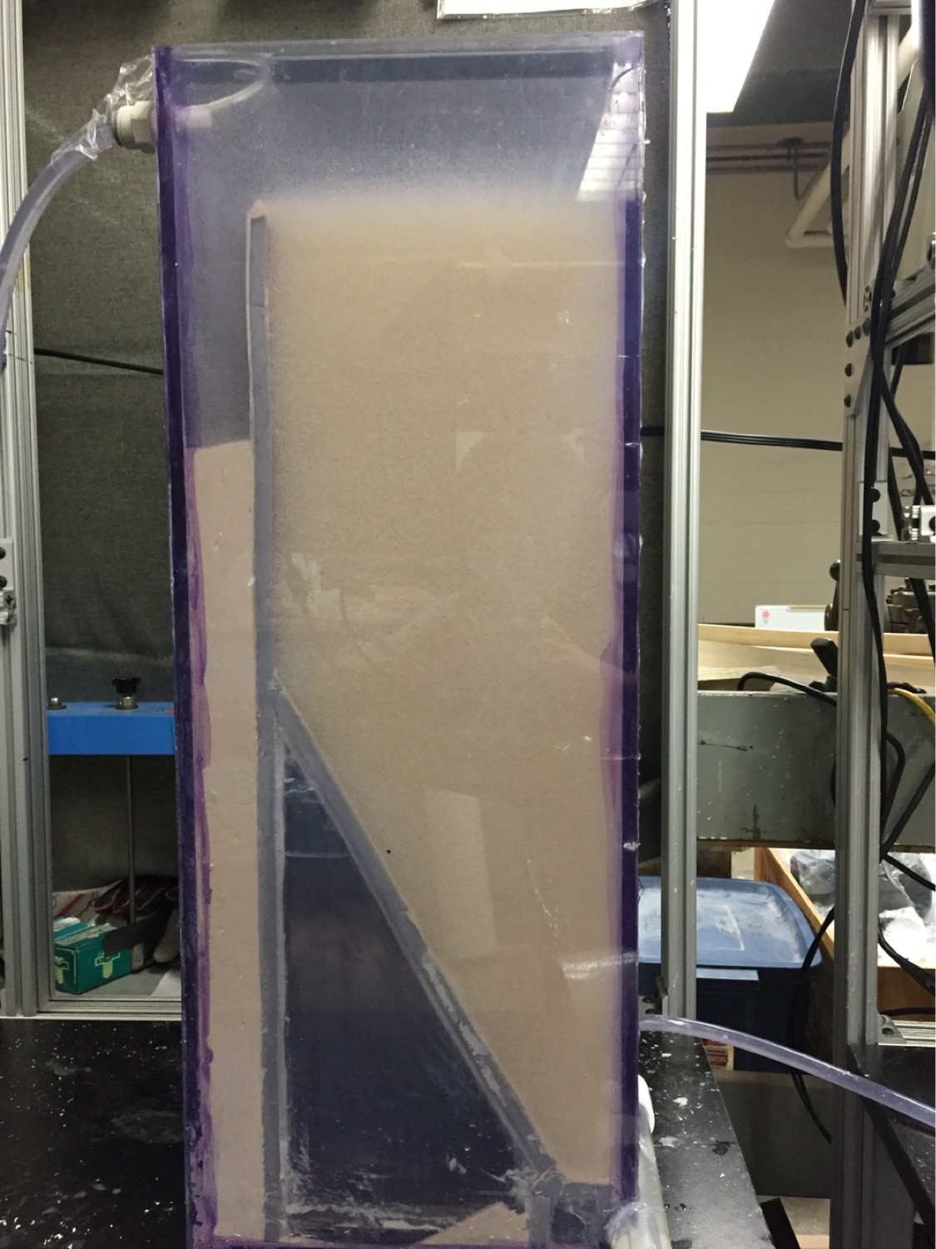
In-blanket settlers changed floc blanket behavior
HRS1 | Research | Final Presentation Spring 2016
Notes:
Sedimentation tank with no plate settlers at 2mm/s.
Sedimentation tank with plate settlers in the bottom at 3mm/s.
Sedimentation tank with plate settlers in the top at 3mm/s.
Red circle is from where we took our samples.
For experimental conditions refer appendix slide A.

Slide 8
Sludge Re-Circulation
https://drive.google.com/file/d/0BxBRJ1mr_EDUNTdORk1iR3Bjb2c/view?usp=drivesdk
HRS1 | Research | Final Presentation Spring 2016

Slide 9
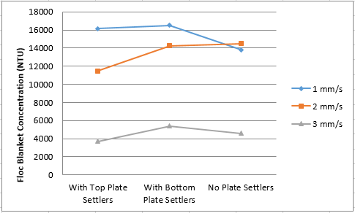
Bottom settlers can marginally increase floc blanket concentration
HRS1 | Research | Final Presentation Spring 2016
Notes:
Across all of the experiments the floc blanket concentration was the most dense with plate settlers at the bottom of the tank. There was a visible decrease in floc blanket concentration when plate settlers were removed from the sedimentation tank. Plate settlers decrease the upflow velocity by adding a horizontal component. As a result, more flocs are able to settle thus increasing the concentration of the floc blanket. There is a general downwards trend mirroring plate settlers were in the tank versus when they were removed.

Slide 10
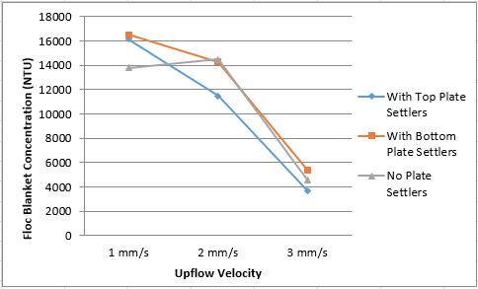
Floc blankets thin as upflow velocity increases
HRS1 | Research | Final Presentation Spring 2016
Notes:
The floc blanket concentration decreased as the upflow velocity increased. This was expected; the ability of flocs to settle down to strengthen the floc blanket is greatly inhibited by a higher upflow velocity.

Slide 11
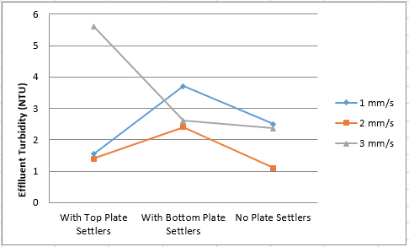
Bottom settlers provided worst performance
HRS1 | Research | Final Presentation Spring 2016

Slide 12
In-blanket settlers changed floc blanket behavior
HRS1 | Research | Final Presentation Spring 2016
Notes:
Sedimentation tank with no plate settlers at 2mm/s.
Sedimentation tank with plate settlers in the bottom at 3mm/s.
Sedimentation tank with plate settlers in the top at 3mm/s.
Red circle is from where we took our samples.
For experimental conditions refer appendix slide A.

Slide 13
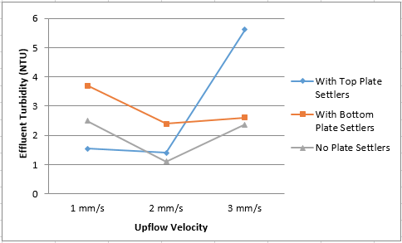
Higher upflow velocity decreases efficiency
HRS1 | Research | Final Presentation Spring 2016
Notes:
Generally, effluent turbidity increased at high upflow velocities (3 mm/s) regardless of the presence or absence of plate settlers in the sedimentation tank. This increase was expected because at higher upflow velocities flocs do not have adequate time to settle out and as a result they are likely to wash out in the effluent. The effluent turbidity was the lowest at a 2 mm/s upflow velocity with and without plate settlers. It is not exactly clear why this was the result.

Slide 14
Without
Sludge Re-Circulation
HRS1 | Research | Final Presentation Spring 2016

Slide 15
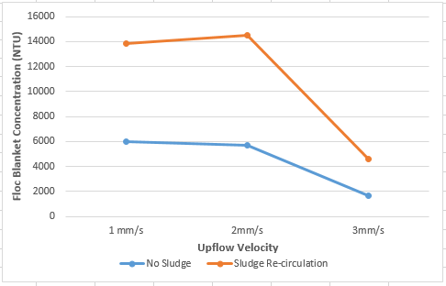
Floc Blankets thinned without sludge re-circulation
Without plate settlers
HRS1 | Research | Final Presentation Spring 2016

Slide 16
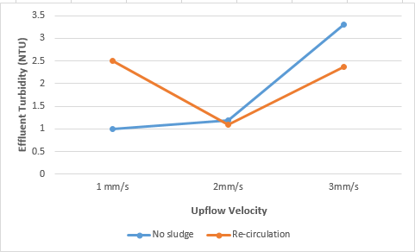
Effluent was similar to results with sludge re-circulation
Without plate settlers
HRS1 | Research | Final Presentation Spring 2016

Slide 17
Floc Breakup
HRS1 | Research | Final Presentation Spring 2016

Slide 18
4mm/s results were dependent on floc breakup
20
5.5
2.8
NTU
HRS1 | Research | Final Presentation Spring 2016
Notes:
When the new, larger inlet was installed, the effluent turbidity dramatically increased at high upflow velocities.

Slide 19
Conclusion
The relationship between effluent turbidity and floc blanket concentration is strong, but cannot be compared across different setups.
Optimum position for plate settlers at the top of the tank is unclear
Floc size is important for high rate sedimentation
HRS1 | Research | Final Presentation Spring 2016

Slide 20
Future Work
Tolerance to dissolved organic materials
Low turbidity test with tube settlers
Further investigation for super dense floc blanket generation
HRS1 | Research | Final Presentation Spring 2016

Slide 21
Questions
and
Recommendations
Oge Anyene
Chemical Engineering
ova3@cornell.edu
Vanessa Ziwei Qi
Chemical Engineering
zq33@cornell.edu
Isha Chaknalwar
Environmental Engineering
iac34@cornell.edu
Josiah Hinterberger
Civil Engineering
jh2462@cornell.edu
HRS1 | Research | Final Presentation Spring 2016

Slide 22
Appendix
Slides
HRS1 | Research | Final Presentation Spring 2016
Notes:
From this point on, add any slides with figures that will help support your thesis. You might pull these figures from your Final Report.

Slide 23
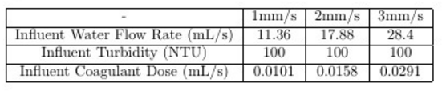
Experimental Conditions for Iteration 2:
HRS1 | Research | Final Presentation Spring 2016
Notes:
Appendix A

