Slide 1

Regional Planning
Analyze the feasibility and need for AguaClara plant in India by gathering data on India’s water sources, demographics, geography and economics. Created optimization algorithm on MATLAB to visually display variables in a color-coded map.
More information on - https://www.overleaf.com/4566736tqvggd#/13757353/
Regional Planning |Administration | Final Presentation Spring 2016
Notes:
[[Insert your abstract here.]]
The scope of the semester was to analyze the feasibility and need for an AguaClara plant in India. The team decided to focus on India as a country of potential implementation as India already has AguaClara LLC workers on the ground building connections. The team approached the analysis through large-scale research, gathering data on India's water sources, demographics, geography, and economy. There are ten ideal characteristics that would suggest a potential site. The team conducted research on India to determine locations with these characteristics. The team also created an optimization model using Matlab to visually display the deliverable in the form of a color-coded map.
[[Add a link to your full report here. ]]
https://www.overleaf.com/read/zzvvmnwndqbh

Slide 2
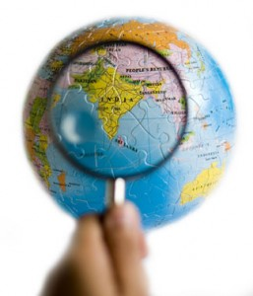
This is the framework of the semester.
Location: India
  Tata-Cornell Initiative
Site Selection Criteria
States -> Districts -> Subdistricts -> Towns
Regional Planning |Administration | Final Presentation Spring 2016
Notes:
Caption: Focus on India
This slide is to explain why we chose India in the first place.
Cornell currently has a partnership with the Tata group called the Tata-Cornell Initiative. Cornell’s role in this partnership is to help improve India’s quality of life we could help. Also AguaClara LLC already has people on the ground in India so we could help them theoretically by doing research and they are currently establishing connections with local partners so we could correlate our findings with the partnerships they have made. For all these reasons we thought that it made sense to choose India as the country to focus our site selection on.
Research paper(Karim Beers, Kenichi Victor, Nishikawa Chavez), discussions with Monroe came up with this site selection criteria and the way we are going to tackle this task of finding the ideal place in this huge country is to go from broad to narrow scale. We are going from states to districts to subdistricts and finally to the town level.

Slide 3
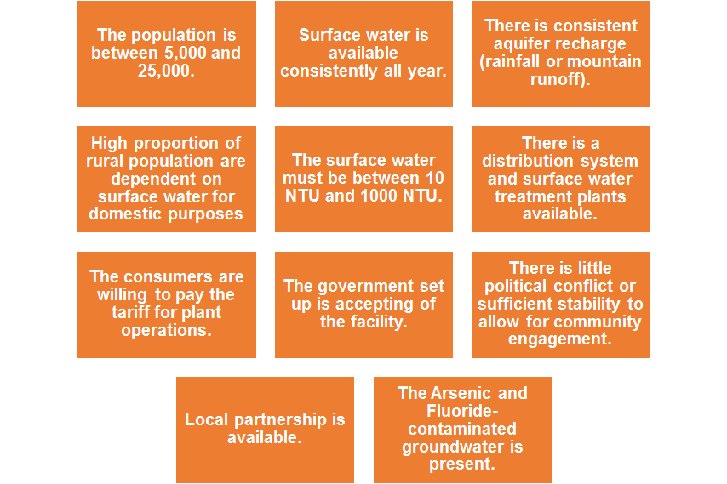
There are 11 ideal site characteristics.
Regional Planning |Administration | Final Presentation Spring 2016
Notes:
The first step to selecting an ideal site is to find and this slide lists the 11 ideal site characteristics that the regional planning team came up with and each will be discussed in further detail in later slides.
The order is not in order is not in the order of significance.
We are only going to look at the criteria for population size when we get down to the district/subdistrict level.
We are focusing on Rural areas as it is harder to implement AguaClara technology in Urban areas because Indian Law is different for Rural areas and Urban areas.
Although NTU is very important it has proved very difficult to find and we aren’t even sure if the data is out there so we had to exclude that from our calculations later on.
Also as of now our team has been able to narrow down the search to the district level and so have yet to do research on the government set up or the political conflict or sufficient stability to allow for community engagement. However, these are definitely a very important factor to consider as a government that is not so accepting will provide many difficulties and the success of the water treatment facility depends on the community’s trust and engagement.

Slide 4
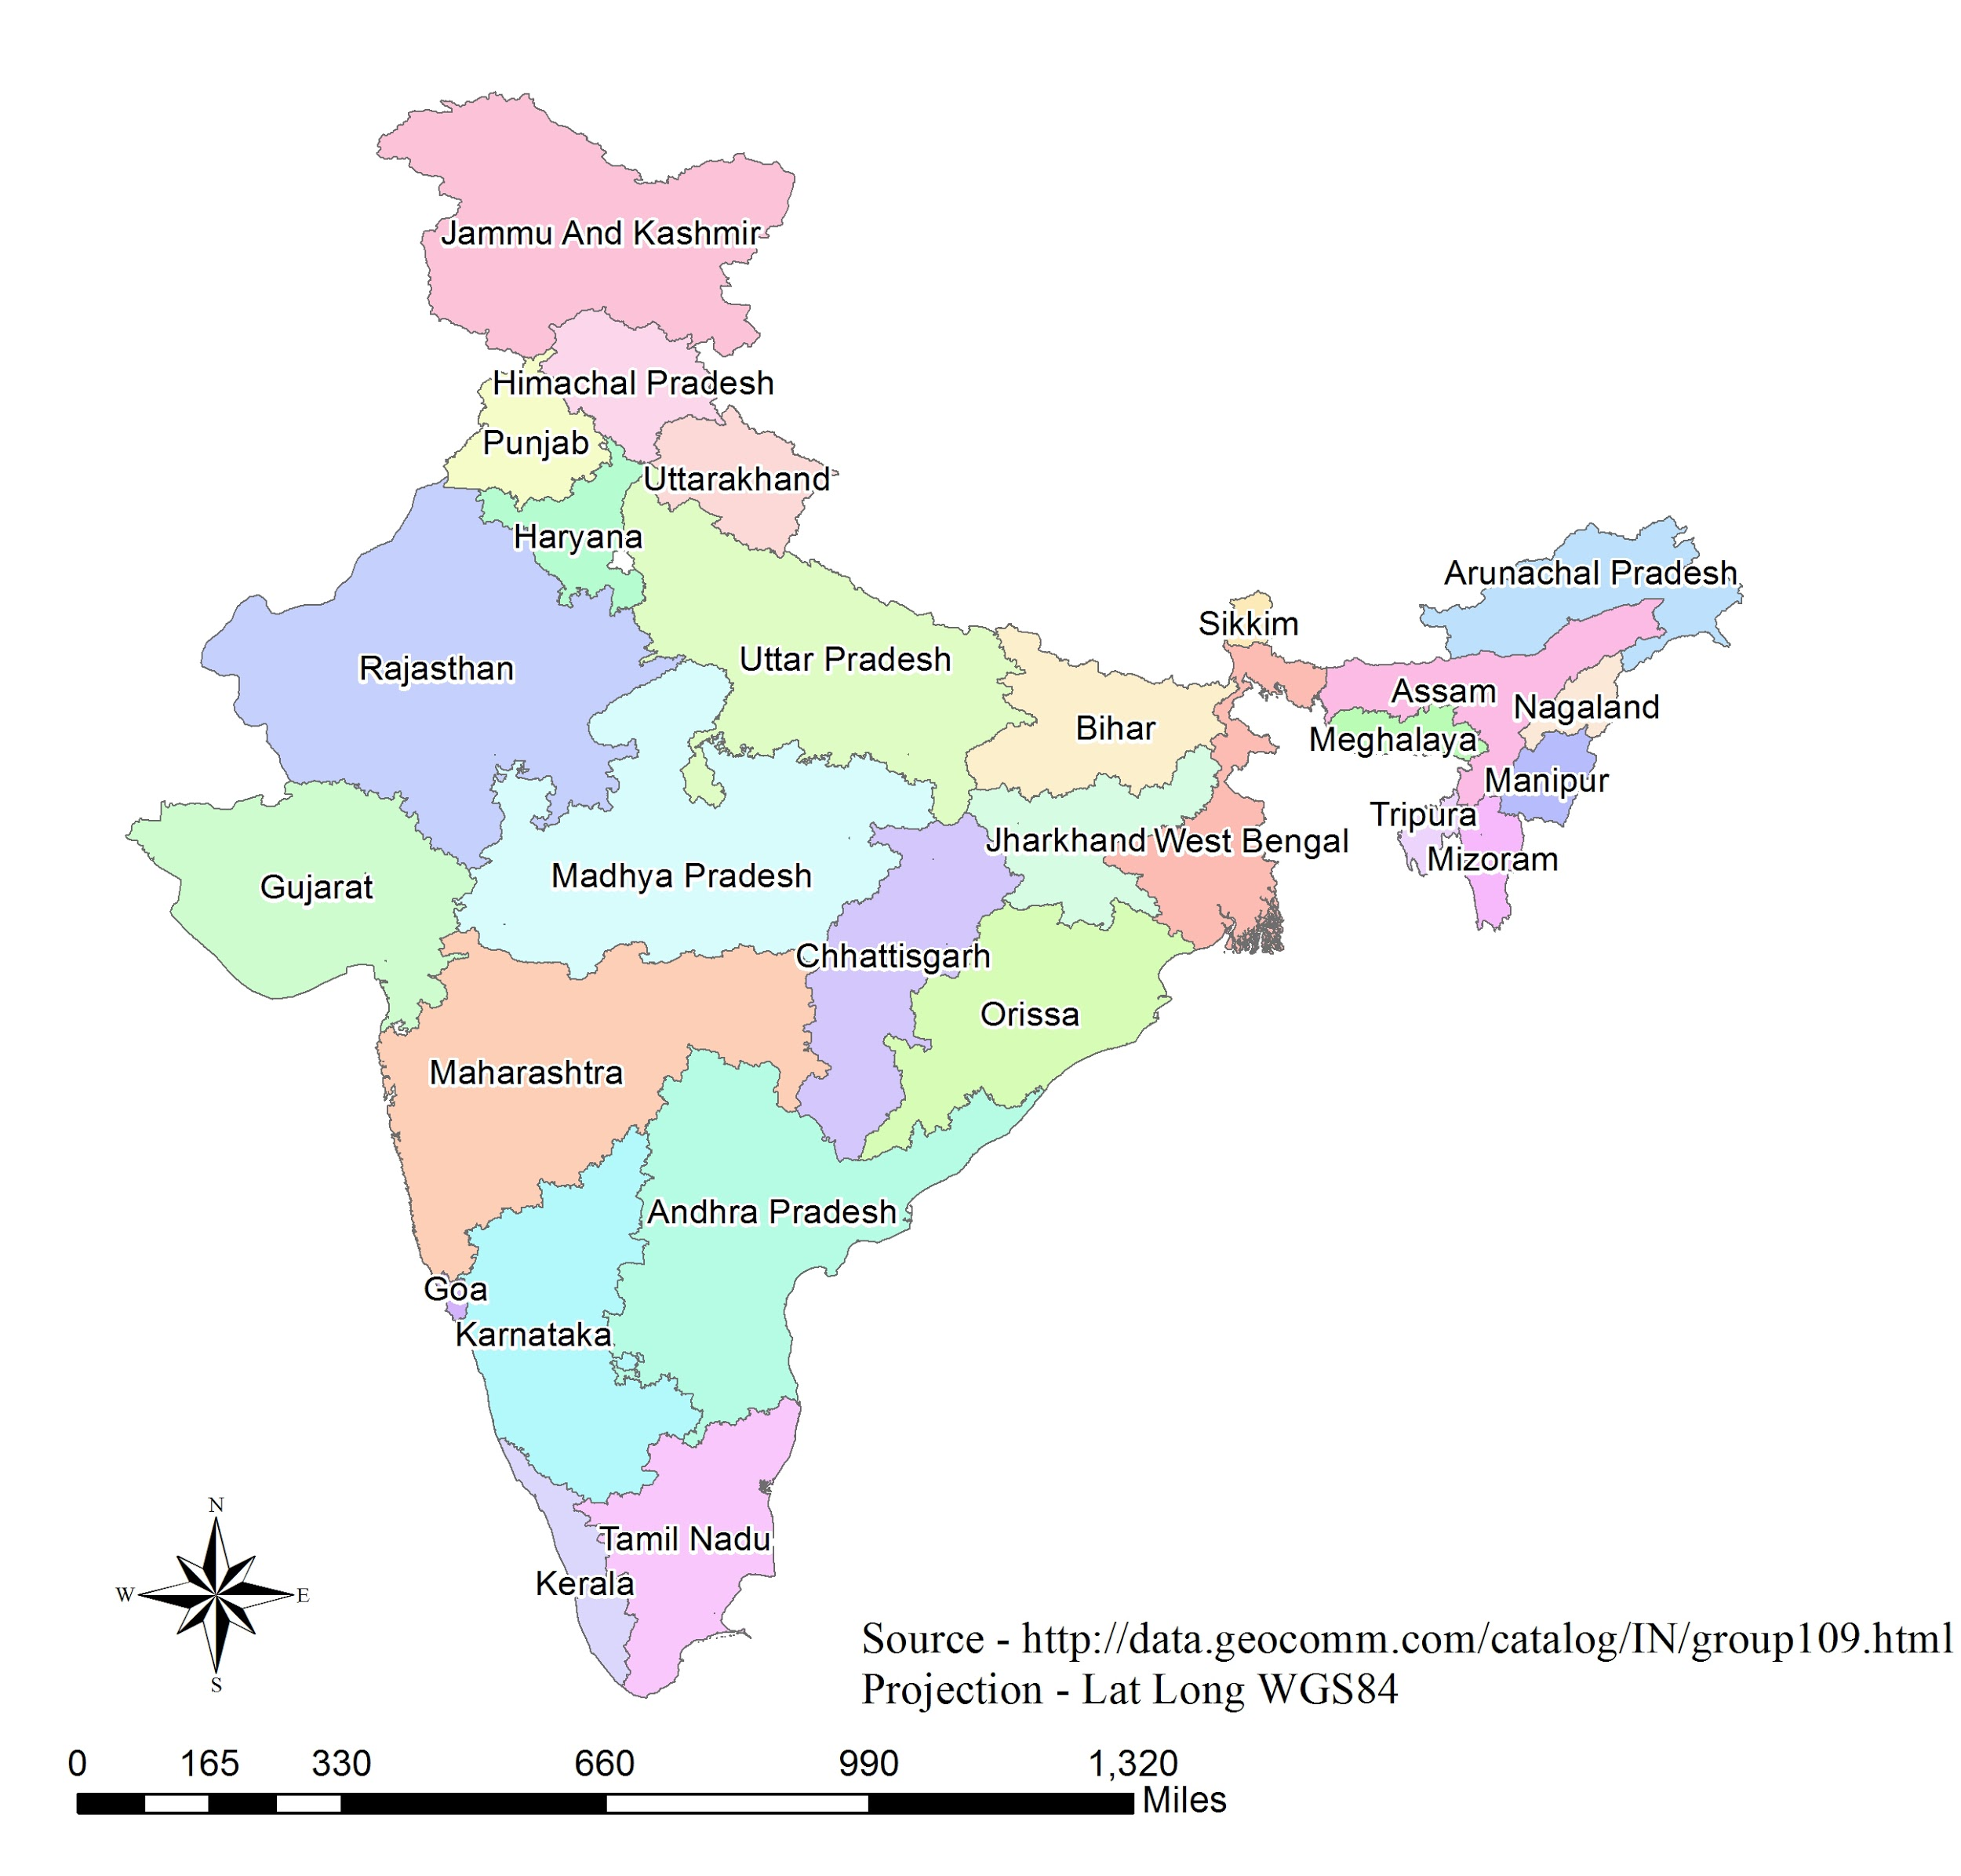
Preliminary analysis was done at the state level
India consists of 29 states, and 7 Union Territories (not considered)
Within those states, there are 688 districts and over 600,000 villages
The goal of the Planning team is to choose a village, starting from the state level.
Regional Planning |Administration | Final Presentation Spring 2016
Notes:
source; http://data.geocomm.com/catalog/IN/group109.html
The image is of the Administrative boundaries of India.
This slide is to introduce the fact that preliminary analysis was done at the State level and to show how the states look like (familiarize with how India looks).
The reasons why we excluded the 7 Union Territories:
Ruled by Central government and have different government set up.
Have mainly urban and we are focusing in Rural.

Slide 5
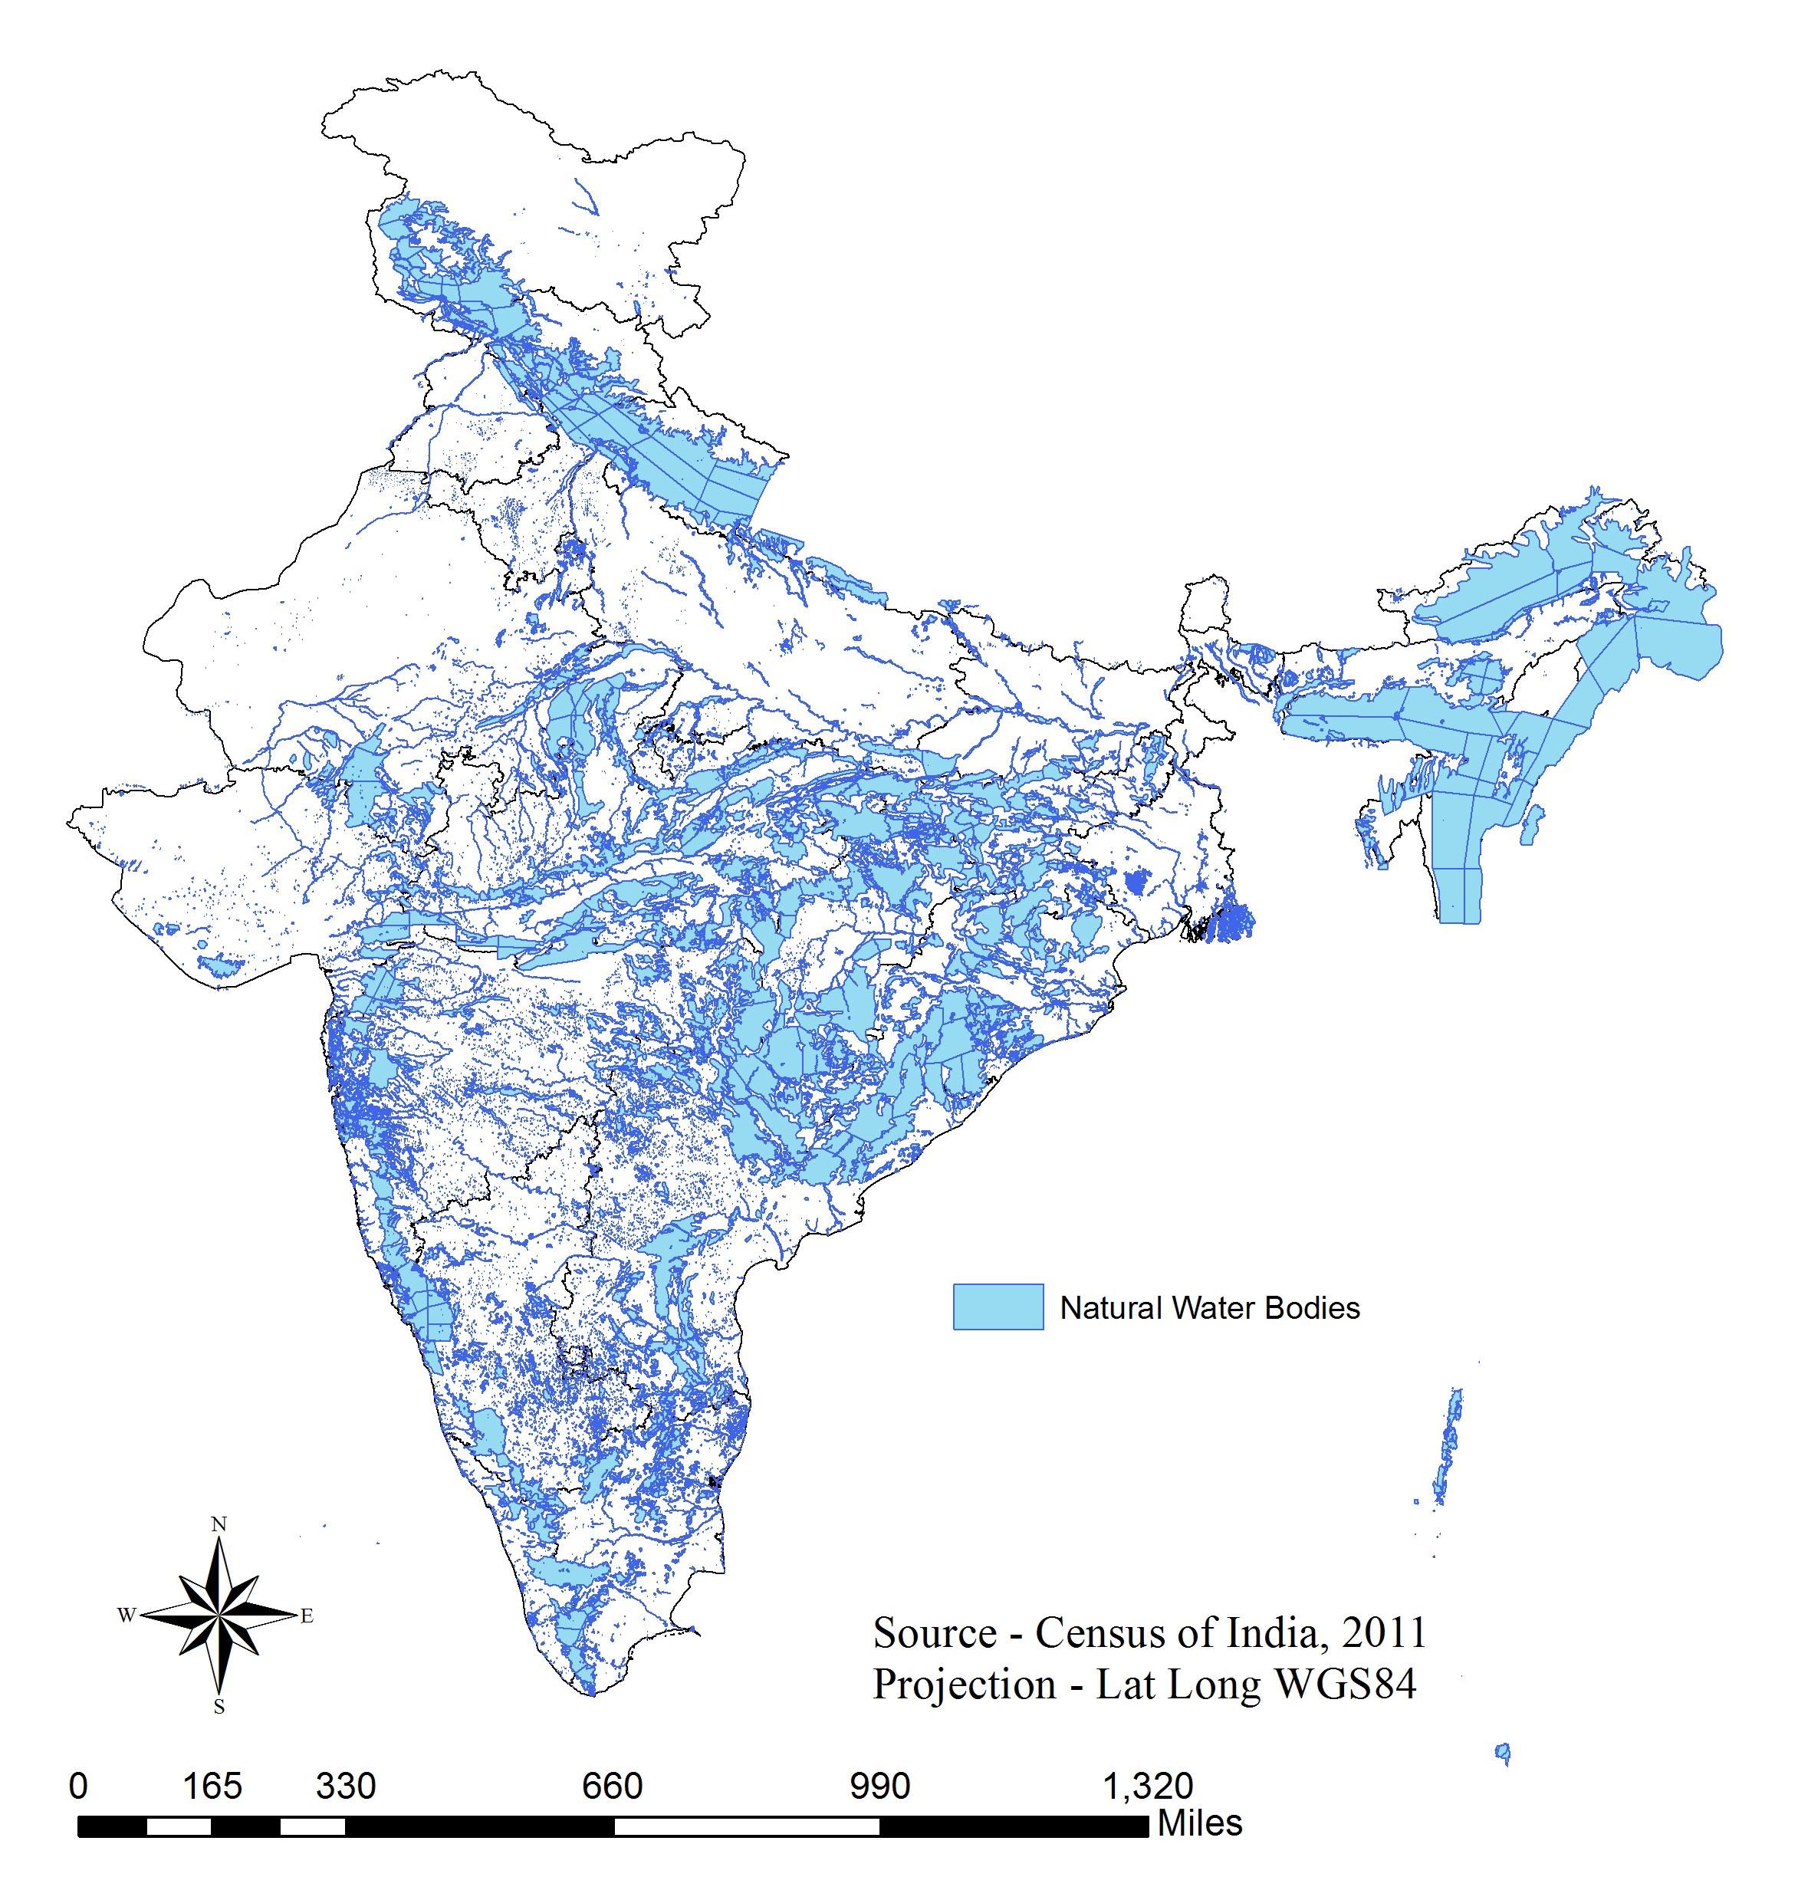
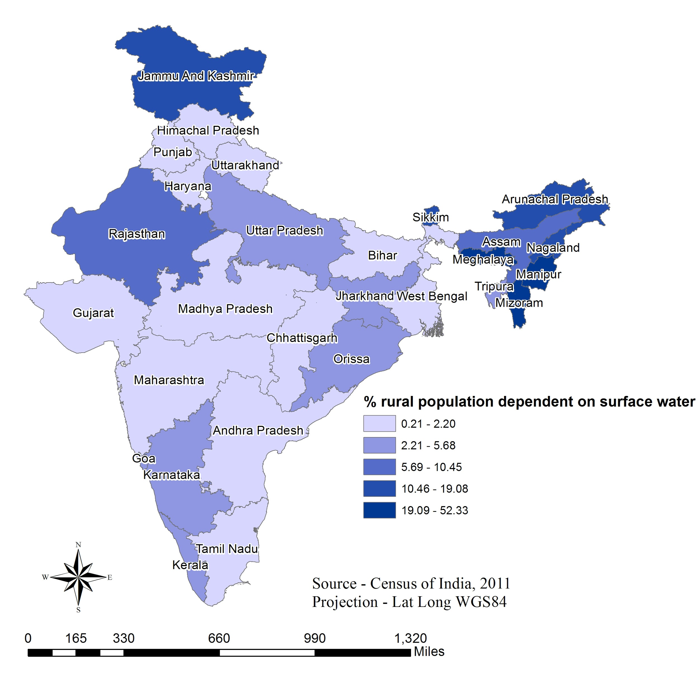
Availability of water correlates with
population dependence on surface water
Surface water availability is highly correlated with % of rural population dependent on surface water for drinking purposes.
Regional Planning |Administration | Final Presentation Spring 2016
Notes:
Up to here is Yu Jin’s
The left picture: State-wise distribution of natural water bodies
The right picture: Percentage of Rural Population dependent on surface water for drinking purposes
This is one of the criterias that we looked at to determine the most optimal site.
We found that the surface water availability is highly correlated with % of rural population dependent on surface water for drinking purposes. This is important because this represents the demand for the water treatment facility. If no one uses surface water for drinking purposes there is no need for the AguaClara treatment plant.
This slide shows why we factored in surface water availability into our Matlab code.

Slide 6
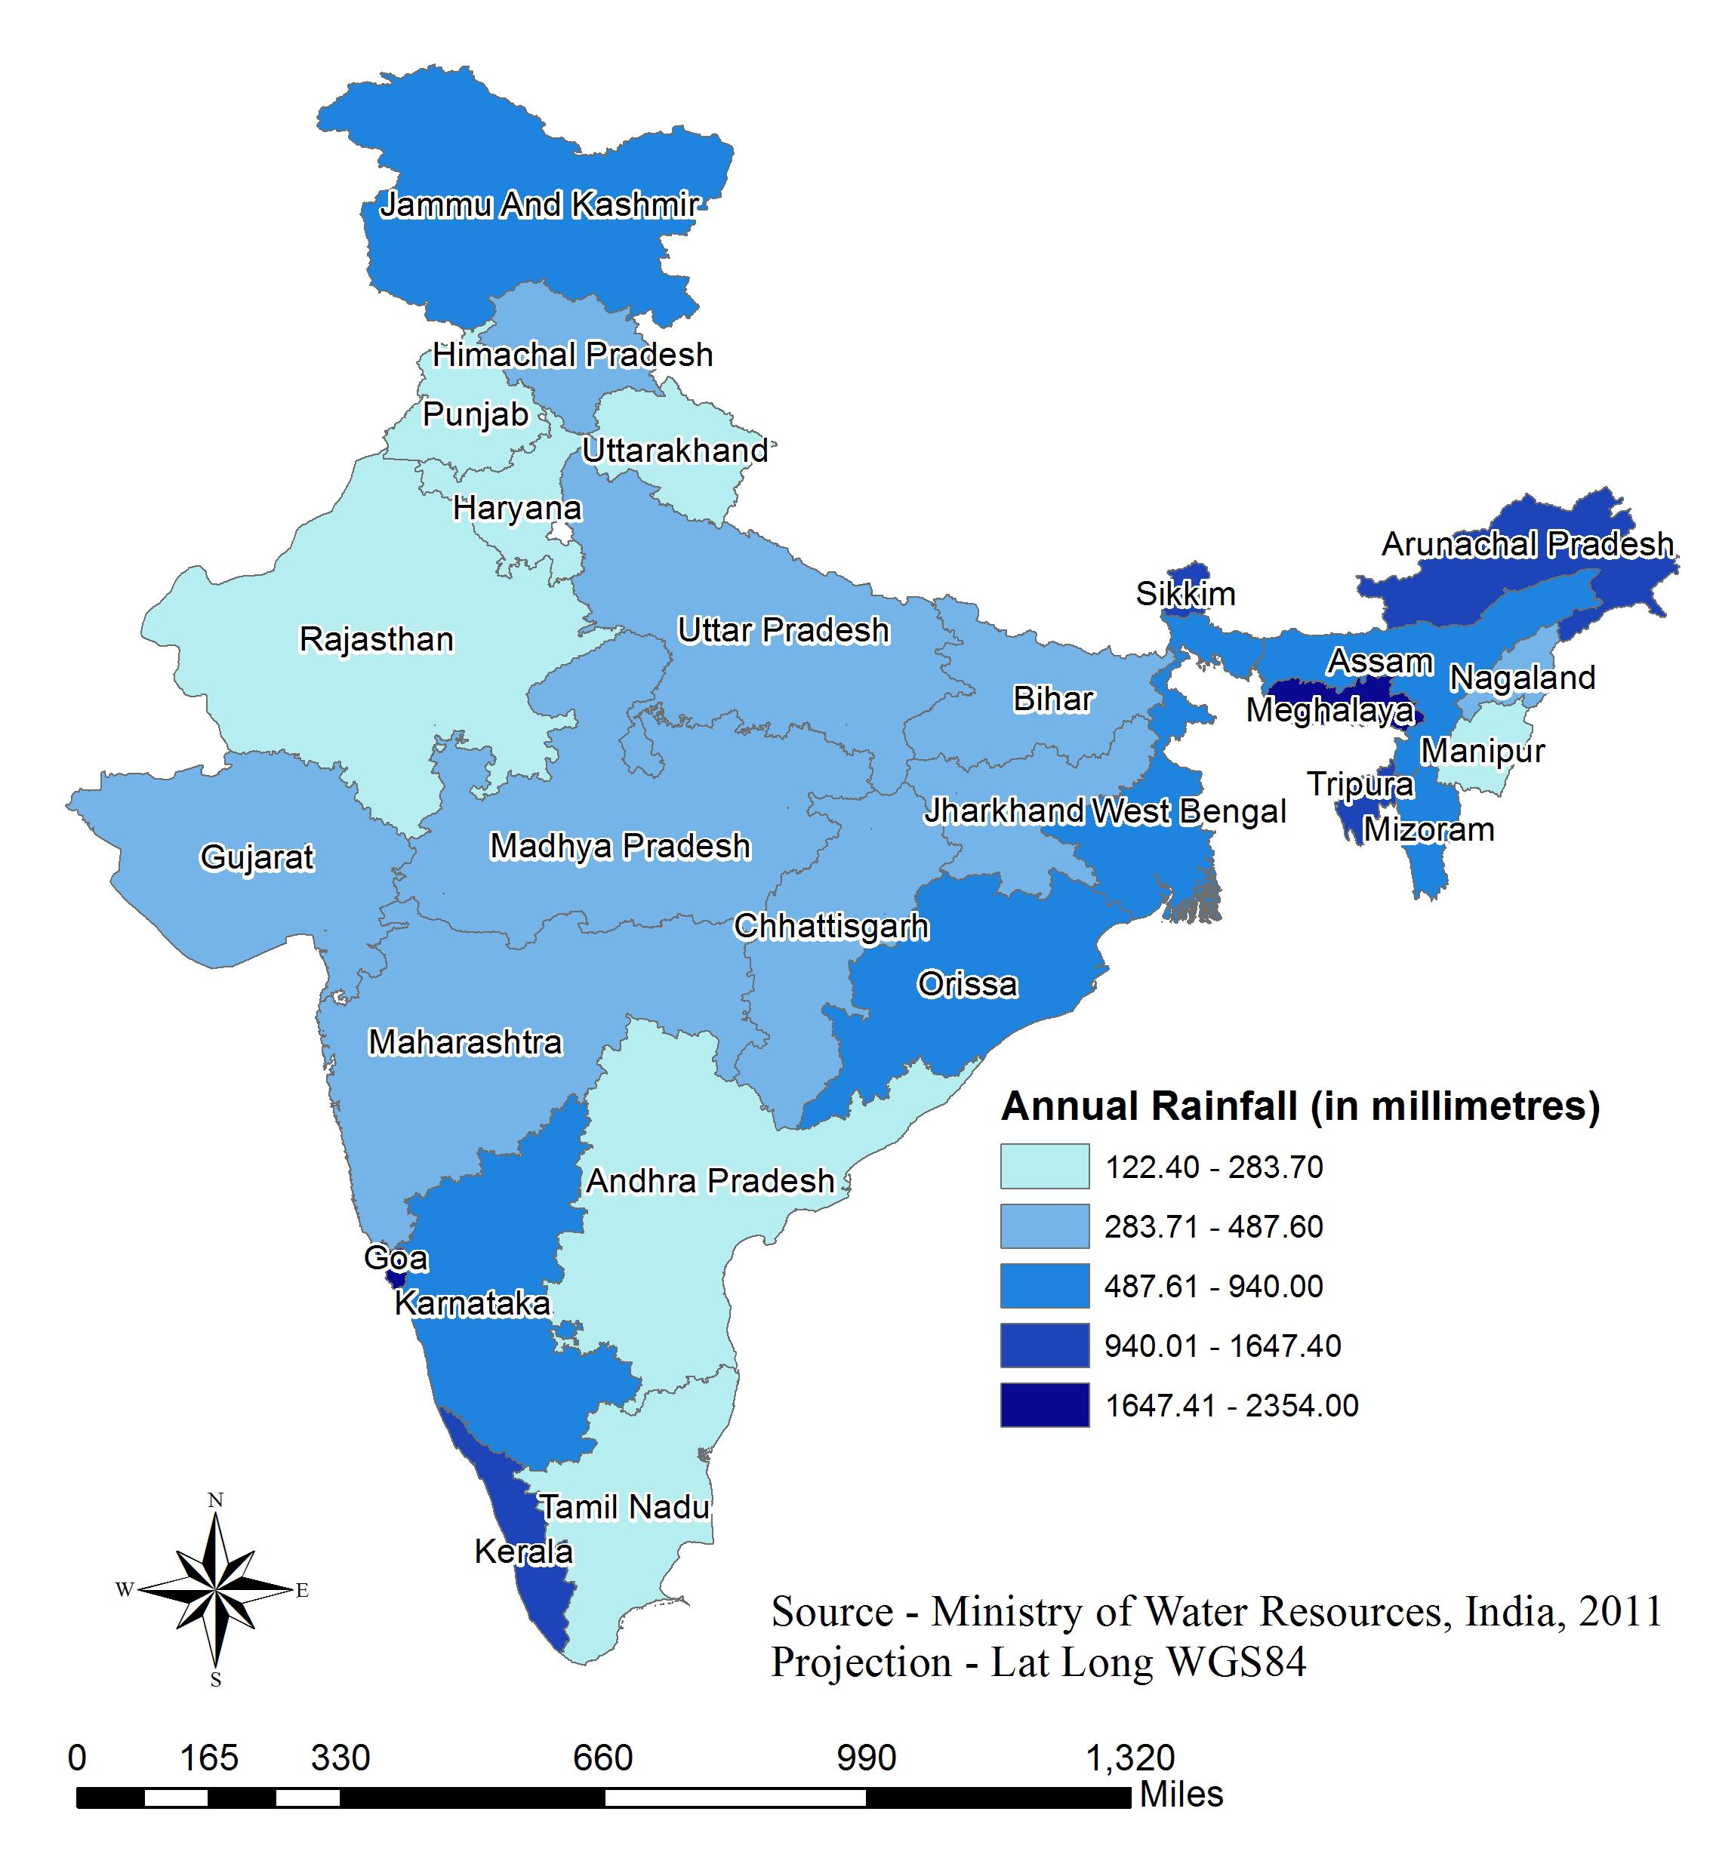
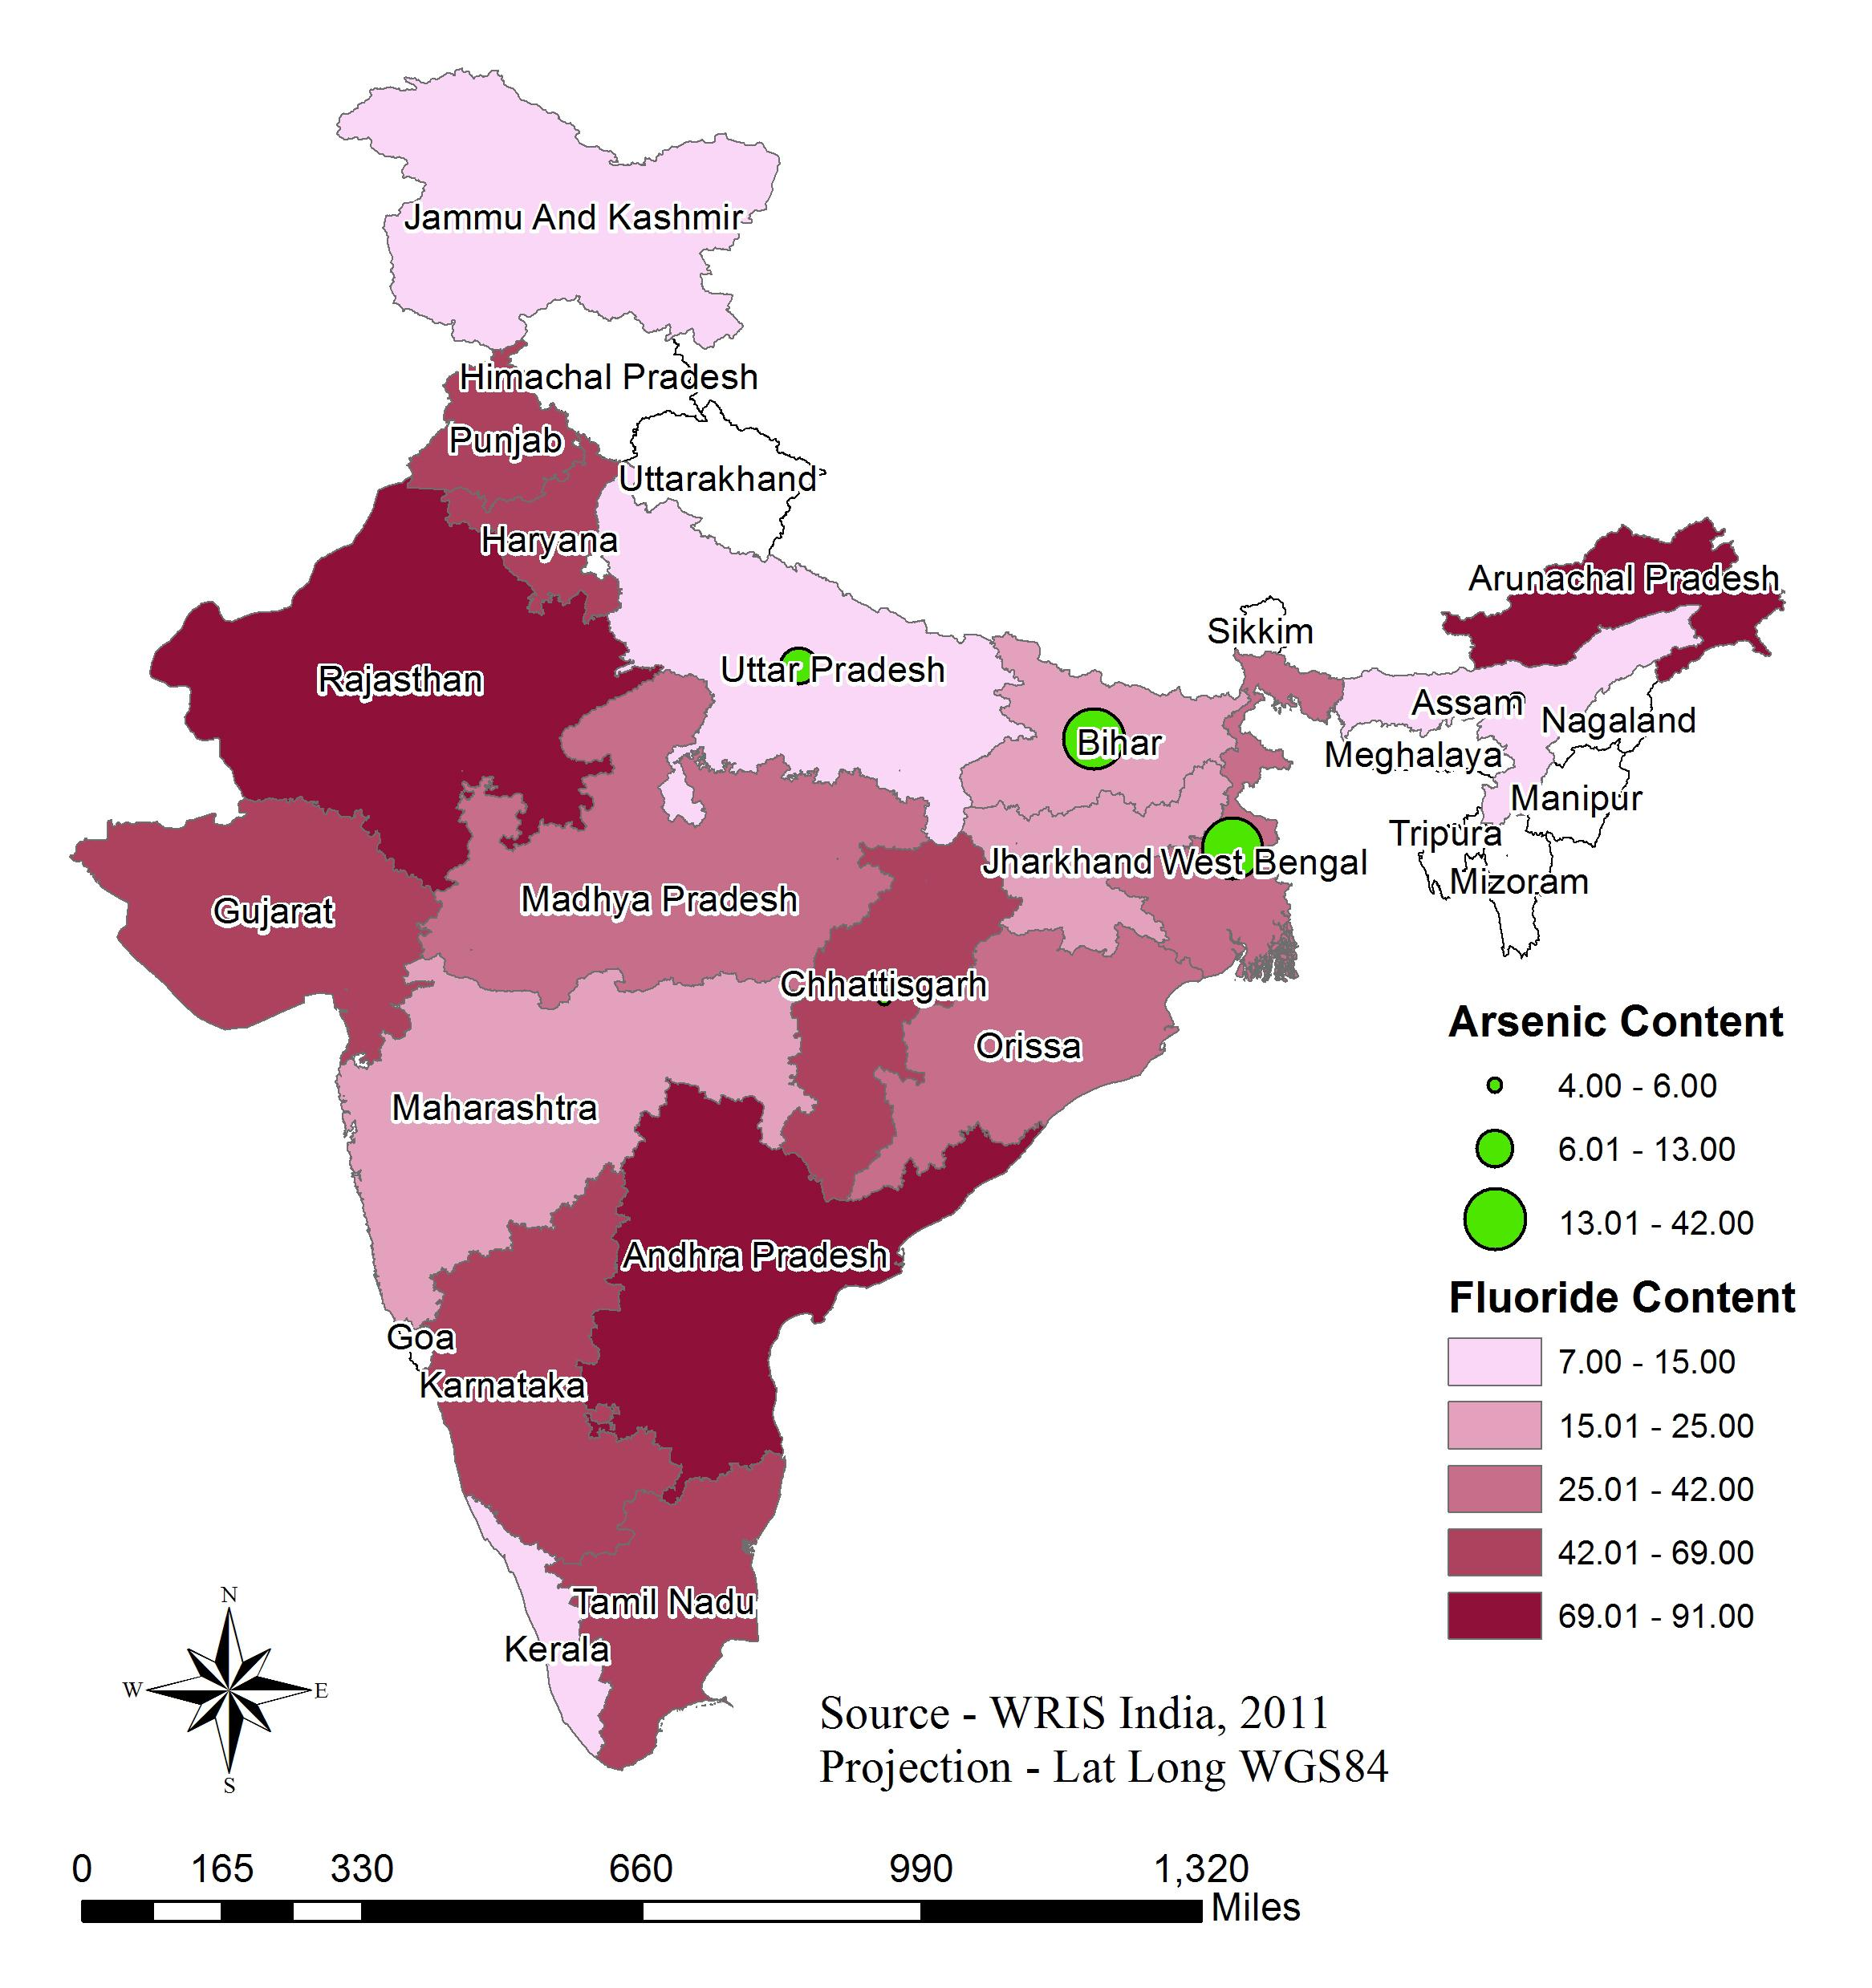
Also considered are the annual rainfall and arsenic & fluoride content.
These two criterias are not necessary but are correlated with a need for a surface water treatment plant in the area.
Regional Planning |Administration | Final Presentation Spring 2016
Notes:
Map on the left shows annual normal rainfall in millimetres. Annual rainfall is one of the major contributors of surface water run off along with snowmelt and irrigation water. For viable sites selection, we consider the states with annual rainfall more than 1000 millimeters. Although, this is not a limiting constraint since, it is possible that a drier region has a continuous source of surface water from a canal or from mountain snow runoff, or other sources. We have generated a map on ArcGIS, for annual normal rainfall data per state, sourced from the Ministry of Water Resources, India. We notice that the regions of North-east India and states of Jammu and Kashmir, Karnataka, Kerala, Goa, Orissa and West Bengal receive the highest amount of rainfall annually.
Map on the right shows states with Arsenic and Fluoride contaminated groundwater. Arsenic or fluoride contaminated groundwater could be another factor correlated with a need for surface water treatment. The contamination level for Fluoride according to the Central Groundwater Board, India, is more than 1.5 mg per liter and for Arsenic it is more than 0.05 mg per liter. According to the map, the states of Rajasthan, Andhra Pradesh and Arunachal Pradesh have the highest proportion of districts with Fluoride contaminated groundwater. For Arsenic, Bihar and West Bengal show the highest contamination.
Source - http://indiawater.gov.in/IMISWeb/DataEntry/RWS/AAPFormat/AAPFormatReport.aspx?FN=1&Rep=Y

Slide 7
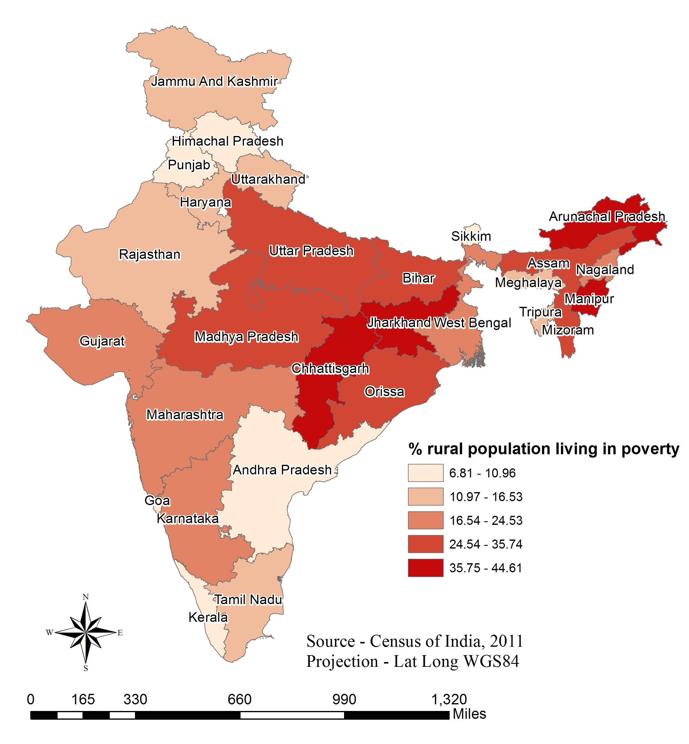
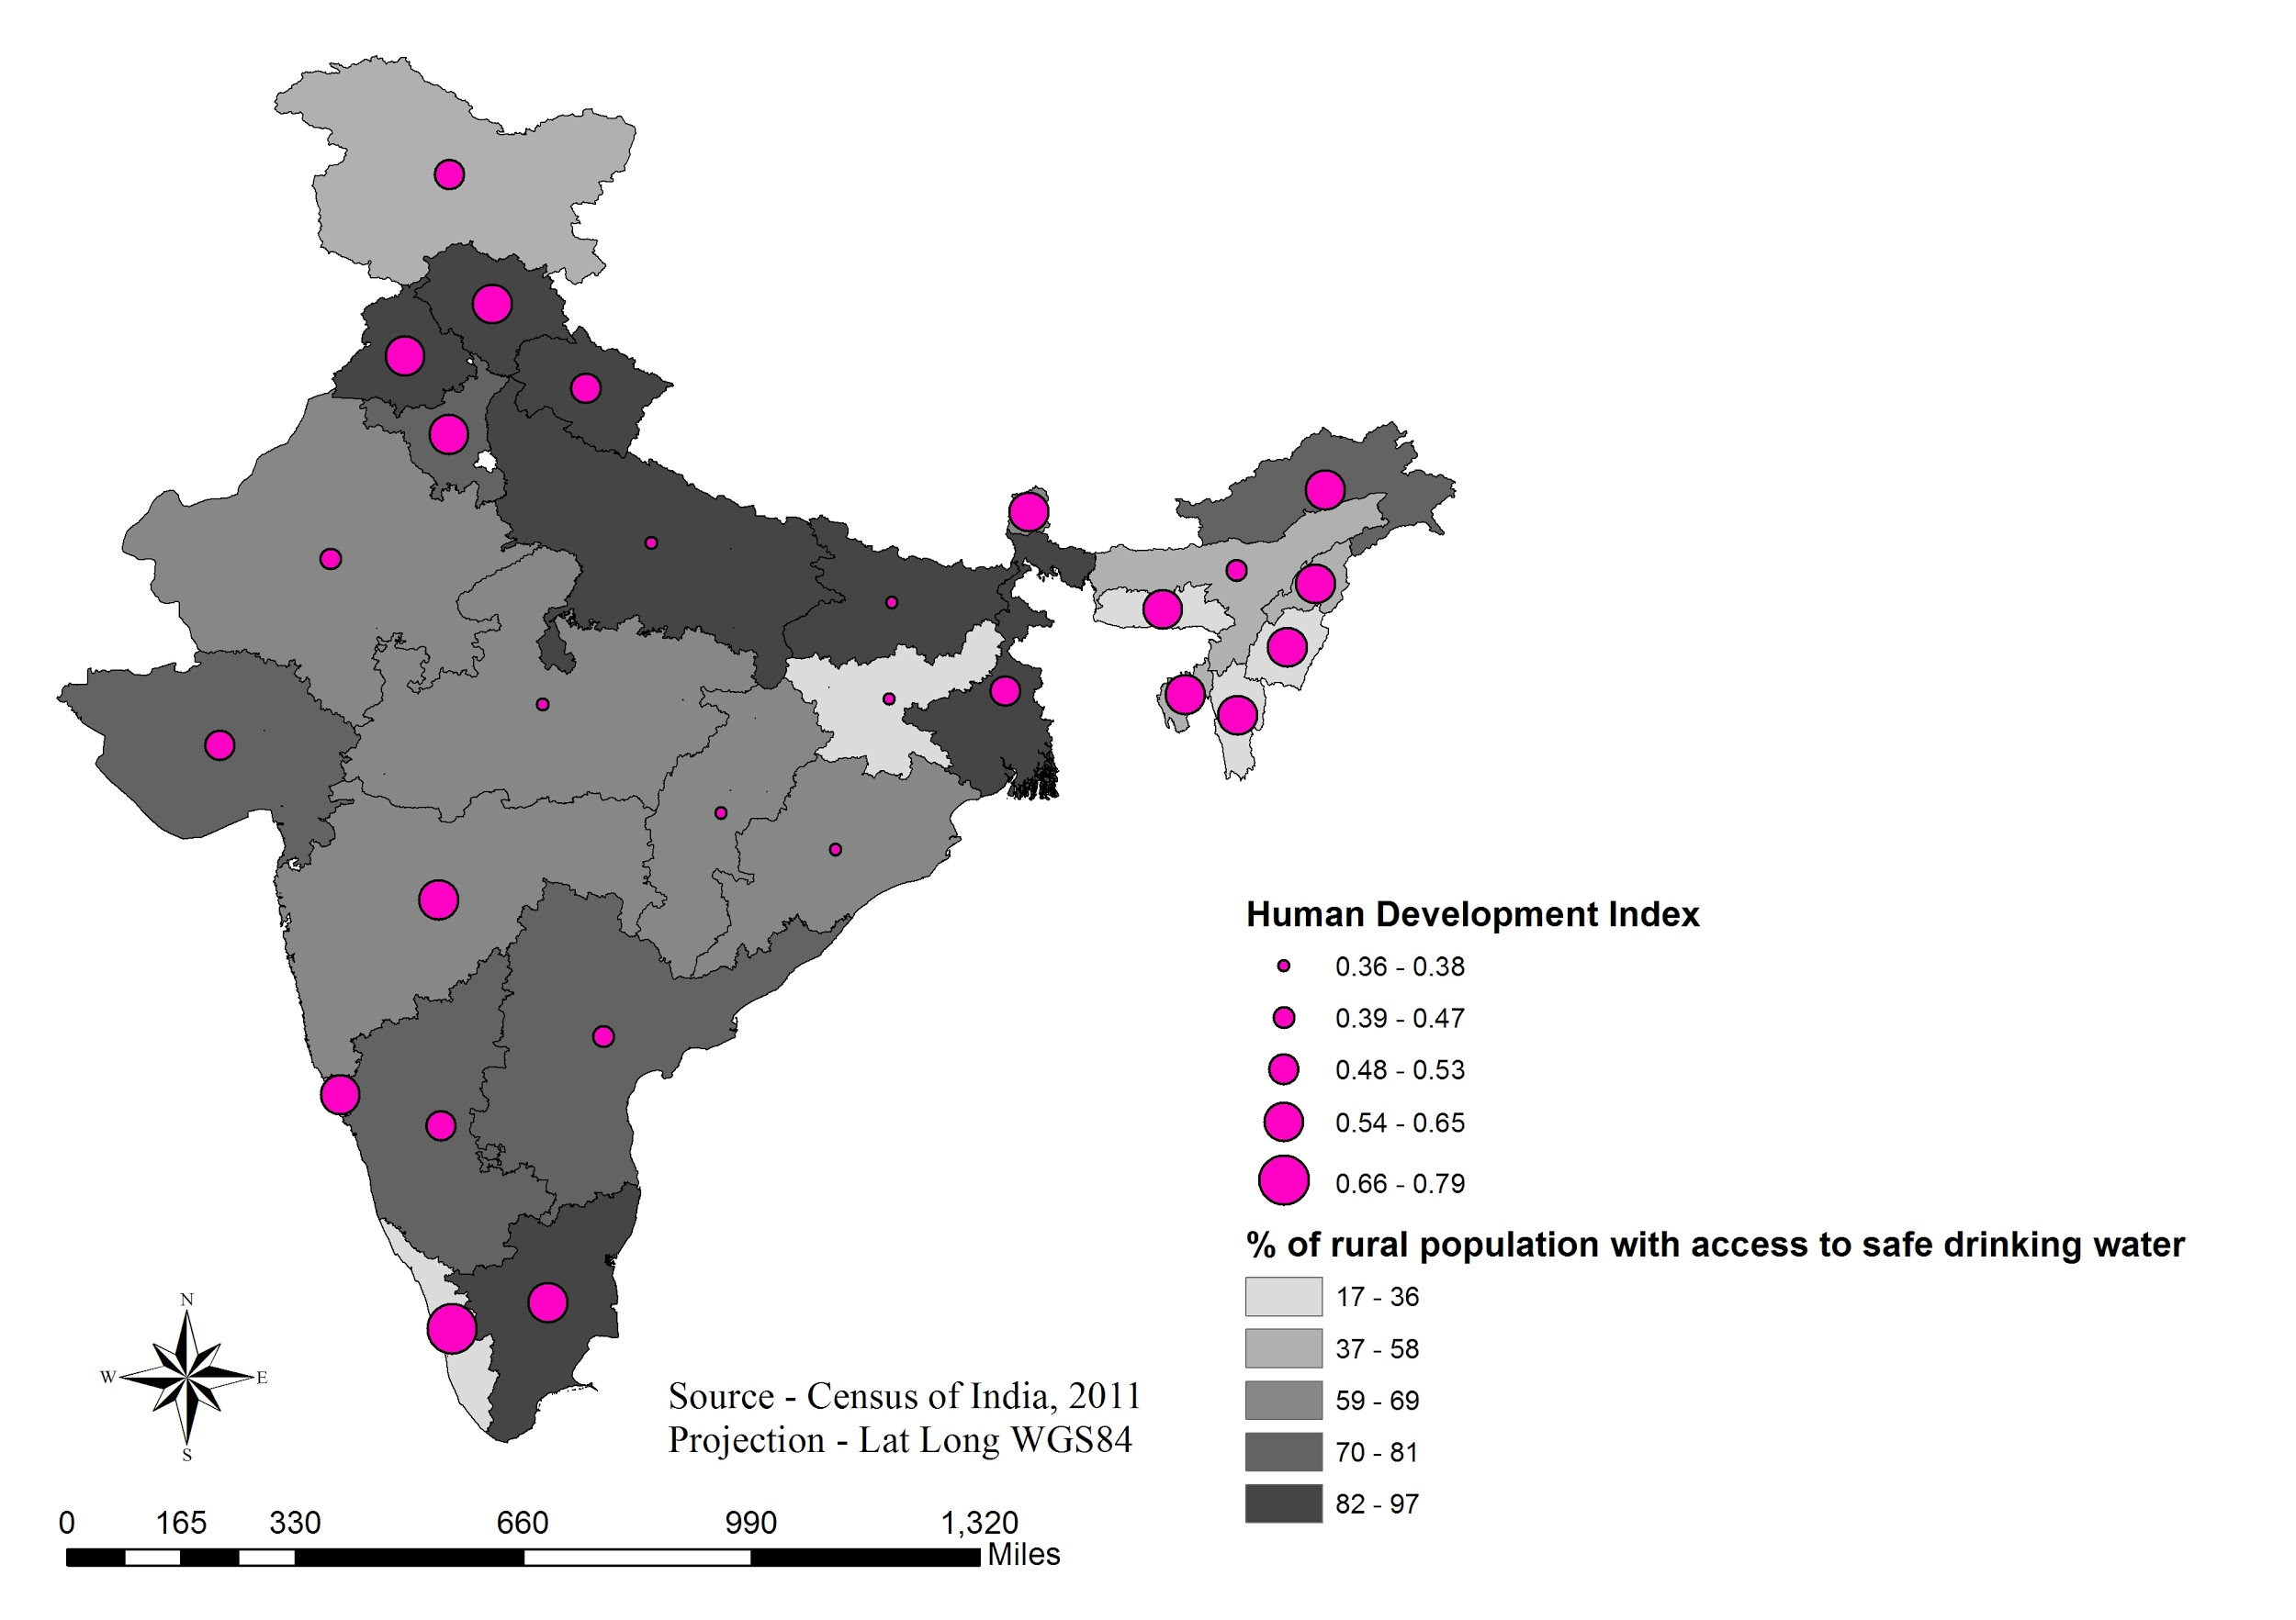
Socio-economic characteristics helped with insight on willingness to pay.
States with higher HDI and lower poverty ratios have higher percentage of rural population without access to safe drinking water that are willing to pay.
Regional Planning |Administration | Final Presentation Spring 2016
Notes:
Because households will be paying for the operation of the plant through a tariff, the optimal community should 1) be financially able to pay for this tariff, and 2) have enough demand for water treatment that they will want to pay the tariff in exchange for cleaner water. To begin quantifying willingness to pay, the team gathered data from the Census of India with poverty rates throughout India as shown in the map on the left. The higher the poverty level, the more unlikely that there will be funds to pay the necessary tariff, considering that the tariff will be, at current estimate, over 10 percent of the average rural family's income. Looking at the rural poverty ratios of each state, the data shows that the states of Jharkhand, Chattisgarh, Arunachal Pradesh and Manipur have the highest poverty ratio averaging to 41% compared to a national average of 26%.
Another parameter found is data on the percentage of people with access to clean drinking water. This is an important parameter because this will correlate with a higher demand for water treatment and accessibility. We correlated the percentage rural population with access to safe drinking with Human Development Index, as shown in the map on the right. This index takes into account the educational attainment, life expectancy ratios and GDP of the state. The national average HDI was 0.52 in the year 2011 while the national average coverage of drinking water in rural India is 90%. The map showed that the states of Bihar, Jharkhand, Chattisgarh, Orissa and Uttar Pradesh have the lowest HDI while the states of Kerala, Manipur, Meghalaya and Mizoram have the lowest percentages of rural population with access to drinking water.
One surprising fact we found was the states with higher HDI and lower poverty ratios (these can be the states with higher tendency towards willingness to pay) have higher percentage of rural population without access to safe drinking water.
Sources - http://dx.doi.org/10.3886/ICPSR36151.v3
http://www.iamrindia.gov.in/ihdr_book.pdf

Slide 8
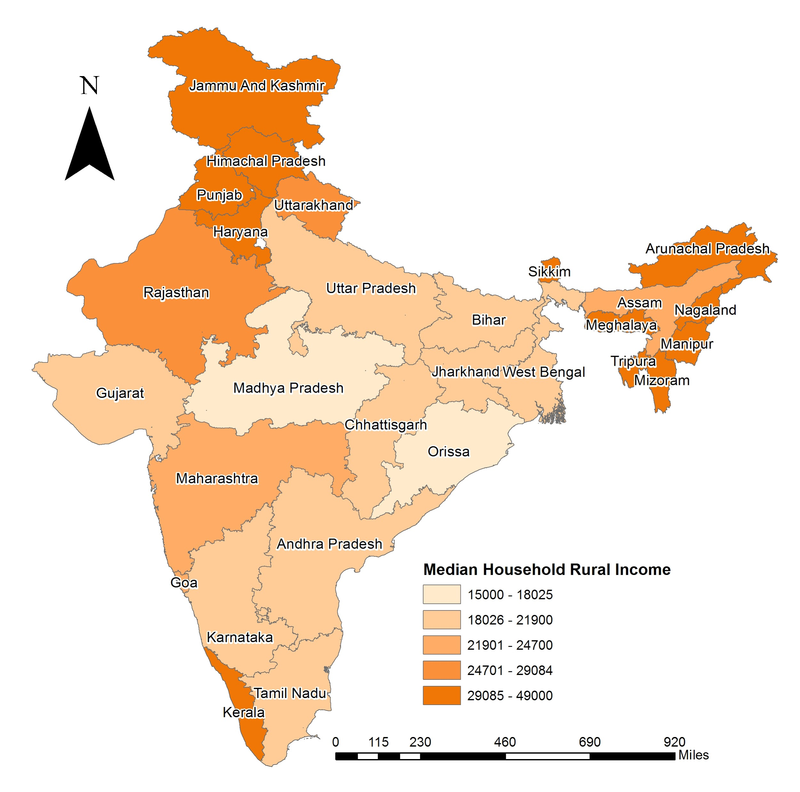
The estimated water tariff is too high for rural Indian households.
Current monthly water tariff in Honduras = $3
Assuming the same range of tariff is used in India
Average monthly income = INR 22,400 ~ US $28
US $3-$4 = 10-14% of a rural household's income.
For developing nations, WTP is between 0.29 and 10.7% of monthly income
The current tariff estimate ($3-$4) is outside the range of willingness to pay for rural Indian households
Regional Planning |Administration | Final Presentation Spring 2016
Notes:
Current estimates show that households in Honduras pay a tariff of $3 a month. Assuming the same range of tariff is used in India, it wil expensive for rural households, and past the upper limit for a rough figure on a rural household's willingness to pay for better quality water. This upper limit is based on a study conducted in 2000, which analyzed 15 contingent value studies from various developing nations and found the range of willingness to pay between 0.29 and 10.7 percent of monthly income. The average annual income of rural Indian households was found to be 22,400 rupees, which equals a monthly income of 28.03 US dollars. Based on this value, requiring $3 of tariff per month would take away 14 percent of a rural household's income. Therefore, the current tariff estimate is outside the range of willingness to pay that was found through multiple studies in developing nations.
Sources - https://confluence.cornell.edu/display/AGUACLARA/Publications?preview=/77267239/184582250/2011-08%20SIWI%20Poster%20Final.pdf
http://www-wds.worldbank.org/external/default/WDSContentServer/WDSP/IB/2008/07/23/000333037_20080723000750/Rendered/PDF/447900PP0P09411413B01PUBLIC10PAPER1.pdf
Caption your figure and explain its relevance to your presentation/thesis here. You can take the caption from your Final Report and modify it.
Write a summary of this slide here. A future team member or client should be able to read this note and understand this slide without having your team explain it to them.
If there are any appendix slides that are relevant to this slide, mention it in your notes.

Slide 9
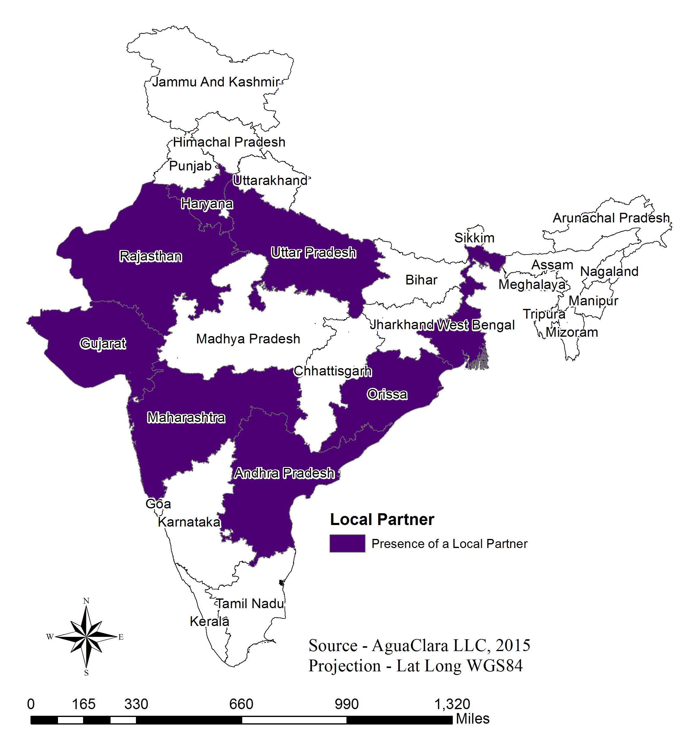
Aguaclara LLC has contacts with the following local organizations.
Potential Partners
  FORCE
  Swajal
  CURE
  TATA Group
  WASMO
  Gram Vikas
  Drinkwell
AguaClara LLC contacts on the ground will be vital to the success of a new AguaClara plant.
Regional Planning |Administration | Final Presentation Spring 2016
Notes:
Another consideration also included is the existence of a local partner. AguaClara LLC currently has people on the ground speaking with local partners and gauging their ability, reach, and infrastructure. John Finn, senior director at AguaClara LLC, provided a report detailing their progress on the ground in India. Within his report is a list of potential local partners for AguaClara's future work based on the groups they have gotten into contact with to this date. The current list has eight potential partners and spans a large region of India. Map shows the states where there are local partners presently working with AguaClara LLC on ground.
FORCE = focused on community mobilization; implements water ATMs (which are solar powered and take in groundwater purified at local plans). Delhi and Haryana.
Swajal = for profit company that implements their own water purification systems and solar pumps; they operate in Haryana, Uttar Pradesh, Rajasthan, and West Bengal.
Cure = center for urban and regional excellence, a development NGO working on empowerment programs for low income communities, operating in Uttar Pradesh.
Tata Group = has water supply projects headed by Siddharth Gahoi, works in Maharashtra,
WASMO = Water and Sanitation Management Organization, has implemented different drinking water technologies with piped infrastructure in rural Gujarat.
Gram Vikas = development NGO working with the Rural Health & Environment Programme; trains communities to maintain sanitation facilities.
Drinkwell Systems = for-profit US based enterprise, treating water affected by arsenic and fluoride, works in West Bengal.

Slide 10
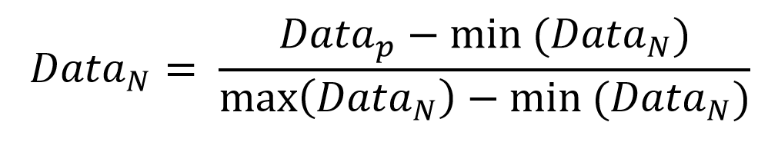
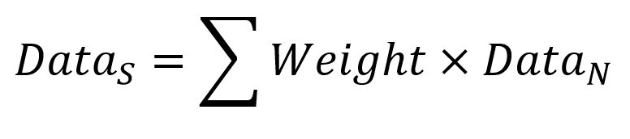
The optimization algorithm was coded in Matlab.
Equation (1)
Weight = Weight1, Weight2, Weight3, Weight4, Weight5, Weight6, Weight7
Equation (2)
Equation (3)
Attributes | Weights
Dependence upon surface water | 1.3
Poverty Ratio | 0.75
Annual Rainfall | 0.01
HDI | 0.25
Rural Population % per state | 0.3
Presence of a Local Partner | 0.15
Rural population in state by total rural population in India | 0.3
Regional Planning |Administration | Final Presentation Spring 2016
Notes:
Cite your sources here.
This slide represents the summary of the optimization code written in Matlab. The code is located on the AguaClara google drive under “regional planning”. The optimization algorithm is based on a weighting system that the team determined after research and experimentation. The seven weights that are displayed in teh table are the metrics we were able to find hard, consistent quantifiable data for. The higher the weight, the more importance the characteristic will have in the result: the higher the number, the more it will add to that state’s total number, and the highest number was the most optimal state. Equation 1 represents the Matlab vector that will be used in Equation 3, and Equation 2 is the normalization of the data, so that each metric was within the same scale. The summation is ddone in equation 3.

Slide 11
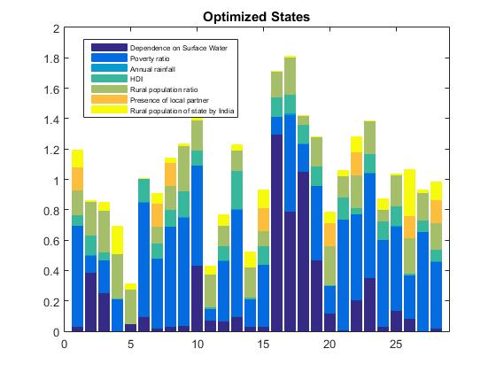
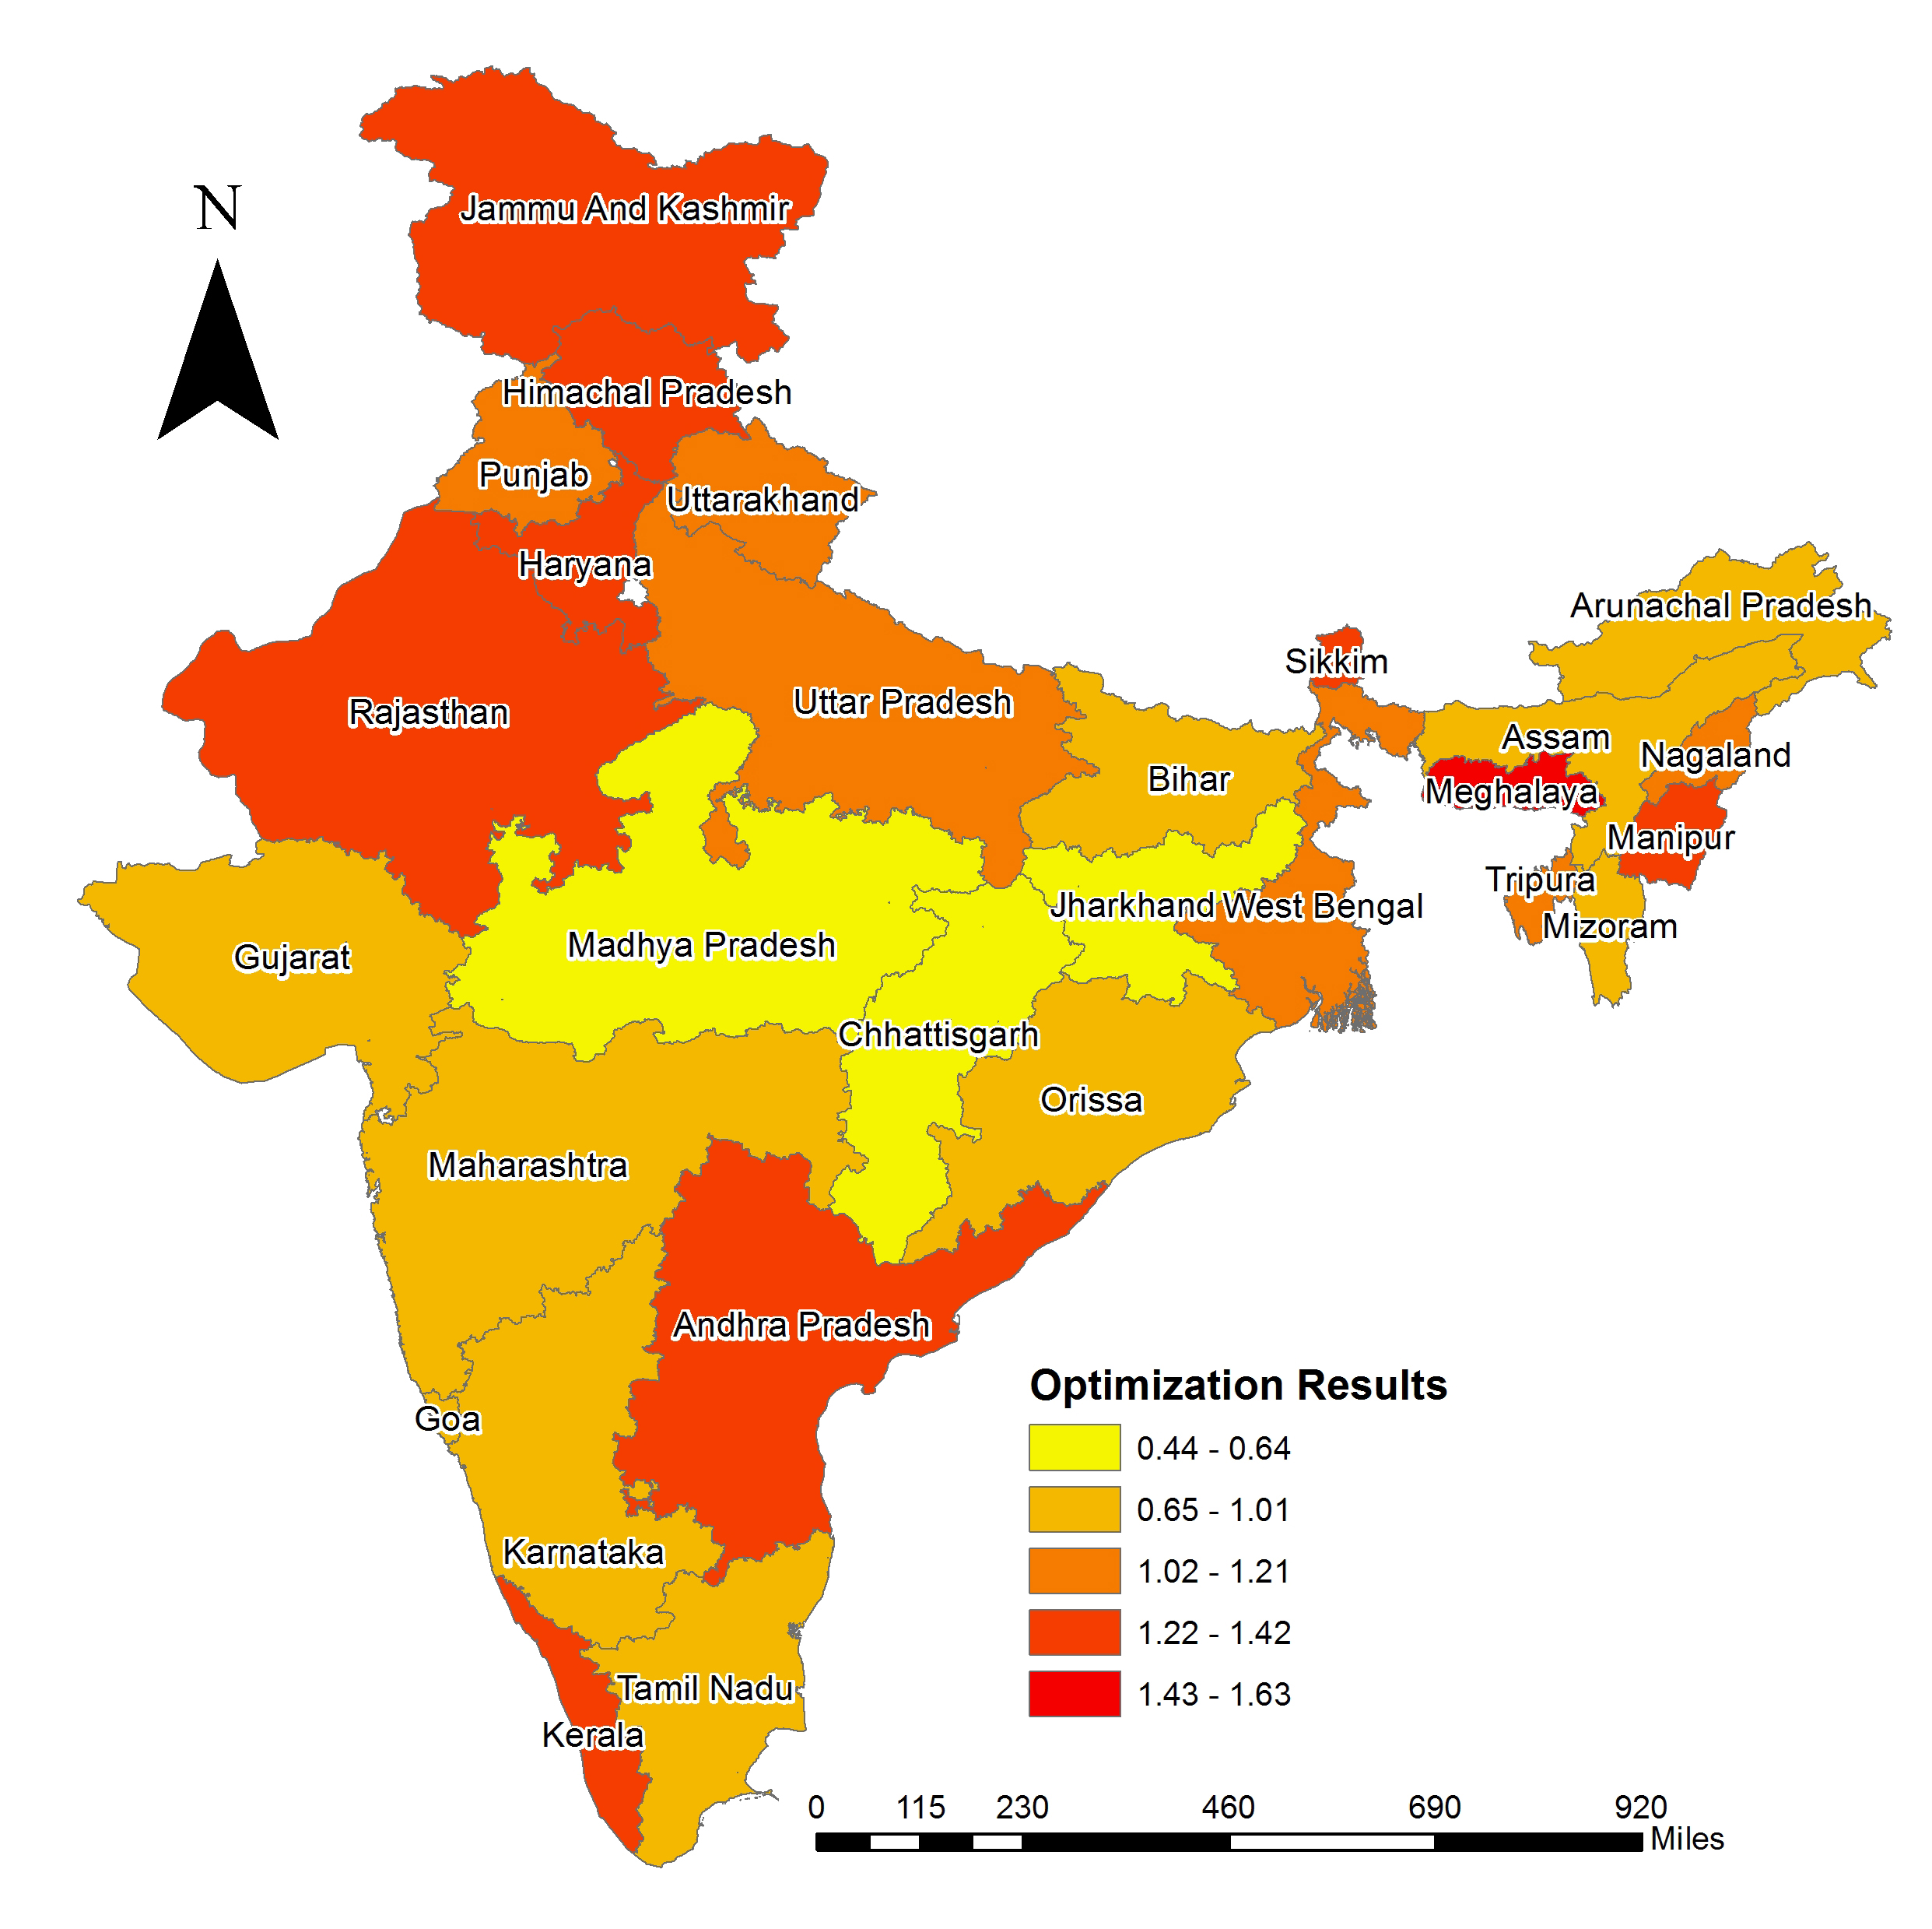
The optimization results are represented by a color-optimized map.
Himachal Pradesh, Rajasthan, Sikkim, Meghalaya and Kerala =
top 5 most optimal states
Regional Planning |Administration | Final Presentation Spring 2016
Notes:
The stacked bar chart on the left was generated in Matlab. A stacked bar chart is the best way to represent this result because it shows us exactly which characteristic actually determined the result. For example, the most optimal state here is Meghalaya, the highest bar. We can see that meghalaya must have a high dependence on surface water and also a low poverty ratio (we want low poverty so the data for poverty ratio was flipped so that higher numbers were considered worse).
The color coded map on the right was generated in Python, and the code for the maps are also on the AguaClara drive. The darkest colors here are considered more optimal. We did this because it’s a good visualization tool in terms of geography and orientation like it’s interesting that the most optimal states are not clustered together, for example. Himachal Pradesh, Rajasthan, Sikkim, Meghalaya, and Kerala are the top five most optimal states.

Slide 12
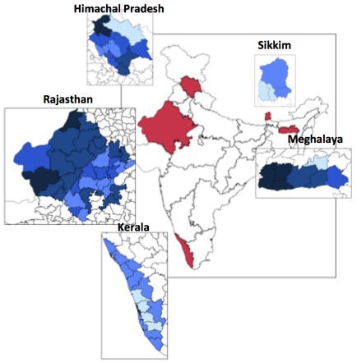
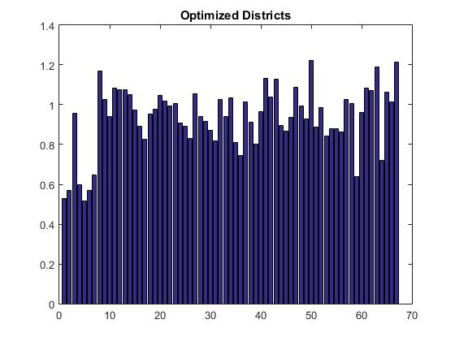
Same method was used for district-level analysis.
South Garo Hills, Chamba, Barmer, East Garo Hills and West Garo Hills = top 5 most optimal districts
Regional Planning |Administration | Final Presentation Spring 2016
Notes:
Matlab, Python.
The same data was gathered on the district level for the top five states. Since there were over 70 districts analyzed in this code, a stacked bar chart was not generated because it would be cognitiely overwhelming. As you can see, many of the districts were around the same overall number after hte optimization. The map on the right shows in red the states that were chosen and then those states are blown up into districts, and the darker again is the more optimal. The top five optimized districts are called South Garo Hills, Chamba, Barmer, East Garo Hills, and West Garo Hills.
South, East, and West Garo Hills are all in Meghalaya. Chamba is in Himachal Pradesh, and Barmer is in Rajasthan.

Slide 13
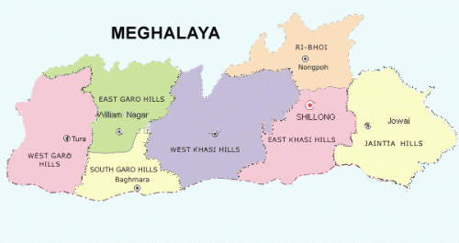
Preliminary results from the semester.
Top optimal state also has 3 of the top 5 optimal districts!
Local partner in Meghalaya?
http://www.miscw.com/meghalaya-bid-2022-national-games-4850.html
Research can only take us so far - we need on the ground communication!
Regional Planning |Administration | Final Presentation Spring 2016
Notes:
http://www.miscw.com/meghalaya-bid-2022-national-games-4850.html
This is a picture of Meghalaya, the top optimized state, that also has 3 of the top 5 optimized districts. The three top districts are West Garo Hills, East Garo Hills, and South Garo Hills, which are hte three to the left.
Preliminary results: AguaClara LLC should look for a local partner in Meghalaya to further increase its feasibility as an optimal site.
The planning team cannot get much further than the district level, because information is simply not available on the smaller scale. Plus, so much of this work is going to be about communication on the ground -- communicating with locals, seeing where the demand is, who’s going to be open to a foreign company changing their way of life, trying to build relationships with organizations who can provide insight to the area, culture, etc. That’s why AguaClara LLC being on the ground in India was such a huge factor in our decision to analyze India this semester. THe next team’s job will focus a lot on the aspects that cannot be found through the Internet.

Slide 14
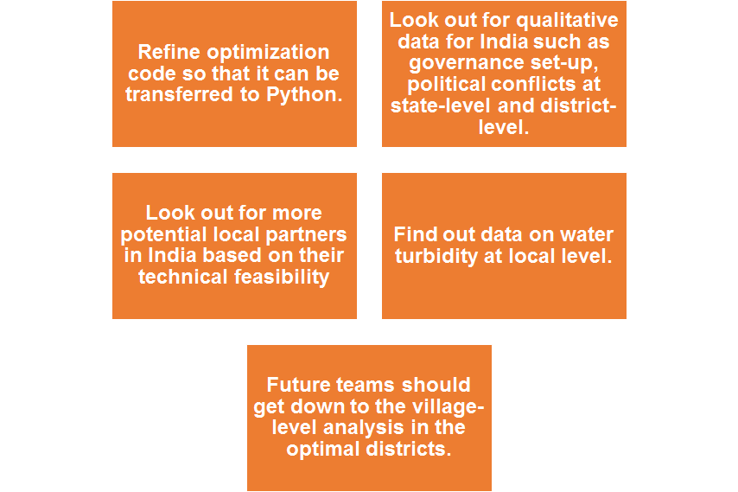
Future work will be local communication.
Regional Planning |Administration | Final Presentation Spring 2016
Notes:
Like I said in the previous slide
THe next team’s job will be less research orientated and more focused on getting on the ground data that is not available online. For example, water turbidity is such a huge factor in determining the feasibility and need for an AguaClara plant, but that data for Indian water bodies is NOT publicly available. AguaClara LLC has been going in and doing their own turbidity tests. Same with the local partner -- a strong foundation will be built by reaching out and establishing connections with organizations in India, and that is best done on the ground work. With this on the ground work, the district level can be narrowed down into the village level.
Also, it would be helpful if the optimization code in Matlab could be written in one big Python script, since it’s python that’s generating the color-coded maps, but the team was not familiar enough in Python to get it done this semester. oh and another thing that teams could play with is the weighting system for the optimization code. it’s entirely impossible that our chosen weights are exactly perfect.

Slide 15
Questions
and
Recommendations
Lauren Frazier
Master of Engineering, CEE
lmf228@cornell.edu
Yu Jin Hur
Operations Research
yh586@cornell.edu
Disha Mendhekar
Master of Regional Planning
ddm93@cornell.edu
Regional Planning |Administration | Final Presentation Spring 2016

Slide 16
Appendix
Slides
Regional Planning |Administration | Final Presentation Spring 2016
Notes:
From this point on, add any slides with figures that will help support your thesis. You might pull these figures from your Final Report.

Slide 17
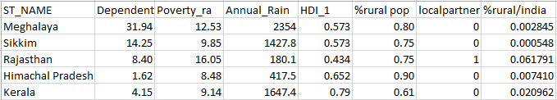
Analyzing the optimal states.
This shows the breakdown of characteristics that determine the optimality of these states. “Dependent”=percent population dependent on surface water.
Regional Planning |Administration | Final Presentation Spring 2016
Notes:
Cite your sources here.
Dependent= percent dependent upon surface water.
Poverty ratio = percent living under the poverty line.
%rural pop = rural population of that district within the state.
This is in the order of the optimization results.

Slide 18
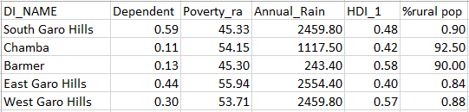
Analyzing the optimal districts.
This shows the breakdown of characteristics that determine the optimality of these districts. “Dependent”=percent population dependent on surface water.
Regional Planning |Administration | Final Presentation Spring 2016
Notes:
Cite your sources here.
Dependent= percent dependent upon surface water.
Poverty ratio = percent living under the poverty line.
%rural pop = rural population of that district within the state.

