Slide 1
Regional Planning
Lauren Frazier Yu Jin Hur Disha Mendhekar
Notes:
Hello name is …….
Talk about what we do.
AguaClara is ready to expand. We’re ready to take the technology that we have and place it in somewhere else in the world. The big question is where? Where would the most optimal site be? Since AguaClara has been success in Honduras but not so much in Jharkhand so we know that it isn’t as simple as finding a place where water treatment facility is needed. There are other factors to consier. The Regional Planning team was made in order to answer this question of where next?

Slide 2
Framing the Semester
Location: India
  Tata-Cornell Initiative
Site selection criteria
States→ districts→ subdistricts→ towns
Notes:
Cornell currently has a partnership with the Tata group called the Tata-Cornell Initiative. Cornell’s role in this partnership is to help improve India’s quality of life we could help. Also AguaClara LLC already has people on the ground in India so we could help them theoretically by doing research and they are currently establishing connections with local partners so we could correlate our findings with the partnerships they have made. For all these reasons we thought that it made sense to choose India as the country to focus our site selection on.
Research paper(Karim Beers, Kenichi Victor, Nishikawa Chavez), discussions with Monroe came up with this site selection criteria and the way we are going to tackle this task of finding the ideal place in this huge country is to go from broad to narrow scale. We are going from states to districts to subdistricts and finally to the town level.

Slide 3
Site Selection Criteria
Population between 5,000 and 25,000
Rural areas
%people dependent on surface water >40%
Consistent surface water available
Annual rainfall > 1000 mm/year
Notes:
The order is not in order is not in the order of significance.
When on this slide, mention that we are only going to look at the criteria for population size when we get down to the district/subdistrict level.
We are focusing on Rural areas as it is harder to implement AguaClara technology in Urban areas because Indian Law is different for Rural areas and Urban areas.
We need to have a decent amount of people who is going to use the water treatment plant so we are going to look for places where the percentage of people dependent on surface water is above 40%
We want consistent surface water availability.
We also put in annual rainfall above 1000 mm/year because there is a high chance that the optimal site will have a decent amount of rainfall.

Slide 4
Site Selection Criteria
10 NTU < turbidity < 1000 NTU
Consumer ability to pay tariff for plant operations
Accepting government set up
Stability in the region
Local partnership available
Notes:
(We have not yet determined the necessary tariff in India.)
NTU (Nephelometric Turbidity Unit)
We need a place where the people are able to pay the extra tariff so we aren’t looking for poorest of poor.
A governance set up that is not welcoming of new technology makes it harder to install and successfully run a sustainable water treatment plant; we also need a certain stability in the government so they are also part of the site selection criteria. By stability in the region we are also considering trust between people.
Local partnership availability is also important as they have local data that we need. Also to run a successful water treatment plant we need engineers that have the technical expertise to run water treatment plants and these local partnerships are able to provide this resource.

Slide 5
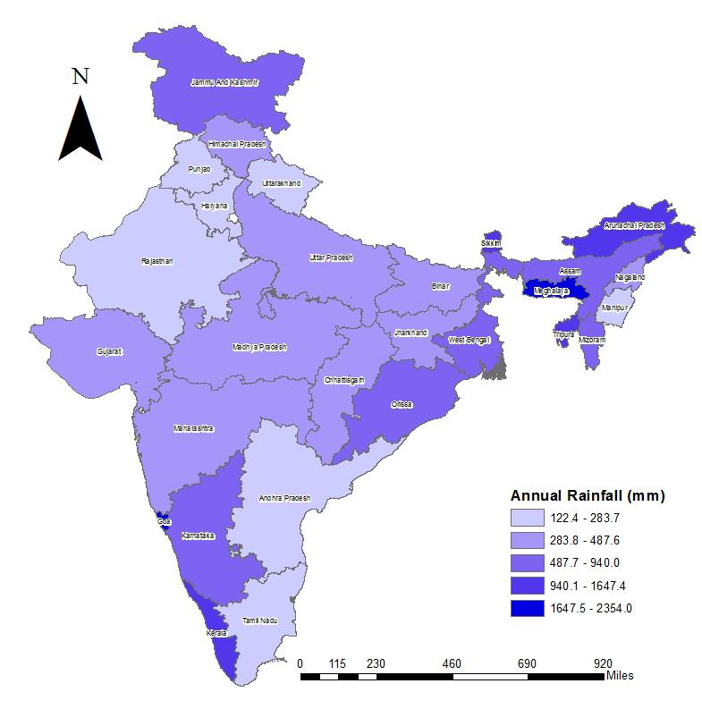
Annual Rainfall
> 1000mm/year
Not limiting constraint
Majority of North-east India and states of Kerala, Karnataka, Goa, Orissa and West Bengal
Picture/graph/table
Source: Ministry of Water Resources, India 2011
Notes:
For the purpose of our analysis, we have considered 28 states of India and excluded all the 7 Union territories and the islands of Andaman and Nicobar and Lakshadweep. The first parameter is annual normal rainfall in millimetres as it is one of the major contributors of surface water run off along with snowmelt and irrigation water. For viable sites selection, we consider the states with annual rainfall more than 1000 millimeters. Although, this is not a limiting constraint since, it is possible that a drier region has a continuous source of surface water from a canal or from mountain snow runoff, or other sources. We have generated a map on ArcGIS, for annual normal rainfall data per state, sourced from the Ministry of Water Resources, India. We notice that the regions of North-east India and states of Jammu and Kashmir, Karnataka, Kerala, Goa, Orissa and West Bengal receive the highest amount of rainfall annually.

Slide 6
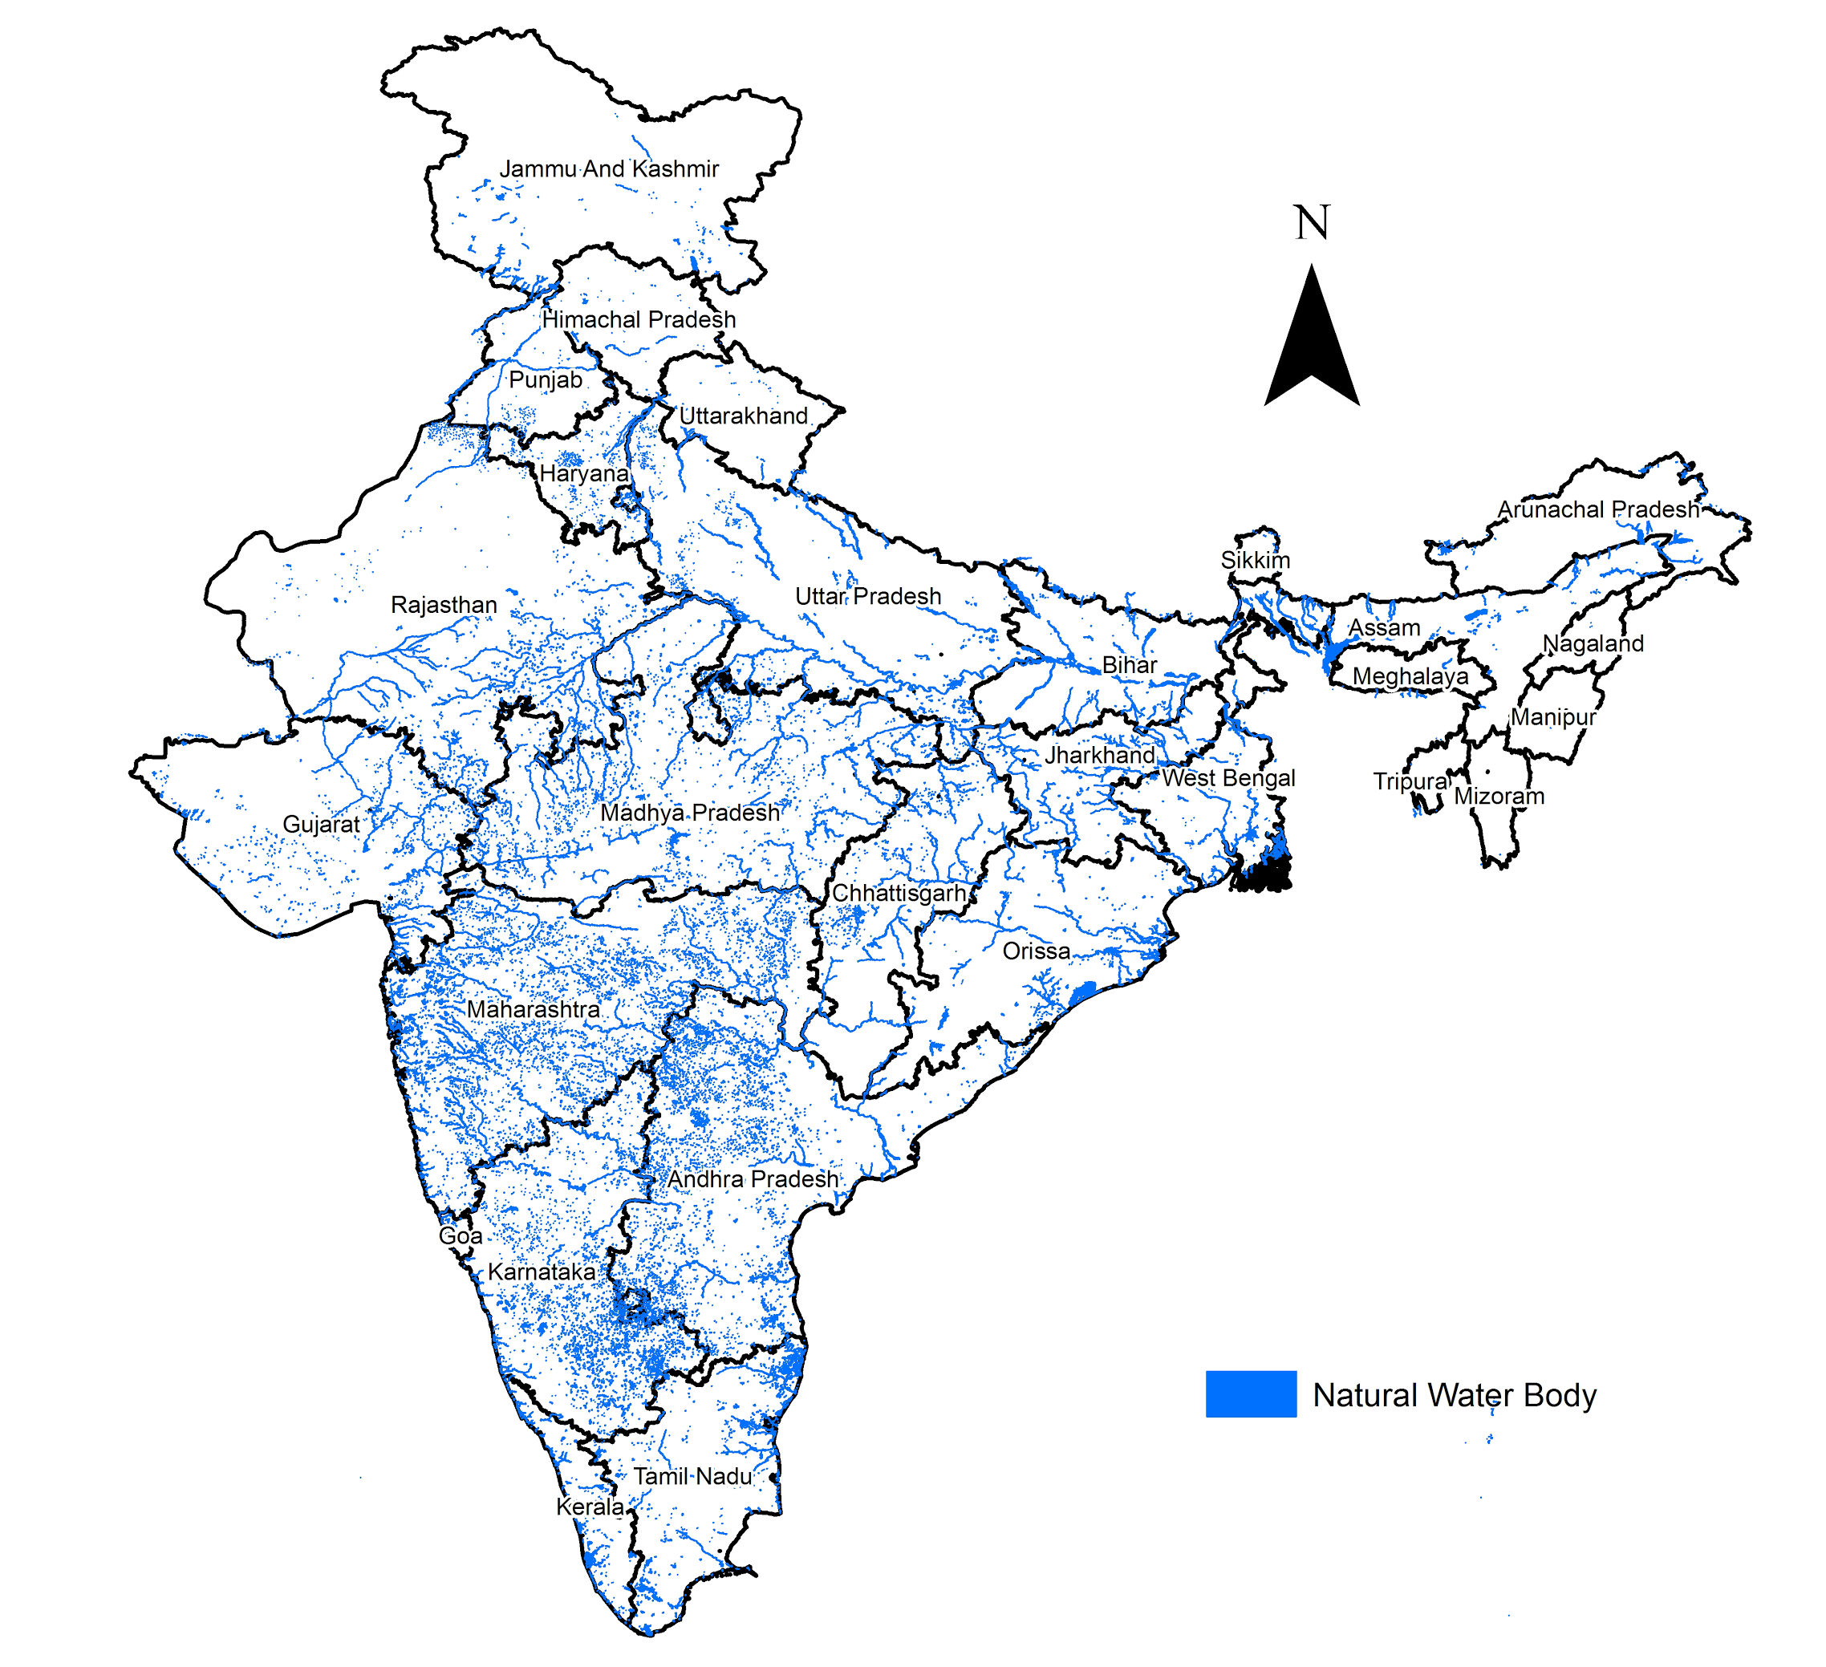
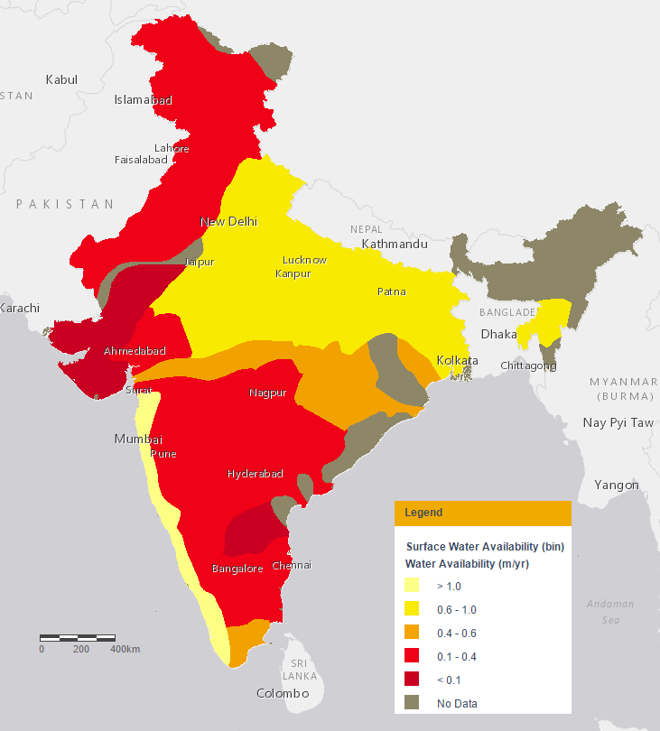
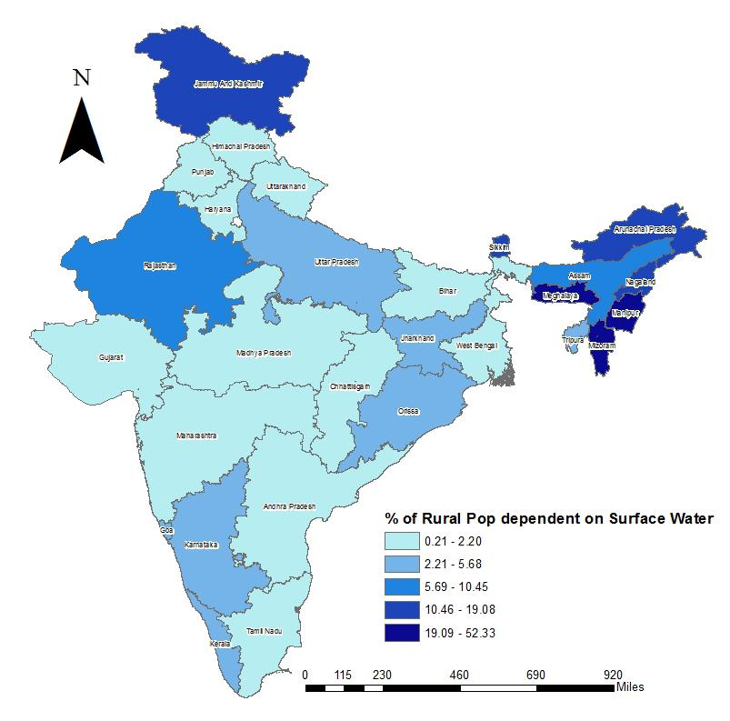
Surface Water Availability
Surface Water Availability Map
113 river basins
84% of total drainage area
Majority of surface water in the Great Northern Plains and the Western Coast.
Natural Water Bodies
Ganga-Brahmaputra-Meghna Basin
Source: http://www.indiawatertool.in/
Notes:
For planning purposes, the country is divided into 20 river units, 14 of which are are major river basins. The rest 99 river basins have been grouped into 6 river units. The major river basins form about 84% of the total drainage area of the country. The Ganga-Brahmaputra-Meghna basin covers 34% of the area and 59% of the total water resources, hence we notice the highest surface water availability in this region. These rivers are formed by melting snow and glaciers from the Himalayas as well as rainfall and therefore have a continuous flow throughout the year. The coastal rivers on the western side are short in length with limited catchment areas but are actually rainfed and fluctuate in volume and therefore are perennial. Hence, highest surface water availability can be seen here as well, unlike the eastern coast which exhibits lower amounts of rainfall and many non-perennial rivers. The water resources potential of the country as a whole is estimated at 1864.33 km3, of which only 58.41% is utilizable, in view of topography, uneven distribution of the resource over space and time, geological factors and the contemporary technoligical knowledge. From that 58.41%, 63.35% comes from surface water and the rest from groundwater.

Slide 7
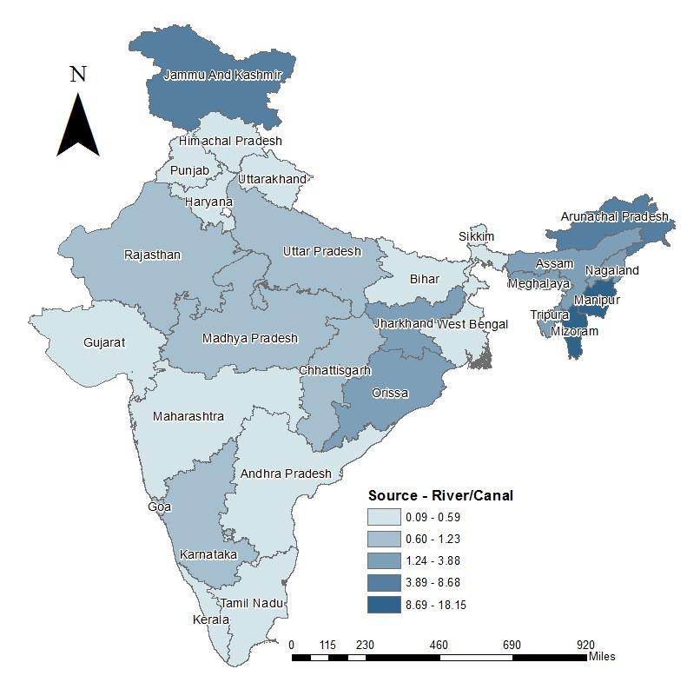
Surface Water Availability
Surface Water Dependency Map
Surface water sources include rivers, canals, ponds, lakes and springs.
Northeast India & Jammu and Kashmir =highest percentages
%rural dependent on surface wt & surface water availability
Source: Ministry of Water Resources, India 2011
Notes:
According to AguaClara website, one of the technical requirements for establishing a water treatment plant in rural communities is that the water source should be surface water. On these lines, we pulled in data from Ministry of water resources, India on state-wise percentage of rural population dependent on surface water for drinking purposes. The surface water sources include rivers, canals, springs, tanks, ponds and lakes. This data give us an idea about which states in India have the highest demand for surface water. We have mapped this data out on ArcGIS and analyzed which of the states have higher percentage of population dependent on surface water for drinking purposes. If we compare the surface water availability map and the percentage of rural polation dependent on surface water, we will be able to see which areas have good surface water availability along with a decent amount of Rural Population dependent on Surface Water for Drinking Purposes. The surprising fact we notice is that Jammu & Kashmir and the states in the north-east part of India are highly dependent on surface water for for drinking purposes but do not have as much of surface water availability. This could be because of the topography of these regions. These regions are located in the Himalayas, high above the sea level and extract water from the streams that flow downhill from the glaciers and mountain snow. Due to this reason, the surface water here is not as much polluted as compared to other regions where there exist instances of high pollution in the rivers owing to industrialization.
Even Rajasthan has a higher percentage of population dependent on surface water but lower surface water availability. This is due to the construction of Indira Gandhi Canal which deviates 30% of the waters from Punjab and Haryana to the deserts in Rajasthan, supplying drinking water to hundreds of people in far-flung areas.

Slide 8
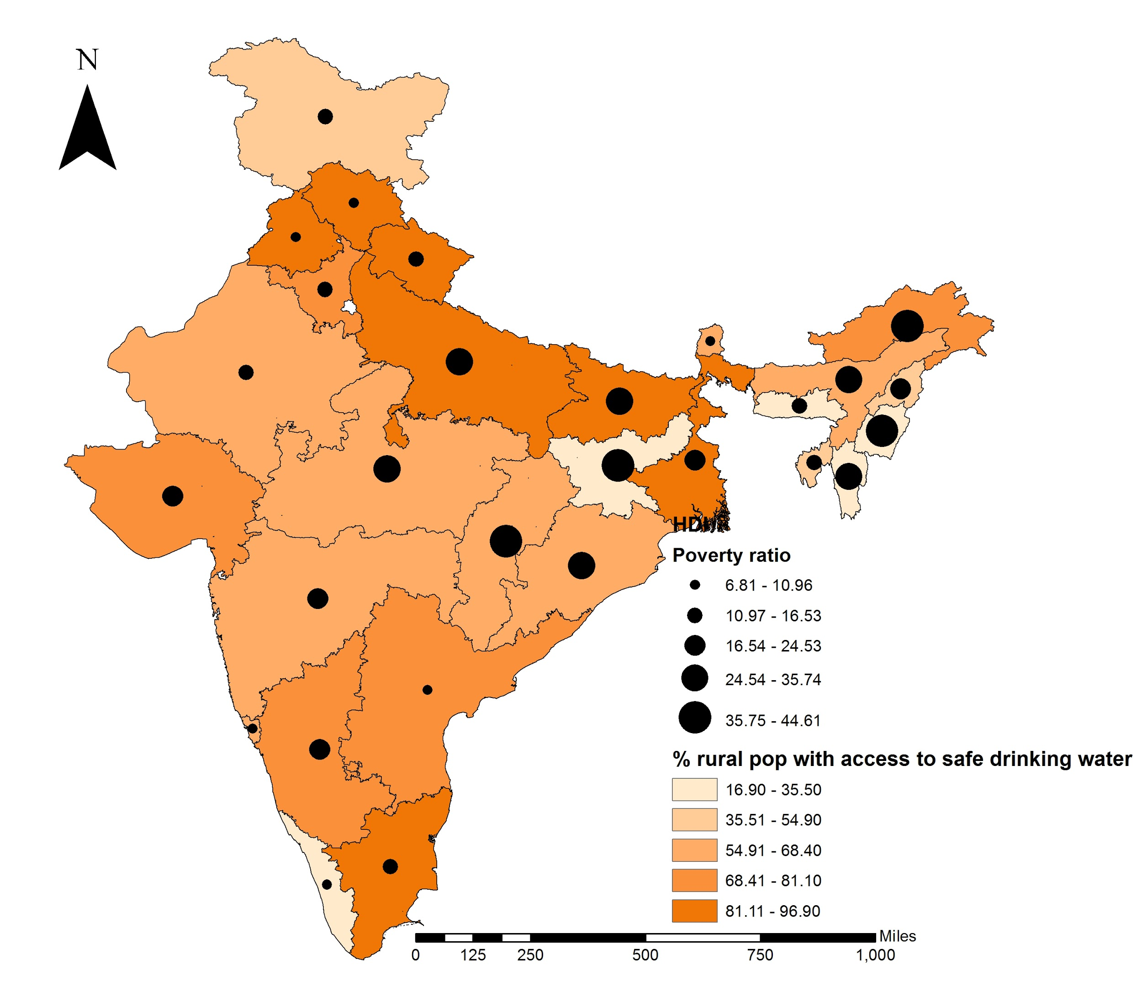
Socio-economic Characteristics
Consumer willingness to pay
Higher poverty = lower ability to pay the water tariff.
Ideal: lower poverty, lower % access
HDI map
Source: Planning Commission India, 2011
Notes:
This graph represents the correlation between poverty levels in a state and the percentage of its rural population with access to safe drinking water. Ideally, we would be looking for a state with a lower poverty, the cutoff of which we have not determined yet, and a lower percentage of rural population with access to safe drinking water - this would imply they have the ability to pay the tariff, but also have the demand for water treatment. We will also correlate these states, later on, with other characteristics: such as availability of surface water, and HDI, the human development index, which will input more social and economic characteristics. Of course, since these are just averages over the state, we will also be doing this correlation on the district and subdistrict level.

Slide 9
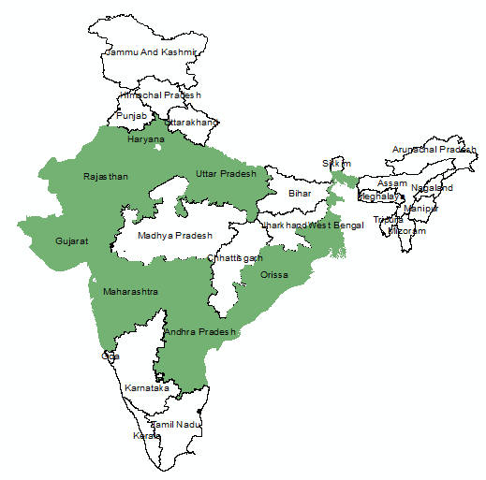
Other Considerations
Potential partners (AguaClara LLC)
  FORCE
  Swajal
  CURE
  Tata Group
  WASMO
  Gram Vikas
  Drinkwell
Source: AguaClara LLC, 2016
Notes:
FORCE = focused on community mobilization; implements water ATMs (which are solar powered and take in groundwater purified at local plans). Delhi and Haryana.
Swajal = for profit company that implements their own water purification systems and solar pumps; they operate in Haryana, Uttar Pradesh, Rajasthan, and West Bengal.
Cure = center for urban and regional excellence, a development NGO working on empowerment programs for low income communities, operating in Uttar Pradesh.
Tata Group = has water supply projects headed by Siddharth Gahoi, works in Maharashtra,
WASMO = Water and Sanitation Management Organization, has implemented different drinking water technologies with piped infrastructure in rural Gujarat.
Gram Vikas = development NGO working with the Rural Health & Environment Programme; trains communities to maintain sanitation facilities.
Drinkwell Systems = for-profit US based enterprise, treating water affected by arsenic and fluoride, works in West Bengal.

Slide 10
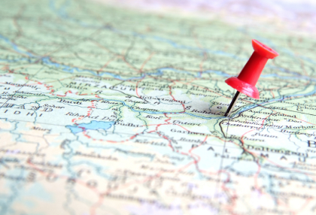
Looking Forward...
Turbidity
Political data: stability and social capital
Tariff
Local partners
Notes:
Ongoing struggle to find turbidity data.
Political data will include stability of the area, which is based on if laws being passed are being implemented; the governmental levels cannot be too far apart ie a state government can’t be handling a town’s water supply (too many degrees of separation-not stable). Social capital: the caste system in India makes it difficult sometimes for different communities to interact, or if there are many castes in one community, they may not use the same resources: a homogenous caste village will be easier to work in.
Define a number for how high the tariff will be, to create a constraint based on income and HDI. The HDI values will help us to determine other social considerations besides poverty, such as literacy rate and the inequality coefficient. We will create more correlations with HDI and poverty, as well as HDI and access to drinking water.
We are going to narrow in on place and as we go down to smaller scale we are going to have to do more specific research into these places.

Slide 11
Questions for you!
Suggestions for determining/locating water turbidity data?
Suggestions for other considerations?

Slide 12
Thank you!
Questions for us?

