Slide 1
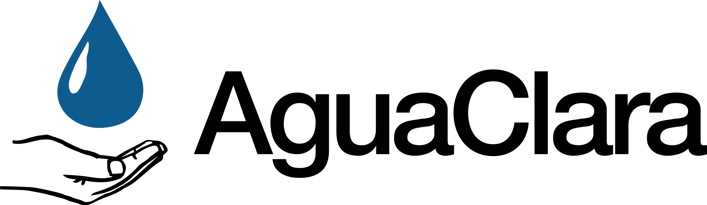
Pre-fab
The goal of the Pre-fab team was to research, test, and provide fabrication methods to be used when constructing a 1 L/s flow-rate plant in Honduras. More information can be found in the
Prefab Spring 2016 Final Report
Pre-fab | Fabrication | Final Presentation Spring 2016
Notes:
The goal of the Prefabrication 1 L/s team was to research, test, and provide fabrication methods to be used when constructing the 1 L/s plant design in Honduras. The team worked on an approximate 1/10th flow rate scale model to design novel geometries for a low-flow flocculator and sedimentation tank while implementing known AguaClara fluid mechanic techniques. The cost per capita associated with these plants will be much lower than plants built using traditional construction methods. Recommendations on design and fabrication methods were relayed to future teams working on full-scale plant production.
Link: AguaClara - Prefab Spring 2016 Final Report

Slide 2
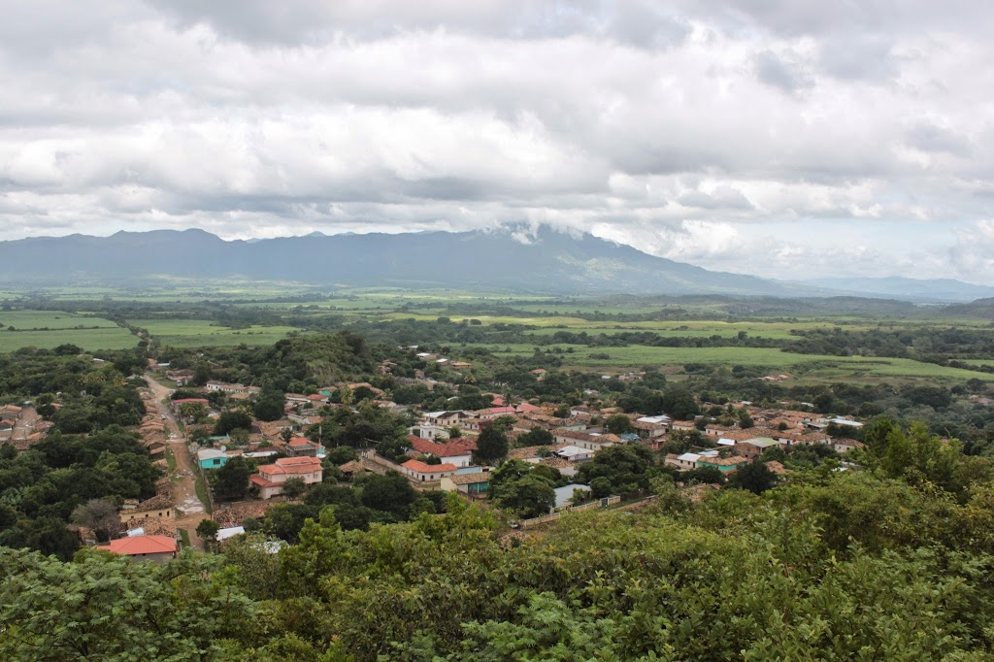
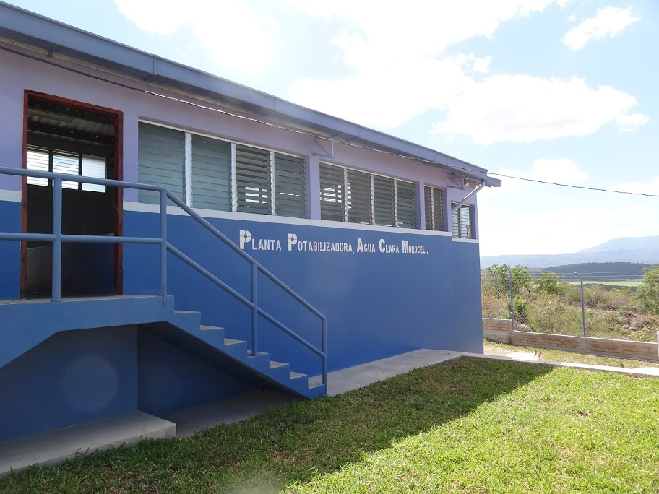
A different approach is needed to provide clean water to small communities.
Pre-fab | Fabrication | Final Presentation Spring 2016
Notes:
The goal of AguaClara is to provide clean water to small communities that do not have access to traditional water treatment infrastructure . While over the course of the last ten years AguaClara has been successful at designing plants for populations ranging from 2,000 (Ojojona) (6L/s) to 12,000 (Las Vegas) (70 L/s) the current traditional plant design has a high fixed cost making it unavailable to smaller communities. To provide treated water to smaller communities ranging from 100 to 1,000 people a new design is required using materials that are low cost and available in the areas where the fabrication will take place. See appendix slides for cost per person over a range of community sizes.
photos from http://picasaweb.google.com/100703814570796592714?gsessionid=2XeBDetkcaujpF0hUPTK4g

Slide 3
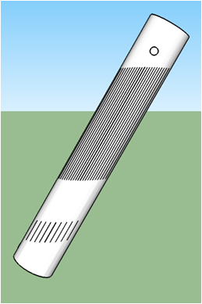
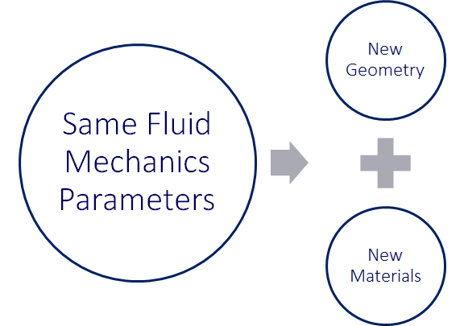
The initial design was developed in the Fall of 2015.
Pre-fab | Fabrication | Final Presentation Spring 2016
Notes:
Keep all fluid mechanics parameters the same, including upflow velocities through plate settlers, resuspension velocities through jet diffusers the, etc. All key parts were kept the same as well
In order to choose a lightweight, yet durable, alternative to concrete, we knew that inherently meant using a cylinder in order to maintain structural integrity and have all walls retain their shape (rigid)
The 2 main design alterations were the transition from concrete to plastic, and from rectangular to cylindrical. But how do we make them work?
Figure: The initial design was altered slightly.

Slide 4
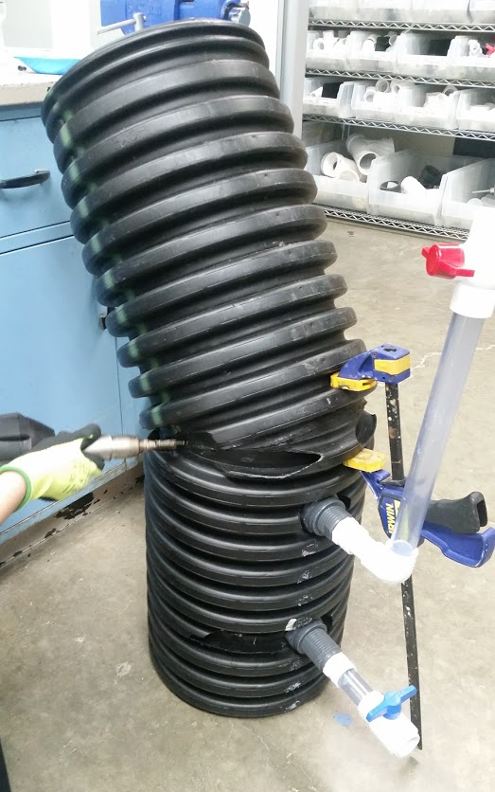
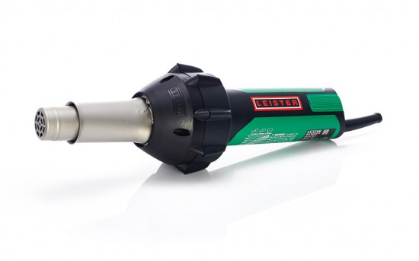
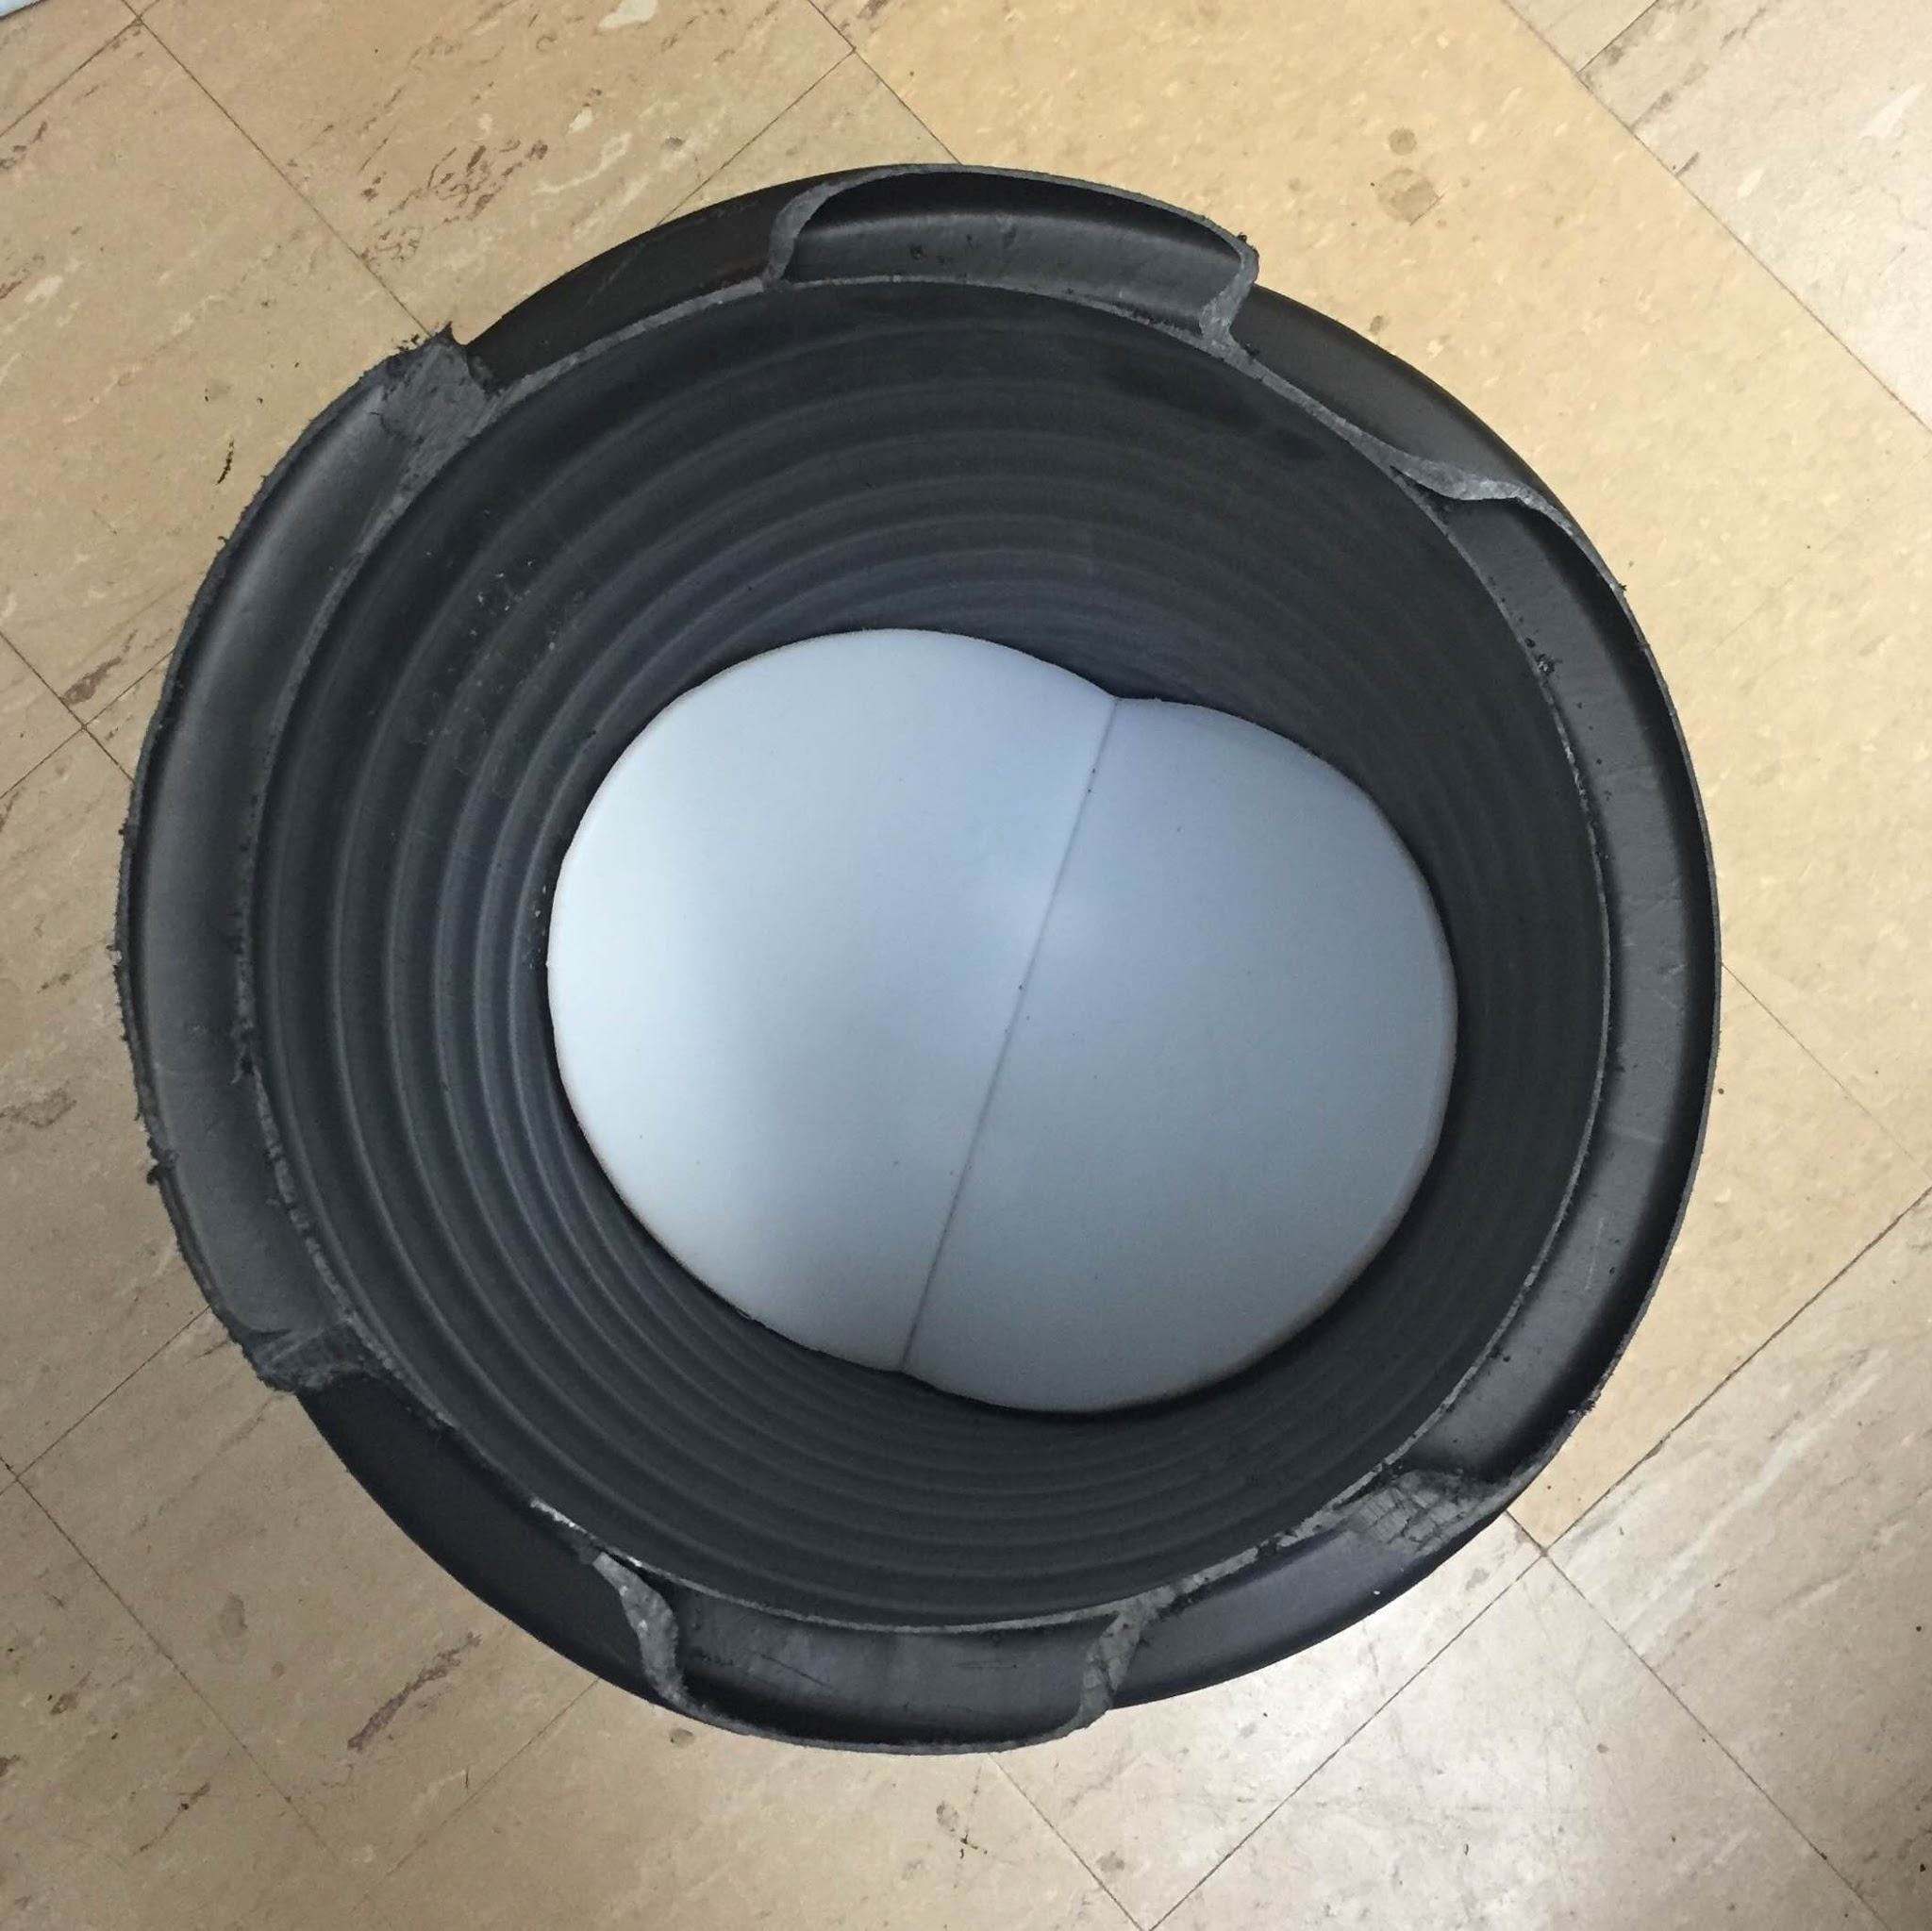
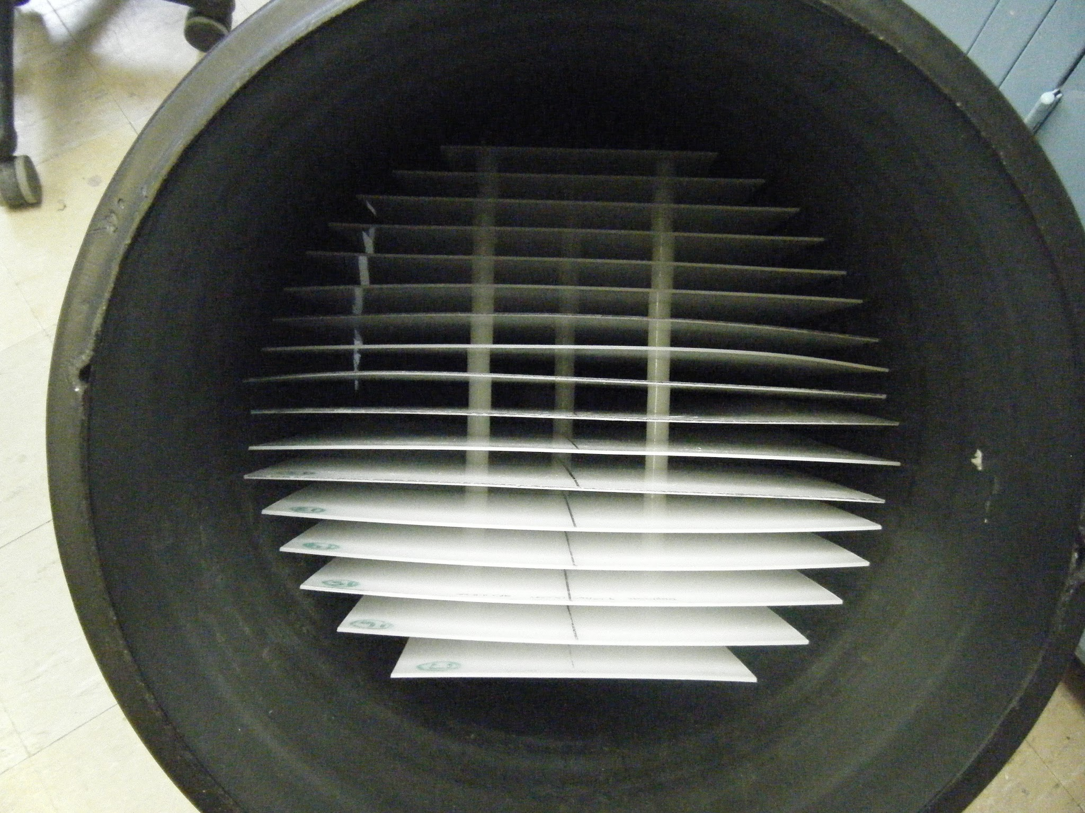
We tested fabrication techniques for a
1 L/s plant.
“Back of a pick-up truck bed” goal
Minimize wasted space
Eliminate all horizontal surfaces
Pre-fab | Fabrication | Final Presentation Spring 2016
Notes:
Design objectives:
Eliminate wasted space and horizontal surfaces where flocs can build up → SOLUTION: keep all walls and plates at a 60 degree angle so flocs don’t settle
BUT how to arrange the plate settlers?
Solution was to turning the plate settlers from a uniform row of the same size and shape to a bundle of varying widths, installed parallel to the walls of the plate
In order to make this bend, we utilized plastic welding, which is a new tool to AguaClara this year, to determine whether or not it would be viable and provide a water-tight and structurally sound seal. As stable and reliable as a concrete base would be, without the on-site construction costs and lack of portability.
30 degree bend means that the tank can stand on its own without extra supports
Figure 1: Finished low-flow sedimentation tank. The inlet manifold and the floc hopper are visible from this view.
Figure 2: Plate settlers of varying widths installed parallel to tank walls optimize the use of the space.
Figure 3: Base of sed tank keeps 60 degree slopes and is the same material as the sed tank walls for welding
Figure 4: Photo of the Leister Plastic Welder used in the process
Source: Leister welder photograph found at: http://www.welwyntoolgroup.com/plastic-welding/

Slide 5
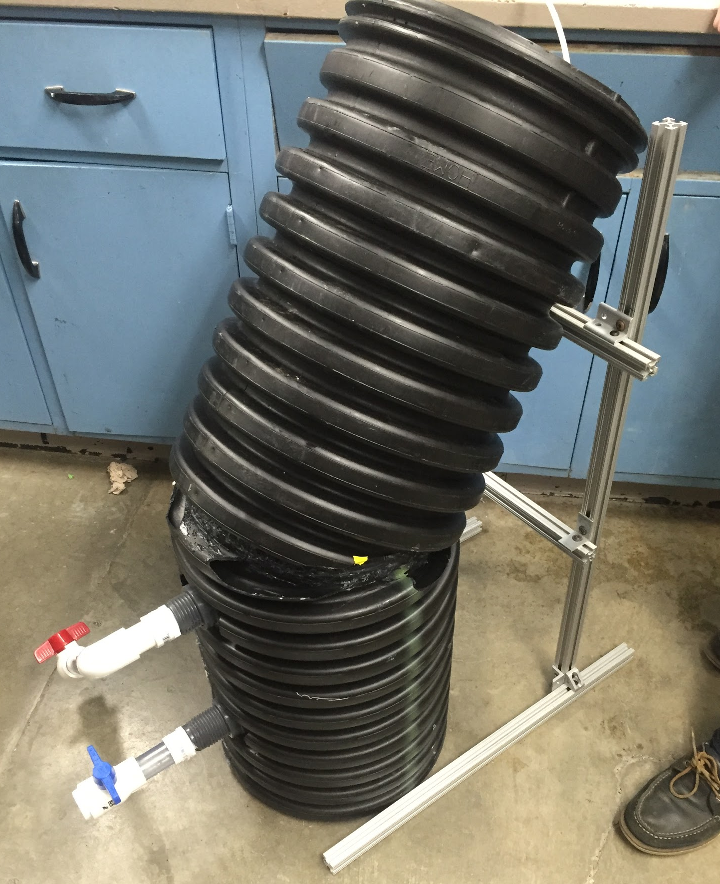
Available materials determined the scale of the built prototype.
1’ diameter HDPE
Roughly 1/10th scale
The prototype is made of HDPE, but the full-scale plants will be entirely PVC.
Pre-fab | Fabrication | Final Presentation Spring 2016
Notes:
A 1ft diameter HDPE pipe was donated by the Ithaca City Works Department and this pipe set the scale of our prototype to be 1/9 of the full size plant. Additionally, this pipe was made of HDPE which meant that due to plastic welding and material congruency, the base plates also needed to be made of HDPE while in the full size plant, the material will hopefully be PVC which is slightly easier to work with.

Slide 6
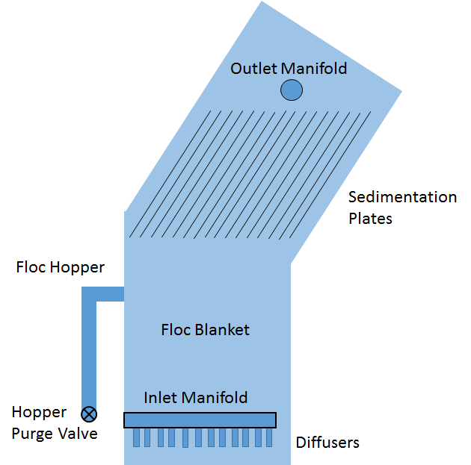
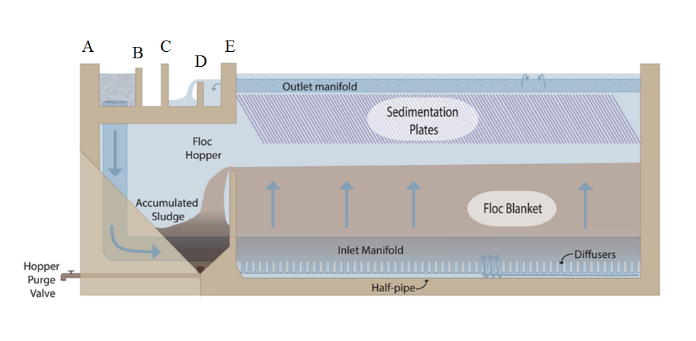
Low flow rate design requires a different geometry.
Pre-fab | Fabrication | Final Presentation Spring 2016
Notes:
The figure to the left displays the traditional AguaClara sedimentation tank in a rectangular tank. The figure to the right displays our updated sedimentation tank in an angled, circular pipe. Each tank component present in the traditional tank is also present in our re-organized low flow tank.
Traditional sedimentation tank figure from CEE 4550 Sedimentation: http://courses.cit.cornell.edu/cee4540/Sedimentation.pptx
Appendix slides: Low Flow Sed Tank Geometry Outline

Slide 7
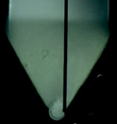
The geometry of the base is modeled after that in a traditional plant.
The 60° slopes at the bottom of the tank and the jet diffuser positions were kept the same for the 1 L/s plant.
Pre-fab | Fabrication | Final Presentation Spring 2016
Notes:
Figure on the Left: Image of the HDPE prototype with base inserted. The jet reverser is not yet installed.
Figure on the Right: Cross sectional view of a traditional plant’s sedimentation tank with jet diffuser and jet reverser..
The goal was to keep the geometry the same as the traditional plant, 60 degree sloped sides. The challenges presented in the fabrication of the base were due to the circular geometry of the tank and in the welding of the two ellipses that composed the base. The jet reversor was made from half a HDPE pipe and the sides were sheets of ¼ inch HDPE plastic.
Traditional sedimentation tank photo from CEE 4550 Sedimentation: http://courses.cit.cornell.edu/cee4540/Sedimentation.pptx

Slide 8
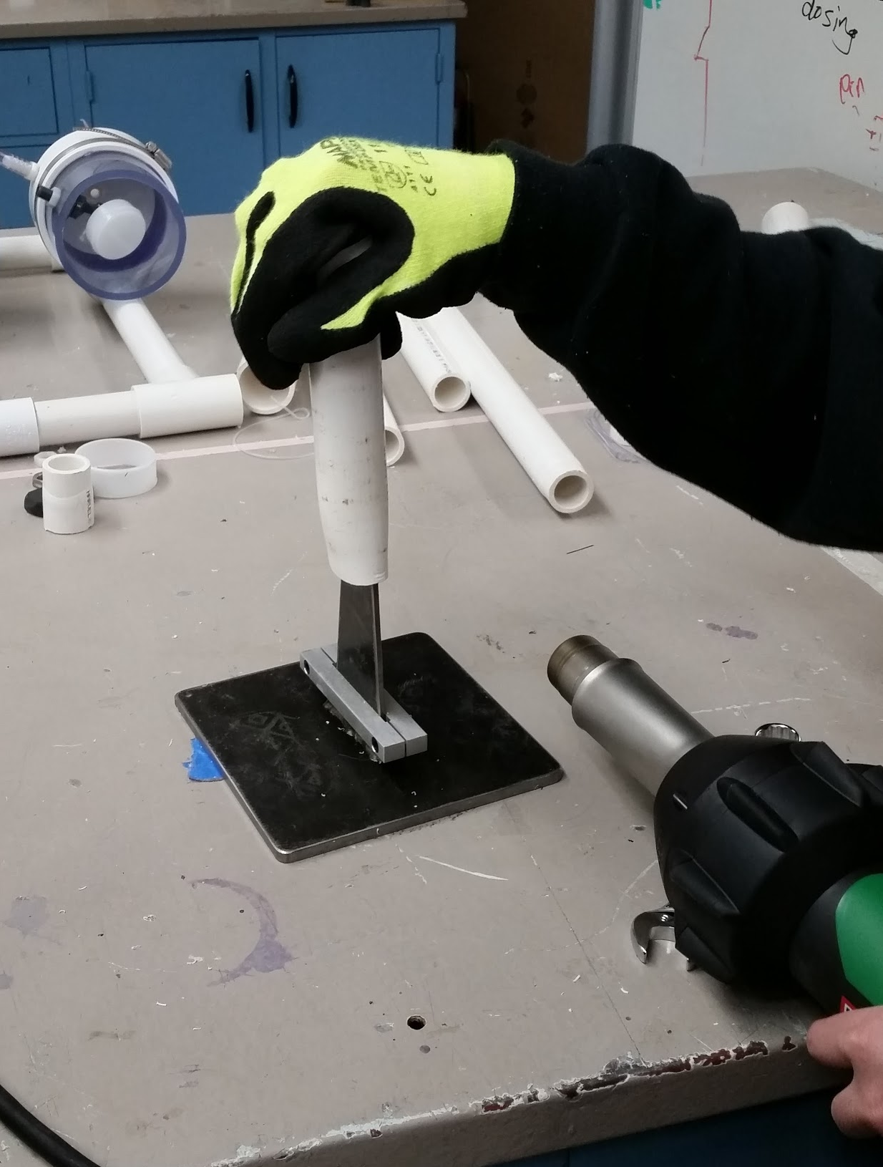
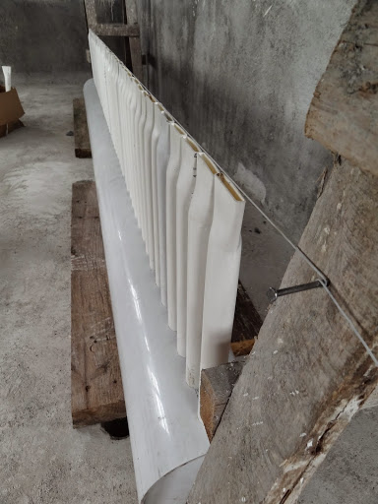
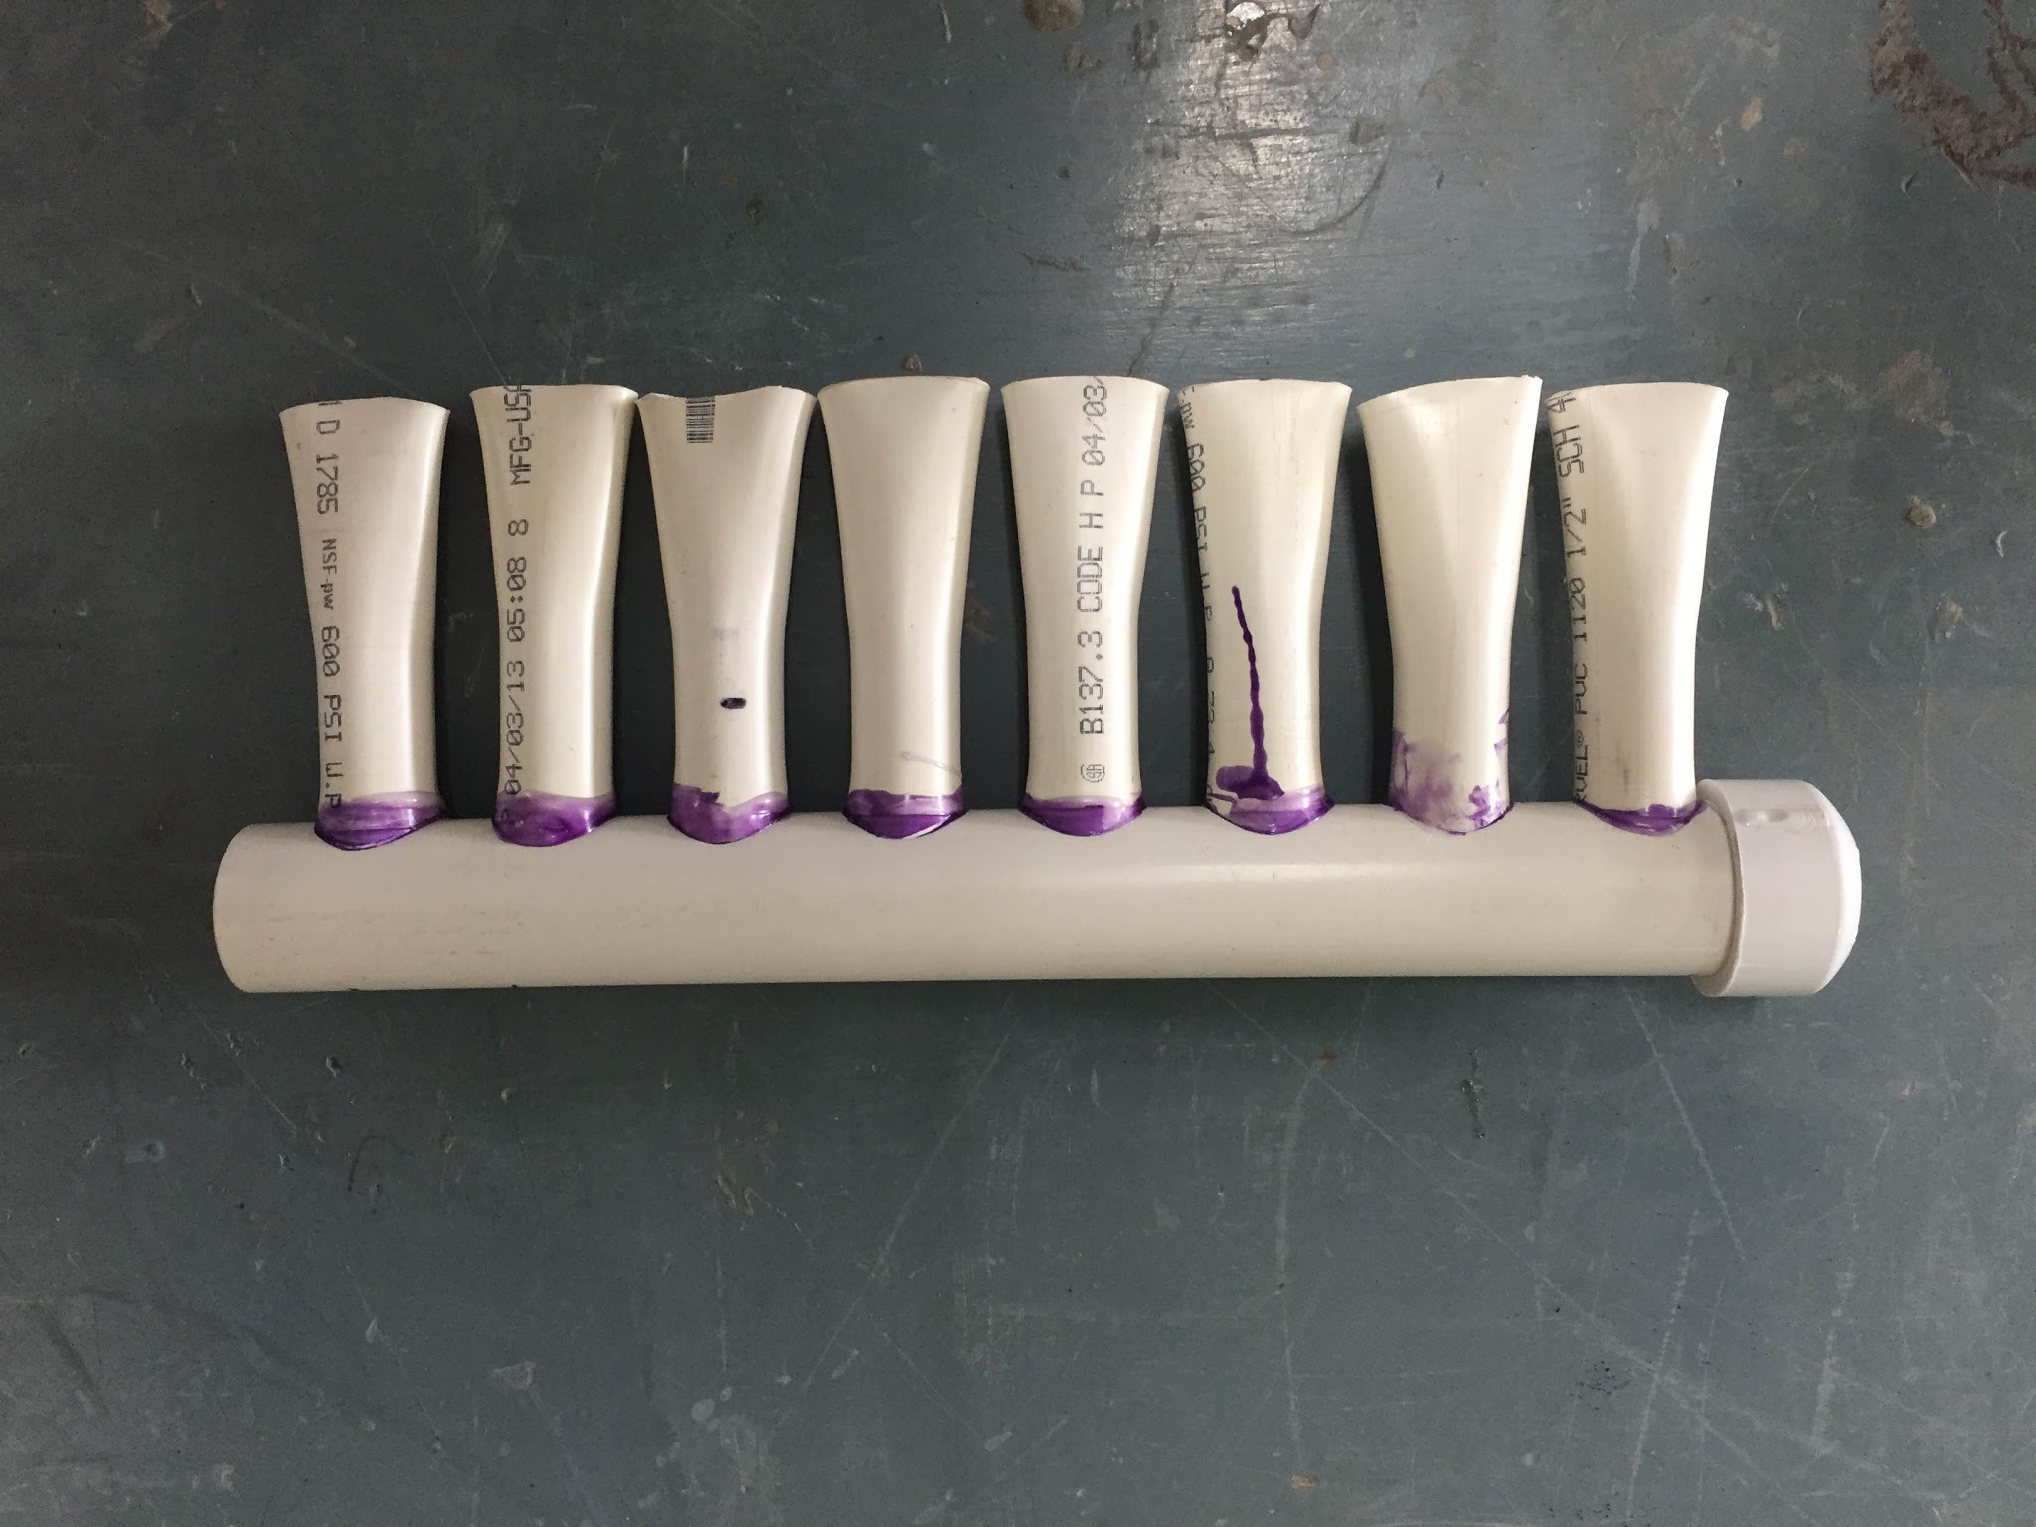
The influent pipe was also modeled after existing plants.
Prototype influent pipe with jet diffusers
Full scale influent pipe in a traditional plant
Jet diffuser fabrication.
Pre-fab | Fabrication | Final Presentation Spring 2016
Notes:
The inflow pipe was designed to be as similar to the traditional plant as possible. The scale of inlet pipe to diffusers was kept about the same and diffusers were created in the same manner of heating the pipes and forming them around a metal mold.
Figures from left to right:
The firsts picture shows an upside-down traditional inlet manifold.
The second picture shows our prototype influent pipe.
The third picture shows the diffuser forming process where the plastic was heated with the plastic welder and molded using an inverted triangular metal shape.

Slide 9
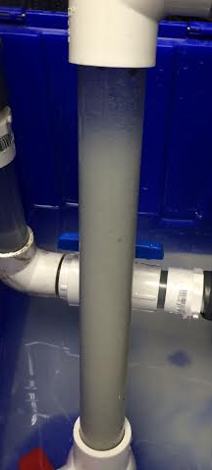
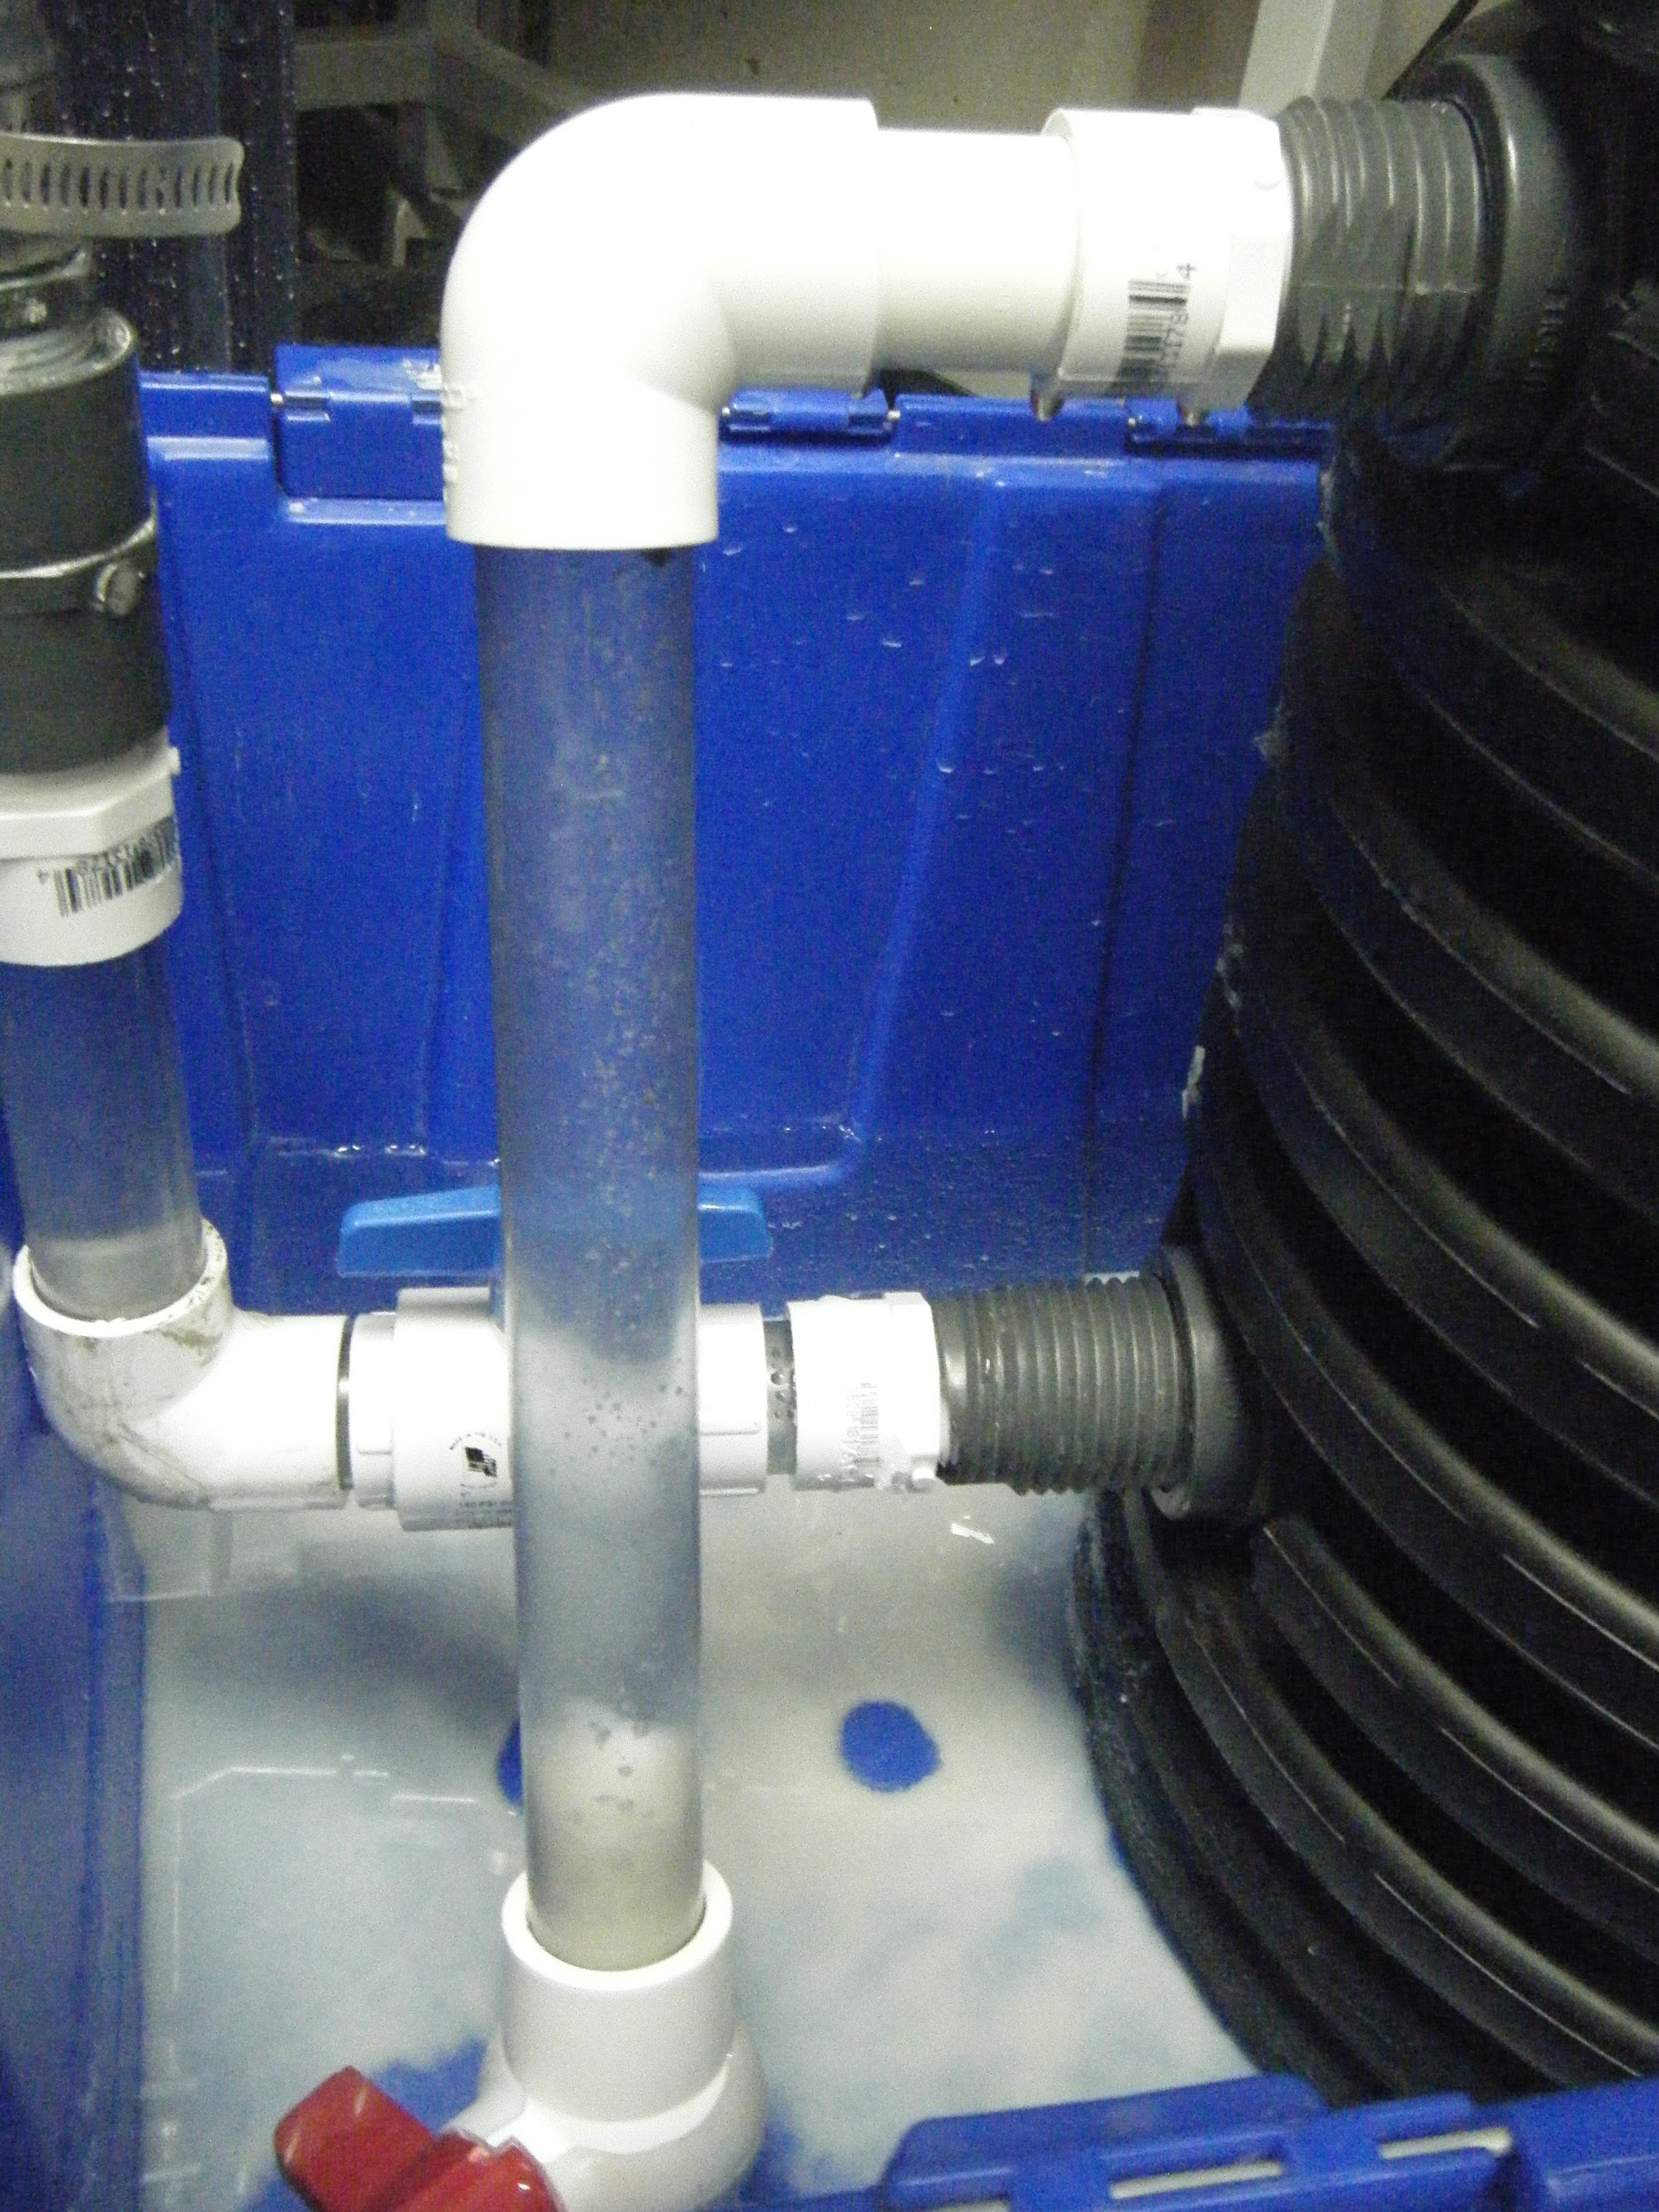
The floc hopper has an altered geometry but still functions successfully.
Floc Hopper
Pre-fab | Fabrication | Final Presentation Spring 2016
Notes:
The goal of the floc hopper is to remove flocs from the tank to prevent sludge build up and consequent draining. In addition, the floc hopper determines the height of the floc blanket which plays a critical role in improving plant efficiency. In traditional plants a floc weir divides the sedimentation tank from an area of stagnant water where the flocs settle out known as the floc hopper. In our design the entrance to the floc hopper is a hole where a bulkhead fitting is fixed to the side of the tank. This fitting creates a water tight connection to a horizontal pipe that connects to an elbow to a clear vertical pipe that is capped with a valve allowing us to see the build up of flocs in the floc hopper. Although ideally there would be no horizontal surfaces anywhere in the plant to prevent floc build up, the fabrication of a pipe at a 60 degree angle proved very difficult and as one can observe the current design has been proven successful.
Figures from Left to Right:
Diagram showing traditional plants’ floc weir.
Prototype’s floc hopper after 8 hours of tank operation. The flocs have begun to accumulate in the floc hopper.
Floc hopper after priming. Flocs were stirred up and are therefore more visible.

Slide 10
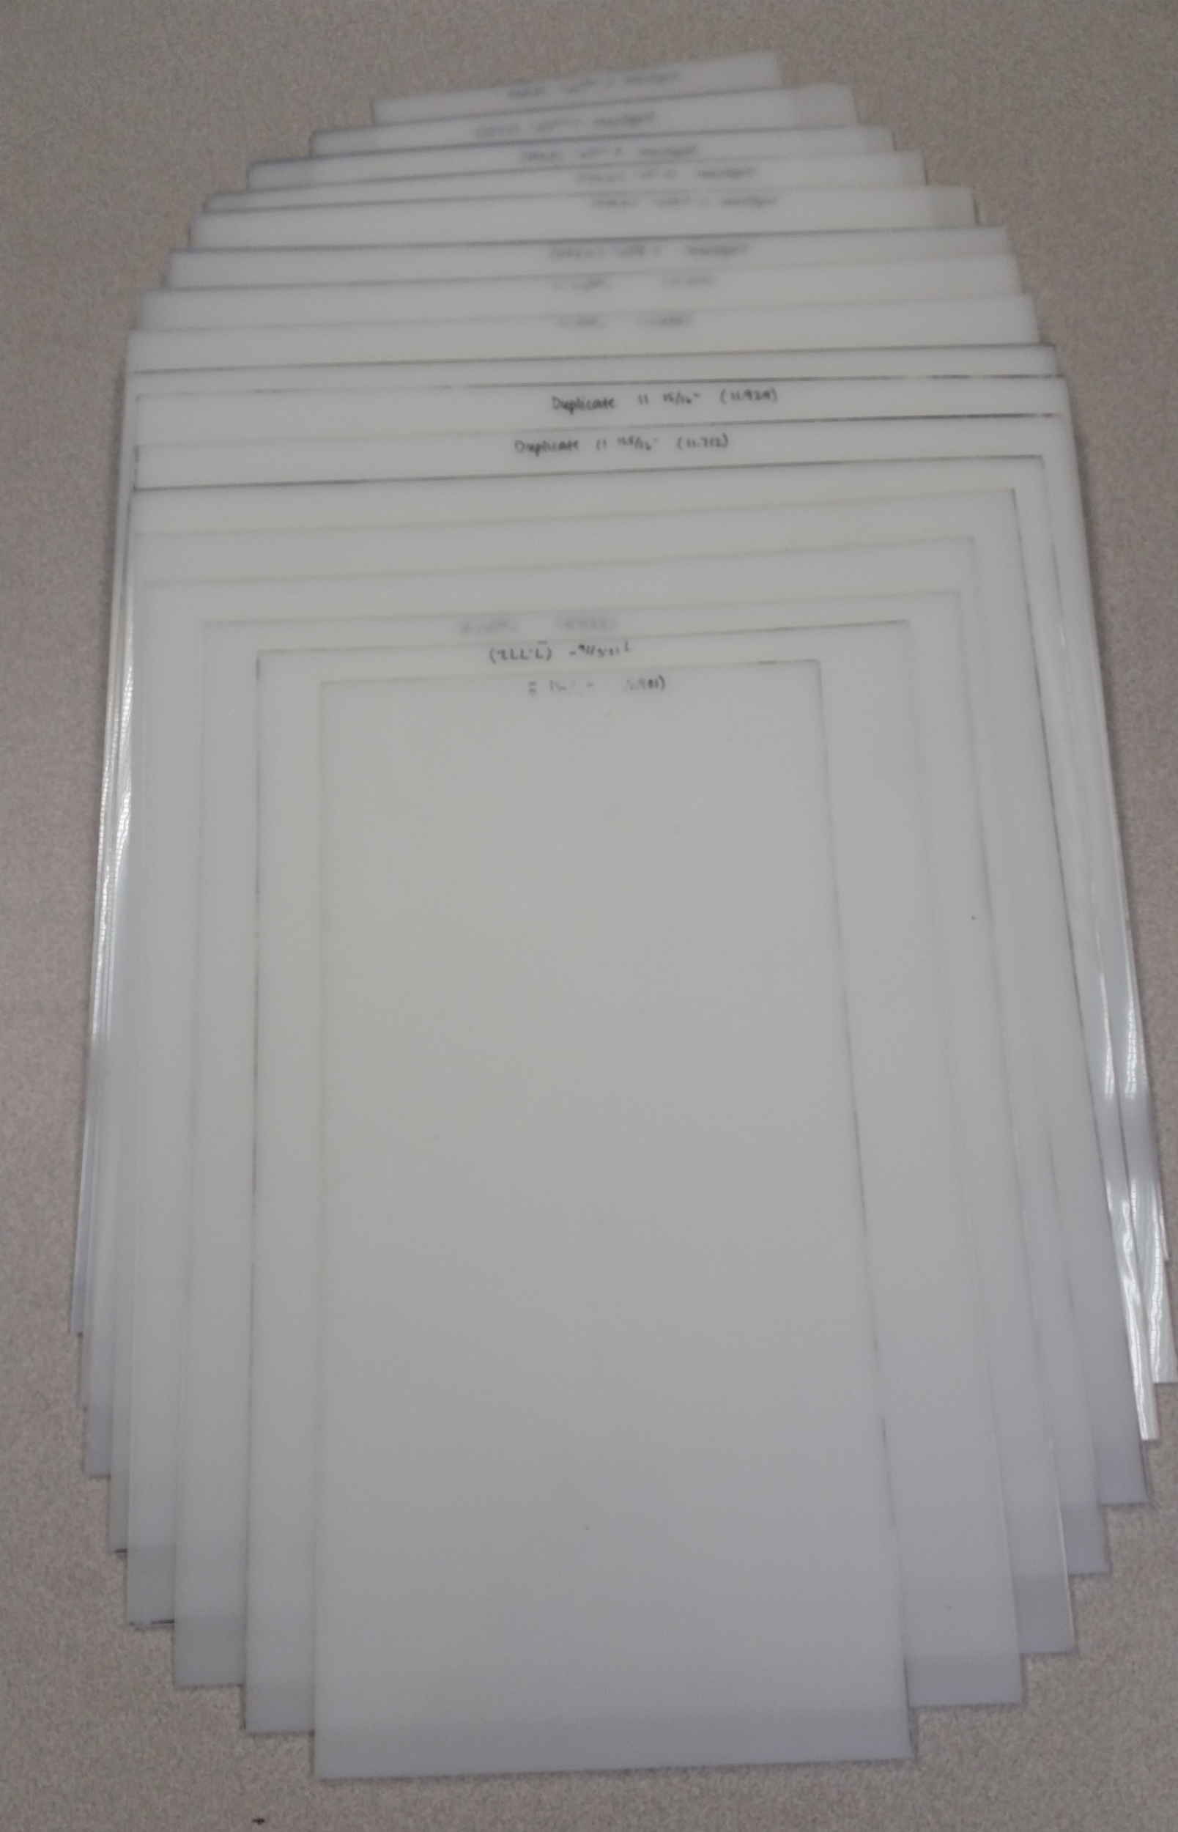
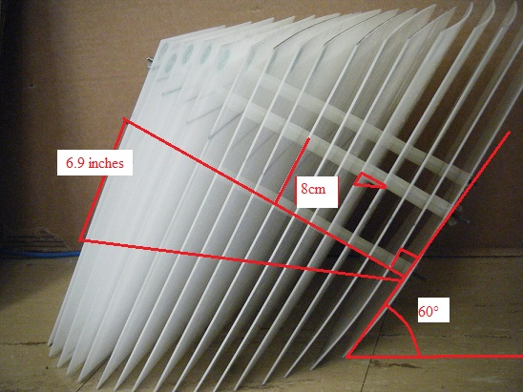
The plate settlers were redesigned to optimize space constraints.
Pre-fab | Fabrication | Final Presentation Spring 2016
Notes:
The plate settler module was redesigned to accommodate changes in space and upflow velocity. The smaller space caused the plates to have a shorter length which consequently required smaller spacing for effective floc removal. The plates are varying sizes to match the curved geometry of the pipe and the module is designed so that the plate are parallel to the slanted portion of the pipe to maximize space. The single module design makes it easy to remove for cleaning and maintenance purposes.
Figure on Left: Diagram showing the spacing between plates and the positioning of the rods in the module.
Figure on Right: Photo showing the varying widths of each plate settler.

Slide 11
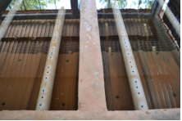
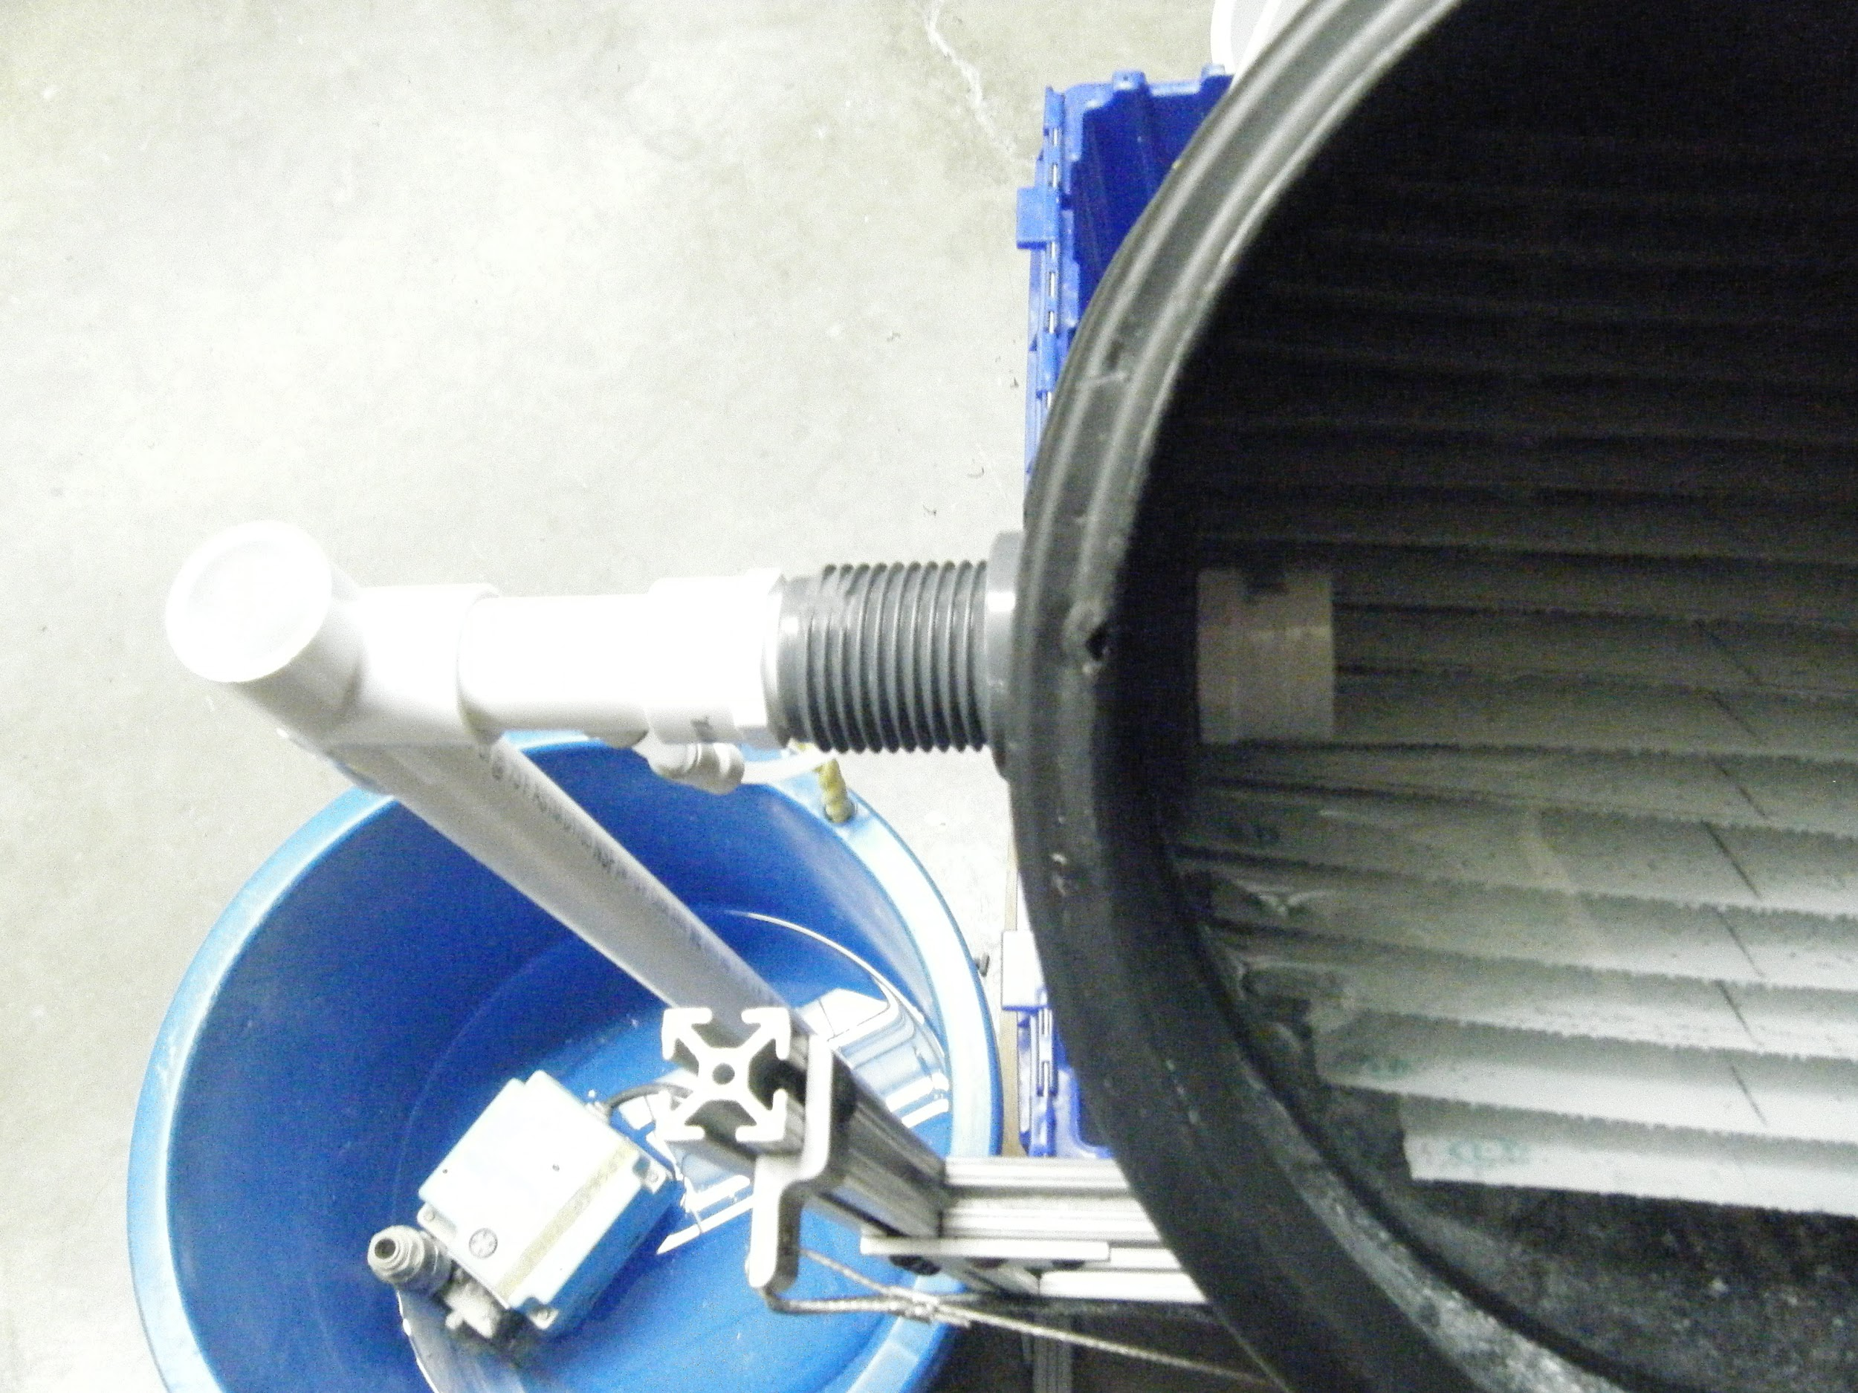
The outlet pipe is modeled after the current design in traditional plants.
Traditional plant exit launder
Prototype outlet pipe
Pre-fab | Fabrication | Final Presentation Spring 2016
Notes:
The traditional outlet pipe, known as the exit launder is a pipe with holes in the top that extends the length of the sedimentation tank allowing water to exit uniformly. The current outlet on our prototype is only a hole sealed by a bulkhead fitting that releases the water to a storage container where it is pumped into a sink. Due to the small size of our prototype the maximum distance the water must travel is minimal and does not have a detrimental effect on the outflow. The prototype previously had an exit launder but the holes were not sufficiently large to allow water to exit at the same velocity that it was pumped in. We hope to drill the holes larger so that we can use the exit launder as an outlet again.
Photo on Left: Photo of traditional plant’s exit launder. (Source: https://picasaweb.google.com/100703814570796592714?gsessionid=VGh3N-ILPR0eUxvrGAfmcA)
Photo on Right: Prototype’s outlet manifold is currently a hole in the pipe but will be comparable to a traditional exit launder later on.

Slide 12
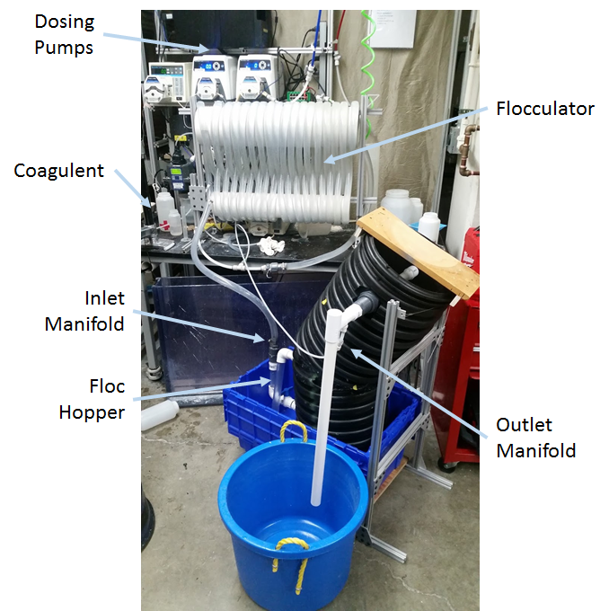
Our tank achieved its target flow rate of about 100mL/s
Notes:
We chose to focus on fabrication techniques for the sedimentation tank rather than the flocculator or the dosing components because we felt that the sedimentation tank was the least scalable component and has the most potential for innovation. Our goal throughout the semester was to be able to actually test our sed tank. We borrowed the high rate sed team’s flocculator and ran it at approximately twice their nominal flow rate using a direct line from the overhead water system and achieved a flow rate of 115 mL/s.
Figure: Photo of the set-up for a test run of the sedimentation tank prototype.

Slide 13
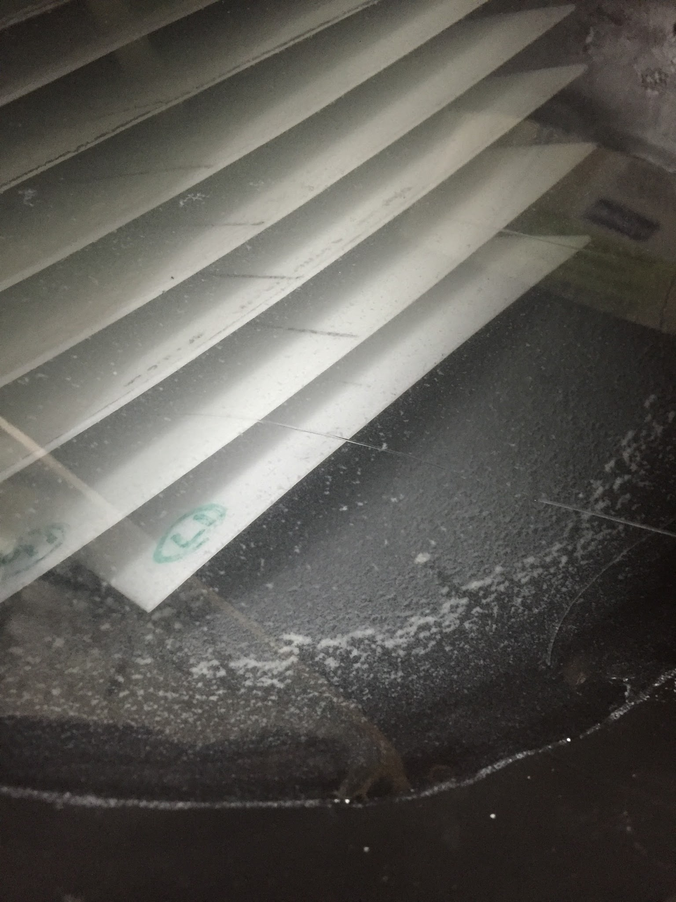
Flocs were removed from the water and slid down the plates and tank walls
Pre-fab | Fabrication | Final Presentation Spring 2016
Notes:
During the initial run, flocs settled out onto the plate settlers and the tank walls, gradually accumulating and sliding back down to the main portion of the tank. The flocs rejoined the floc blanket and were removed through the floc hopper.
Figure: Photo showing the coagulated particles settling and sliding down the walls of the tank, down to the floc blanket.

Slide 14
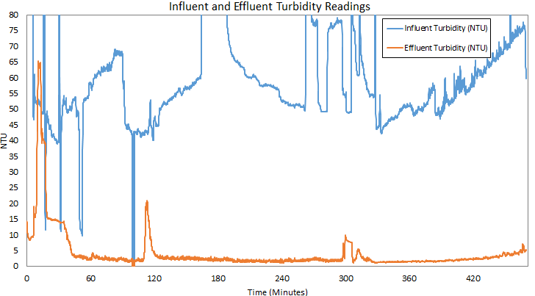
Our tank successfully cleans water to meet WHO standards of < 5 NTU!
Pre-fab | Fabrication | Final Presentation Spring 2016
Notes:
Our sedimentation tank successfully cleaned inflow water with a turbidity of over 50 NTU to meet WHO standards of less than 5 NTU. Traditional AguaClara plants have effluent turbidities of less than 0.3 NTU and this is ultimately our goal. One key area that could improve performance is the presence of a floc blanket.

Slide 15
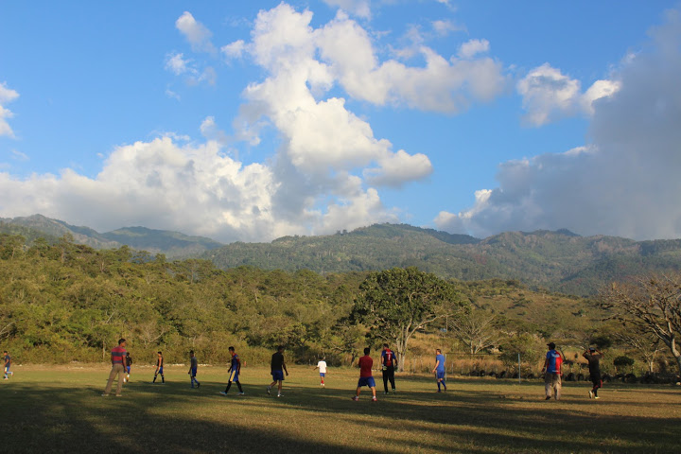
The next step will be to build a 1 L/s plant here in Ithaca.
Pre-fab | Fabrication | Final Presentation Spring 2016
Notes:
There is a lot more work to be done here in Ithaca to scale up to the 1 L/s plant. Future work regarding welding at a larger scale, scaling up plate settler module, and the option of purchasing a pre-welded angled tank will all be investigated before implementation in Honduran communities.

Slide 16
Questions
and
Recommendations
Claire DeVoe
Bachelor’s of Science,
Civil Engineering
cmd288@cornell.edu
Meryl Kruskopf
Bachelor’s of Science, Environmental Engineering
mjk347@cornell.edu
Kimberly Buhl
Bachelor’s of Science,
Civil Engineering
knb39@cornell.edu
Felix Yang
Bachelor’s of Science,
Mechanical Engineering
fyy2@cornell.edu
Pre-fab | Fabrication | Final Presentation Spring 2016

Slide 17
Appendix
Slides
Pre-fab | Fabrication | Final Presentation Spring 2016

Slide 18
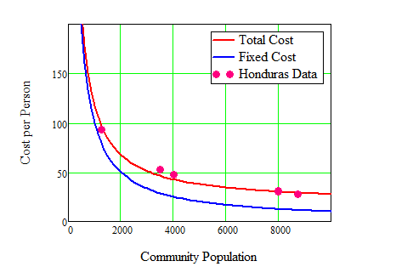
Traditional plants in small communities are expensive
Traditional AguaClara plants cost per person becomes prohibitive in small communities.
Pre-fab | Fabrication | Final Presentation Spring 2016
Notes:
The plot of total cost per person vs population the plant served. In large populations, the cost per person remained low, but in smaller plants the cost per person increased dramatically to where it becomes prohibitive.
Source: Agua Para el Pueblo, Plant Cost Calculations

Slide 19
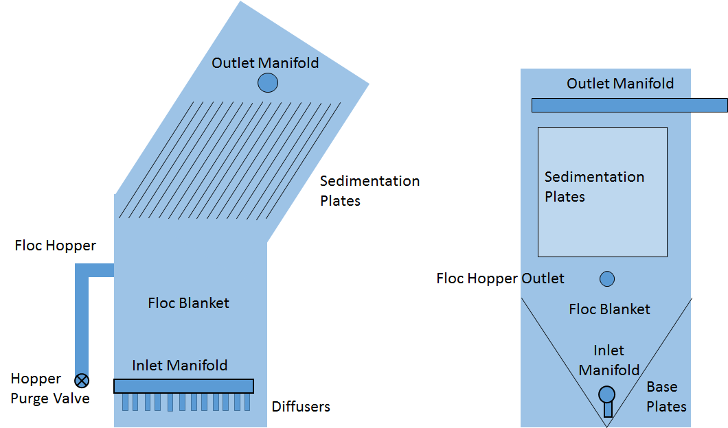
Sedimentation Tank Design
The low flow sed tank is made up of the same components as traditional concrete AguaClara sedimentation tanks.
Pre-fab | Fabrication | Final Presentation Spring 2016
Notes:
Water flows into the tank at the base through the diffusers in the inlet manifold and resuspends flocs that settle on the angled base plates. The floc hopper removes settled flocs and the hopper purge valve allows for draining the sludge. The sedimentation plates provide additional surface for the flocs to settle out on and clean water exits the tank through the outlet manifold at the top.

