Slide 1

Pre-Fabrication 1L/s
To discuss the progress of Fall 2016 team and the changes we are making to the process of fabricating the 1L/s plant
Fabrication | Symposium Presentation Fall 2016
Notes:
[[Insert your abstract here.]]
[[Add a link to your full report here. ]]

Slide 2
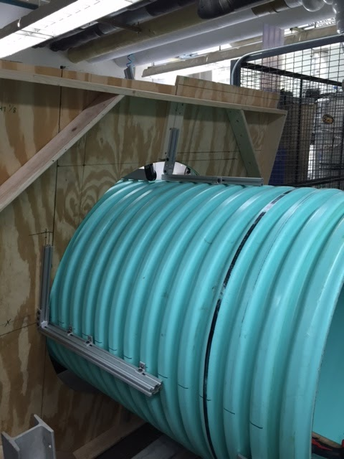
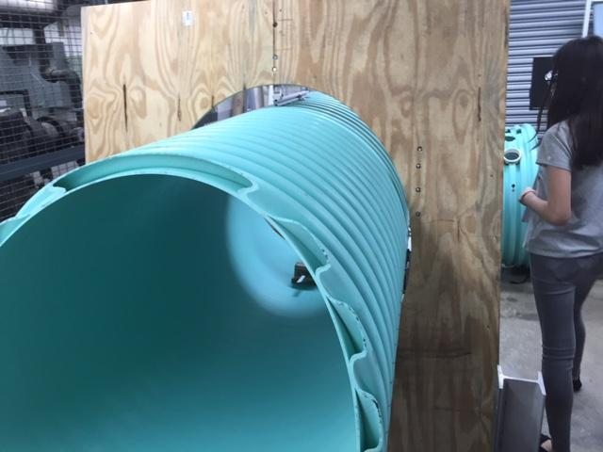
Sedimentation Tank Fabrication
In order to cut the pipe, a wooden jig consisting of a board with an ellipse cut in its center was fit over the pipe.
The jig was fixed using 80/20 bars and joints, screwed directly to the pipe
Pipe from other side
Pipe before it was cut
Pre-Fab 1 L/s | Research | Symposium Presentation Fall 2016
Notes:
https://www.overleaf.com/5664827xxxksv#/18394639/
This slide shows the jig mounted and prepared on the sed tank for the cutting process. The proper angle and argument for the jig can be found in the appendix slide on sed tank geometry.

Slide 3
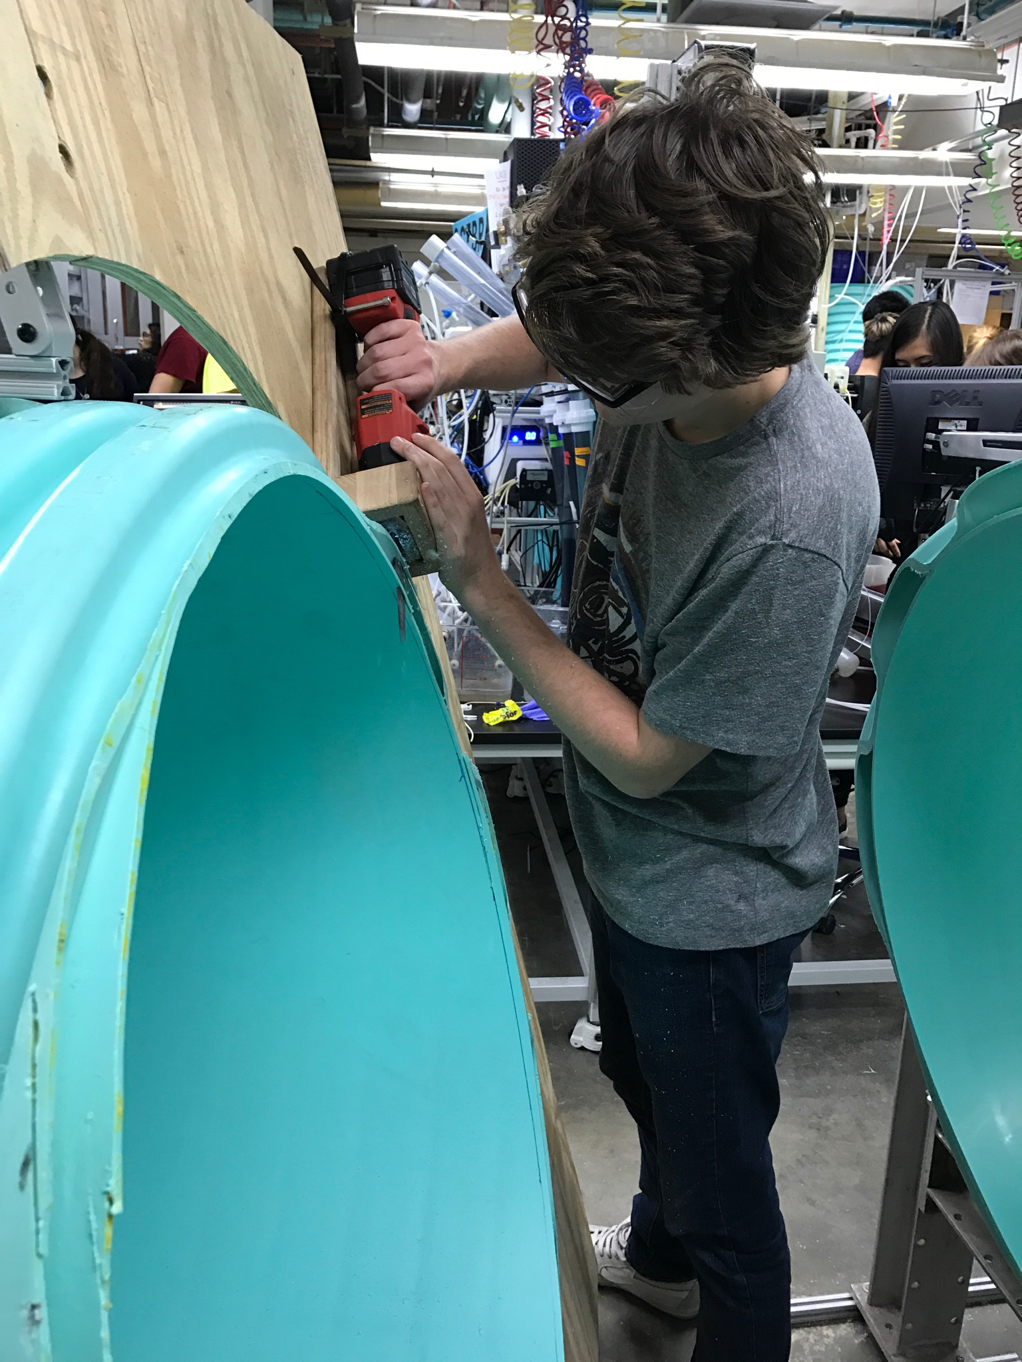
Sedimentation Tank cont.
In order to actually make the cut, a reciprocating saw was fit into a cradle and brought around the circumference of the pipe.
Sean cutting the pipe
Pre-Fab 1 L/s | Research | Symposium Presentation Fall 2016
Notes:
Cite your sources here.
This picture shows the general technique for cutting the sed tank. This is the primary step in fabricating the sed tank.

Slide 4
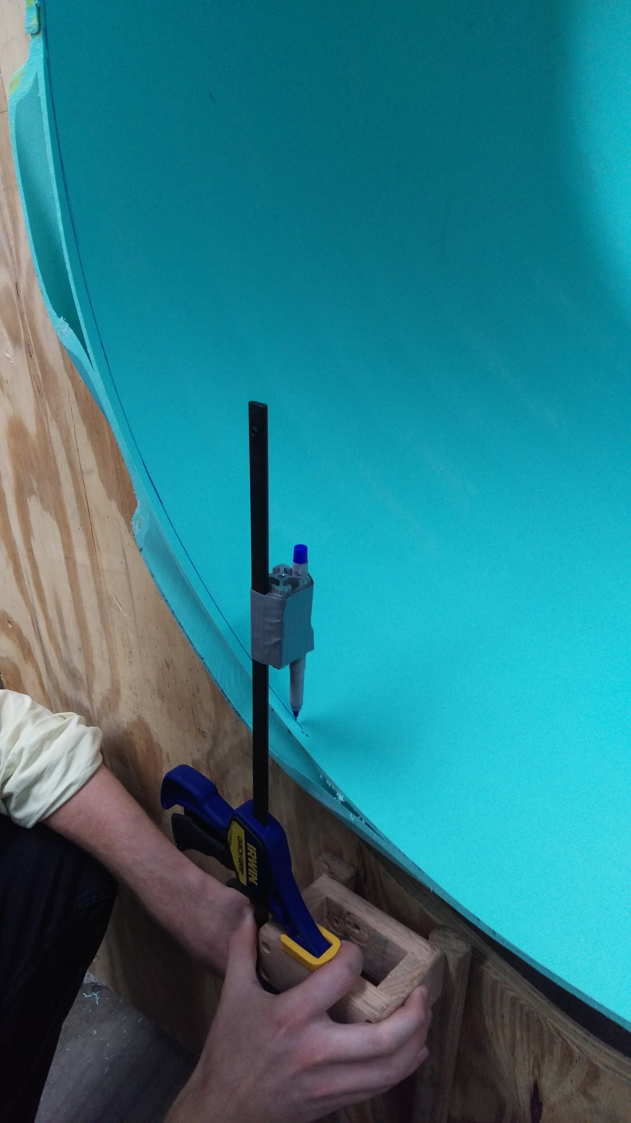
Recutting the Sed Tank, Marker Jig
Initial cut was not satisfactory. Had to cut again.
Jig was constructed to make it more accurate.
This new system accomplished its goal.
Even more accurate methods of cutting should be explored.
Using the jig
Pre-Fab 1 L/s | Research | Symposium Presentation Fall 2016
Notes:
Citation : Pre-Fabrication 1L/s, Fall 2016

Slide 5
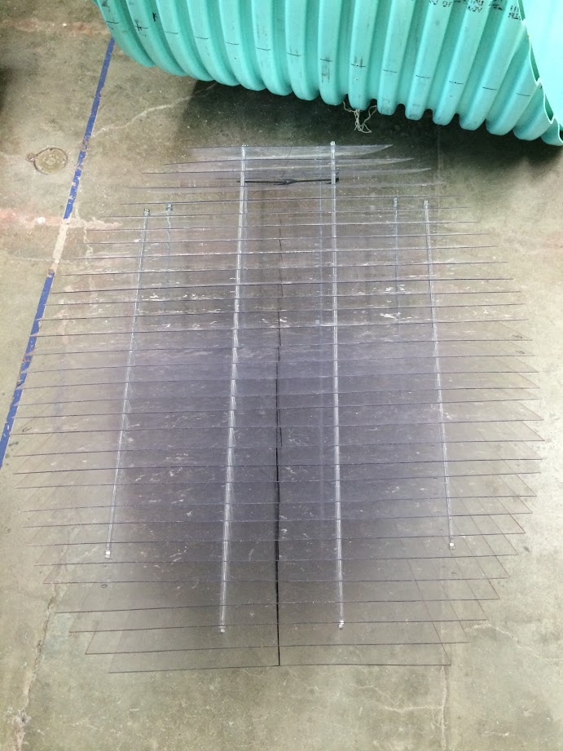
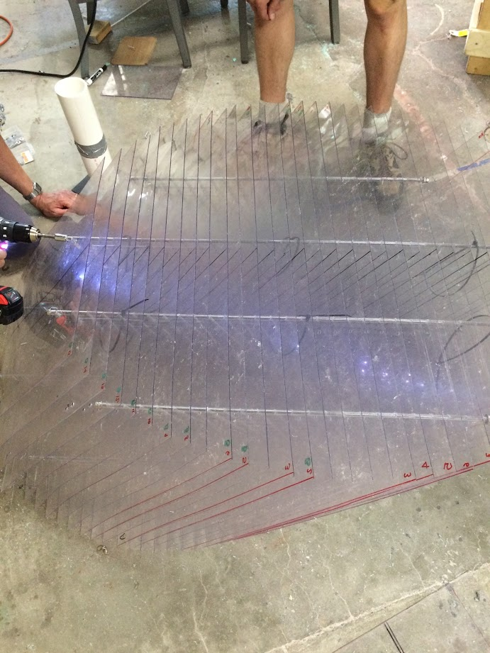
Plate Settlers
Plate settlers spacers were cut longer than they needed to be
Resulted in the loss of 3 plates.
Though the plant still worked, it was not ideal.
Assembled Plate Settlers Top View
Assembled Plate Settlers Side View
Pre-Fab 1 L/s | Research | Symposium Presentation Fall 2016
Notes:
Refer to Appendix about Plate Settler Geometry: The purpose of the plate settler is to trap flocs that rise above the floc blanket. (Flocs that did not collide with and join the floc blanket and reintroduce them into the floc blanket- increasing the chance of a collision and subsequent removal of the floc through the sludge drain.). Each plate settler is followed by a rod called a spacer. There is supposed to be 34 plate settlers and 33 spacers. However, because the cumulative error in spacers being cut longer (approximately 0.4cm longer), it resulted in a loss of 3 plates.
Citation: Summer 2016 AguaClara Mini-Plant

Slide 6
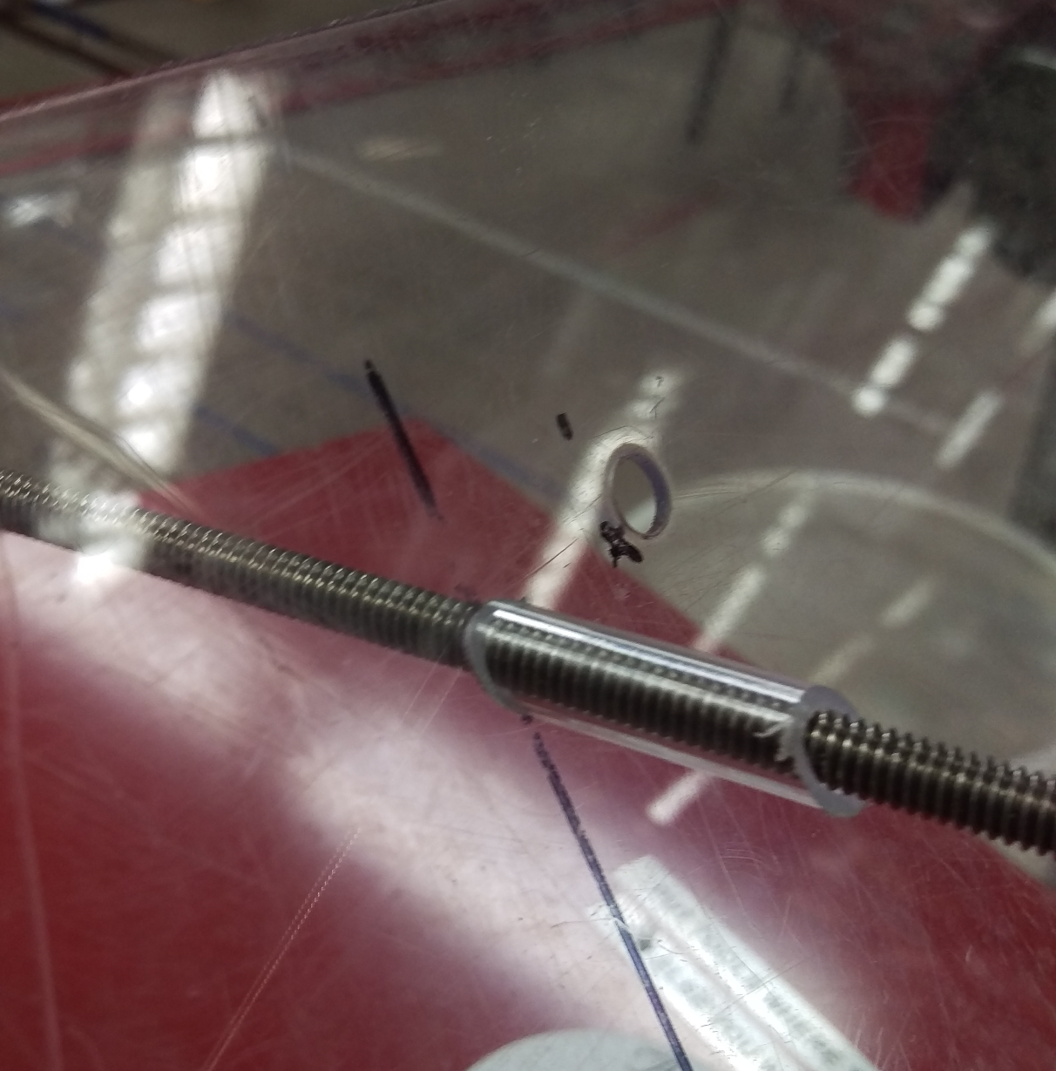
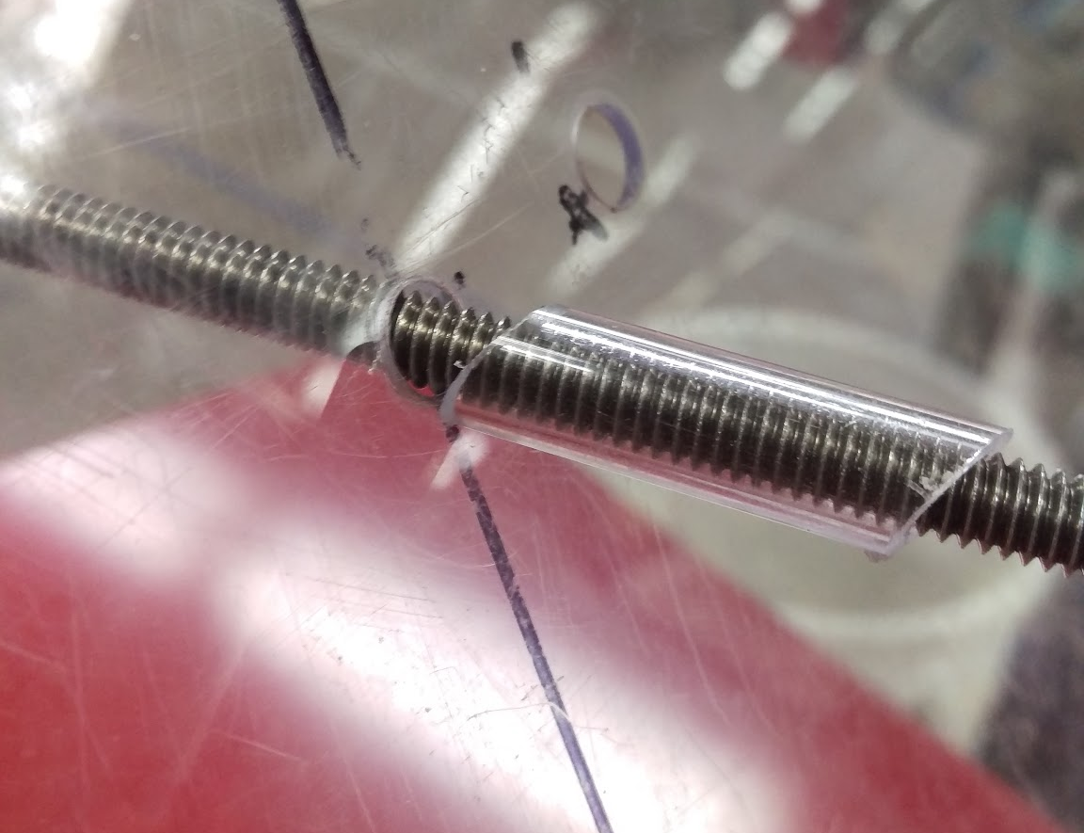
Plate Settlers cont.
Incorrect spacer orientation
Correct spacer orientation
Pre-Fab 1 L/s | Research | Symposium Presentation Fall 2016
Notes:
In addition to the error in the spacers, there was some error when assembling the plate settlers altogether. When assembling, the spacers tend to rotate. If they are not in the correct orientation, they can increase the distance between the plate settlers, which adds to the cumulative error.

Slide 7
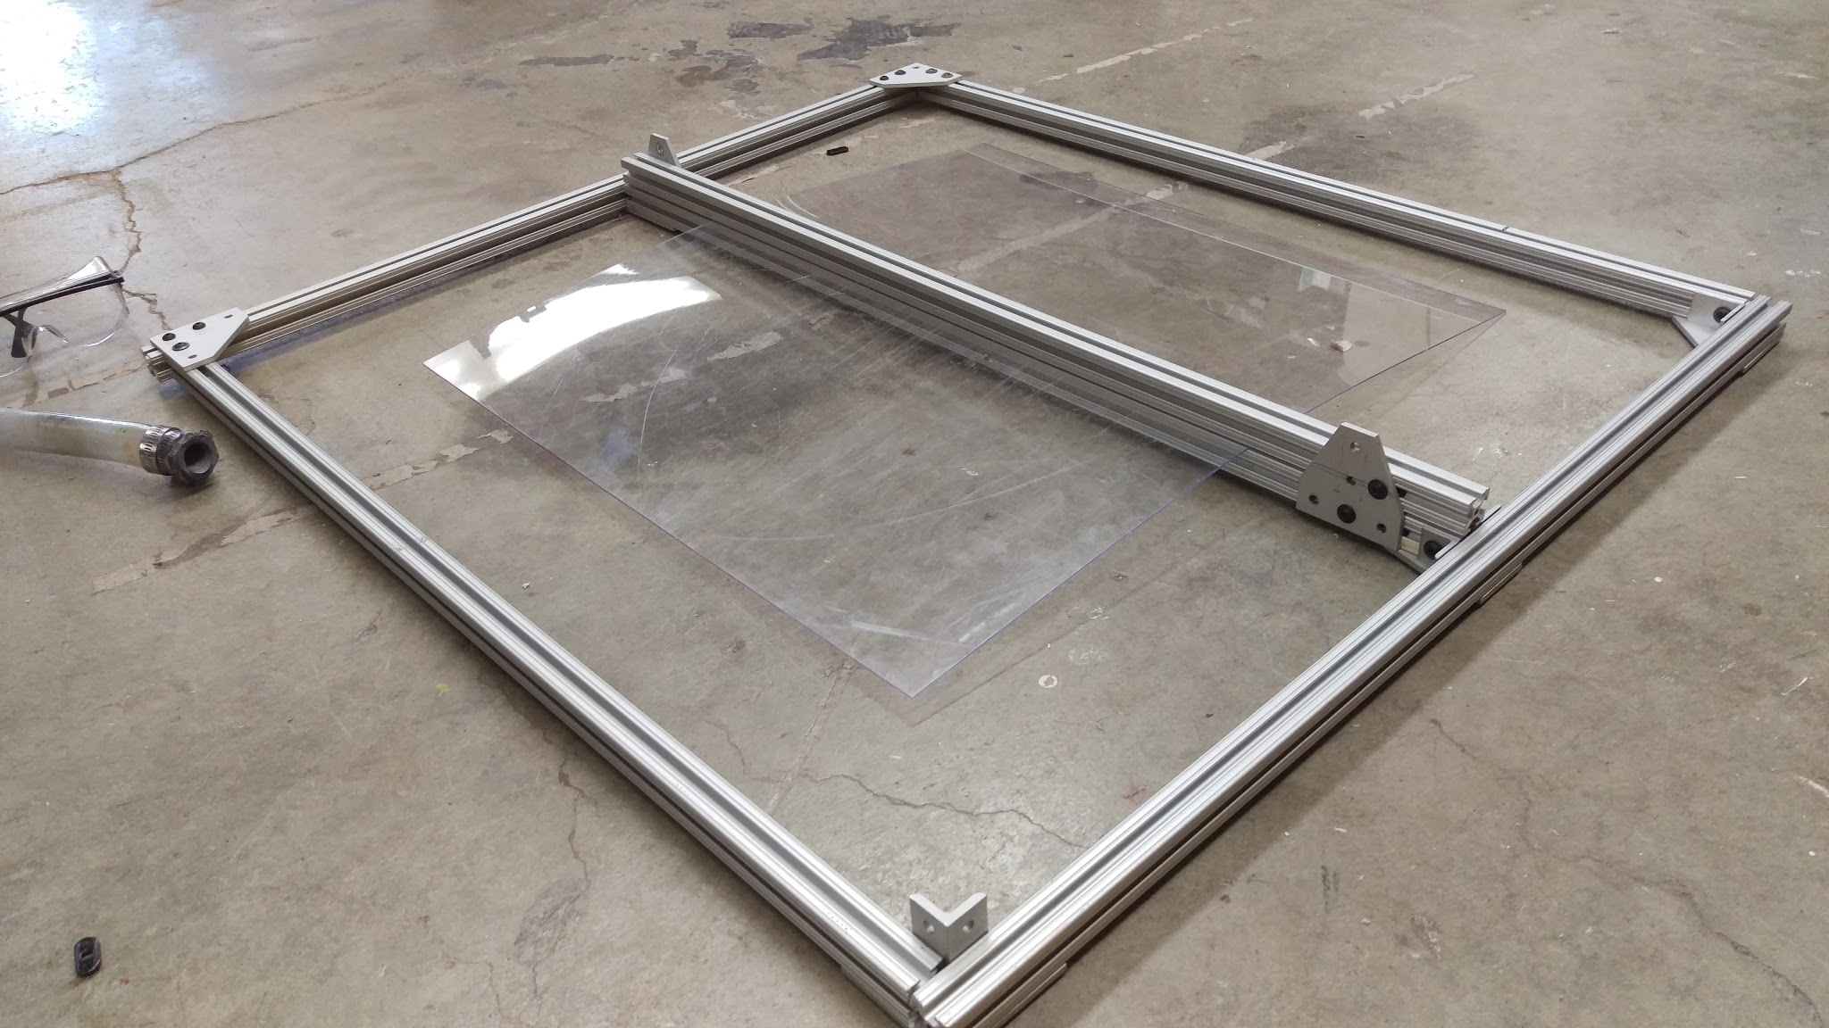
Plate Settler Shear-Jig
Allows for the shear to cut plate settlers more accurately.
Does this by having a surface to lay against.
Is easily reproduced and only requires 80/20
Plant Settler Shear- Jig Top View
Pre-Fab 1 L/s | Research | Symposium Presentation Fall 2016
Notes:
Citation : Pre-Fabrication 1L/s, Fall 2016
As for the plates themselves, there was some error resulting from how the plates and holes weren’t cut and drilled accurately. When drilling the holes, the plates were clamped together and had a centerline drawn. There was error in aligning the plate settlers because of the error in markings and drilling the holes. In addition, the drill bit size that was used was a bit tight for the rod which made assembly difficult.
In order to more accurately cut the plates and drill the holes, we created a jig. This jig allows for the shear to cut the plates settlers in equal sizes. Instead of cutting each of the plate settlers to their individual smaller sizes and then drilling, we will drill the holes onto the plate settlers when they are all the same size to make sure that the holes align first. This jig is easily reproducible and requires only 80/20 pieces.

Slide 8
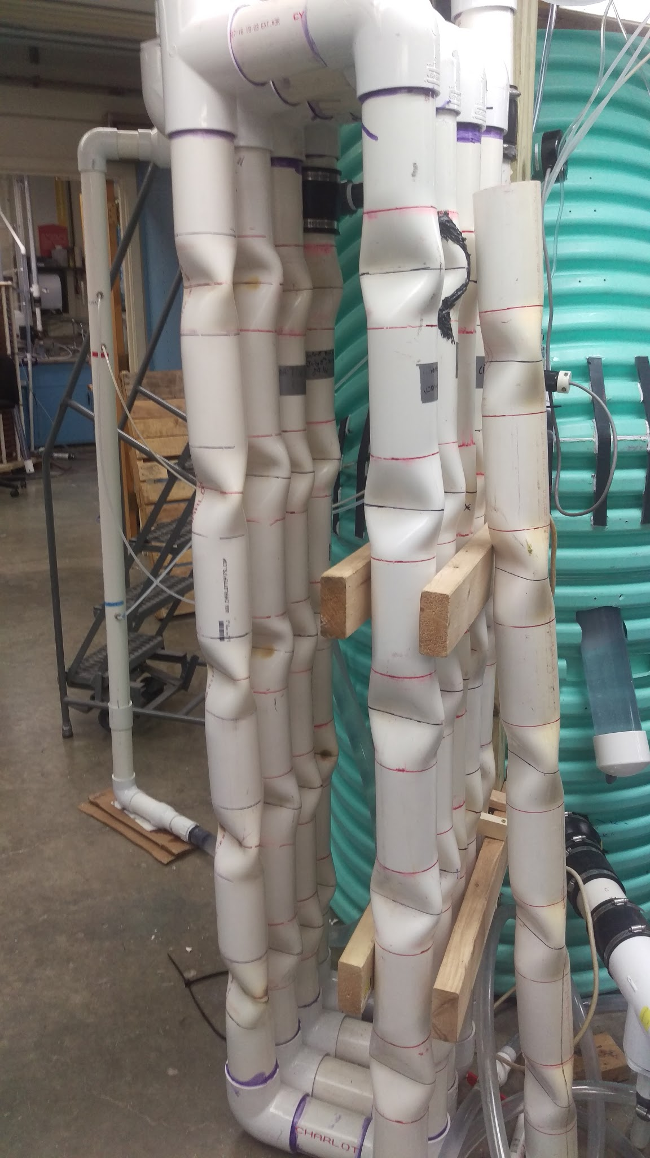
Flocculator
Flocculators now are designed for spacial efficiency.
Works the same as traditional flocculators.
First time produced at such a scale
Pipe needs contractions to get target headloss.
Current Flocculator
16.8m
Pre-Fab 1 L/s | Research | Symposium Presentation Fall 2016
Notes:
Citation Summer 2016 Pre-Fab 1L/s
Lfloc=Vfloc*Residence Time=.15m/s*80

Slide 9
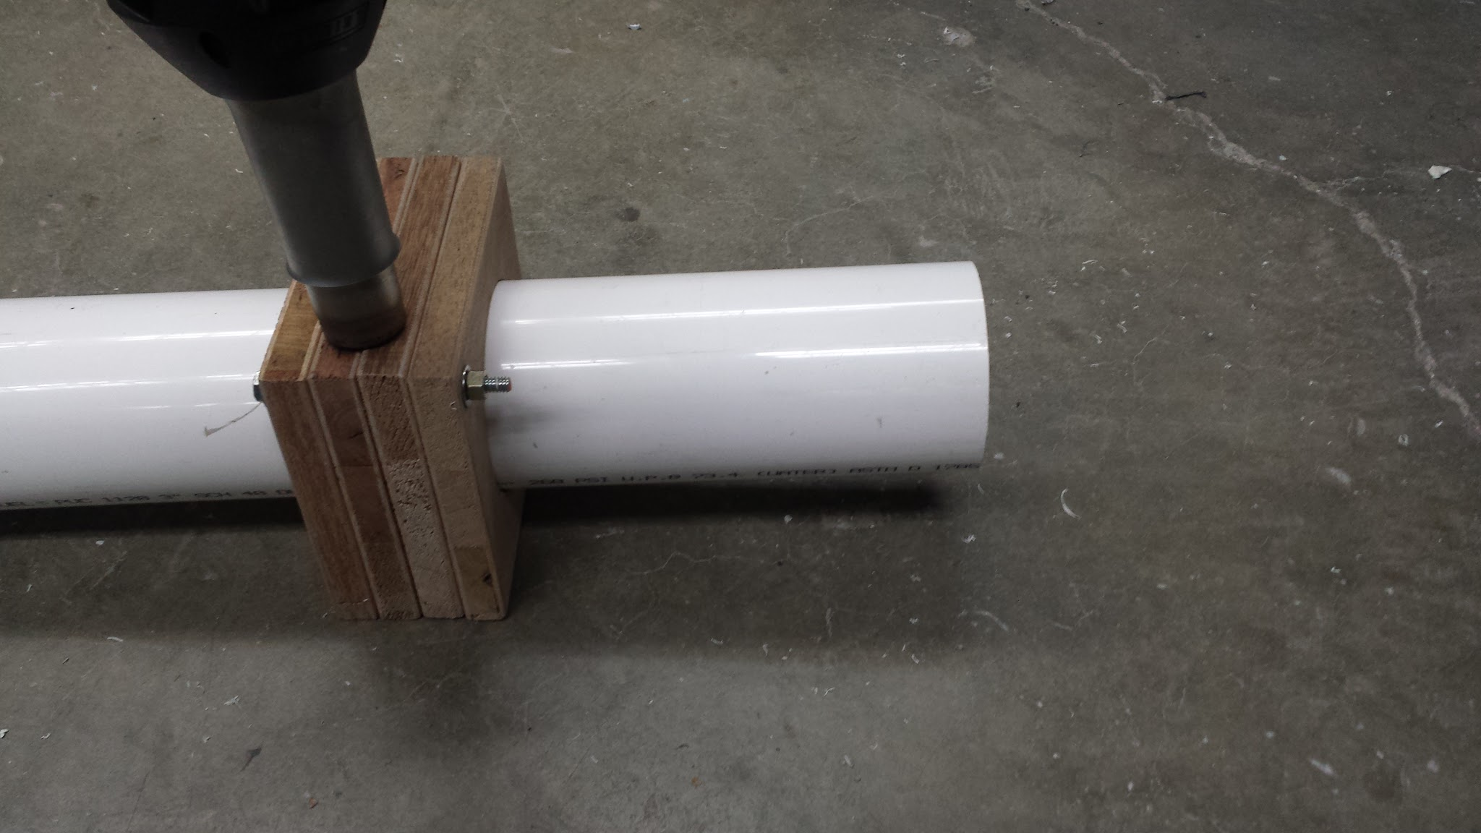
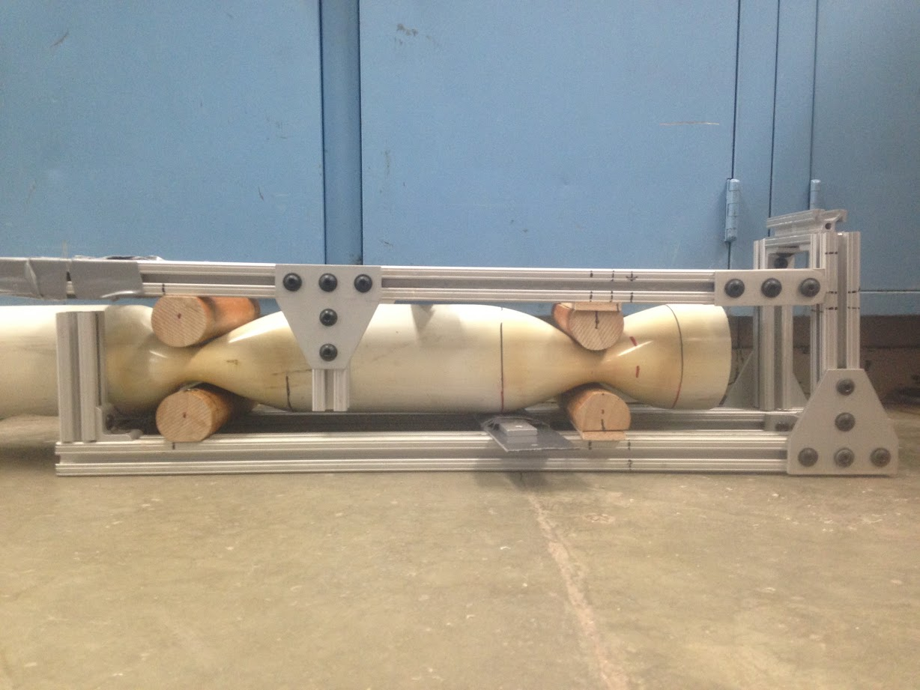
Flocculator Cont.
Summer 2016 crimping method worked on paper
However calculations were done for circles and not ellipsoids
Shapes had same area but results were not ideal
“The oven” was created to heat desired section
After heating an 80/20 jig was used to “crimp”
Pre-Fab 1 L/s | Research | Symposium Presentation Fall 2016
Notes:
Citation Summer 2016 Pre-Fab 1L/s
30 cm vs 51cm target headloss

Slide 10
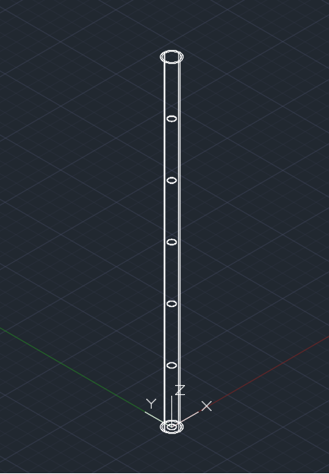
Flocculator Cont.
New design will have orifices that have the same area as the old design.
Just requires rodding to keep them in place.
Target: 51 cm of headloss
5 orifices per 6 feet pipe
Pre-Fab 1 L/s | Research | Symposium Presentation Fall 2016
Notes:
5 orifices per section of 6 ft pipe for a total of 45 orifices in nine 6 ft pipe.. Each orifice has a 1.851 cm and .728 inch radius. 12 inch spacing from each other from 72cm/6
51 cm of headloss. 51cm/45 orifices = 1.133 cm cm per orifice.
Citation Summer 2016 Pre-Fab 1L/s

Slide 11
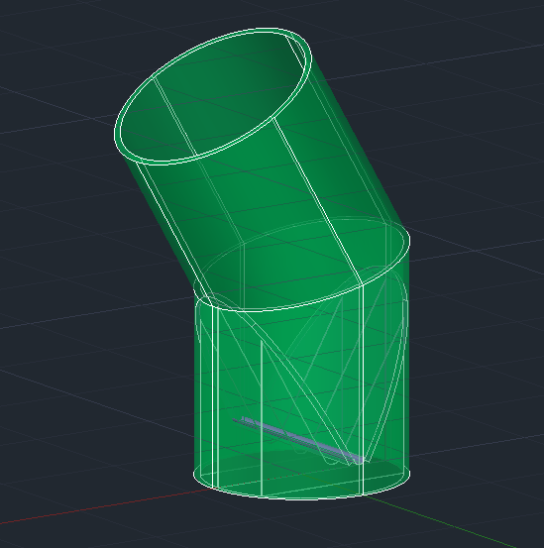
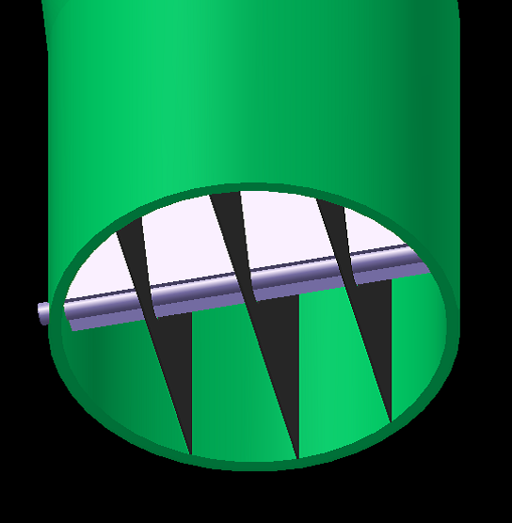
Structural Analysis
Taken into consideration:
  Relative price
  Conservative
  Shipping issues
Sedimentation tank without plate settlers
Bottom of sedimentation tank
Prefab 1 L/s | Research | Symposium Presentation Fall 2016
Notes:
Citation: Pre-Fabrication 1L/s, Fall 2016

Slide 12
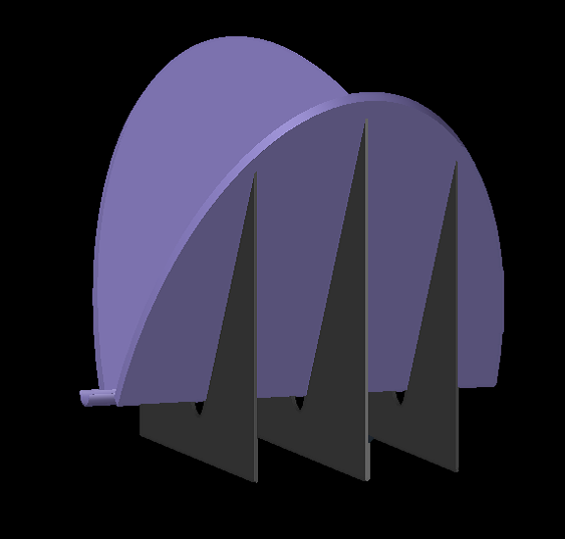
Structural Analysis
Taken into consideration:
  Relative price
  Conservative
  Shipping issues
Worst case scenario:
  Pressure
  Material
  Shape of PVC sheets
Base plates with supports
Prefab 1 L/s | Research | Symposium Presentation Fall 2016
Notes:
Citation: Pre-Fabrication 1L/s, Fall 2016

Slide 13
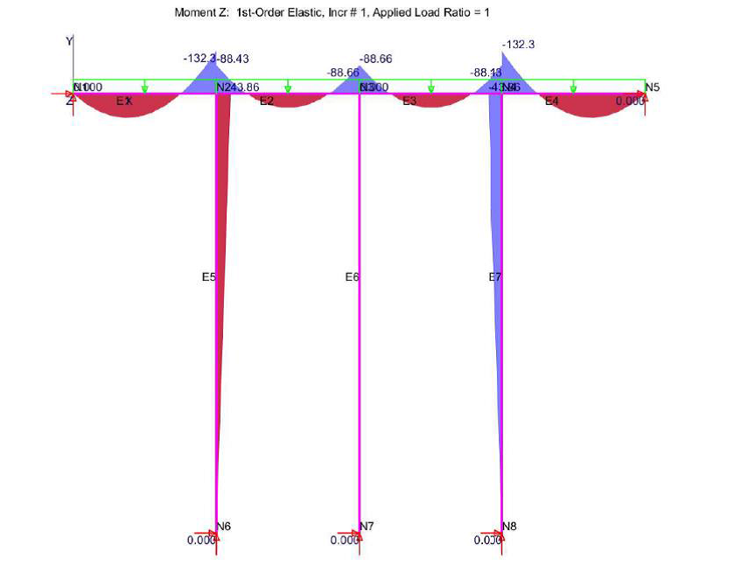
Structural Analysis
Analysis performed using open software Mastan®.
Considers a elastic regime as strains are much smaller than 0.001.
All necessary parameters have been obtained to lay on the safety side (dimensions, inertia, load)
Picture, chart, or graphic
(without the box around it)
Bending moment diagram
Prefab 1 L/s | Research | Symposium Presentation Fall 2016
Notes:
Citation: Pre-Fabrication 1L/s, Fall 2016

Slide 14
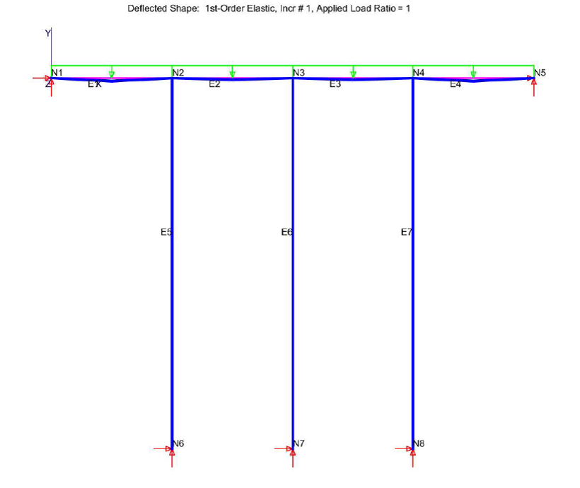
Structural Analysis
Analysis performed using open software Mastan®.
Considers a elastic regime as strains are much smaller than 0.001.
All necessary parameters have been obtained to lay on the safety side (dimensions, inertia, load)
Picture, chart, or graphic
(without the box around it)
Deflection with no scale applied
Prefab 1 L/s | Research | Symposium Presentation Fall 2016
Notes:
Citation:Pre-Fabrication 1L/s, Fall 2016

Slide 15
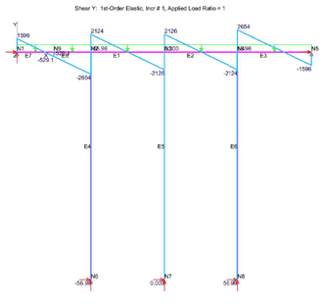
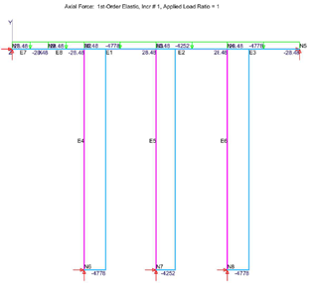
Structural Analysis
Analysis performed using open software Mastan®.
Considers a elastic regime as strains are much smaller than 0.001.
All necessary parameters have been obtained to lay on the safety side (dimensions, inertia, load)
Shear force diagram
Axial force diagram
Prefab 1 L/s | Research | Symposium Presentation Fall 2016
Notes:
Citation:Pre-Fabrication 1L/s, Fall 2016

Slide 16
Structural Analysis
 |  | Three supports | Two supports | One support
Maximum deflection (mm) |  | 6.5 (¼ in) | 50 (2 in) | 100 (4 in)
Maximum positive bending moment (Nm) |  | 75 | 180 | 270
Maximum negative bending moment (Nm) |  | 130 | 350 | 530
Maximum shear force (N) |  | 2100 | 4300 | 5300
Maximum axial force (N) |  | 4800 | 7000 | 10000
Prefab 1 L/s | Research | Symposium Presentation Fall 2016
Notes:
Citation:Pre-Fabrication 1L/s, Fall 2016

Slide 17
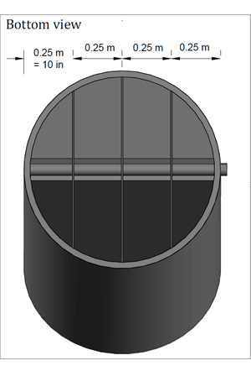
Structural Analysis
Assembling model
Prefab 1 L/s | Research | Symposium Presentation Fall 2016
Notes:
Citation:Pre-Fabrication 1L/s, Fall 2016

Slide 18
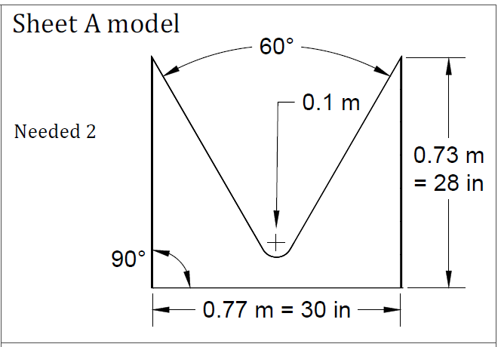
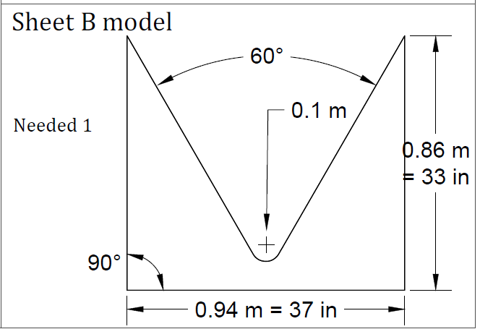
Structural Analysis
Cutting models:
Prefab 1 L/s | Research | Symposium Presentation Fall 2016
Notes:
Citation:Pre-Fabrication 1L/s, Fall 2016

Slide 19
Questions
and
Recommendations
Sean King
Materials Science & Engineering
spk52@cornell.edu
Felix Yang
Mechanical Engineering
fyy2@cornell.edu
David Herrera
Civil Engineering
dh644@cornell.edu
Yinghan Hua
Environmental Engineering
yh696@cornell.edu
Sung Min Kim
Environmental Engineering
sk2795@cornell.edu
Prefab 1 L/s | Research | Symposium Presentation Fall 2016

Slide 20
Appendix
Slides
Prefab 1L/s | Research | Symposium Presentation Fall 2016
Notes:
From this point on, add any slides with figures that will help support your thesis. You might pull these figures from your Final Report.

Slide 21
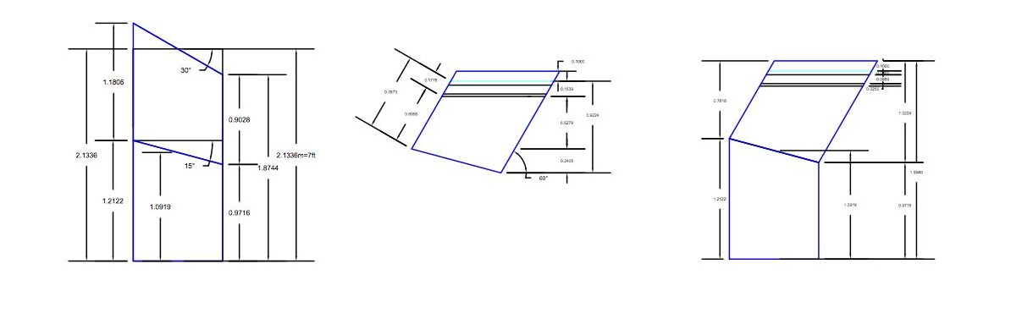
Sedimentation Tank Geometry
The angles for the Sed Tank geometry were chosen because the optimal angle for the plate settlers was 30 degrees from horizontal. This angle ensures adequate settling but also ensures there won’t be too much buildup in the settlers.
Thus, the main cut for the Sed tank was chosen to be 15 degrees, so that when the pieces were rotated for the correct shape, the total bend angle would add to 30 degrees.
Pre-Fab 1L/s | Research | Symposium Presentation Fall 2016
Notes:
Cite your sources here.
Caption your figure and explain its relevance to your presentation/thesis here. You can take the caption from your Final Report and modify it.
Write a summary of this slide here. A future team member or client should be able to read this note and understand this slide without having your team explain it to them.
If there are any appendix slides that are relevant to this slide, mention it in your notes.

Slide 22
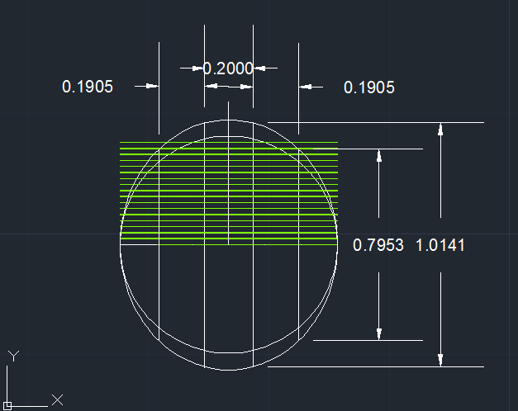
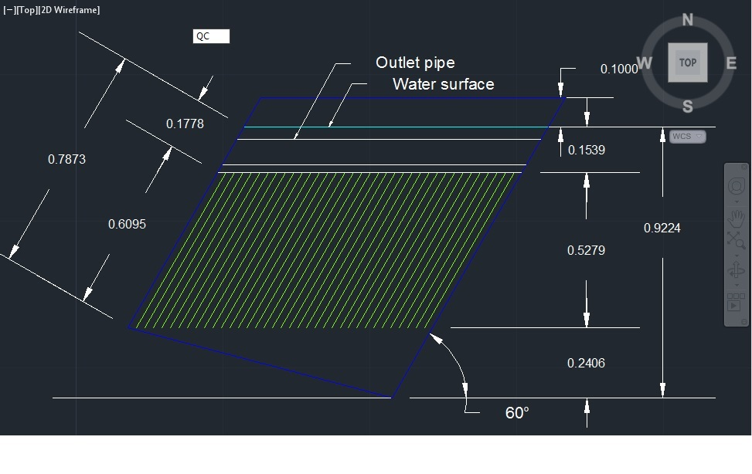
Plate Settlers Geometry
The plate settlers are angled 60 degrees from the horizontal because it is the critical angle for the plate settlers to be so the flocs do not roll up the plates and settle at the bottom.
The number of plate settlers were chosen to maximize trapping the flocs.
Pre-Fab 1L/s | Research | Symposium Presentation Fall 2016
Notes:
Please see CEE 4540 Sedimentation Slide Notes for derivations of the exact number of plate settlers.

