Slide 1
Expanded Granular Sludge Bed Reactors
Zoe Maisel, Cho Shen, and Stephen Galdi

Slide 2
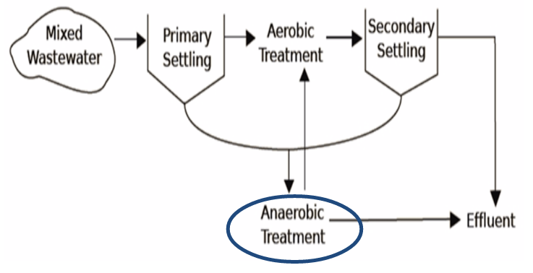
Proposed Treatment
Process Flow
Combining anaerobic and aerobic treatment can reduce the need for downstream processing

Slide 3
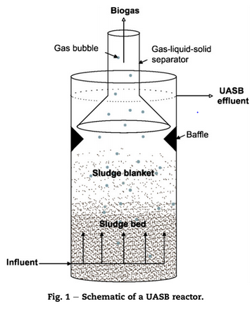
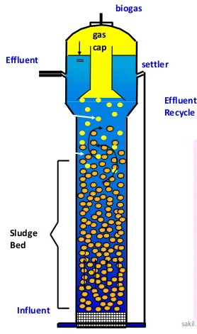
UASB vs. EGSB design
Notes:
Highlight differences
HRT
Upflow velocity
Effluent recycle
Expansion of bed vs. empty space
Motivation for team creation

Slide 4
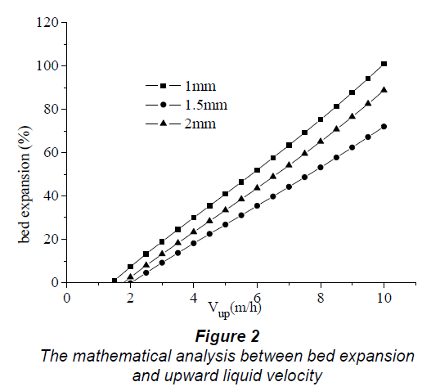
Literature Review
Conventional Parameter: Upward Velocity
-Figure Taken from Liu et al. 2006
Notes:
Reviews of the EGSB and UASB technology from 1998 published by Argentinian and Dutch Universities find that 4 m/h to 8 m/h (1.1-2.2 mm/s) is a typical upflow velocity at which a reactor is classified as an EGSB
Any slower and it is a UASB, any faster and suspended solids either wash out or accumulate in the recycle flow and overload the granules with VFAs which inhibit anaerobic degradation and lead to reactor failure

Slide 5
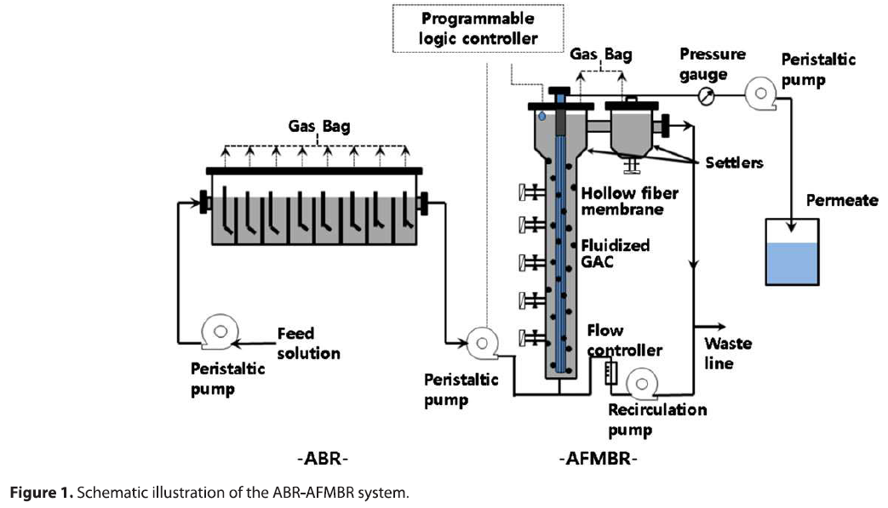
Literature Review
Potential Solution: Improved Solids Capture
-Figure from McCarty et. al 2014
Notes:
Successfully treats waste at 25 C, as a polishing step after traditional anaerobic reactor using artificial sewage substrate

Slide 6
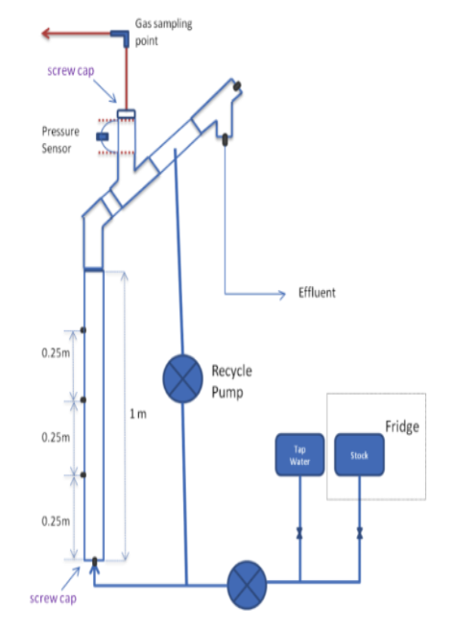
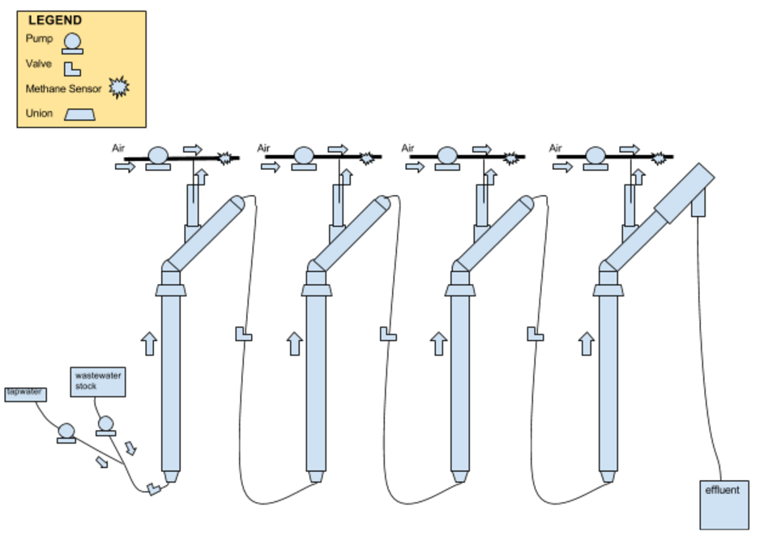
UASB vs. EGSB design
UASB
UASB
EGSB
Notes:
Compare new design to old

Slide 7
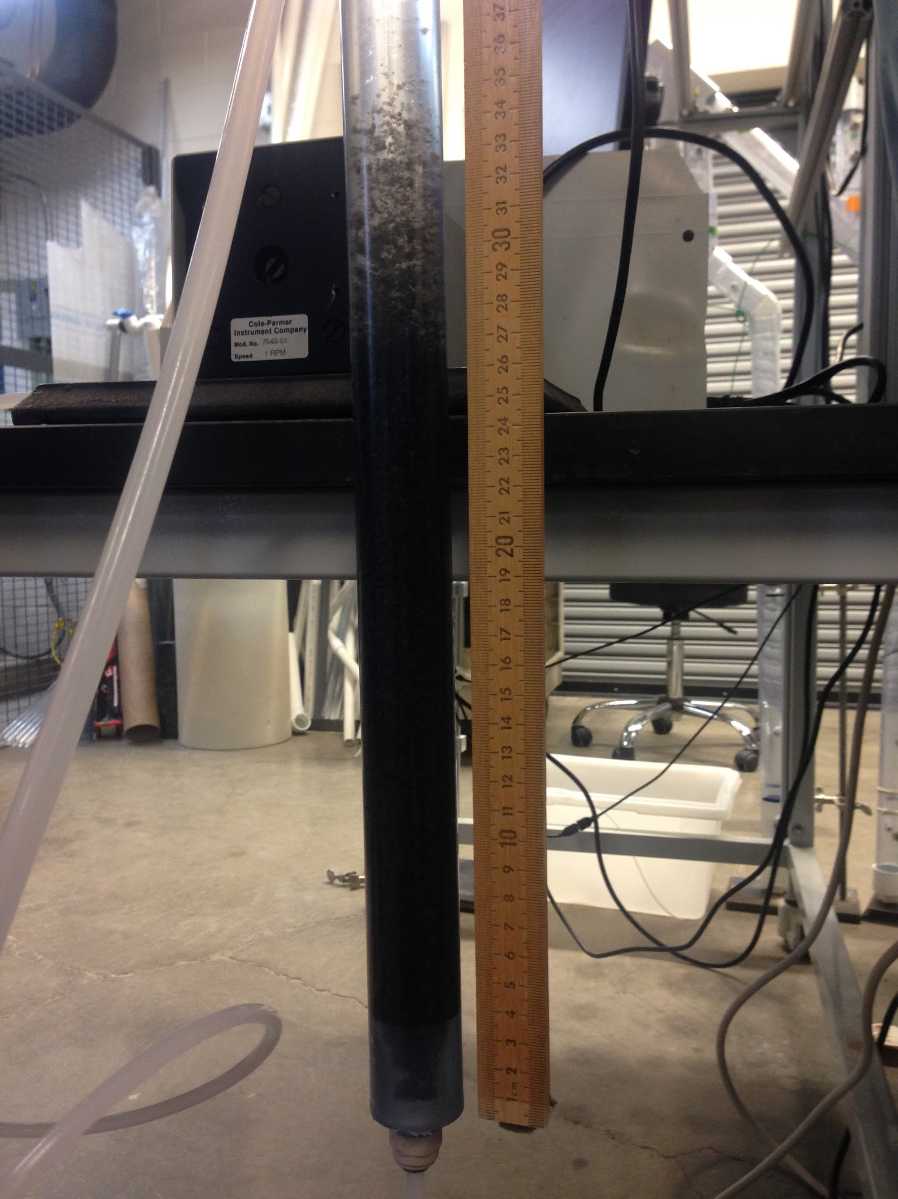
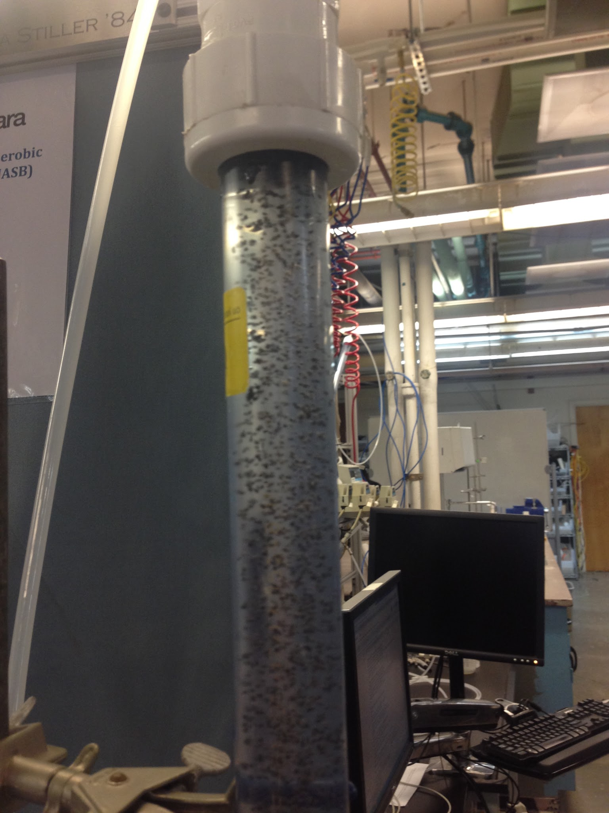
Pretests
Settling Velocity

Slide 8
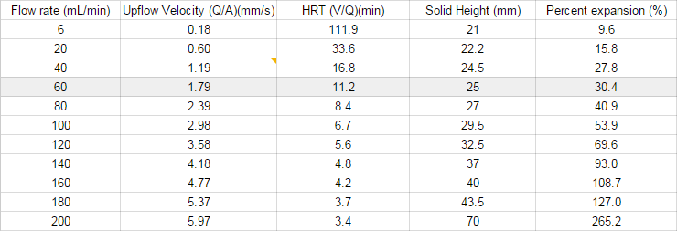
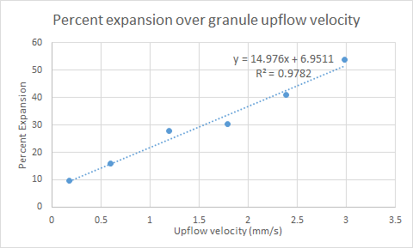
Pretests
Fluidization

Slide 9
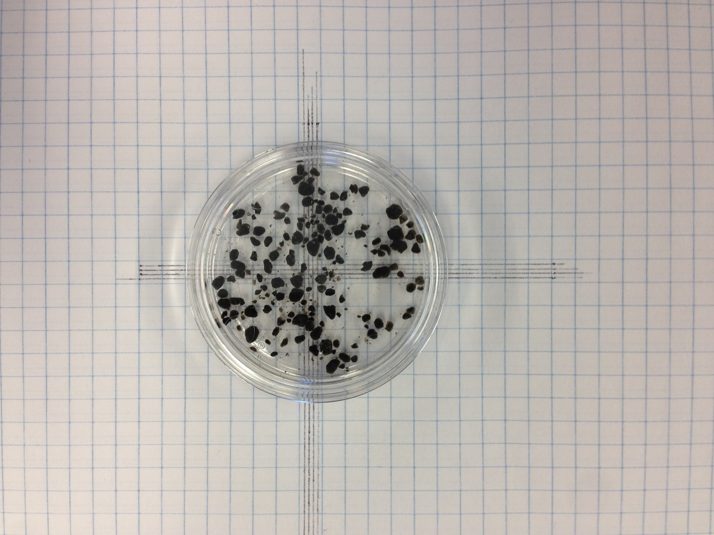
Pretests
Granule Characterization
average diameter : 2.05 mm

Slide 10
Reactor Parameters
HRT = 1 hour
Upflow velocity = 1.79 mm/s

Slide 11
Biogas collection 1

Slide 12
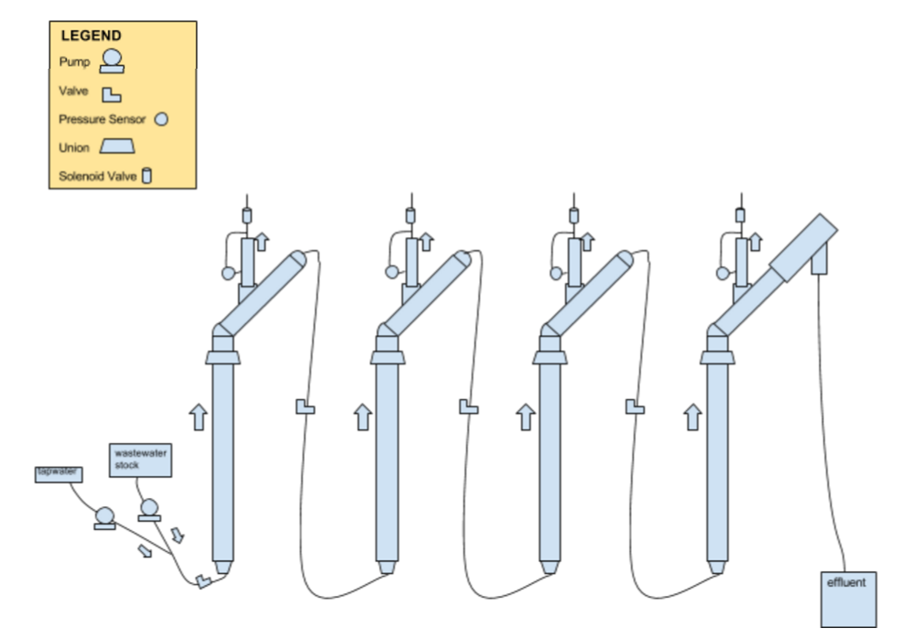
Biogas collection 2

Slide 13
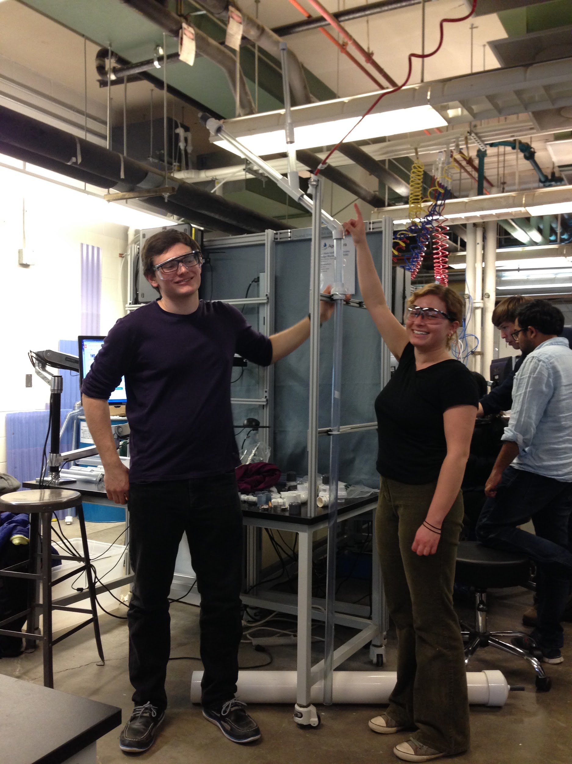
Construction

Slide 14
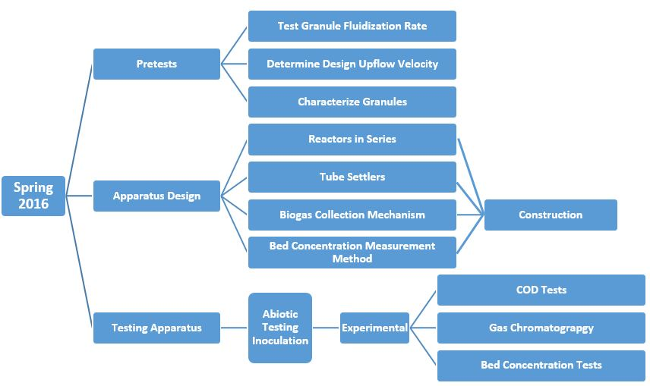
Future Work
Task Map

Slide 15
Questions?

