Slide 1

Expanded
Granular Sludge Bed (EGSB)
To share the results and analyses from AguaClara EGSB Spring 2016 team. More research can be found on AguaClara wiki page.
Research | Final Presentation Spring 2016
Notes:
[[Insert your abstract here.]]
[[Add a link to your full report here. ]]

Slide 2
Presentation Roadmap
Motivation
Reactor Design
Challenges
  Headloss
  Clogging
  Acidification
Results
  COD tests
  Methane production
  Granule characterization
Future work
Q&A
EGSB | Research | Final Presentation Spring 2016
Notes:
Cite your sources here.
Caption your figure and explain its relevance to your presentation/thesis here. You can take the caption from your Final Report and modify it.
Write a summary of this slide here. A future team member or client should be able to read this note and understand this slide without having your team explain it to them.
If there are any appendix slides that are relevant to this slide, mention it in your notes.

Slide 3
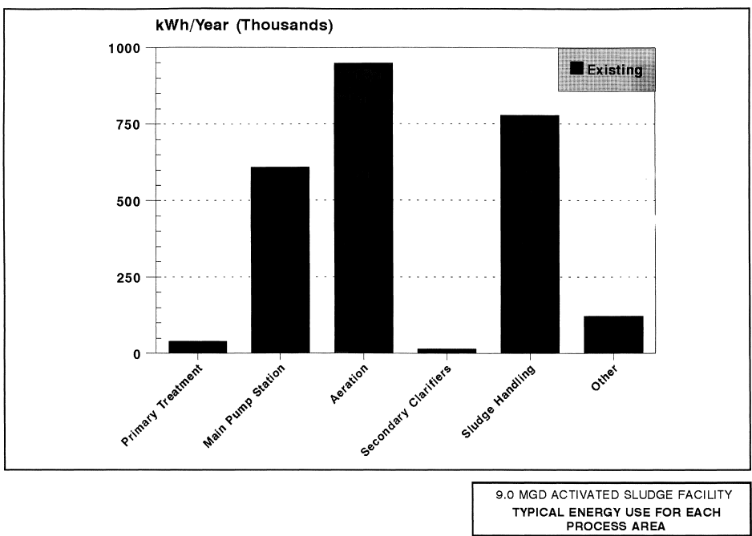
Is Anaerobic Digestion (AD) the Future?
Activated Sludge Expensive
  Energy Costs
AD Produces Methane
  Potentially Energy Neutral
Anaerobic Sewage Treatment is a huge potential step toward global sustainability!
-NYSERDA 1995 Wastewater Treatment and Sludge Management Study
EGSB | Research | Final Presentation Spring 2016
Notes:
Cite your sources here.
Caption your figure and explain its relevance to your presentation/thesis here. You can take the caption from your Final Report and modify it.
Write a summary of this slide here. A future team member or client should be able to read this note and understand this slide without having your team explain it to them.
If there are any appendix slides that are relevant to this slide, mention it in your notes.

Slide 4
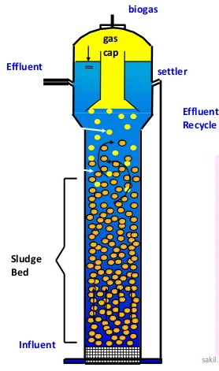
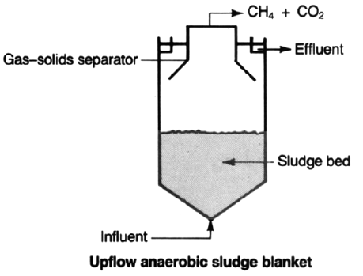
EGSBs offer Small Volume and Fast Treatment
Expanded
Granular
Potentially Cheap & Sustainable Water Treatment and Bioenergy
-Taken from Jewell 1987
-http://www.slideshare.net/sakiliubat/uasb-water-treatment-process
EGSB | Research | Final Presentation Spring 2016
Notes:
Left Figure: Jewell, William. “Anaerobic Sewage Treatment.” Environmental Science Technology 21 No. 1, 1987, 16.
Right Figure: Taken from Sakil Ahmed, at URL: http://www.slideshare.net/sakiliubat/uasb-water-treatment-process: accessed 5/19/16
Upflow Anaerobic Sludge Blanket (Left Figure): typical anaerobic reactor configuration with a wide sludge bed in contact with influent water flowing up the reactor for an hydraulic residence time (HRT) of a few hours to a few days depending on influent flow rate. Produced methane and carbon dioxide escape out the top of the reactor.
Expanded Granular Sludge Bed (Right Figure): a modified upflow anaerobic sludge blanket that uses recycle to fluidize the granular bed without overloading the methanogens, which in turn can allow for a smaller reactor size and shorter HRT with the proper waste characteristics.
The advantages of an EGSB are that the granule
If there are any appendix slides that are relevant to this slide, mention it in your notes.

Slide 5
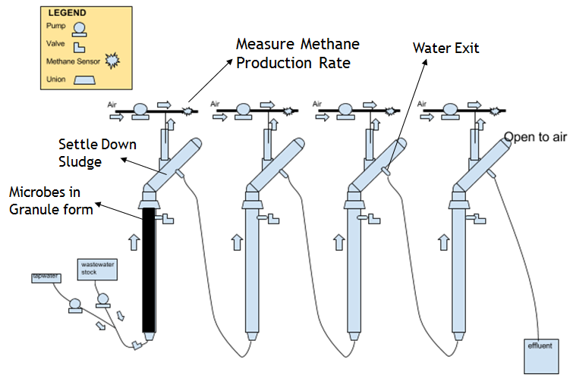
Reactor Design
Upflow velocity pretests ->1.8 mm/s
Hydraulic Retention Time = 1 h
Design Flow Rate = 60 mL/min
1” PVC pipe
2.3 m (7.5 ft) tall
4 reactors in series
45 degree tilted tube settler
Gas collector to separate biogas (CH4 + CO2)
Influent pumped into 1st reactor
2nd to 4th reactor gravity driven
Free water surface in gas collectors and tube settler arms
Biogas diluted with certain speed airflow, then flow over methane sensors
EGSB | Research | Final Presentation Spring 2016
Notes:
Stock recipe and upflow velocity pre-tests data seen in Appendix.
Caption your figure and explain its relevance to your presentation/thesis here. You can take the caption from your Final Report and modify it.
Write a summary of this slide here. A future team member or client should be able to read this note and understand this slide without having your team explain it to them.
If there are any appendix slides that are relevant to this slide, mention it in your notes.

Slide 6
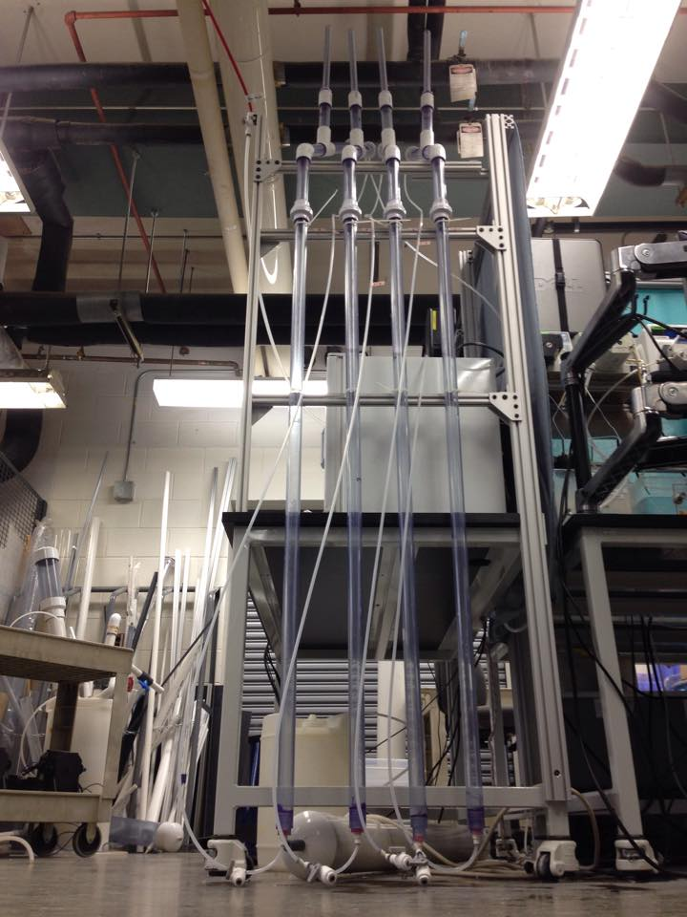
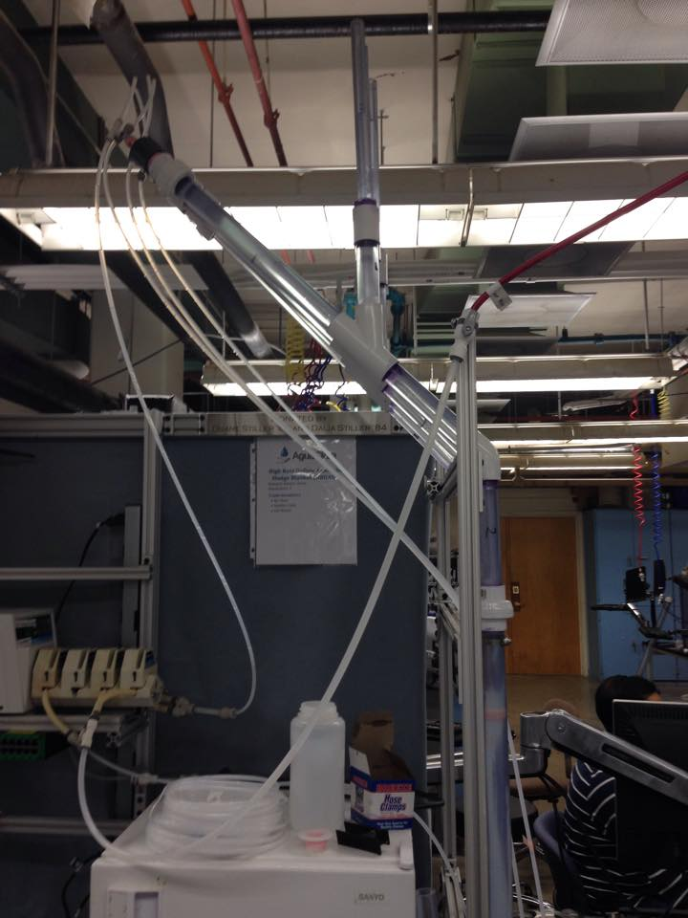
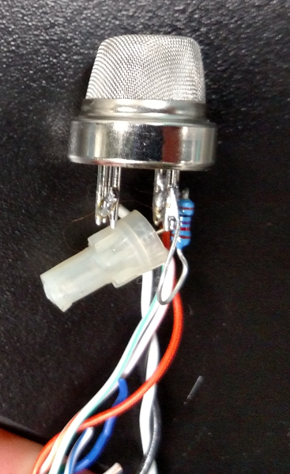
Reactor Design
Methane
EGSB | Research | Final Presentation Spring 2016
Notes:
Cite your sources here.
Caption your figure and explain its relevance to your presentation/thesis here. You can take the caption from your Final Report and modify it.
Write a summary of this slide here. A future team member or client should be able to read this note and understand this slide without having your team explain it to them.
If there are any appendix slides that are relevant to this slide, mention it in your notes.

Slide 7
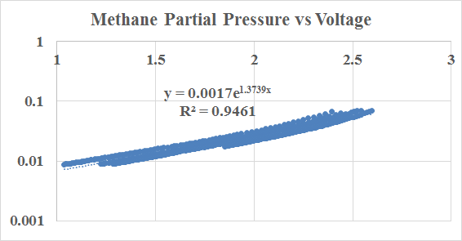
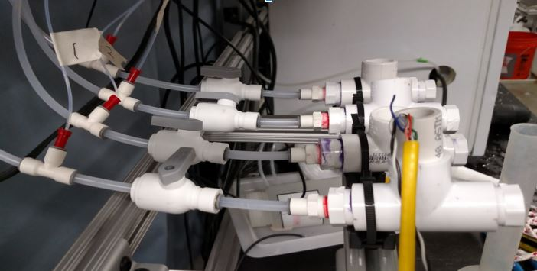
Reactor Design
Air Pump
Methane sensors
Gas Collectors on reactor settling arms
4
3
2
1
5 V Power
PorCoDA signal
EGSB | Research | Final Presentation Spring 2016
Notes:
Sensor Fabrication Detail seen in Appendix.
Caption your figure and explain its relevance to your presentation/thesis here. You can take the caption from your Final Report and modify it.
Write a summary of this slide here. A future team member or client should be able to read this note and understand this slide without having your team explain it to them.
If there are any appendix slides that are relevant to this slide, mention it in your notes.

Slide 8
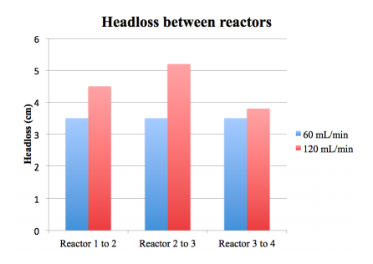
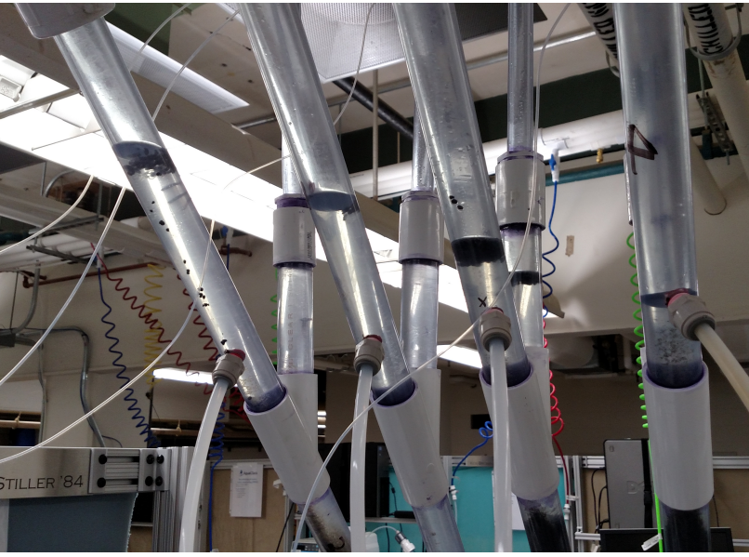
Headloss was larger than expected
Expected headloss: 0.397 mm
Actual headloss: > 3.5 cm
Headloss impacted by:
  flow rate
  tubing size (¼’’ vs ⅜”)
  line clogging
  granule plugs
EGSB | Research | Final Presentation Spring 2016
Notes:
The image on the left shows headloss with the new effluent exit. The chart on the right shows comparisons of headloss between reactors at different flow rates and shows that higher flow rates lead to higher headloss.
Initial headloss calculations suggested that headloss between reactors would be negligible, at 0.397 mm. However, after inoculation and fluidization attempts, it was clear that actual headloss was much greater. Headloss was an issue because it lead to reactor overflows if the headloss was too high, and negatively impacted fluidization. The team observed that flow rate, tubing size, line clogging and granule plug presence all contributed to different levels of headloss. Greater flow rate, smaller tubing sizes, line clogs and granule plugs all increased headloss. These variables were experimented with in an attempt to find a reactor design that minimized headloss but still allowed for fluidization.

Slide 9
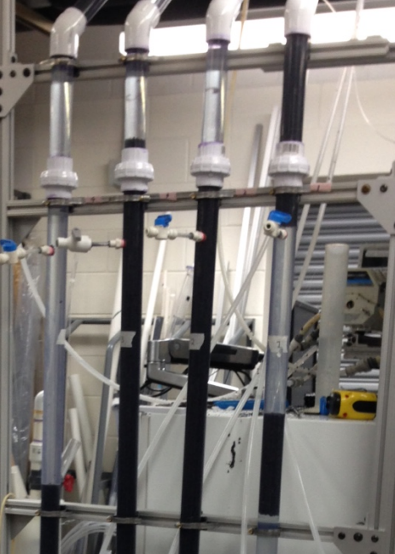
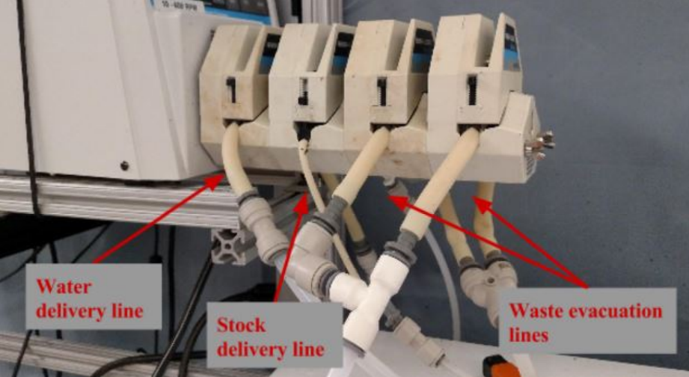
Clogging was a major issue
Granule and stock cloggings were major issues throughout the semester.
EGSB | Research | Final Presentation Spring 2016
Notes:
The image on the left shows what granule plugs looked like in the reactor. The image on the right shows our pump head set up, with water lines, stock lines, and waste evacuation lines. The stock line repeated clogged and required detachment and reattachment of parts to try to dislodge clogged areas.
Clogging in the form of granule plugs and stock delivery line clogs continued to be an issue throughout the entire semester. The granule plugs increased headloss, decreased fluidization, and led to washout from rising granules. Different methods were attempted to address the reactor clogging issue. The stock delivery line issue was addressed by changing the tubing from ¼” size to microbore tubing, in an attempt to push the stock through at higher velocities and limit clogging. However, clogging was still experienced in the stock container to microbore tubing connection, which required constant monitoring. The stock was later dyed red to make it easier to see when there was a stock failure event, but the extent to which the granules were not fed is not well known.

Slide 10
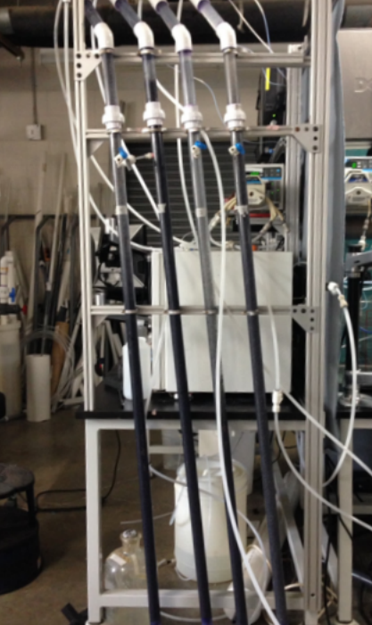
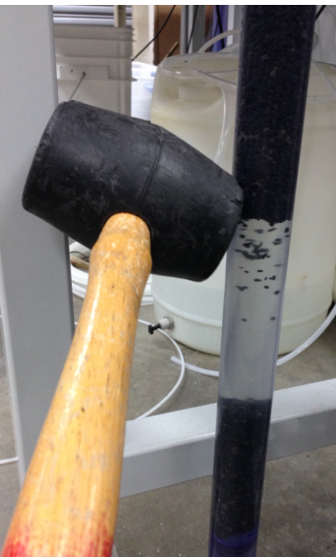
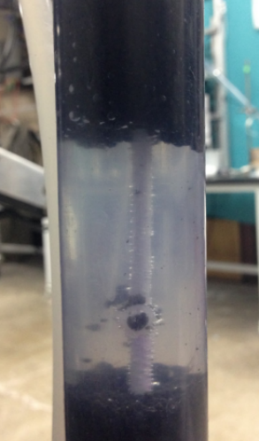
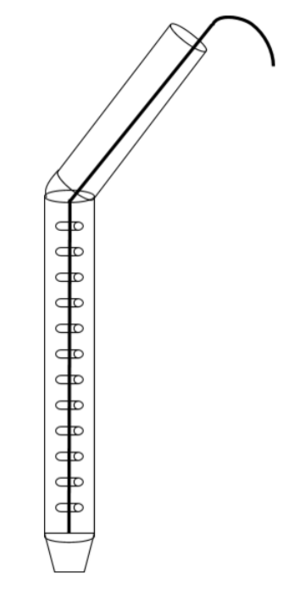
Different solutions were attempted
Agitation was needed to dislodged granule clogs and prevent failure events.
EGSB | Research | Final Presentation Spring 2016

Slide 11
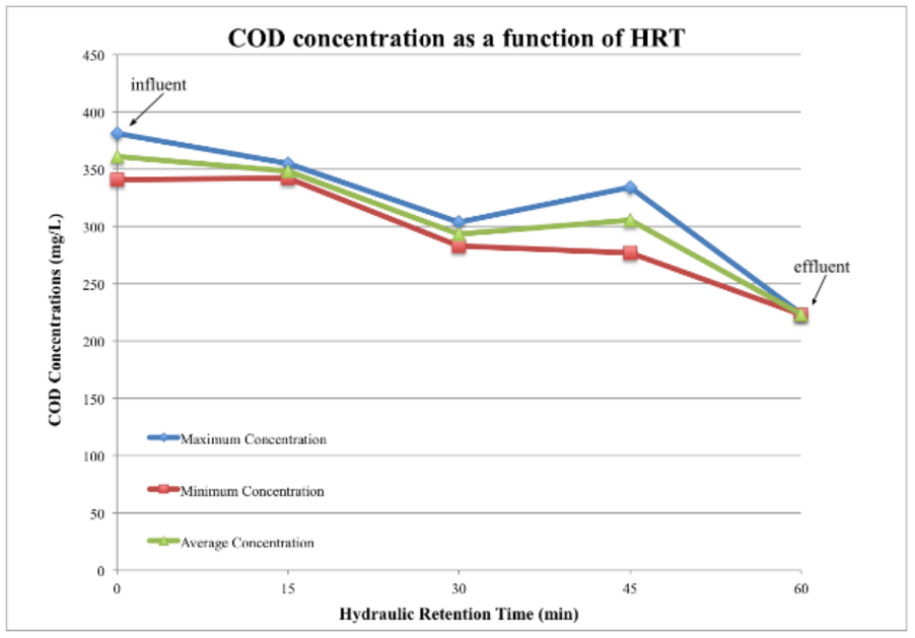
Tests showed COD removal
38% average COD removal on May 7th
Need more COD tests to better understand treatment efficacy.
EGSB | Research | Final Presentation Spring 2016
Notes:
Original COD tests data seen in Appendix.
Caption your figure and explain its relevance to your presentation/thesis here. You can take the caption from your Final Report and modify it.
Write a summary of this slide here. A future team member or client should be able to read this note and understand this slide without having your team explain it to them.

Slide 12
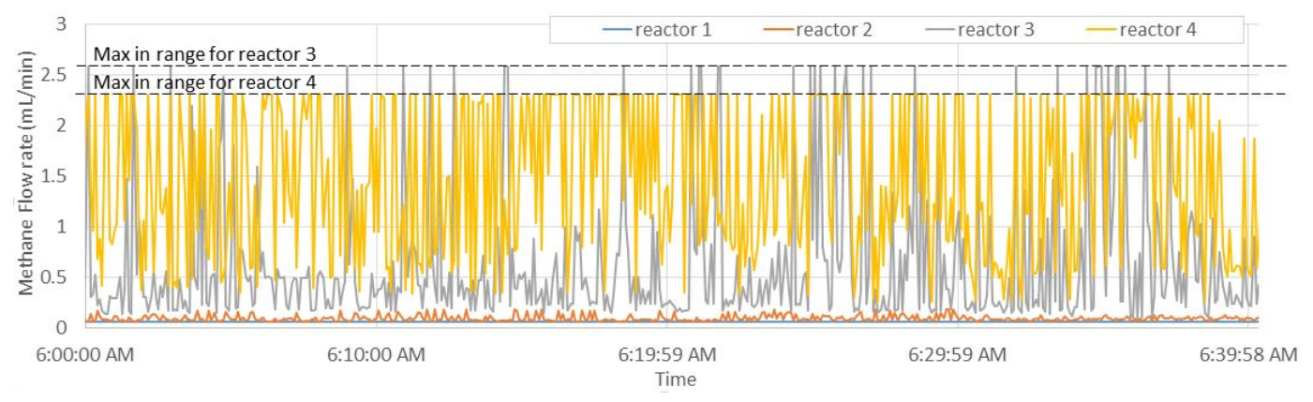
Methane production was recorded
EGSB | Research | Final Presentation Spring 2016
Notes:
Cite your sources here.
Caption your figure and explain its relevance to your presentation/thesis here. You can take the caption from your Final Report and modify it.
Write a summary of this slide here. A future team member or client should be able to read this note and understand this slide without having your team explain it to them.
If there are any appendix slides that are relevant to this slide, mention it in your notes.

Slide 13
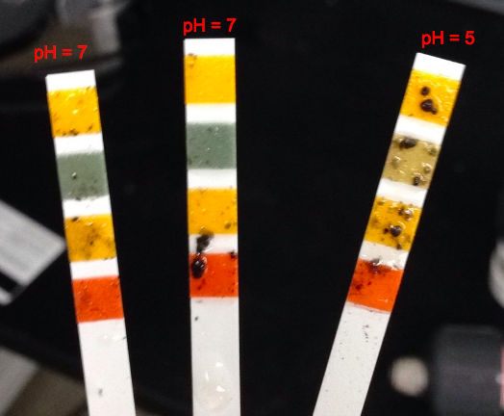
Acidification extent is unclear
3 pH tests from reactor 1 showed different results.
EGSB | Research | Final Presentation Spring 2016
Notes:
Cite your sources here.
Caption your figure and explain its relevance to your presentation/thesis here. You can take the caption from your Final Report and modify it.
Write a summary of this slide here. A future team member or client should be able to read this note and understand this slide without having your team explain it to them.
If there are any appendix slides that are relevant to this slide, mention it in your notes.

Slide 14
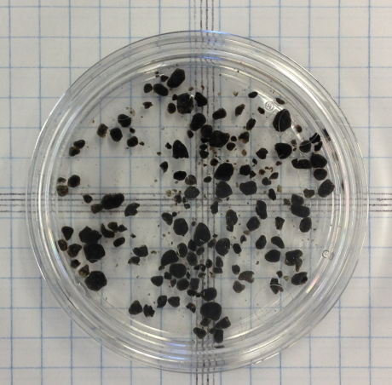
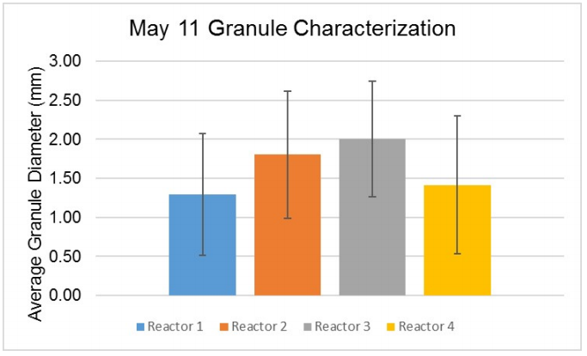
Granule characterization showed changes in diameters
pre-inoculation
post-inoculation
Size decreased from pre-inoculation 2 mm diameter to post-inoculation between 1.3 mm and 2 mm.
EGSB | Research | Final Presentation Spring 2016
Notes:
Cite your sources here.
Caption your figure and explain its relevance to your presentation/thesis here. You can take the caption from your Final Report and modify it.
Write a summary of this slide here. A future team member or client should be able to read this note and understand this slide without having your team explain it to them.
If there are any appendix slides that are relevant to this slide, mention it in your notes.

Slide 15
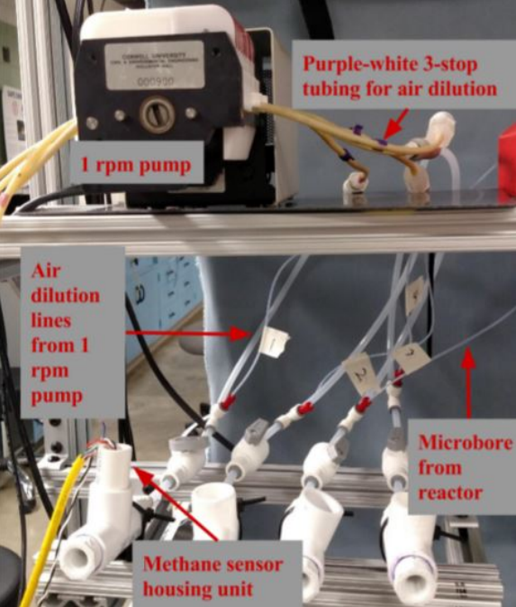
Future Work: Data
Methane Calibrations
  Controlled Dilution Pump
pH Monitoring
COD Removal Efficiency
EGSB | Research | Final Presentation Spring 2016
Notes:
Cite your sources here.
Caption your figure and explain its relevance to your presentation/thesis here. You can take the caption from your Final Report and modify it.
Write a summary of this slide here. A future team member or client should be able to read this note and understand this slide without having your team explain it to them.
If there are any appendix slides that are relevant to this slide, mention it in your notes.

Slide 16
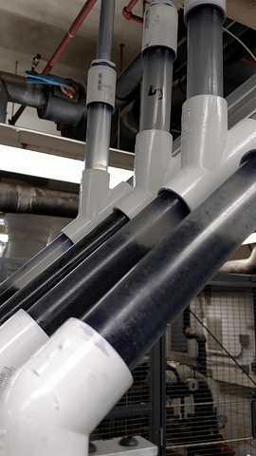
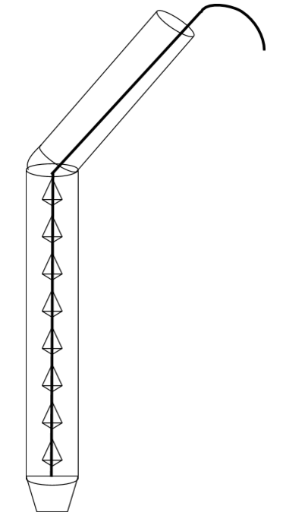
Future Work:
Operation
Better Settler
Barbed Rod Agitation
Reactor Maintenance Ports
Stock Concentration
EGSB | Research | Final Presentation Spring 2016
Notes:
Cite your sources here.
Caption your figure and explain its relevance to your presentation/thesis here. You can take the caption from your Final Report and modify it.
Write a summary of this slide here. A future team member or client should be able to read this note and understand this slide without having your team explain it to them.
If there are any appendix slides that are relevant to this slide, mention it in your notes.

Slide 17
Questions
and
Recommendations
Zoe Maisel
B.S. Environmental Engineering
zam7@cornell.edu
Cho Shen
M.Eng in Environmental Water Resource Engineering
qs62@cornell.edu
Stephen Galdi
B.S. Environmental Engineering
smg296@cornell.edu
EGSB | Research | Final Presentation Spring 2016

Slide 18
Appendix
Slides
EGSB | Research | Final Presentation Spring 2016
Notes:
From this point on, add any slides with figures that will help support your thesis. You might pull these figures from your Final Report.

Slide 19
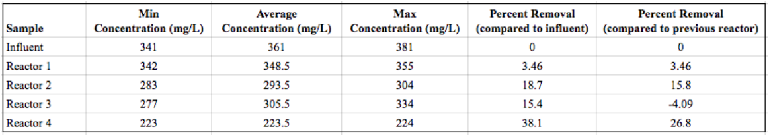
COD Tests Data
COD test 1
COD test 2
EGSB | Research | Final Presentation Spring 2016
Notes:
Cite your sources here.
Caption your figure and explain its relevance to your presentation/thesis here. You can take the caption from your Final Report and modify it.
Write a summary of this slide here. A future team member or client should be able to read this note and understand this slide without having your team explain it to them.

Slide 20
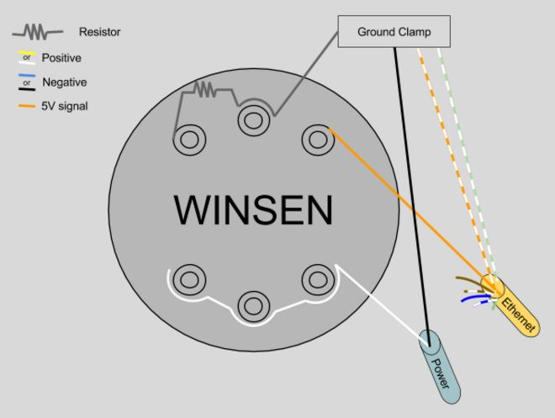
Fabrication of Methane Sensors
EGSB | Research | Final Presentation Spring 2016
Notes:
Cite your sources here.
Caption your figure and explain its relevance to your presentation/thesis here. You can take the caption from your Final Report and modify it.
Write a summary of this slide here. A future team member or client should be able to read this note and understand this slide without having your team explain it to them.

Slide 21
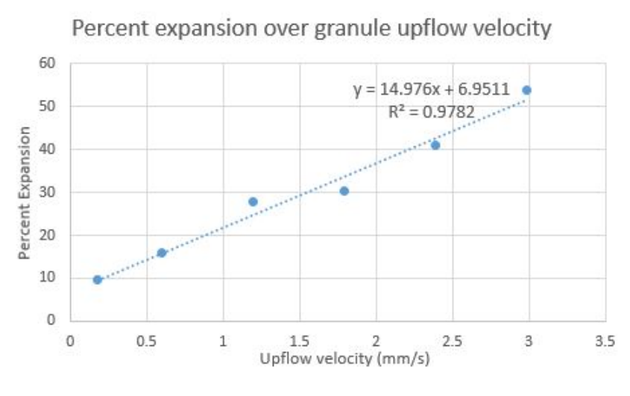
Upflow velocity pre-test data
EGSB | Research | Final Presentation Spring 2016
Notes:
Cite your sources here.
Caption your figure and explain its relevance to your presentation/thesis here. You can take the caption from your Final Report and modify it.
Write a summary of this slide here. A future team member or client should be able to read this note and understand this slide without having your team explain it to them.

Slide 22
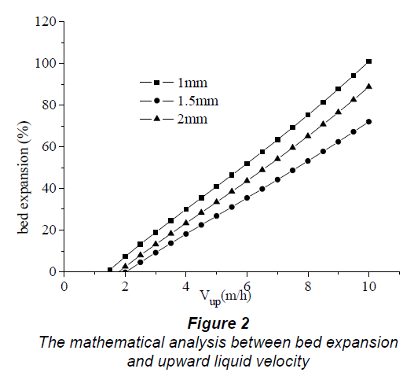
Expansion vs Upflow Velocity from Liu et al. 2006
EGSB | Research | Final Presentation Spring 2016
Notes:
Cite your sources here.
Caption your figure and explain its relevance to your presentation/thesis here. You can take the caption from your Final Report and modify it.
Write a summary of this slide here. A future team member or client should be able to read this note and understand this slide without having your team explain it to them.

Slide 23
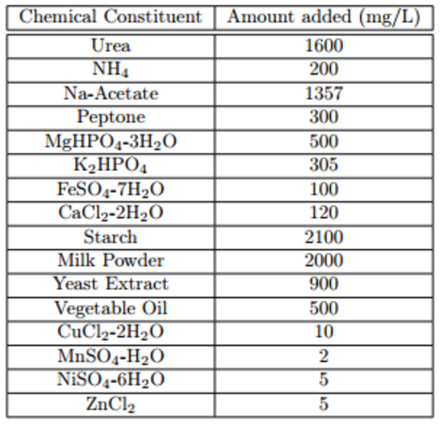
Stock Recipe
Size 18 to 13 tubing pumping speed ratio was 70.57 to 1. Size 13 tubing required 4.52x concentration of the original stock recipe.
Cl
EGSB | Research | Final Presentation Spring 2016
Notes:
Cite your sources here.
Caption your figure and explain its relevance to your presentation/thesis here. You can take the caption from your Final Report and modify it.
Write a summary of this slide here. A future team member or client should be able to read this note and understand this slide without having your team explain it to them.

