Slide 1

Expanded
Granular Sludge Bed (EGSB)
To share the results and analyses from AguaClara EGSB Spring 2016 team. More research can be found on AguaClara wiki page.
Research | Final Presentation Spring 2016
Notes:
The Expanded Granular Sludge Bed (EGSB) team was created to work within the wastewater subteam to design and run new, bench-scale, high rate anaerobic reactors. New reactors were designed to create a system with increased upflow velocity of influent, a fluidized bed, and decreased hydraulic retention time without decreased granular retention. Reactors were designed with simple operation in mind, with narrow modules in series rather than a single large reactor with recycle. The reactors were inoculated following abiotic testing of pumping rates, connection seals, and methane sensors. Immediately after inoculation, the granules began to form blockages and back up the reactor. Various forms of agitation seem to alleviate the problem, and automated solutions to the blockage problem has been proposed. In addition to blockages, the first module of the reactor was acidifying due to the low hydraulic residence time and relatively high specific organic loading rate. However, the following three modules were observed producing significant amounts of methane via the sensors, and at the end of an uninterrupted week of operation a COD test indicated about 40 percent total COD removal. With improved methane sensor calibrations and a blockage prevention system, the bench-scale setup for high rate anaerobic treatment could potentially become a very versatile tool for testing the limits of anaerobic wastewater treatment and methane bioenergy reclamation.
https://www.overleaf.com/4441416kybgvy#/13286682/

Slide 2
Presentation Roadmap
Motivation
Reactor Design
Challenges
  Headloss
  Clogging
  Acidification
Results
  COD tests
  Methane production
  Granule characterization
Future work
Q&A
EGSB | Research | Final Presentation Spring 2016

Slide 3
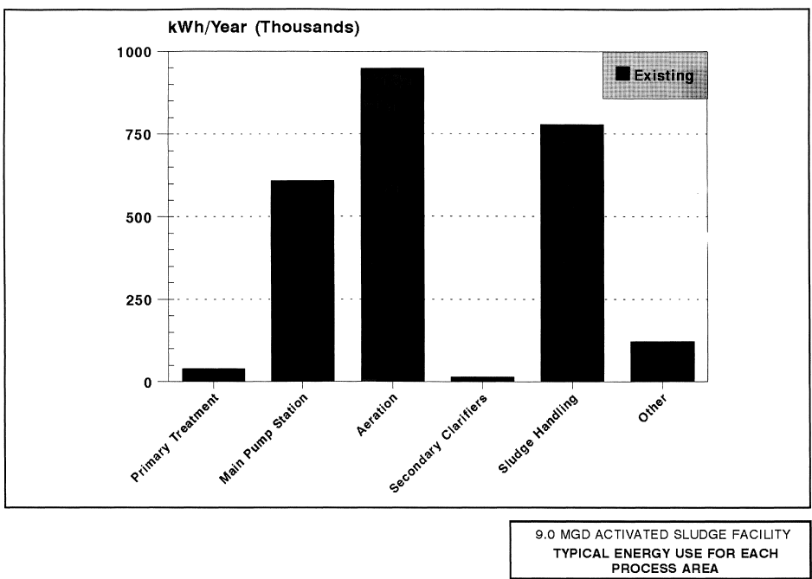
Is Anaerobic Digestion (AD) the Future?
Activated Sludge Expensive
  Energy Costs
AD Produces Methane
  Potentially Energy Neutral
Anaerobic Sewage Treatment is a huge potential step toward global sustainability!
-NYSERDA 1995 Wastewater Treatment and Sludge Management Study
EGSB | Research | Final Presentation Spring 2016
Notes:
References: Pakenas, Lawrence J.. Smith, David A.. and Karen W. Clark P.E.. Wastewater Treatment and Sludge Management: Energy Reference Guide. New York State Energy Research and Development Authority (NYSERDA)
Figure: 1995 Typical Annual Energy Consumption of a 9 MGD Activated Sludge Plant in kWh/yr
-This figure demonstrates the huge electricity consumption, and thus costs, of conventional activated sludge treatment. Although the data is from 1995, most wastewater treatment plants run on a 30-40 year investment cycle, so a large number of the same plants are likely still online today.
As highlighted by the figure, conventional wastewater treatment in the United States (activated sludge) consumes a significant amount of electricity. Anaerobic alternatives to activated sludge (an aerobic process), appear promising as they would require minimal sludge processing and no aeration: the two most energy consuming steps in activated sludge. In addition, due to the reducing conditions present in anaerobic digestion, the carbon present in the organic sewage waste is reduced completely to methane rather than oxidized to carbon dioxide. Although methane is a potent greenhouse gas, it is also the main component in natural gas; which if captured can be used sustainably as a biofuel (for heat or electricity generation) that only releases biogenic carbon dioxide into the atmosphere (which has minimal impact on climate compared to fossil carbon dioxide sources).

Slide 4
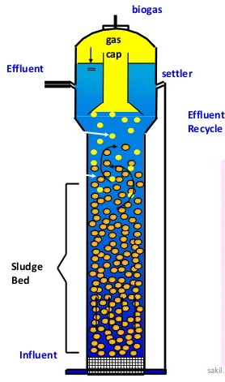
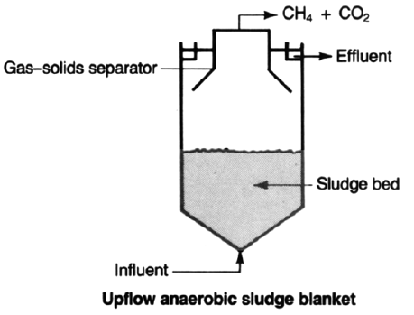
EGSBs offer Small Volume and Fast Treatment
Expanded
Granular
Potentially Cheap & Sustainable Water Treatment and Bioenergy
-Taken from Jewell 1987
-http://www.slideshare.net/sakiliubat/uasb-water-treatment-process
EGSB | Research | Final Presentation Spring 2016
Notes:
References:
Left Figure: Jewell, William. “Anaerobic Sewage Treatment.” Environmental Science Technology 21 No. 1, 1987, 16.
Right Figure: Taken from Sakil Ahmed, at URL: http://www.slideshare.net/sakiliubat/uasb-water-treatment-process: accessed 5/19/16
Upflow Anaerobic Sludge Blanket (Left Figure): typical anaerobic reactor configuration with a wide sludge bed in contact with influent water flowing up the reactor for an hydraulic residence time (HRT) of a few hours to a few days depending on influent flow rate. Produced methane and carbon dioxide escape out the top of the reactor.
Slide Summary:
Expanded Granular Sludge Bed (Right Figure): a modified upflow anaerobic sludge blanket that uses recycle to fluidize the granular bed without overloading the methanogens, which in turn can allow for a smaller reactor size and shorter HRT with the proper waste characteristics. This is due to the increased portion of the reactor volume that contains active biomass, which shortens the distance that dissolved waste must diffuse in order to be degraded (by the microbes in the granules) and in turn allows the wastewater to travel more rapidly through the reactor. Although EGSBs are typically run with high recycle ratios, the industries that use them in such a configuration have highly concentrated waste streams. It is possible that since sewage is more dilute than these industrial wastes, recycle can be eliminated or considerably reduced without inducing reactor failure or unacceptably low removal of organic waste.
The plot of Expansion as a function of Upflow Velocity generated by Liu et. al in 2006 highlights the range of velocities and expansions that are typical in an EGSB. UASBs operate at upflow velocities below this range that experience minimal expansion.

Slide 5
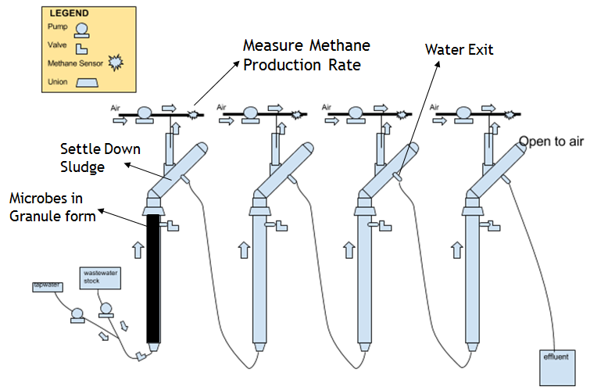
Reactor Design
Upflow velocity pretests ->1.8 mm/s
Hydraulic Retention Time = 1 h
Design Flow Rate = 60 mL/min
4 reactors in series
1” PVC pipe
2.3 m (7.5 ft) tall
45 degree tilted tube settler
Gas collector to separate biogas (CH4 + CO2)
Influent pumped into 1st reactor
2nd to 4th reactor gravity driven
Free water surface in gas collectors and tube settler arms
Biogas diluted with certain speed airflow, then measured with methane sensors
No recycle - energy saving
EGSB | Research | Final Presentation Spring 2016
Notes:
Figure generated by sub-team members.
Stock recipe and upflow velocity pre-tests data seen in Appendix.
Figure shows the final version of reactor design.
This is the final reactor design. The most important parameter in reactor design was upflow velocity.So we did a pretests to find the minimum fluidization velocity. It was 1.8 mm/s. Then we need to balance between large reactor volume, which means more fabrication, and less hydraulic retention time, which means inadequate reaction. Finally we have 4 reactors in series as shown in the graph. Each of them was 1 inch in diameter and about 2.3 m tall. The granules are put into the column. As water flows upward through the granules, the biodegradable substrates are removed by the microrganisms. Then we have a 45 degree tilted tube settler to reduce sludge washout. The 1st reactor was driven by pump, and the rest of them are driven by gravity. The biogas produced by microorganism activities was collected by gas collectors on the settling arm. Then the biogas was diluted with a certain speed of airflow, and measured with methane sensors.

Slide 6
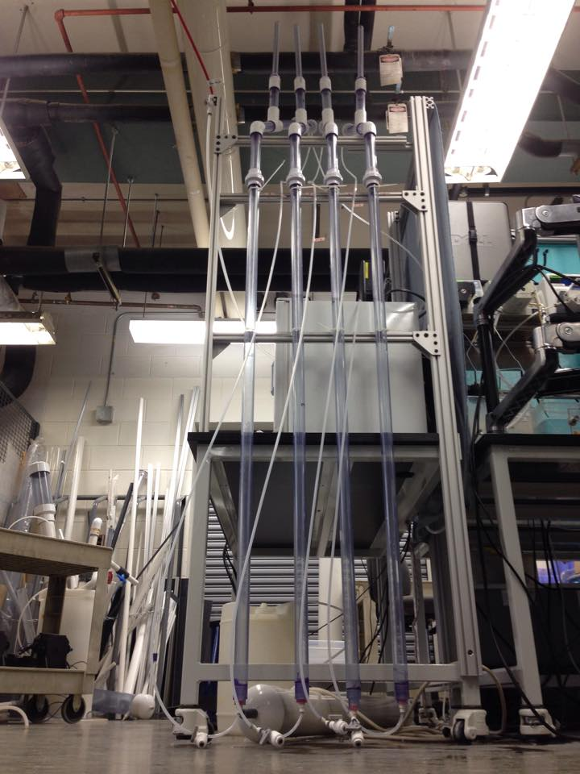
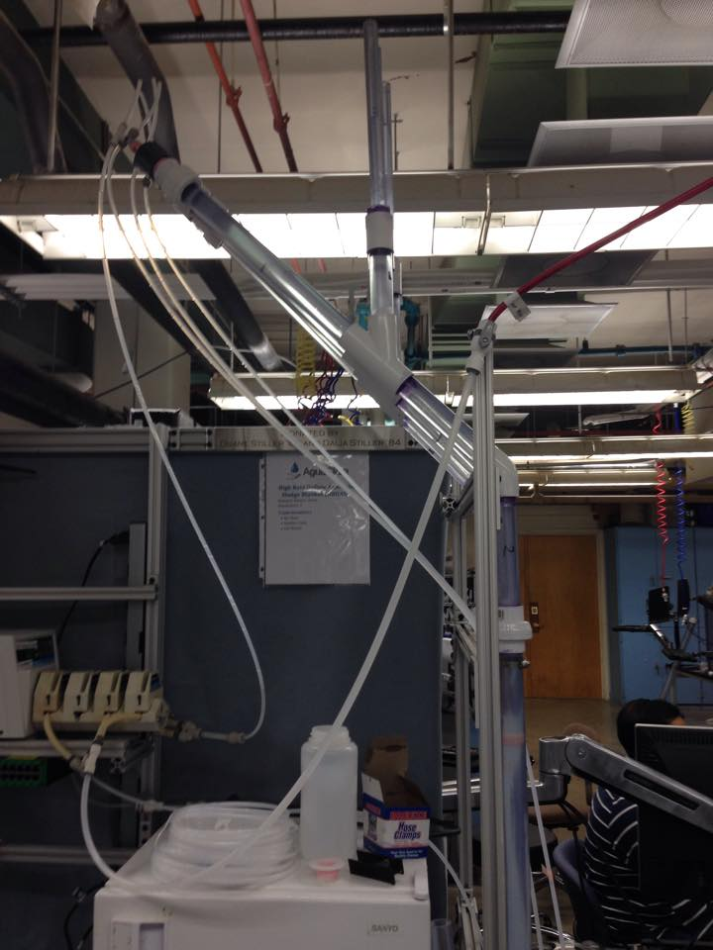
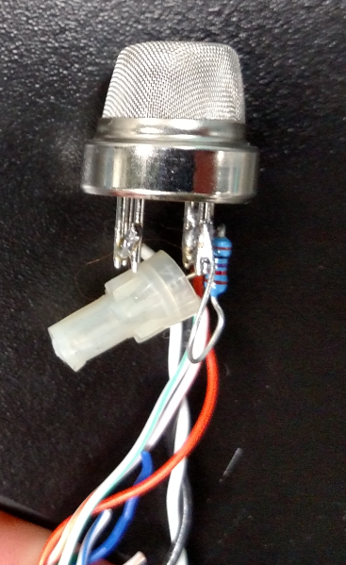
Reactor Design
Methane
EGSB | Research | Final Presentation Spring 2016
Notes:
Photos taken by EGSB sub-team in the AguaClara Lab Space.
Figure 1 and 2 shows the reactor setup before inoculation.
Figure 3 shows a methane sensor after soldering the wires on.
To clarify, figure 1 and 2 were taken before inoculation. In the early design, the water exits were at the end of tube settlers. Then, due to high water level in gas collectors, the team drilled holes at the middle of tube settlers and lowered the water exit, as is shown in slide 8.

Slide 7
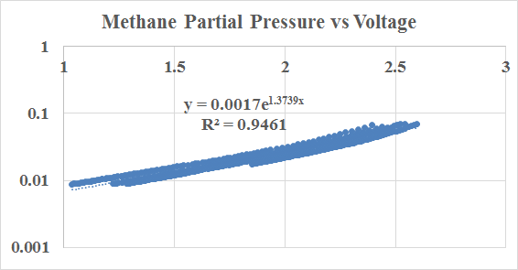
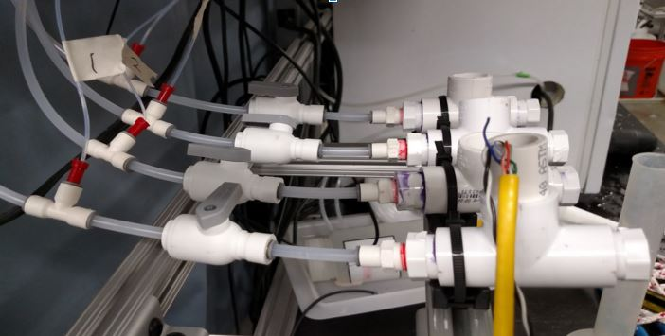
Reactor Design
Air Pump
Methane sensors
Gas Collectors on reactor settling arms
4
3
2
1
5 V Power
ProCoDA signal
EGSB | Research | Final Presentation Spring 2016
Notes:
Photo taken by EGSB sub-team in the AguaClara Lab Space.
Sensor Fabrication Detail seen in Appendix.
Table 1 shows the working air flow rate at 100 rpm pumping speed.
Figure 1 shows the calibration curve of the methane sensors.
Figure 2 shows the methane sensor setup (only 1 methane sensor working at the time the photo was taken)
The output of the methane sensors in ProCoDA was in voltage. AguaClara advisor Cristina made the calibration curve for us, as shown in the figure. There is a good linear relationship between methane partial pressure and voltage output. Methane flow rate can be neglected compared with air flow rate. So the methane flow rate can be calculated as methane partial pressure times air flow rate.

Slide 8
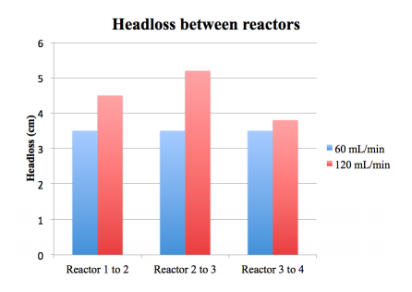
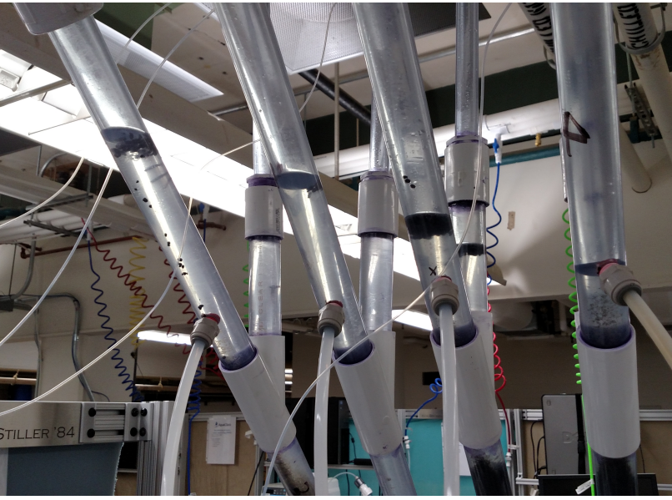
Headloss was larger than expected
Expected headloss: 0.397 mm
Actual headloss: > 3.5 cm
Headloss impacted by:
  flow rate
  tubing size (¼’’ vs ⅜”)
  line clogging
  granule plugs
EGSB | Research | Final Presentation Spring 2016
Notes:
Photo taken by EGSB sub-team in the AguaClara Lab Space and chart generated by sub-team members.
The image on the left shows headloss with the new effluent exit. The chart on the right shows comparisons of headloss between reactors at different flow rates and shows that higher flow rates lead to higher headloss.
Initial headloss calculations suggested that headloss between reactors would be negligible, at 0.397 mm. However, after inoculation and fluidization attempts, it was clear that actual headloss was much greater. Headloss was an issue because it lead to reactor overflows if the headloss was too high, and negatively impacted fluidization. The team observed that flow rate, tubing size, line clogging and granule plug presence all contributed to different levels of headloss. Greater flow rate, smaller tubing sizes, line clogs and granule plugs all increased headloss. Line clogging happens when sludge rise up and enter the ⅜” tubing, which can increase the headloss between 2 reactor and cause overflow in the previous one. Granule plugs will be introduced in next slide. These variables were experimented with in an attempt to find a reactor design that minimized headloss but still allowed for fluidization.

Slide 9
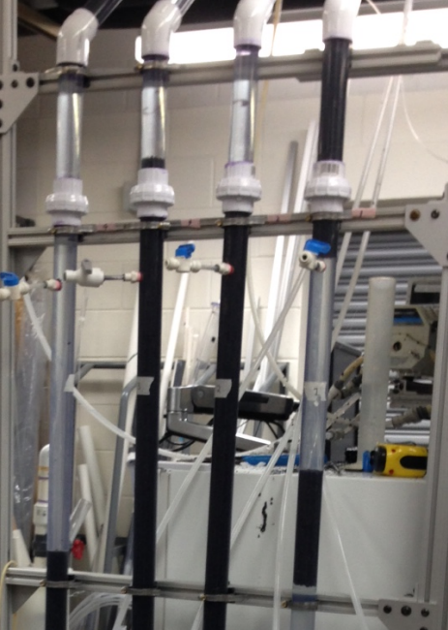
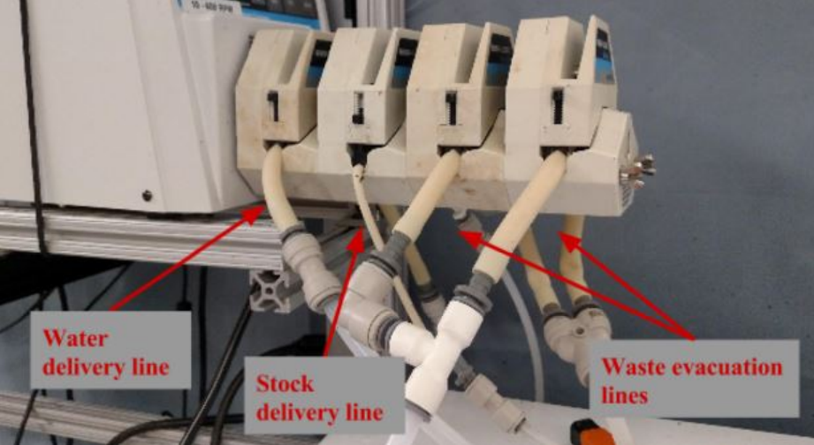
Clogging was a major issue
Granule and stock cloggings were major issues throughout the semester.
EGSB | Research | Final Presentation Spring 2016
Notes:
Photos taken by EGSB sub-team in the AguaClara Lab Space.
The image on the left shows what granule plugs looked like in the reactor. The image on the right shows our pump head set up, with water lines, stock lines, and waste evacuation lines. The stock line repeated clogged and required detachment and reattachment of parts to try to dislodge clogged areas.
Clogging in the form of granule plugs and stock delivery line clogs continued to be an issue throughout the entire semester. The granule plugs increased headloss, decreased fluidization, and led to washout from rising granules. The reason of clogging is unknown. Perhaps it is because gas produced on the surface of granules create surface tension that hold the granules together. As water can not easily go through the plug, it pushes the granules plugs all the way up into tube settler and effluent. And if the clogging accumulates high headloss, the reactor overflows. Different methods were attempted to address the reactor clogging issue. The stock delivery line issue was addressed by changing the tubing from ¼” size to microbore tubing, in an attempt to push the stock through at higher velocities and limit clogging. However, clogging was still experienced in the stock container to microbore tubing connection, which required constant monitoring. The stock was later dyed red to make it easier to see when there was a stock failure event, but the extent to which the granules were not fed is not well known.

Slide 10
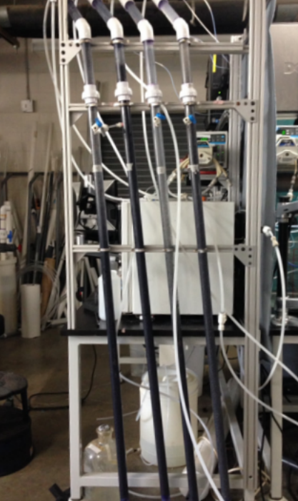
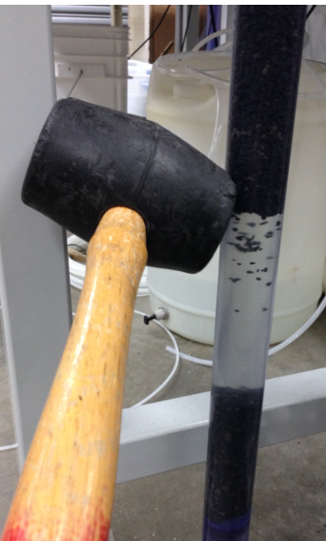
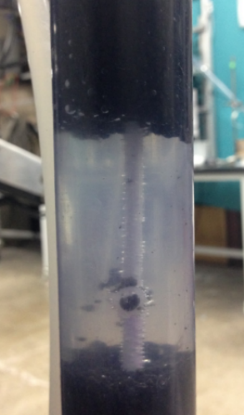
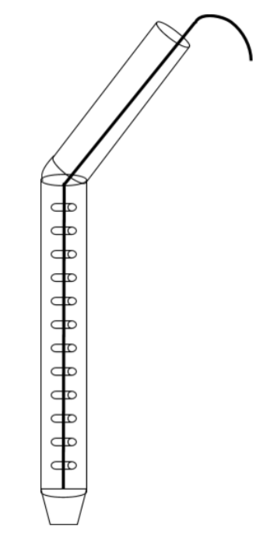
Different solutions were attempted
Agitation was needed to dislodged granule clogs and prevent failure events.
EGSB | Research | Final Presentation Spring 2016
Notes:
Photos taken by EGSB sub-team in the AguaClara Lab Space.
The four images show different attempts at remediating granule clogs. The image on the far left shows the reactors tilted at about 6 degrees, in an attempt to create preferential flow along the top side of the reactor. The second image from the left shows a granule plug being externally agitated by a mallet; moderate strength hitting with the mallet applied enough force to destabilize the and allow the granules to fall back down. The third and fourth images show the addition and operation of a barbed rod into the main reactor column. The barbed rod was an attempt to prevent plugs from being formed and destabilize any ones that were rising. However, the rod had limited use because plugs still formed but were only trapped from rising past the next barb, and the barbs were not enough to completely dislodge the plug. Pulling the rod from the top helped break plugs, but only with limited use as well because the plugs would just travel up the reactor without constant agitation. Additionally, too forceful agitation increased granule washout by helping the granules ride with the upflow velocity applied from pulling the rod.

Slide 11
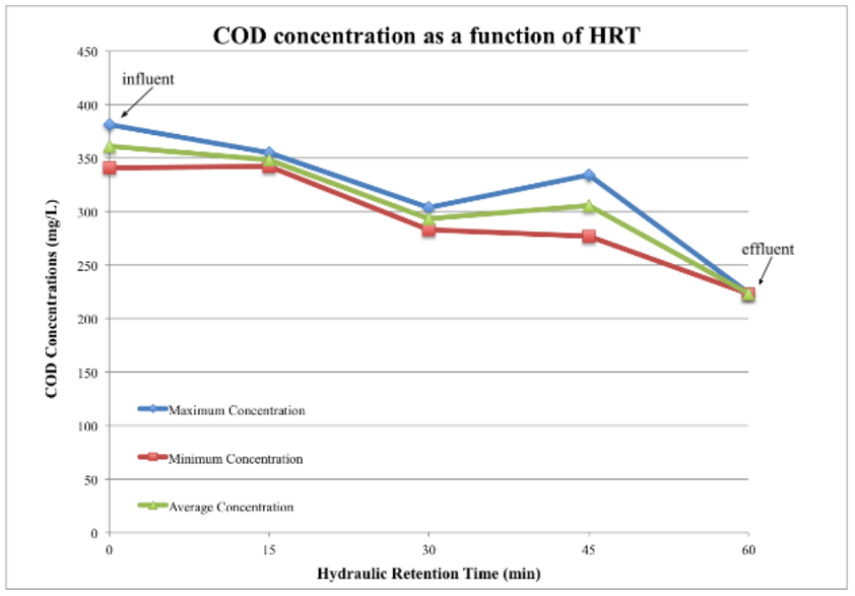
Tests showed COD removal
38% average COD removal on May 7th
Need more COD tests to better understand treatment efficacy.
EGSB | Research | Final Presentation Spring 2016
Notes:
Figure generated by sub-team members.
The figure shows COD concentration as a function of hydraulic residence time (HRT), for a total of 38% COD removal.
Original COD tests data seen in Appendix.
Chemical oxygen demand (COD) tests were conducted in an attempt to understand how effective the reactors were are COD removal and how the COD treatment compared to methane production. A test from a single day took two samples from influent, effluent, and each reactor to find a 38% COD removal. The overall trend is downward and the rise in COD levels in the 3rd reactor could be attributed to statistical errors, or be due to the fact that the reactors are not well mixed and “clumps” of COD could be in certain parts of the reactors before they reach treatment.
A separate COD test done on only influent and effluent showed 80% removal, which only emphasizes that the COD data was not enough to draw conclusions about treatment efficacy.

Slide 12
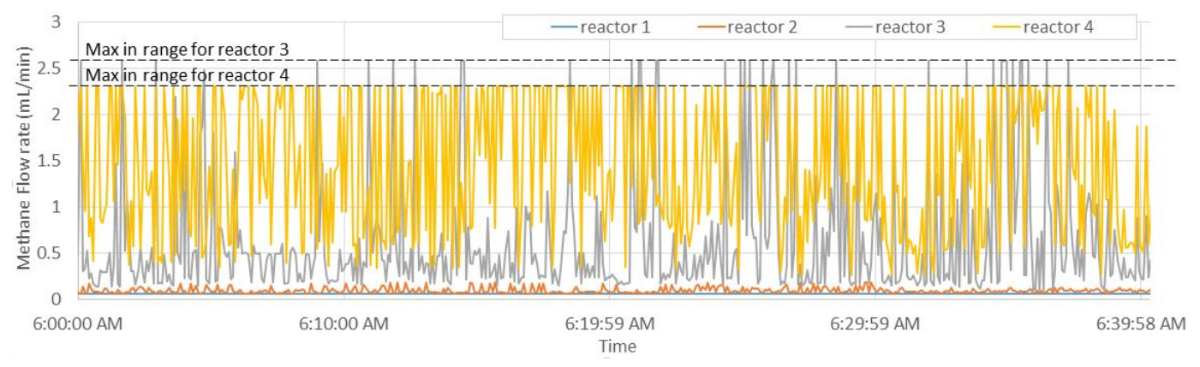
Methane production was recorded
EGSB | Research | Final Presentation Spring 2016
Notes:
Figure and table generated by EGSB sub-team members.
The top figure shows the produced methane flow rate over a 40 minute period, after data processing to cap flow rates within methane sensor ranges. The bottom table shows the methane production from each reactor, as well as the total production, calculated according to the methane sensor data, individual flow rate readings, and integration over time.
Methane sensors were constructed and used for the first time this semester to better quantify methane production in real time, without having to do gas chromatography (GC) tests. The methane sensors were ordered, constructed, and attached to the reactor system. Each sensor had a maximum methane concentration that the manufacturer said was in range, so methane lines from the reactors were diluted with air pumps. Using the dilution flow rates and a calibration curve that AguaClara advisor, Cristina, developed, ProCoDA recorded methane sensor voltages that were converted to methane flow rate. However, each reactor produced different amounts of methane, with reactor 4 producing the most, and sometimes even with dilution the readings were out of range and needed to be capped for total methane production calculations.
The calculated methane production exceeds the theoretical methane production indicated from the COD test, and can be explained by the following possible reasons:
The methane sensors used to create the calibration curve had a 10 kohm resistor, while the ones that were used in reactor operation were constructed with a 10.9 kohm resistor. This difference could have significantly impacted the calibration curve, making the 10 kohm calibration curve inapplicable to the 10.9 kohm resistors, thereby messing up the calculated methane production.
The COD test that showed ~40% removal might not be indicative of actual removal (as shown by the second COD test of 80% removal). If COD removal is actually greater than 40%, it would account for the greater methane production.
See appendix slide “Fabrication of methane sensors” for a diagram of the methane sensor.

Slide 13
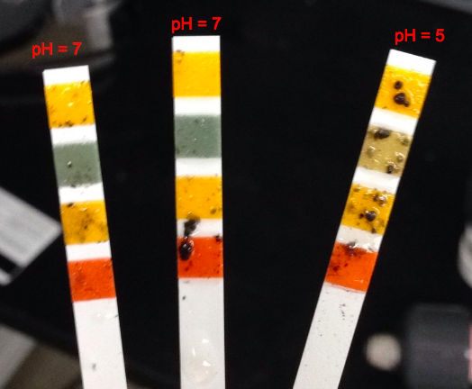
Acidification extent is unclear
3 pH tests from reactor 1 showed different results.
EGSB | Research | Final Presentation Spring 2016
Notes:
Photo taken by EGSB sub-team in the AguaClara Lab Space.
The image shows three pH strips used in reactor 1 with different results. The first sample, on the right, showed a pH of 5 while the second two both reported 7.
Reactor acidification was a concern in reactor 1. One of the preceding reactions to methanogenesis is acidogenesis and due to the plug-flow qualities of the reactors, the team believed that acidogenesis was happening in the first reactor. Different pH tests were done, but with limited results because pH strips showed different results for different tests. Tests with the pH probes were attempted, but were eventually incomplete because the pH probe failed. While there are no conclusive pH readings, reactor acidity is assumed because the first reactor had almost no methane production and granules in that reactor turned grey and white to different intensities.

Slide 14
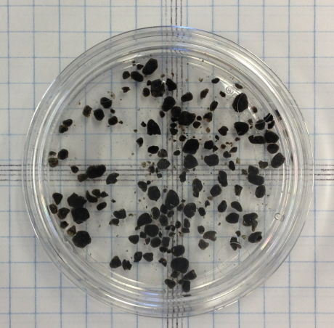
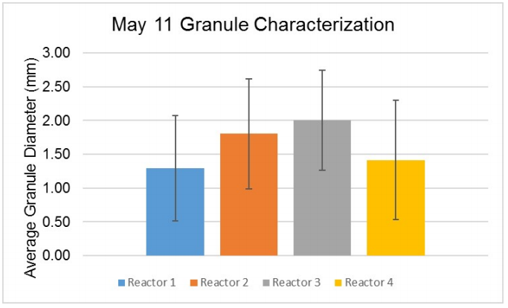
Granule characterization showed changes in diameters
pre-inoculation
post-inoculation
Size decreased from pre-inoculation 2 mm diameter to post-inoculation between 1.3 mm and 2 mm.
EGSB | Research | Final Presentation Spring 2016
Notes:
Photo taken by EGSB sub-team in the AguaClara Lab Space and table generated by sub-team members.
The image on the left shows granules taken from the granules pre-inoculation. The chart on the right shows granule characterization from each reactor, post-inoculation.
The granules used for were obtained in the late Fall of 2015 from a Syracuse Brewery and stored in a refrigerator until use. Pre-inoculation granule characterization was done to help determine design parameters for reactor construction, including parameters like settling arm length needed for granule settling. Post-inoculation granule characterization was done to help determine how the granules have grown or died over operation. The table shows that granule size varied between reactors. The size trend does not correlate with methane production, so granule size as related to granule efficiency is unclear from these results.

Slide 15
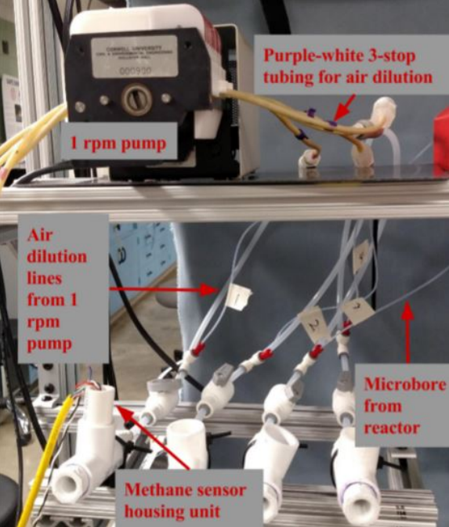
Future Work: Data
Methane Calibrations
  Controlled Dilution Pump
pH Monitoring
COD Removal Efficiency
EGSB | Research | Final Presentation Spring 2016
Notes:
Photo taken by EGSB sub-team in the AguaClara Lab Space
Methane Sensor Bench-Top Setup: The gas from the sealed reactor headspace is siphoned continuously via micro-bore tubing into a diluting air stream, which is pumped via a peristaltic pump at a controllable rate. The diluted reactor gases are then passed over the methane sensors, and registered as a voltage by ProCoDA. The voltage can then be converted to volumetric methane flow rate via a calibration curve taken at known methane flow rates.
Future work on data collection needs to be done:
-The methane sensors assembled for the reactor use a different resistor than the sample sensor calibrated by our research advisor. As a result a new calibration curve needs to be generated for the new sensors to determine the influence of the change in resistance (10.9 kOhms instead of 10 kOhms) as well as verify that the wiring is consistent (as the team had to solder the sensor individually). In addition, the dilution pump rate needs to be dynamically adjusted as the methane concentration approaches the upper and lower limits of the sensor’s measurable range to prevent the concentration from leaving that range. This could potentially be done through ProCoDA connected to the peristaltic pump supplying the diluting air, but if the first reactor continues to show negligible methane production it may be necessary to downsize the tubing that dilutes the air from the first reactor so that methane can be measured at lower concentrations for that reactor.
-Measuring pH needs to occur more frequently and with more precision than the pH strips so that the cause and extent of the first reactor’s acidification can be determined and potential solutions implemented and evaluated.
-COD removal efficiency also needs to be measured more frequently across the semester, primarily so that it can be paired with better calibrated methane data. This pairing will allow the methane measurements to be validated, and provide the data necessary to calculate the amount of dissolved methane leaving the reactors in the effluent.
The methane sensor wiring diagram is in the appendix, and shows a bit of how the sensor measures the changing resistance of a special metal mesh that methane adsorbs to and gets burned off of by a heating element as well as the placement of the resistor that we had to change.

Slide 16
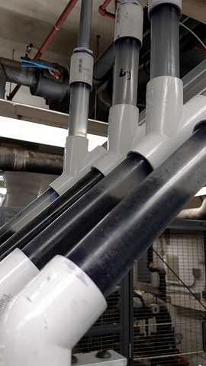
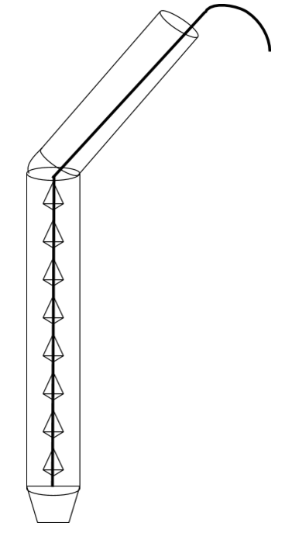
Future Work:
Operation
Better Settler
Barbed Rod Agitation
Reactor Maintenance Ports
Stock Concentration
EGSB | Research | Final Presentation Spring 2016
Notes:
Photo taken by EGSB sub-team in the AguaClara Lab Space
Left Figure (GIF): This gif shows the granule accumulation at the bend of the reactor tube settlers. This accumulation occurs even when the bottom portion of the reactor is properly fluidized.
Right Figure: Second Design Iteration for the Barbed Rod Agitator
-Settler improvement: Settling appears to be occurring fairly well in the tube settler, with granules seen rising along the top of the first settler and falling back to the bottom of the settler in the figure. However, the 45 degree elbow needs to be changed in order to allow the settled granules to fall back into the expanded bed section of the reactor. It is hypothesized by the team that a sharper bend, ideally achieved without an elbow using the pvc welder, will alleviate this problem.
-The Barbed Rod’s current iteration can trap but not disrupt granule blockages in the reactor. This prevents large granule wash-out, but still leads to headloss accumulation and ultimately flooding failure of the reactors. The new design uses pointed barbs in an attempt to encourage blockage breakup rather than just impeding their movement. It may require mechanical agitation, but likely less than the current iteration.
-Reactor Maintenance Ports: As granules die they can become hollow and rise to the top of the reactor. This has raised concerns of granule accumulation in the gas collection chamber, which could obstruct gas bubbles and increase the intermittency of the methane flow entering the sensors (which makes the methane concentration more likely to stray outside the sensor’s measurable range)
-Stock Concentration: Due to the high flow rate required by the reactors to expand the granular bed, there is a large stock requirement to run the reactors. As a result, the stock concentration was doubled from the UASB recipe. This caused the micro-bore delivery tubing to clog at the entrance, due to the high amount of suspended material in the double concentrated stock. As a temporary fix some of the larger suspended particles were filtered out, but this reduces the influent waste strength. The reduction in influent waste strength could make our reactors perform better than they would at high strength (or worse), so it should be avoided if possible in the future.

Slide 17
Questions
and
Recommendations
Zoe Maisel
B.S. Environmental Engineering
zam7@cornell.edu
Cho Shen
M.Eng in Environmental Water Resource Engineering
qs62@cornell.edu
Stephen Galdi
B.S. Environmental Engineering
smg296@cornell.edu
EGSB | Research | Final Presentation Spring 2016

Slide 18
Appendix
Slides
EGSB | Research | Final Presentation Spring 2016
Notes:
From this point on, add any slides with figures that will help support your thesis. You might pull these figures from your Final Report.

Slide 19
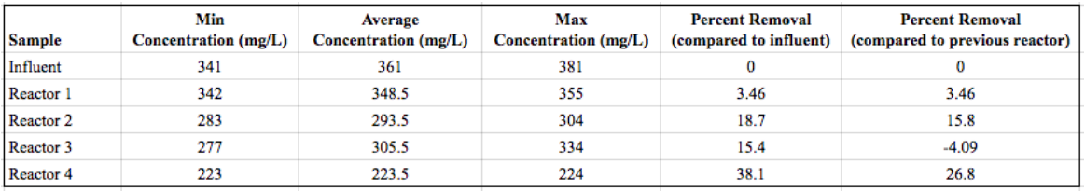
COD Tests Data
COD test 1
COD test 2
EGSB | Research | Final Presentation Spring 2016
Notes:
COD test conducted by EGSB sub-team in the Teaching lab and table generated by sub-team members.
Tables show the original data from the 2 COD tests.
More details seen in report.

Slide 20
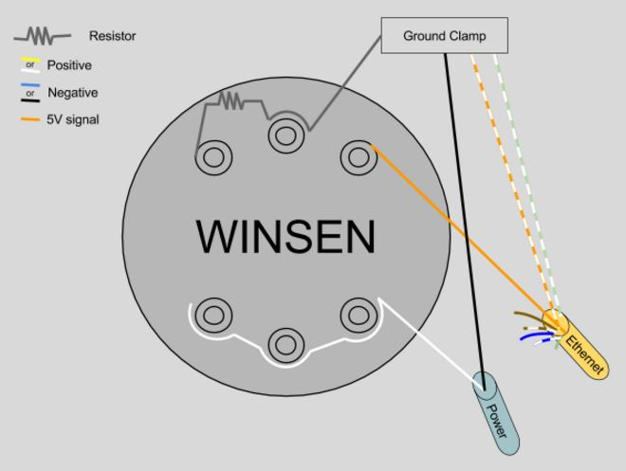
Fabrication of Methane Sensors
EGSB | Research | Final Presentation Spring 2016
Notes:
Figure generated by EGSB sub-team members.
Figure shows how to solder the wires onto the methane sensors.
There are 6 legs on the methane sensor. The orange line export signal to procoda, the black line is ground, white provides line power.

Slide 21
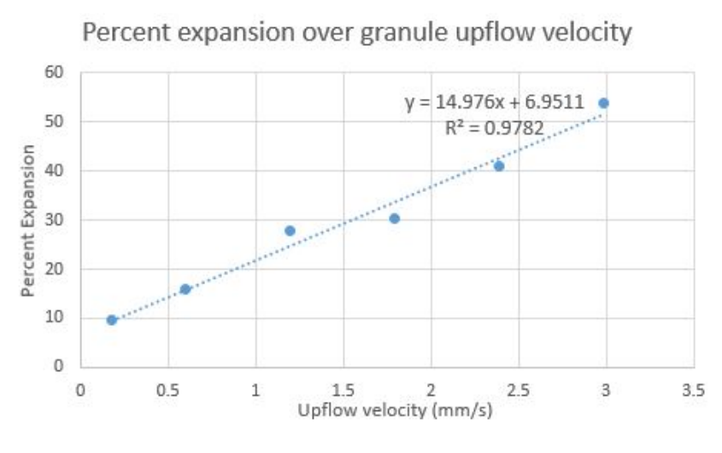
Upflow velocity pre-test data
EGSB | Research | Final Presentation Spring 2016
Notes:
Figure and table generated by EGSB sub-team members.
Figure shows the result of fluidization pretest.

Slide 22
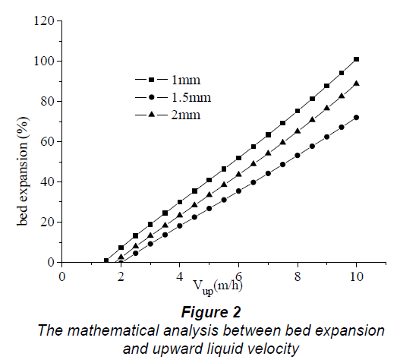
Expansion vs Upflow Velocity from Liu et al. 2006
EGSB | Research | Final Presentation Spring 2016
Notes:
Cite your sources here.
Caption your figure and explain its relevance to your presentation/thesis here. You can take the caption from your Final Report and modify it.
Write a summary of this slide here. A future team member or client should be able to read this note and understand this slide without having your team explain it to them.

Slide 23
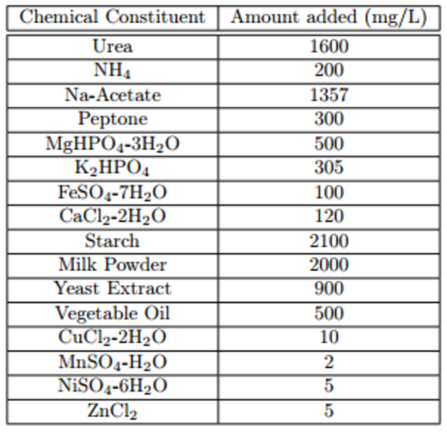
Stock Recipe
Size 18 to 13 tubing pumping speed ratio was 70.57 to 1. Size 13 tubing required 4.52x concentration of the original stock recipe.
Cl
EGSB | Research | Final Presentation Spring 2016
Notes:
Table developed by AguaClara wastewater team 2013.

