Slide 1
Floc Size and Count App
Anthony, Christian, Deniz

Slide 2
Importance
Measure size and number of flocs from image
Helps with testing for optimal designs of the plant
Operators in AguaClara plants can determine if plant is functioning properly
More advanced research

Slide 3

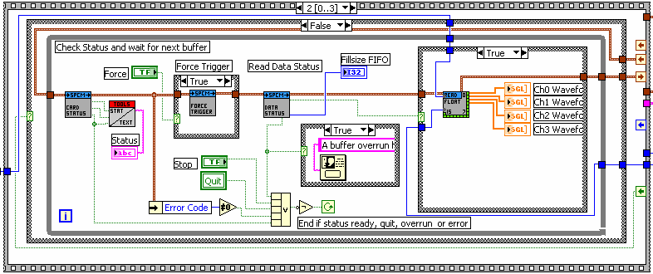
What we are working with
Prior Work
  Siwei Sun (Thesis)
  Casey Garland (Program)

Slide 4
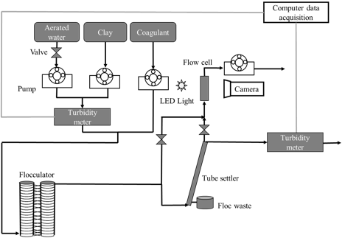
Thesis
Better understanding App
Tested different conditions
  Will be more useful in the future

Slide 5
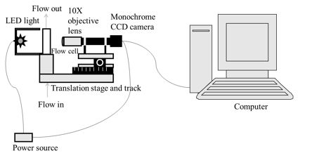
Thesis
Very Specific descriptions
Program Steps
  Gaussian Filter
  Local Thresholding
  Close Holes
  Remove

Slide 6
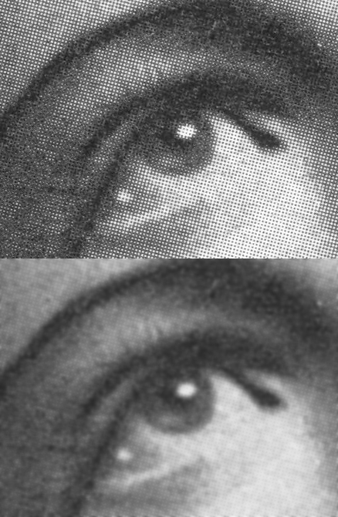
Thesis

Slide 7
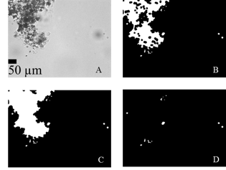
Thesis

Slide 8
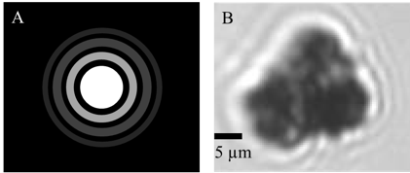
Thesis
Airy Disks

Slide 9
Learning LabVIEW
We started by learning the syntax and the variable types
We also learned different types of loops
After covering the basics, we started learning about shift registers and state machines
We also learned using configuration files to set up an app
Lastly, we learned how to use subVIs and type definitions

Slide 10

Casey’s Program
Received March 9, 2016
Demonstration
Not user-friendly
We don’t have access to image processing extension of labview!

Slide 11
Future Plans
Create a simple program using all the aspects of LabVIEW we learned
Learn how to make a stand-alone app with LabVIEW
Make Casey’s code more user-friendly
Test code with actual data
Create a working version of the post processing image analysis part of the program

Slide 12
Bibliography
LabVIEW logo image(3): https://www.google.com/search?q=Labview&espv=2&biw=1536&bih=756&source=lnms&tbm=isch&sa=X&ved=0ahUKEwivyKKb0bvLAhVBGB4KHZ22AP4Q_AUIBigB#imgrc=rL5ks39ZQYr33M%3A
LabVIEW program image(3):
https://www.google.com/search?q=labview+programming&espv=2&biw=1536&bih=756&source=lnms&tbm=isch&sa=X&ved=0ahUKEwjOpZfA0bvLAhWClh4KHUffD44Q_AUIBygC#imgrc=OkPM_kG9GdCv0M%3A
Gausian blur image(6): https://en.wikipedia.org/wiki/Gaussian_blur#/media/File:Halftone,_Gaussian_Blur.jpg

