Slide 1

Floc Size and Count App
For more information please visit https://confluence.cornell.edu/display/AGUACLARA/Floc+Size+And+Count+App
Apps and Algorithms | Symposium Presentation Fall 2016
Notes:
[[Insert your abstract here.]]
https://www.overleaf.com/6236094pfvkbt

Slide 2

What do we do?
Make a program
Average Size and Count
Short-term: Help other
teams
Long term: Help Honduras
workers
The floc app will be a valuable tool both in the lab and the field.
Floc App | Apps and Algorithms | Symposium Presentation Fall 2016
Notes:
Image retrieved from clipart
Caption of Slide: This slide introduces the main goals of the floc app team and how it serves as a valuable resource for other subteams focused on research with flocculators.
Summary: The Floc App team is very important to Agua Clara. Developing software that can take in images and analyze them to determine the size and number of flocs is important for many of the research subteams in Agua Clara. Thus, the short term goal of the team is to help other Agua Clara subteams that are researching flocculation. However, helping research groups is not the only goal of the floc app; the long term goal of the floc app is to serve as a tool for on-site workers in Honduras so they can quickly determine whether their plant is functioning properly. By simply running the program, they can get an accurate estimate of the average size and number of flocs at specific points in the filtration process, thus making our plants more efficient and easier to check up on.

Slide 3
Methods
First Step: Research
Floc App | Apps and Algorithms | Symposium Presentation Fall 2016
Notes:
To train ourselves with LabVIEW, all members of the team watched a series of LabVIEW tutorials on the National Instruments website (http://www.ni.com/academic/students/learn-labview/)
We then proceeded to watch supplemental YouTube videos from a variety of channels. Some of us also looked at the LabVIEW White Papers and practiced their exercises.Finally, we used Siwei Sun’s research report to help us better understand how to implement the floc app.

Slide 4
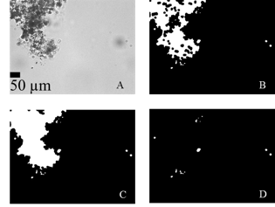
Sun’s Image Analysis
A. Original | B. Local Thresholding | C. Filling | D. Removal
Floc App | Apps and Algorithms | Symposium Presentation Fall 2016
Notes:
Image retrieved from Siwei Sun (2016). Characterization of Flocs and Floc Size Distributions Using Image Analysis. Partial Fulfillment of the Requirements of Degree of Master of Science, Cornell University, Ithaca, New York.
Caption of Slide: These are the steps of image analysis as outlined in Siwei Sun’s Thesis. These steps are used in the original program and served as model we used when organizing the original code into subVIs (functions).
Summary:
These are the steps of image analysis as outlined in Sewei Sun’s Thesis.
Figure A Represents the image before any changes are made for processing.
Figure B represents the original image after the Gaussian filter and local thresholding have been applied
Figure C is Figure B after large holes inside the flocs were filled. This makes the image easier to process.
Figure D Represents Figure C after the removal of unanalyzable flocs. This group includes flocs that are out of focus, too small, or on the boundary of the generated picture.
The problem with “border” flocs is that measurements are ambiguous.
Flocs that are out of focus cannot be used to obtain accurate data.
The issue with small flocs is airy disks that form.

Slide 5

Flocs on the image’s border are removed
Floc App | Apps and Algorithms | Symposium Presentation Fall 2016
Notes:
Image retrieved from:
Sewei Sun (2016). Characterization of Flocs and Floc Size Distributions Using Image Analysis. Partial Fulfillment of the Requirements of Degree of Master of Science, Cornell University, Ithaca, New York.
Caption of Slide: Explains why flocs touching boundary are removed.
Summary:The problem with “border” flocs is that measurements are ambiguous. One is unable to determine how far the floc extends past the allotted image size, so the border flocs are not counted as one of the flocs in the image.

Slide 6
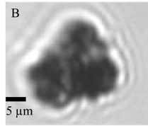
Small particles and unfocused flocs were removed
Floc App | Apps and Algorithms | Symposium Presentation Fall 2016
Notes:
Image retrieved from:
Sewei Sun (2016). Characterization of Flocs and Floc Size Distributions Using Image Analysis. Partial Fulfillment of the Requirements of Degree of Master of Science, Cornell University, Ithaca, New York.
Caption of Slide: Explains why Casey’s Code Removes Small Particles.
Summary: If a particle is too small (with dimensions of 2.6 μm), “light rings” form around it. This phenomenon occurs when a particle’s dimensions are close to the wavelength of light. This makes measurements inaccurate, so such particles are removed.

Slide 7
Methods
Second Step: Finishing the Code
Floc App | Apps and Algorithms | Symposium Presentation Fall 2016
Notes:
We had to comment a lot of the code to make it easier for future programmers to understand and edit. After this step was completed, we worked on making the graphical user interface more aesthetically appealing. Then, we worked on implementing the buffer into the code.

Slide 8
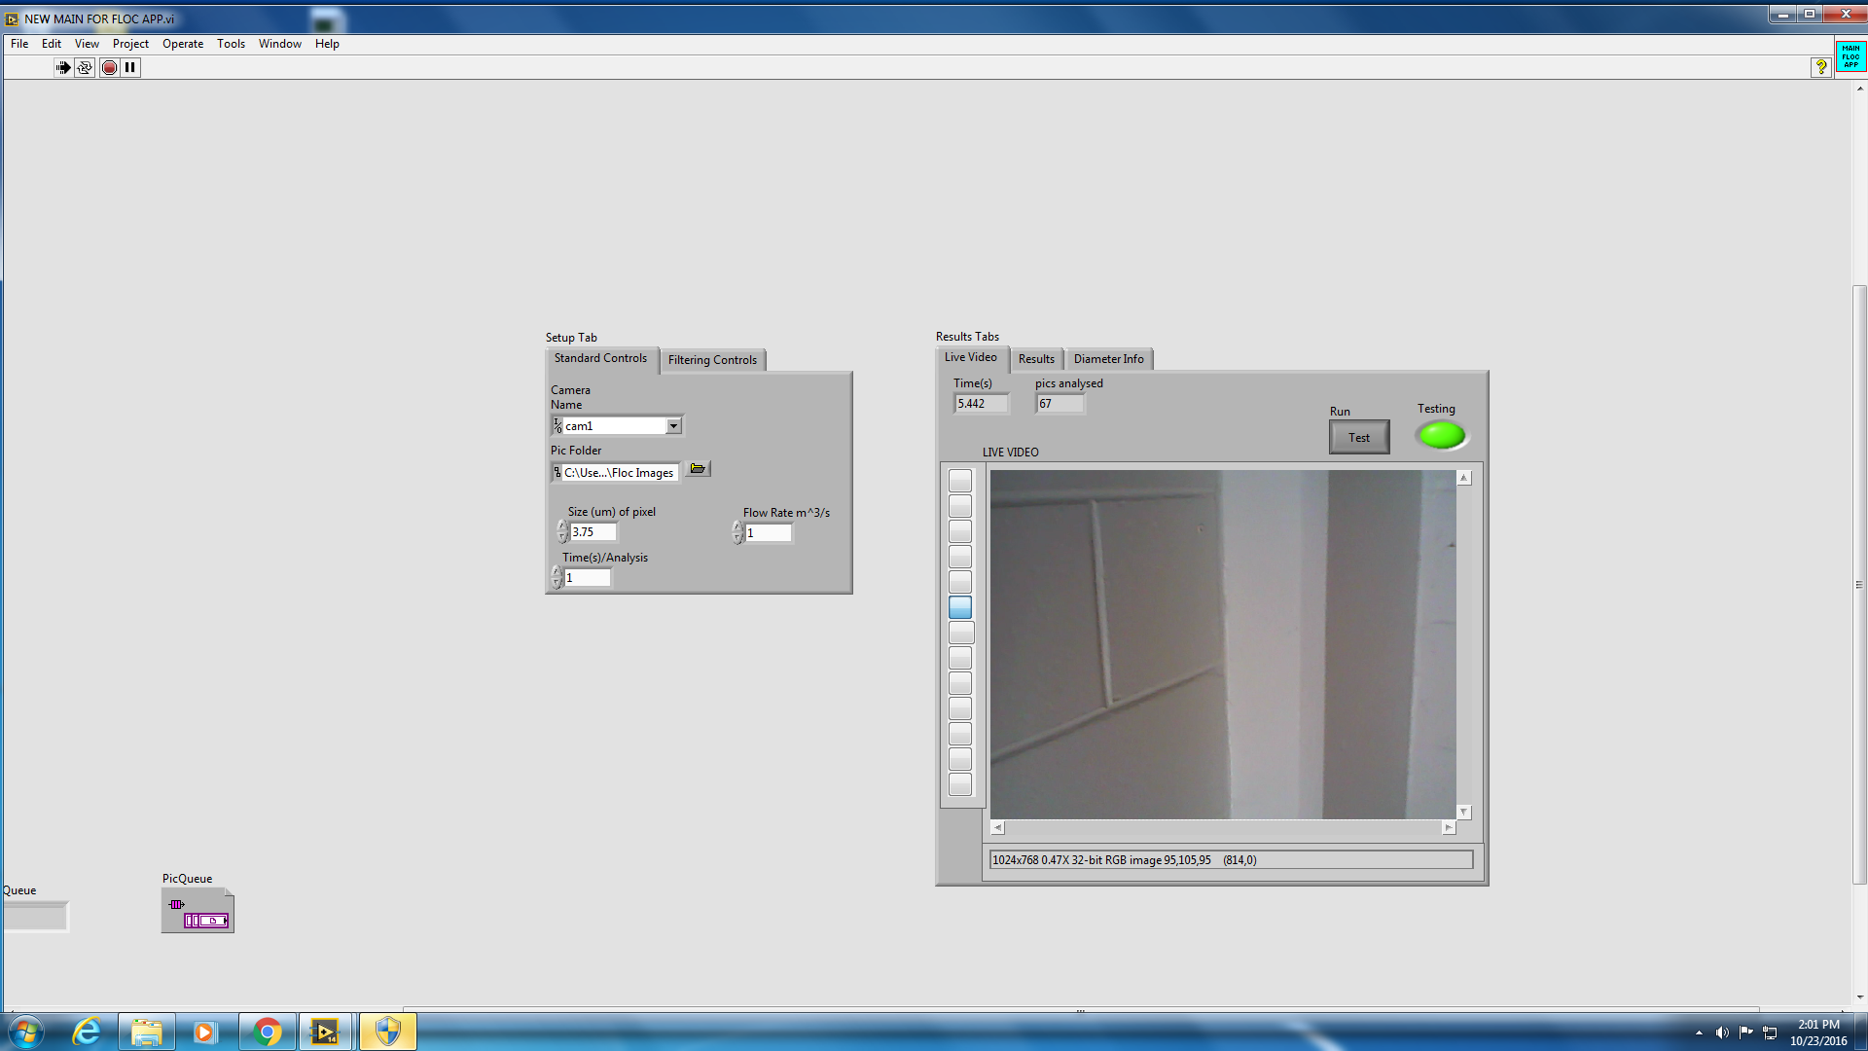
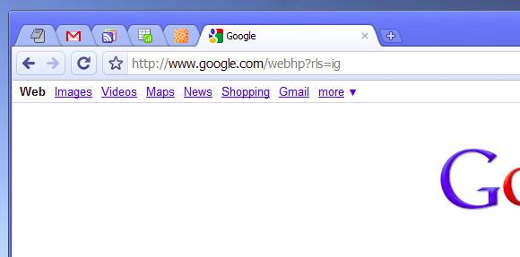
Tabs were used to organize settings and collected data
Floc App| Apps and Algorithms | Symposium Presentation Fall 2016
Notes:
In terms of aesthetics, there were a few issues with the original graphical user interface (GUI). The user interface was too large to view on a single screen. Moreover, it was difficult to find certain inputs in the GUI. In order to organize the controls and information on the screen, the team decided to divide the information on the screen into two tabs, one to display/store the user’s inputs and the other for the outputs. Each of these tabs was further divided into different pages.
For the output tab, one page is dedicated to displaying the live video of the test, another for displaying the latest camera image analysed, and a third for displaying the data chart.
For the inputs-tab, the controls were divided into two tabs based on priority and ease to understand. For example, the file in which the program stores its analysed images and the time per analysis were deemed to be both important and easy to understand. The thresholding method and the kinds of particles to look for were deemed unimportant because they should not be changed from their default values too often and they require some knowledge on computer graphics and the program itself in order to understand their significance
Image: http://popdevelop.com/wp-content/uploads/2010/06/screenshot.144edit.png

Slide 9
Live video was incorporated for debugging and confidence
Floc App| Apps and Algorithms | Symposium Presentation Fall 2016
Notes:
The team decided that the Floc App should have run a live video while the selecting an image to analyse after a certain time interval. The team assumed that the users of this program would appreciate this feature and would use it as a means by which to make sure that the test is operating as it should. The original program provided to the team did not have a feature for doing and a simple implementation of live video acquisition did not seem available in the LabVIEW standard library.
The team, decided to turn to LabVIEW online community for help. in the National Instruments website, one such solution was found (see hyperlink below). This solution was then analysed, and its ideas were incorporated into the Floc App program.
https://decibel.ni.com/content/docs/DOC-29589

Slide 10
Queues as buffer structures
Queues are a great tool to implement buffers but not instantaneous which causes problems
Floc App| Apps and Algorithms | Symposium Presentation Fall 2016
Notes:
Queues are a great tool to implement buffers but not instantaneous which causes problems. However, they did prove more useful than simple arrays. First, arrays were used for the buffer structures, but timing issues were accentuated.

Slide 11

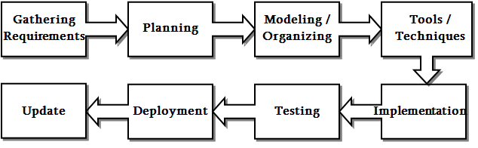
Future Work
Solve problems raised by parallel loops and non-instantaneous executions
Create a hardware component
Get user feedback
Fix problems and get user feedback
Floc App| Apps and Algorithms | Symposium Presentation Fall 2016
Notes:
picture source: https://2.bp.blogspot.com/-CDn3722vYhU/UPRvN64rUdI/AAAAAAAABBs/pAqI5Fvvuww/s1600/software_engineering_3.png

Slide 12
Questions
and
Recommendations
Christian Rodrigues
Computer Science
cer95@cornell.edu
Anthony Verghese
Computer Science
akv26@cornell.edu
Deniz Yilmazer
Computer Science
dy223@cornell.edu
Floc App| Apps and Algorithms | Symposium Presentation Fall 2016

Slide 13
Appendix
Slides
Floc App| Apps and Algorithms | Symposium Presentation Fall 2016
Notes:
From this point on, add any slides with figures that will help support your thesis. You might pull these figures from your Final Report.

Slide 14
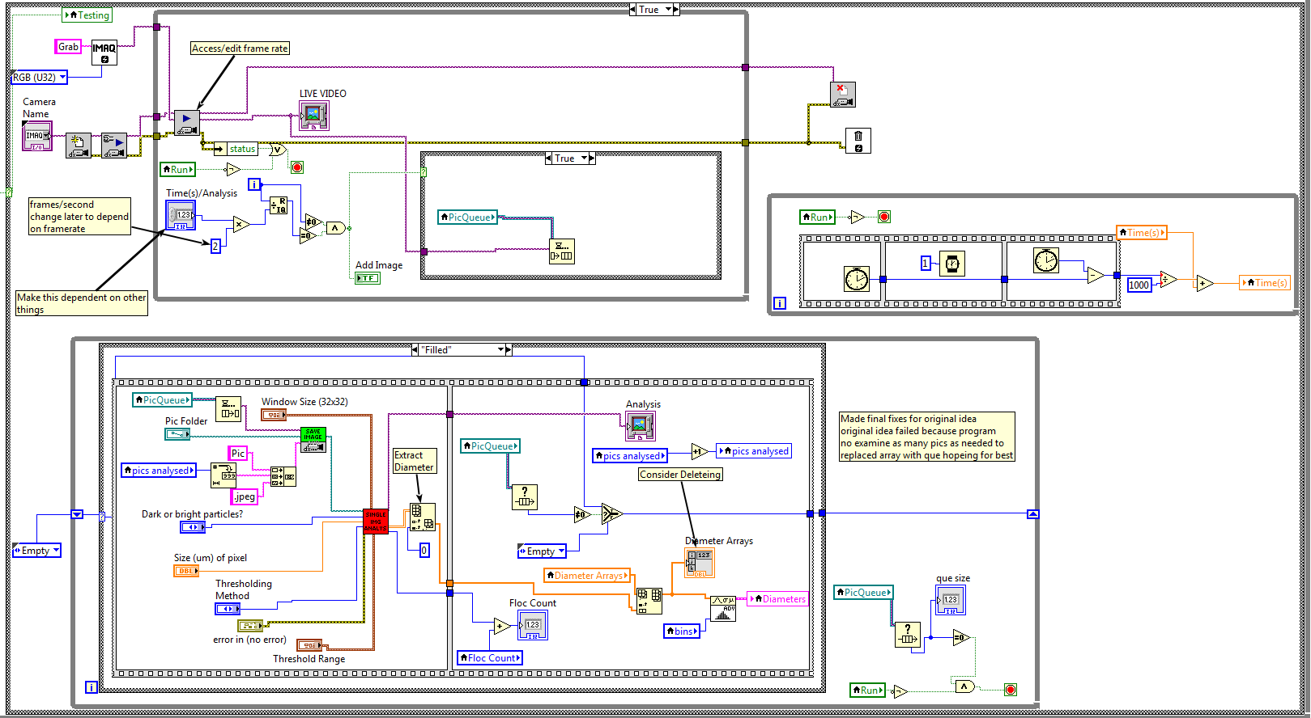
Concurrent execution was used to increase program speed
Create Live video
Legend
While Loop
Case Structure
Regularly Put Image into Analysis Queue
Keep Track of Time
Analyse Pictures in Queue
Floc App| Apps and Algorithms | Symposium Presentation Fall 2016
Notes:
Multithreading is the process by which a computer executes multiple threads of code at the same time as opposed to only working on one thread at a time.
This is necessary for the Floc App because the program should analyse the chosen images while displaying the test live. This is done so that once the user ends the test, he
or she would not have to wait for all the selected photos to be analysed. Luckily LabVIEW makes multithreading very simple to implement. One simply places several while loops in the same structure of the program, one per thread.

