Slide 1

Floc Size and Count App
The presentation will discuss progress made by the Floc Size and Count App team since the symposiums.
For more information please visit https://confluence.cornell.edu/display/AGUACLARA/Floc+Size+And+Count+App
Floc App | Apps and Algorithms |Final Presentation Fall 2016
Notes:
[[Insert your abstract here.]]
[[Add a link to your full report here. ]]

Slide 2

What do we do?
Make a program
Average Size and Count
Short-term: Help other
teams
Long term: Help Honduras
workers
The floc app will be a valuable tool both in the lab and the field.
Floc App | Apps and Algorithms | Final Presentation Spring 2016
Notes:
Image retrieved from clipart
Caption of Slide: This slide introduces the main goals of the floc app team and how it serves as a valuable resource for other subteams focused on research with flocculators.
Summary: The Floc App team is very important to Agua Clara. Developing software that can take in images and analyze them to determine the size and number of flocs is important for many of the research subteams in Agua Clara. Thus, the short term goal of the team is to help other Agua Clara subteams that are researching flocculation. However, helping research groups is not the only goal of the floc app; the long term goal of the floc app is to serve as a tool for on-site workers in Honduras so they can quickly determine whether their plant is functioning properly. By simply running the program, they can get an accurate estimate of the average size and number of flocs at specific points in the filtration process, thus making our plants more efficient and easier to check up on.

Slide 3
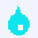
Executables are a standard means of distributing software
Floc App | Apps and Algorithms | Final Presentation Fall 2016
Notes:
Executables, or applications, provide instructions directly to a computer. In order to make the Floc App useable for the public, the team had to generate an executable and accompanying installer from the program’s source code.
Running the program is faster than running it through the LabVIEW Development Environment.
It is also more convenient to run the program this way. One merely double clicks an icon as opposed to opening the Development Environment and then finding the appropriate vi to open.

Slide 4
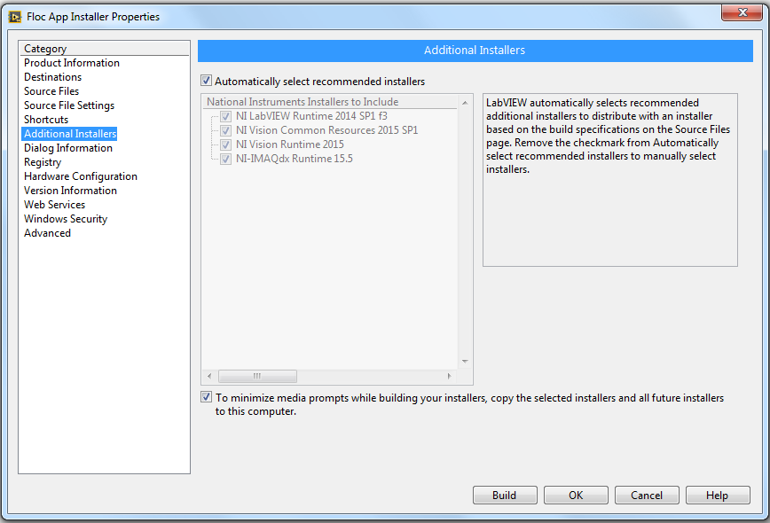
LabVIEW provided a simple interface for creating both
Floc App | Apps and Algorithms | Final Presentation Fall 2016
Notes:
LabVIEW provided a very simple means of creating both of these. First, a project folder was containing all the pertinent VIs was created. After this, a user would simply click a menu option proceed and“build” an executable and accompanying interface. Both of these actions generated popup menu asking the user for numerous inputs. The most pertinent ones involved the program’s name, “main vi” (the first to execute), and several GUI options. For creating the installer, it was very convenient to see that the LabVIEW environment was able to generate a collections of additional programs that would be installed in addition to the Floc App. These are all necessary to run both the main LabVIEW code and those pertinent to the non-standard libraries used.

Slide 5
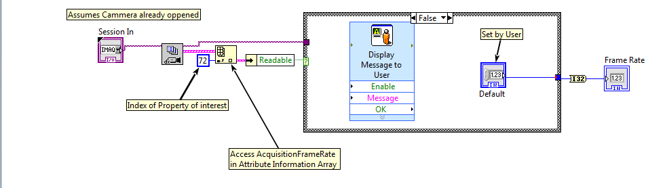
The program is capable of reading a camera's frame rate
Floc App | Apps and Algorithms | Final Presentation Fall 2016
Notes:
So far, after creating a functional prototype, the team has made two major updates. The most important of these is the incorporation of a subvi that reads the frame rate of the camera being used. This is important because the timer and the selection of photos for analysis depend on the camera’s frame rate. If the camera does not have this property, the team has decided that the subvi should output 30 fps. This is because the only cameras used by this program will be the Logitech Webcam C310 (which don’t have this attribute) and a Point Grey Camera, which is sophisticated enough to have this attribute. The team has also modified the code so that an accompanying spreadsheet is generated. None of these updates have been fully tested yet.

Slide 6
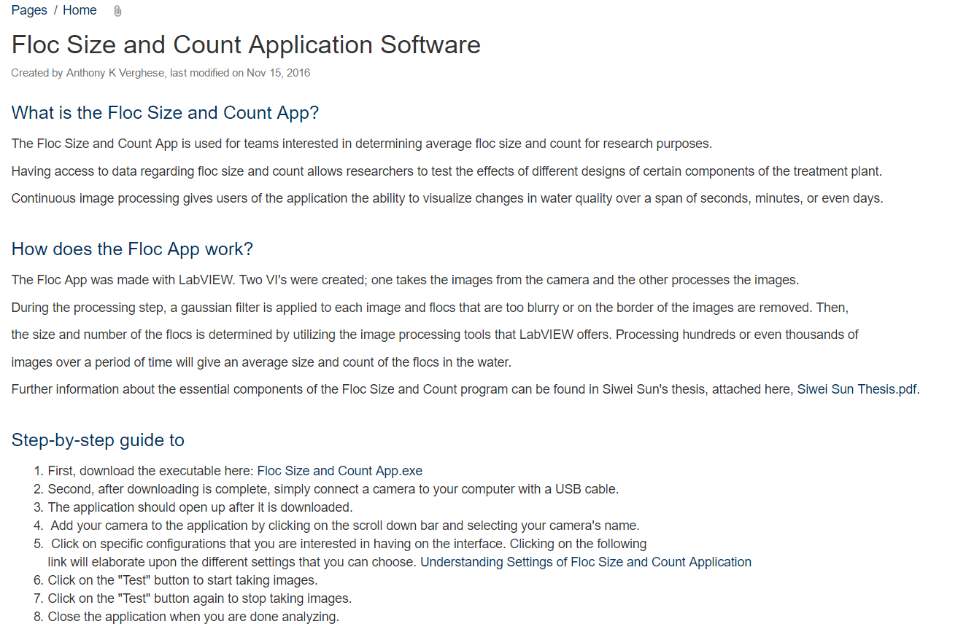
Creating a Wiki Page
Floc App | Apps and Algorithms | Final Presentation Fall 2016
Notes:
Image retrieved from the AguaClara Wiki Site
Caption of Image: This is the wiki page for the floc application. It provides a means of downloading the software and understanding how it works.
Summary: Making the floc application easily downloadable through a public site and providing a step-by-step guide allows for users to quickly take advantage of the floc application. Without the wiki page, we would have to send the executable link to people who ask us, which is much more inefficient. In addition, without this wiki page, research groups from other universities would be restricted from experimenting with the floc application, which is not our goal.

Slide 7

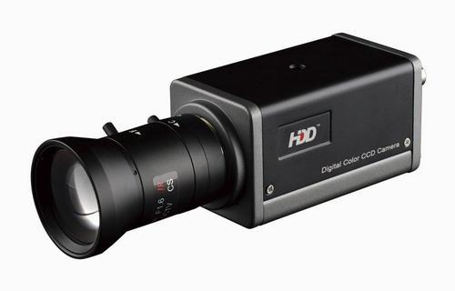
Hardware Integration
A camera with very high resolution is needed
Very expensive
Will be used in one experiment
A camera with very high resolution is needed however it is very expensive.
Floc App | Apps and Algorithms | Final Presentation Spring 2016

Slide 8

User Feedback on Interface
The full experiment structure is expensive
Less feedback than we would like
We can still get feedback on the user interface
How?
A fun way to encourage use!
Try to get the dimensions of Monroe’s head with floc app!
The integrated hardware is not the only way to get feedback. Other ways to get feedback on interface.
Floc App | Apps and Algorithms | Final Presentation Spring 2016

Slide 9

What Next?
Our program is done
Working progress
We need feedback from you!
Hardware component
We will be continuing to change and develop the floc app according to the feedback we get.
Floc App | Apps and Algorithms | Final Presentation Spring 2016

Slide 10
Questions
and
Recommendations
Christian Rodrigues
Computer Science
cer95@cornell.edu
Anthony Verghese
Computer Science
akv26@cornell.edu
Deniz Yilmazer
Computer Science
dy223@cornell.edu
Floc App | Apps and Algorithms | Final Presentation Fall 2016

Slide 11
Appendix
Slides
Floc App | Apps and Algorithms | Final Presentation Fall 2016
Notes:
From this point on, add any slides with figures that will help support your thesis. You might pull these figures from your Final Report.

Slide 12
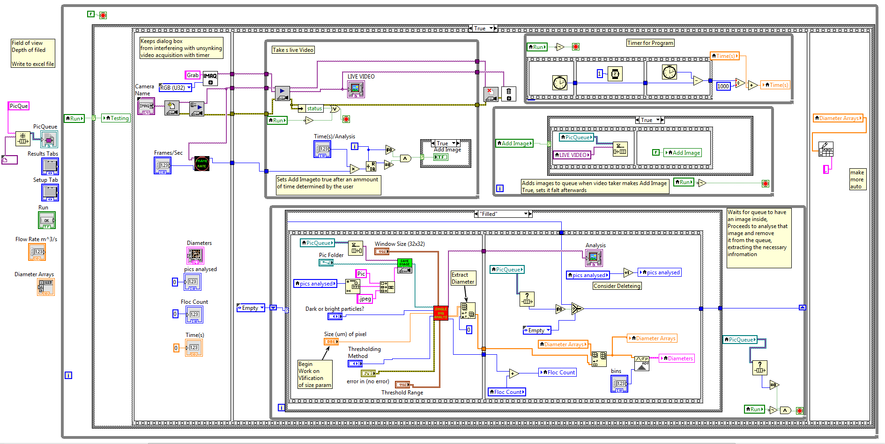
Where variables were declared caused problems with the program
new declaration
former declaration
Floc App | Apps and Algorithms | Final Presentation Fall 2016
Notes:
When the executable was first run, none of the values in the output section of the code were updating. After toying with the source code, it was discovered that the cause of this was the locations in which the indicator variables were declared. Originally, all of the variables were initialized inside of the thread in which they were updated. By moving the declarations outside of the threads and replacing them with local variables, this problem was resolved. What was strange about this issue was that the code worked perfectly fine in the LabVIEW development environment in both cases.

