Slide 1

Floc Size and Count App
For more information, visit https://confluence.cornell.edu/pages/viewpage.action?pageId=333352614
Apps and Algorithms | Symposium Fall 2017

Slide 2
What does our program do?
Analyze floc images
Determine the average floc size and count
Short-term
Provide subteams with floc data analysis
Long term
Enable Honduras workers to better track plant functionality
Apps and Algorithms | Symposium Fall 2017
Notes:
Caption of Slide: This slide introduces the main goals of the floc app team and how it serves as a valuable resource for other subteams focused on research with flocculators.
Summary: The Floc App team is very important to Agua Clara. Developing software that can take in images and analyze them to determine the size and number of flocs is important for many of the research subteams in Agua Clara. Thus, the short term goal of the team is to help other Agua Clara subteams that are researching flocculation. However, helping research groups is not the only goal of the floc app; the long term goal of the floc app is to serve as a tool for on-site workers in Honduras so they can quickly determine whether their plant is functioning properly. By simply running the program, they can get an accurate estimate of the average size and number of flocs at specific points in the filtration process, thus making our plants more efficient and easier to check up on.
The floc app will be a valuable tool in both the lab and in the field.
Long term: Provide Honduras workers with a tool to manage program/plant functionality

Slide 3
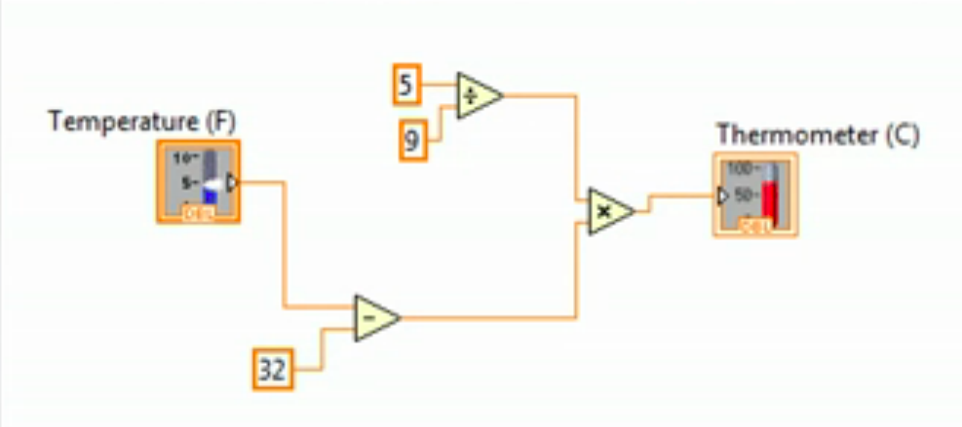
Training
LabVIEW tutorials and exercises
Basic Labview Environment
Graphical Programming
Data structures
Execution Structures
Apps and Algorithms | Symposium Fall 2017
Notes:
Image caption:
Program to Convert Temperature from Degrees Fahrenheit to Celsius
LabVIEW tutorials and exercises
Labview Environment - inside the vi, front panel has a friendly user interface to drop down objects including controls, indicators and constants
Controls palette contains various indicators, outputs and controls, inputs
Controls include knobs, buttons, sliders, strings to adjust data
Block diagram is mapping of visual elements, include terminals and functions which transfer data along wires through objects
SubVIS inside of VIs, VIS used to build separate subvis, sort of like a subroutine call in text-based programming
Graphical programming- data flow programming in which we have several terminals. Wires transfer data between control and indicator terminals.
Also learned about construction of charts and graphs and displaying data collected on graphs
And we have several functions to process data
Broken wire = error/ incompatible data types
Basic Data structures we learned about include strings, numerics (floating point or ints), booleans, clusters (storing several data types), and arrays. Arrays had a particularly cool autoindexing functionality -- link each iteration to loop to stored data value
We learned about while loops and for loops. While loops execute code until stop condition is met, while for loops execute graphical code some number of times. Big stop button on the side helps determine termination
Case Structures - several subdiagrams correlating to several different cases, use inputs to determine which case to execute
Shift registers help pass data between previous and final iterations of the loops
State machines - Transitioning between different states, user input data to determine which state to go to next, created from state diagram, has default initial state

Slide 4
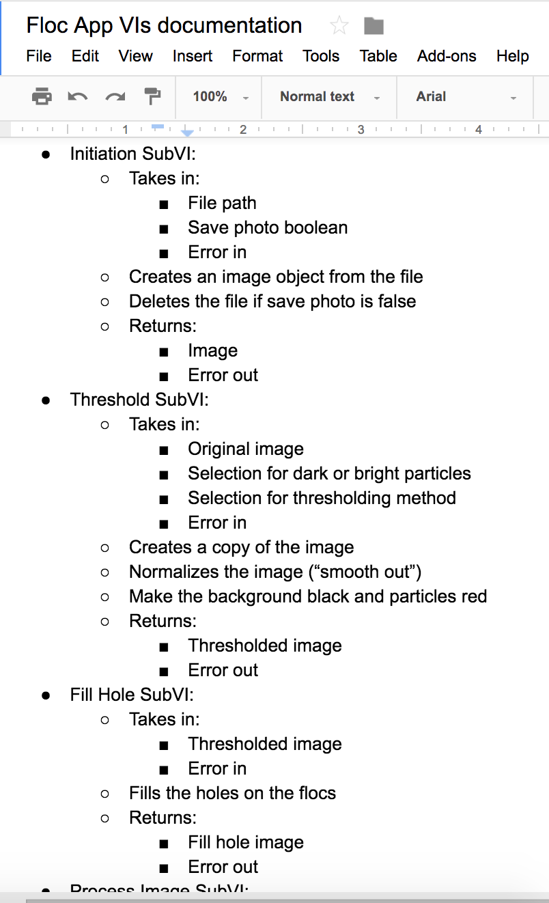
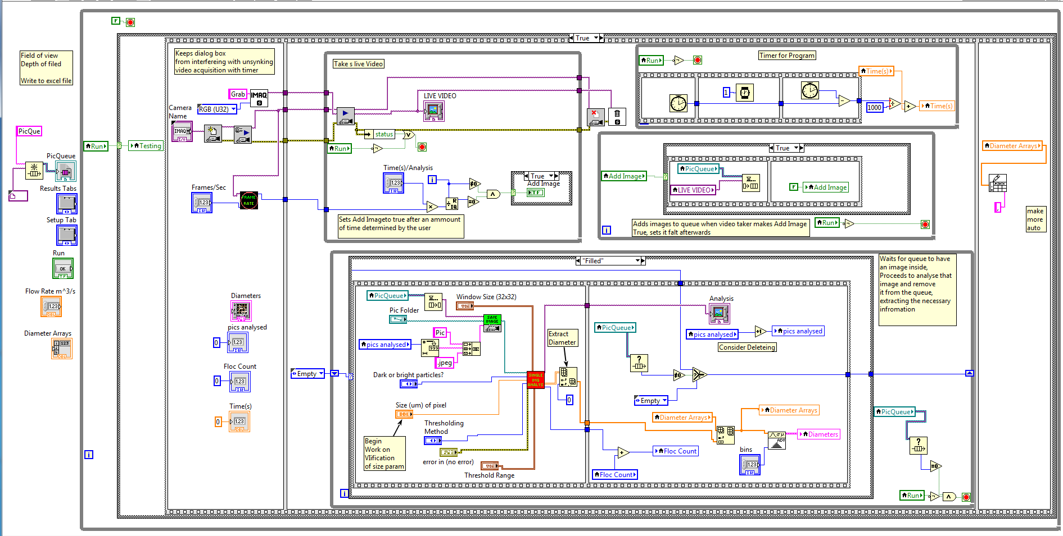
Documentation and Transition to Git
Apps and Algorithms | Symposium Fall 2017
Notes:
Deniz:
Since we are changing as a team, I thought it necessary to create a documentation of all the software that has been developed during the past 3 semesters. It is a very basic one that explains the inputs necessary for each element of the program, its basic function, and its output. This way, the new members can look up the parts they need whenever they want.
We also transitioned to git from teamforge since git is more widely used both in the lab and outside of it.

Slide 5


Timestamps vs Time Counter
Apps and Algorithms | Symposium Fall 2017
Notes:
Deniz:
The program used to have a time counter as an integer variable that was updated every second by a continuous loop. This semester, we decided that this was both inefficient and would be hard to use if the program to run for a long time (who wants to convert 2,734,895 seconds from now - Nov 16 7:40:14 am. Before - Sept 14 01:17:04 am). Therefore we moved to use timestamps instead. The program does not have to keep a timer, it just uses the timer of the computer it is run on. Shows the date and time. If program ran for days or months, still easy to understand when the data was acquired exactly without having to know when the timer was started, etc. Can graph with respect to timestamps.

Slide 6
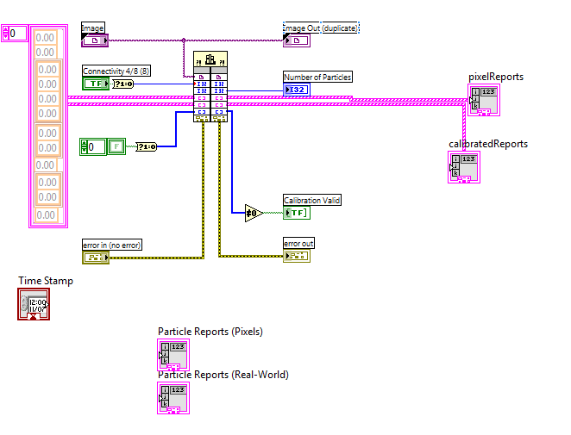
Important Fix with Data Connections
Apps and Algorithms | Symposium Fall 2017
Notes:
Deniz:
As I was trying to implement the timestamps, I needed to go deep through the code to include it to the dataset produced for all the flocs. During this, I realized the data was actually never outputted since a connection was missing. Had to go back and change the code so that I could connect the output to the result of the analysis. Some of the data types had to be changed as well in the process.

Slide 7
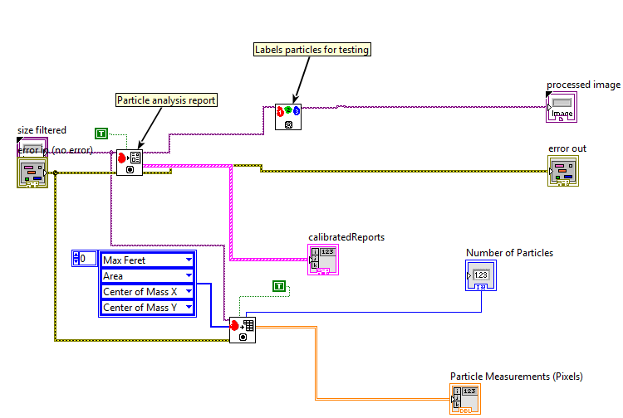
Important Fix with Data Connections
Apps and Algorithms | Symposium Fall 2017
Notes:
Deniz:
As I was trying to implement the timestamps, I needed to go deep through the code to include it to the dataset produced for all the flocs. During this, I realized the data was actually never outputted since a connection was missing. Had to go back and change the code so that I could connect the output to the result of the analysis. Some of the data types had to be changed as well in the process.

Slide 8
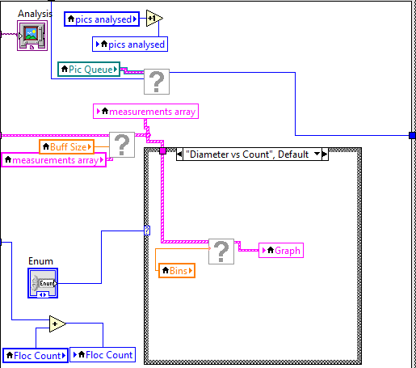
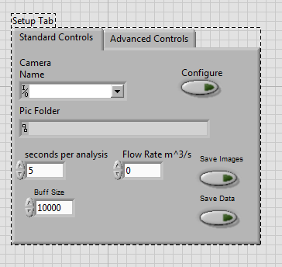
Data Management
Apps and Algorithms | Symposium Fall 2017
Apps and Algorithms | Symposium Fall 2017
Notes:
To better manage the acquisition of data, we plan to set up a buffer of data that is kept live as the computer is acquiring data
Data is saved to both the disk and the buffer
Allows user to specify what data is needed - retrieving data from previous months can be taken from disk data
Immediate, live data acquiring graphs can be generated and updated using buffer data
Program could be running for months, so we want to ensure that months of continuous data can be stored, and it can function long term
Ensures that no data files become too big
We constructed a circular array
LabVIEW has code to set up buffers
Graphs will have a time window, and will dump the buffer data past a certain size or time period
Create algorithm for each chart display that processes data from the buffer and keeps updating as data comes into buffer
Manage data acquisition using a buffer of data
Running program long term
Algorithm to generate and update graphs with live data
Constructed circular buffer array

Slide 9

Option to Save Images and Data
Apps and Algorithms | Symposium Fall 2017
Notes:
Deniz:
Again, looking forward to long-term use, we decided to give the user the option to be able to save the pictures taken during the execution of the program or not as well as saving the data at the end of execution. There are a lot of photos that would be needed to saved so it saves a lot of memory but also gives the option to keep them if used for research purposes.

Slide 10
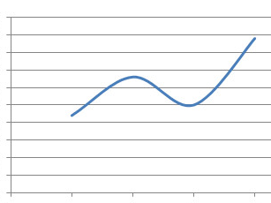
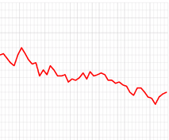
More Graphs!
Floc Size
Floc
Volume
Timestamp
Count
Apps and Algorithms | Symposium Fall 2017
Notes:
Deniz:
We decided that different users of the program might need different representations of the data. The program initially graphs size vs count. However, for example, a user might want to see the change over the time of floc accumulation, in which case volume vs time graph would be more beneficial to them. We want this app to have the functionality to be able to graph more than one graph with the acquired data. That is why, the team started to create functions that take the data and generate a specified graph and the user has the option to choose between them. At the moment, only one graph at a time is produced but if we see there is need for it, the functionality to draw multiple graphs at the same time can be added as well in the future.

Slide 11
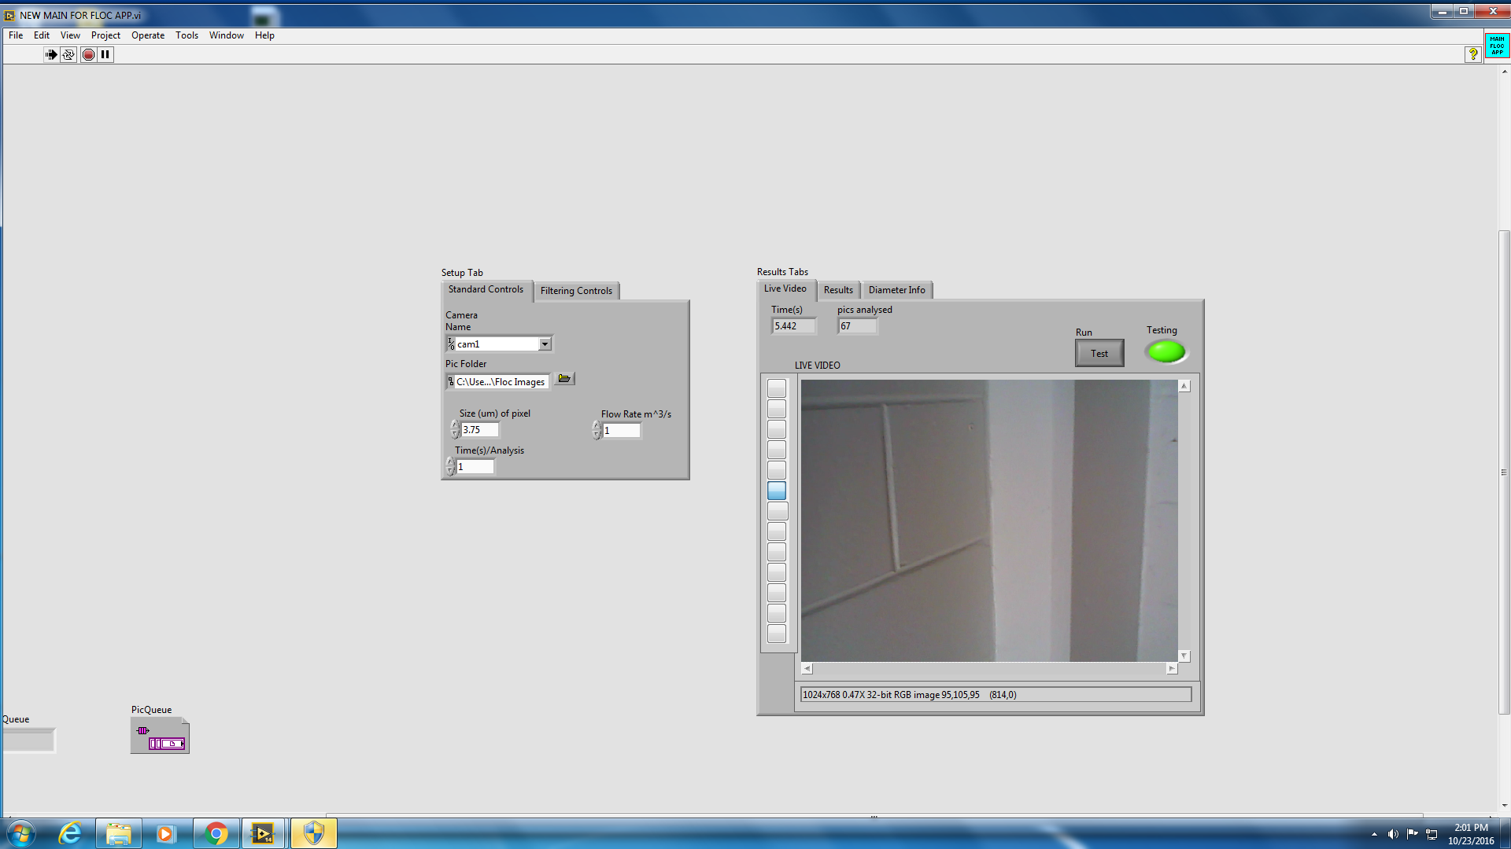
Future Work
Enhance user-friendliness
Increase graph display options
  Count vs size
  Count vs time
  Range of values vs time
Set of sample data to test
Apps and Algorithms | Symposium Fall 2017
Notes:
Update types of graphs, giving the user a dropdown of different data analysis options
User graph choices:
Size range, using graph cursors (on instantaneous graph from image)
For time series, how many particles or total area of particles within that particle size range / count of particles in that range
Create a system to allocate for more types of displays to be added
Allows operator to set [time] bounds for charts (using cursors, tracking user events)
Use event structures
Example: count v size chart, user sets cursors for focus → count v time chart, or range of possibilities for that y axis (count, area, volume, etc)
Want raw pixel data
We want a standard set of sample data to easily run tests and trials on programs/data analysis
Image caption:
Screenshot from previous term’s work

Slide 12
Questions
and
Recommendations
Deniz Yilmazer
Computer Science
dy223@cornell.edu
Melanie Lim
Mechanical Engineering
ml876@cornell.edu
Shaima Parveen
Computer Science
sp822@cornell.edu
Floc App| Apps and Algorithms | Symposium Presentation Fall 2017

