Slide 1

Plant Operations Smartphone Tracker
Building a robust system for water quality tracking and general plant management
Apps and Algorithms | Symposium Presentation Fall 2016
Notes:
The Plant Operations Smartphone Tracker (POST) is a set of mobile phone applications used to track water quality data from drinking water treatment plants in Honduras. Through POST, plant operators can easily log fluctuations in plant performance and view visualizations of plant data. POST is a robust data-capture system that works seamlessly with intermittent internet connections and features an intuitive interface.
https://www.overleaf.com/read/kqmrpxbcpgtv

Slide 2


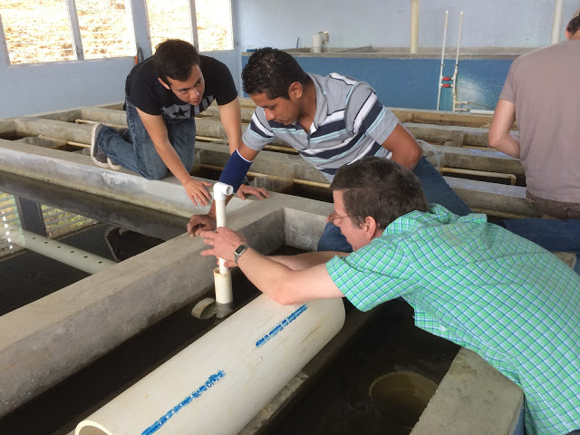

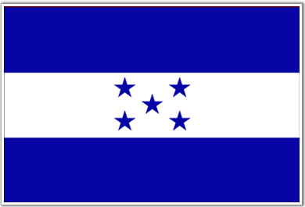
POST is necessary
POST | Apps and Algorithms | Symposium Presentation Fall 2016
Notes:
Data flow is messy! AguaClara has many divisions, stakeholders, partners, and goals. But AguaClara doesn’t just develop technology, it interacts with the community at global, national, and local level, so communication becomes just as important, if not more so, than the actual tech we develop.
We can build the perfect solution to end the clean water problem for all nations for all time, but it won’t mean anything if we can’t convince government agencies, non-profits, and the global foreign aid community to fund or adopt it.
To that end we have a partner NGO on the ground in Honduras which trains operators in new methods and technologies.
We have investment, media, and business teams tasked with helping AguaClara expand by attracting investors and informing the global foreign aid community.
---
Slide adapted from POST Spring 2016 Symposium
honduran flag: http://www.mapsofworld.com/images/world-countries-flags/honduras-flag.gif

Slide 3
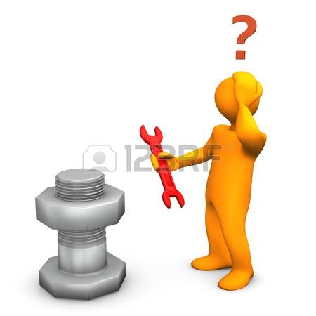
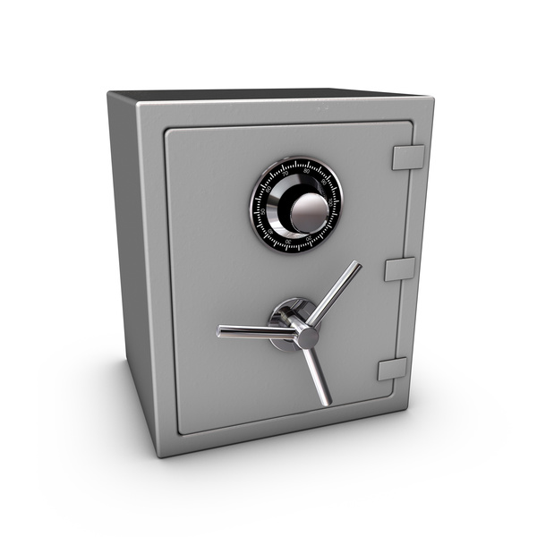
Very little water treatment data exists
POST | Apps and Algorithms | Symposium Presentation Fall 2016
Notes:
The problem is that very little data exists on the efficacy of water treatment methods in developing nations,
and the data that does exist is either privatized or riddled with human error.
How do we know that the effluent turbidities we report are accurate? What if the turbidimeter was not calibrated correctly?
How do we know that the Chemical Dose Controller is calibrated correctly and not malfunctioning?
Is our coagulant dosage model efficient?
Are we backwashing filters too often? Not enough?
This sparsity of both global and internal data
(1)impedes research,
(2) leads to sub-optimal plant performance,
(3) and fails to encourage potential investors or adopters. If AguaClara intends to roll this technology out to the rest of the continent, and possibly the rest of the world, there is a gap which needs to be bridged.
---
Slide adapted from POST Spring 2016 Symposium
Safe: http://www.advancedsafeandlock.com/wp-content/uploads/2013/02/safe.jpg

Slide 4
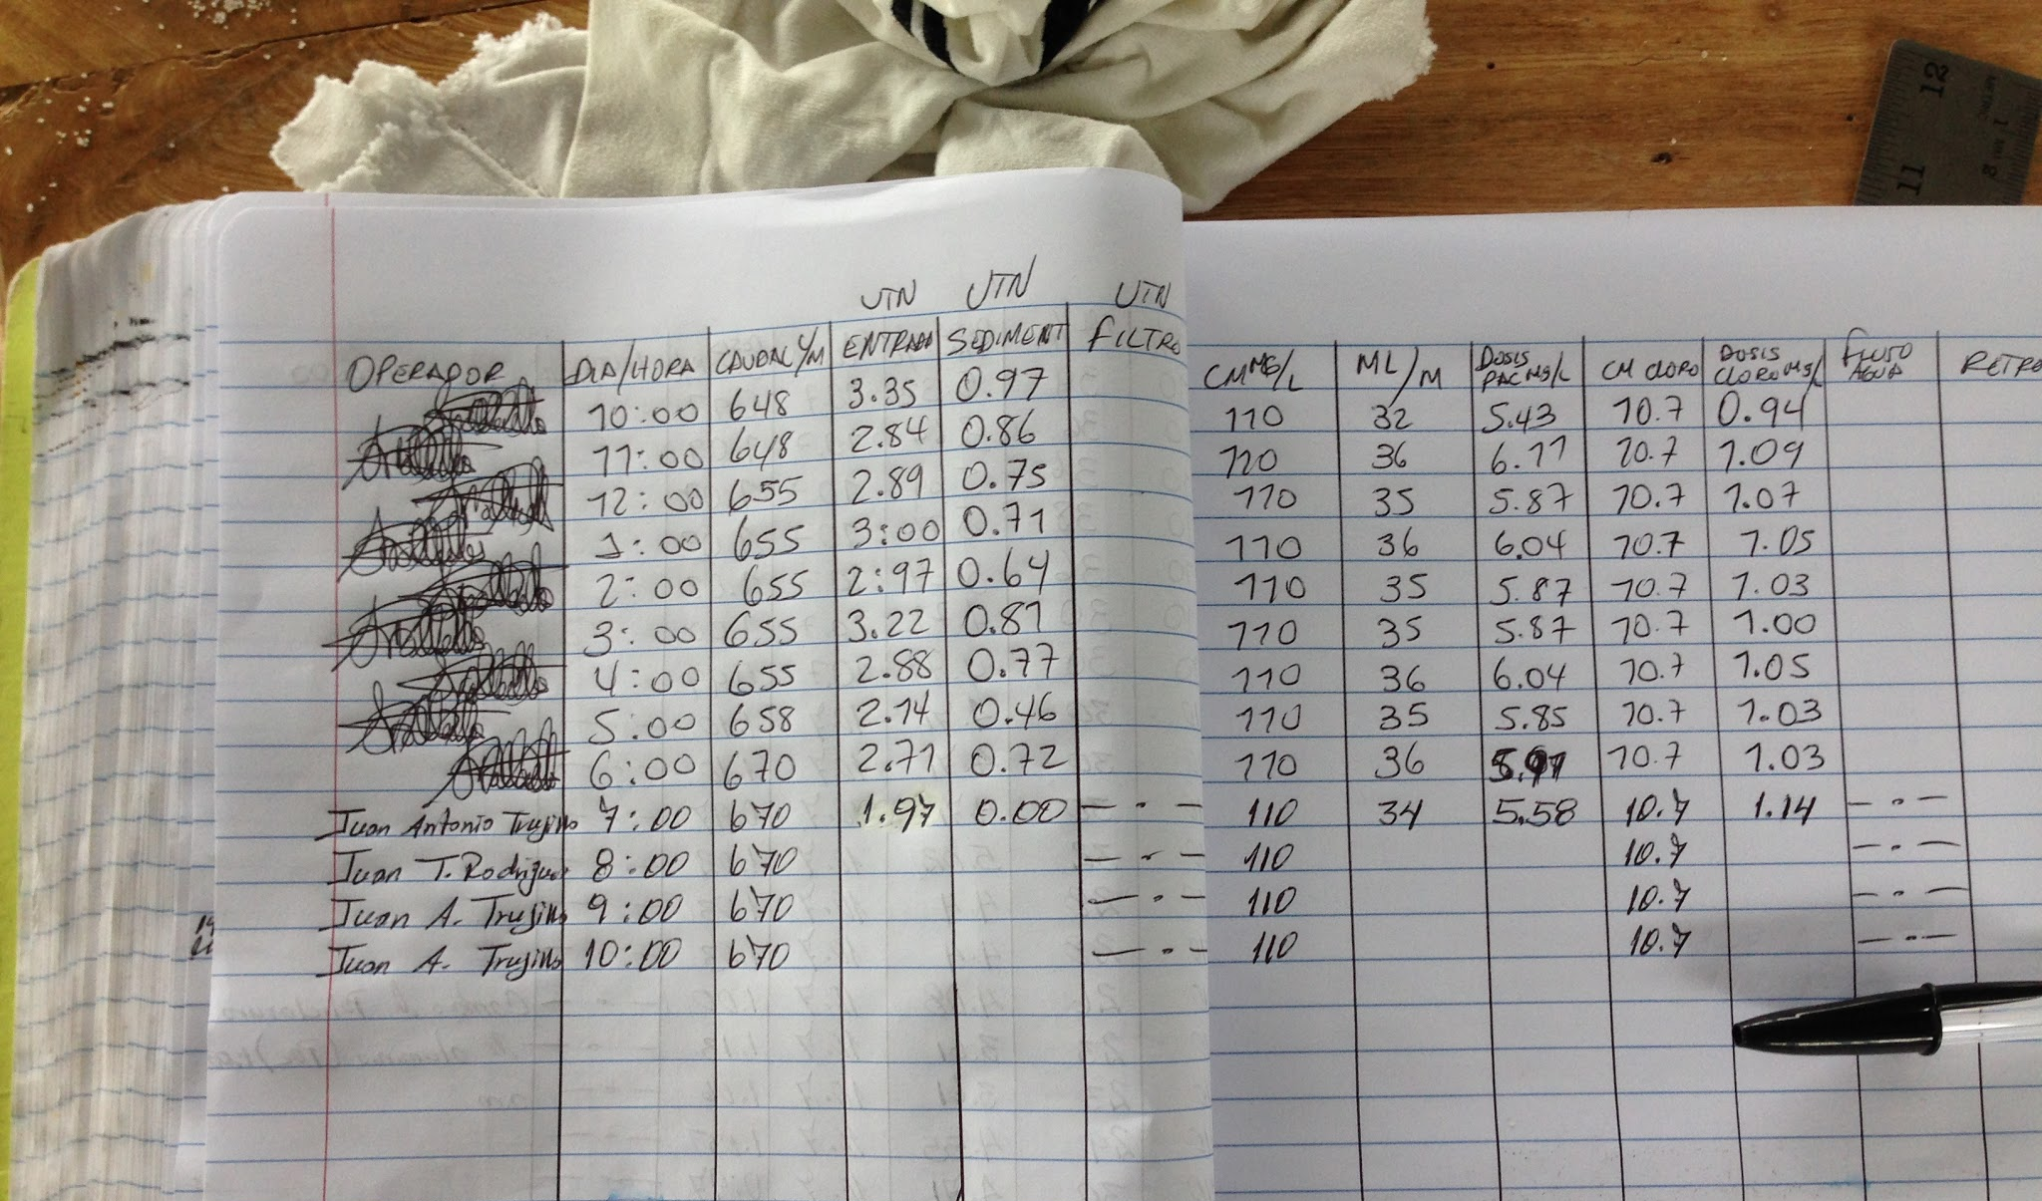
AguaClara plant data is not
being well-utilized.
Collection is clunky, infrequent, and not used for meaningful analysis by plant operators/the world at large.
POST | Apps and Algorithms | Final Presentation Spring 2016
Notes:
Steven
Logbook photo: AguaClara Picasa https://drive.google.com/a/cornell.edu/file/d/0B6-9lpNdw-3HZlpsUEFGa0QxUlU/view?ts=56c63d08
Operators in Honduras currently record data manually in paper logbooks. Thus, there are no error-prevention measures in place, nor incentives for operators to log data consistently--they seldom look at the logbook except for when they are writing in it, so there is no return on their investment. Furthermore, a paper logbook cannot be shared with engineers and interested parties around the world (though there are some internet-based collection methods, which we will discuss on the next slide, they are not necessarily updated with the same regularity as this logbook.)

Slide 5

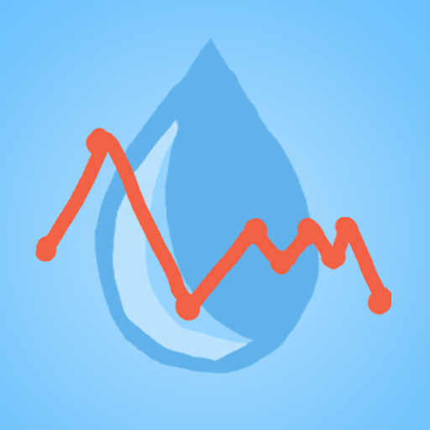
POST is necessary
POST | Apps and Algorithms | Symposium Presentation Fall 2016
Notes:
This sparsity of information
(1)impedes research,
(2) leads to sub-optimal plant performance,
(3) and fails to encourage potential investors or adopters. If AguaClara intends to roll this technology out to the rest of the continent, and possibly the rest of the world, there is a gap which needs to be bridged.
---
Slide adapted from POST Spring 2016 Symposium

Slide 6


_{POST is three components}
POST.DOSE
POST | Apps and Algorithms | Symposium Presentation Fall 2016
Notes:
Here’s a look at POST from a lower level.
The current iteration is a small network of smartphone applications: ODK Collect, POST Graficos, and (New!) POST.DOSE.
Open Data Kit, or ODK, is a lightweight open source data collection tool for android which allows WTP operators to easily submit performance data to our servers with intuitive surveys that look like [this].
---
Images and sources:
POST Graficos icon: https://drive.google.com/file/d/0B7AU1OmHxavKWHFjc1paVGJtYzQ/view?usp=sharing
ODK icon: https://pbs.twimg.com/profile_images/1333706283/odk_medium_square.png
Android icon: https://cnet4.cbsistatic.com/hub/i/2011/10/27/a66dfbb7-fdc7-11e2-8c7c-d4ae52e62bcc/android-wallpaper5_2560x1600_1.jpg

Slide 7
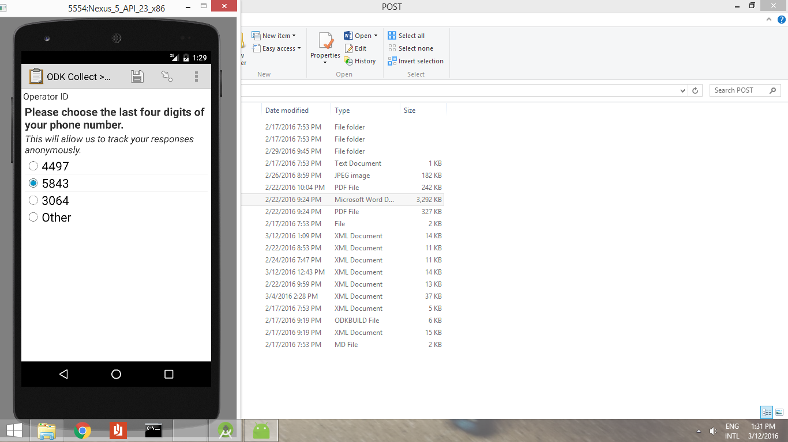
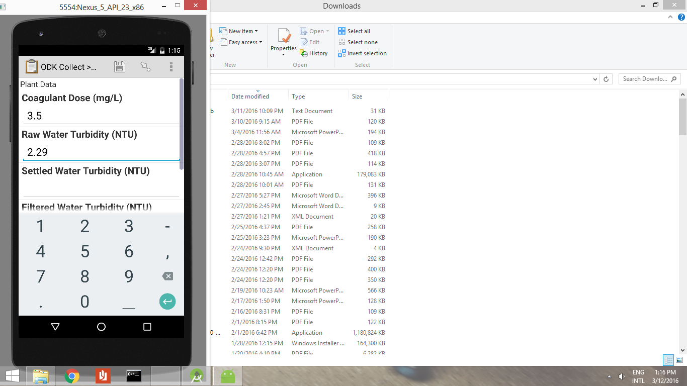
_{POST is intuitive}
POST | Apps and Algorithms | Symposium Presentation Fall 2016
Notes:
Here’s a look at POST from a lower level.
The current iteration is a small network of smartphone applications: ODK Collect, POST Graficos, and (New!) POST.DOSE.
Open Data Kit, or ODK, is a lightweight open source data collection tool for android which allows WTP operators to easily submit performance data to our servers with intuitive surveys that look like [this].
This is the foundation of our platform. This is how all raw plant and feedback data is collected. POSTs task is to devise, design, implement, test, and iterate on useful applications for this data.
---
Images and sources:
POST Graficos icon: https://drive.google.com/file/d/0B7AU1OmHxavKWHFjc1paVGJtYzQ/view?usp=sharing
ODK icon: https://pbs.twimg.com/profile_images/1333706283/odk_medium_square.png
Android icon: https://cnet4.cbsistatic.com/hub/i/2011/10/27/a66dfbb7-fdc7-11e2-8c7c-d4ae52e62bcc/android-wallpaper5_2560x1600_1.jpg

Slide 8
_{POST is transparent}
ODK Aggregate
POST | Apps and Algorithms | Symposium Presentation Fall 2016
Notes:
Link to the ODK Aggregate server. All submitted data from ODK Collect is sent to this hub. From here we can upload new surveys, and publish to various services like Google FusionTables.
---
Images and sources:

Slide 9
_{Post is three components cont.}
POST.DOSE
POST | Apps and Algorithms | Symposium Presentation Fall 2016
Notes:
The third, brand new element is POST.DOSE which Andrew will tell you about in a minute.
---
Images and sources:
POST Graficos icon: https://drive.google.com/file/d/0B7AU1OmHxavKWHFjc1paVGJtYzQ/view?usp=sharing
ODK icon: https://pbs.twimg.com/profile_images/1333706283/odk_medium_square.png
Android icon: https://cnet4.cbsistatic.com/hub/i/2011/10/27/a66dfbb7-fdc7-11e2-8c7c-d4ae52e62bcc/android-wallpaper5_2560x1600_1.jpg

Slide 10
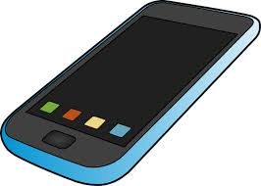
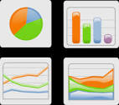
A quick overview
POST
POST | Apps and Algorithms | Symposium Presentation Fall 2016
Notes:
Here’s a quick summary of the POST data flow from a slightly higher level. Operators in Honduras monitor daily activities at their plants. In addition to writing in their antiquated paper logbooks, they now also enter the same data - plus extra data - to the ODK Collect application on the Android device we supplied them with.
The operators leave at the end of the day for a cafe with a wifi hotspot and use ODK to submit the new data to our server.
We use this data to create visualizations, tables, models, and algorithms.
Then everything and anything we produce, including until recently the passwords to all our servers and accounts, is made visible to operators, AguaClara engineers, APP, and the rest of the world.
---
Slide adapted from POST Spring 2016 Symposium

Slide 11
In Development:
POST.DOSE
A coagulant dose recommendation module
Apps and Algorithms | Symposium Presentation Fall 2016

Slide 12
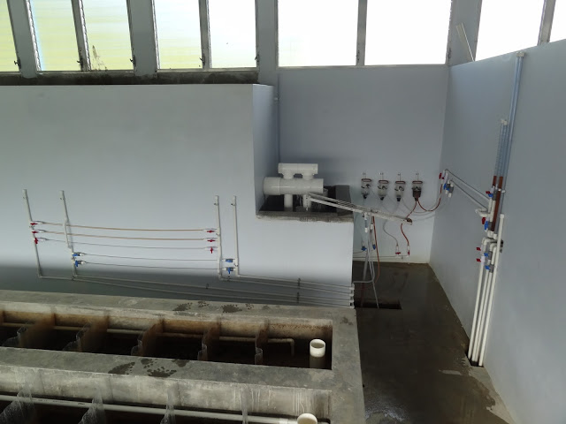
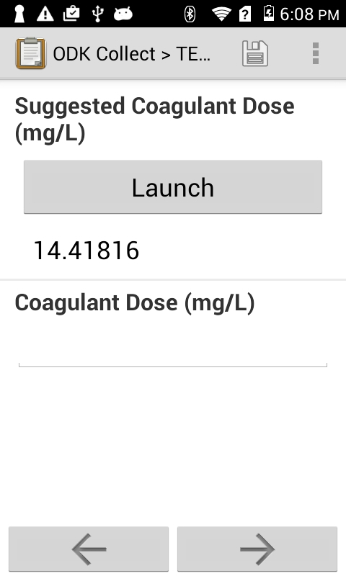
It isn’t easy to decide how much coagulant to use
Influent turbidity is 50 NTU!
POST | Apps and Algorithms | Symposium Presentation Fall 2016
Notes:
Here is an image of the Chemical Dose Controller.
put yourself in the shoes of a new operator. You have been trained in the physical workings of the plant. As many of you here have been.
You’ve just measured the influent turbidity, it went up to 50NTU! How much PACl should you dose?
Well, you can always check the log book to see what the last operator used when the influent was 50NTU
-Thats not going to be easy
So just check your phone!
Thats the whole point of the POST.dose app.
Because we are having plant operators use a smartphone to record data rather than a logbook we can make recommendations for things like PACl dosage based on past operators dosage.
Cite your sources here.
Photos are from Meghan Furton, Last year’s POST symposium, and a screenshot on my mac.
Caption your figure and explain its relevance to your presentation/thesis here. You can take the caption from your Final Report and modify it.
Write a summary of this slide here. A future team member or client should be able to read this note and understand this slide without having your team explain it to them.
If there are any appendix slides that are relevant to this slide, mention it in your notes.

Slide 13


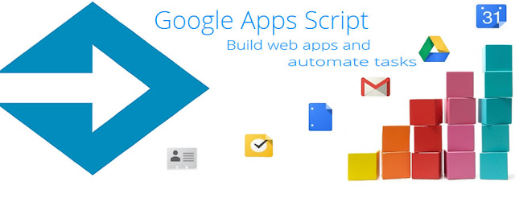
This is a typical remote procedure call
Forms
Turbidity Information
Dosage Suggestion
POST | Apps and Algorithms | Symposium Presentation Fall 2016
Notes:
This slide demonstrates how a typical remote procedure call works.
First we have ODK which holds the forms, and presents them to the user to fill out. In the middle of the form the user inputs turbidity information, and wants a suggested dosage. So a Remote Procedure Call (RPC) is launched to ask a Google Scripts App how much PACl should be added. The Scripts app runs a regression (or has run a regression recently) and gives an answer. This dosage suggestion is then returned from the RPC and ODK displays it to the user. Afterwards the form is sent off to Google Fusion Tables for storage in the cloud.
Images used: https://cnet4.cbsistatic.com/hub/i/2011/10/27/a66dfbb7-fdc7-11e2-8c7c-d4ae52e62bcc/android-wallpaper5_2560x1600_1.jpg
http://derekeder.com/images/blog/fusion-tables-logo-beta.gif
http://1.bp.blogspot.com/-PmoMZWWE63U/UQMZ1p7dQ9I/AAAAAAAAB78/X50Edl5GweE/s640/GoogleAppsScript.jpg
https://pbs.twimg.com/profile_images/1333706283/odk_medium_square.png
https://www.google.com/images/branding/googlelogo/2x/googlelogo_color_272x92dp.png

Slide 14
The typical RPC breaks without internet
?????????????????
Forms
Turbidity Information
Dosage Suggestion
POST | Apps and Algorithms | Symposium Presentation Fall 2016
Notes:
However, the RPC breaks if there is no internet. ODK will start the RPC and then time out without a suggestion for the operators. This is particularly problematic because the operators often don’t have internet access while filling out the form. We needed to close this loop so that even without internet connection a dosage suggestion can be made from the turbidity information.
Note: Not our work, but ODK does save form data until operators have internet and choose to upload them to the aggregate server.
Image credits: https://cnet4.cbsistatic.com/hub/i/2011/10/27/a66dfbb7-fdc7-11e2-8c7c-d4ae52e62bcc/android-wallpaper5_2560x1600_1.jpg
http://derekeder.com/images/blog/fusion-tables-logo-beta.gif
http://1.bp.blogspot.com/-PmoMZWWE63U/UQMZ1p7dQ9I/AAAAAAAAB78/X50Edl5GweE/s640/GoogleAppsScript.jpg
https://pbs.twimg.com/profile_images/1333706283/odk_medium_square.png
https://www.google.com/images/branding/googlelogo/2x/googlelogo_color_272x92dp.png

Slide 15
This is the post.dose workflow
Forms
Turbidity Information
Dosage Suggestion
(Daily)
POST.DOSE
Regression Model
POST | Apps and Algorithms | Symposium Presentation Fall 2016
Notes:
Here is the post.dose workflow
First we have ODK which holds the forms, and presents them to the user to fill out. In the middle of the form the user inputs turbidity information, and wants a suggested dosage. So an intent is launched to another android application: Post.dose, containing the entered turbidity information and requesting a PACl recommendation. Post.dose has stored a model of what to recommend (done by the user right after the first download via a button press), so it opens it, and returns a value to ODK which can later pass the form data to the aggregate server. Before terminating POST.dose attempts to query (if there is internet) a google apps script which will return the appropriate model to use for future queries.
This google app script will also do a daily regression analysis to ensure that the models that it is giving to the apps isn’t too old, but also ensuring that tons of redundant computation isn’t performed.
a Remote Procedure Call (RPC) is launched to ask a Google Scripts App how much PACl should be added. The Scripts app runs a regression (or has run a regression recently) and gives an answer. This dosage suggestion is then returned from the RPC and ODK displays it to the user. Afterwards the form is sent off to Google Fusion Tables for storage in the cloud.
Image Credits:
https://cnet4.cbsistatic.com/hub/i/2011/10/27/a66dfbb7-fdc7-11e2-8c7c-d4ae52e62bcc/android-wallpaper5_2560x1600_1.jpg
http://derekeder.com/images/blog/fusion-tables-logo-beta.gif
http://1.bp.blogspot.com/-PmoMZWWE63U/UQMZ1p7dQ9I/AAAAAAAAB78/X50Edl5GweE/s640/GoogleAppsScript.jpg
https://pbs.twimg.com/profile_images/1333706283/odk_medium_square.png
https://www.google.com/images/branding/googlelogo/2x/googlelogo_color_272x92dp.png

Slide 16
post.dose doesn’t break without an internet connection
?????????????????
Forms
Turbidity Information
Dosage Suggestion
(Daily)
POST.DOSE
Regression Model
POST | Apps and Algorithms | Symposium Presentation Fall 2016
Notes:
Note that POST.dose doesn’t break without an internet connection. Models just get a little stale when they aren’t updated.
Image credits: https://cnet4.cbsistatic.com/hub/i/2011/10/27/a66dfbb7-fdc7-11e2-8c7c-d4ae52e62bcc/android-wallpaper5_2560x1600_1.jpg
http://derekeder.com/images/blog/fusion-tables-logo-beta.gif
http://1.bp.blogspot.com/-PmoMZWWE63U/UQMZ1p7dQ9I/AAAAAAAAB78/X50Edl5GweE/s640/GoogleAppsScript.jpg
https://pbs.twimg.com/profile_images/1333706283/odk_medium_square.png
https://www.google.com/images/branding/googlelogo/2x/googlelogo_color_272x92dp.png

Slide 17
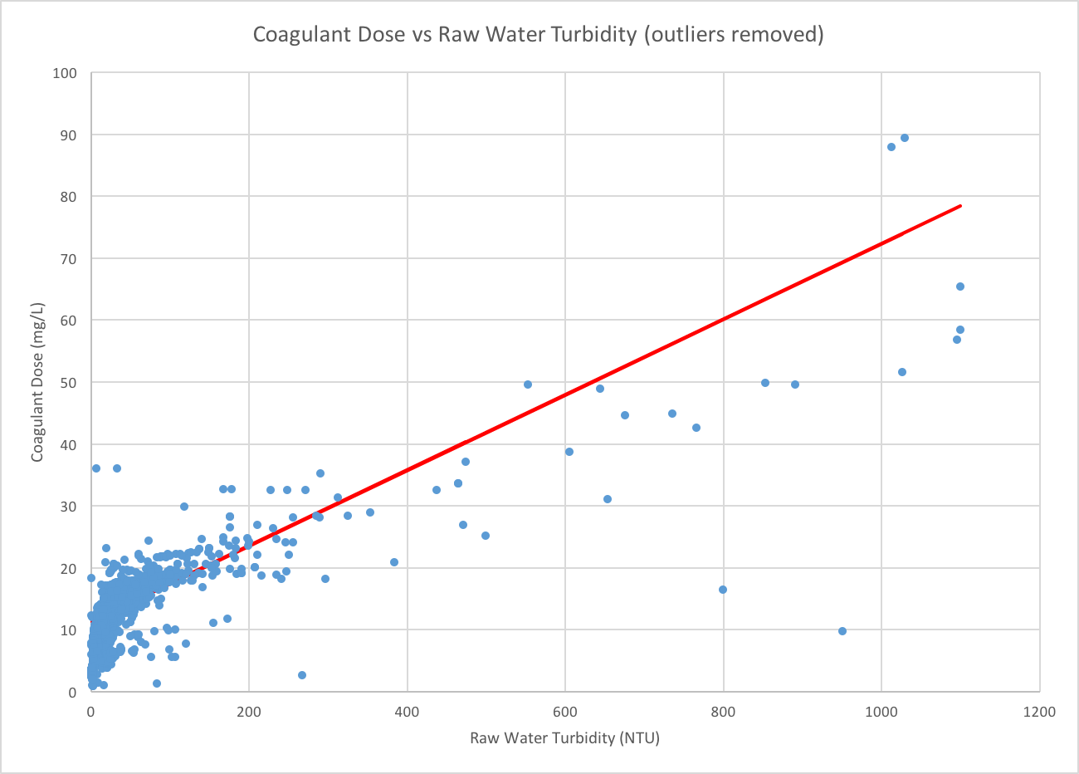
Here is the data and best regression model so far
POST | Apps and Algorithms | Symposium Presentation Fall 2016
Notes:
Here is the data that we are working with.
There are outliers missing from this graph: with very low Raw Water NTU and very high dosage. There is also a very non-linear section that we will try to capture as the next steps: nonlinear models.

Slide 18
In Development:
POST.BLUETOOTH
Reducing data entry errors with automatic reporting
Apps and Algorithms | Symposium Presentation Fall 2016

Slide 19
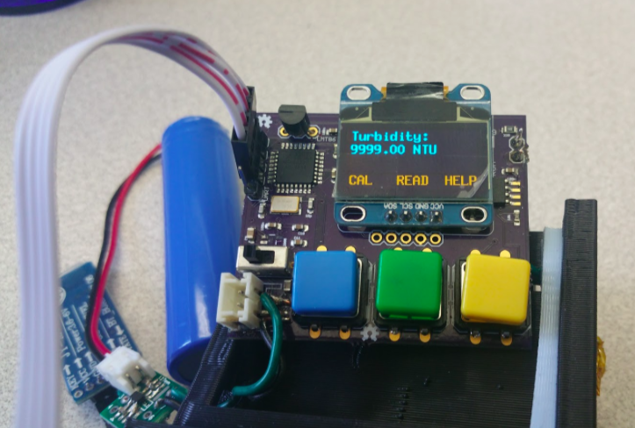
BT turbidimeter implementation
POST | Apps and Algorithms | Symposium Presentation Fall 2016
Notes:
-I’ll be talking about the Bluetooth Turbidimeter Implementation module
1) What turbidimeters do and why they’re important
2) How turbidity is currently recorded and how my project will improve on that
3) A basic overview of how the implementation works

Slide 20
How the turbidimeter works
Importance of the turbidimeter
-The turbidimeter shines light through a sample and measures how much light is scattered
-3 Types: Raw, Settled, Filtered
-Turbidity helps determine coagulant dose recommendations
-We need to meet national health standards
POST | Apps and Algorithms | Symposium Presentation Fall 2016
Notes:
The more light that’s scattered,the dirtier the water is
Raw is the water that comes in
Settled is after flocs are removed, but before chlorine is applied (settled tells us how effective the coagulant was)
Filtered is the final output quality
we dont want people getting sick!
coagulant collides with organic particles in water, first step of cleaning process

Slide 21
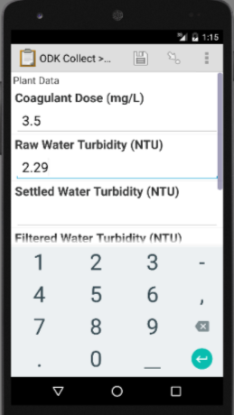
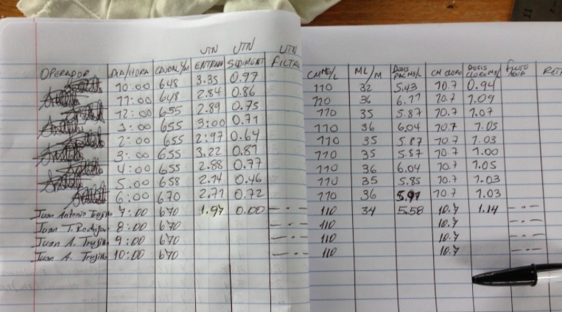
How turbidity is currently recorded
-No bluetooth capability
-Values manually copied down (Errors!)
-Need to move towards autonomous plant monitoring
POST | Apps and Algorithms | Symposium Presentation Fall 2016
Notes:
Currently, there’s no BT capability, plant operators
plant operators read a normal turbidimeter and copy down the value by hand
many issues in the past where decimal is misplaced by plant operators
BT would ensure there are no errors when recording turbidities
this implementation makes it much easier for operators
ultimately want to move towards something better than current state of the art mechanized plants

Slide 22
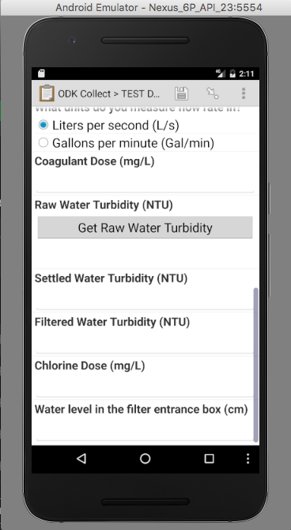

Implementation
Intent
Listen for Data
BT Turbidimeter
My Java App
Value from BT Turbidimeter
Data (JSON output)
POST | Apps and Algorithms | Symposium Presentation Fall 2016
Notes:
Instead of entering a value for turbidity manually, plant operators would simply press a button and the backend would handle the rest. What would come back is the turbidity automatically filled in.
First, the plant operator presses the button and an intent is sent to the java app I made. An intent is just like a message, a way to communicate between the data form and my application.
Next, my application begins to listen for data from the BT Turbidimeter.
My app gets a bunch of data from the Turbidimeter and basically isolates the turbidity value we’re interested in.
Finally, the isolated turbidity value is sent back to ODK and the form is automatically filled.

Slide 23
In Development:
POST.COLLECT
Expansion of ODK source code for extra functionality
Apps and Algorithms | Symposium Presentation Fall 2016

Slide 24
POST is simple
How do we automatically update the dosage model parameters when an internet connection is established?
How do we automatically update our data collection method without requiring an overhaul of our database?
POST | Apps and Algorithms | Symposium Presentation Fall 2016
Notes:
Two branches of the POST team simultaneously encountered different problems which can be solved by the same solution: Editing the ODK source code. POST
---
Slide adapted from POST Spring 2016 Symposium
Safe: http://www.advancedsafeandlock.com/wp-content/uploads/2013/02/safe.jpg

Slide 25
The Future Is Now
ODK Collect
POST Collect
POST | Apps and Algorithms | Symposium Presentation Fall 2016
Notes:
Two branches of the POST team simultaneously encountered different problems which can be solved by the same solution: Editing the ODK source code. POST
---
Slide adapted from POST Spring 2016 Symposium
Safe: http://www.advancedsafeandlock.com/wp-content/uploads/2013/02/safe.jpg

Slide 26
Questions
and
Recommendations
Jose Castro
BS in Computer Science
jec332@cornell.edu
Andrew Mullen
Master of Engineering in Computer Science
asm278@cornell.edu
Dane Limjoco
Bioengineering
mdl259@cornell.edu
Plant Operations and Smartphone Tracking | Apps and Algorithms | Symposium Presentation Fall 2016

