Slide 1
Library Instruction:
What’s Next and How Do We Get There?
Kornelia Tancheva
10 December, 2015

Slide 2
Questions
Roles and balance between unit-based IL programs and CUL’s library-wide efforts to support IL campus-wide
Support for integrating online learning into our IL programs: in-house; partnerships
Importance of information literacy in the new University administration
Other institutions’ IL programs of particular interest
Assessment goals for next semester
SMART practices in library instruction
Assessment of current state of CUL’s Information Literacy Program
Faculty Survey results and library instruction

Slide 3
Context
Library’s mission
New President
ACRL Framework
Surveys, focus groups, and other user practices studies
Administrative meetings
Personal experience
CUL’s focus areas

Slide 4
Statistics
 | FY13 | FY14 | FY15
Presentations to Groups (non-tours) | 1,204 | 1,274 | 1,284
Participants | 17,562 | 23,376 | 20,596
Tours | 239 | 215 | 239
Participants | 3,180 | 3,534 | 3,577

Slide 5
More statistics
 | FY13 | FY14 | FY15
Course-related | 544 | 643 | 662
Workshops | 252 | 216 | 222
Credit courses | 13 | 13 | 10

Slide 6
Time Commitment
1,284 hr
+ 2x1,284=2,568
____________________
=3,852 hr /50=77hr/instructor

Slide 7
Faculty
The sessions provided a little help | 10%
Provided a fair amount of help | 34%
Provided a great deal of help | 56%

Slide 8
undergraduates
Not very helpful | 38.5%
Somewhat helpful | 40.7%
Very helpful | 20.8%

Slide 9
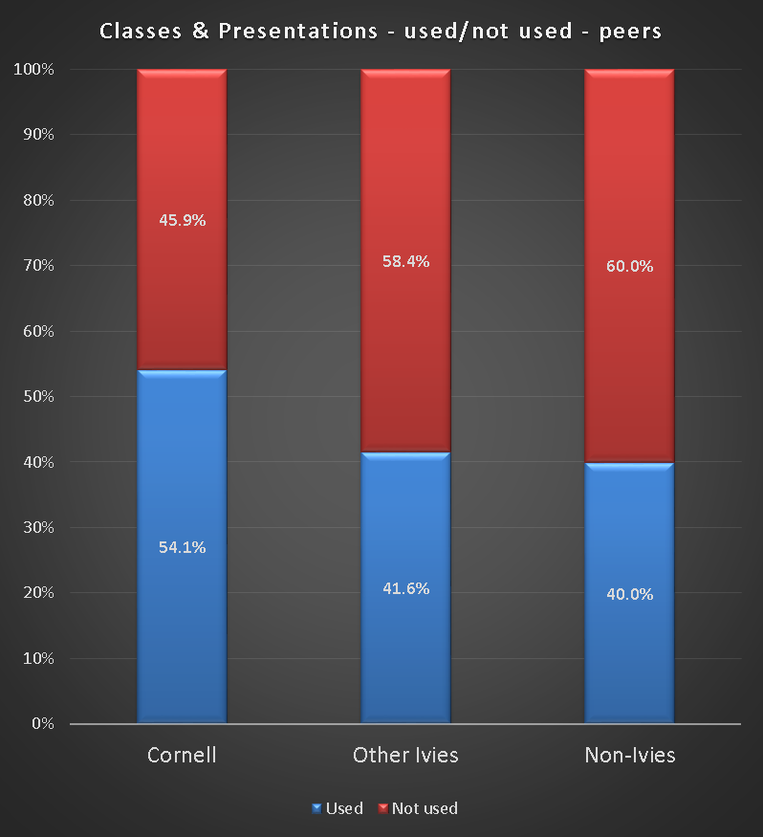
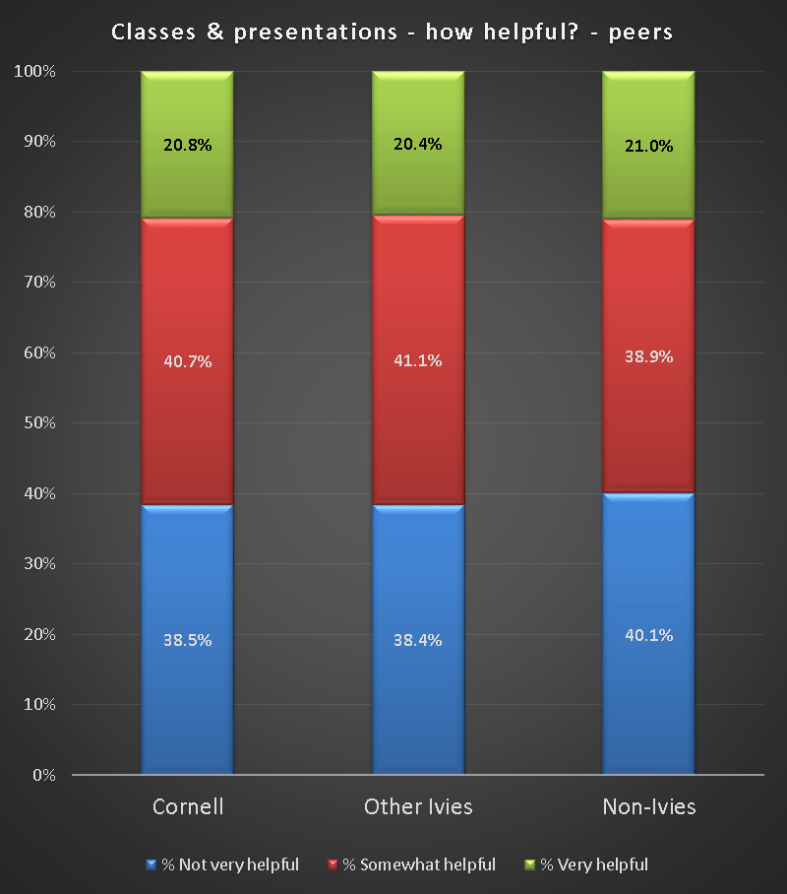
Comparison

Slide 10
slac
Library instruction is forced
It is repetitive and many have gone through it in high school
Redundancy: during their Cornell years, students experience “effectively the same presentation”
Quality of instruction varies (it is often not engaging enough; instructors just “throw tools at you”)
Conceptually, it is often too search-engine-based (which is fairly intuitive); or it is too general

Slide 11
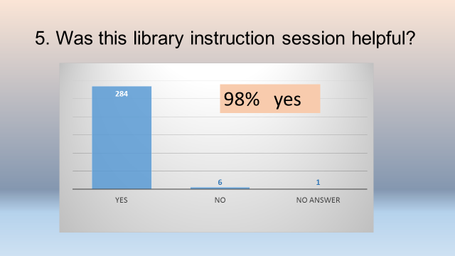
Assessment Sub-Group

Slide 12
Engineering videos
Phased Diagrams: 36 points
Video X: 23 points
Video Y: 18 points

Slide 13
What’s next?
Quality over quantity
Focus on classes where we can have an impact
Focus on classes with a research component/assignment
Focus on teaching critical thinking skills, not tool demonstration and explanation

Slide 14
What’s next?
Focus on teaching that reveals new possibilities
  Transition everything that is procedural to online videos, tutorials
  Reserve classroom time for unique help
Assess constantly
And how do we get there?

Slide 15
Thank you
Questions?

